Slide 1
A Case for solidarity in human enhancement
Rafael Curran

Slide 2
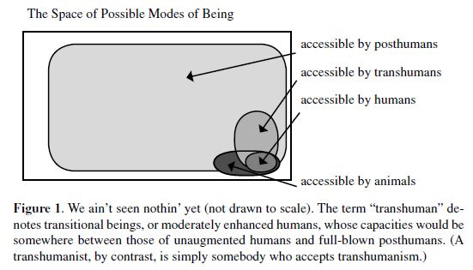
Transhumanism
First coined as a term by Julian Huxley in 1957
Most cited proponent: Nick Bostrom
See Also: Savulescu, Sorgner
Motivation to improve or modify the human condition by means of biotechnology
Often appeal to the fact that we *already* are participating in enhancement projects, and argue for a more formal cultural and legal embrace
Transhumanist Values (2005), Nick Bostrom

Slide 3
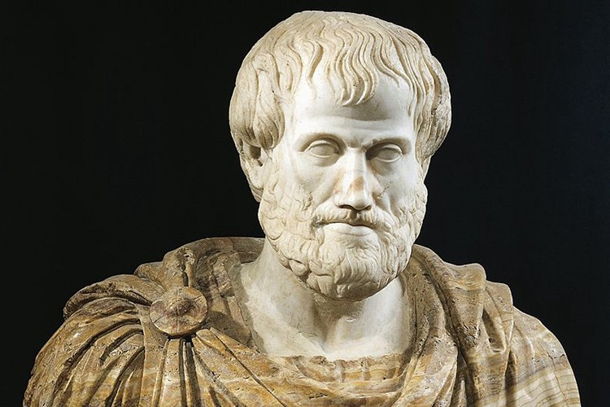
Aristotelian Virtue Ethics
Key Vocabulary
Ergon (Function)
Virtue (State of character in accord with excellence of the soul)
Eudaimonia (the activity of living well)
Telos (final cause, or end)
The telos of human is Eudaimonia
Justification for telos?

Slide 4
Problem: Application of Virtue Ethics in transhumanism
Rational ethics is a component of a scheme which requires a conception of an untutored human nature and a conception of “human-nature-as-it-could-be-if-it-realized-its-telos” (AV 3rd Ed. (2007), Macintyre)
Existentialist rejection of pre-defined essence in favor of one created through radical free choice and authenticity
Guiding Questions
What exactly is the current transhumanist conception of the telos?
Should transhumanism succeed, would a radical re-evaluation of human telos follow, or perhaps a rejection of telos altogether?
How can we work toward an application of virtue ethics which is conducive to mutually intelligible moral discourse in the light of questions which concern the fundamental change of people?

Slide 5
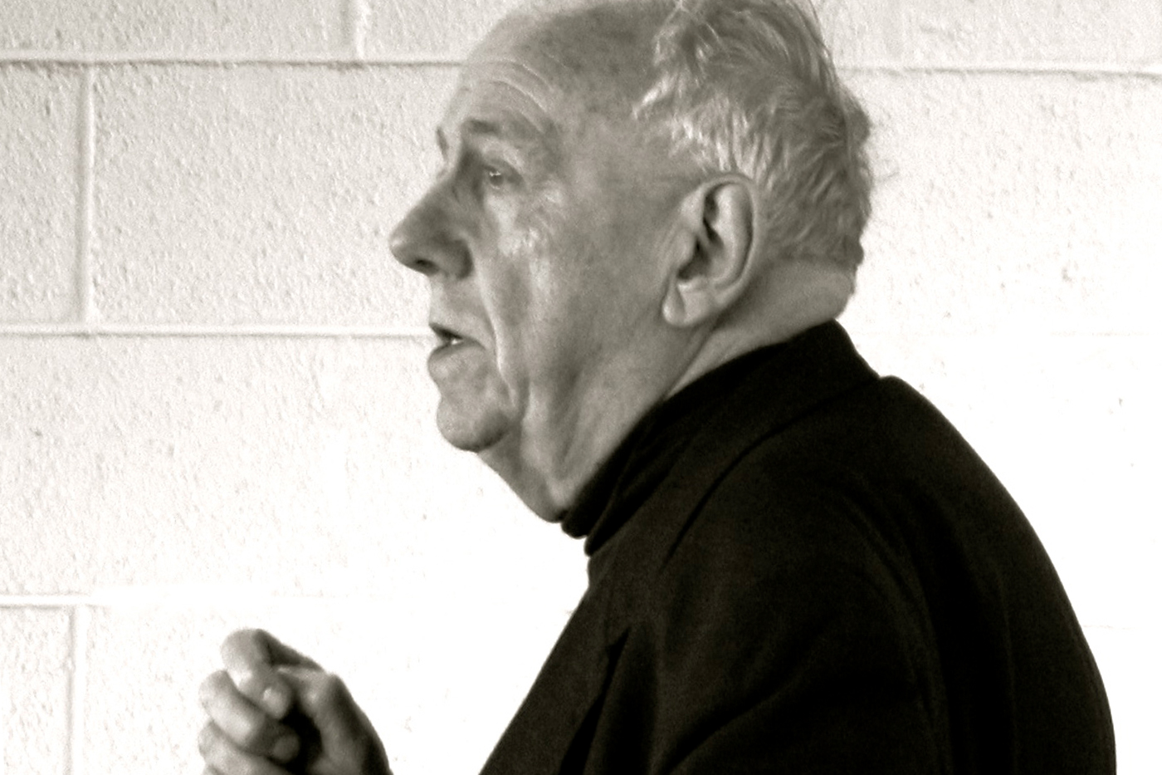
The Non-Essentialist telos of Macintyre
Practices, Narratives, and Traditions provide crucial context for people and actions.
Telos can only be conceived within the accepted rational framework of a given tradition. Tied to narrative of self, community and tradition
How can the telos be radically affected by enhancement projects if we cannot escape the historical narrative we are born into?

Slide 6
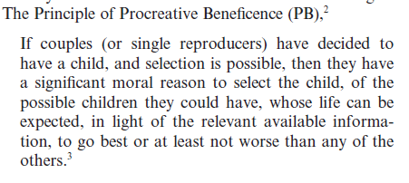
The Faux-Neutrality of Transhumanism
Savulescu espouses the Principle of Procreative Beneficence while contending that he is “neutral with respect to such philosophical disputes about the nature of the good life” (2009 Savulescu & Kahane).
He clearly implicitly endorses a conception of the good person, the only question is: is this conception a good one?
Answer: No

Slide 7
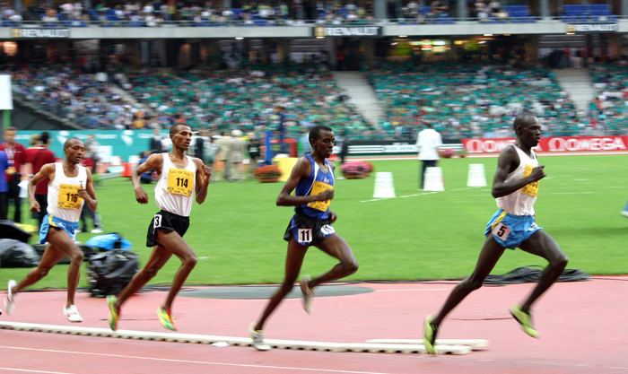
Faster, Higher, Stronger
Sandel: Liberal individualism has engendered a meaningless game of status-jockeying, creating widespread animosity, humiliation, and hubris
Markovits: Meritocracy is bad for the “winners” too

Slide 8
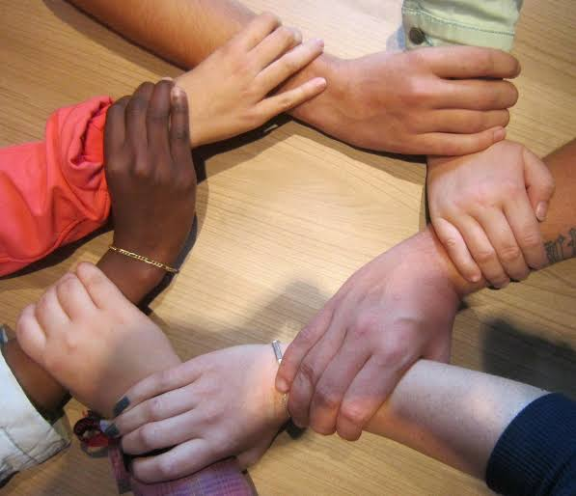
Towards an Ethics of Solidarity
Contemporary individualism precludes the likelihood of virtuous enhancement
Move towards an ethics of solidarity which emphasizes human interdependence rather than individual striving

Slide 9
Questions? Feedback?

