Slide 1
AI and the
United Nations:
AI’s Potential Impact on the UN’s 2030 Sustainable Development Goals

Slide 2
The UN’s SDGs--What are they?
Adopted in 2015 with achievement goal set to be 2030
We’re entering the “decade of action”
17 goals focused around economic, social and environmental pillars
Notes:
Include: poverty, hunger, education, equality, water, health, energy, climate, economics, peace, and partnerships

Slide 3
Why are the SDGs and AI particularly important right now?
Impact of COVID-19 across the world
Forecasts of 71 million pushed into extreme poverty in 2020 alone
Disruption of previous progress and even complete reversals
Education, health, violence prevention programs
AI field is expanding… better to act now than later!

Slide 4
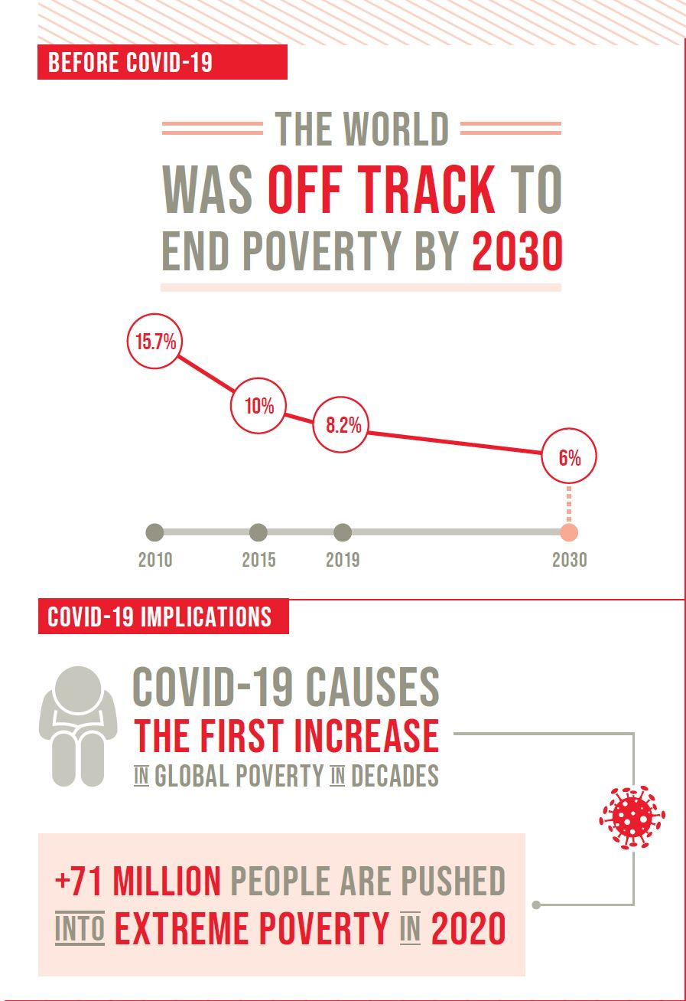
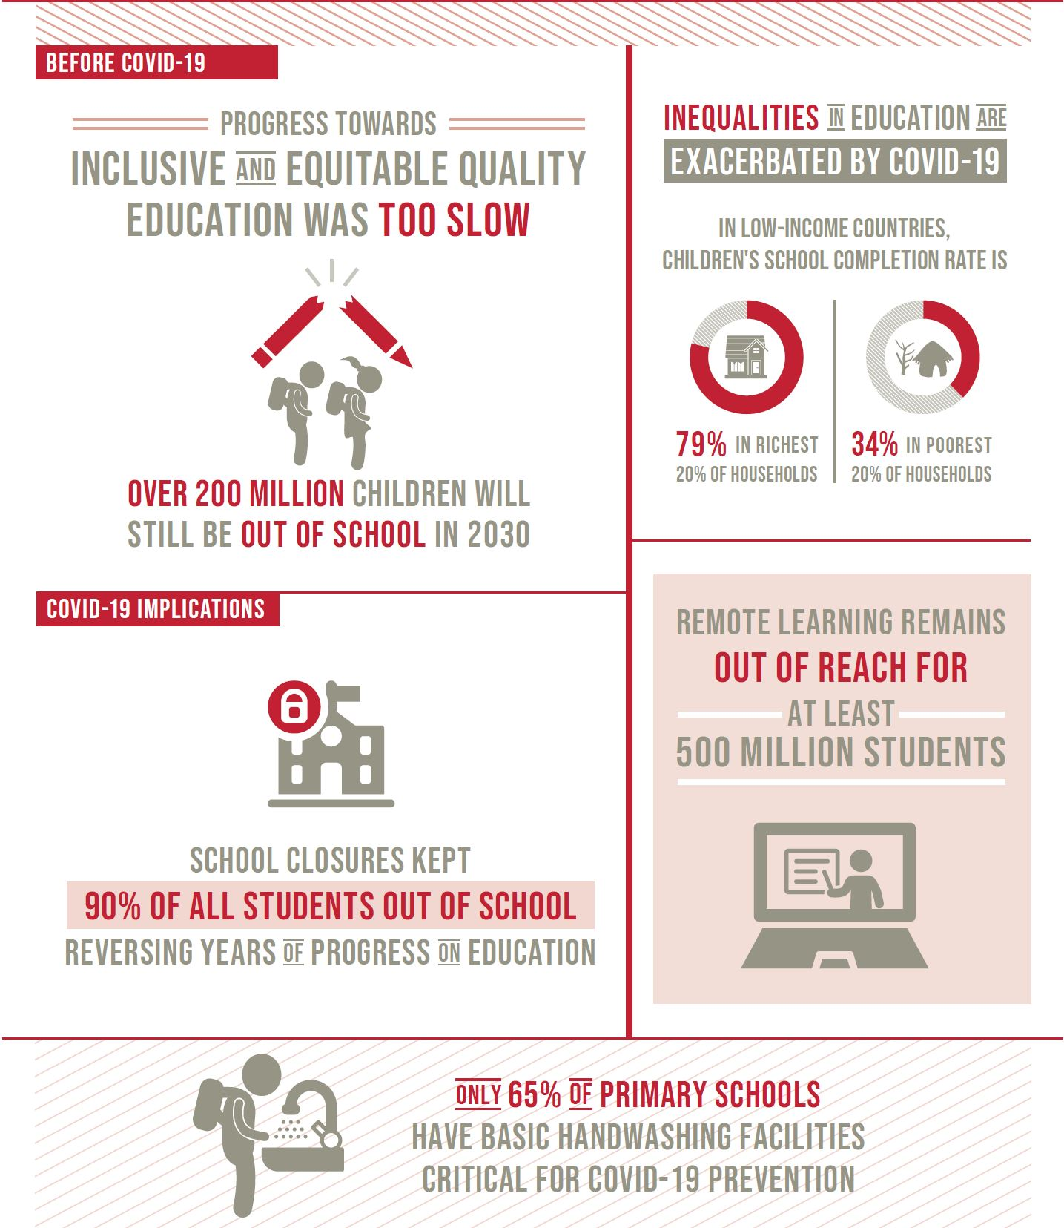

Slide 5
AI and the SDGs
Researchers and organizations are interested in this
79% of SDGs will be “enabled” through AI, while 35% would potentially be negatively impacted
Need to invest in prudent research, development, regulation, and implementation

Slide 6
3 Focus Areas of AI:
Computer Vision
Natural Language Processing (NLP)
Structured Deep Learning

Slide 7
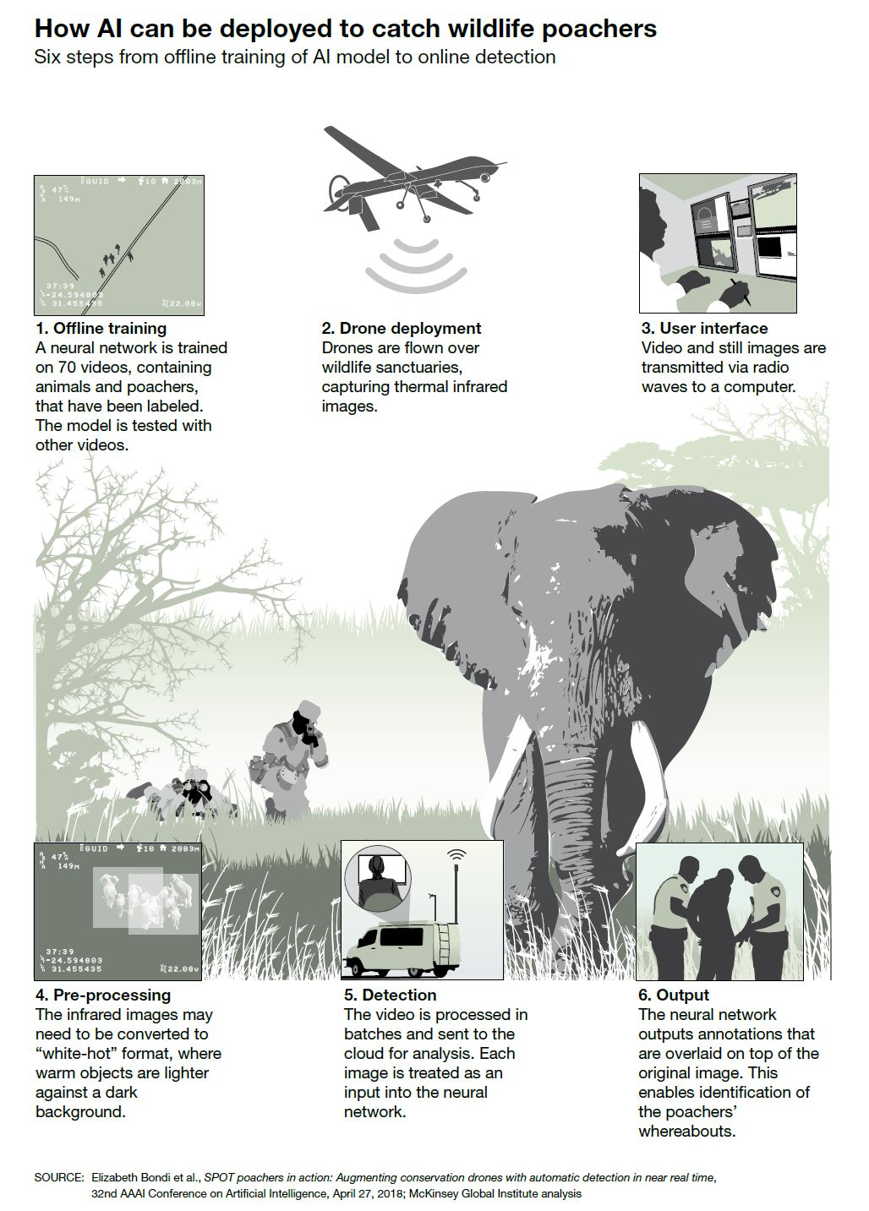
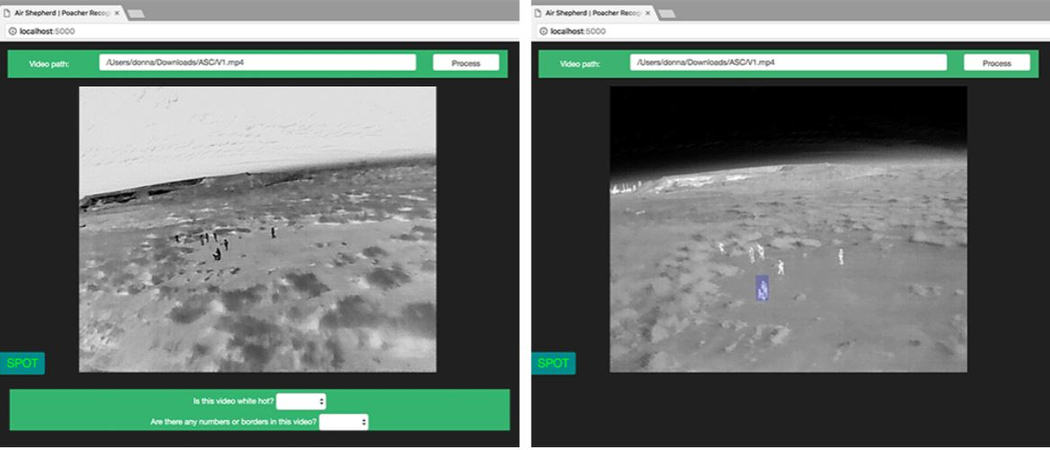
SPOT Software Case Study

Slide 8
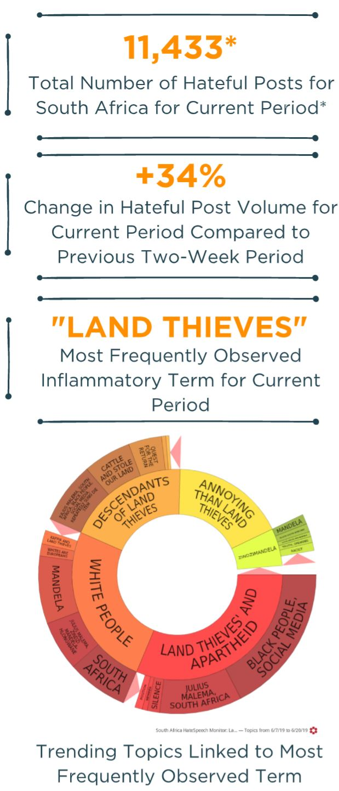
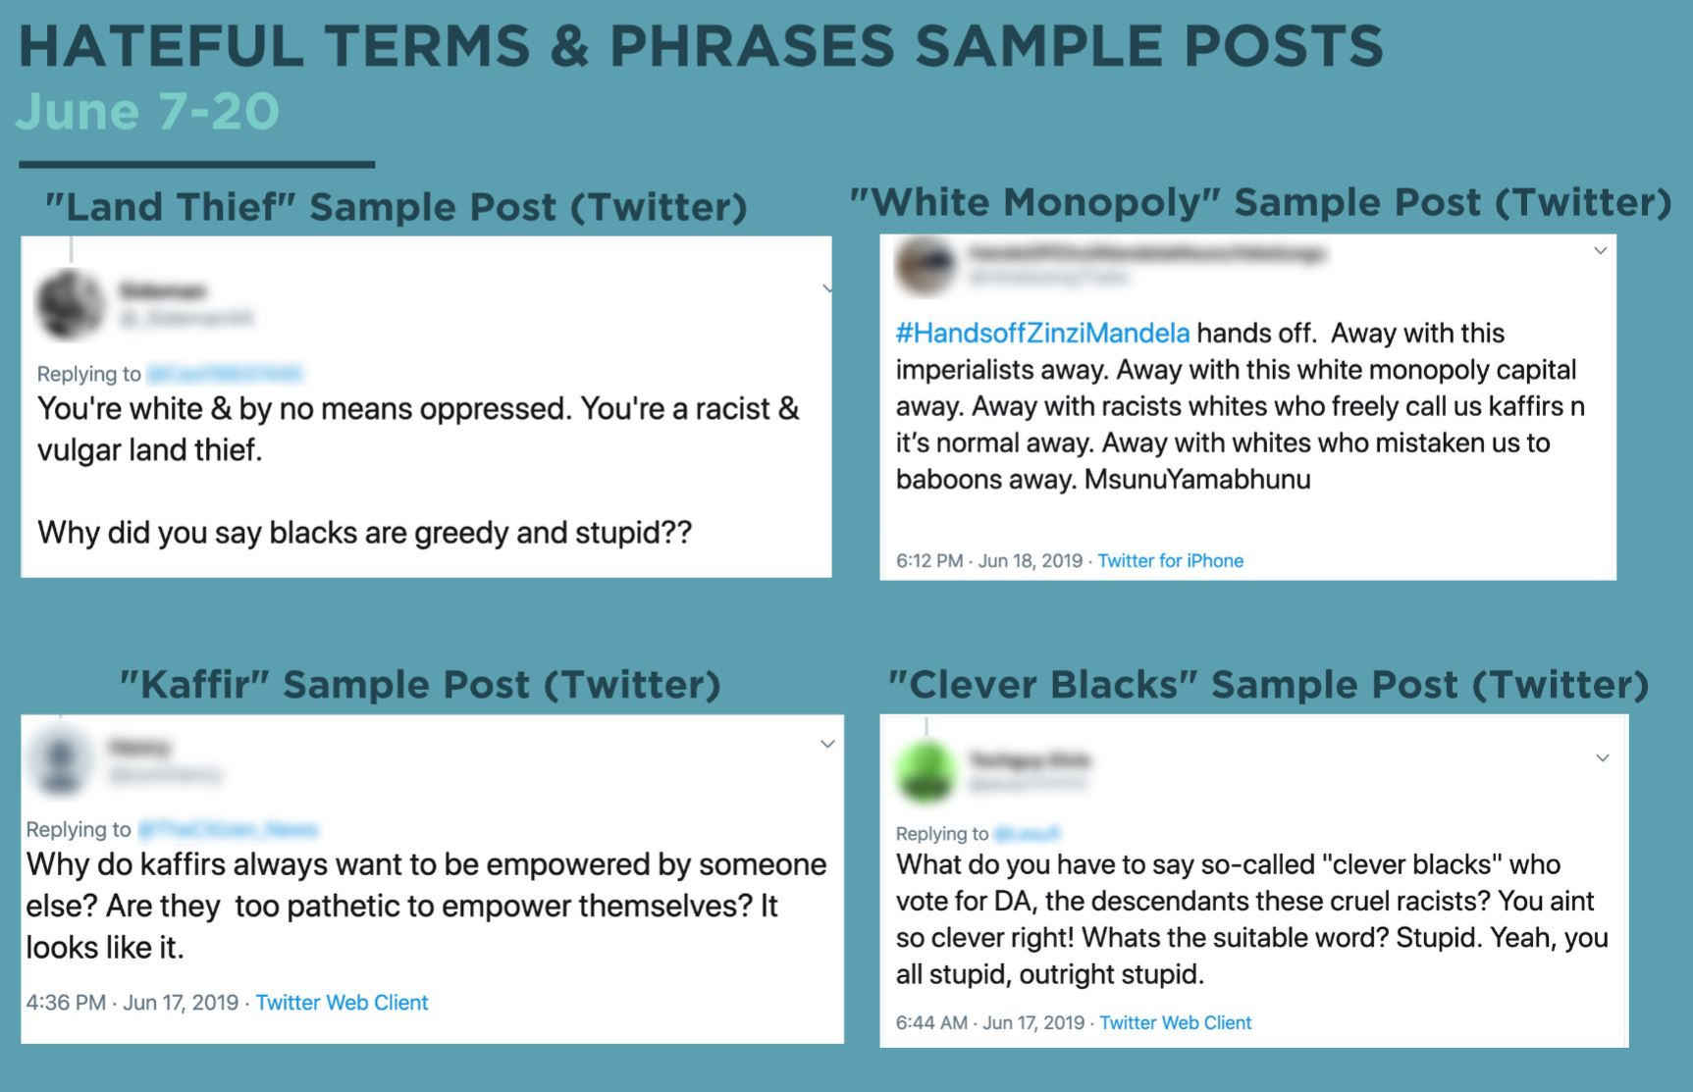
PeaceTech Labs in South Africa Case Study

Slide 9
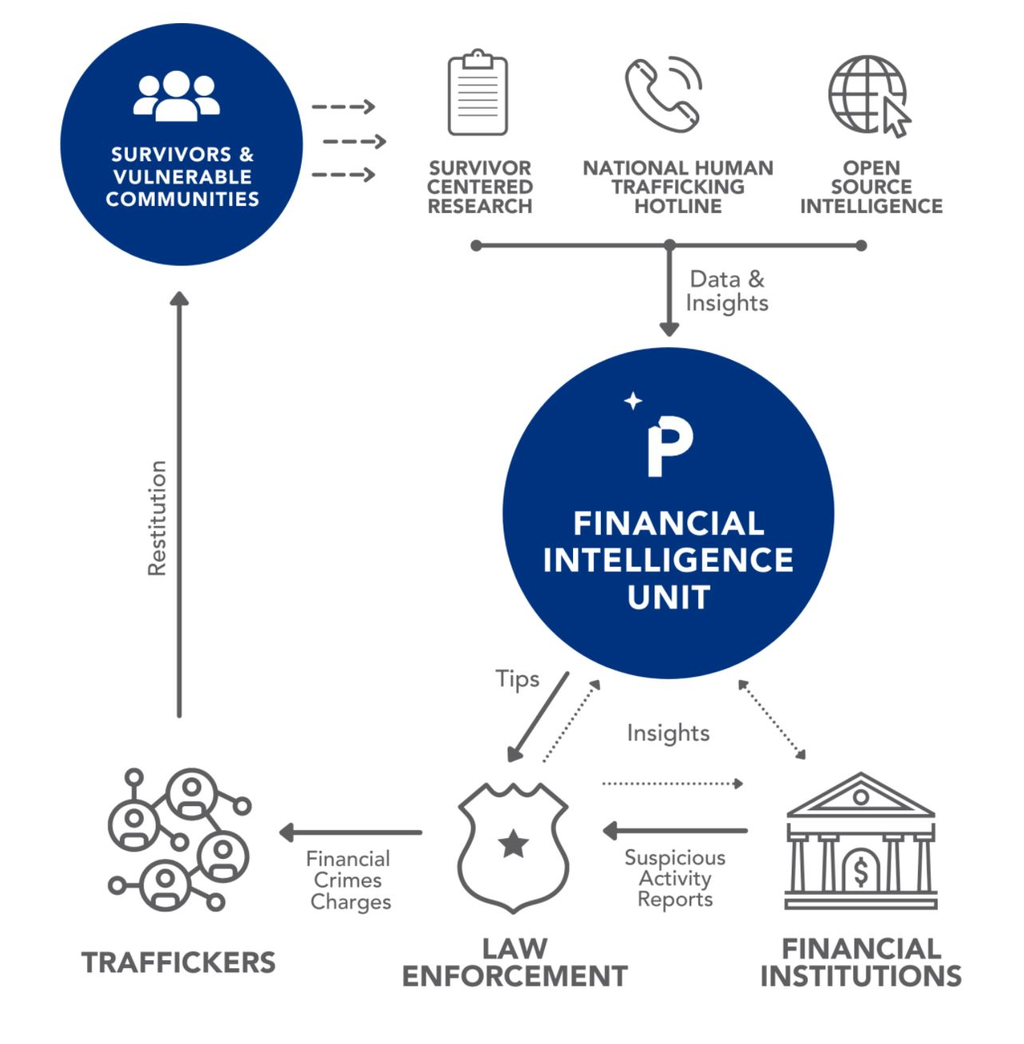
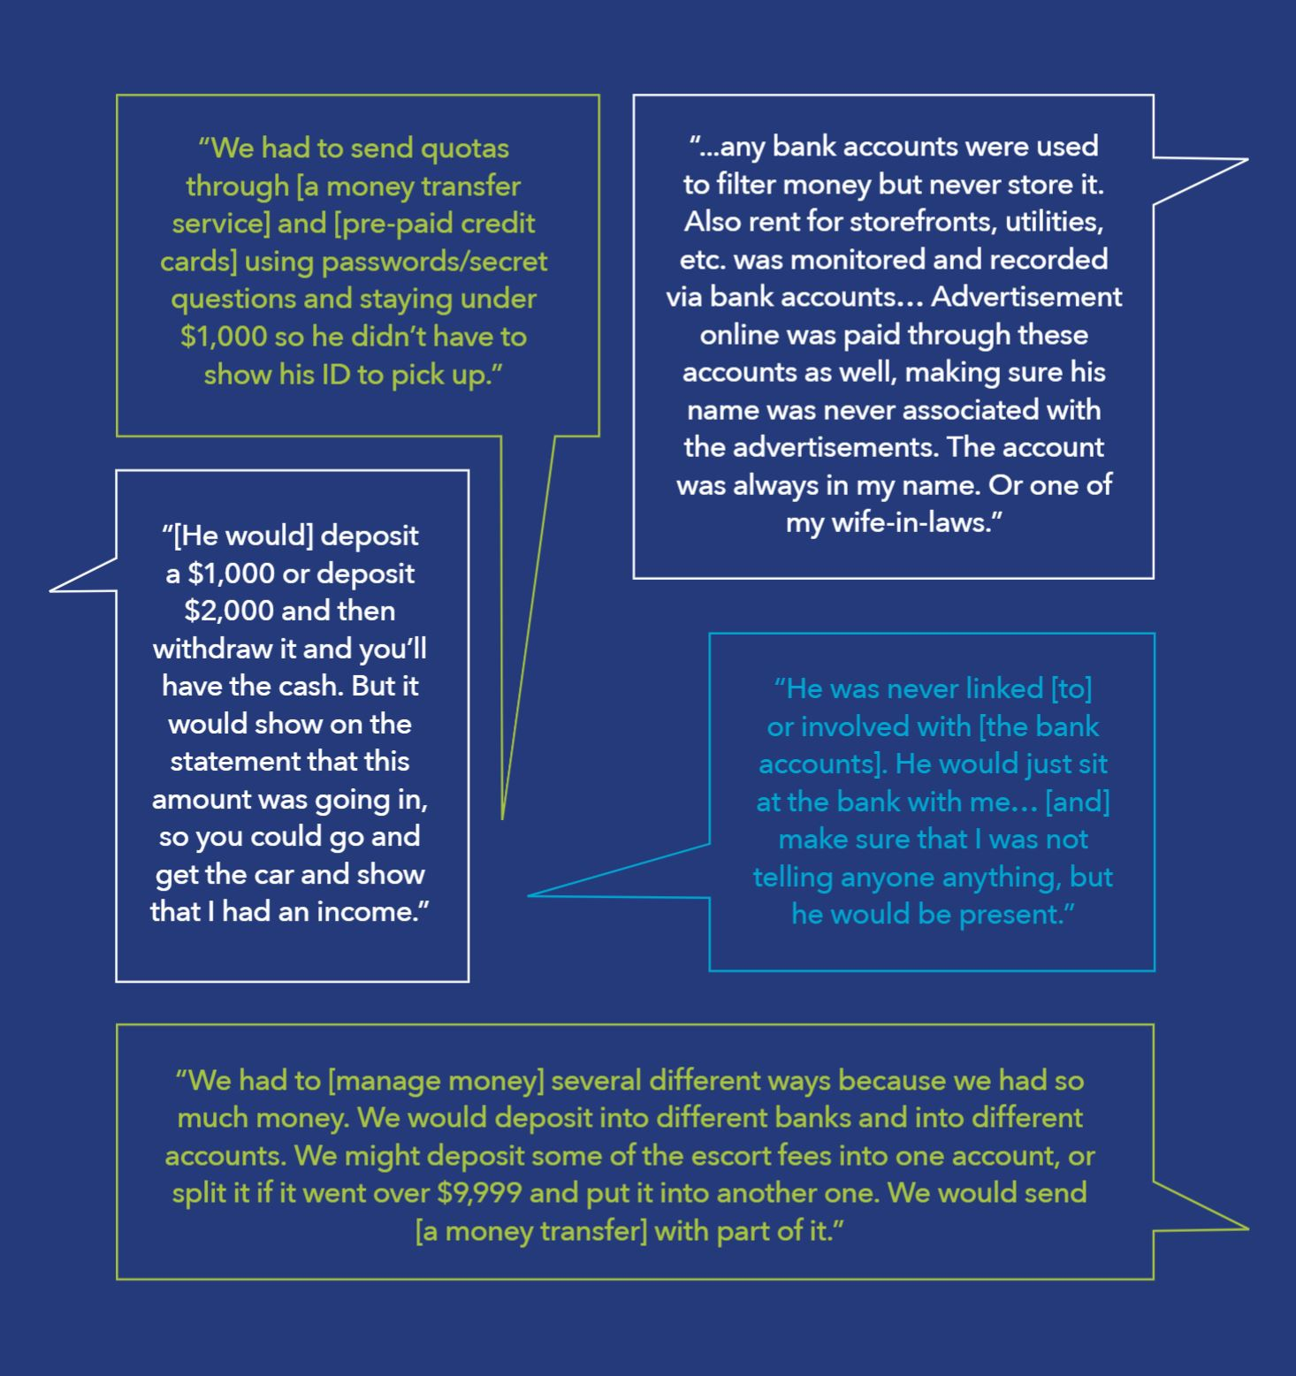
Polaris Human Trafficking Case Study

Slide 10
Challenges and Dangers
Access to high-quality data
AI expertise (and continued support)
Malicious use
Technological colonialism

Slide 11
Solutions
Emphasize theory-informed data
Build relationships between developer companies, social organizations, and universities
Call for increased responsibility and accountability for developers and users

