Slide 1
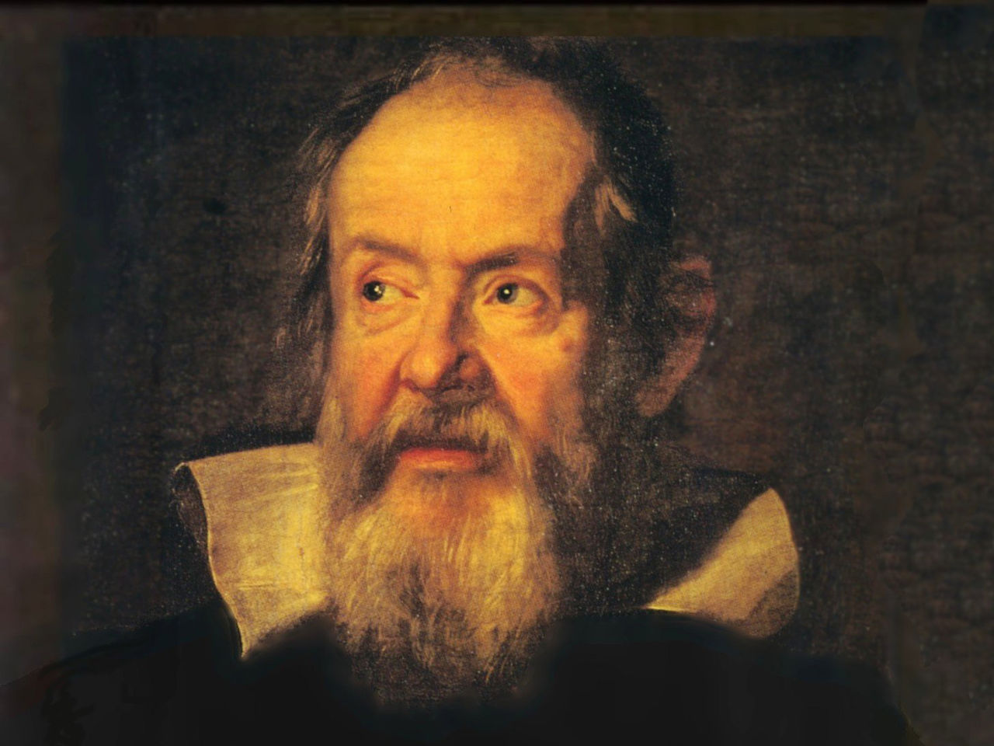
Galileo on Motion
Darin Habermel

Slide 2
Impetus theory
Impetus – an imparted, enduring force
John Philoponus (6th century)
Jean Buridan (14th century)
“When a mover sets a body in motion he implants into it a certain impetus, that is, a certain force enabling a body to move in the direction in which the mover starts it, be it upwards, downwards, sidewards, or in a circle. The implanted impetus increases in the same ratio as the velocity. It is because of this impetus that a stone moves on after the thrower has ceased moving it. But because of the resistance of the air (and also because of the gravity of the stone) which strives to move it in the opposite direction to the motion caused by the impetus, the latter will weaken all the time. Therefore the motion of the stone will be gradually slower, and finally the impetus is so diminished or destroyed that the gravity of the stone prevails and moves the stone towards its natural place..”

Slide 3
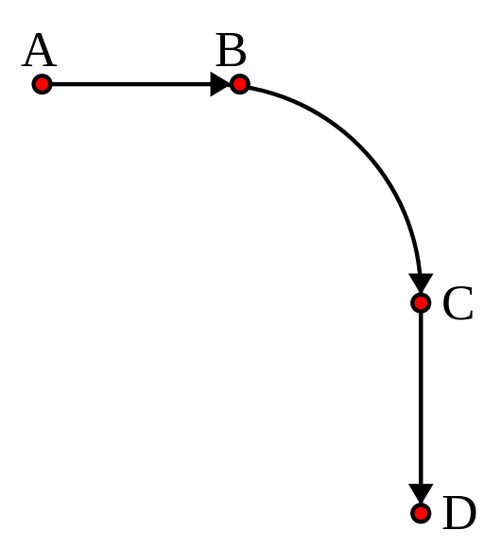

Slide 4
Tunnel experiment
Imagine a cannonball is dropped from a given height through a hole in the Earth. The cannonball is given impetus by its natural motion and rises to the exact same height on other side of Earth. Unlike Aristotelian ideas, it explains oscillatory motion.

Slide 5
the right and wrong:
Like momentum, impetus, once imparted to an object, will endure forever unless corrupted by an outside force.
Not like inertia: in modern inertia, rest and motion are equivalent. But impetus has no meaning for a non-moving object.
In modern theory, we differentiate between linear and angular (circular motion) momentum, but angular motion requires a force to be maintained. Buridan used impetus theory to explain linear as well as circular motion. These were essentially the same; impetus was the force that tended to uphold the initial motion, whether straight or circular. This idea survived for 300 years until Galileo.

Slide 6
Enter galileo.

Slide 7
biography
Father (Vincenzo) and brother (Michelagnolo) were lutists
Considered priesthood, but father pushed him to medicine
Had three children out of wedlock with Marina Gamba
Body was buried then reburied minus three fingers and a tooth; Right hand middle finger is on display in Museo Galileo

Slide 8
“Naturally accelerated motion”
Bodies accelerate toward Earth at constant rate
Did not propose a dynamic model for this
Published works in Italian so they could be read by larger audience
Cushing claims his key insight was to think of time as independent variable

Slide 9
but how original was he?
14th century - Oxford group came up with law of falling bodies and stated and demonstrated mean speed theorem
14th century - Nicole Oresme in his Physics Commentary defines time as the successive duration of things that is, the duration of the actual existence of things as opposed to Aristotle’s measure of time in relation to motion; Aristotle believed time was not independent of motion

Slide 10
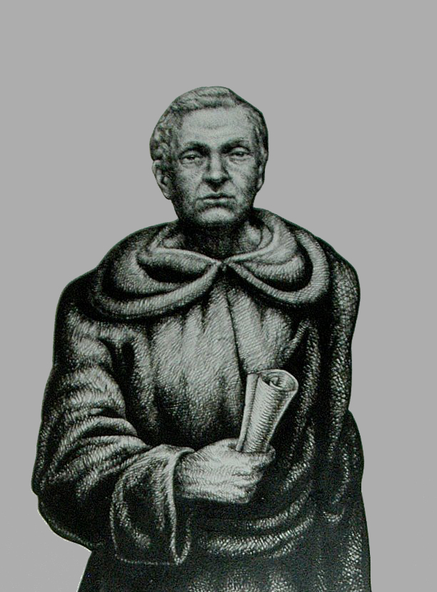
Domingo de soto
Domingo de Soto proposed that bodies falling through a homogeneous medium would be uniformly accelerated. De Soto most likely did not have experimental evidence to back this up. Galileo mentions de Soto in Tractatus de Elementis.

Slide 11
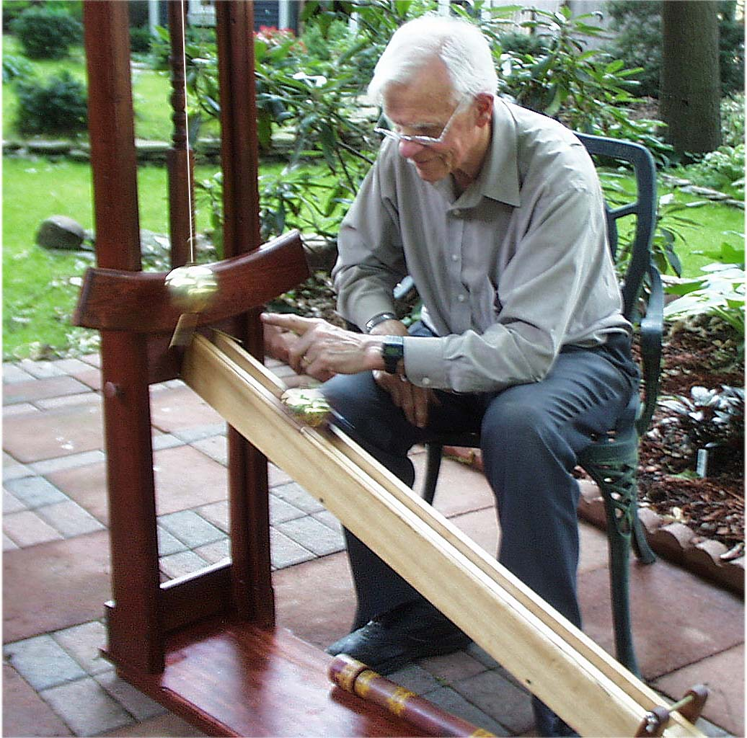
Inclined plane Experiments
Galileo used inclined planes to study motion because his methods of time keeping were not sufficiently accurate to measure free fall.
http://muse.tau.ac.il/~museum/java/pc/LawOfFall/english/act_inclined_eng.html

Slide 12
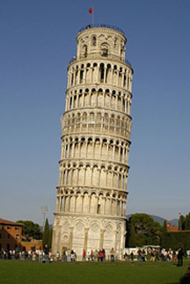
Leaning Tower of pisa experiment
Fact or Fiction?
Most scholars agree that this was a thought experiment
Vincenzo Viviani- pupil of Galileo’s claimed it happened

Slide 13
Projectile motion
Galileo posits independence of horizontal and vertical motion
Determined that when the two motions were combined, they gave the equation of a parabola
http://galileo.phys.virginia.edu/classes/109N/more_stuff/Applets/ProjectileMotion/enapplet.html

Slide 14
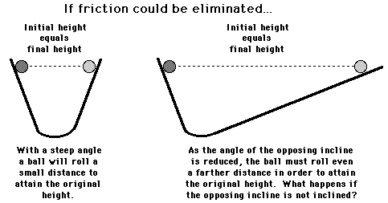
Momentum and inertia
Momentum – same concept and formula as Buridan’s impetus
Inertia – an object’s tendency to remain in motion
Galileo used the concept of friction to explain discrepancies in observed results

Slide 15
Not quite inertia
Galileo was correct in his statement that objects in motion tend to stay in motion, but he seemed to believe that inertial motion moved equidistant from the center of the Earth.
http://www.physicsclassroom.com/mmedia/newtlaws/il.cfm

Slide 16
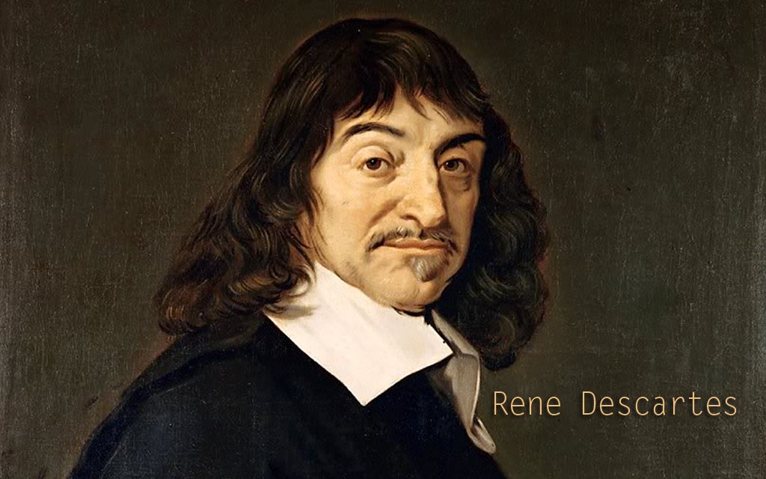
Descartes
Descartes was the first one to correctly state that an object in motion continues its motion in a straight line.

Slide 17
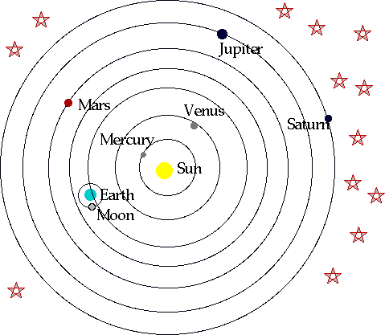
Inertia allowed for planets to continue orbits without outside force
Space as a vacuum

Slide 18
So what else did galileo do?
Constructed a telescope with 30x magnification
Led to his observation of Kepler’s supernova, sun spots, mountains and craters on the moon, three moons of Jupiter, all the phases of Venus, Saturn, Neptune, and Milky Way’s stars

Slide 19
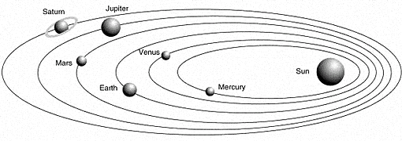
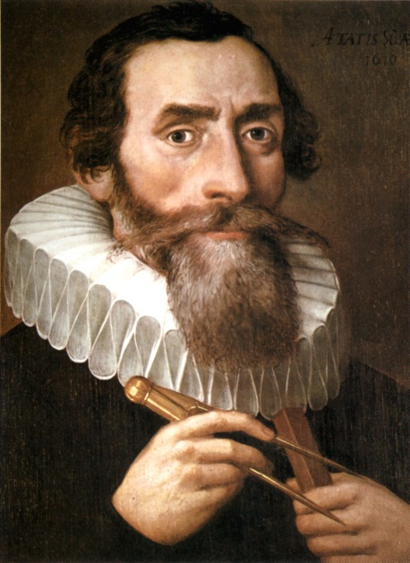
Galileo’s heliocentric model still proposed perfect circles for planetary orbits. Kepler was a contemporary of his yet he still opposed elliptical orbits. Galileo’s heliocentric model was only unique in that it had better evidence.

Slide 20
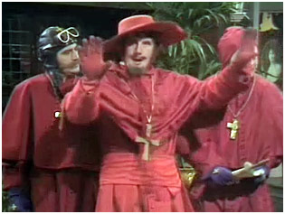
The consequences
Galileo’s observations did a great deal to support heliocentrism. His claims that nature could be understood with mathematics and compelling evidence for heliocentrism led to his house arrest by the Catholic Church. His book Dialogue Concerning the Two Chief World Systems was subsequently banned.

Slide 21
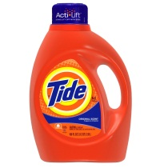
Other thoughts
Galileo and Kepler disagreed on the cause of tides. Galileo thought it was caused by the oceans sloshing back and forth due to the Earth’s non-uniform acceleration. Kepler was of the opinion that it was caused by the moon. Galileo also rejected Kepler’s elliptical orbit theory.

Slide 22
Overlooked discoveries
One of the first people to understand sound frequency
Basic principle of relativity
One of the first compound microscopes
Thermoscope

