Slide 1
CH 10
PATHOLOGIZING HUMAN NATURE

Slide 2
TRANSHUMANISM
“mechanizing, biologizing,
and pathologizing” human nature

Slide 3
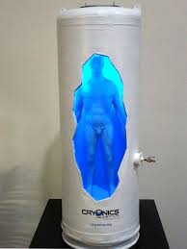
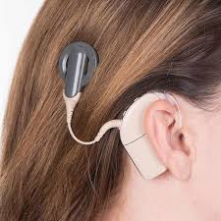
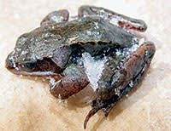
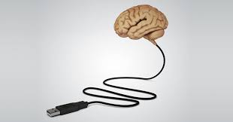
TRANSHUMANISM
“mechanizing, biologizing,
and pathologizing” human nature

Slide 4
TRANSHUMANISM
HUMAN EXCEPTIONALISM VS HUMAN LIMITATION
Humans are different from all organisms
All human behavior is controlled by control & free will
Reject tinkering with human nature
Humans are flawed/limited
We should “transhuman” and overcome our flaws

Slide 5
TRANSHUMANISM
FIXING DESIGN FLAWS
Psychological / behavioral fixes
Drugs as aids
Must be combined with effort
Techno-optimists
Transhumanism is a new source of promise and meaning for humanity
Do we not have enough purpose/tasks set in front of us?
Hundreds and thousands of people dying from HIV, yet the new task for humanity is “transhumanism”?
Or is this a conservative mindset that will hinder technological development?

Slide 6
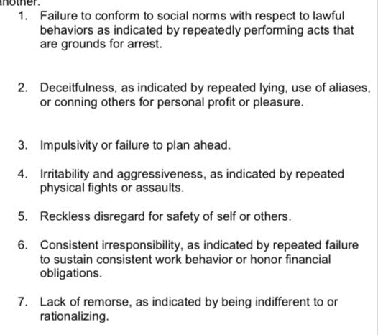
DEFINING FLAWS
Narcissistic personality disorder
Antisocial personality disorder
Avoidant personality disorder

Slide 7
DEFINING FLAWS
What we view / categorize as “flaws” is subjective
What we view / categorize as “flaws” changes with time
bad eyesight
Narcissism
ADHD
DISEASES should be fixed?
FLAWS are human?
As our history shows, will our standards for diseases keep evolving to include more things? To the point where even death must be fixed?
What is the line between “treatment of disease” and “greedy enhancements”?
Who should get to decide this turning point?

Slide 8
ENHANCED MORALITY
Propanol for PTSD
Oxytocin: empathy, trust, love
“hard to argue against moral enhancement from a societal perspective”
POTENTIAL DOWNSIDES?
Can morality be technologically manufactured / designed?

Slide 9
BIOLOGIZING AND MECHANIZING
SCIENTIFIC REDUCTIONISM VS GESTALT THEORY
Consciousness is merely an emergent property of synaptic activity in the brain
Certain economic benefits
Lab vs field experiments
Human vs animal experiments
- The whole is more than a mere sum of its parts
But are the results applicable?
Are experiments based on scientific reductionism worth it?

Slide 10
CH 11
DRIVERS OF THE STORM

Slide 11
DRIVERS VS SPEEDBUMPS
Security / defense sector
Medical research / healthcare
Tragedy / accidents

Slide 12
SECURITY AND DEFENSE
LOGIC:
FALLACY:
Weaker foes will be intimidated
Similar strength will be restrained by fear of mutually assured destruction
Technological supremacy will prevail
Commercialization of technology initially developed for defense purposes
Response to terror has resulted in more terror
Staying ahead in the arm race does not have an endgame other than eventual destruction
What if we restricted military technology from the public / commercial use? Will this slow down the techstorm? Is this desirable?
Should citizens accept some degree of risk and not hold governments at fault?

Slide 13
CONTROL / REGULATION
Socialized medicine
Caps on malpractice settlements
HEALTHCARE DILEMMA:
REFLECTION OF CURRENT VALUES:
Emphasizing the financial crisis caused by the rising cost of healthcare could jeopardize investment in essential medical research
Emotional values
Political values
Control / regulation can be seen as not giving the best effort for loved ones who are sick

Slide 14
HEALTHCARE
Will better technology lower the cost of healthcare?
So far, it has raised it.
WHY?
Belief that medical science sits on the verge of solving all human ailments
Greed/ambition is endless
Even when price goes down, cumulative cost goes up as tech gets distributed more broadly
Expensive diagnostic tests
Availability of high-tech equipment
Threat of lawsuits

Slide 15
LOWER-QUALITY, CHEAP, ACCESIBLE HEALTHCARE
VS
HIGH-QUALITY, EXPENSIVE, INEQUAL HEALTHCARE?

Slide 16
PRIORITIES?
EXTENDING THE LIF OF AN ELDELY AUNT FOR A BRIEF PERIOD
VS
NEICE”S EDUCATION
VS
BUILDING ESSENTIAL INFRASTRUCTURE
VS
LOW PROBABILITY EVENTS THAT WILL HAVE A VERY HIGH IMPACT

