Slide 1
The Tools for How We Should Understand Technological Change
Complexity, Pace of Change, and Tradeoffs
Reactionary Innovation Cycle
Complexity
Technology: A tool for humanity that is not human
Chaos Theory vs. Complexity Science
Tipping Points -> Complex Systems
Disasters Arise for 4 Reasons
Flash Crash
Decoupling and Modularity
Human Body: Biomarkers
New Technology Introduced
Positive and Negative Effects
Mitigate Negative Effects at Policy Level
Modeling Tech: What Should Be Included
Integral Factor (Yes)
Not Important (No)
Don't Understand (No)
Solving Lapses in Complex Systems
Decentralization
Modeling Systems
Testing models and experimenting
Allowing for sufficient testing innovation time

Slide 2
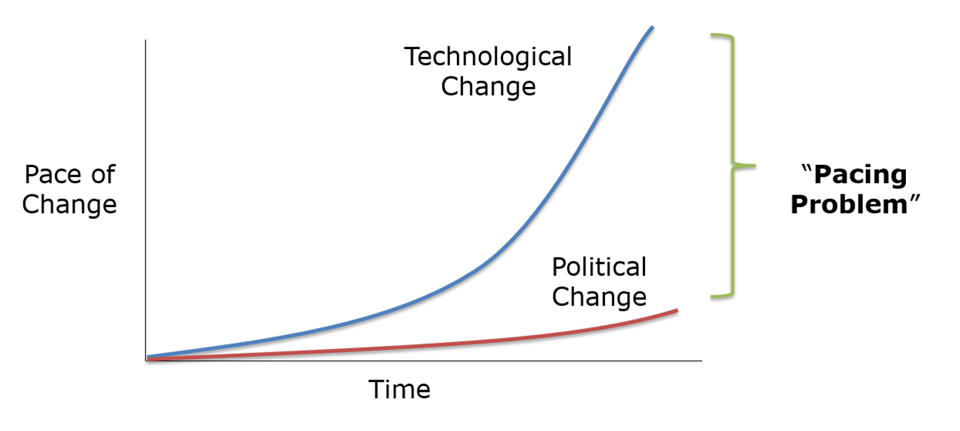
The Tools for How We Should Understand Technological Change
Complexity, Pace of Change, and Tradeoffs
Pace of Change
Pacing Problem
3D Printing Guns
Information Age: Before Internet → After Internet
Technological Singularity
Turing Test: Are computers capable of thinking?
The Law of Accelerating Returns – Inevitability
Collingridge Dilemma
Computer Technology
Inevitable development of technology
No Computers
Computers overtake humanity
Iterations to Improve User Experience
Cannibalized for faster innovation

Slide 3
The Tools for How We Should Understand Technological Change
Complexity, Pace of Change, and Tradeoffs
Tradeoffs
Positive and Negative Applications for Technology
Geoengineering – Ethics and Politics vs. Economics
Nanotechnology – Safety vs. Speed
Societal Costs of Technology
Nuclear Power – Existential Risks vs. Environmental Solutions
Clean Energy Solutions
Wind Energy
Nuclear Power
Solar Energy
Natural Gas
Specific Use Case Alternatives
Energy Conservation?

