Slide 1
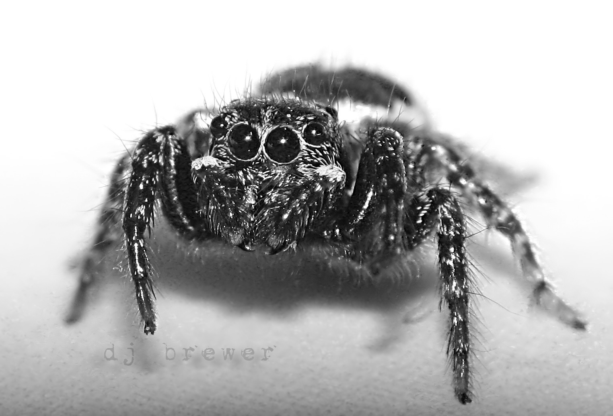
Fear and Mortality-Salience increase Volunteering
Elise Murray, Kellen Mrkva, Travis Pruitt, Emily Conron, Elizabeth Peterson, Darcia Narvaez
Abstract
We examined the effects of incidental (fearful mood) and integral (task-related) fear on volunteering, and the effects of incidental and integral mortality-salience. Study 1 participants primed with their own death were more willing to sign up for a volunteering opportunity. In Study 2, induction of fear mood increased sign-ups for a volunteering opportunity and individual differences in moral identity moderated the effects. Study 3 examined the effects of integral (task-related) fear and integral mortality-salience on volunteering. When the volunteering opportunity involved fear, participants were less likely to volunteer, but were more likely to volunteer when the opportunity involved death.
Background
Many of the opportunities to be moral that we face involve some form of fear—whether a fear of putting ourselves or others in danger, fear that we are providing help that is not desired, or fear of negative evaluations from others. Our moral decisions can also be affected if we are in a fearful mood—having just finished watching a horror movie, we may react differently to opportunities to help others. Emotion researchers have made a common distinction made by emotion researchers between incidental fear (e.g. fearful mood) and integral (task-related) fear on volunteering, as well as the effects of incidental mortality-salience and integral mortality-salience. Only incidental mortality-salience has been examined in relation to moral judgment or behavior in past studies.
Triune Ethics Theory (TET, Narvaez, 2008) proposes three moral orientations emerged from human evolution, which arise out of biological propensities (Safety, Engagement, Imagination). People who rely too much on their safety ethic tend to be more self-oriented and self-protective. However, some contexts involving fear seem to actually increase prosocial behavior, either due to desires to escape that emotional state or by signaling that action is called for.
Participants:
Study 1: 85 undergraduate students
Study 2: 133 undergraduate students
Study 3: 67 undergraduate students
Contact Information
kellen.mrkva@colorado.edu, dnarvaez@nd.edu, emurray3@nd.edu
Results (Cont.)
Study 3
Participants were marginally less likely to volunteer for the activity involving fear, but significantly more likely to volunteer for the activity involving talking about death (t=2.47, p=.007)
Conclusions and Implications
The findings of this study indicate that undergraduates in a fearful mood are more likely to volunteer for prosocial behavior compared to those in a neutral mood. However, they are less likely to volunteer for activities which themselves will involve fear. Finally, activities involving discussing death seem to increase individuals’ willingness to volunteer.
Future research should determine why activities involving thinking about death increase volunteering (e.g. do they arouse more empathy or signal that the recipients are in greater need?)
References
Joireman, J., & Duell, B. (2005). Mother Teresa versus Ebenezer Scrooge: Mortality salience leads proselfs to endorse self-transcendent values (unless proselfs are reassured). Personality and Social Psychology Bulletin, 31(3), 307-320.
Jonas, E., Schimel, J., Greenberg, J., & Pyszczynski, T. (2002). The Scrooge effect: Evidence that mortality salience increases prosocial attitudes and behavior. Personality and Social Psychology Bulletin, 28(10), 1342-1353.
Narvaez, D. (2008). Triune ethics: The neurobiological roots
of our multiple moralities. New Ideas in Psychology, 26,
95-119.
Reed, A., Aquino, K., & Levy, E. (2007). Moral identity and
judgments of charitable behaviors. Journal of Marketing,
71, 178–193.
Methods
Study 1 procedure
Participants wrote for 5 minutes, either about what would happen leading up to their physical death (mortality-salience) or about everyday activities (neutral)
They were informed about a volunteering opportunity at the Center for the Homeless, and asked whether they would be willing to sign-up.
They completed personality measures and moral identity measures and were debriefed and told the true purpose of the experiment.
Study 2 procedure
Identical format to study 1, except the writing manipulation was replaced with a room environment manipulation. Participants were assigned to either a room which were set up to induce mild amounts of fear (e.g. books about terrorism), or a neutral room
Study 3 procedure
Study 3 was exclusively online. Participants read about two volunteer opportunities and were asked whether or not they were willing to sign up for each.
Volunteer activity involving mortality-salience: participants were given an opportunity to volunteer in a mentorship program with kids at the Center for the Homeless; it involved discussion of issues in their lives. In the mortality-salience condition, the description also mentioned that the kids in the program had recent deaths in their family which would be the topic of some of the discussion.
Results
Study 1
Participants who wrote about death were more willing to volunteer (t=2.05, p=.04), replicating the “Scrooge Effect”
Study 2
Participants placed in the "fear" room were more willing to volunteer (t=2.37, p=.01)
Engagement moral identity also predicted higher volunteering. Anxiety interacted with condition such that those who were more anxious and assigned to the fear room were especially likely to volunteer.

