Slide 1

Triune-Ethical Orientations: Validation of Safety, Engagement, and Imagination
Darcia Narvaez and Ashley V. Lawrence

Slide 2
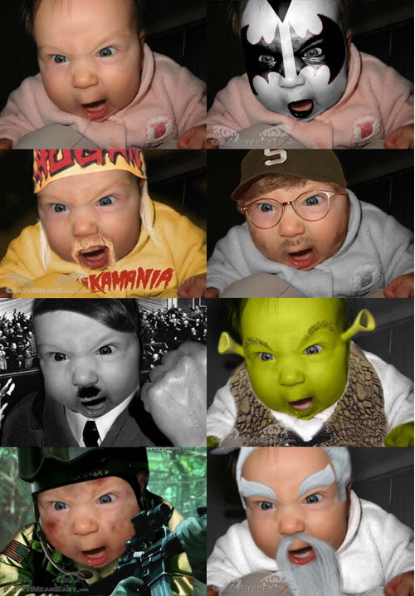
Triune-Ethics Theory
(Narvaez, 2008, 2012)
Global brain states (MacLean, 1990) shift motivation:
  Self-protection
  Relational attunement
  Abstraction
Capacities are influenced by early experience
Represent alternative “moral natures”
Notes:
You can be pulled downward to evolutionarily prior systems for self-protection and self-enhancement, which can be very satisfying in the moment.

Slide 3
What is an ethic?
EVENT
Emotion-cognitive response
Triggers behavior that trumps other values
Subjectively, it is an ethic

Slide 4
My Safety (group)
Engagement
Distress
Entangled
Fear-based Ingroup
Companionship
Resistant
Superorganism
Communal
Cacostatic
Internalizgin< ----→Externalizing
Shepherd
Vicious
Bombard
Eco-
Common Self
Wisdom
Impositional Altruism
Aversive
Pathological Altruism
Vacant
Personal
Detached
My Safety (solo)
Imagination

Slide 5
Epigenetics of Moral Development
Neurobiology of Self and Relationships
Experience early
Personality
Agreeableness (Kochanska)
Empathic orientation
(Tomkins)
Cooperative self-regulation (Sroufe)
Positive, prosocial emotions (Schore)
Ethical Orientation
Safety
Engagement
Imagination
(Triune Ethics, Narvaez)
and during sensitive periods
[caregiving, social support and climate]
Notes:
DN

Slide 6
Validating TET Orientations
(1) Present a list of characteristics (like Aquino & Reed, 2002)
  SAFETY: Controlled, tough, unyielding, competitive
  ENGAGEMENT: Caring, compassionate, merciful, cooperative
  IMAGINATION: Reflective, Thoughtful, Inventive, Reasonable
(2) Rate statements (Likert-type: 1-5) that represent
  Explicit self-ideals (conscious self), e.g.: It would make me feel good to be a person who has these characteristics.
  Perceptions others have of self (unconscious self), e.g.: My family thinks I have these characteristics

Slide 7
Participants: 1,519 adults (panel organized by Knowledge Networks) completed online survey.
We compared three TET orientations with Aquino & Reed’s Moral Identity Scale.

Slide 8
Predictor Variables
Early Caregiving: Close Relationship Questionnaire (Bartholomew & Horowitz, 1993): secure, preoccupied, fearful, dismissive attachment style
Habitual Emotions: Dispositional Positive Emotion Scale (DPES; Shiota et. al, 2006)
Bio-Cultural Attitudes: Moral Foundations (MFT: Graham, Haidt & Nosek, 2009; ingroup, fairness, purity, authority, willingness to harm).
Self-Regulation: Integrity Scale (Schlenker, Wei- gold, & Schlenker, 2008)

Slide 9
Correlations: Safety
Safety orientation was positively correlated with
  fearful (r=.116, p<.01), preoccupied (r=.128, p<.01), and dismissing attachment (r=.147, p<.01)
  Willingness to harm (r=.158, p<.01)
negatively associated with
  secure attachment (r=-.093, p<.01)
  Authority (r=-.083, p<.01), ingroup (r=-.072, p<.01), fairness (-.123, p<.01)
  integrity (r=-.166, p<.01)

Slide 10
Correlations: Engagement
Engagement orientation was positively associated with
  secure attachment (r=.256, p=.000)
  all subscales of the DPES (lowest correlation coefficient= .225, all p-values ≤ .000),
  integrity (r=.224, p=.000),
negatively associated with
  dismissing attachment (r=-.138, p=.000) and fearful attachment (r=-.058, p=.026).

Slide 11
Correlations: Imagination
Imagination orientation related positively to
  Secure attachment (.173, p <.01);
  all DPES emotions (. 29 or higher, p=.000);
  MFT authority (.073, p <.01) and Fairness (.127, p <.01);
  integrity (.183, p <.01)
Negatively to
  MFT Willingness to harm (.096, p <.01)

Slide 12
Results: Regressions
Four models tested using same set of predictors for: Safety, Engagement, Imagination, Aquino & Reed’s Moral Identity.
  Model 1 reflects early caregiving: Attachment (secure, preoccupied, fearful, dismissive
  Model 2 reflects result of emotion habits built from childhood experience: added Dispositional Positive Emotions Sum
  Model 3 reflects childhood bio-cultural effects: added Moral Foundations
  Model 4 reflects self-regulation and autonomy space: added Integrity

Slide 13
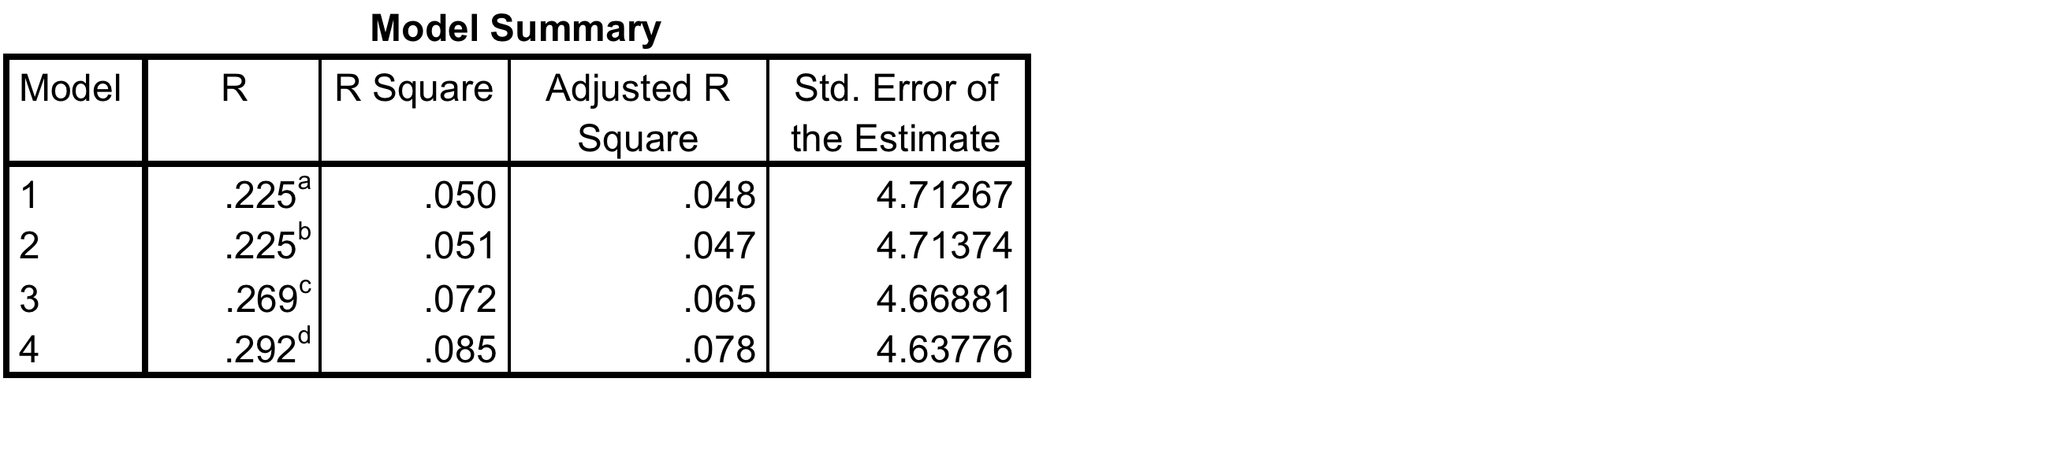
Regression on Safety

Slide 14
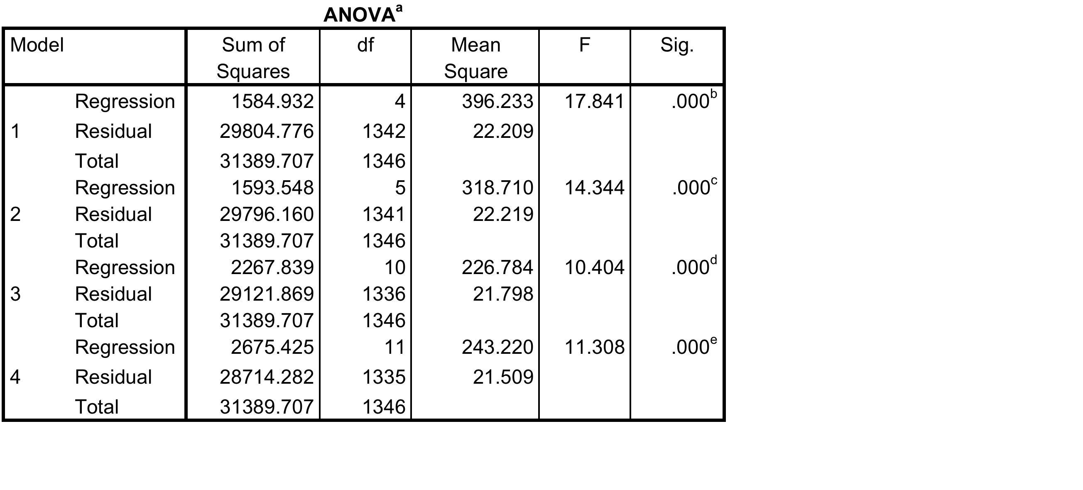

Slide 15
Model 4 Standardized
Coefficients t Sig.
Beta
(Constant) 5.839 .000
Secure -.031 -1.025 .305
Fearful .029 .993 .321
Preoccupied .104 3.673 .000
Dismissing .132 4.625 .000
Disposition for
Positive Emotion .051 1.805 .071
Will to Harm .162 4.426 .000
Fairness .016 .397 .692
Ingroup .040 1.073 .284
Authority -.004 -.104 .917
Purity .034 1.009 .313
Integrity -.126 -4.353 .000

Slide 16
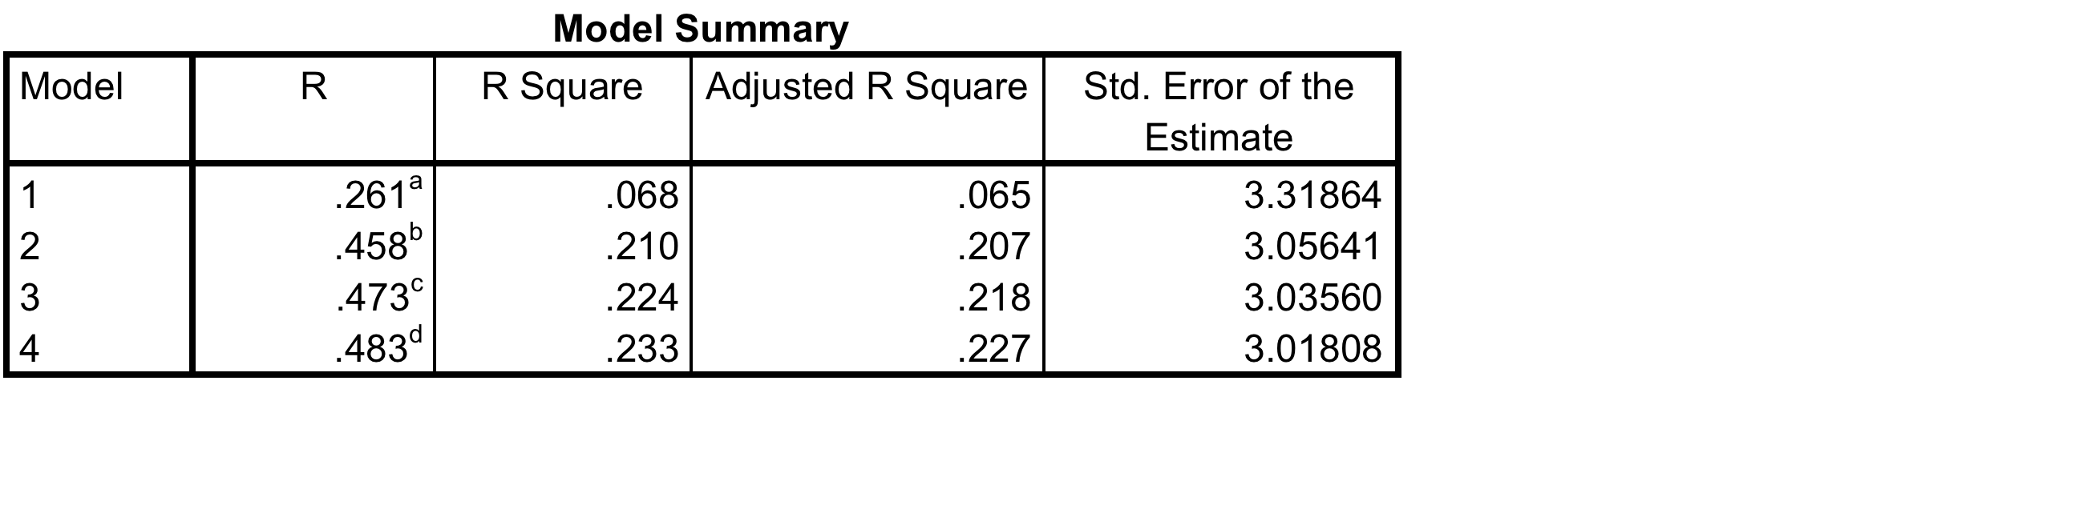
Regression on Engagement

Slide 17
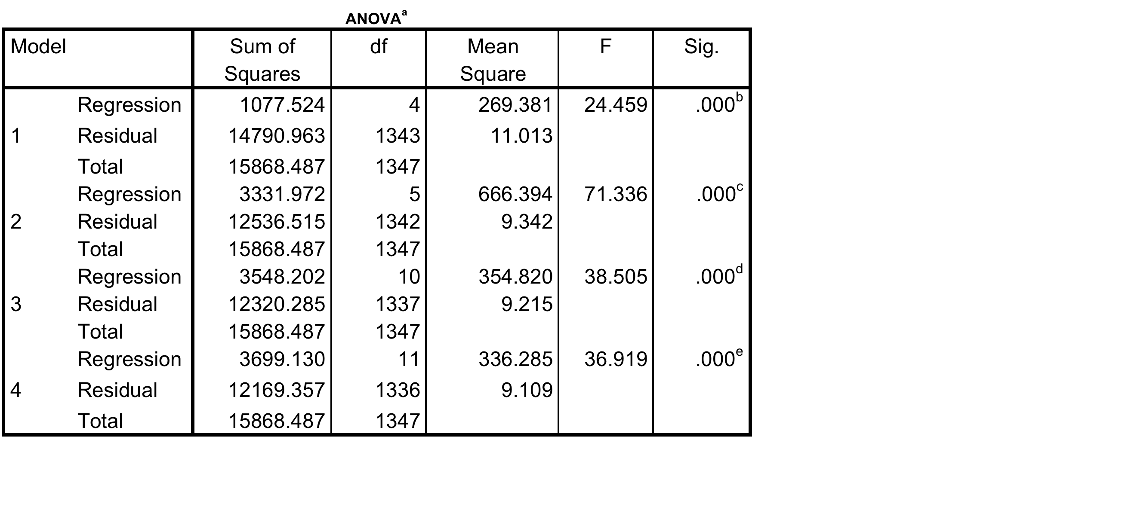

Slide 18
Model Standardized Coefficients t Sig.
Beta
(Constant) 6.998 .000
Secure .098 3.510 .000
Fearful .037 1.372 .170
Preoccupied .033 1.287 .198
Dismissing -.063 -2.400 .017
Disposition for
Positive Emotion .373 14.303 .000
Will to Harm -.059 -1.754 .080
Fairness .044 1.223 .222
Ingroup .001 .020 .984
Authority -.020 -.582 .561
Purity .016 .539 .590
Integrity .107 4.071 .000

Slide 19
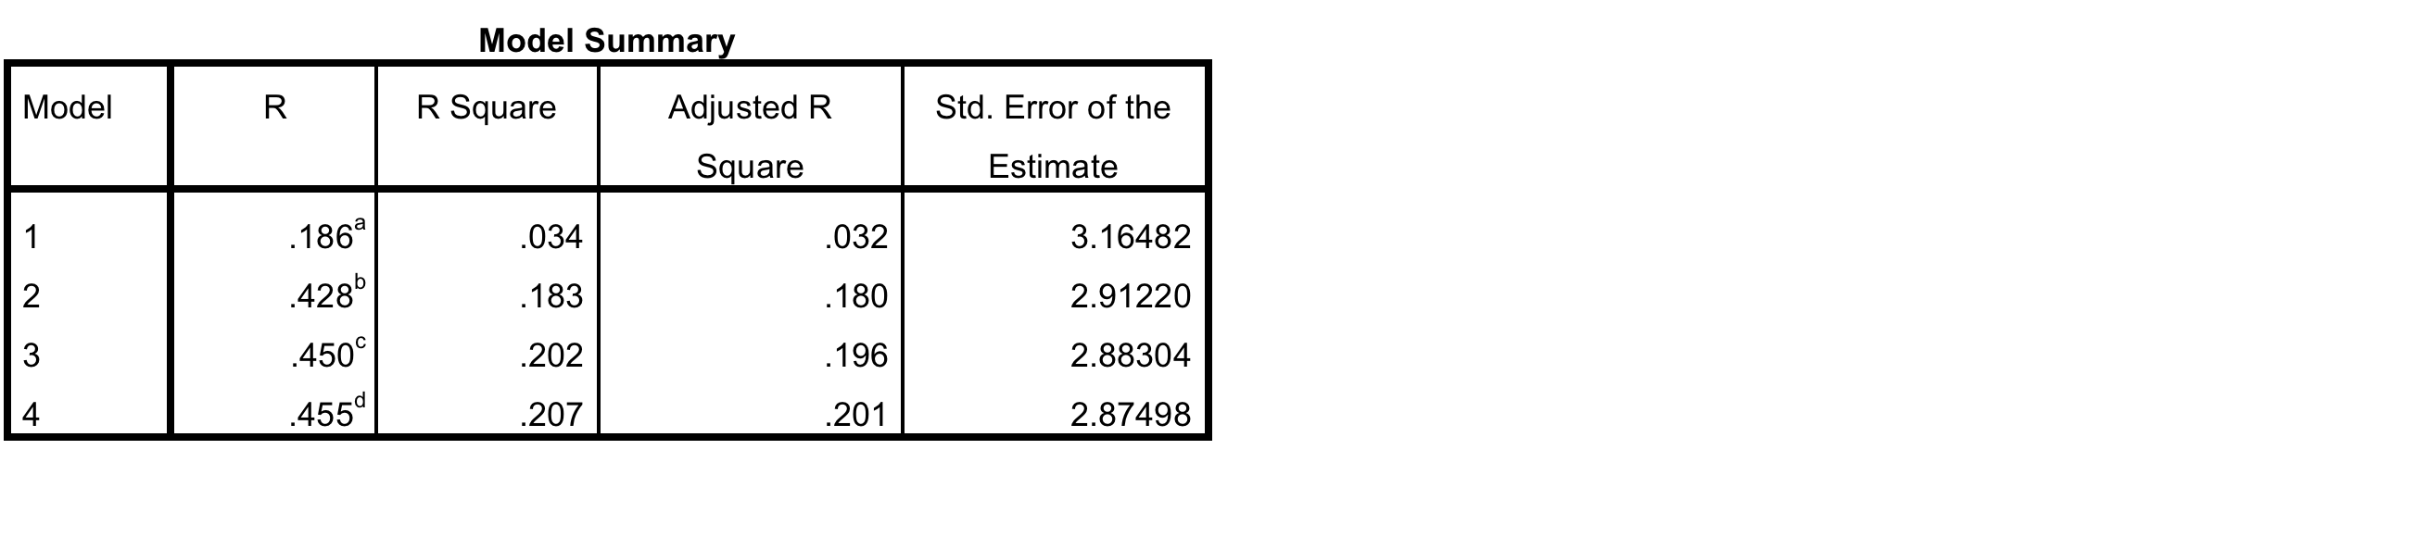
Regression on Imagination

Slide 20
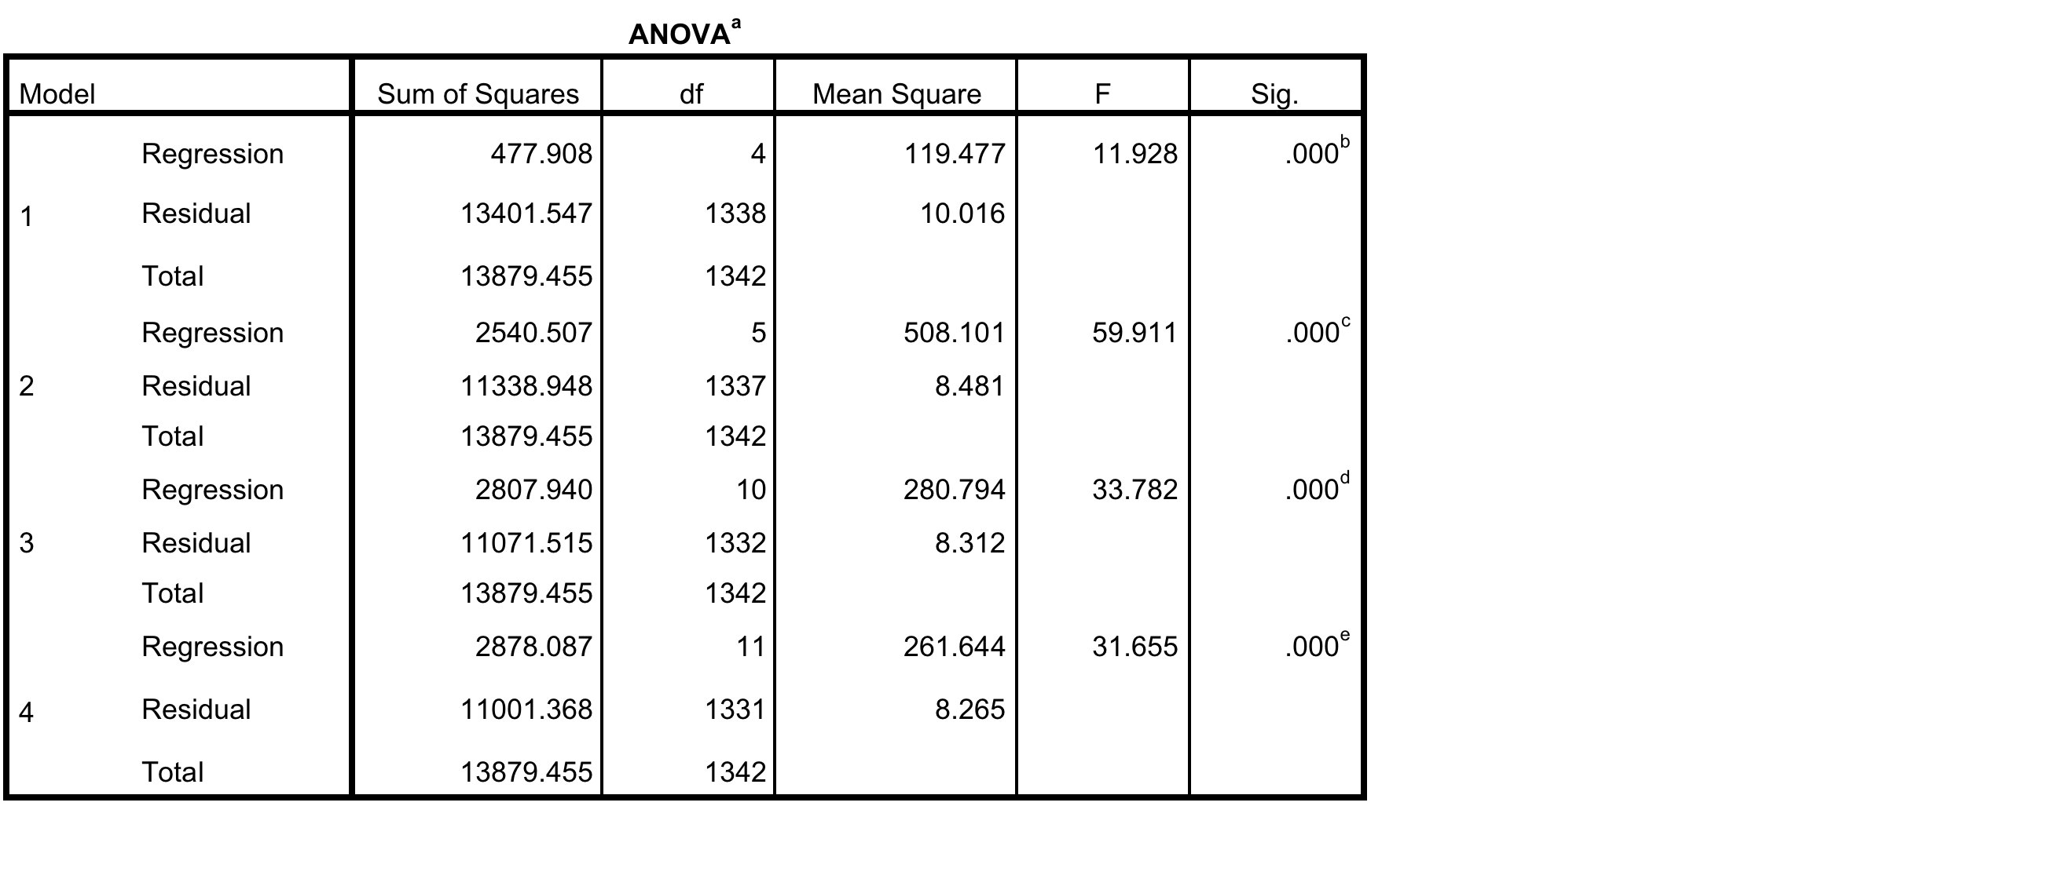

Slide 21
Model Standardized
Coefficients t Sig.
Beta
4 (Constant) 8.803 .000
Secure .059 2.081 .038
Fearful .029 1.056 .291
Preoccupied -.014 -.543 .588
Dismissing .032 1.218 .224
Disposition for
Positive Emotion .392 14.800 .000
Will to Harm -.028 -.824 .410
Fairness .111 3.023 .003
Ingroup -.099 -2.798 .005
Authority .028 .825 .410
Purity -.074 -2.363 .018
Integrity .079 2.913 .004

Slide 22
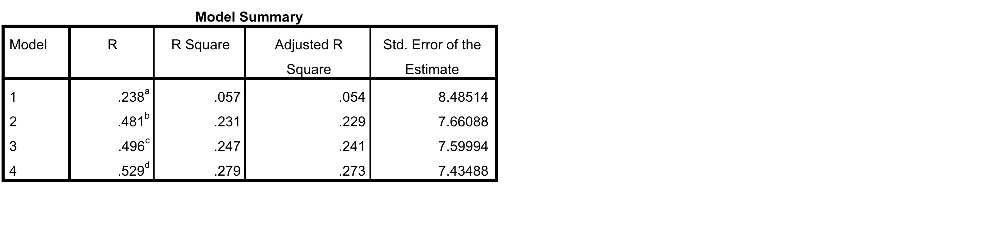
Regression on Aquino & Reed’s Moral Identity

Slide 23
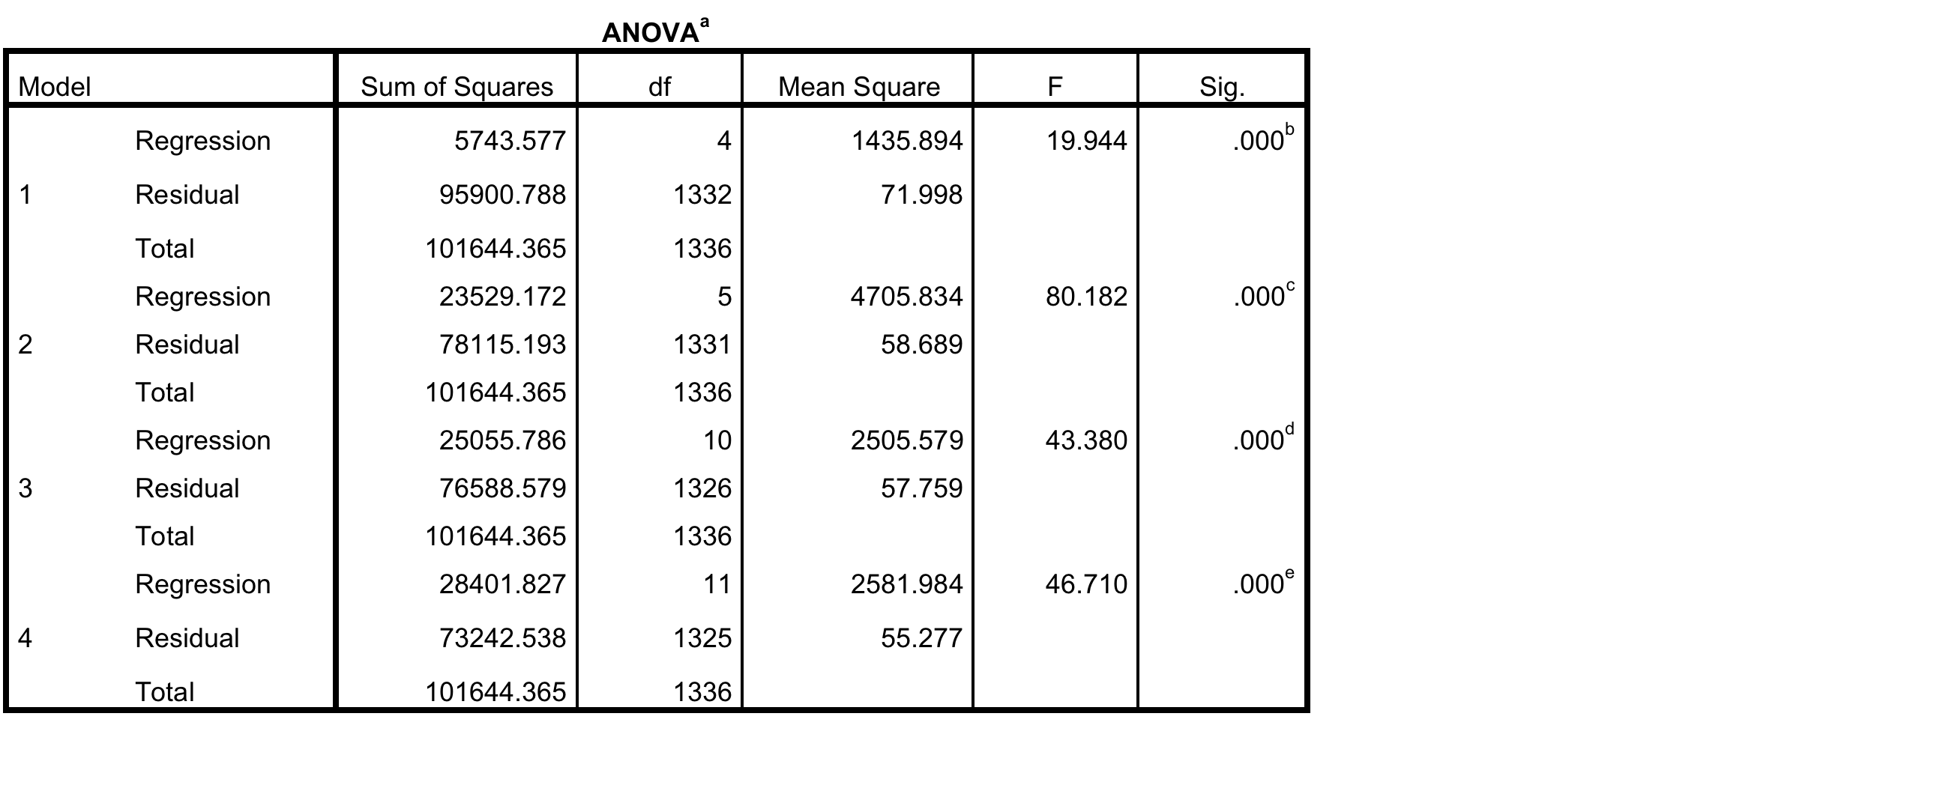

Slide 24
Model Standardized
Coefficients t Sig.
Beta
4 (Constant) 5.747 .000
Secure .069 2.546 .011
Fearful .031 1.168 .243
Preoccupied .015 .574 .566
Dismissing -.035 -1.365 .172
Disposition for
Positive Emotion .403 15.836 .000
Will to Harm -.057 -1.739 .082
Fairness .009 .254 .800
Ingroup -.011 -.320 .749
Authority .017 .515 .607
Purity .016 .558 .577
Integrity .199 7.780 .000

Slide 25
Summary and Discussion
All Model 4s explained the most variance.
As hypothesized, Safety Ethical orientation was best predicted by Insecure attachment, Moral Foundations Theory’s (MFT) Willingness to Harm, and Integrity (negatively).
  A safety disposition reflects a socially-impaired, stress-reactive brain with impaired self-regulation due to poor early experience (indicated by attachment style)

Slide 26
Aquino and Reed’s Moral Identity measure performed most like the Engagement ethic (secure attachment, positive emotion and integrity, trend for willingness to harm).
Engagement orientation was predicted positively by secure attachment, greater overall positive emotions, and higher self-reported integrity but also negatively by dismissive attachment.

Slide 27
Imagination ethic was predicted by secure attachment, positive emotions, and integrity, just like Engagement. But it was also significantly positively predicted by MFT fairness and negatively by MFT purity and ingroup.
  This suggests that Imagination adds additional capacities, beyond Engagement.

Slide 28
Conclusions
Aquino and Reed’s Moral Identity Measure aligns best with the Engagement Ethic
  though Engagement provides more insight into moral functioning in that it was also significantly related to dismissive (avoidant) attachment also.
Safety and Imagination give a fuller picture of moral orientation than Engagement alone.

Slide 29
TET shows more variability
The Safety ethic was not just the opposite of Engagement but was predicted by willingness to harm.
Beyond characteristics shared with Engagement, Imagination related to greater fairness and less ingroup and purity focus than the other ethics.

Slide 30
Moral Foundations Theory aligns differently with different triune ethics.
  Safety: willingness to harm
  Imagination: Fairness, negatively to purity and ingroup
TET view of Moral Foundations Theory is that it reflects primarily socio-cultural influences (including early life experience shaping neurobiology and personality), not evolutionary inheritance (see also Fry & Souillac, 2013, JME).

Slide 31
Implicit Social Cognition formed in Early Years
Social Effectivity
Social Pleasure
Empathic Effectivity Core

Slide 32
Early Experience Builds Procedural Knowledge for
Social Life
“Cultural Commons” for Human Nature
Empathic Core (parameters for Communion)
Autonomy Space (parameters for Agency)
Moral Imagination (parameters for Wisdom)

Slide 33
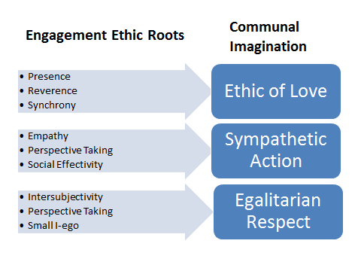

Slide 34
EDN

Slide 35
Parenting Practice & Child Outcomes
 | Empathy | Conscience | Self-regulation | Cooperation | IQ | Depression (not) | Aggression (not)
Natural Childbirth
Breastfeeding initiation
Breastfeeding Length
Touch
Responsivity
Play
Social support/ Multiple caregivers

Slide 37
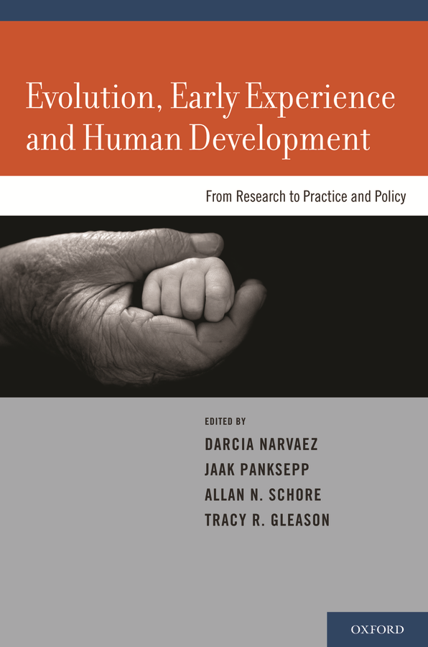

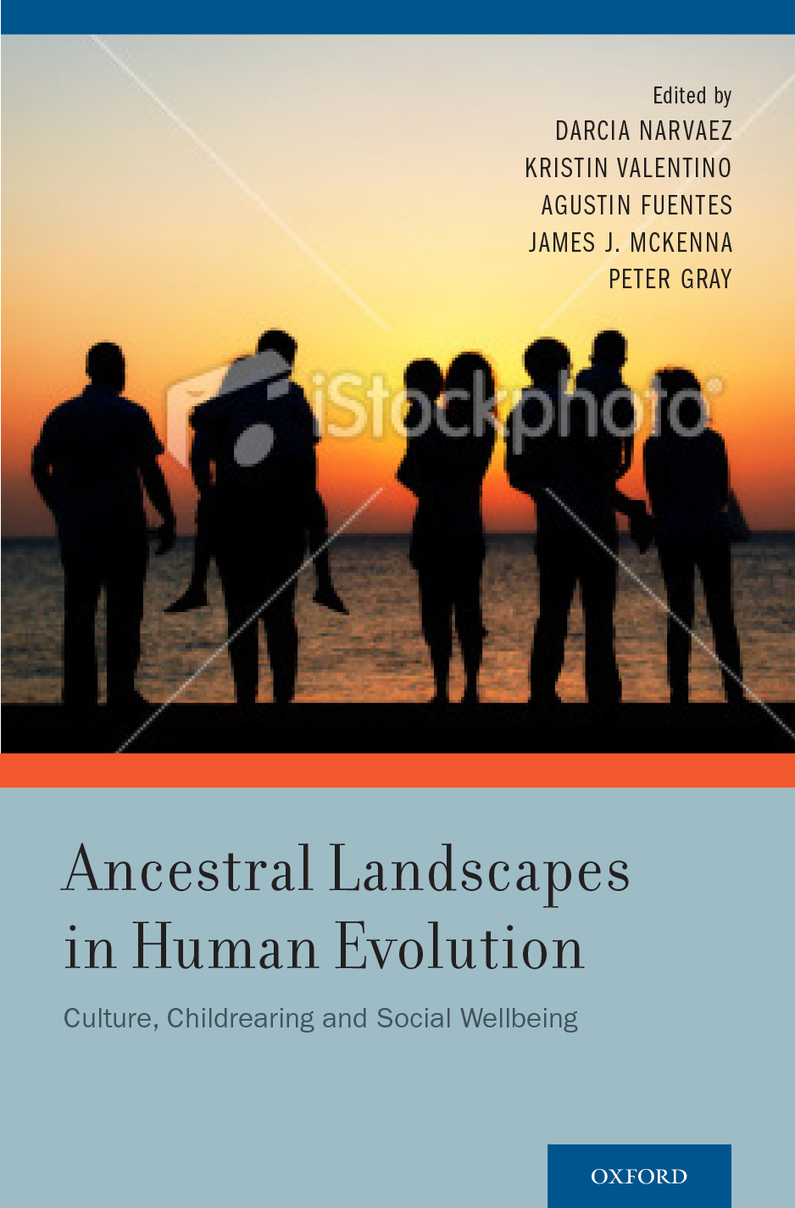
2014, W.W. Norton Series on Interpersonal Neurobiology

Slide 38
For more information
Darcia Narvaez (dnarvaez@nd.edu)
Webpage (download papers): http://www.nd.edu/~dnarvaez/
My blog at Psychology Today: Moral Landscapes http://www.psychologytoday.com/blog/moral-landscapes

Slide 40
Regression on Safety
Model 1: Attachment (secure, preoccupied, fearful, dismissive)
  F=17. 841; R²= .050
Model 2 added Dispositional Positive Emotions
  F=14.344; R²= .051
Model 3 added Moral Foundations
  F=10.404; R²= .072
Model 4 added Integrity
  F=11.308; R²= .085

Slide 41
Regression on Engagement
Model 1: Attachment (secure, preoccupied, fearful, dismissive)
  F = 24.349 (.000); R²=.068
Model 2 added Dispositional Positive Emotions
  F = 71.336; R²=.210
Model 3 added Moral Foundations
  F= 38.505; R²=.224
Model 4 added Integrity
  F= 36.919; R²=233

Slide 42
Regression on Imagination
Model 1: Attachment (secure, preoccupied, fearful, dismissive)
  F=11.928; R²=.034
Model 2 added Dispositional Positive Emotions
  F=59.911; R²=.183
Model 3 added Moral Foundations
  F=33.782; R²=.202
Model 4 added Integrity
  F=31.655; R²=.207

Slide 43
Regression on Aquino and Reed
Model 1: Attachment (secure, preoccupied, fearful, dismissive
  F=19.944; R²=.057
Model 2 added Dispositional Positive Emotions
  F=80.182; R²=.231
Model 3 added Moral Foundations
  F=42.380; R²=.247
Model 4 added Integrity
  F=48.710; R²=.279

