Slide 1
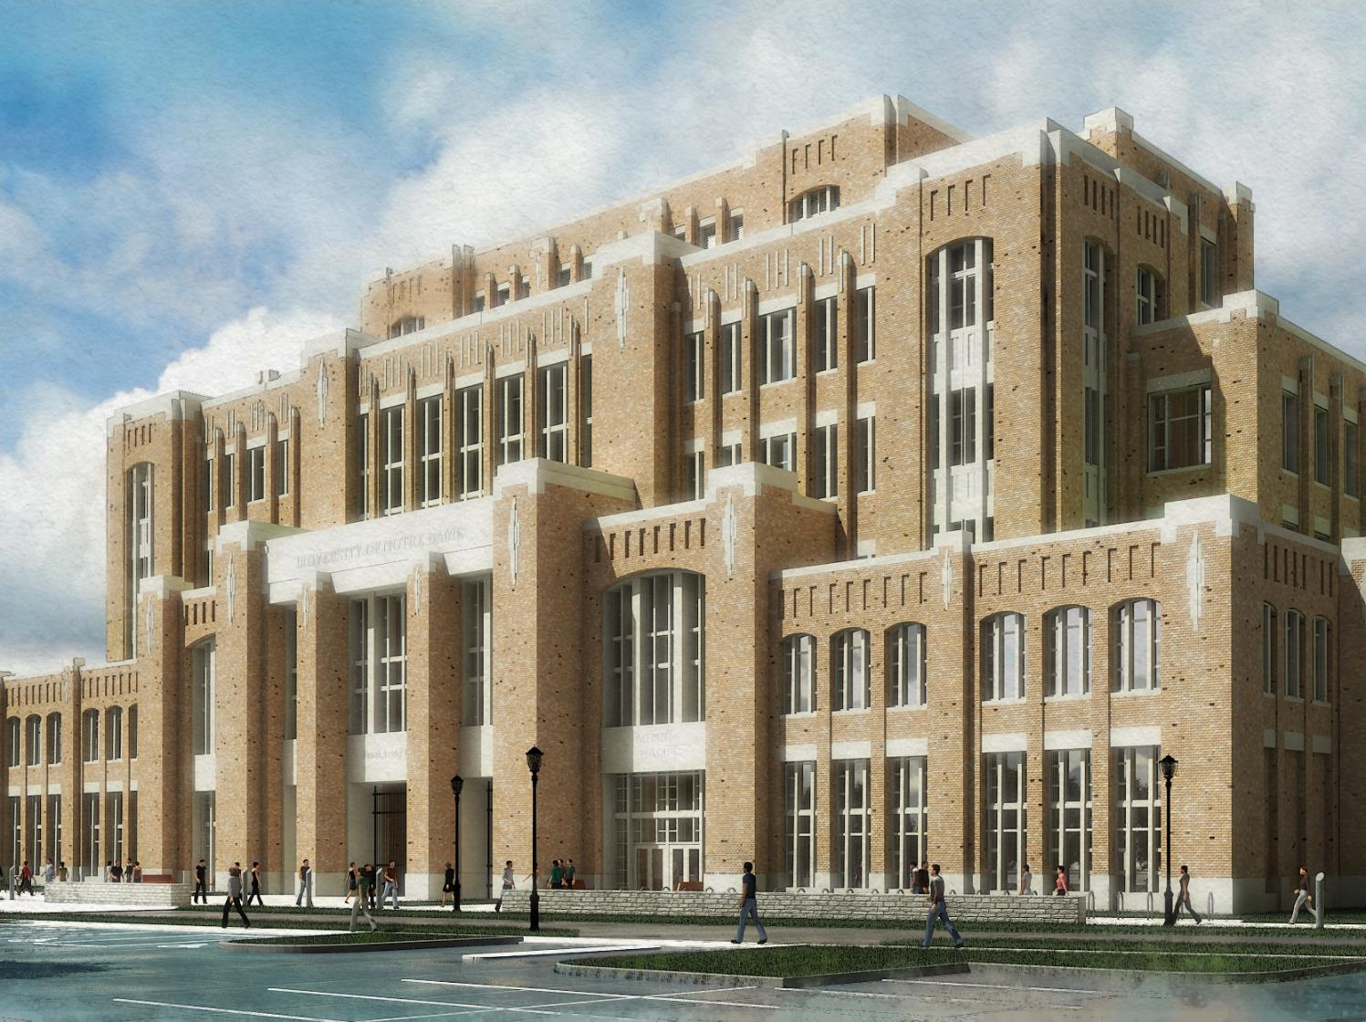

Slide 2
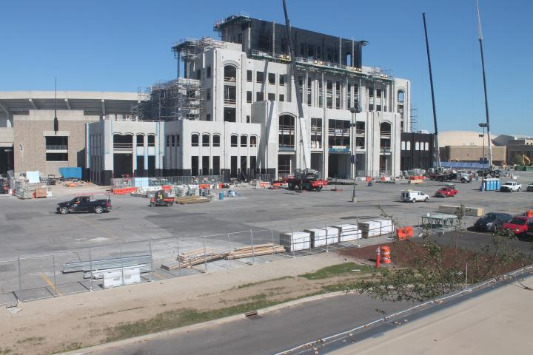

Slide 3
Music Library – Just the Facts
Approximately 8200 sq. ft.
Info Desk, 2 offices, work room
Computer Lab (6 work stations)
Seminar Room (seating for 12)
3 Group Study Rooms (4-6 people)
Closed Collection (primarily media)
Restricted Collection/Quiet Room
Study seating for 30-35
Lounge Seating for 25-30

Slide 6
Music Library – Hours/Staffing
Proposed Hours:
  Fall/Spring:
  M-Th: 9-11, F 9-6, Sa 12-5, Su 1-11
  Summer/Breaks: M-F 9-6
Staffing:
  Music Librarian
  Music Library Specialist
  Students

Slide 7
Comparison with Current Branches
 | Hours per Week | Staff | CHG | Faculty
Business | 72 | 3.5 | 32,254 | 140
Engineering | 78 | 3 | 17,324 | 177
Math | 83 | 2-3 | 12,511 | 67
Chem/Phys | 84 | 3 | 15,689 | 116
Architecture | 80 | 2.5 | 2,099 | 32
Music | 80 | 2 | 1,909 | 29

Slide 8
Music Library – Timeline
Ongoing – Collections prep and planning
August 2015 – Blueprints finalized
November 2015 – Major construction begins
March/April 2016 – Furniture and finishes finalized
Fall 2016 – Target start date for new Music Lib. Specialist
Spring 2017 – Move target materials to Annex (or sooner)
Summer 2017 – MOVE IN
August 2017 – Fall Semester begins
January 2018 – Building Opens
“Welcome to the [Your Name Here] Music Library!”

