Slide 1
Experience with Adopting Clouds at Notre Dame
Douglas Thain
University of Notre Dame
IEEE CloudCom, November 2010

Slide 2
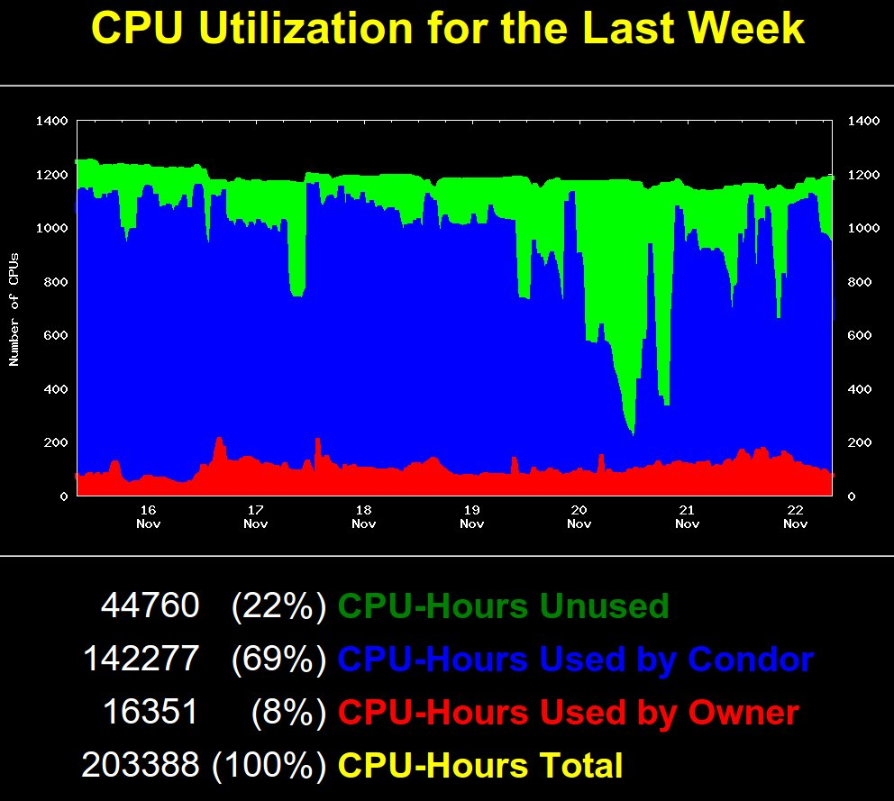
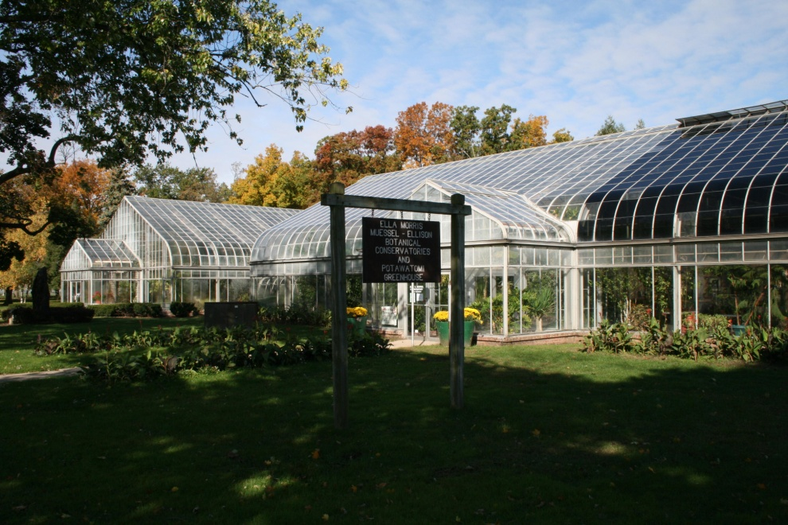
Hardware is not the problem.
1200-core campus grid
8000-core HPC clusters.
Private clusters.
And yet -
Amazon EC2/S3
Windows Azure
Campus IT Cloud
And yet -
Talks by N. Regola and P. Sempolinski on Thurs at 11AM

Slide 3
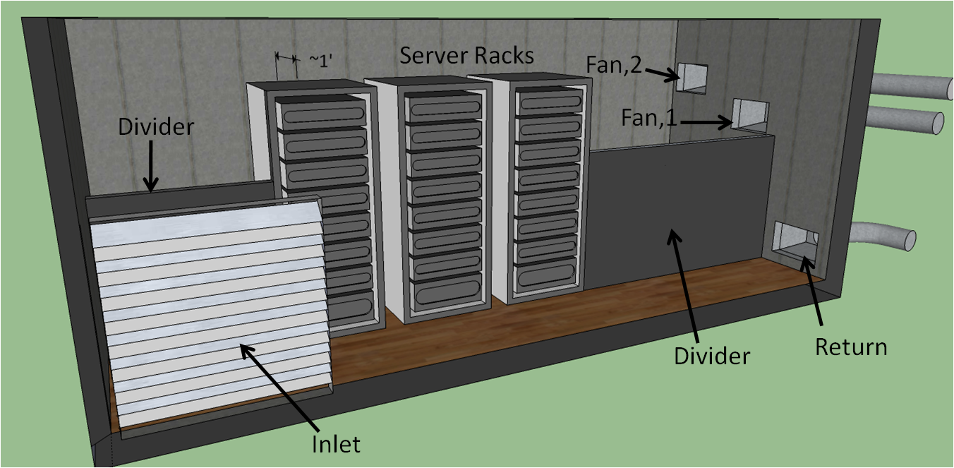
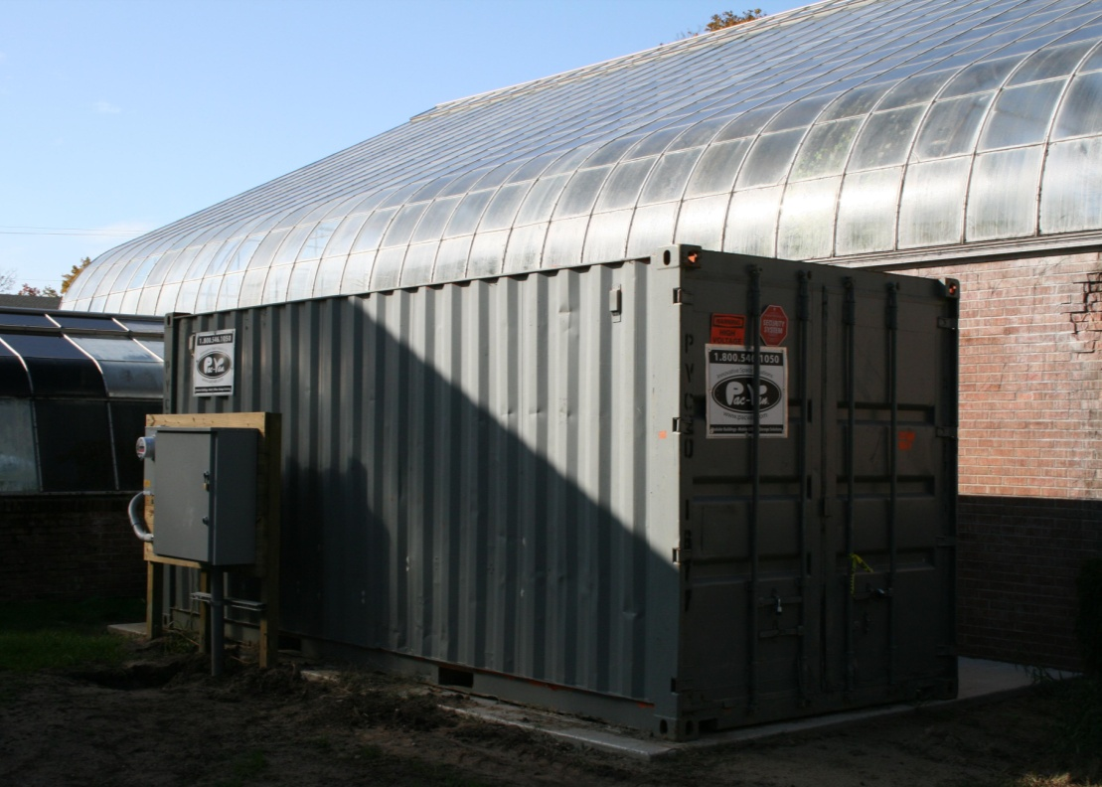
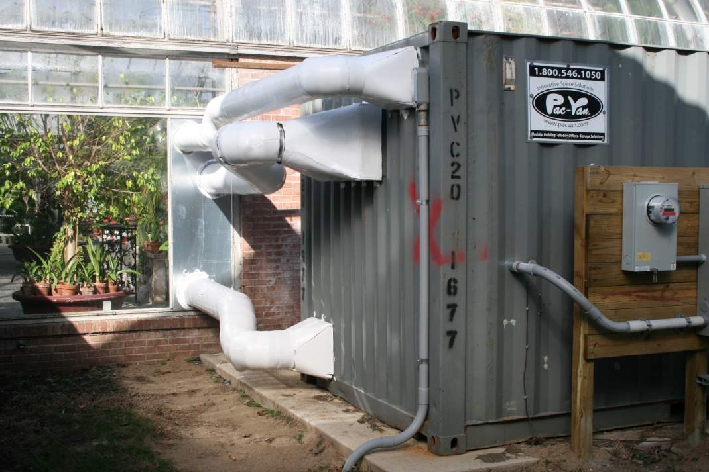
http://greencloud.nd.edu

Slide 4
Clouds Invert Software Design
Parallel application design:
I have a machine this big already paid for.
How do I write a program to use the hardware most efficiently?
Elastic application design:
I have a problem this big today.
How many resources do I need to solve it?
Like grids, except there is a $ cost to inefficiency.

Slide 5
We haven’t gotten much interest in writing Map-Reduce apps.
Run Hadoop for 3 years on 64 cores and 128 TB.
Lots of education and outreach.
Nobody really found it that useful!
Reasons why not:
Existing apps written in C, C++, Fortran, Python, etc use the filesystem in non trivial ways.
“We re-wrote the application” is a phrase that has a negative connotation outside of CS.
No good way to integrate into existing workflows and other execution system.
In short, it’s a self-contained world. (A CS virtue)

Slide 6
Campus Condor Pool
App
App
App
Parrot
Parrot
Parrot
Chirp
Hadoop Storage Cloud
Patrick Donnelly, “Attaching Cloud Storage to a Campus Grid”, Thursday at 4PM

Slide 7
How do we take existing applications and data, and make them both portable and scalable?

Slide 8
Work Queue
sge_submit_workers
Personal
Beowulf
Cluster
Private
SGE
Cluster
Your Program
Hundreds of Workers in a
Personal Cloud
submit
tasks
tasks
done
Work Queue Library
Campus
Condor
Pool
Public
Cloud
Provider
Local Files and Programs
condor_submit_workers
ssh
http://www.nd.edu/~ccl/software/workqueue

Slide 9
Example Applications
AGTC
ACTCAT
ACTGAGC
TAATAAG
Raw Sequence Data
Fully Assembled Genome
Scalable
Assembler
AGTCACACTGTACGTAGAAGTCACACTGTACGTAA…
Work Queue
Align
Align
Align
Replica Exchange
x100s
Work Queue
T=10K
T=20K
T=30K
T=40K

Slide 10
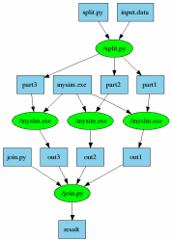
Makeflow = Make + Workflow
part1 part2 part3: input.data
split.py ./split.py input.data
out1: part1 mysim.exe
./mysim.exe part1 >out1
out2: part2 mysim.exe
./mysim.exe part2 >out2
out3: part3 mysim.exe ./mysim.exe part3 >out3
result: out1 out2 out3 join.py
./join.py out1 out2 out3 > result
http://www.nd.edu/~ccl/software/makeflow

Slide 11
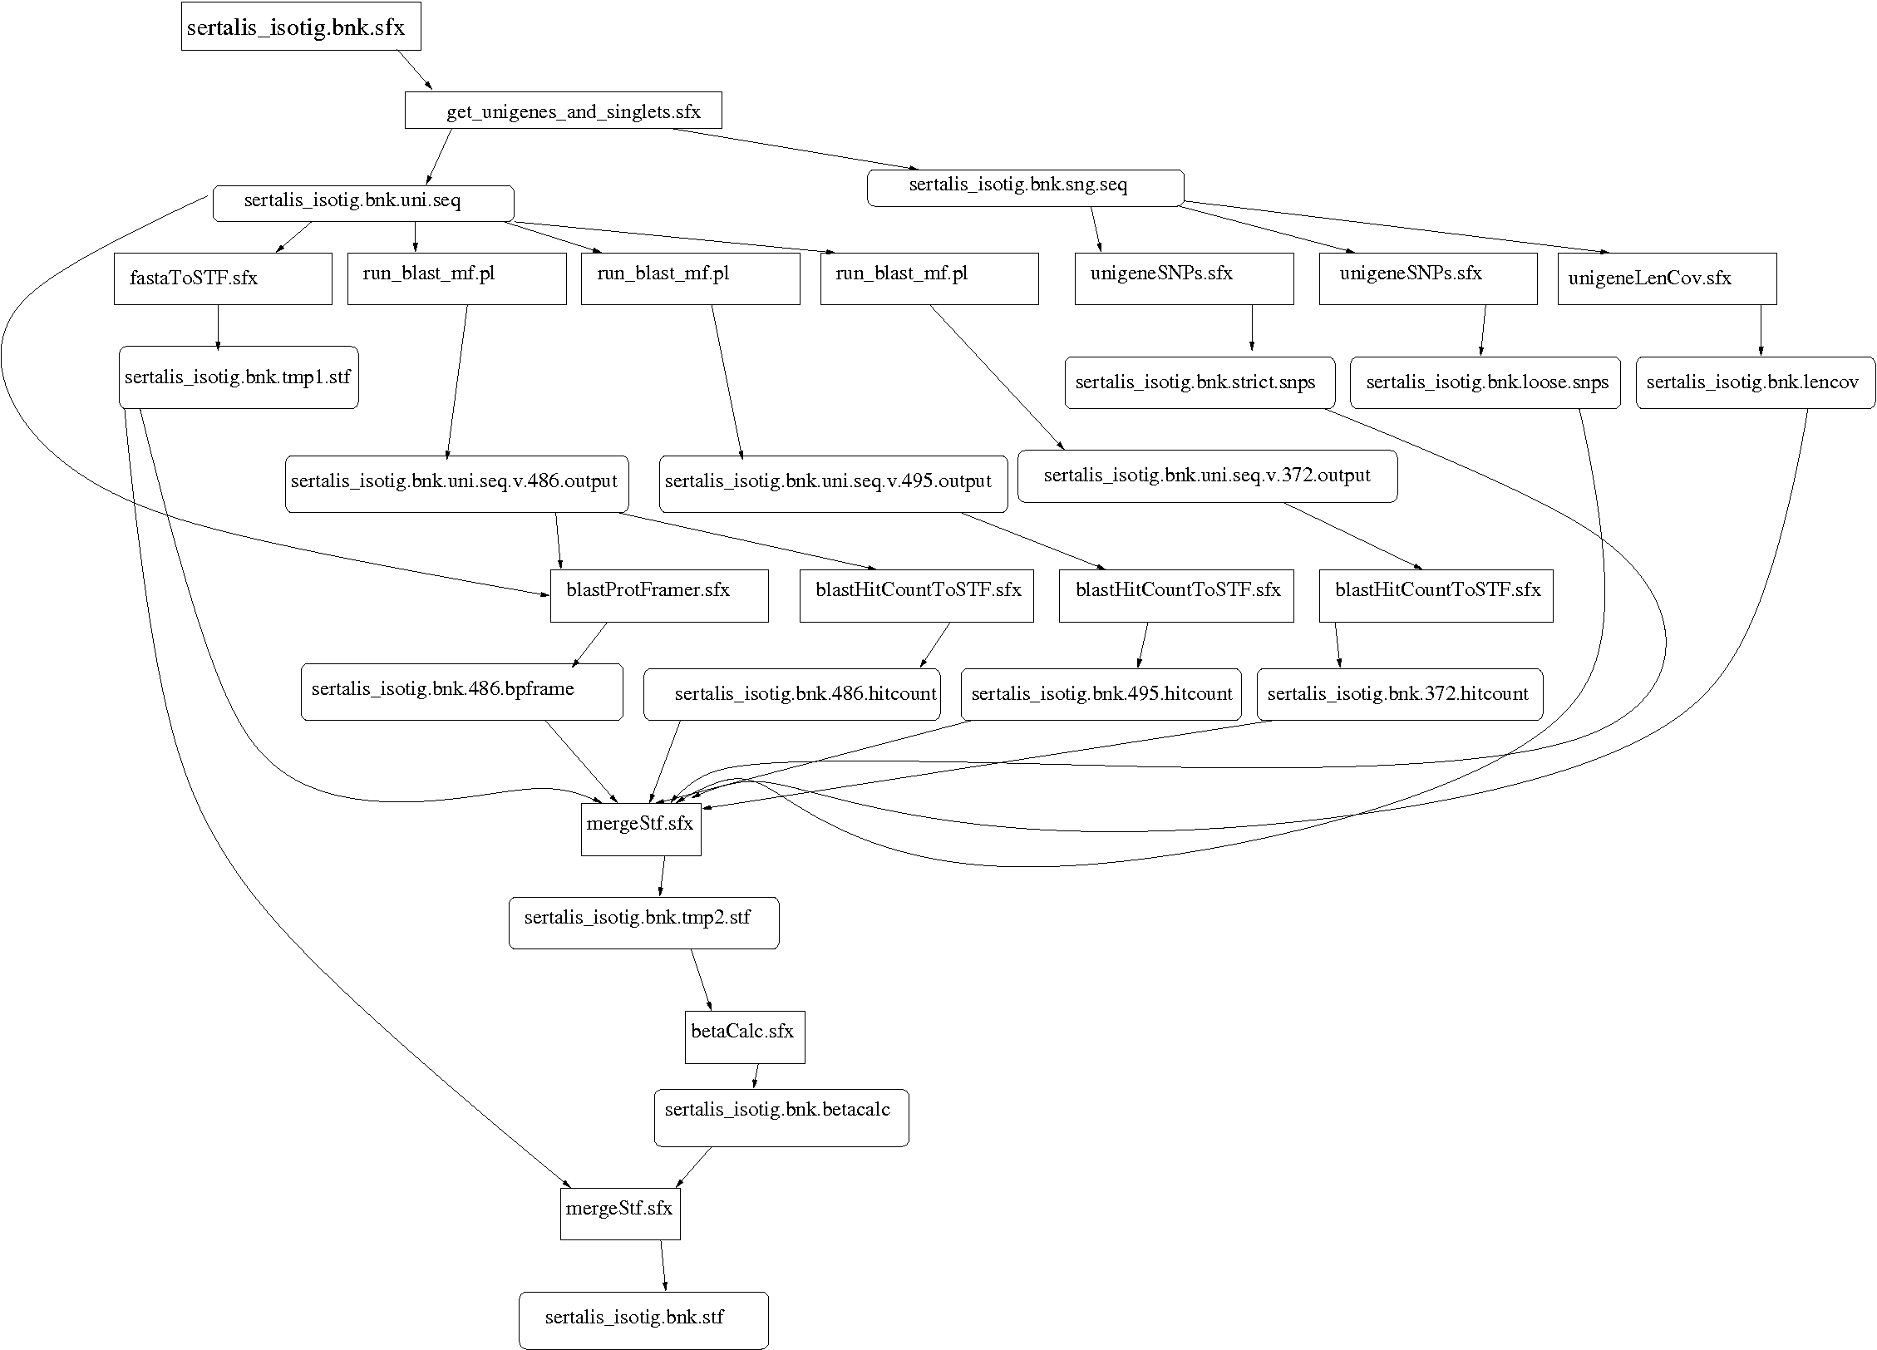
Makeflow for Bioinformatics
BLAST
SHRIMP
SSAHA BWA
Maker..
http://biocompute.cse.nd.edu

Slide 12
sge_submit_workers
Makeflow
Personal
Beowulf
Cluster
Private
SGE
Cluster
Hundreds of Workers in a
Personal Cloud
submit
tasks
tasks
done
Work Queue
Campus
Condor
Pool
Public
Cloud
Provider
Local Files and Programs
http://www.nd.edu/~ccl/software/makeflow
ssh
condor_submit_workers

Slide 13
Bad News: A Scalable Application is a Denial-of-Service Weapon in Disguise!

Slide 14
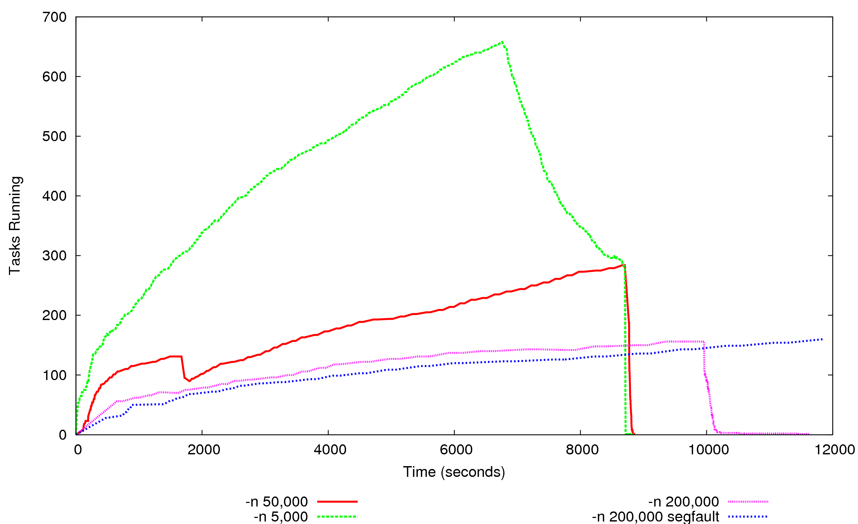
How to Shape the Application?

Slide 15
Observations
Our users (and yours?) want to connect and scale existing data intensive applications and systems.
Adoption of a new model/concept requires that the user be suffering already and the solution is orders of magnitude better than what exists.
People are beginning to confront the real costs of computing (a quality TB-year is expensive!)
End users need a lot of help in understanding when and how to scale. Apps should be self scaling/adjusting/throttling.
http://www.nd.edu/~ccl

