Slide 1
Condor Compatible Tools for Data Intensive Computing
Douglas Thain
University of Notre Dame
Condor Week 2011

Slide 2
The Cooperative Computing Lab
We collaborate with people who have large scale computing problems in science, engineering, and other fields.
We operate computer systems on the scale of 1200 cores. (Small)
We conduct computer science research in the context of real people and problems.
We publish open source software that captures what we have learned.
http://www.nd.edu/~ccl

Slide 3
What is Condor Compatible?
Work right out of the box with Condor.
Respect the execution environment.
Interoperate with public Condor interfaces.

Slide 4
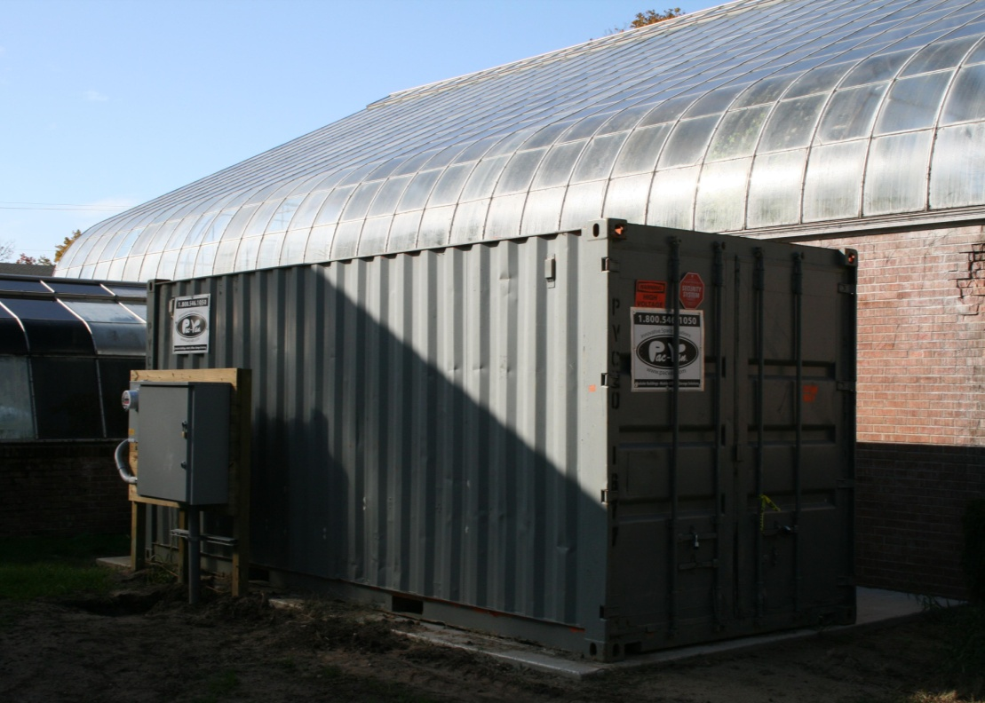
http://condor.cse.nd.edu
http://greencloud.crc.nd.edu

Slide 5
And the “challenging” users…
I submitted 10 jobs yesterday, and that worked, so I submitted 10M this morning!
And then I write the output into 10,000 files of 1KB each. Per job.
Did I mention each one reads the same input file of 1TB?
Sorry, am I reading that file twice?
What do you mean, sequential access?
Condor is nice, but I also want to use my cluster, and SGE, and Amazon and…

Slide 6
Idea: Get the end user into telling us more about their data needs. In exchange, give workflow portability and resource management.

Slide 7
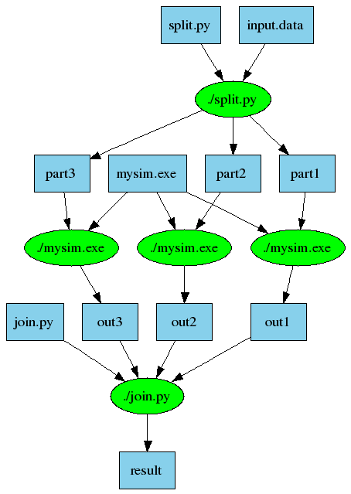
Makeflow
part1 part2 part3: input.data split.py
./split.py input.data
out1: part1 mysim.exe
./mysim.exe part1 >out1
out2: part2 mysim.exe
./mysim.exe part2 >out2
out3: part3 mysim.exe
./mysim.exe part3 >out3
result: out1 out2 out3 join.py
./join.py out1 out2 out3 > result
Douglas Thain and Christopher Moretti, Abstractions for Cloud Computing with Condor, Syed Ahson and Mohammad Ilyas, Cloud Computing and Software Services: Theory and Techniques, pages 153-171, CRC Press, July, 2010.

Slide 8
Makeflow = Make + Workflow
Transaction Log
Makeflow Core Logic
Abstract System Interface
Local
Condor
SGE
Hadoop
Work
Queue

Slide 9
Transaction Log
Makeflow Core Logic
Abstract System Interface
Local
Condor
SGE
Hadoop
Work
Queue
Shared-Nothing
Running Condor
Shared-Disk
Running SGE
Distributed Disks
Running Hadoop
NFS
Michael Albrecht, Patrick Donnelly, Peter Bui, and Douglas Thain, Makeflow: A Portable Abstraction for Cluster, Cloud, and Grid Computing.

Slide 10
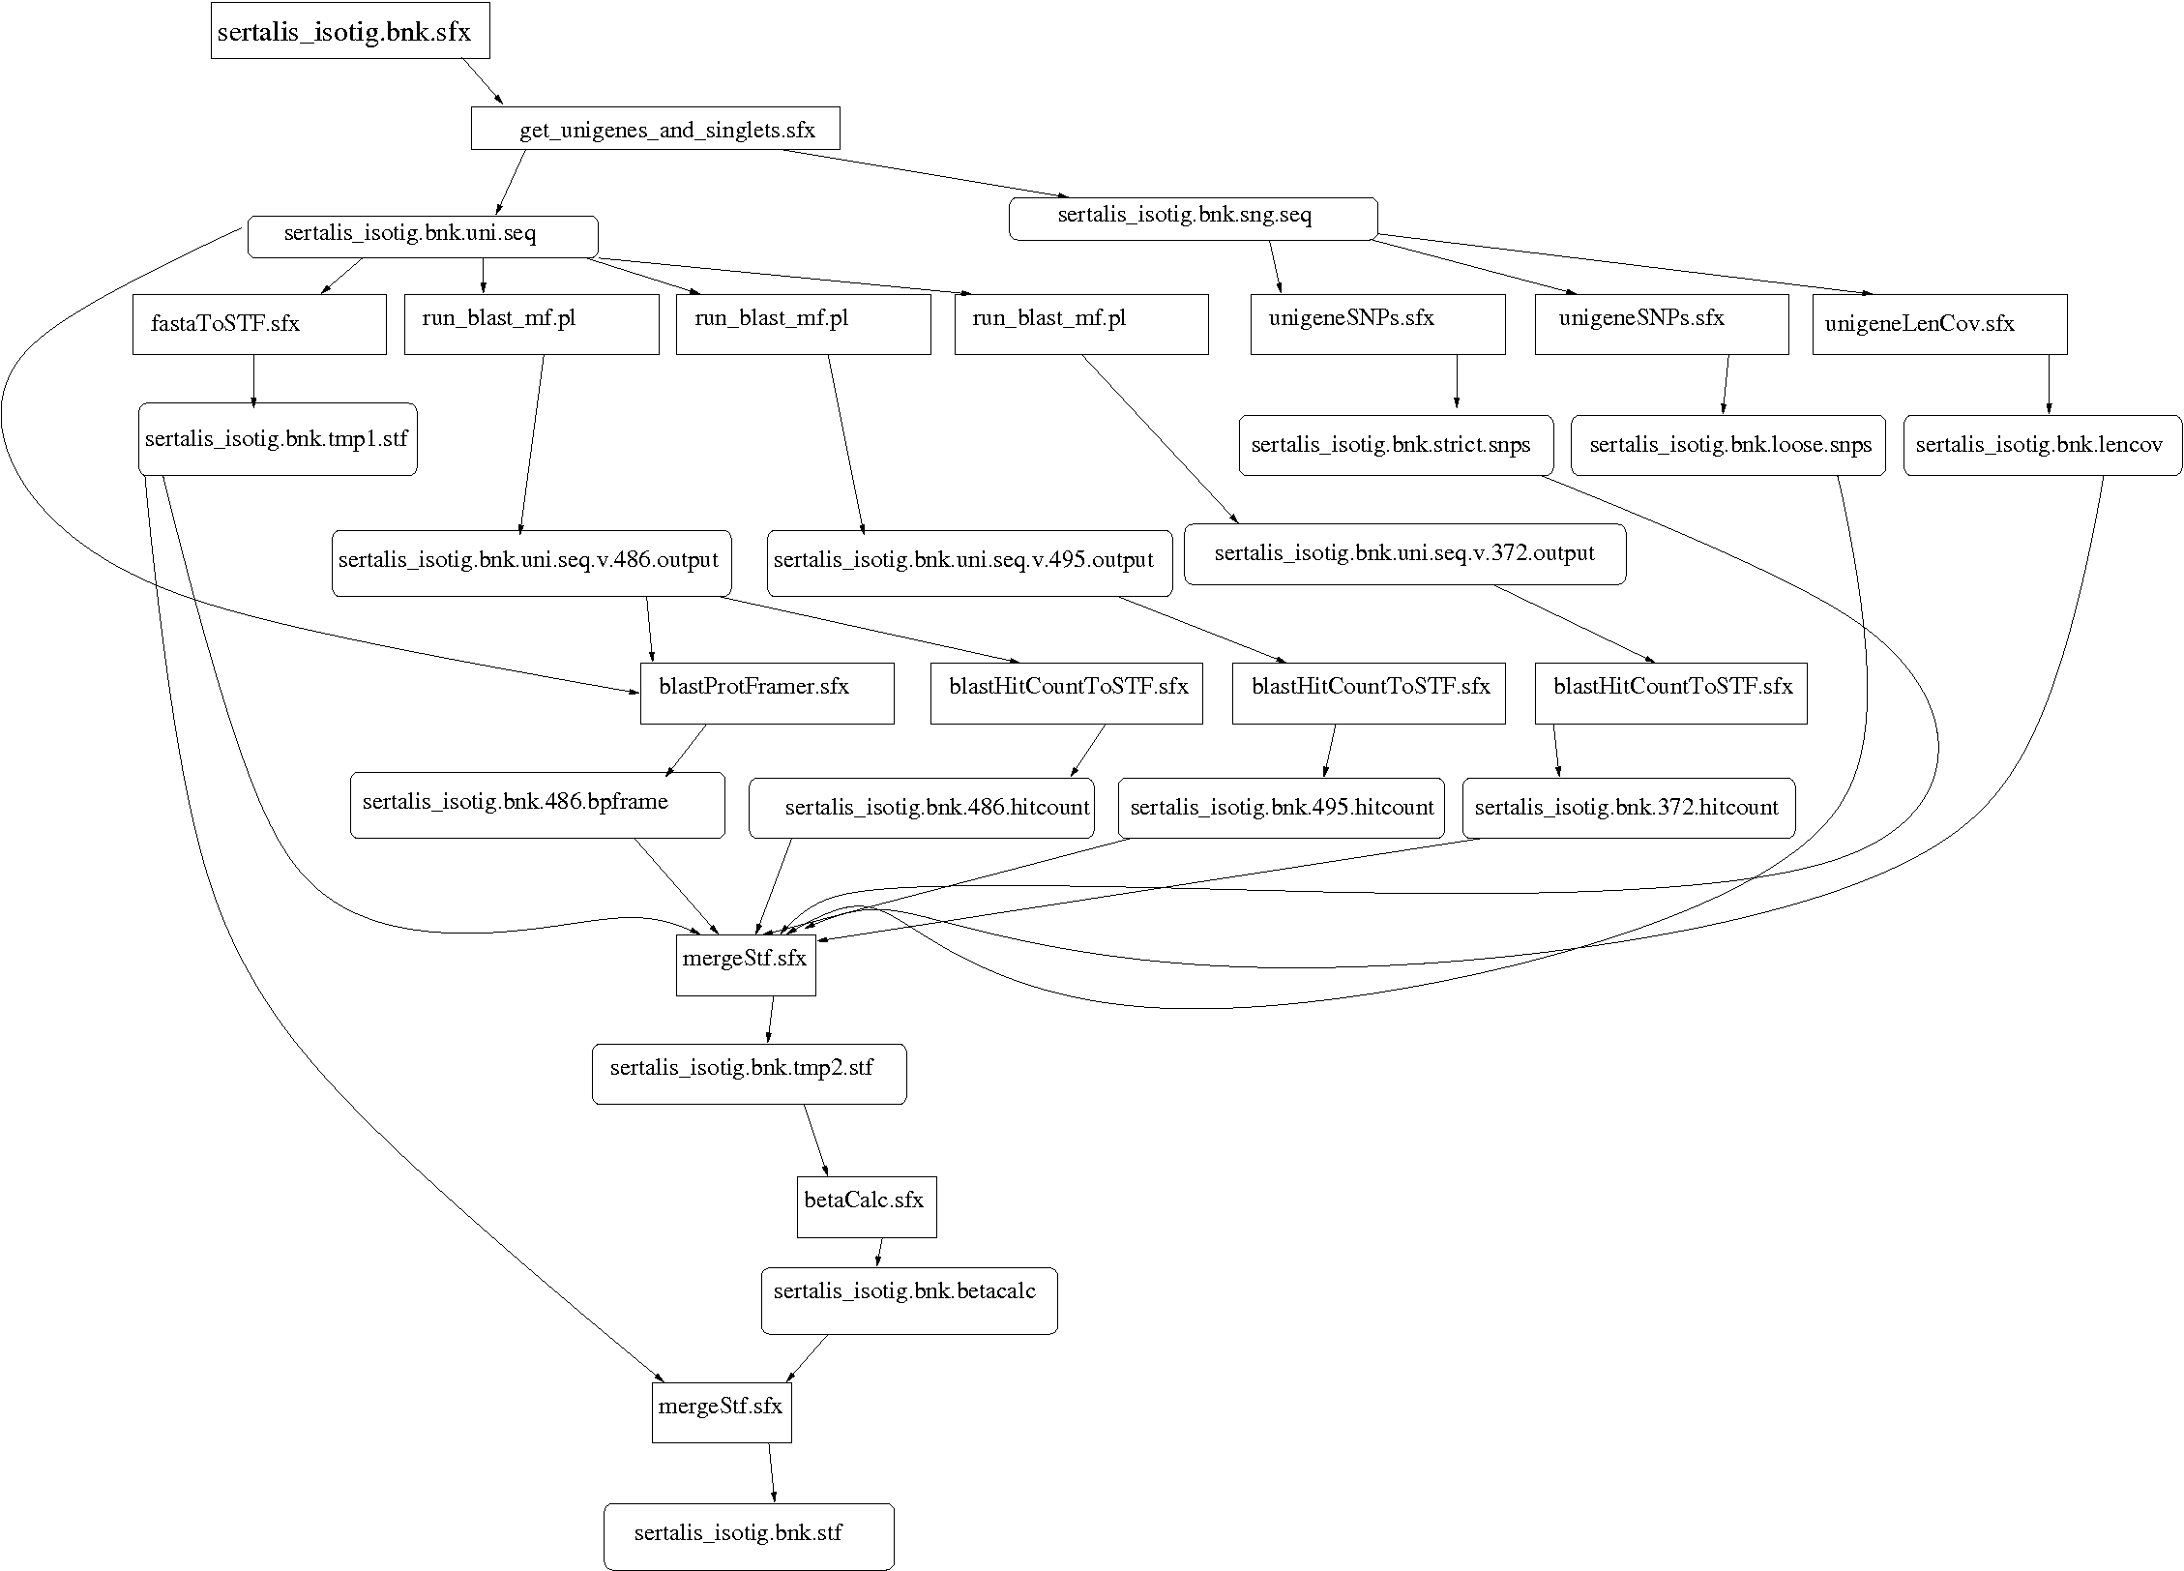
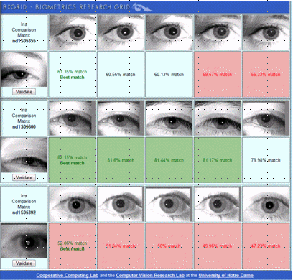
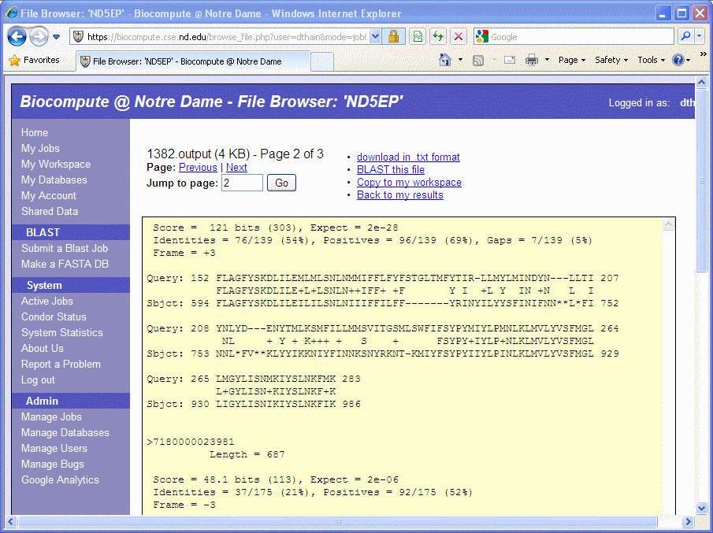
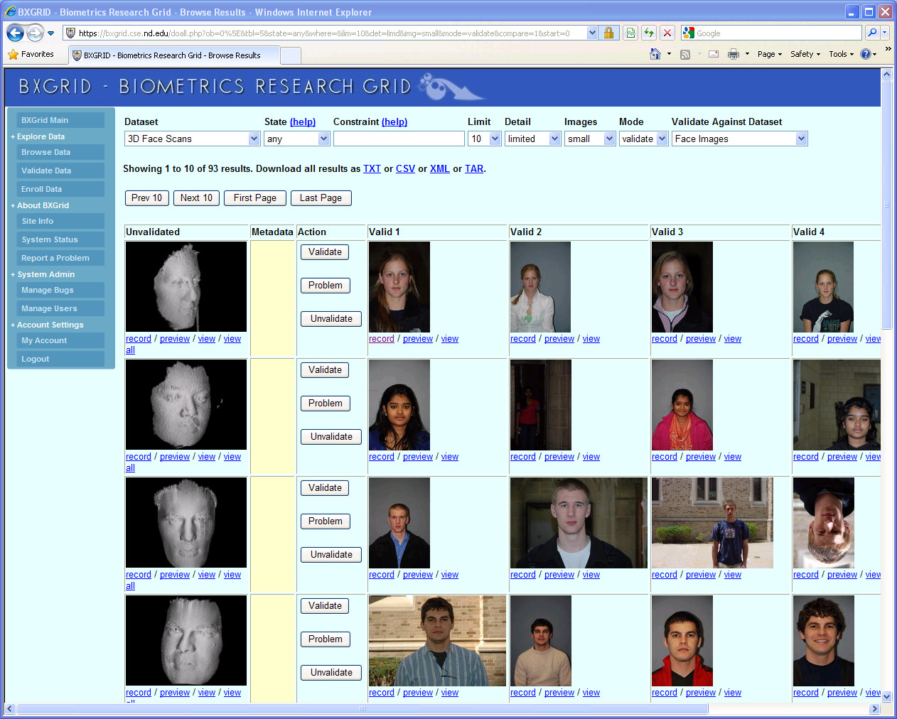
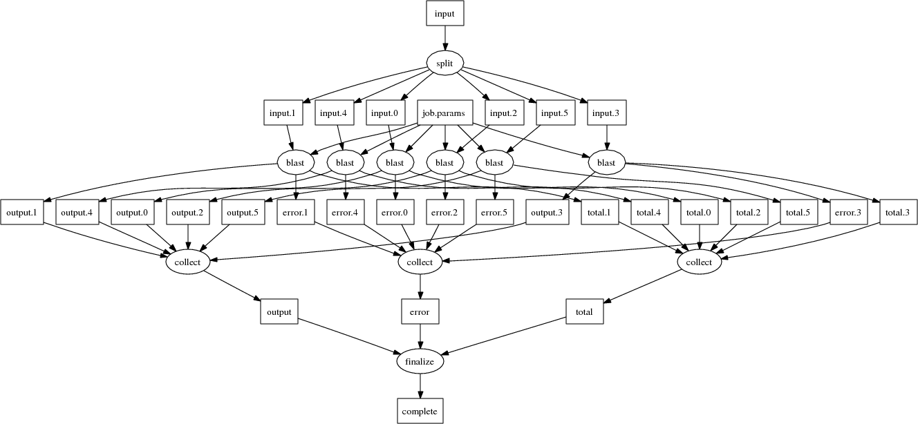
Andrew Thrasher, Rory Carmichael, Peter Bui, Li Yu, Douglas Thain, and Scott Emrich, Taming Complex Bioinformatics Workflows with Weaver, Makeflow, and Starch, Workshop on Workflows in Support of Large Scale Science, pages 1-6, November, 2010.

Slide 11
Weaver
# Weaver Code
jpgs = [str(i)+'. jpg ' for i in range (1000)]
conv = SimpleFunction('convert',out_suffix ='png ')
pngs = Map(conv,jpgs)
# Makeflow Code
0.png: 0.jpg /usr/bin/convert
/usr/bin/convert 0.jpg 0.png
1.png: 1.jpg /usr/bin/convert
/usr/bin/convert 1.jpg 1.png
...
999.png: 999.jpg /usr/bin
/usr/bin/convert 999.jpg 999.png
Peter Bui, Li Yu and Douglas Thain, Weaver: Integrating Distributed Computing Abstractions into Scientific Workflows using Python, CLADE, June, 2010.

Slide 12
Makeflow and Work Queue
worker
100s of workers
dispatched to
the cloud
worker
bfile: afile prog
prog afile >bfile
worker
worker
worker
worker
queue
tasks
detail of a single worker:
makeflow
master
work
queue
put prog
put afile
exec prog afile > bfile
get bfile
worker
tasks
done
Two optimizations:
Cache inputs and output.
Dispatch tasks to nodes with data.
afile
prog
bfile

Slide 13
Makeflow and Work Queue
sge_submit_workers
Private
Cluster
Private
SGE
Cluster
Makefile
Wv
W
Hundreds of Workers in a
Personal Cloud
W
W
$
submit
tasks
W
W
Makeflow
Campus
Condor
Pool
$
W
Public
Cloud
Provider
$
W
W
W
W
W
W
Local Files and Programs
condor_submit_workers
ssh

Slide 14
SAND - Scalable Assembler
AGTC
ACTCAT
ACTGAGC
TAATAAG
Raw Sequence Data
Fully Assembled Genome
Scalable
Assembler
AGTCACACTGTACGTAGAAGTCACACTGTACGTAA…
Work Queue API
Align
Align
Align
x100s
Christopher Moretti, Michael Olson, Scott Emrich, and Douglas Thain, Highly Scalable Genome Assembly on Campus Grids, Many-Task Computing on Grids and Supercomputers (MTAGS), November, 2009

Slide 15
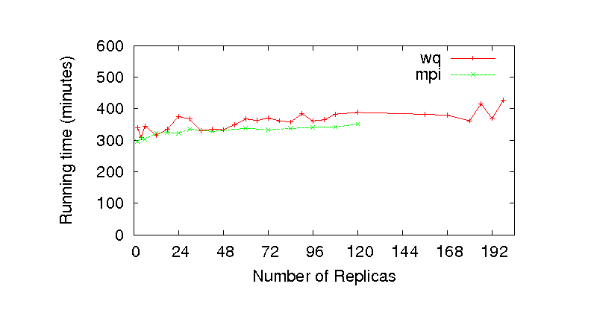
Replica Exchange on WQ
Replica Exchange
Work Queue API
T=10K
T=20K
T=30K
T=40K

Slide 16
Connecting Condor Jobs to Remote Data Storage

Slide 17
Parrot and Chirp
Parrot – A User Level Virtual File System
Connects apps to remote data services:
HTTP, FTP, Hadoop, iRODS, XrootD, Chirp
No special privileges to install or use.
Chirp – A Personal File Server
Export existing file services beyond the cluster.
Local disk, NFS, AFS, HDFS
Add rich access control features.
No special privileges to install or use.

Slide 18
Condor Distributed Batch System
CPU
CPU
CPU
CPU
CPU
CPU
CPU
Unix
App
Problem: Requires consistent Java and Hadoop libraries installed everywhere.
Parrot
HDFS
HTTP
FTP
Chirp
xrootd
Hadoop Distributed File System
Disk
Disk
Disk
Disk
Disk
File
File
File

Slide 19
Campus Condor Pool
App
App
App
Parrot
Parrot
Parrot
Chirp
Hadoop Storage Cloud
Patrick Donnelly, Peter Bui, Douglas Thain, Attaching Cloud Storage to a Campus Grid Using Parrot, Chirp, and Hadoop , IEEE Cloud Computing Technology and Science, pages 488-495, November, 2010.

Slide 20
Putting it All Together

Slide 21
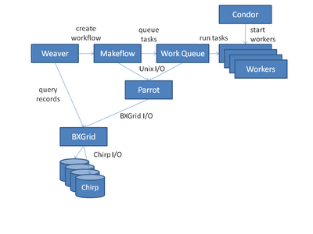

Slide 22
Computer Science Challenges
With multicore everywhere, we want to run multiple apps per machine, but the local OS is still very poor at managing resources.
How many workers does a workload need? Can we even tell when we have too many or too few?
How to automatically partition a data intensive DAG across multiple multicore machines?
$$$ is now part of the computing interface. Does it make sense to get it inside the workflow and/or API?

Slide 23
What is Condor Compatible?
Work right out of the box with Condor.
makeflow –T condor
condor_submit_workers
Respect the execution environment.
Accept eviction and failure as normal.
Put data in the right place so it can be cleaned up automatically by Condor.
Interoperate with public Condor interfaces.
Servers run happily under the condor_master.
Compatible with Chirp I/O via the Starter.

Slide 24
A Team Effort
Faculty:
Patrick Flynn
Scott Emrich
Jesus Izaguirre
Nitesh Chawla
Kenneth Judd
Grad Students
Hoang Bui
Li Yu
Peter Bui
Michael Albrecht
Patrick Donnely
Peter Sempolinski
Dinesh Rajan
Undergrads
Rachel Witty
Thomas Potthast
Brenden Kokosza
Zach Musgrave
Anthony Canino
NSF Grants CCF-0621434, CNS-0643229, and CNS 08-554087.

Slide 25
For More Information
The Cooperative Computing Lab
http://www.nd.edu/~ccl
Condor-Compatible Software:
Makeflow, Work Queue, Parrot, Chirp, SAND
Prof. Douglas Thain
dthain@nd.edu

