Slide 1
Potential measurement strategy with lidar and sonics: Opportunity and issues
R.J. Barthelmie¹ and S.C. Pryor²
¹ Sibley School of Mechanical and Aerospace Engineering
² Department of Earth and Atmospheric Sciences
Cornell University

Slide 2
Cornell people
Rebecca J Barthelmie
Specializing in wind resources & wakes
20+ years of atmospheric measurement experience on- and offshore
Interest here: Variability of wind speed/turbulence profiles
+ graduate students with measurement/modeling experience at NOAA, NREL, SgurrEnergy, 3EE
Sara C Pryor
Specializing in fluxes, surface exchange
20+ years of atmospheric measurements in forest, coastal and desert landscapes
Interest here: Fluxes, profiles and forest edges

Slide 3
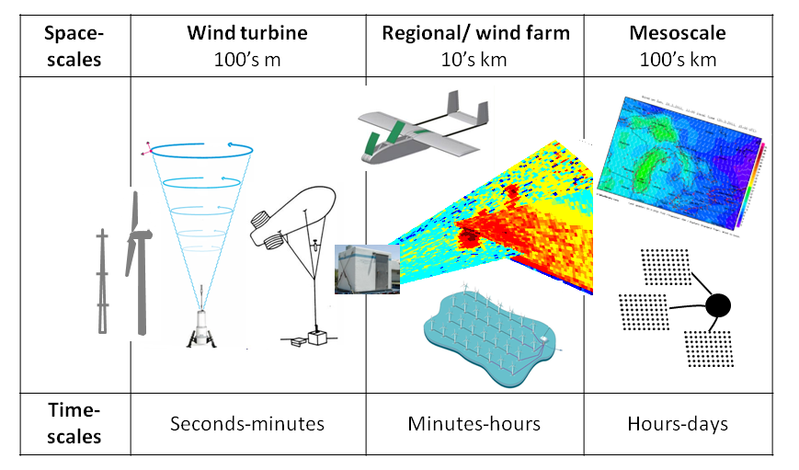
Challenges
Integrate data from (different) models and (different) measurements
Framing research questions – scale linkages/interactions

Slide 4
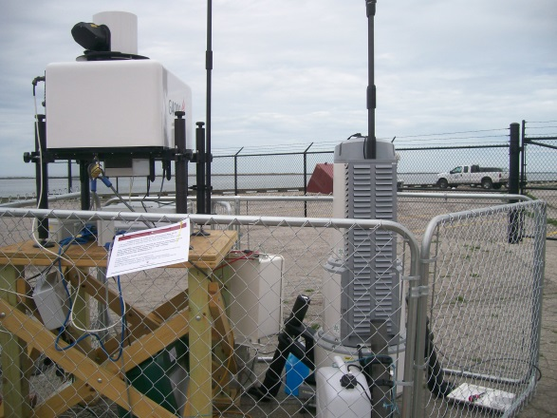
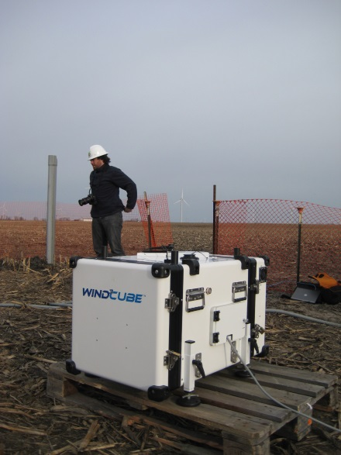
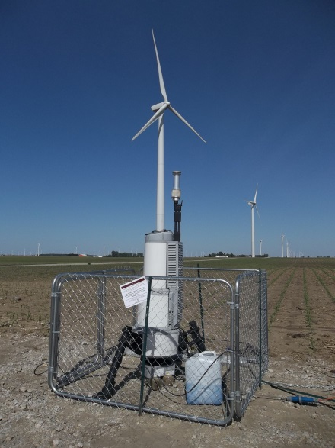
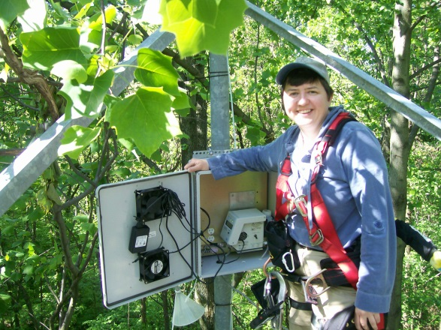
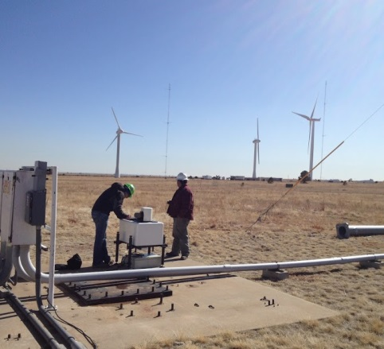
Instrumentation + example campaigns
Lots of measurements at Risoe/DTU/DMU
DoE funded flux measurements at MMSF (10 years+)
Long-term wake measurements at Indiana Wind Farm (2 years +)
Campaigns at Indiana wind farms (weeks), NREL (months), Lake Erie (weeks)

Slide 5
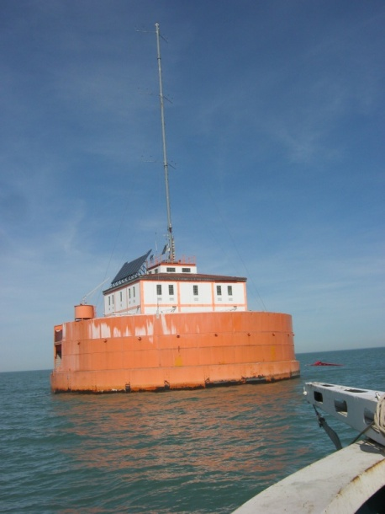
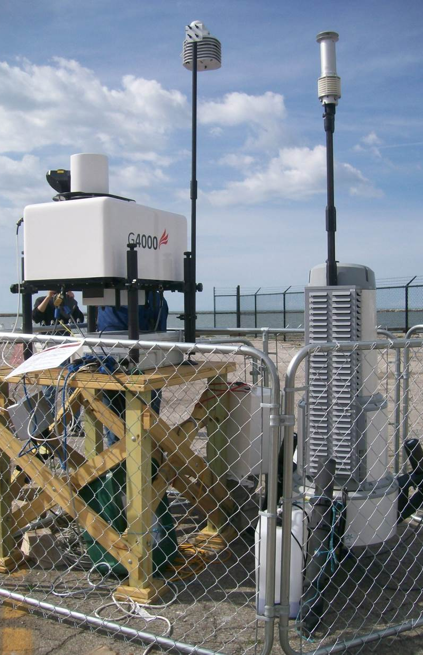
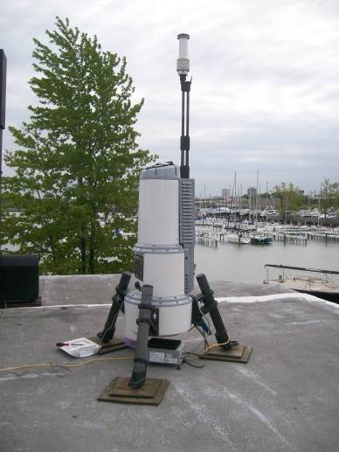
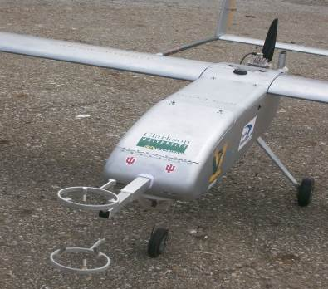
Instrumentation Lake Erie
2 km

Slide 6
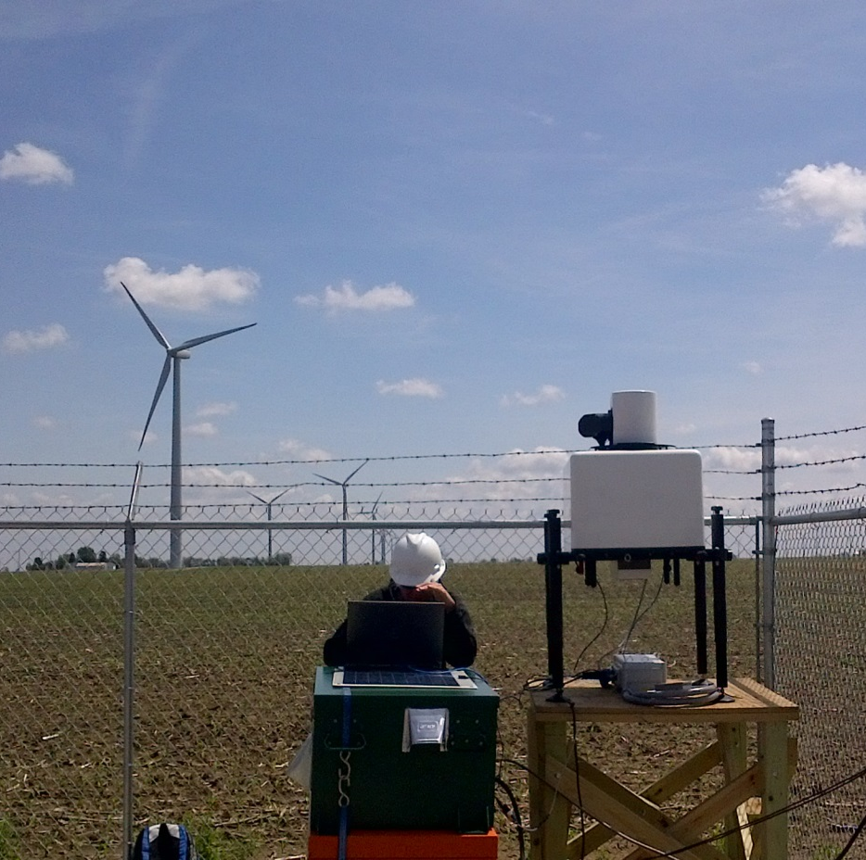
Instruments 1: Galion
Scanning pulse lidar
Scan geometries: VAD, PPI, RHI
‘Output’
Wind speed/direction profiles
Turbulence (‘staring mode’)/momentum flux (RHI)
Data processing
Uncertainty quantification & propagation as f(scan geometry, heterogeneity)
Optimization of scans (trade-off spatial sampling v. temporal ‘repetitions’)
Optimization of data screening QA/QC (SNR, weighted least squares, outlier detection, flow inhomogeneity assessment)

Slide 7
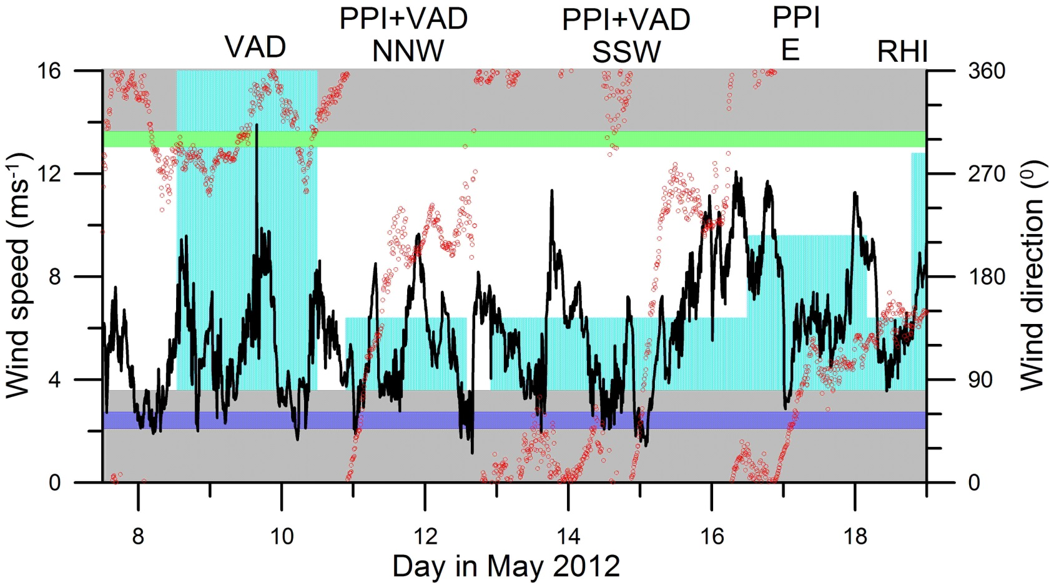
Overview of Galion scans

Slide 8
Spatial variability 11/12 May 2013

Slide 9
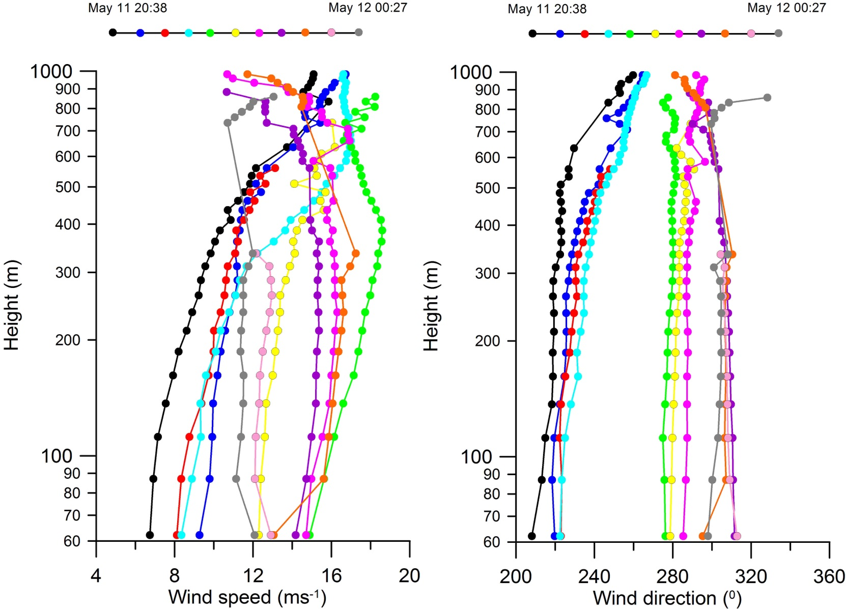
Vertical profiles

Slide 10
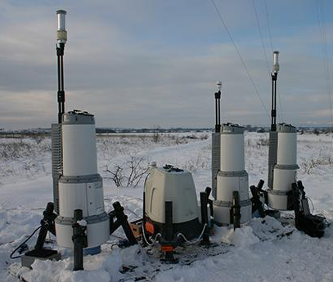
Instrument 2: ZephIR 320
Continuous wave lidar
10 measurement heights
Wind speed/direction profiles to 200 m
Vertical wind speed, “turbulence intensity”

Slide 11
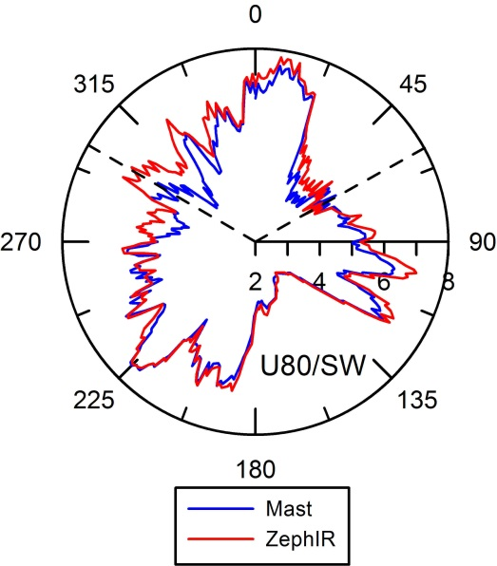
ZephIR lidar

Slide 12
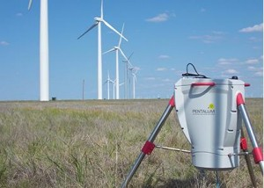
Instrument 3: SpiDAR
Lower cost lidar
Made by Pentalum

Slide 13
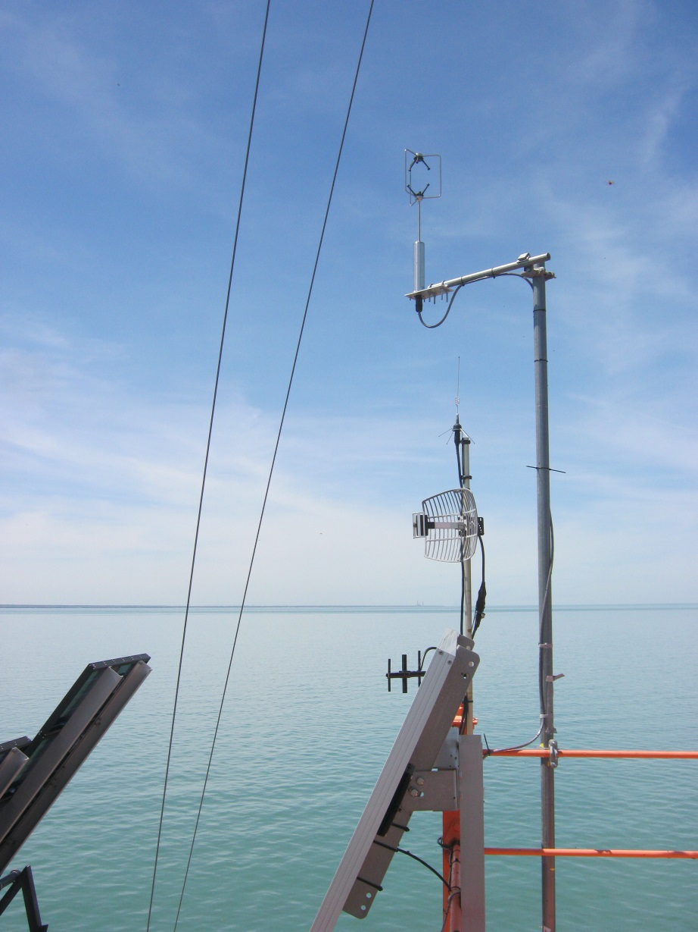
Instrument 4: Sonics
Various Gill, Metek 3D sonics
Frequency up to 20 Hz
Turbulent wind components (u,v,w)
Derive heat and momentum fluxes

Slide 14
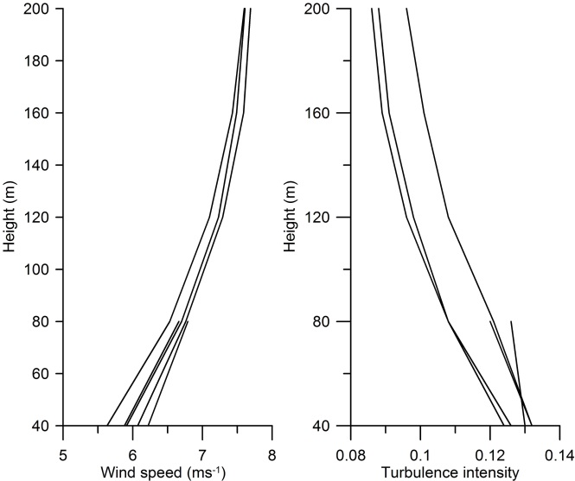
Data closure
r | SW MM | NE MM | Z1 SW | Z2 SW | Z3 NE
NE MM | 0.99
Z 1 SW | 0.94 | 0.95
Z2 SW | 0.94 | 0.95 | 1.00
Z3 NE | 0.83 | 0.83 | 0.85 | 0.83
GL SW | 0.89 | 0.90 | 0.91 | 0.82 | 0.79
Barthelmie et al. 2014 BAMS

Slide 15
Integrating different measurements

Slide 16
Example WRF plan
Double or triple nest simulations.
Outer domain at 12 km
Inner domain 4 km
Central domain at 1 km
70 vertical levels
Output every 10 minutes
Objectives:
Optimizing WRF parameterizations/choices
PBL
Surface layer
Surface energy balance closure
Optimal resolution
Input datasets (e.g. LULC, SST, terrain)
WRF simulation & nesting

Slide 17
Research tasks
Instrument inter-comparison
Diagnosing measurement differences (physical or instrumental)
Short time scale – how to cross-calibrate, analyze and then measure
Direction offsets
Integration of model/measurements
Measuring vertical fluxes and profiles in complex terrain especially at forest edges
Specific research questions
(i) To what degree are wind and turbulence profiles through the heights relevant to wind energy ‘non-ideal’ relative to theoretical predictions made by invoking similarity theory (or derivatives thereof)?
(ii) Can the meandering component of wind turbine wake expansion be quantified and differentiated from diffusive expansion (with a specific focus on wake behavior in complex terrain)?

Slide 18
Cornell capabilities summary
Pulse scanning lidar (Galion) | 1 | Wind speed (ws), direction (wd) and turbulence intensity (TI). Details = f(operating mode). Vertical range ~500- 1000 m and the horizontal range 1-4 km
Continuous wave vertically-pointing Doppler lidars (ZephIR 150 and 300) | 2 | ws, wd, TI. Vertical range 40-200 m (5 or 10 heights)
Gill WindMaster Pro 3-D sonics | 4 | u, v, w, T at 20 Hz
Other: TSI CPC3788, 3025, FMPS3091, APS3321 |  | Fluxes of other scalars (particles, CO₂, H₂O), particle size distribution (relevant to lidar retrievals)
WRF modeling

