Slide 1
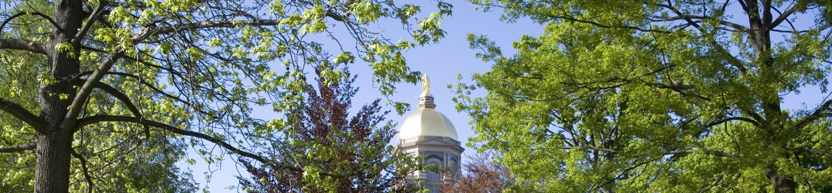
Workshop on
Microscale Modeling of Complex-Terrain Flows
September 25-26, 2014
112-114 McKenna Hall, University of Notre Dame
Sponsors:
Army Research Office (Environmental Science Division)
Wayne & Diana Murdy Endowment Fund,
at University of Notre Dame

Slide 2
Appreciation
Laura Leo (local organizer)
Julie Lundquist and Steve Oncley
(Co-organizers – project leadership role)
ARO (PO: Gordon Videen)
Agencies – ARL, NOAA and NCAR
---------------------------------
Debbie Piacsek (logistics)
Samaresh Midya (maps)
Scott Coppersmith (laboratory)
Ashish Sharma and Chris Hocut
jakob

Slide 3
Jakob Mann could not be here..
Our condolences are with him and his family
tips

Slide 4
Operational Tips
All presentations – please provide to Ashish Sharma
Reimbursements – see Ms. Piacsek
Keep presentations focused – science related to microscale modeling
Lab visits and free time – 12.30-1.30 (leave here + free time; Chris Hocut will lead)
Working lunches – promote discussions – inform lunch choices
Dinner at Morris Inn - Hesburgh dining room
technical

Slide 5
Microscale Modeling of Complex-Terrain Flows
Environmental Applications
Wind Applications
Security Applications

Slide 6
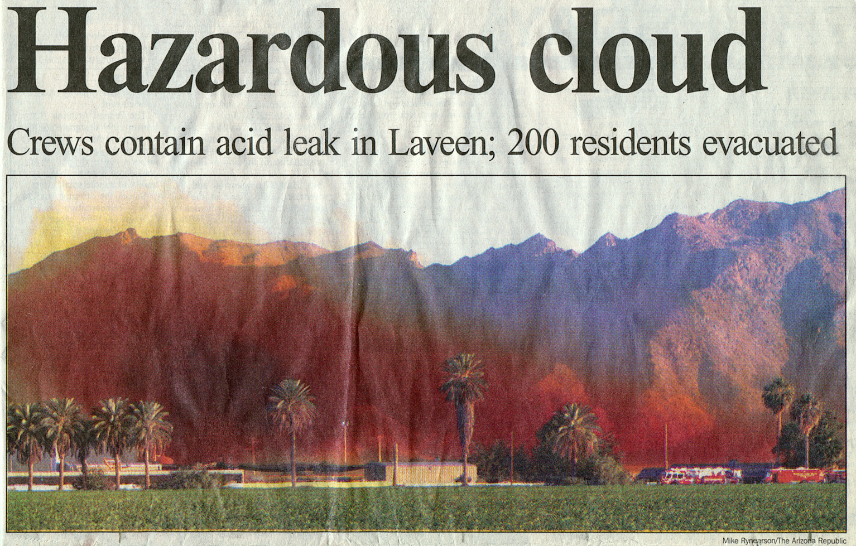
Microscale modeling applications urban pollution and accidents
From the Arizona Republic

Slide 7
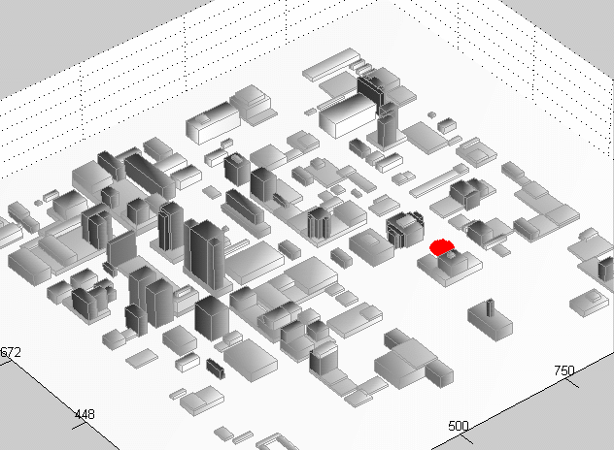
Dense Gas Dispersion in a City
Courtesy: Mike Brown, Los Alamos National Laboratory
Salt Lake City Dense Gas Simulation
(10 minute animation)

Slide 8
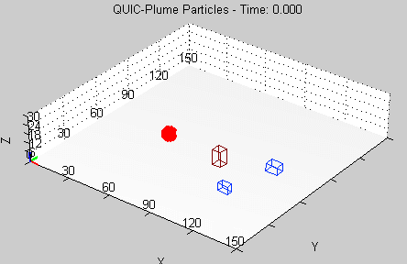
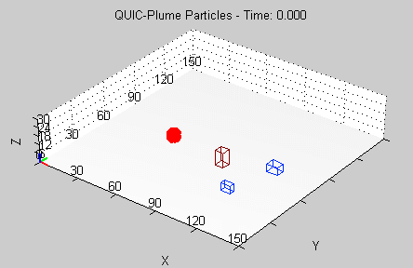
Dense Gas & Topography
Wind
Wind
Downhill
3 m/s wind, no slope
3 m/s wind, 2% slope
patrick

Slide 9

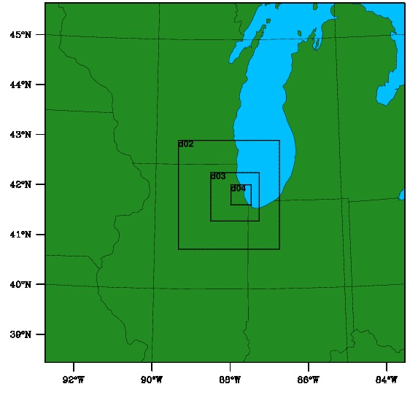
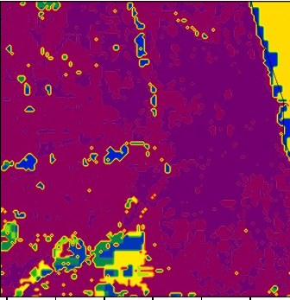
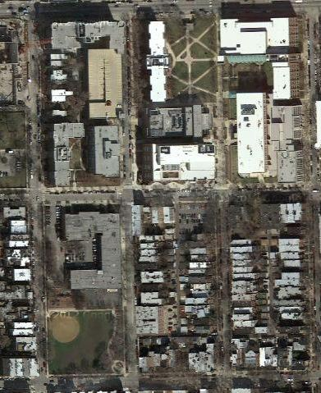
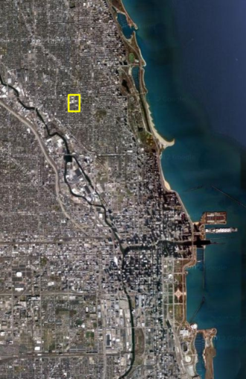
Climate -> Meter Scales
Multi-scale approach
1 km
0.333 km
EnviMet
City of Chicago – from climate to pedestrian scales
Patrick Conry and Ashish Sharma
University of Notre Dame
2 m scale resolution
Notes:
33, 32, 32 represent high-, medium and, and low- intensity urban

Slide 10

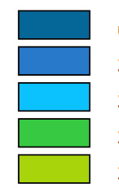
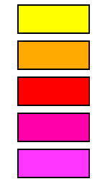
Climate change impacts
12:00 LST
Present
Air Temperature T_{a}
Future (2081)
ΔT_{a}
2.5 °C
ΔT_{a} = 0.38 °C
< 23.8 °C
23.8 °C
23.9 °C
24.0 °C
24.1 °C
24.2 °C
24.3 °C
24.4 °C
24.5 °C
> 24.5 °C
ΔT_{a} = 0.60 °C
< 26.5 °C
26.5 °C
26.6 °C
26.7 °C
26.8 °C
26.9 °C
27.0 °C
27.1 °C
27.2 °C
> 27.2 °C
Notes:
Extremes between zones more extreme

Slide 11
Microscale Wind Energy Applications
(a) Mesoscale modeling (5.12 km resolution) output of the wind energy (in color) for the installation of five 2MW turbines (shown in green).
(b) Same as in (a), but with a microscale model with 20 m resolution model nested in the mesoscale model in (a).
AEP - 39 GWh
AEP - 54 GWh
From -- Palma et al. 2008
aim

Slide 12
WORKSHOP AIMS:
Identify critical issues related to microscale modeling of complex terrain flows – science/applications? (Grubišić, Banta)
Review novel research tools that may help improve microscale predictions in complex terrain in leaps (all)
Possible participation of US governmental agencies (Steve Oncley/Vanda Grubišić, Dave Knapp)
Discuss opportunities to closely collaborate with the European ERANET+: New European Wind Atlas (NEWA) project - Perdigão, Experiments in 2016-2017 (Palma)
Map out crucial research topics that would augment or collaborate with Perdigão field program (all)
Develop a joint science plan/instrumentation for Perdigão deployment (all)
Research support from NSF (mainly), ARO (all)
Future urban microscale research enterprise (agency personnel)
products

Slide 13
Toward the end - products/results
Need some testable hypotheses, testing strategies, equipment available (especially novel equipment)
  Augment Europeans or working with them (whole is greater than the sum of parts)
  Modus operandi for collaboration (NEWA Project)
  Knowledge on national and international facilities for microscale work
  Foray for other larger projects (US agencies – DOD, DOE, ARO, NOAA)
genesis
genesis

Slide 14
From Jacob Mann, 01/28/2012, 8.31 pm
We are a group of European research labs working on establishing a big atmospheric flow experiment in complex terrain with the purpose of providing a database for validation of various flow models focused on wind energy. We work with the European Commission to secure some funding. For more details http://indico.conferences.dtu.dk/conferenceDisplay.py?confId=70
We would like to get American labs involved too, specifically NCAR, and we were thinking that you might be interested to work together with NCAR and NSF to join the experiment.
This is a very informal inquiry, and if you think it could be interesting, I would love to send you much more details a week from now.
Best regards, Jakob

Slide 15
ERANET+ (ERA = European Research Area)
ERANET+: under the sixth framework. The first “funding instrument” was ERANet, with hardly any funding from the Commission, only national funding.
Then came ERANet+. National research programs can work together through ERANET+. Funding comes from national sources, but the Commission adds up to 33%, and European calls are made.
Similar instruments - Networks of Excellence and ESFRI (research infrastructure). At least five countries have to commit themselves with at least 1 M Euro.

Slide 16
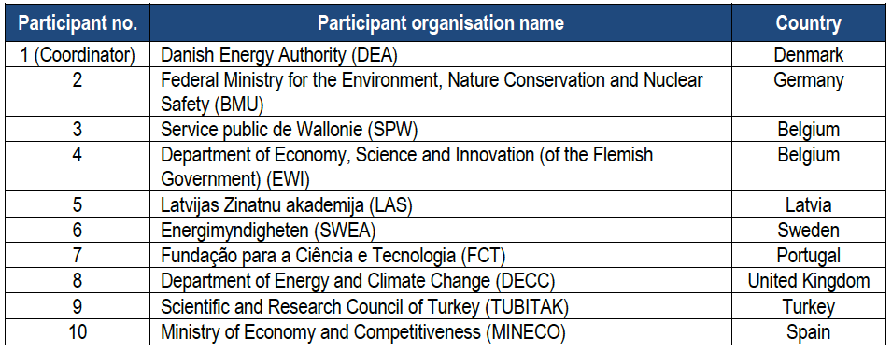
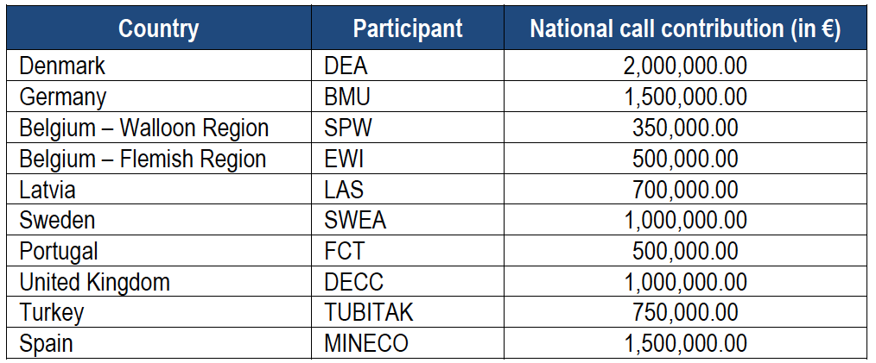

Slide 17
Mann/Palma Time Line(30/03/2012)
May-June 2012 Adoption of work programme (EC, Programme Committee) The official call test is attached.
July ERANET+ Call for national agencies for member states published (EU countries asked who wants to participate)
Feb 2013 Call deadline (at least five countries needed by this time)
May 2013 result of FP7 evaluation
End 2013 Contract signed EC <-> ERANET+ Consortium (=Ministries + Research Agencies from contributing countries);
Mid 2014 Thematic call (now they ask consortia of researchers to apply for the contract)
End 2014 Call Deadline
Mid 2015 (?) Beginning of work. Contracts start
(Eric Bjorklund, Danish Energy Agency – program coordinator)
(early August) – one proposal, 248 pp, eight countries, 9 partners; Project science lead – Jakob Mann
(Oct 01, 2014?
US effort

Slide 18
US Efforts
Revolve around sound science proposals to NSF and NCAR facilities
July 09, 2013 workshop at Notre Dame
Large projects format: SPO from the academics, EDO from NCAR
Lull period, Dec 20th call from Oncley
We submitted (Jan 15, 2014) SPOs and EDO turned down, but asked to resubmit (Jan 15).
http://www3.nd.edu/~dynamics/20130719_WINDletter.pdf

Slide 19
Special Projects Overview
Science focus - improved microscale models via better wind physics and numerics; new parameterizations; reduce errors in wind predictions
- current understanding of flow past hills is grounded on Jackson & Hunt (1975) & Hunt et al. (1988) – RDT based
- RANS, LES, DES have made tremendous progress
Measurement focus – unprecedentedly dense suite of instrumentation, state of the art, high resolution, collaborative
Measurement l focus

Slide 20
Project Overview
Scale focus - ~ 500 m horizontal and ~ 10 m vertical resolutions (previous – mesoscale)
Experimental focus - a new configuration/work with European sites
Exptl focus/other expts

Slide 21
Table 1: Most recent field experiment studies relevant to Perdigão experiment
in chronological order – many complex terrain experiments
→ mostly meso-scale
Time-frames | Field Experiments
1979-1986 | Brent Knoll, Pouzauges Hill, Black Mountain, Ailsa Craig, Kettles Hill, Bungendore Ridge, Sirhowy Valley, Blashaval, Askervein Hill and Nyland Hill (England, Scotland, France, Australia and Canada) Cinder Cone Bute (Idaho)
1982-1983 | Askervein Hill (Scotland)
1984-1985 | Cooper’s Ridge (Australia)
2003 | Gaudergrat Experiment (Gaudex) (Switzerland)
2004, 2006 | Owens Valley (California, USA), Sierra Rotors Project (SRP), followed by Terrain-induced Rotor Experiment (T-REX)
2007-2008 | Bolund Hill (Denmark)
2010 | Benakanahalli Hill (Karnataka, India)
2012-2013 | MATERHORN (Dugway Proving Grounds, Utah)
Select a two-hill experiment near Perdigão
Parameter diag

Slide 22
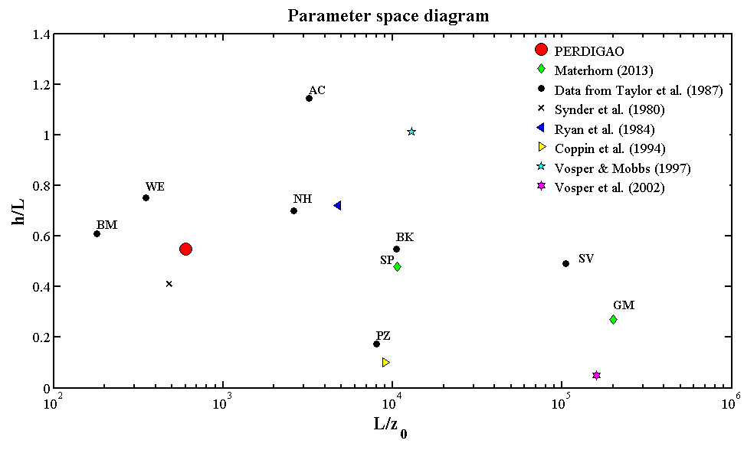
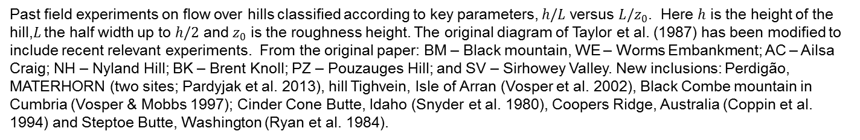
Past field experiments on flow over hills classified according to key parameters, $h/L$ versus $L/z_{0}$. Here $h$ is the height of the hill,$L$ the half width up to $h/2$ and $z_{0}$ is the roughness height. The original diagram of Taylor et al. (1987) has been modified to include recent relevant experiments. From the original paper: BM – Black mountain, WE – Worms Embankment; AC – Ailsa Craig; NH – Nyland Hill; BK – Brent Knoll; PZ – Pouzauges Hill; and SV – Sirhowey Valley. New inclusions: Perdigão, MATERHORN (two sites; Pardyjak et al. 2013), hill Tighvein, Isle of Arran (Vosper et al. 2002), Black Combe mountain in Cumbria (Vosper & Mobbs 1997); Cinder Cone Butte, Idaho (Snyder et al. 1980), Coopers Ridge, Australia (Coppin et al. 1994) and Steptoe Butte, Washington (Ryan et al. 1984).
Research focus

Slide 23
Research Program
Research focus - overarching science needs
- energetic conditions for wind energy
- quiescent conditions for air pollution work
Processes diag

Slide 24
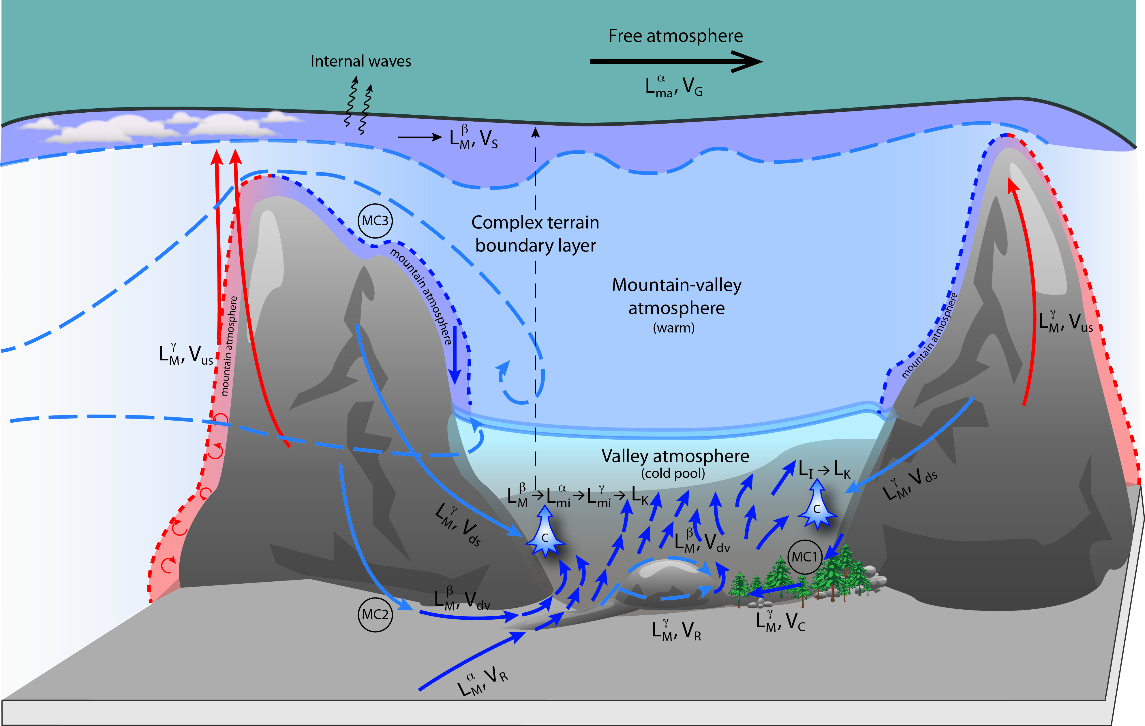
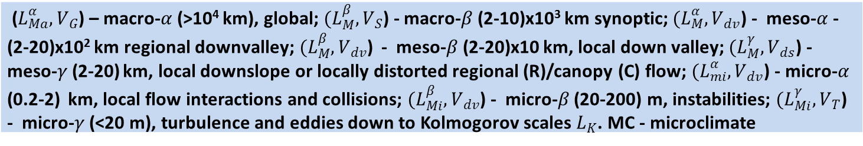
Mountain-Terrain
Processes
Geographic
($L_{Ma}^{α}, V_{G}$) – macro-$α$ (>10⁴ km), global; $(L_{M}^{β}, V_{S}$) - macro-$β$ (2-10)x10³ km synoptic;$(L_{M}^{α}, V_{dv}$) - meso-$α$ - (2-20)x10² km regional downvalley;$(L_{M}^{β}, V_{dv}$) - meso-$β$ (2-20)x10 km, local down valley; $(L_{M}^{γ}, V_{ds}$) - meso-$γ$ (2-20) km, local downslope or locally distorted regional (R)/canopy (C) flow; $(L_{mi}^{α}, V_{dv}$) - micro-$α$ (0.2-2) km, local flow interactions and collisions; $(L_{Mi}^{β}, V_{dv}$) - micro-$β$ (20-200) m, instabilities; $(L_{Mi}^{γ}, V_{T}$) - micro-$γ$ (<20 m), turbulence and eddies down to Kolmogorov scales $L_{K}$. MC - microclimate

Slide 25
Geographic focus - Vale Cobrão near the town of Perdigão
(other NEWA experiments – Kassel ; Forested Hill, Alaiz; Turkish Hill; Northern European Combines Meso Experiments)

Slide 26
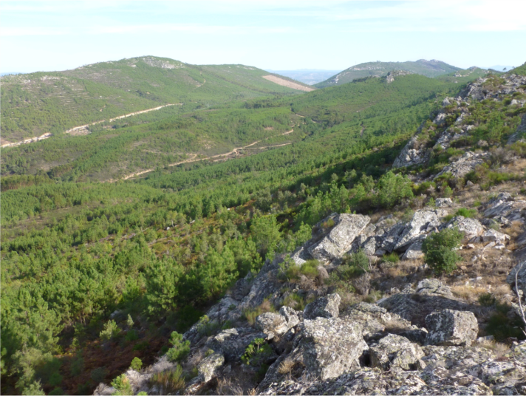
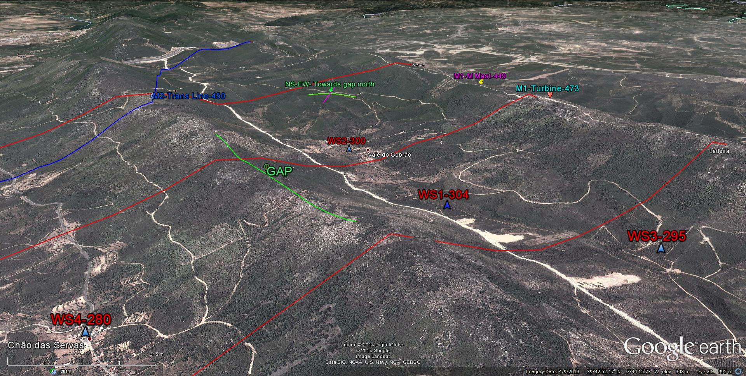
Geometrical Focus – double hill,
almost two-dimensional, broadsided winds
More pics

Slide 28
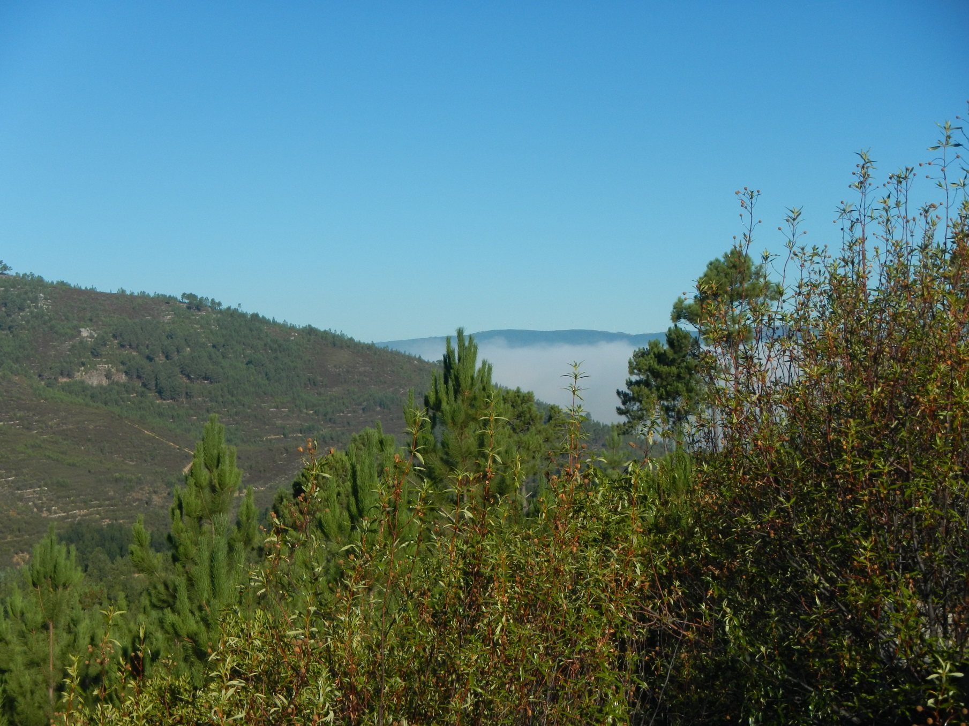
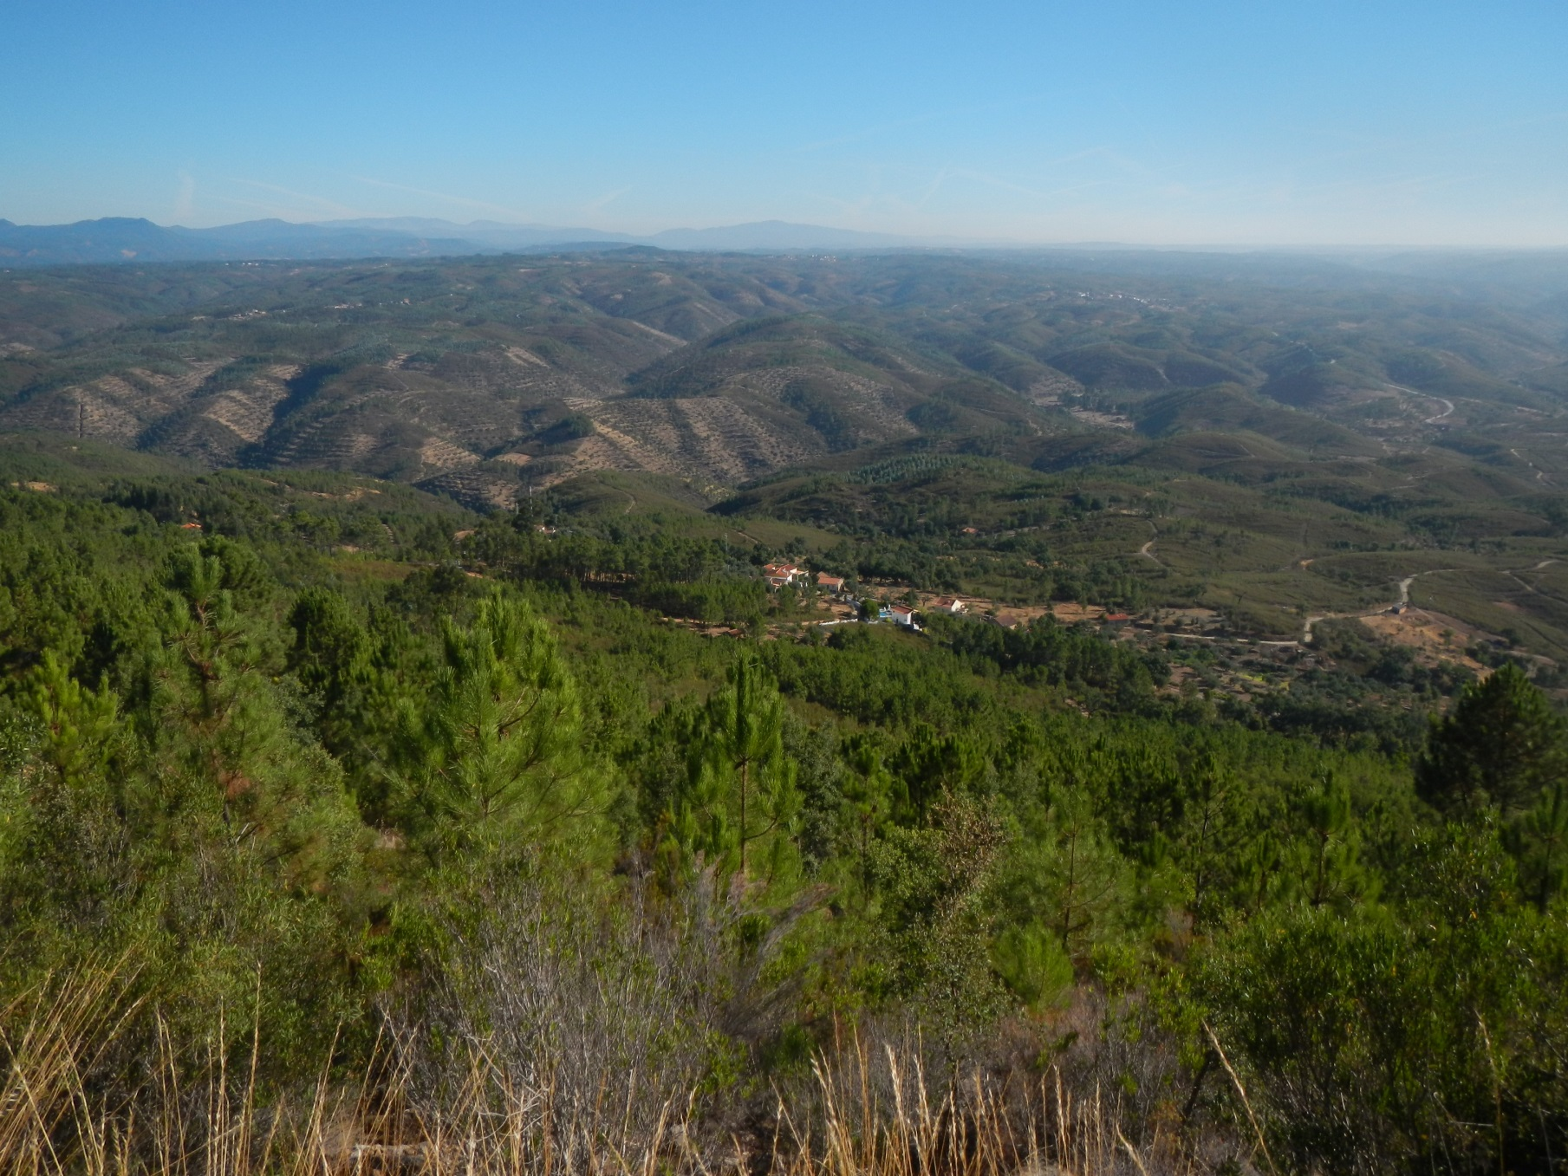
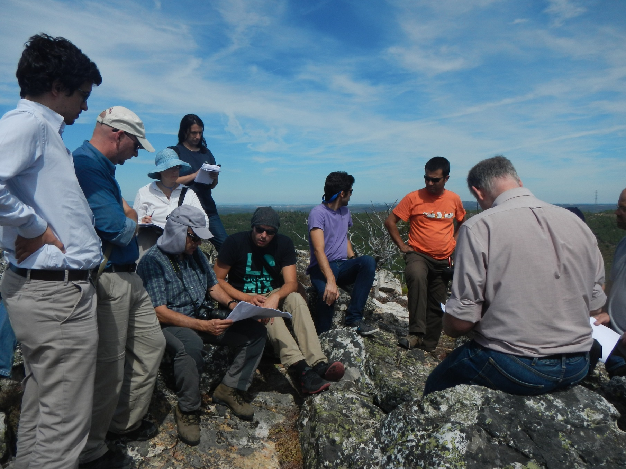
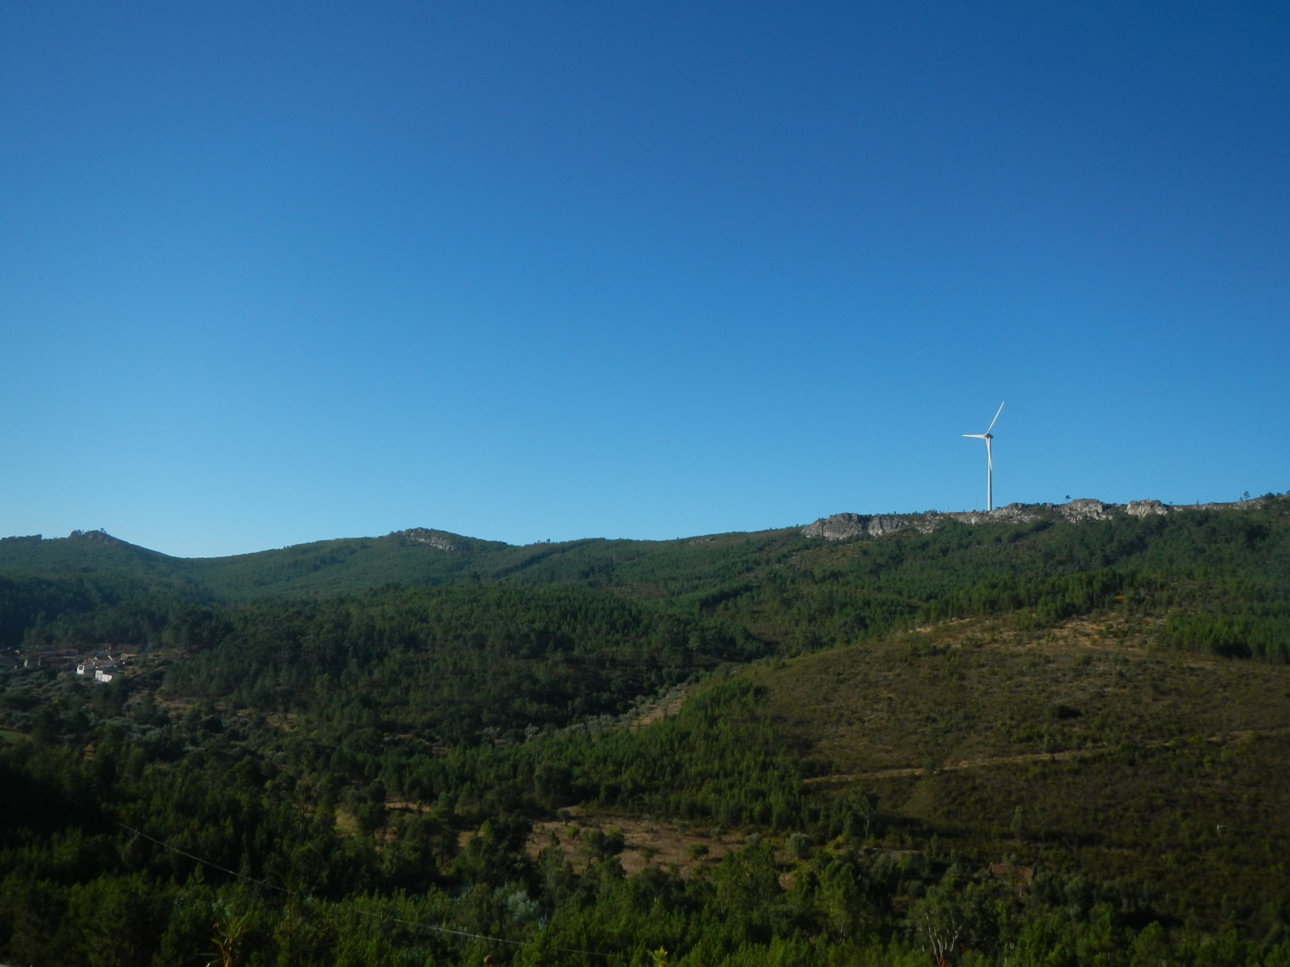
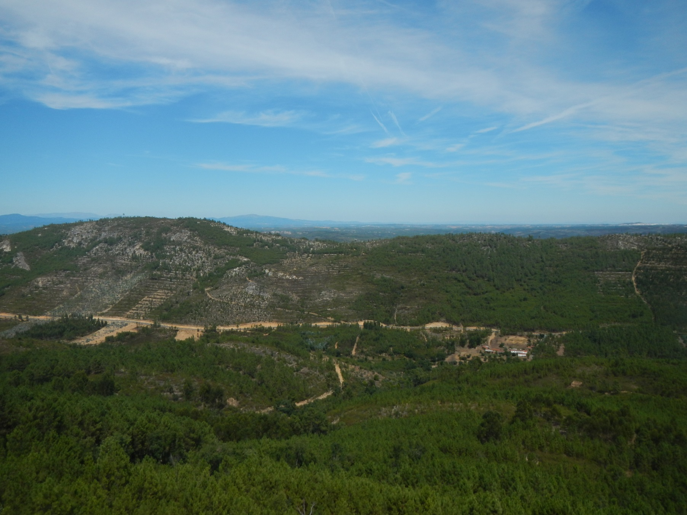
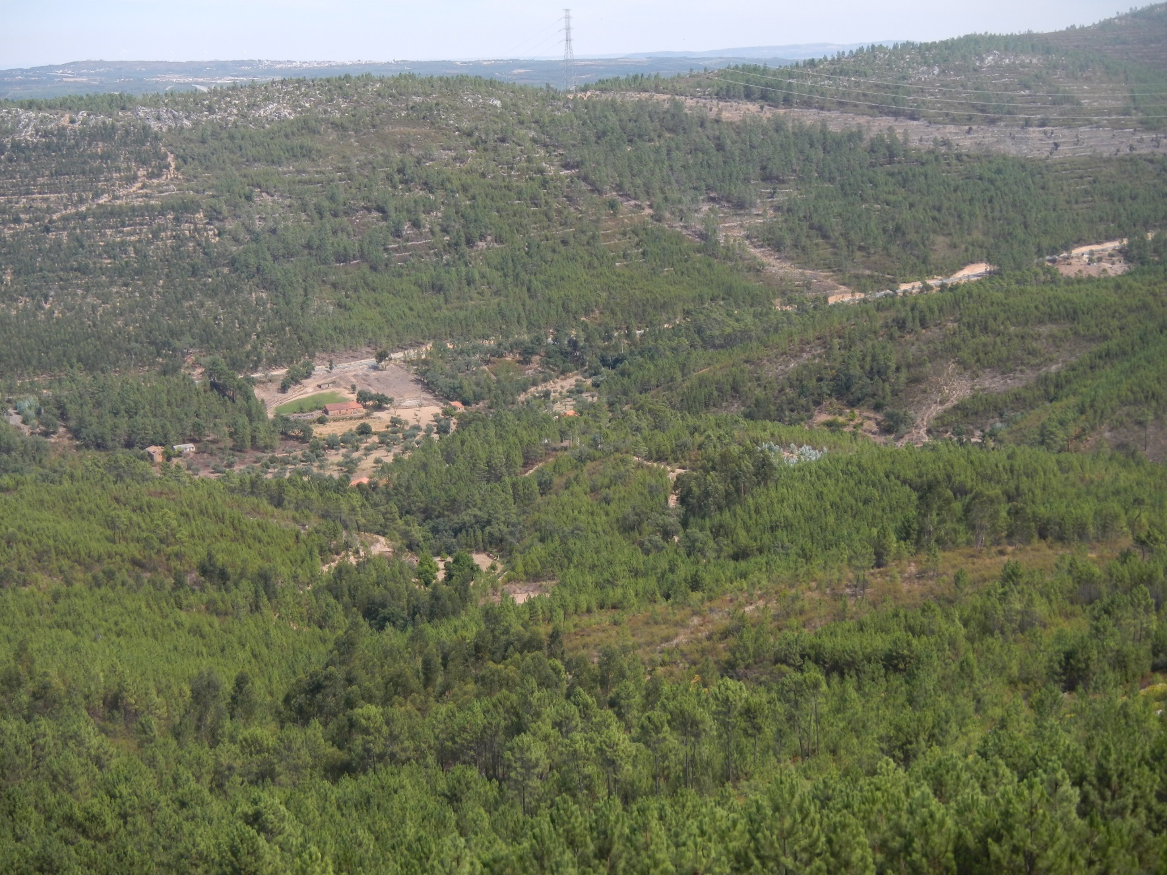
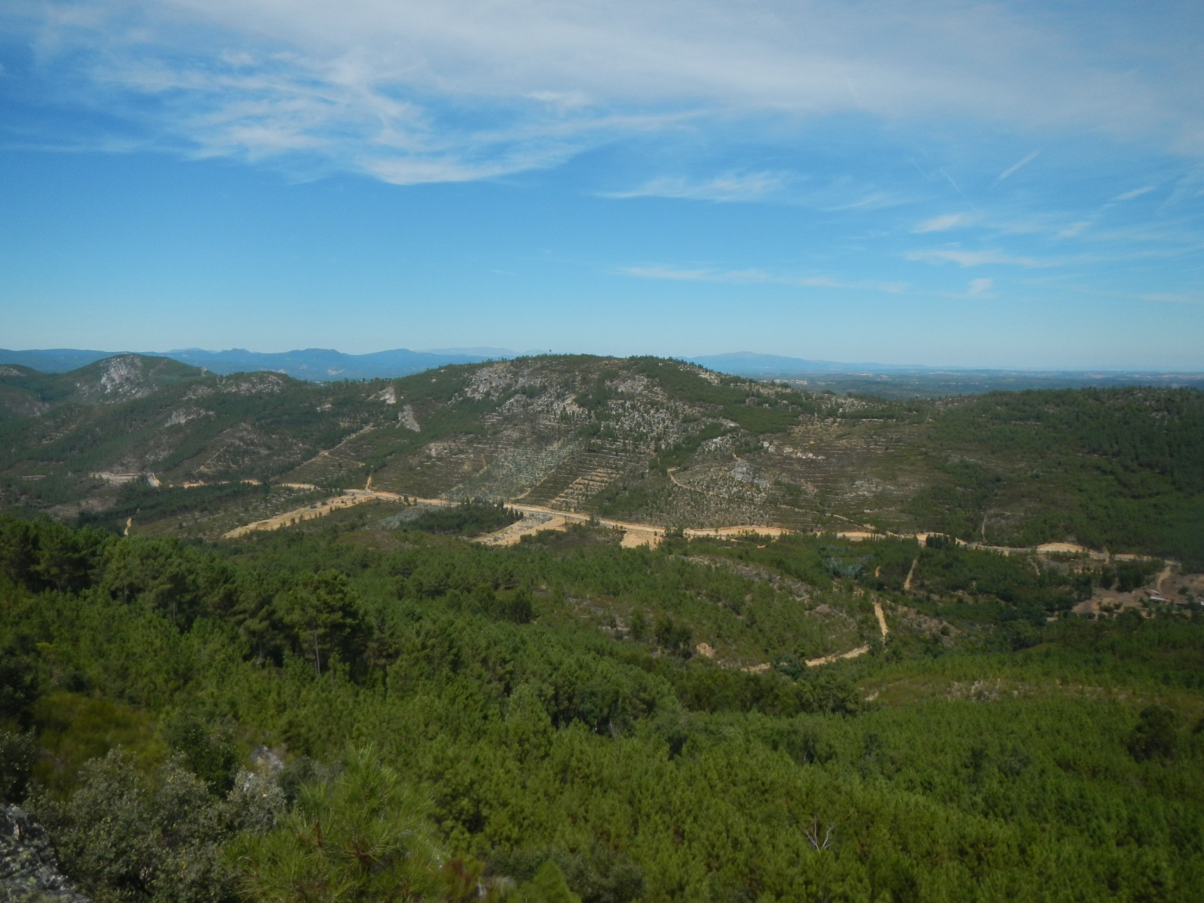
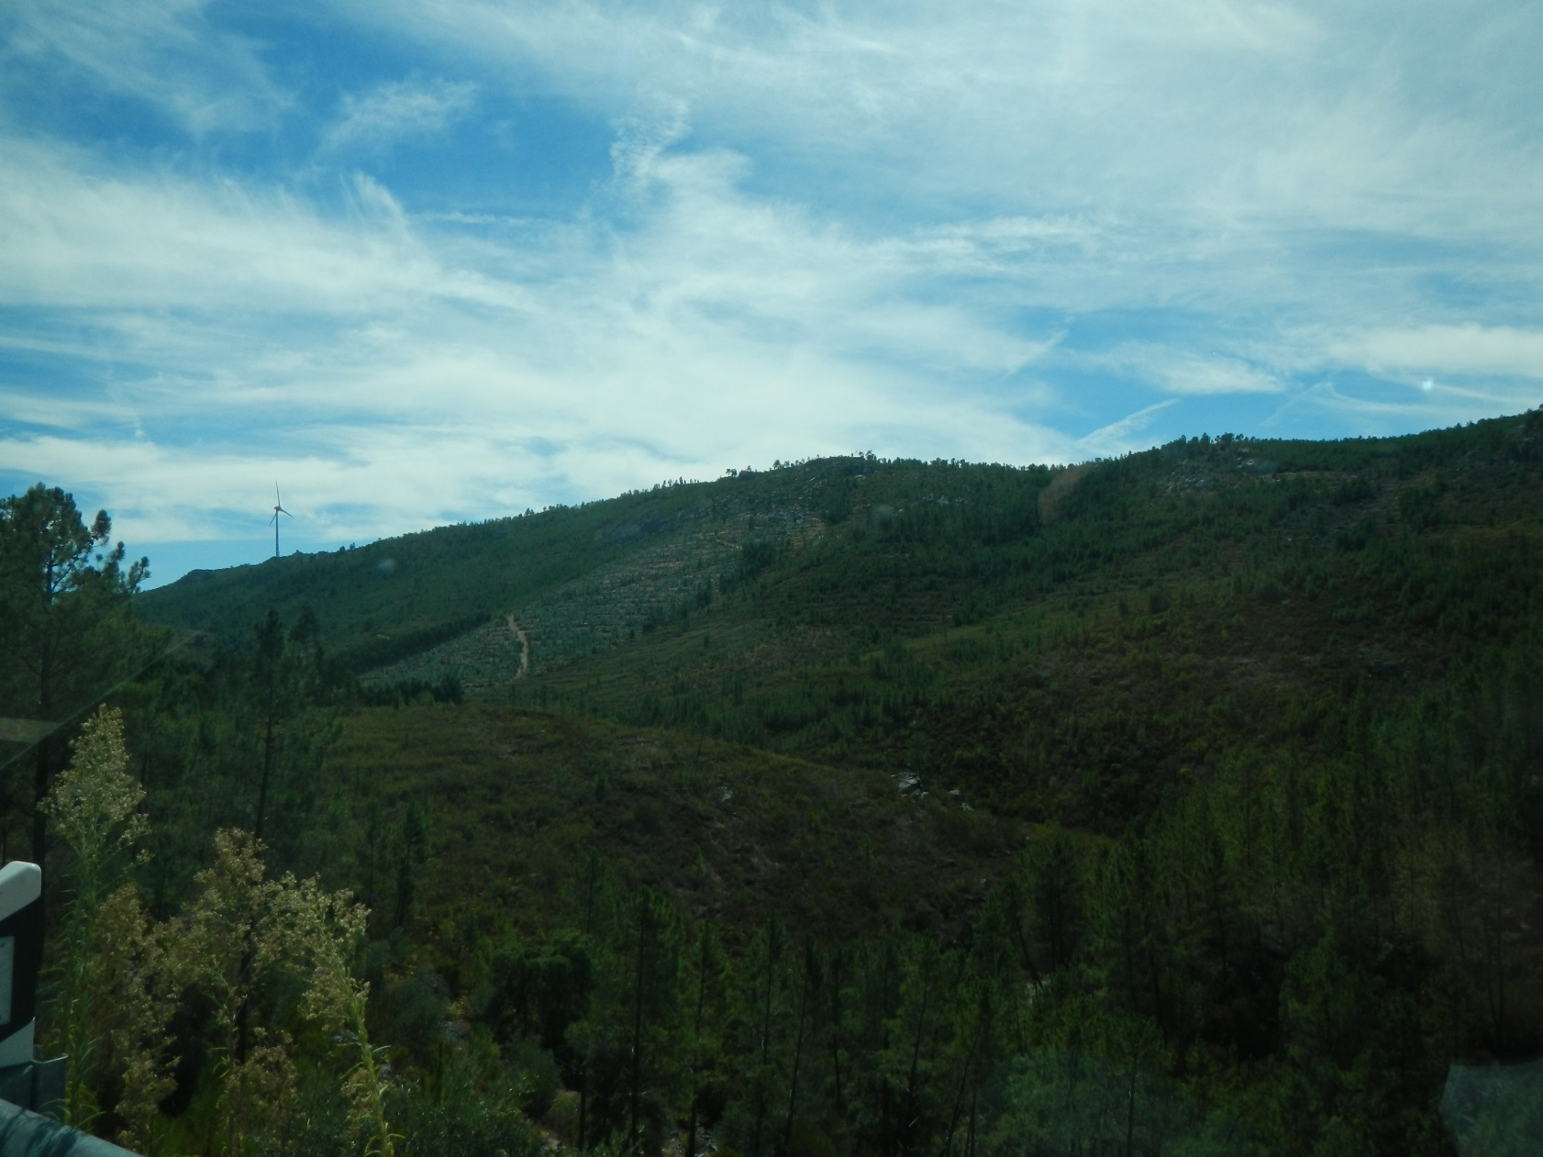
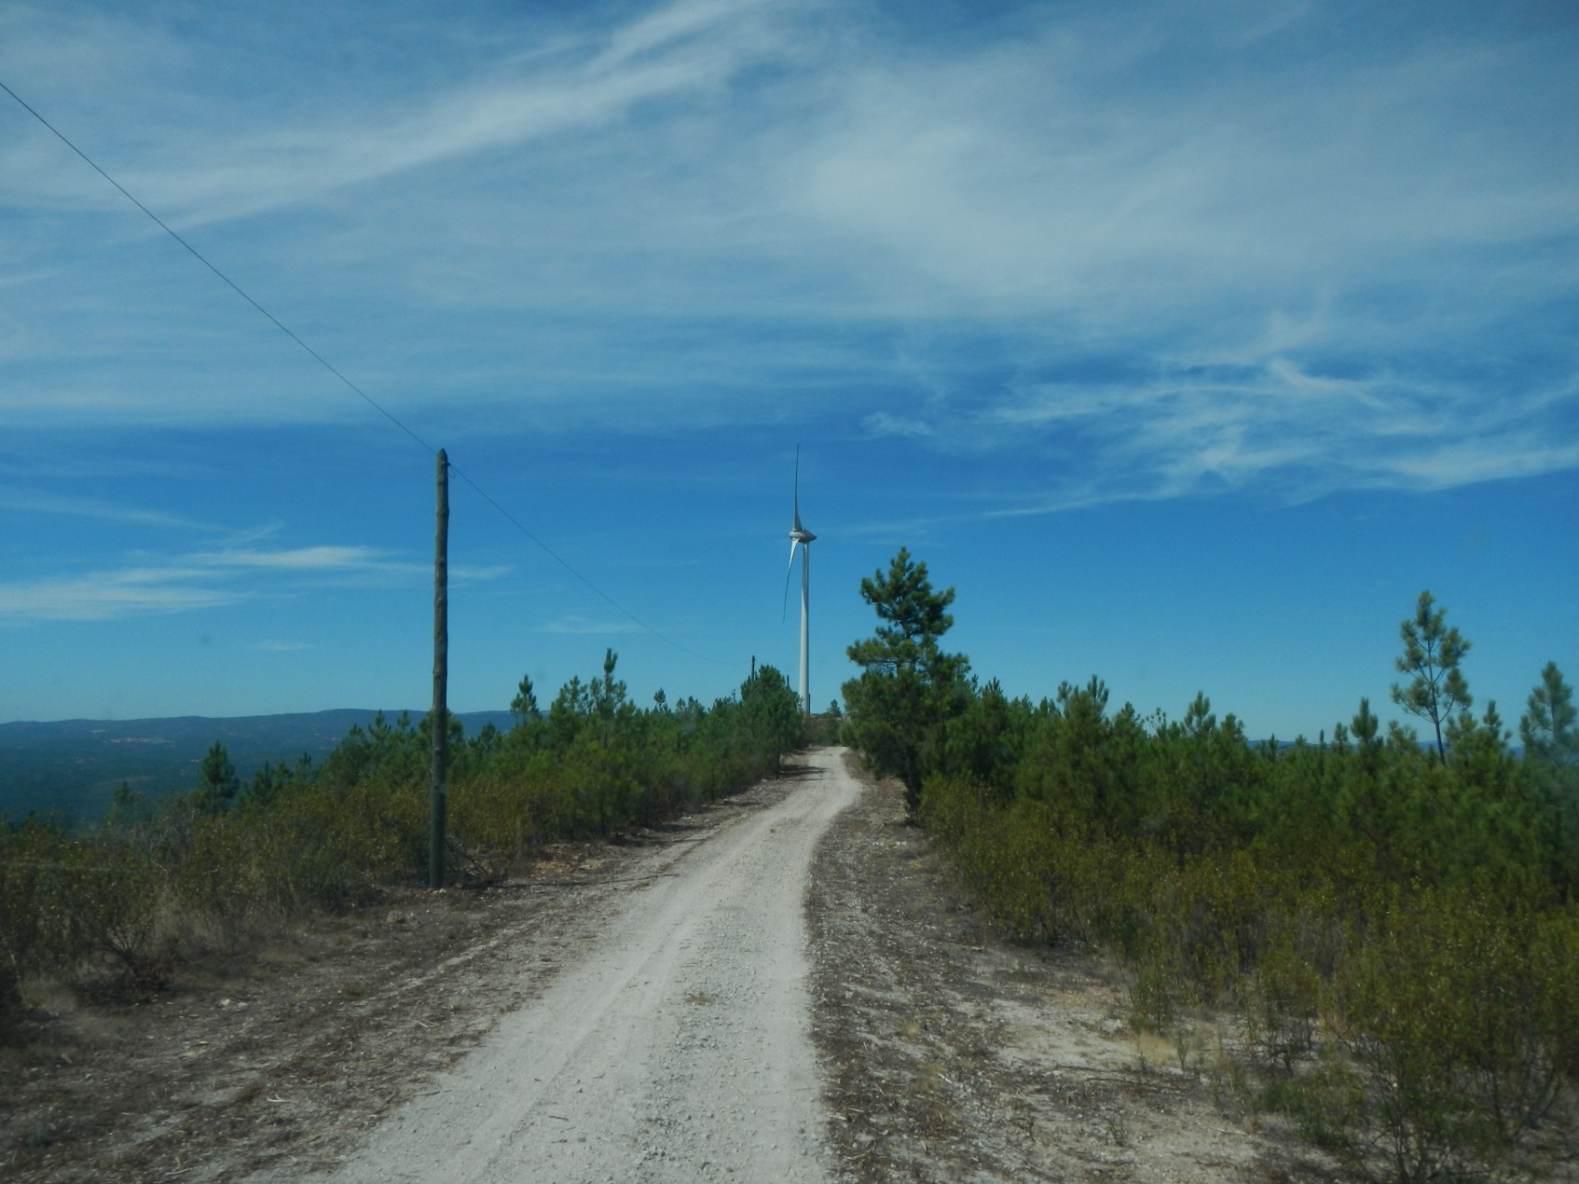
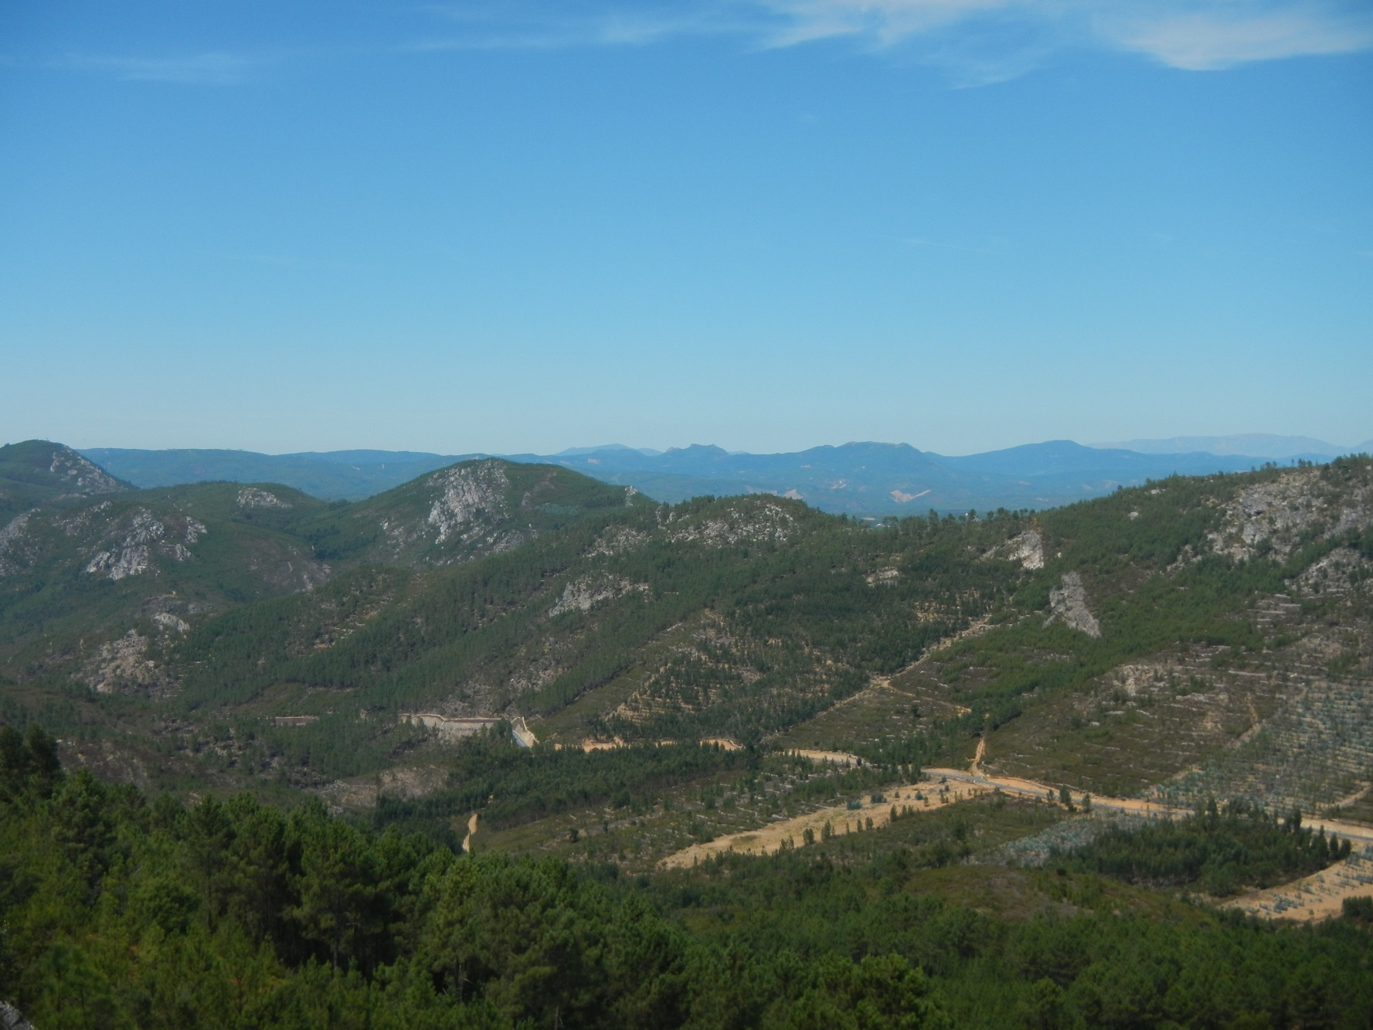
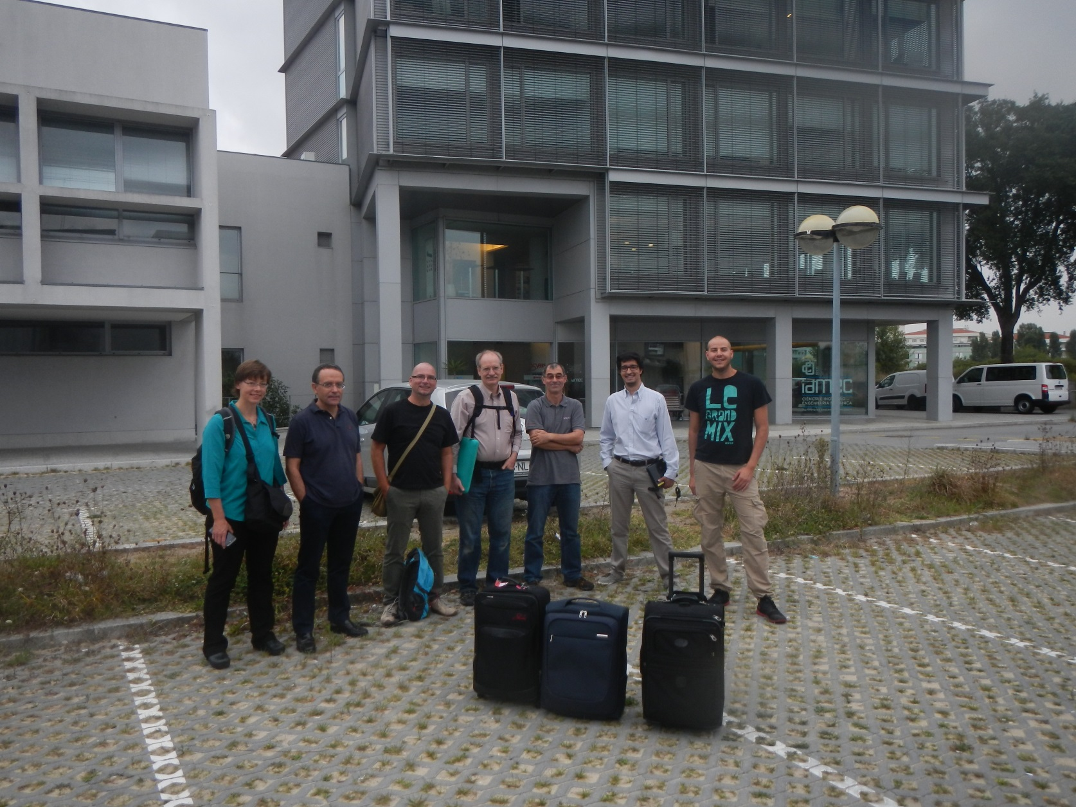
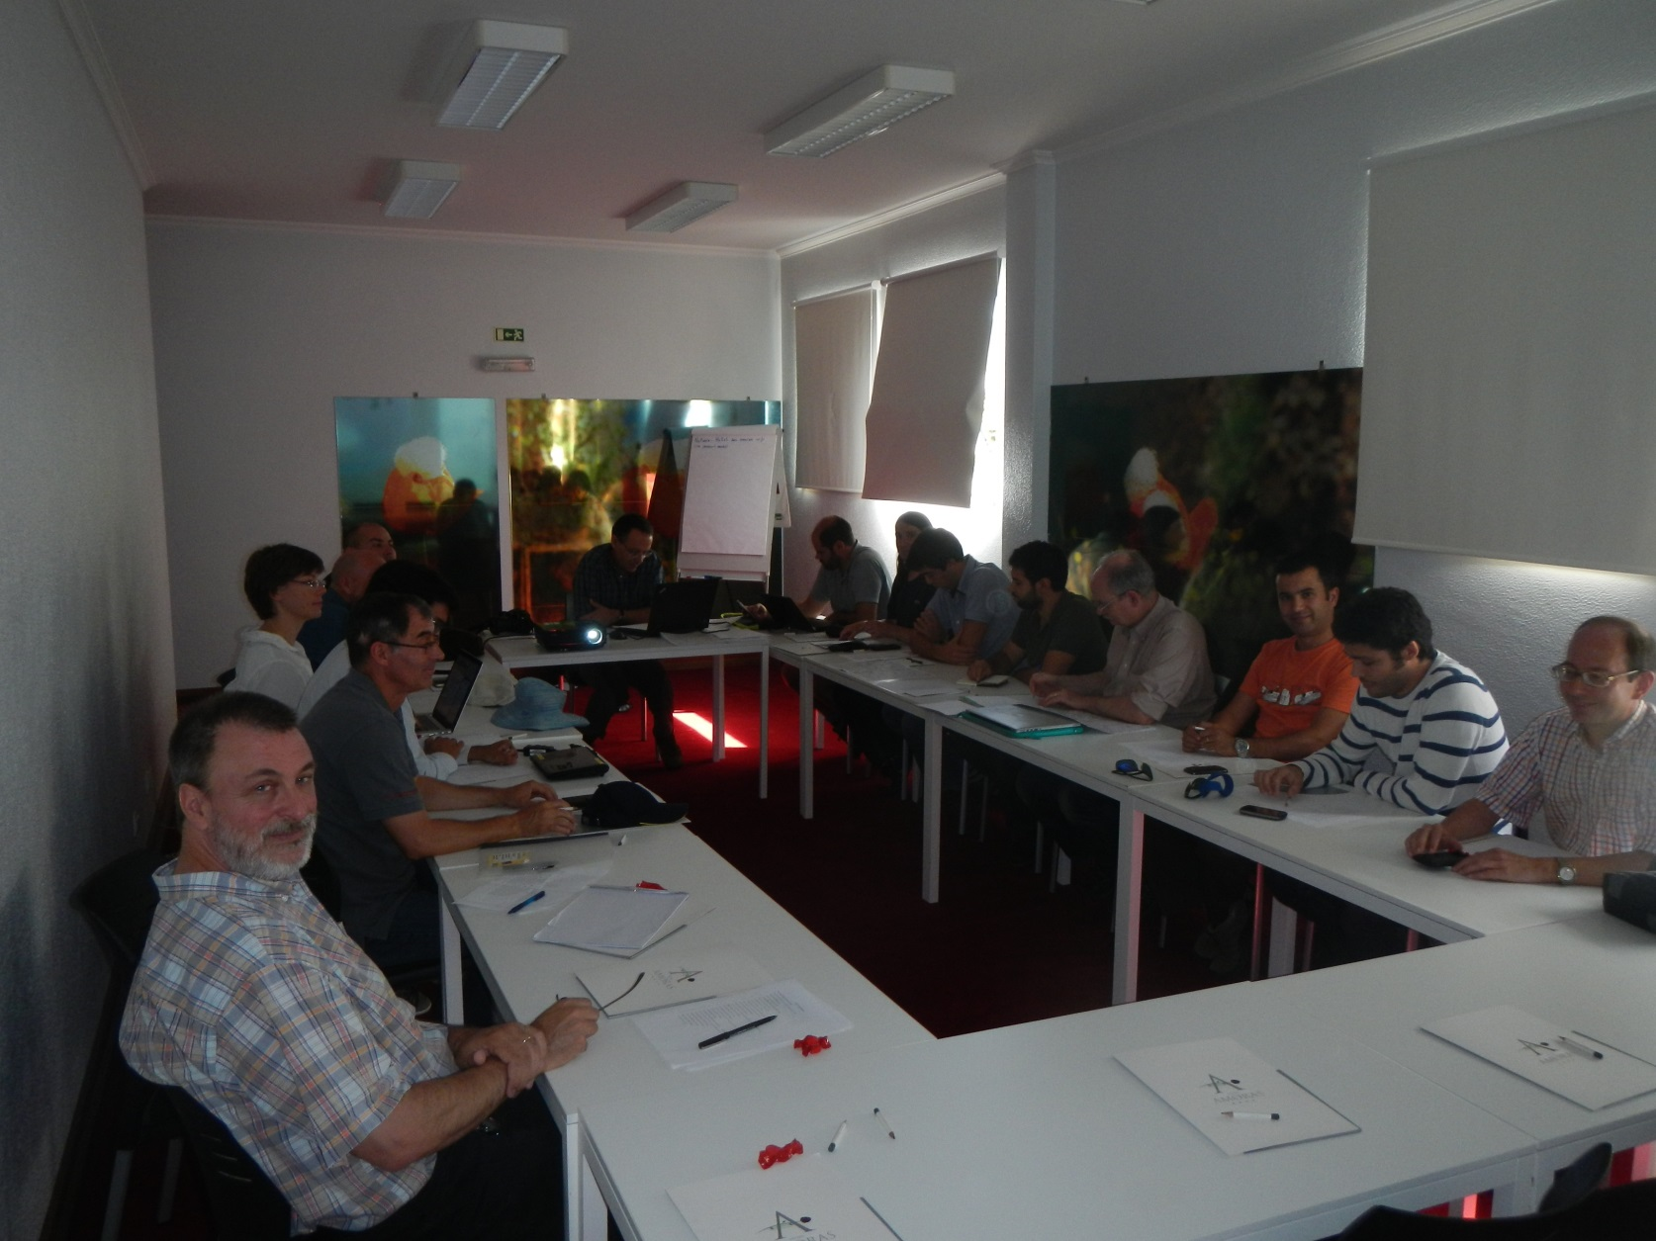
September 4-6 2014 visit to
Perdigão (Oncley, Lundquist, Fernando;
Gordon Videen)

Slide 29
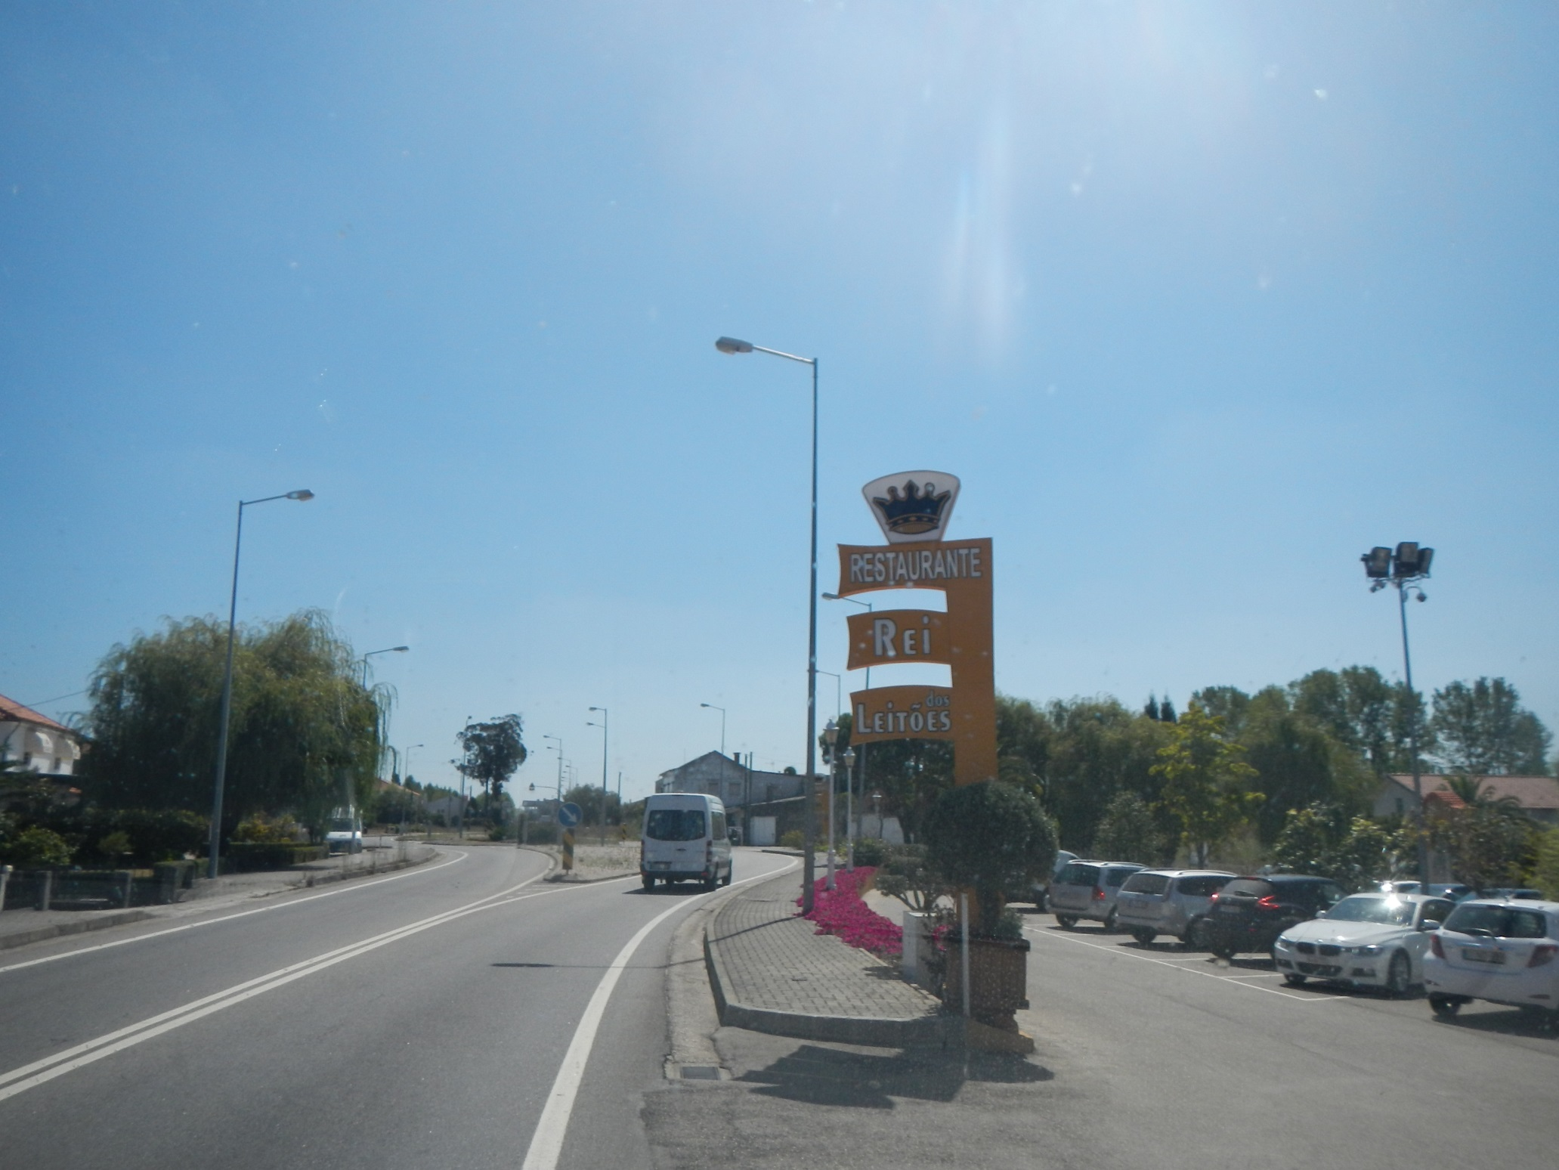

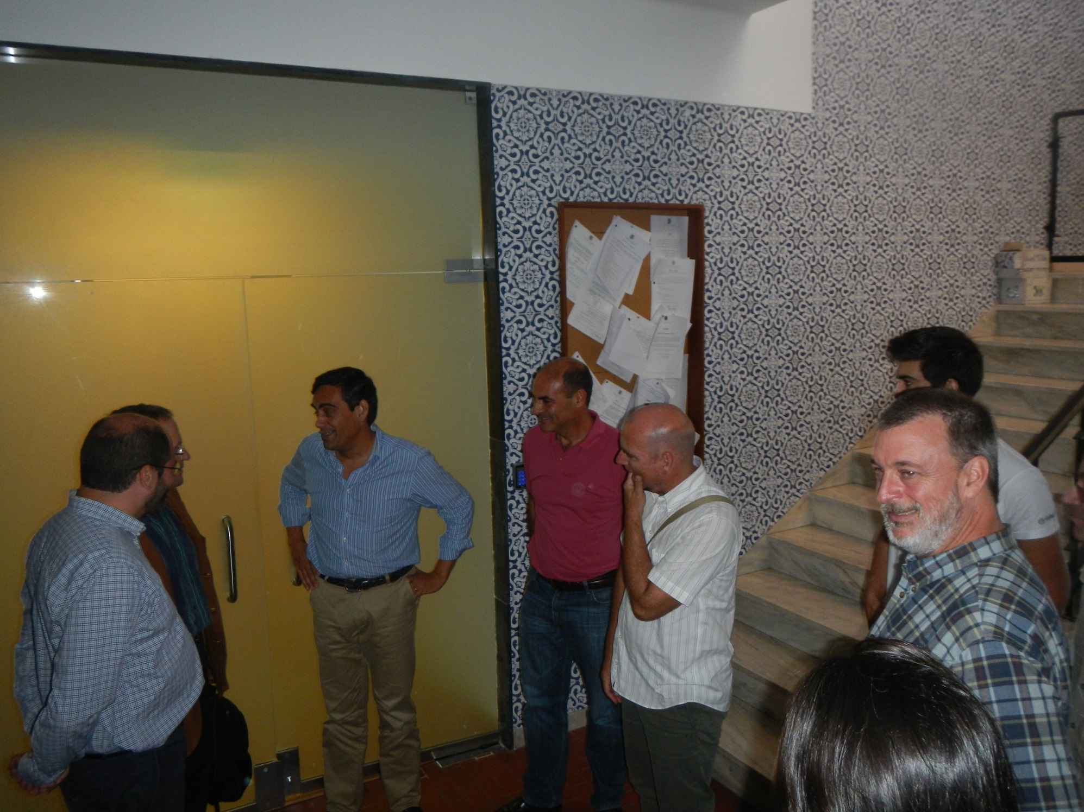
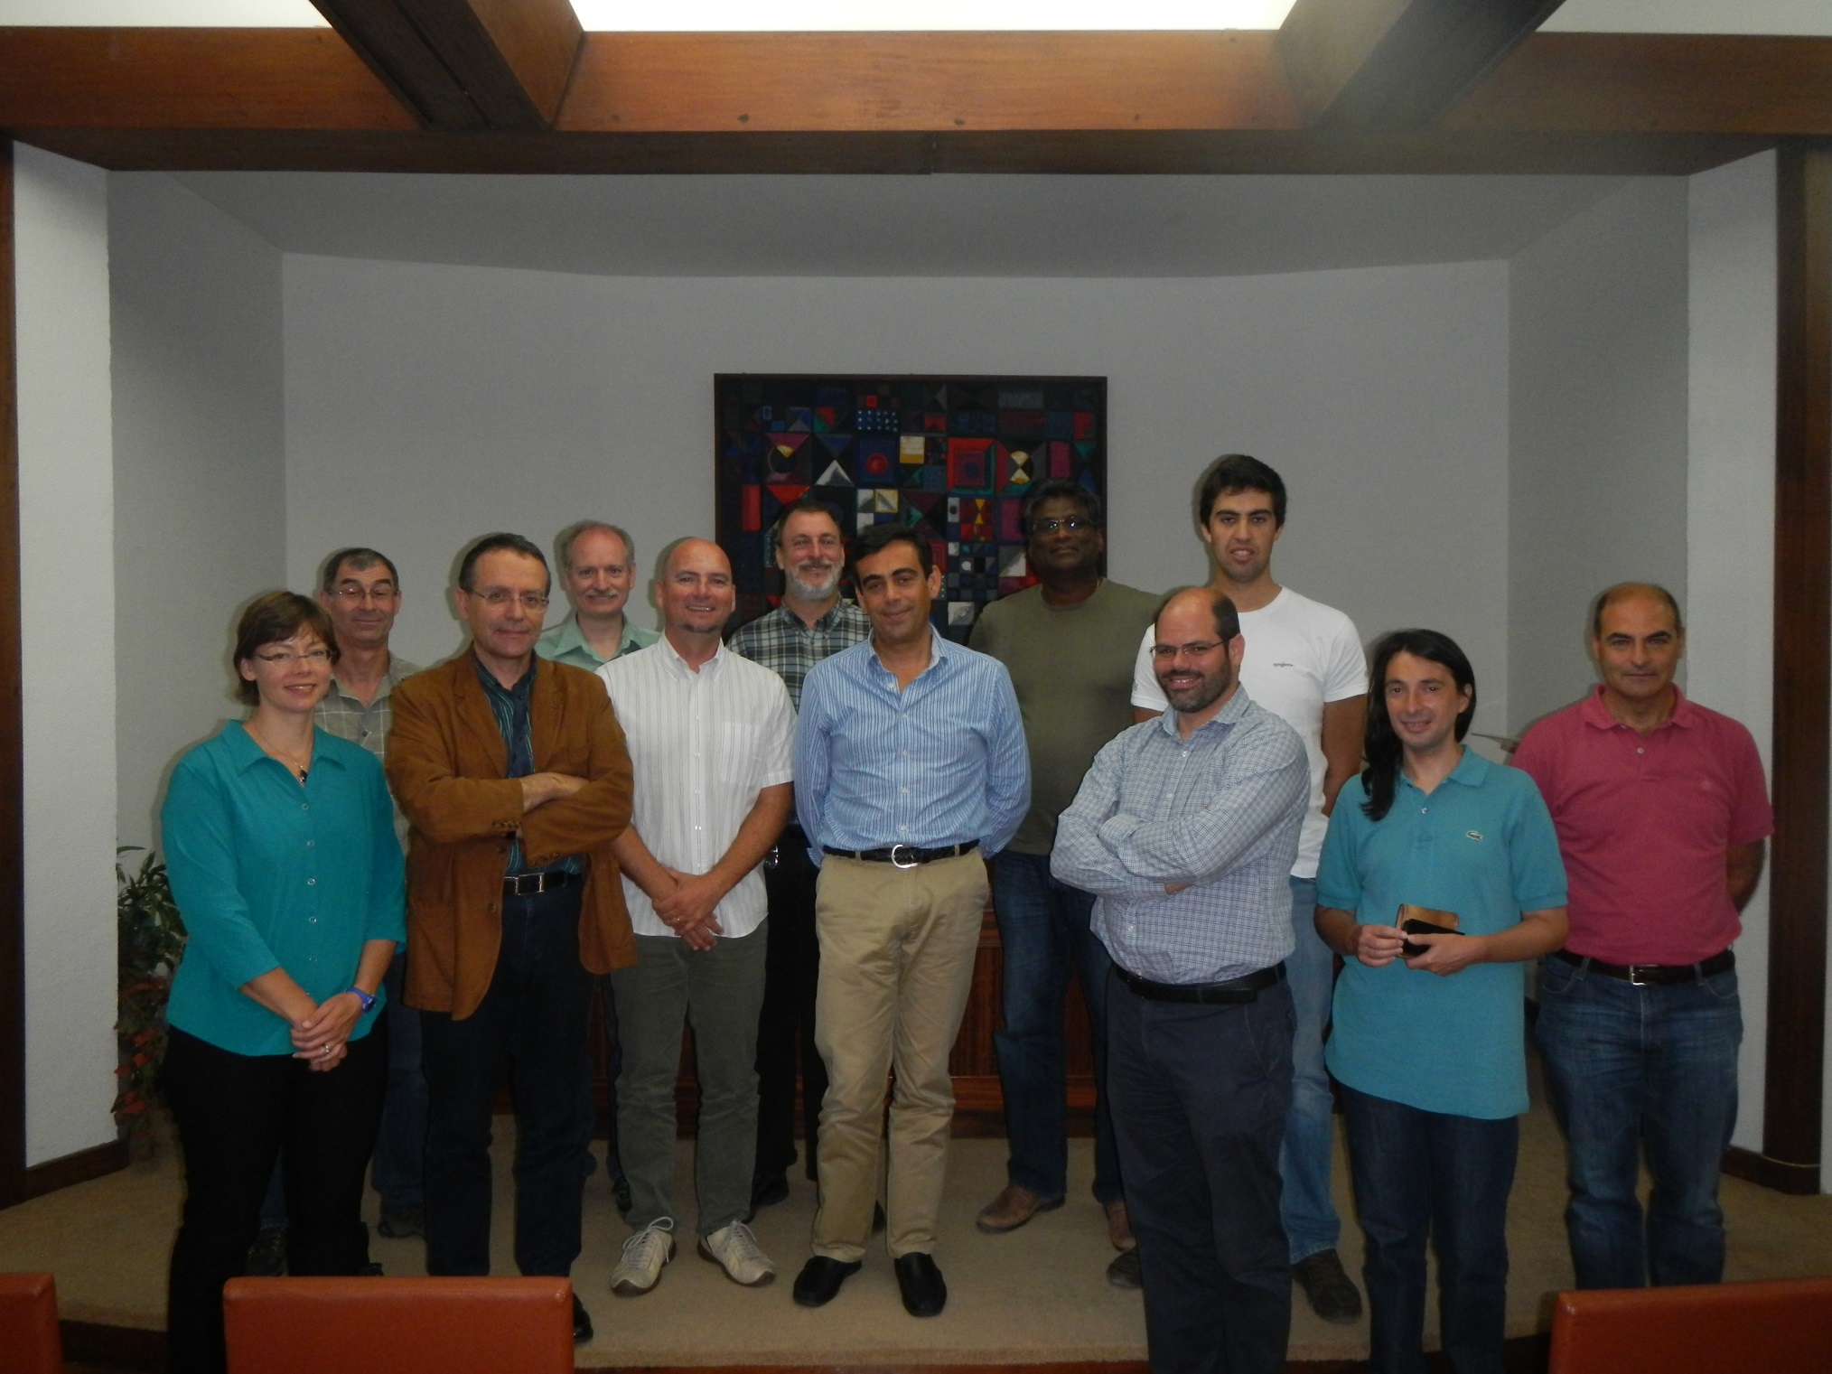

Slide 30
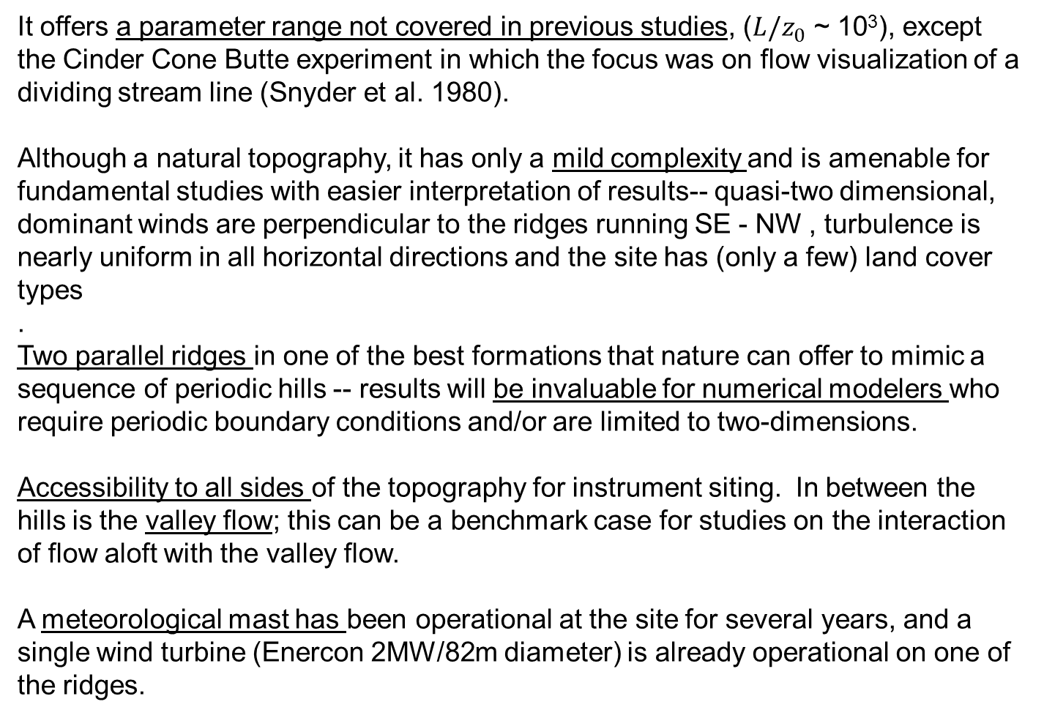
Unique Features of the Topography
It offers a parameter range not covered in previous studies, (${L/z}_{0}$ ~ 10³), except the Cinder Cone Butte experiment in which the focus was on flow visualization of a dividing stream line (Snyder et al. 1980).
Although a natural topography, it has only a mild complexity and is amenable for fundamental studies with easier interpretation of results-- quasi-two dimensional, dominant winds are perpendicular to the ridges running SE - NW , turbulence is nearly uniform in all horizontal directions and the site has (only a few) land cover types
.
Two parallel ridges in one of the best formations that nature can offer to mimic a sequence of periodic hills -- results will be invaluable for numerical modelers who require periodic boundary conditions and/or are limited to two-dimensions.
Accessibility to all sides of the topography for instrument siting. In between the hills is the valley flow; this can be a benchmark case for studies on the interaction of flow aloft with the valley flow.
A meteorological mast has been operational at the site for several years, and a single wind turbine (Enercon 2MW/82m diameter) is already operational on one of the ridges.

Slide 31
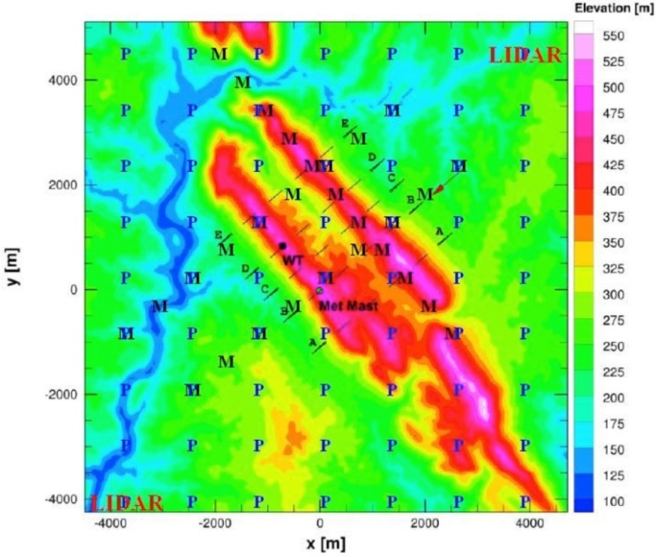
EU Proposal
Arrays of surface flux towers (P) and tall (200m) towers (M) would be used to document the airflow, turbulence characteristics, and atmospheric stability. The tall towers shown are arranged in two along wind and one crosswind transects for winds perpendicular to the ridge lines. Coordinated scans of multiple Doppler LIDARs. The position of the existing wind turbine (WT) and meteorological mast are also shown.

Slide 32
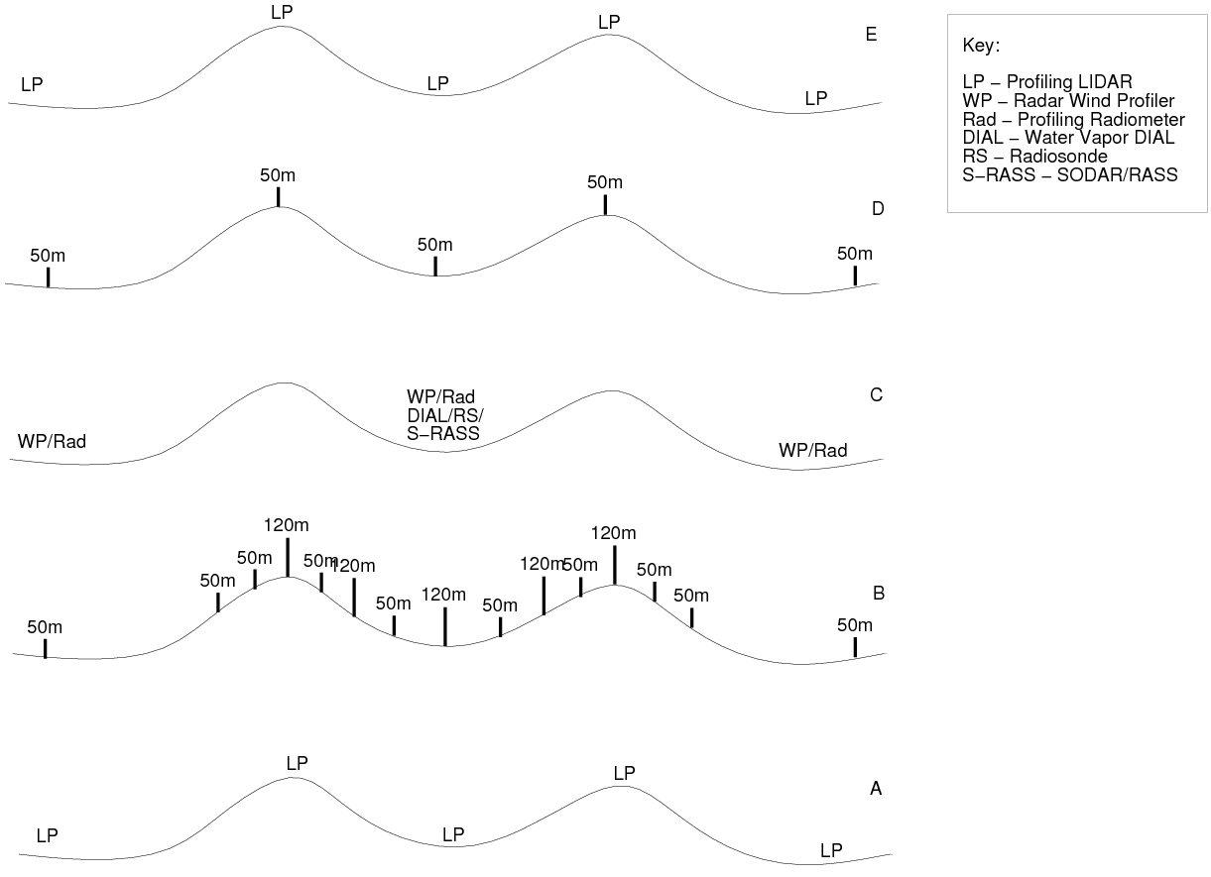
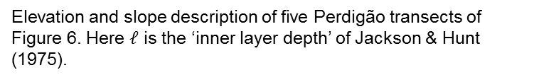
US/NACR proposal
Layout of instrumentation along transects shown in Fig. 6. Vertical lines indicate masts instrumented at multiple heights.
Elevation and slope description of five Perdigão transects of Figure 6. Here $𝓁$ is the ‘inner layer depth’ of Jackson & Hunt (1975).

Slide 33
Comments from Nick Anderson
The SPO is reviewed by NSF and the EDO goes to the Observing Facilities Assessment Panel (OFAP).
Science reviewers were very positive about the proposal and the development of a new community resource, the OFAP was more concerned about the rather “raw” state of the proposed effort.
I tend to side more with the OFAP reviewers for the following reasons:

Slide 34
The SPO was not centered around a set of well-defined, testable hypotheses. At the SPO proposal stage, these should be prominently stated, well-vetted and ready for prime-time. The statement on pg. 13 of your project description that you would be holding “a two-day workshop in the fall of 2014 aimed at developing an integrative research program for US investigators” is inappropriate for an SPO.
The list of research needs was extensive, but it was not well associated with specific measurement strategies. The measurements that are needed for particular scientific objectives should be made obvious.
There was not a well-posed rationale or strategy for the two IOPs.
There was minimal discussion about the education and outreach component.

Slide 35
Despite the declination of this proposal, the science reviewers have made it obvious that the community is excited about this opportunity.
We would welcome a revised submission in the next round (Jan. 2015), with the potential for NSF-funded participation in late 2016 and early 2017. It is also possible that there will be more clarity about the status of CentNet at that point.
I am sorry that the news isn’t better at this time. If you have questions after receiving the reviews and the OFAP summary, please feel free to contact me.

Slide 36
Let’s get to work!

Slide 37
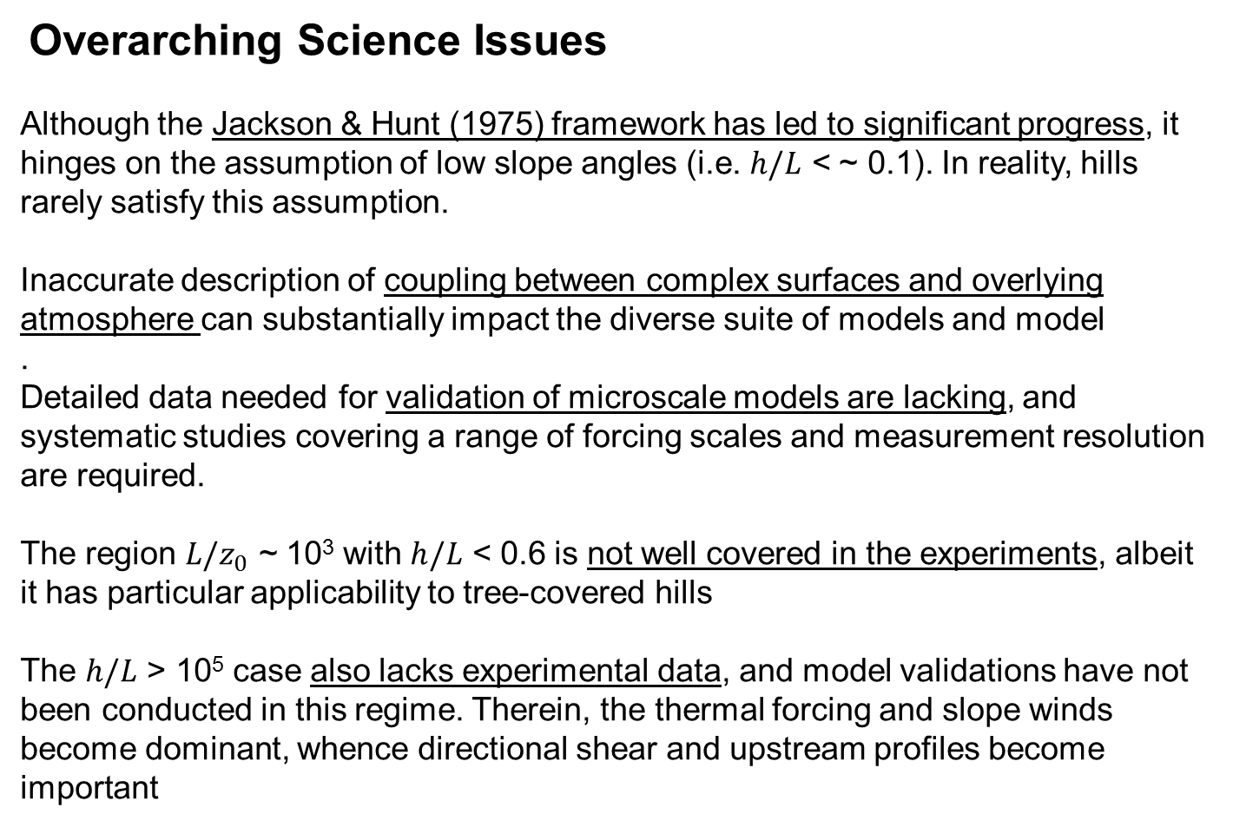
Overarching Science Issues
Although the Jackson & Hunt (1975) framework has led to significant progress, it hinges on the assumption of low slope angles (i.e. $h/L$ < ~ 0.1). In reality, hills rarely satisfy this assumption.
Inaccurate description of coupling between complex surfaces and overlying atmosphere can substantially impact the diverse suite of models and model
.
Detailed data needed for validation of microscale models are lacking, and systematic studies covering a range of forcing scales and measurement resolution are required.
The region ${L/z}_{0}$ ~ 10³ with $h/L$ < 0.6 is not well covered in the experiments, albeit it has particular applicability to tree-covered hills
The $h/L$ > 10⁵ case also lacks experimental data, and model validations have not been conducted in this regime. Therein, the thermal forcing and slope winds become dominant, whence directional shear and upstream profiles become important

Slide 38
There is a need to characterize wind fields with a fine spatial distribution to document flow separation and recirculation regions.
The most appropriate PBL parameterizations for meso-scale models for conditions and height ranges appropriate for wind-turbine operation need to be studied.
Methods to include atmospheric stability in micro-scale models need to be developed, including the appropriate level of complexity required for micro-scale models to simulate over large regions. Also identify suitable turbulence models.
Recent MATERHORN experiments have identified some energetic processes that prevail under conditions of thermally driven winds, the most important being the interaction of multiple thermally driven flows. Are these phenomena applicable to Perdigão conditions, especially under more complex conditions involving thermal forcing and significant (synoptic) mean winds?
Under what conditions do the thermally driven flows become dynamically insignificant over synoptic forcing, and what would be the relevant criteria in determining so?

Slide 39
Simultaneously collected turbulence data on crucial locations of wind turbine siting (upstream, top and lee of a hill) are non-existent, and must be collected at heights useful for surface-layer and wind turbine studies.
Previous work shows that flow and turbulence predictions in the surface layer (PBL dynamics) are quite sensitive to the surface energy budget, and hence the land cover/use. There is a need to validate and improve available land surface-atmosphere interaction models.
There are serious knowledge gaps relevant to wind turbine operations;
How does the installation of wind turbines affect the wind resources themselves?
What are their impacts on land-atmosphere interactions, PBL dynamics and fluxes of scalar quantities such as water vapor and CO₂?
Does the presence of a turbine shift the atmospheric pressure field sufficiently to initiate flow separation over a hill that would not otherwise take place?
Is it possible to identify necessary sampling strategies to substantially improve forecasting skill of wind-speed and turbulence levels?
What are the best methodologies for nesting meso- and micro-scale models, especially in the context of two-way coupling? Downscaling of mesoscale models can be accomplished using LES or RANS models.

Slide 40
How can the rapidly varying topographies be included in micro-scale models and in meso-scale models? Would the spectral representations of topography be helpful?
The issues of variable resolution, optimal coordinate systems and nesting need to be studied, paying attention to spurious modes. What vertical coordinate system [terrain following (pressure), Cartesian (z) or other] works best for mountainous terrain? Other possible variants include the immersed boundaries, shaved cells, distorted grids and step coordinates.
A shift of modeling paradigms may be required, where more emphasis is placed on stochastic rather than deterministic models. Ensembles can be better utilized on smaller scales. As pointed out by Lorenz years ago, the predictability time scales are likely to be too short for calculations on spatial scales of 10 km or less to allow meaningful deterministic forecasts at a reasonable lead time.
Idealized predictability studies and convergence tests need to be conducted to learn when/where accurate large-scale flow can “inform” probabilities of events or lead to deterministic skill in mountain-induced processes (e.g., occurrence of intermittent and clear air turbulence). Conversely, these studies may inform when/where/at what scales lack predictability in the Lorenz sense.

Slide 41
Given the sensitivity of predictions to surface boundary conditions, the use of in-situ measured land use/cover data and surface properties (e.g., albedo, emissivity, hydraulic and thermal conductivity, roughness length, snow cover, soil moisture) ought to be considered for modeling.
The scale compatibility of data and model is an issue, as properties need to be averaged up to the model resolution. Often the model assigns a land use type based on the most covered land-use type within the grid, neglecting heterogeneities within.
Hill-induced shadowing creates space-time heterogeneities, impacting flux and radiation calculations. Some models account for this (e.g., Dudhia shadowing in WRF model), but the absence of small-scale heterogeneities in the models may pose errors in determining local conditions.
The vertical variability of surface features (trees, isolated topography) creates serious issues, much the same way as buildings in urban canopies. Methods are required to account for such variability in mesoscale models. In most cases, these elements protrude beyond the first or first few grid layers, whence the usual similarity theories (e.g., Monin-Obukhov) are invalid.
.

Slide 42
Assumptions such as constant flux layer, horizontal homogeneity and local equilibrium are not valid for mountainous terrain, calling for new theoretical formulations
It is unclear whether conventional surface boundary-layer parameterizations and hydrologic models are valid for sloping terrain. For instance, sloping surfaces induce thermal circulation, vegetation leads to secondary flows and surface runoff is dependent on the slope, vegetation and microclimate.
To address heterogeneity effects, it will be necessary to make high-resolution measurements in the lowest layer. Note that there is no surface layer in conventional sense, given the 3D heterogeneity of fluxes. Optimization methods of sensor siting need to be developed for the case of mountainous terrain.
There is a possibility that observing large scales may help improve small-scale predictions, which depends on the communication between large and small scales.
.

Slide 43
Little is known on turbulence in the stable boundary layer over steep mountains. Intermittency is expected under stable conditions, triggered by mechanisms such as breaking of critical internal waves and strong near-surface shear. The intermittency is dependent on a myriad of factors (e.g., energy content, generating mechanism), which needs to be studied using field measurements
Although the gap and canyon flows may not play a first order role in parameterizations, they are not uncommon and can be useful in energy harvesting. Their intermittent nature ought to be studied, with the aim of incorporating into ensemble forecasts.
In numerical weather prediction models, the drag induced by smaller wavelengths (< 5 km or so) is neglected and most mesoscale models use parameterizations that do not properly account for internal-wave transports (i.e., higher momentum diffusivity compared to scalar diffusivity). Wave excitation in both horizontal and vertical are prevalent in hilly terrain, triggered by a myriad of topographic scales.

Slide 44
Special Issues
Grupo GENERG -- NDA with the US participants

