Slide 1
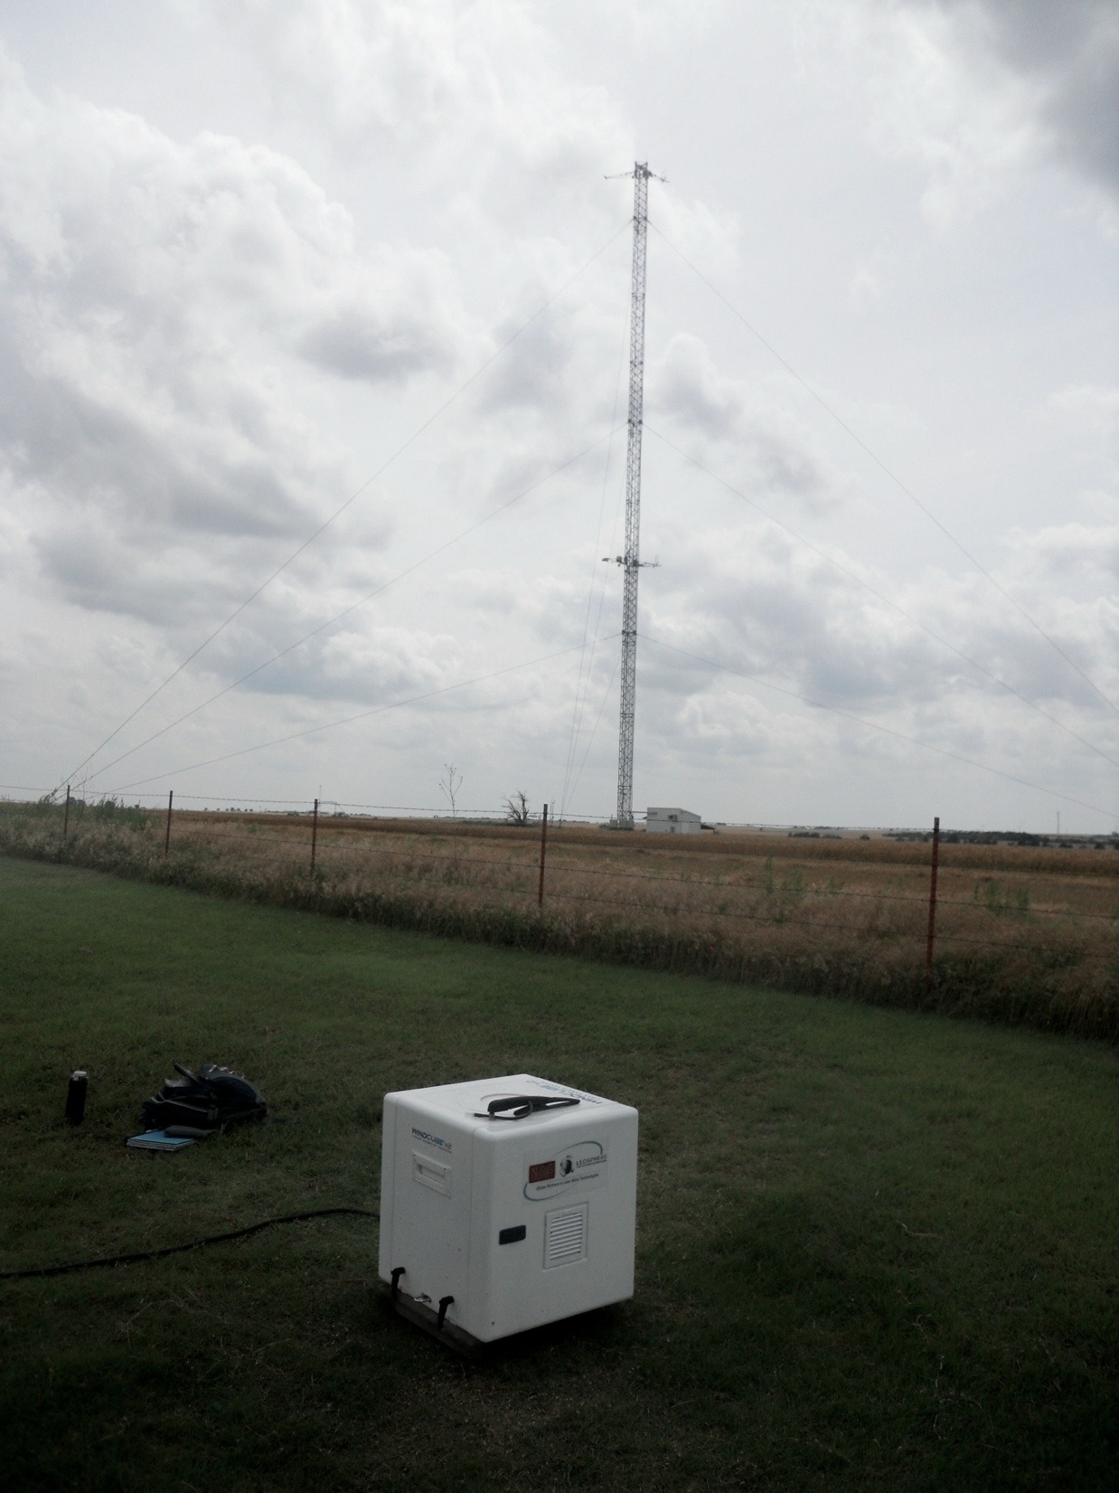
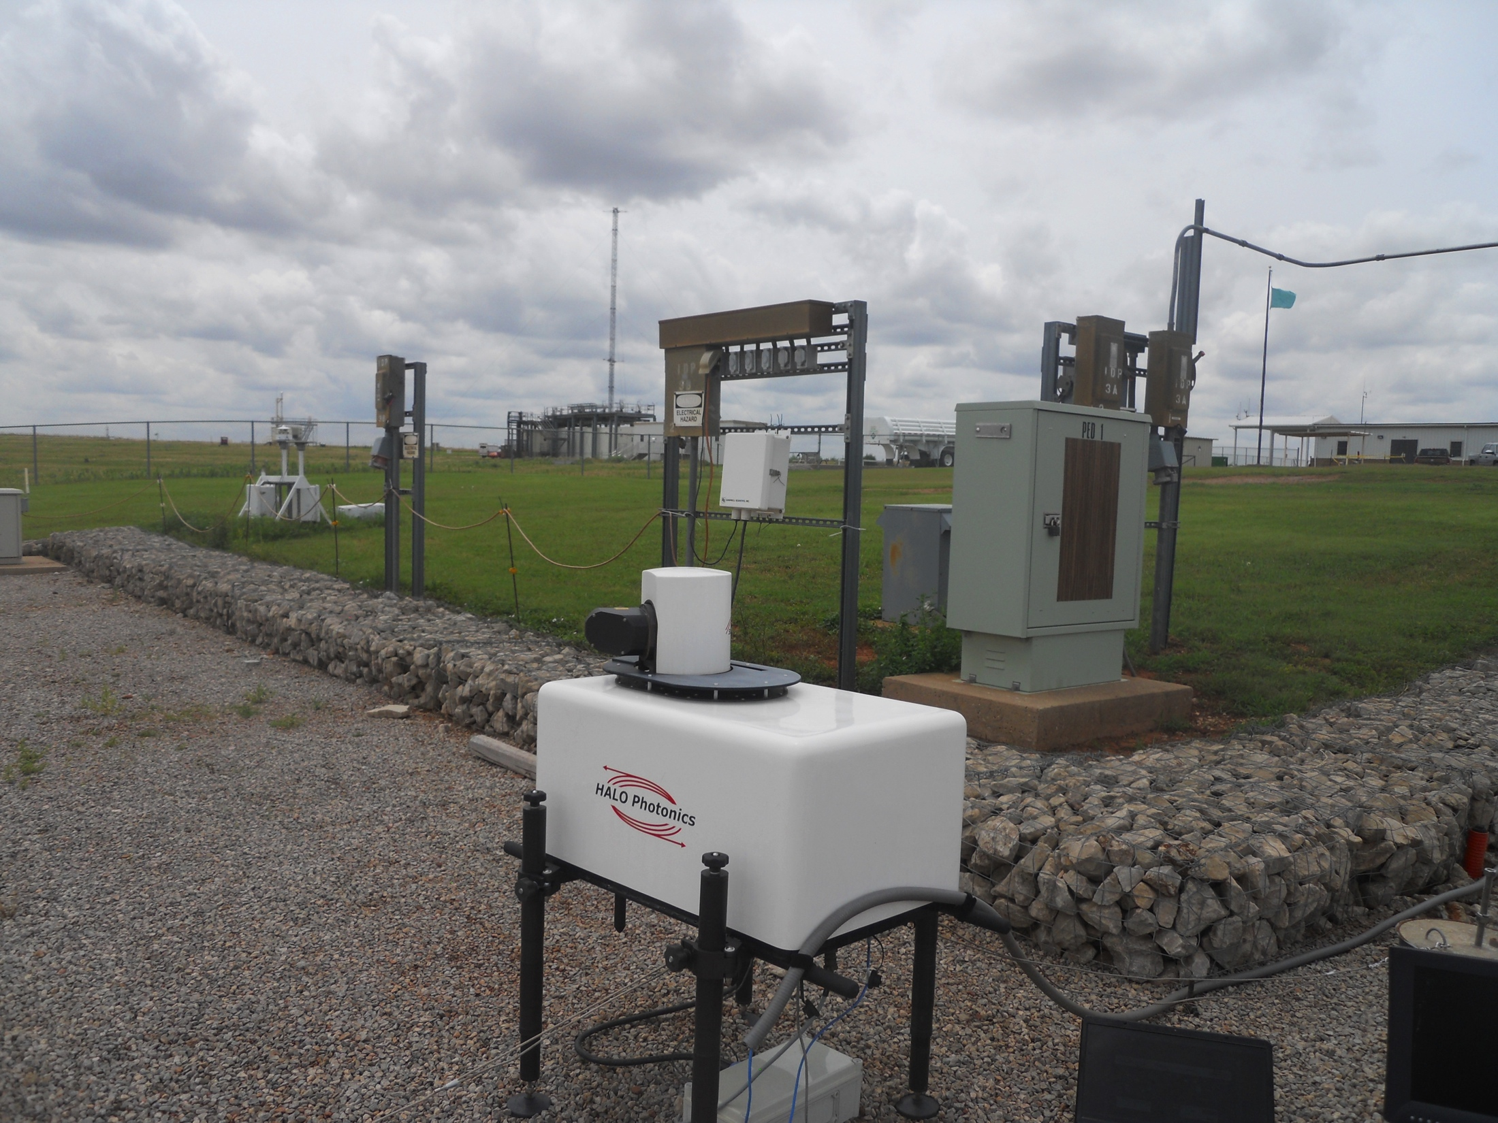
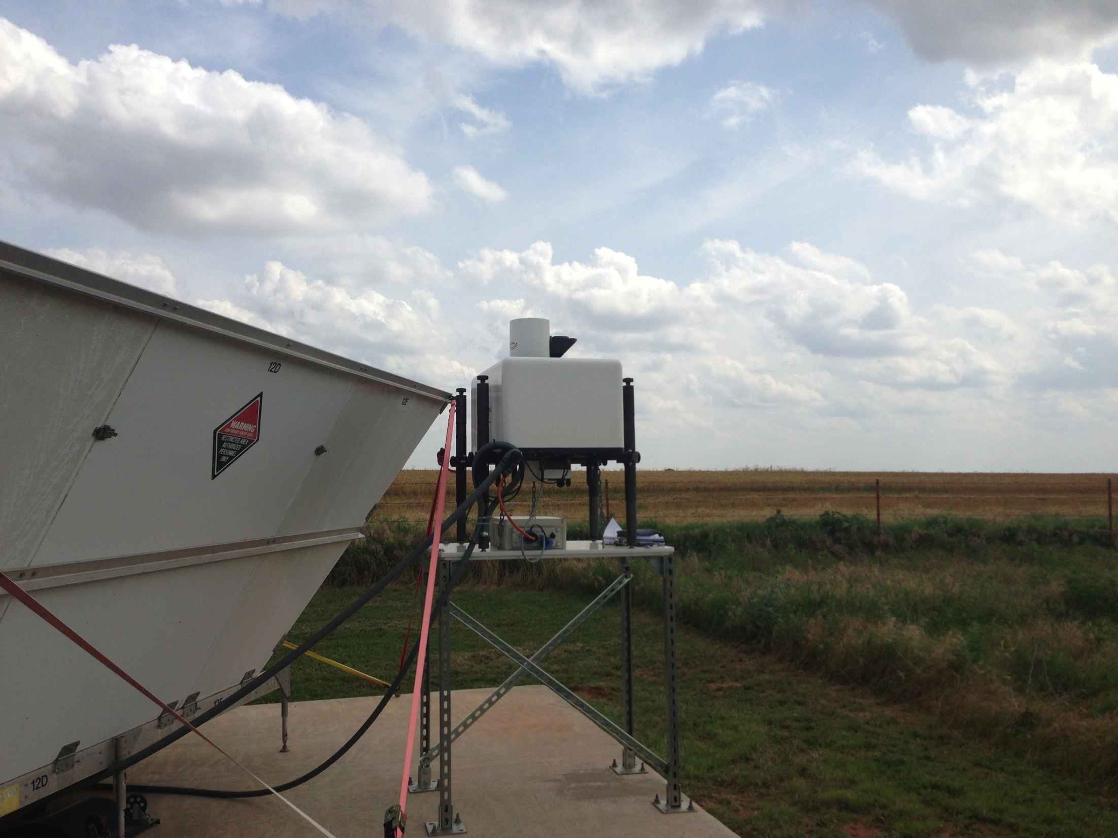
Formation of nocturnal low-level jets and structure of the nocturnal boundary layer
Petra Klein,
Tim Bonin, Jennifer Newman, Greg Blumberg, Charlotte Wainwright, Phil Chilson
School of Meteorology, University of Oklahoma
David Turner
NOAA National Severe Storms Laboratory, Norman, OK
Sonia Wharton
Lawrence Livermore National Laboratory

Slide 2
Introduction
Models often have difficulties simulating the mean and turbulent profiles in the NBL
Nocturnal low-level jet (LLJ) important feature of the nocturnal boundary layer (NBL) which is of great importance for wind energy and other applications
Different theories exist; two basic ones:
  Blackadar (1957): inertial oscillation triggered by reduction (or shut-off) of turbulent mixing after sunset
  Holton (1967): diurnal heating profile of east-west sloping terrain in Great Plains
  Shapiro and Fedorovich (2009) expanded Blackadar model and Du and Rottuno (2014) presented an analytical model that combines the two approaches
LLJ also affects turbulence structure

Slide 3
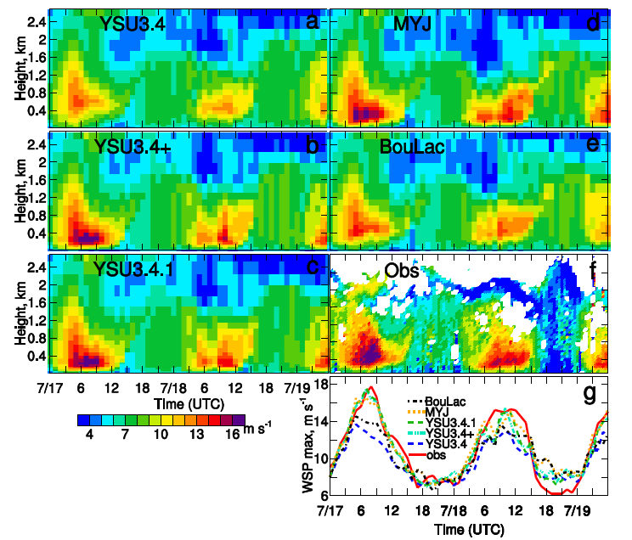
Hu et al., JGR, 2013

Slide 4
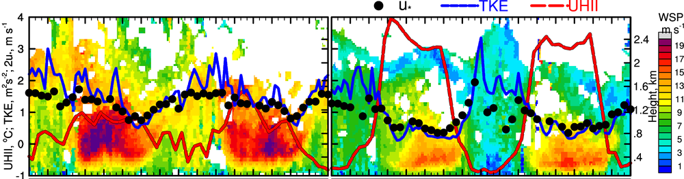
LLJ affects Urban Heat Island
Strong LLJ, weak UHI
Weak LLJ, strong UHI
Two contrasting episodes
Strong LLJ=>strong turbulence=>weak cooling in rural terrain around city
=>weak UHI
Weak LLJ=>weak turbulence=>strong cooling in rural terrain around city
=>strong UHI

Slide 5
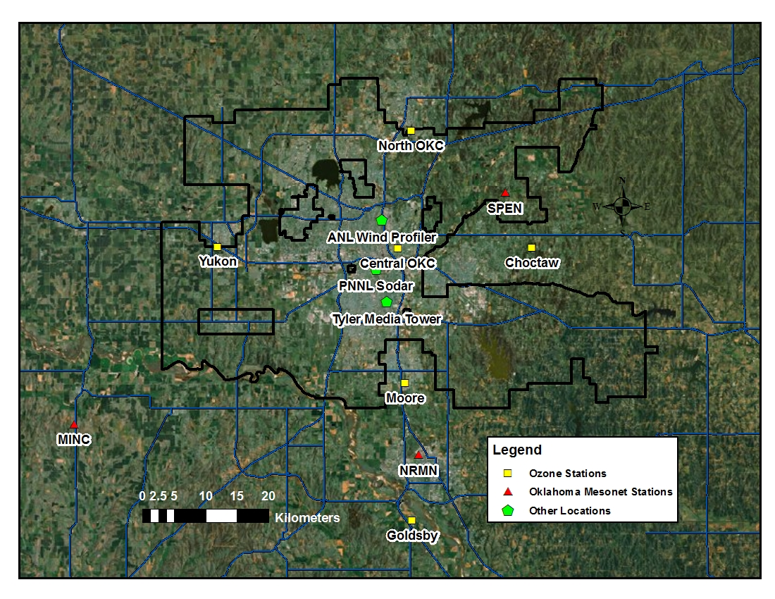
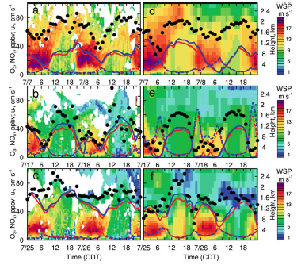
Ozone Concentrations in OKC during 3 Episodes
Observations WRF output

Slide 6
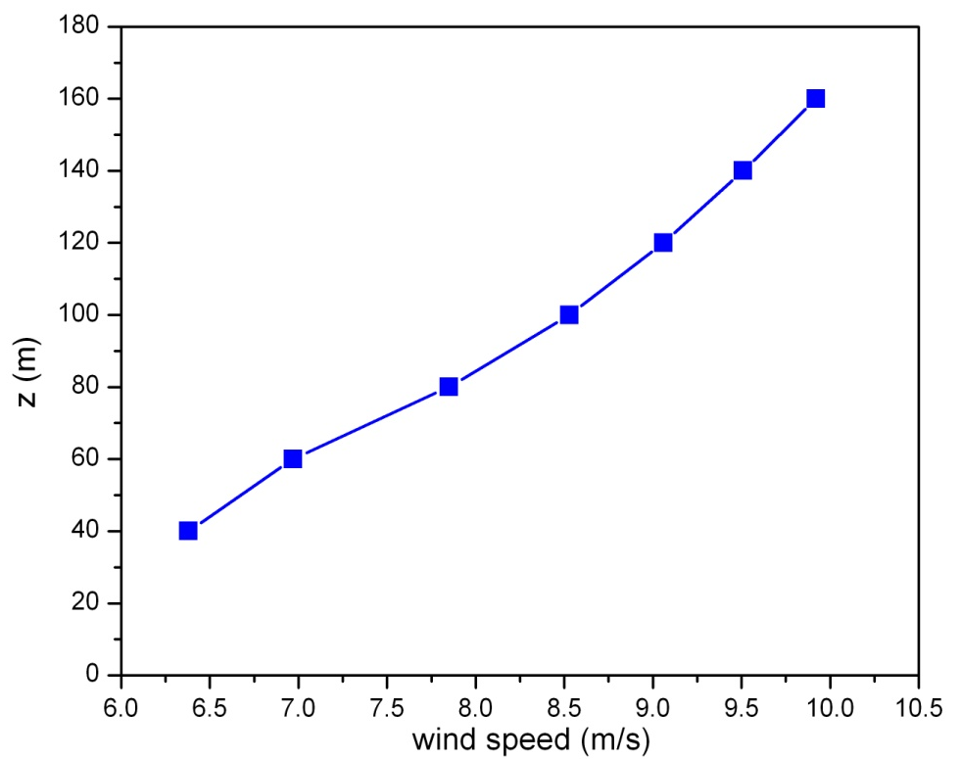
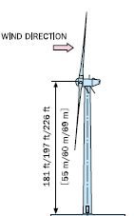
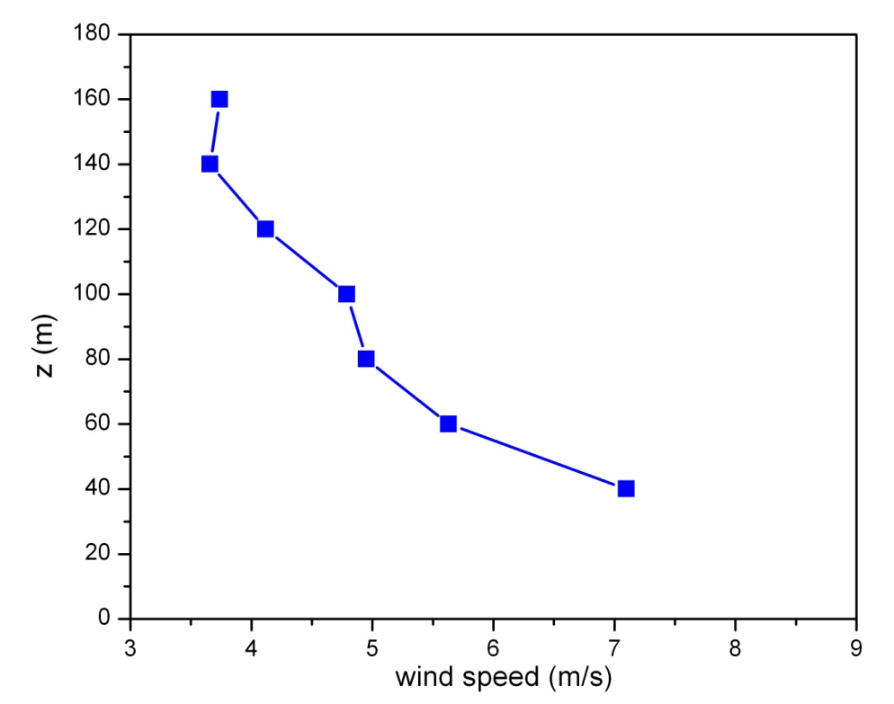
LIDAR rotor disk U = 7.4 m/s
LIDAR hub-height U = 7.0 m/s
Turbine nacelle U = 6.88 m/s
I_{U} = 10%
Direction shear = 2°
Power = 311 kW
Observed inflow conditions at the Altamont Pass Wind Farm
Include times of strong positive and negative wind shear, strong directional shear and high turbulence….all of which affect power generation
Typical nighttime stable flow
LIDAR rotor disk U = 5.6 m/s
LIDAR hub-height U = 5.6 m/s
Turbine nacelle U = 5.5 m/s
I_{U} = 23%
Direction shear = 18°
Power = 177 kW
These examples show that commercially available Lidars provide useful information about mean wind characteristics.
How well can we measure turbulence characteristics?
Nighttime flow with katabatic drainage flows

Slide 7
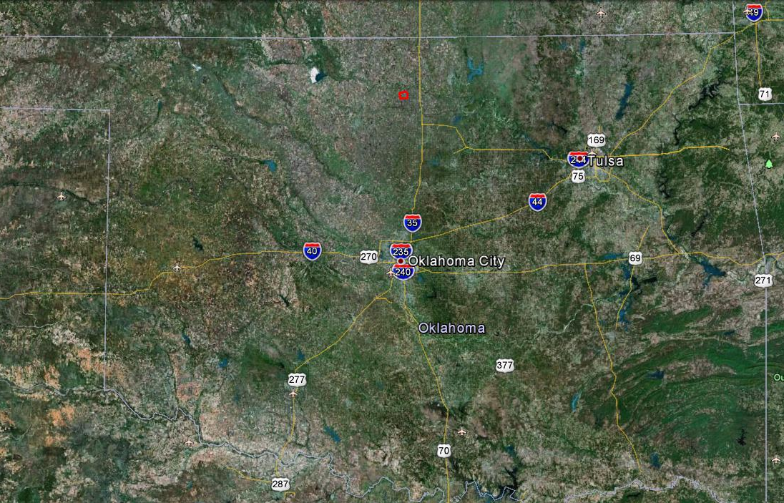
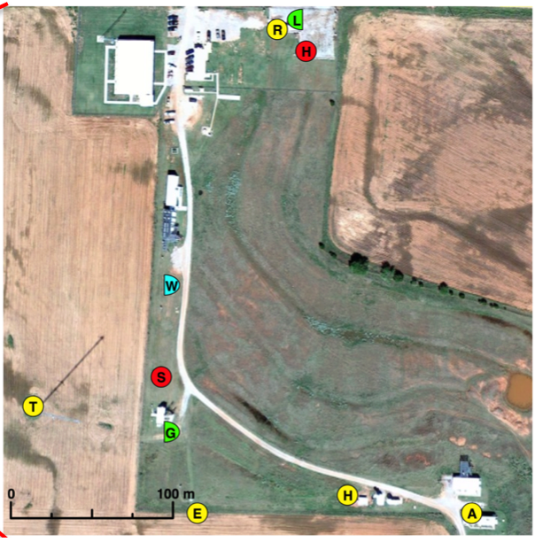
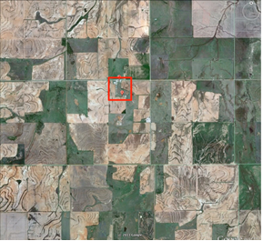
LABLE I and II Study Area
DOE SGP ARM Site
H- ARM Halo Lidar
R- Raman lidar
T- 60-m tower (sonics at 25,60 m)
E- 4-m Eddy Correlation and flux
A- AERI
H- OU Halo Lidar
S- Metek Sodar
L- Leosphere Lidar (I only)
G- Gallion Lidar (II only)
W–Windcube Lidar
LABLE I
Setup:
LABLE I: 09/18-11/13/12
LABLE II: 06/02-07/08/13

Slide 8
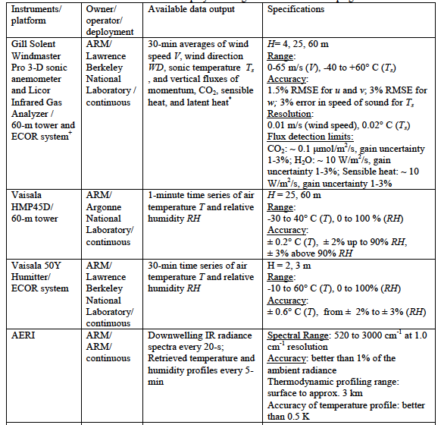
Key Instruments

Slide 9
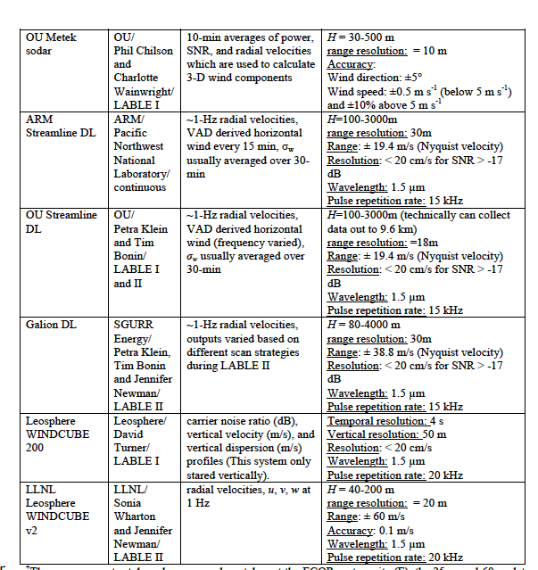
Sodar and Doppler Lidars

Slide 10
Instrumentation

Slide 11
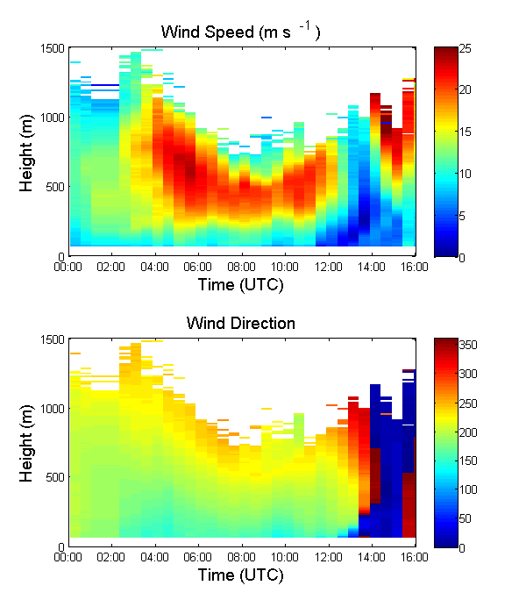
LLJs Observed During LABLE I
20 LLJs with peak winds of 10 m s⁻¹
  17 southerly, 3 northerly
Average LLJ core height ≈500 m AGL
  Varied between 250-1000 m AGL
Typical onset around 0-2Z (shortly after sunset)
  30% of LLJs began after 6Z
October 17

Slide 12
Summary of LLJ Properties during LABLE I

Slide 13
Instrument Comparison LABLE I
10/17/2012
5:30 UTC
11:30 UTC

Slide 14
Near-Surface Temperature Gradient
AERI vs. Radiosonde

Slide 15
Comparisons of 2 LLJ Cases
October 09, 2012
October 24, 2012

Slide 16
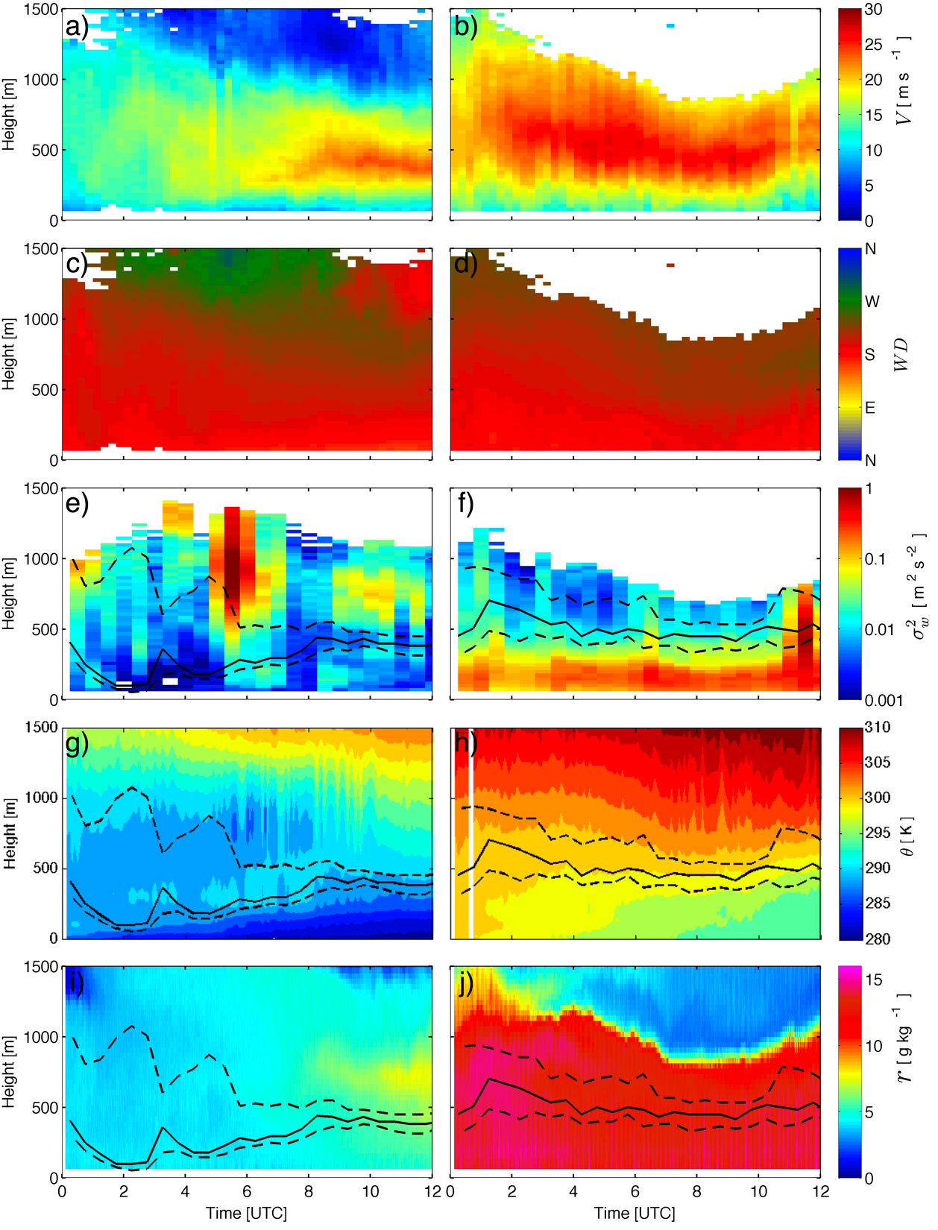
Comparisons of 2 LLJ Cases
October 09, 2012
October 24, 2012

Slide 17
Comparisons of 2 LLJ Cases
October 09, 2012
October 24, 2012
Blue: Bulk shear V_{LLJ}/Z_{LLJ}
Green: Potential temperature gradient (Θ_{LLJ}-Θ_{sfc}/Z_{LLJ}
Red: Mean vertical velocity variance below Z_{LLJ}

Slide 18
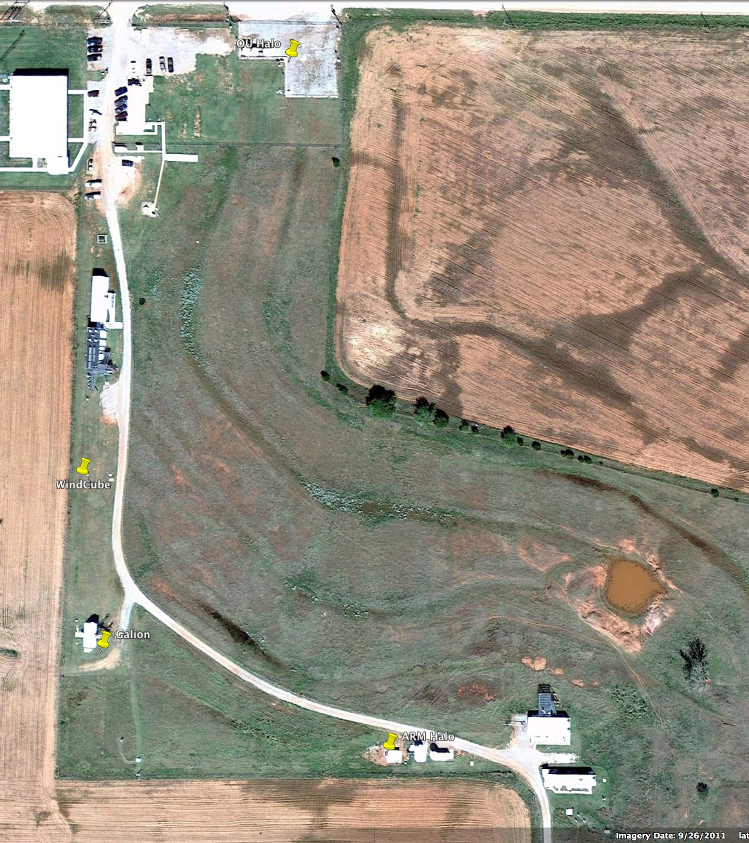
Dual-Doppler wind profile retrieval
OU Halo
L_{OU} • U = Vr_{OU}
L_{GAL} • U = Vr_{GAL}
x
Vr_{50m}
x
Vr_{70m}
x
Galion
x
Vr_{50m}
Vr_{70m}
x
x
Vr_{105m}
Vr_{120m}
Vr_{120m}
x

Slide 19
LABLE II Instrument Comparison
Wind Speed and direction from OU Halo Streamline and Gallion Dual Doppler analysis
Wind Speed and direction from ARM Halo Streamline VAD analysis

Slide 20
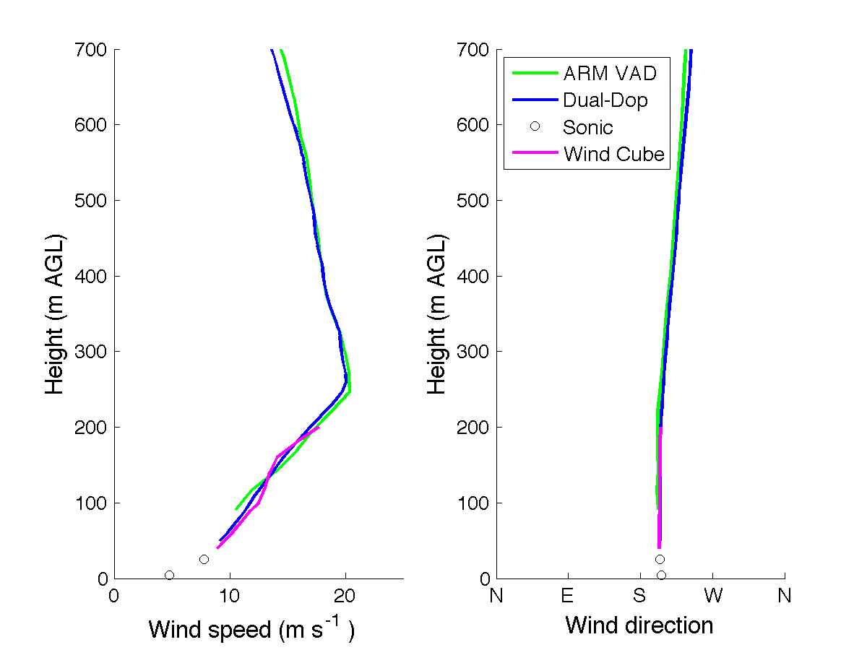
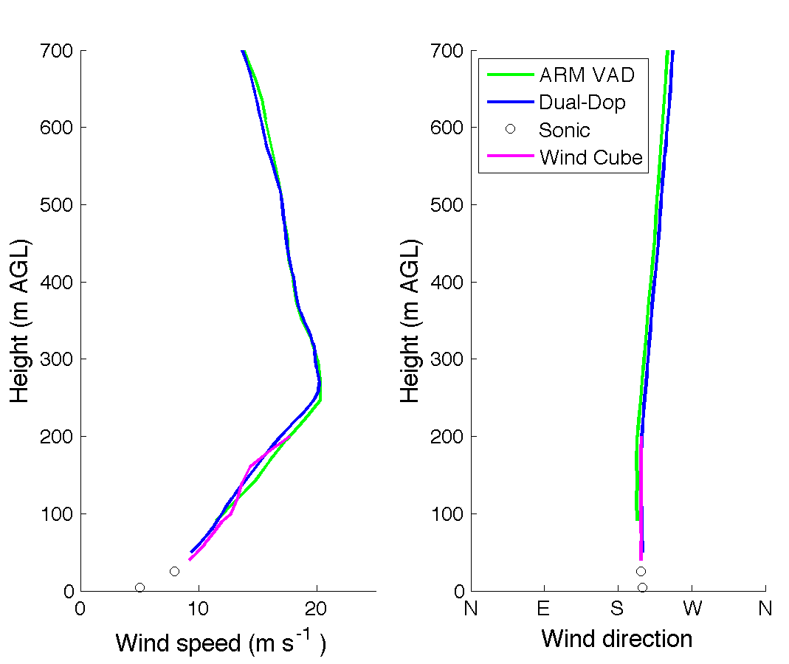
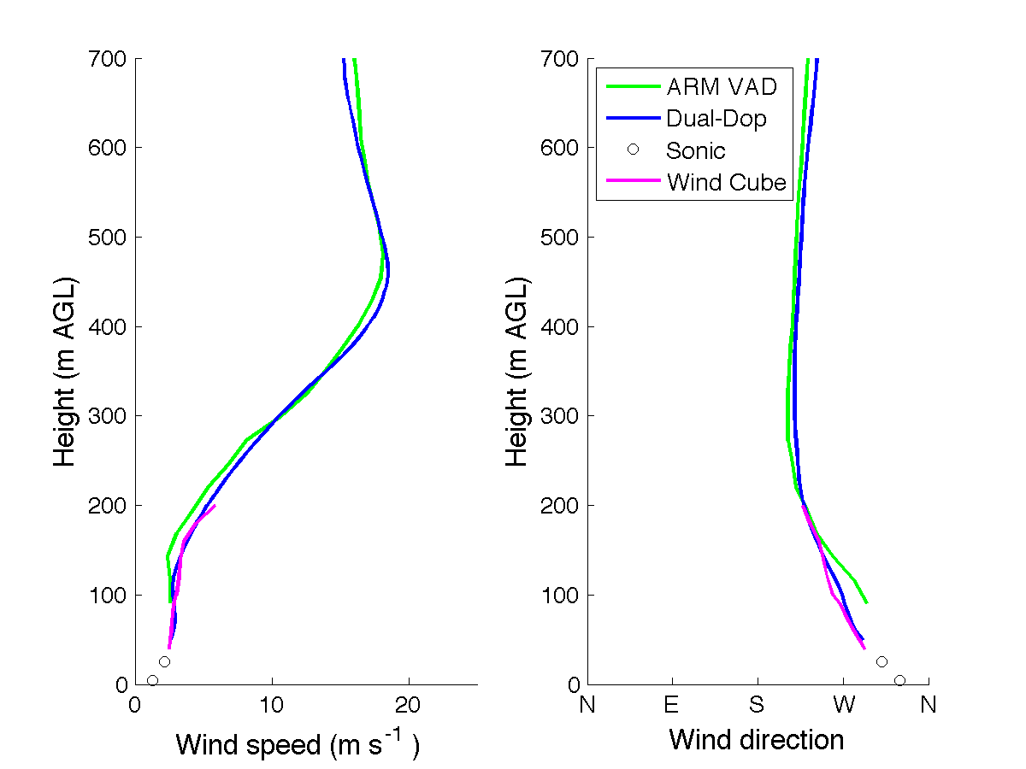
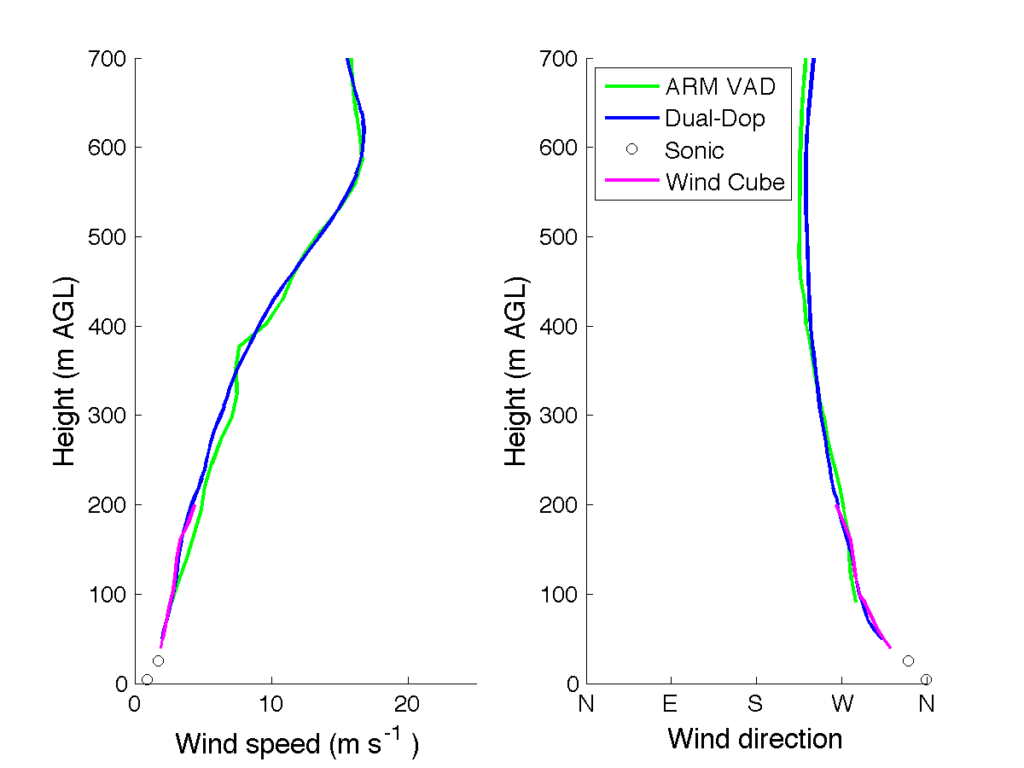
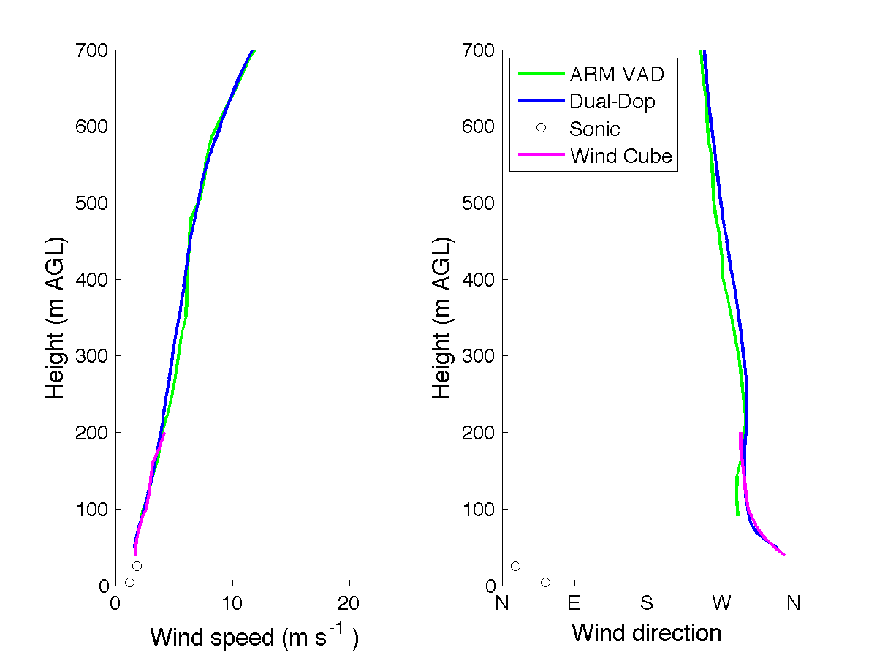
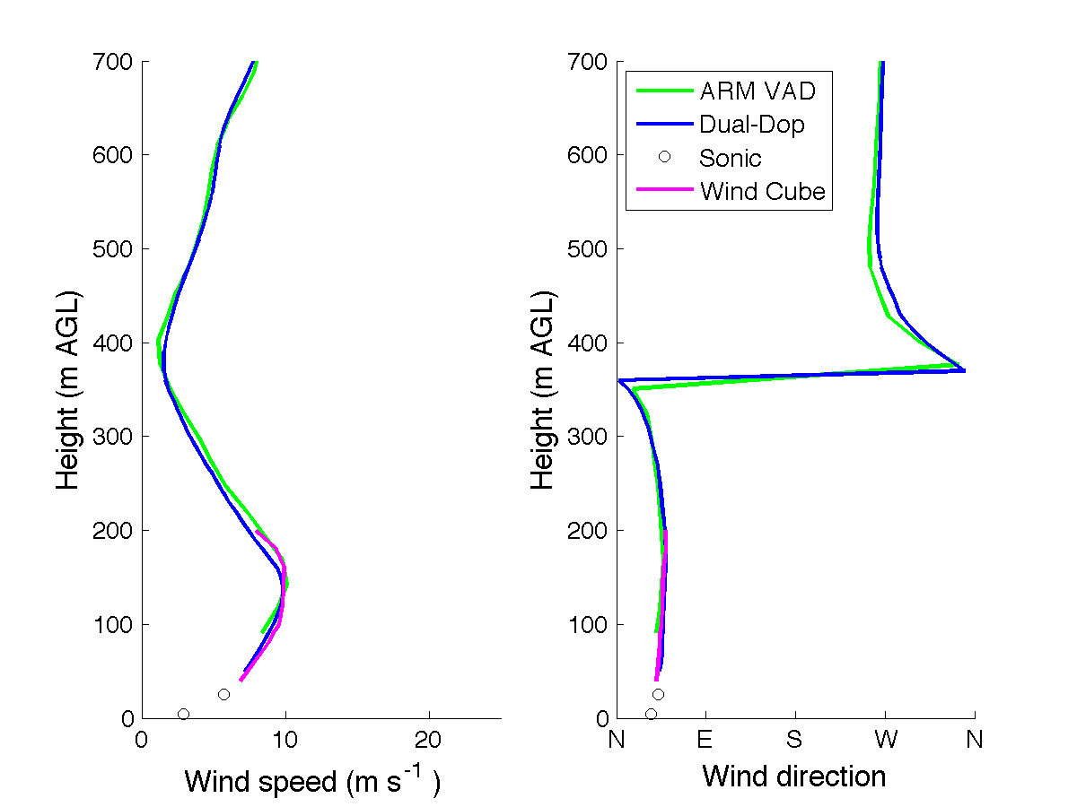
LABLE II 06/13/2013
0500 UTC 0600 UTC 0700 UTC
0800 UTC 0900 UTC 1000 UTC

Slide 21
Conclusions
Lidars measurements provide useful mean wind and turbulence data
  Not only at hub height but also across the entire rotor disk
Continuous monitoring with Lidars and AERI can provide detailed information about structure of the NBL and lead to new insights about development of LLJs
Different scanning strategies are being tested to further improve quality of Lidar turbulence measurements

Slide 22
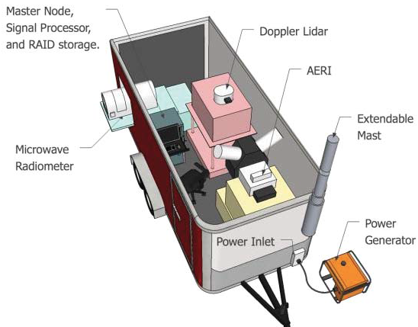
OU CLAMPS
Mobile facility which includes the OU HALO Streamline lidar, a Microwave profile, an AERI and a tower with surface observations.
Will be used in summer 2015 during PECAN project

Slide 23
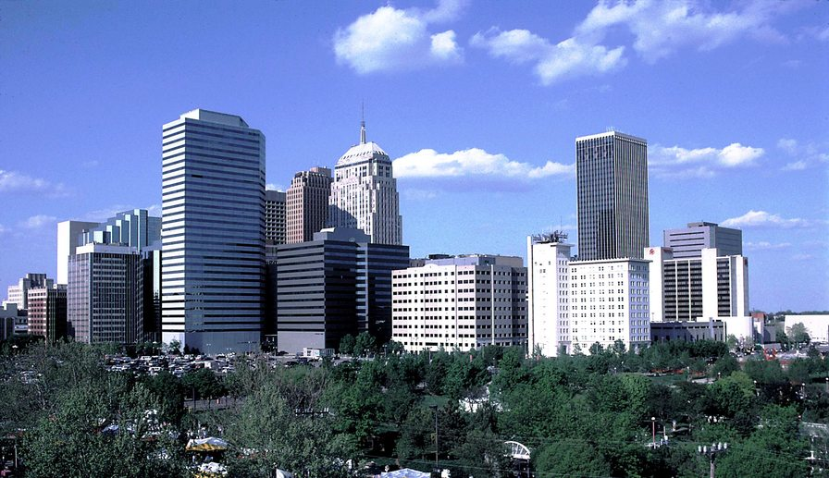
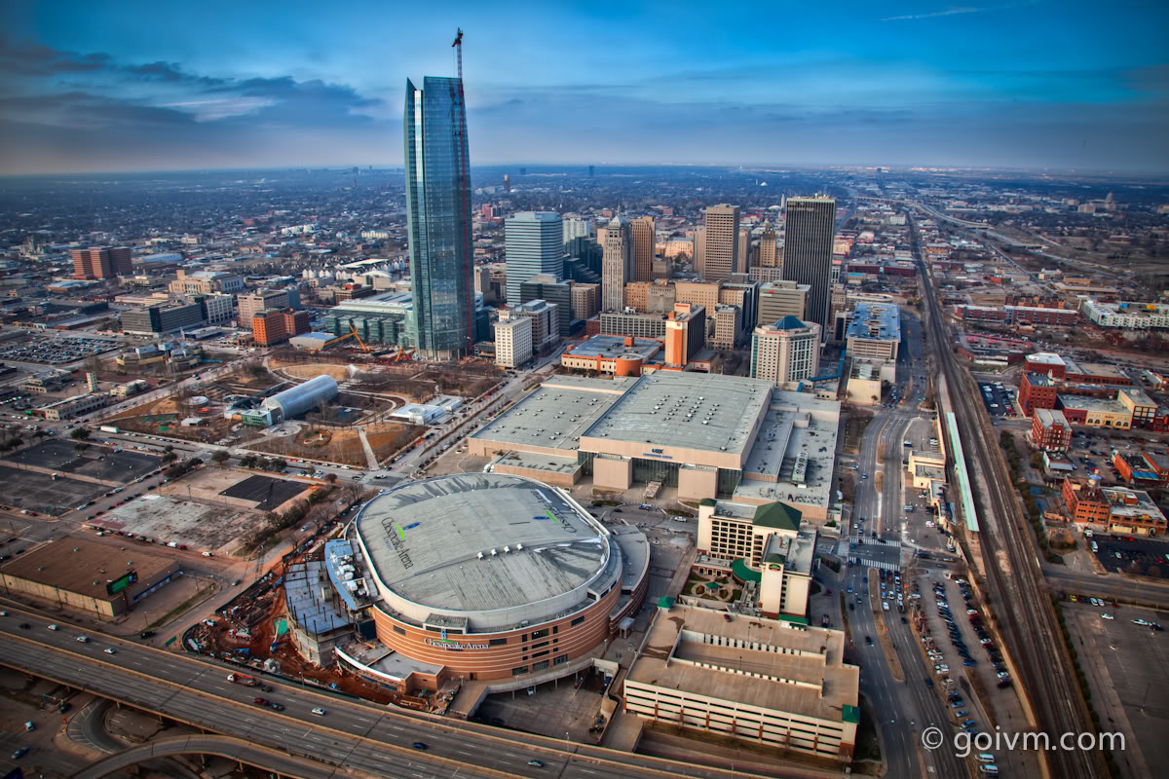
Urban Studies: Oklahoma City
Skyline in 2014
Skyline during JU2003

Slide 24
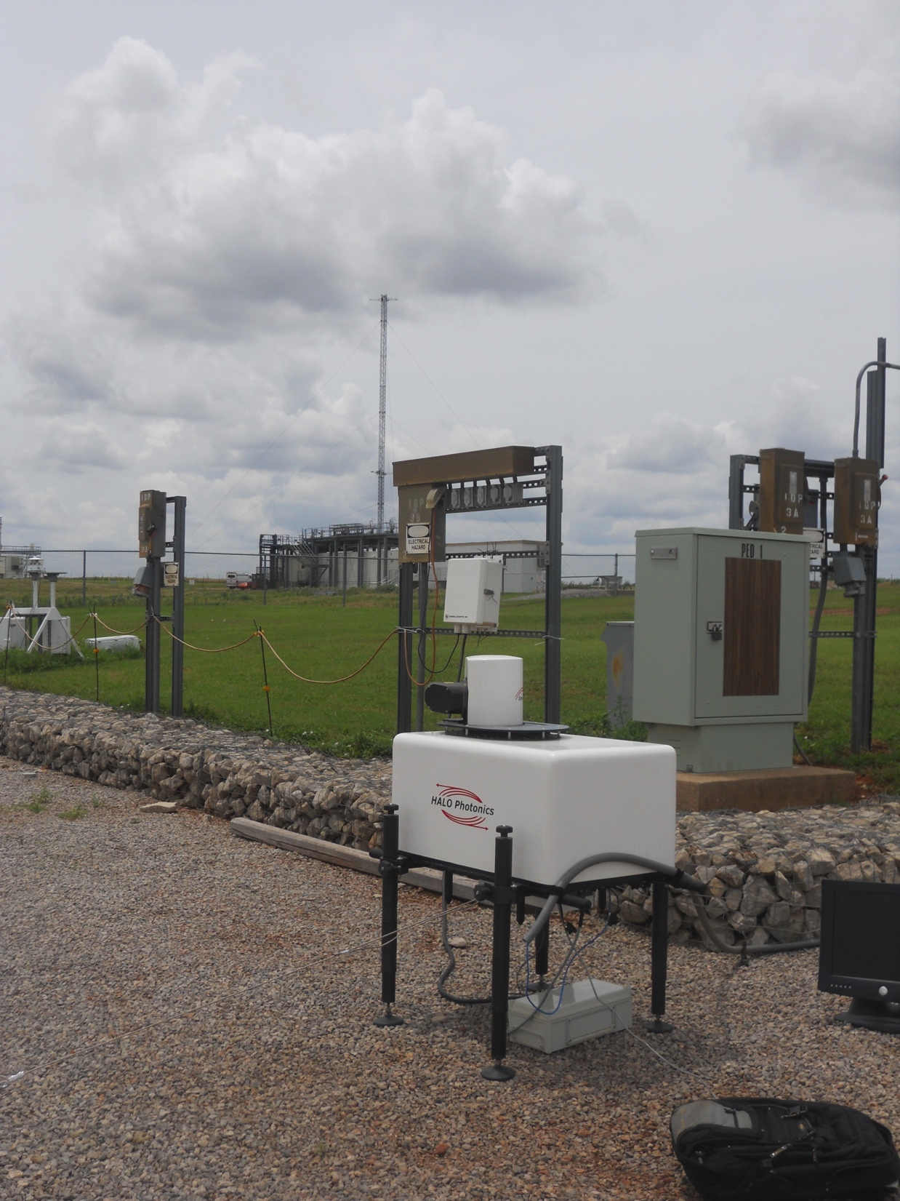
Streamline Halo Doppler Lidar
Pulsed heterodyne lidar
Minimum range ≈100 m
Eye-safe 1.5 μm wavelength
Capable of VAD, DBS, RHI, stare, and custom scans
Range resolution: 18 m (OU)
  30 m (ARM)
Maximum unambiguous velocity: 19.4 m s⁻¹
Maximum rated range: 9.6 km
60-m tower

Slide 25
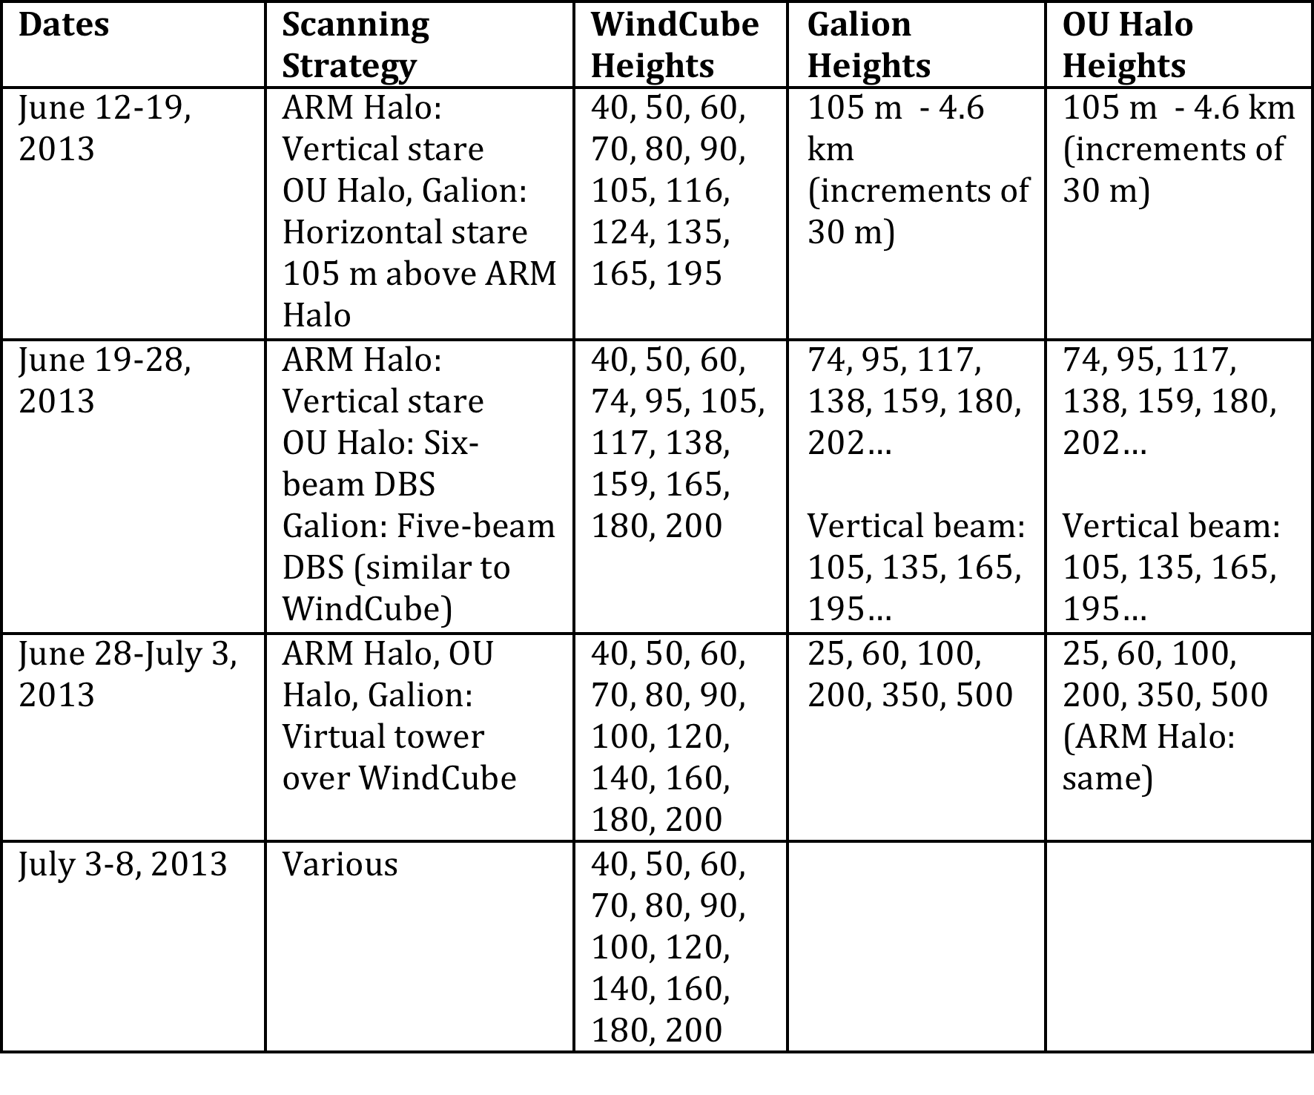
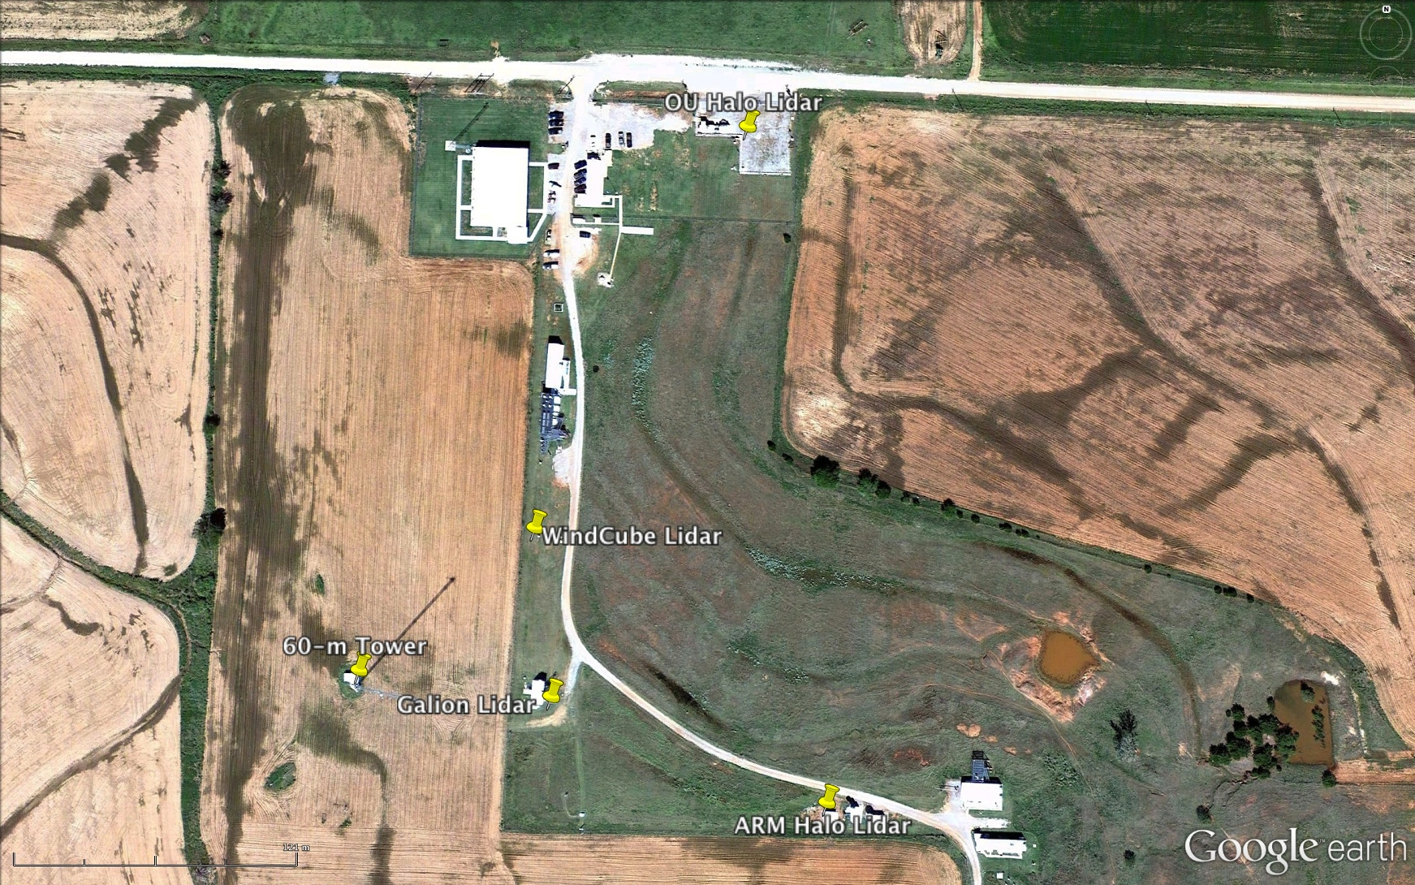
LABLE II

Slide 26
Instrument Comparisons
Sodar vs. Sonic at 60m

Slide 27
Instrument Comparisons
Sodar vs. Lidar at 90m and 160m

Slide 28
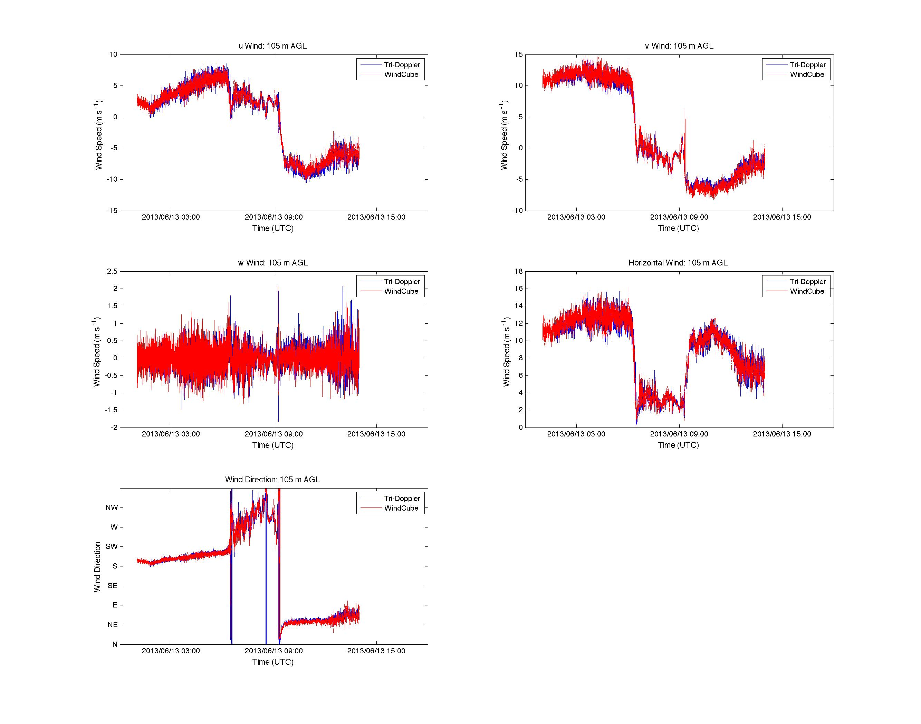
u-comp.
v-comp.
w-comp.
V_{hor}
1s measurements of the 3 wind speed components, horizontal wind speed, and wind direction
WD

Slide 29
Tri-Doppler –WindCube comparison
Tri-Doppler
WindCube

