Slide 1



UNCLASSIFIED / APPROVED FOR PUBLIC RELEASE
Mesoscale and Microscale
Atmospheric Modeling and Sensing at
Army Research Laboratory
Mr. Dave Knapp and Dr. Robb Randall
Battlefield Environment Division
Computational and Information Sciences Directorate
Workshop on Microscale Modeling of Complex-Terrain Flows
25-26 Sep 2014
UNCLASSIFIED / APPROVED FOR PUBLIC RELEASE

Slide 2
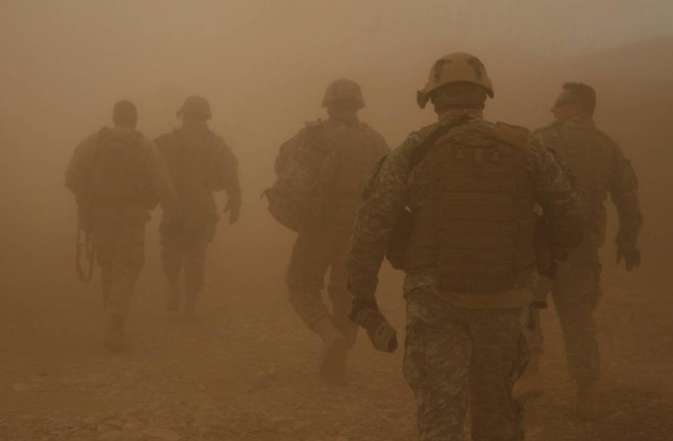
Battlefield Environment Division Strategy
Unique Ground Operations Challenges
The Army fights in the atmospheric boundary layer at fine temporal and spatial scales.
The boundary layer processes are not well understood especially over complex terrain including mountain and urban domains.
Key FOCUS Areas
Develop fine-scale atmospheric models that support Army missions.
Exploit and mitigate atmospheric effects on military systems.
Characterize the environment with innovative sensing tools and techniques with emphasis on the boundary layer.
Impact
Actionable atmospheric information for Solider decisions.

Slide 3
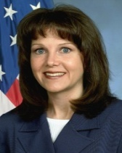
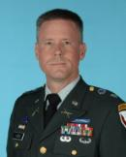
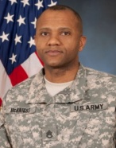
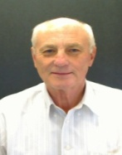


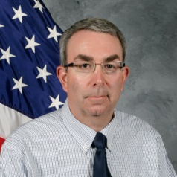

Battlefield Environment Division
Chief
Battlefield Environment Division
Pamela Clark
Associate Chief
Battlefield Environment Division
Terry Jameson
COL John
Olson
SSG Mitchell
McKnight
Dr. Thomas
Vonderhaar
Adelphi, MD
White Sands Missile Range, NM
CHIEF
Atmospheric Sensing
Branch (ASB)
Chatt Williamson
CHIEF
Atmospheric Modeling Branch (AMB)
David Knapp
CHIEF
Atmospheric Dynamics
Branch (ADB)
Dr. Sean O’Brien
Environmental Sensing
EO/Acoustic Propagation
Aerosol Research
Intelligent Optics
Nowcasting & Data Fusion
Microscale Met Models
Probabilistic Forecasting
Model & Product Assessment
Boundary Layer Research
Decision Support Tools
Turbulence & EO effects
Web Enabled Applications
Total 47 Personnel

Slide 4
Battlefield Environment Capabilities
RESEARCH | FOCUS | TRANSITION
Atmospheric Sensing | Environmental Sensing Aerosol Research Propagation (Acoustic) Intelligent Optics | Research & develop applications of sensing systems and techniques Characterize bio-aerosols & weather processes interactions Develop acoustic models for improved sensor performance Develop adaptive optics & reduce long-range propagation effects on directed energy
Atmospheric Modeling | Nowcast Modeling Microscale Modeling Model and Product Assessment | Develop next generation mission execution forecast model (Nowcast) Develop the next generation ABLE 3D hi-res prognostic model & optimize run time Assess Nowcast & weather tool accuracy & value added to Warfighter
Atmospheric Dynamics | Boundary Layer Research Decision Support Tools Turbulence and EO Effects Bio-inspired Applications Networked Weather Services | Establish a Meteorological Sensor Array (MSA) Develop and transition air/ground route optimization and mobile weather tools Develop THz propagation models and passive adaptive optics for turbulence mitigation Wind gust rejection for autonomous vehicles Build web services & new/improved weather decision products for all echelons
Notes:
4

Slide 5
Personnel Profile
Education Profile
Career Field
4 Electronic Engineers
1 Computer Engineer
1 Mechanical Engineer
1 General Engineer
3 Computer Scientists
6 Physical Scientists
13 Meteorologists
11 Physicists
1 Mathematician
5 Technicians
1 Admin / Secretary
Personnel by Office
FY13 Degrees Awarded
PhD: 1
Masters: 2
Two ARL Fellows!

Slide 6
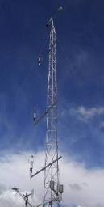
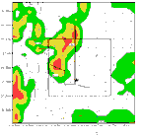
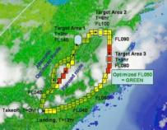
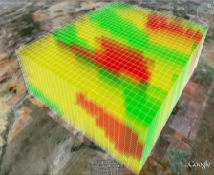
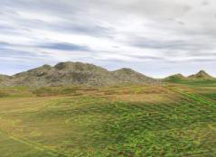

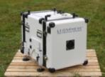
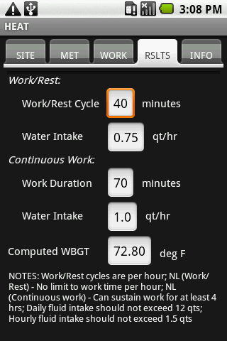


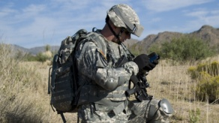
Tactical Weather Data and Products
Theater Scale
Forecast
Army Nowcasting
Weather Impacts/
Small Unit Decision
Support Tools
>3 hr forecasts
0-3 hr local tailoring
of Theater grids
Theater & nested
grids for decision aids
5-15 km grid res.
Local Battlefield
Observations
<1 km grid res.
Impacts/effects
at each grid point
Impacts Routing
Forward Area Observations
Weather Running Estimate-Nowcast Predictions
MyWIDA
Physics Based Micro-MET
& Effects Modeling/Simulation
Mobile Apps

Slide 7
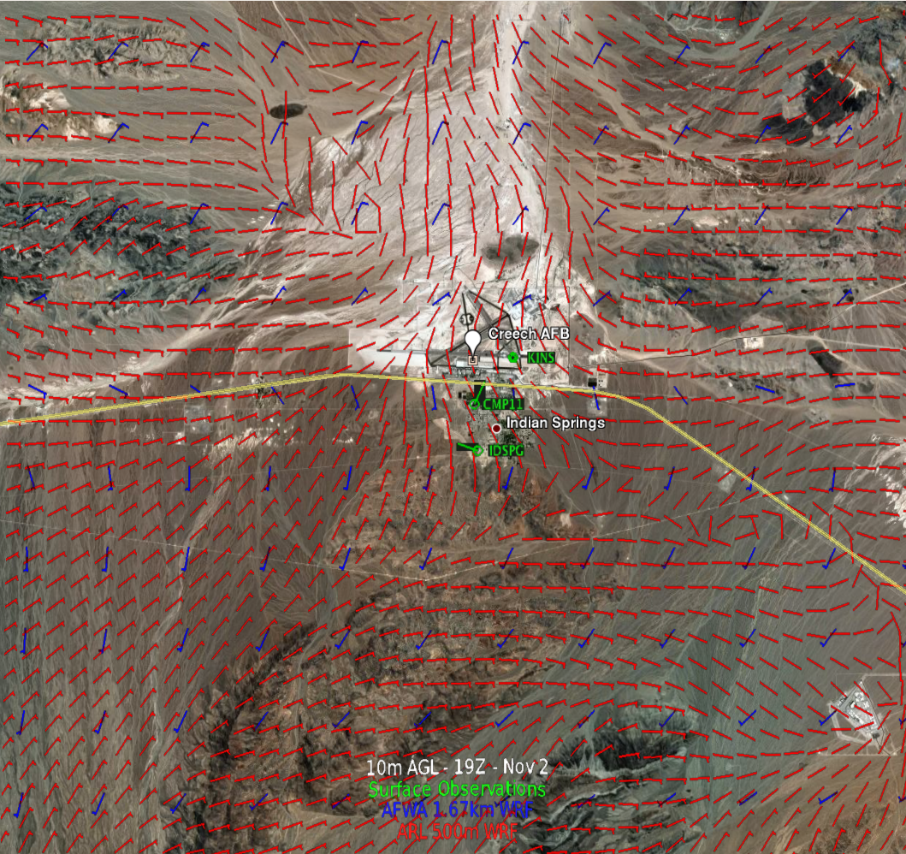
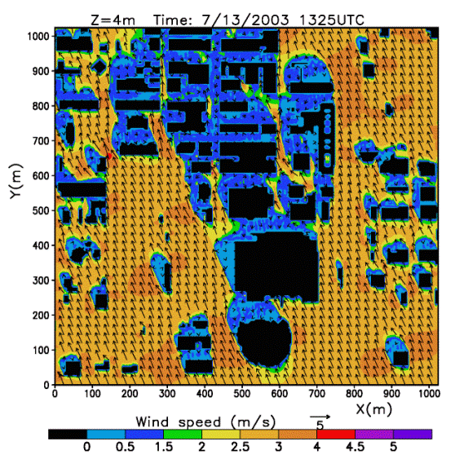
Atmospheric Modeling Branch
VISION: To be the acknowledged leader providing computationally feasible & accurate Nowcasting and micro-scale modeling capabilities for tactical echelons.
MISSION: To provide Warfighters at the tactical echelons the most accurate and timely battlefield mission execution weather data and assessment products.
Tactical-scale weather forecast & mission-tailored “Nowcast” models
Bridging the tactical- to soldier-scale forecast capability gap
Microscale (Soldier-scale) models
Warfighter Value Assessment
OBJECTIVES: Real-time short-term weather predictions for soldier ops
  Develop next generation mission execution forecast model (Nowcast).
  Develop high resolution microscale model for diverse domains.
  Assess Nowcast & Microscale model accuracy & value added to Warfighter.

Slide 8
Mesoscale Nowcast Modeling
Goal:
  Develop a Weather Running Estimate-Nowcast model (WRE-N) that functions at <1 km grid spacing by
  extending the Advanced Research version of the Weather Research and Forecast (WRF-ARW) model to sub-km nesting;
  using & improving observation nudging four dimensional data assimilation (FDDA);
  exploring nudging/variational DA hybrids, for example FDDA & NOAA V-LAPS.
Scientific Objective:
Full-physics Nowcast capability to address scale gaps between existing operational modeling resolutions and the unique needs of the Army.
  How we are getting there:
    Combined FDDA & nudging-3DVar data assimilation methodology for ingest of radar/lidar & satellite observations (e.g.; V-LAPS) into WRE-N.
    “WRF on a laptop” for portability; long-term…ensemble WRF on laptop.
    Improve WRF modeling & nudging at sub-km grid spacing.
    New verification tools like NCAR MET & GIS to assess model accuracies and optimal sensor placement.
Notes:
FNMOC: Fleet Numerical Meteorology and Oceanography Center

Slide 9
Mesoscale Nowcast Modeling
Research Approach:
  Test the WRF model over challenging terrain & meteorological environments at <1 km grid spacing → develop improved understanding of model strengths/weaknesses at “terra incognita” scales.
  Strengthen current & develop new collaborations in Gov’t, DoD, & academia to accelerate this process.
    NCAR, NOAA, NRL, AFRL, Colorado State, Penn State, San Jose State, University of Wisconsin-Milwaukee, Mississippi State University, Oklahoma, UTEP, University of Utah, Notre Dame…
  Improved data assimilation and spatial analysis methods both for real-time WRE-N data ingest and for developing WRE-N observation targeting strategies.

Slide 10
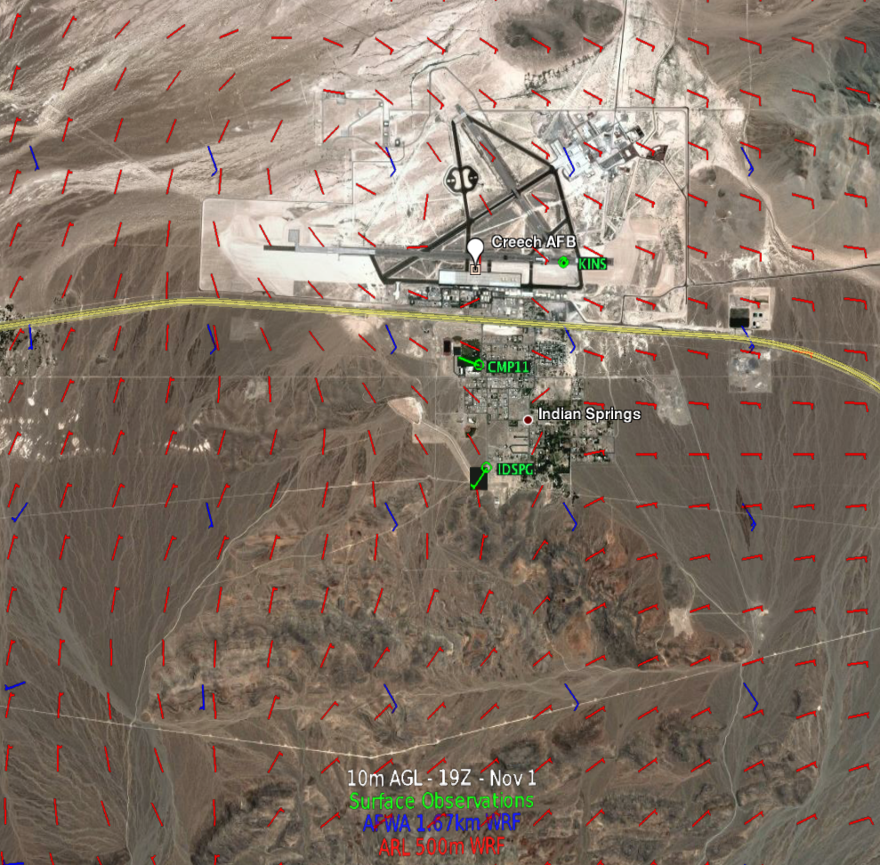
Mesoscale Nowcast Modeling
1 KM WRF/ WRE-N Studies
Influences of High-Resolution Terrain

Slide 11
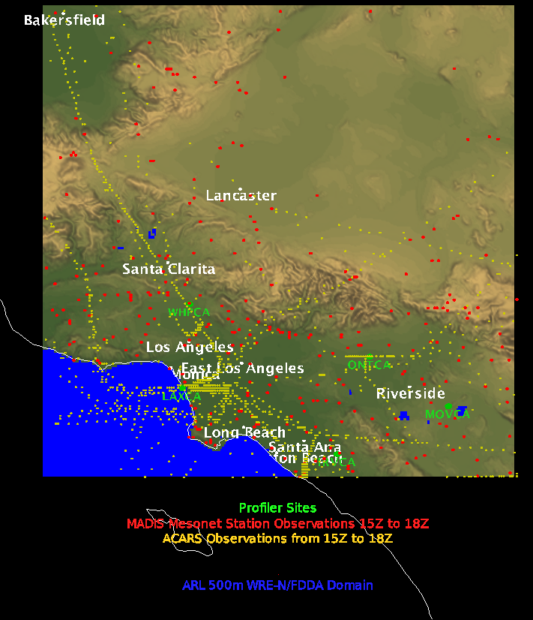
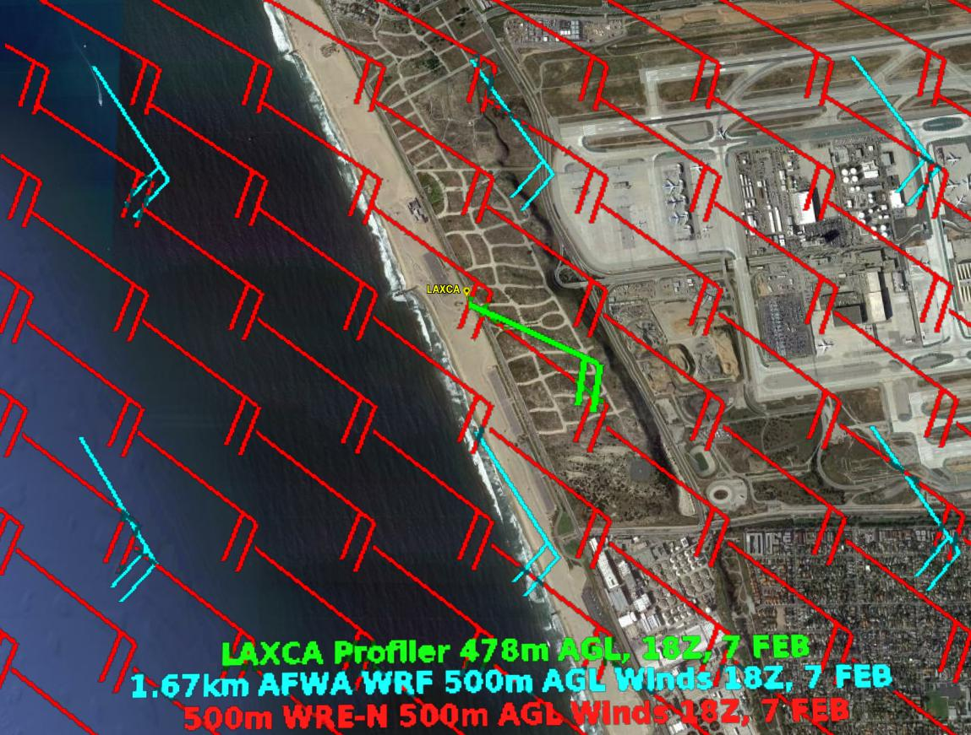
Mesoscale Nowcast Modeling
Verification Studies
Using GIS Tools to Enhance Model Verification

Slide 12
Microscale Modeling
Goal:
Develop advanced full-physics microscale atmospheric prediction model for applications in urban and complex terrain domains.
The Atmospheric Boundary Layer Environment model (ABLE)
    1~100m spatial resolution
    1~15 min temporal resolution
  Significant leap forward from the current 3-D Wind Field model (3DWF), a diagnostic wind model
Scientific Objectives:
Couple & predict/simulate wind, temp, radiation, moisture, pollutant transport
    Develop 3D ABLE LBM (Lattice Boltzmann Method) that includes turbulence, validating the results with lab and field results
    Extend current ABLE TCFD (Traditional CFD) to complex terrain using the immersed boundary method, turbulence model.
Develop new algorithms/methods for different computer platforms (e.g. HPC, GPU) for numerical modeling atmospheric flow and transport.
Notes:
Acronyms:
TPA: Technology Planning Agreement
TRL: Technology Readiness Level
FTE: Full Time Equivalent

Slide 13
Microscale Modeling
Research Approach:
Apply the most advanced atmospheric sciences and computational technologies to improve ABLE’s accuracy and efficiency.
ABLE development involves iterative test and validation processes.
      Test for correctness of computer code via flow simulations.
      Test and validate more complex flows observed in the real atmospheric boundary layer in complex terrains and urban environments.
  Research Process:
    Turbulence models implemented in the 3D ABLE (both in LBM and TCFD) model
    Treatment for complex terrain & urban in both LBM and TCFD model components
    Parallel code development for HPC platform
    Massively parallel code development for GPU/MIC platform
    Development of GUI using the web GIS
ABLE will be much more accurate & more versatile for Army applications. But…ABLE will use more computing resources → the algorithms must be efficient on parallel and massively parallel systems

Slide 14
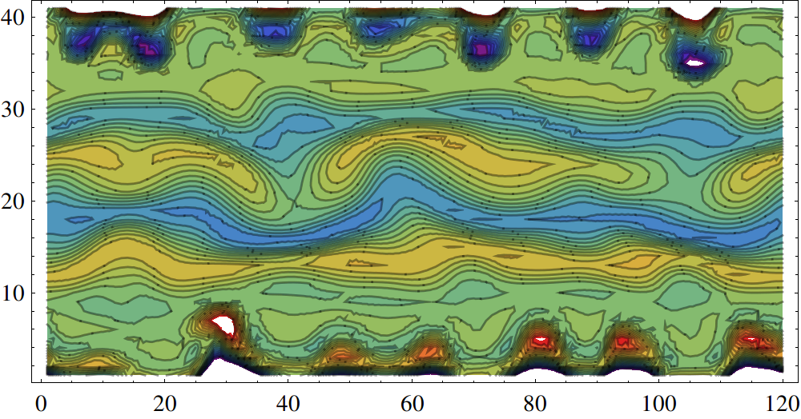
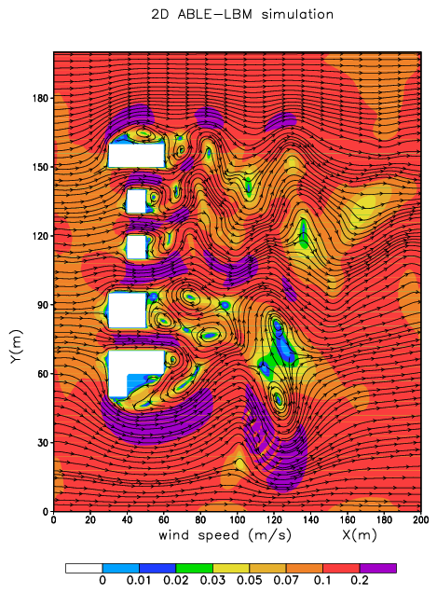
Microscale Modeling
Where we’re going:
ABLE modeling of KH wave instability
Where we’ve been:
3DWF in Oklahoma City
ABLE modeling flow around buildings

Slide 15
Development of a Meteorological Sensor Array at White Sands Missile Range
UNCLASSIFIED / APPROVED FOR PUBLIC RELEASE
PI: Robb M. Randall, PhD
UNCLASSIFIED / APPROVED FOR PUBLIC RELEASE

Slide 16
Objective and Vision
Vision
Develop a reliable, sustained, and world-class resource that has ability to:
  Address a community need for high resolution observational data for developing and evaluating high resolution mesoscale forecast models.
  Integrate a high-quality observational resource with state of the art V&V tools to provide the best possible meso/micro scale decision aids/applications.
  Explore new phenomena and analysis methods in weather forecasting.
  Ability to verify/validate sensor development
Objective
To improve decisions by strengthening environmentally-dependent decision aids through validated high resolution atmospheric models in the boundary layer.
To provide reliable and persistent data resources that allow atmospheric modelers and sensor developers to validate and compare performance in terrain of varying complexity.

Slide 17
Technical Barriers and Approach
Technical Barriers
High resolution atmospheric data are difficult to find, but high resolution (<1km) atmospheric data are needed to develop and improve decisions aids.
Models and measurements usually do not coincide on the same grid resolution, leading to assessment uncertainties.
Technical Approach
ARL is designing a meteorological sensor array driven by model grid requirements.
To best address model V&V requirements, ARL is pursuing traditional and non-traditional model validation and verification methods.

Slide 18
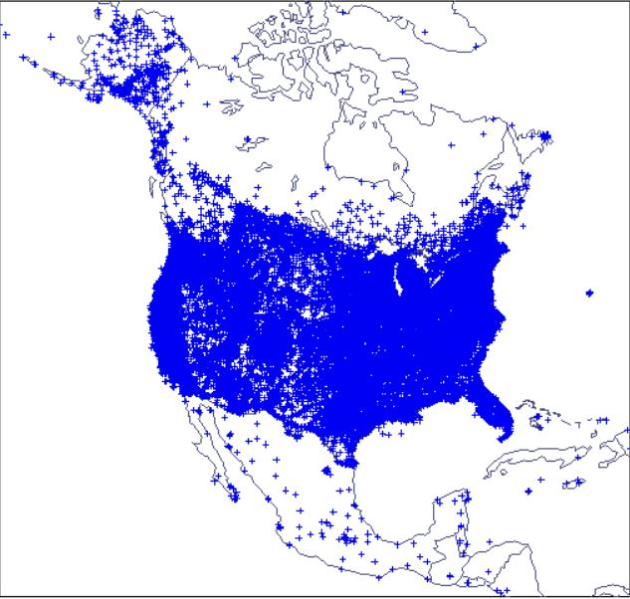
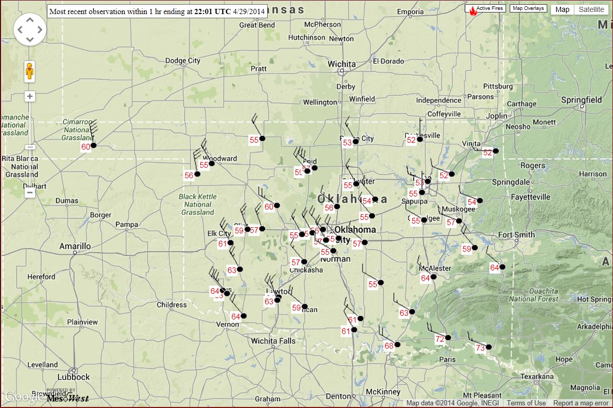
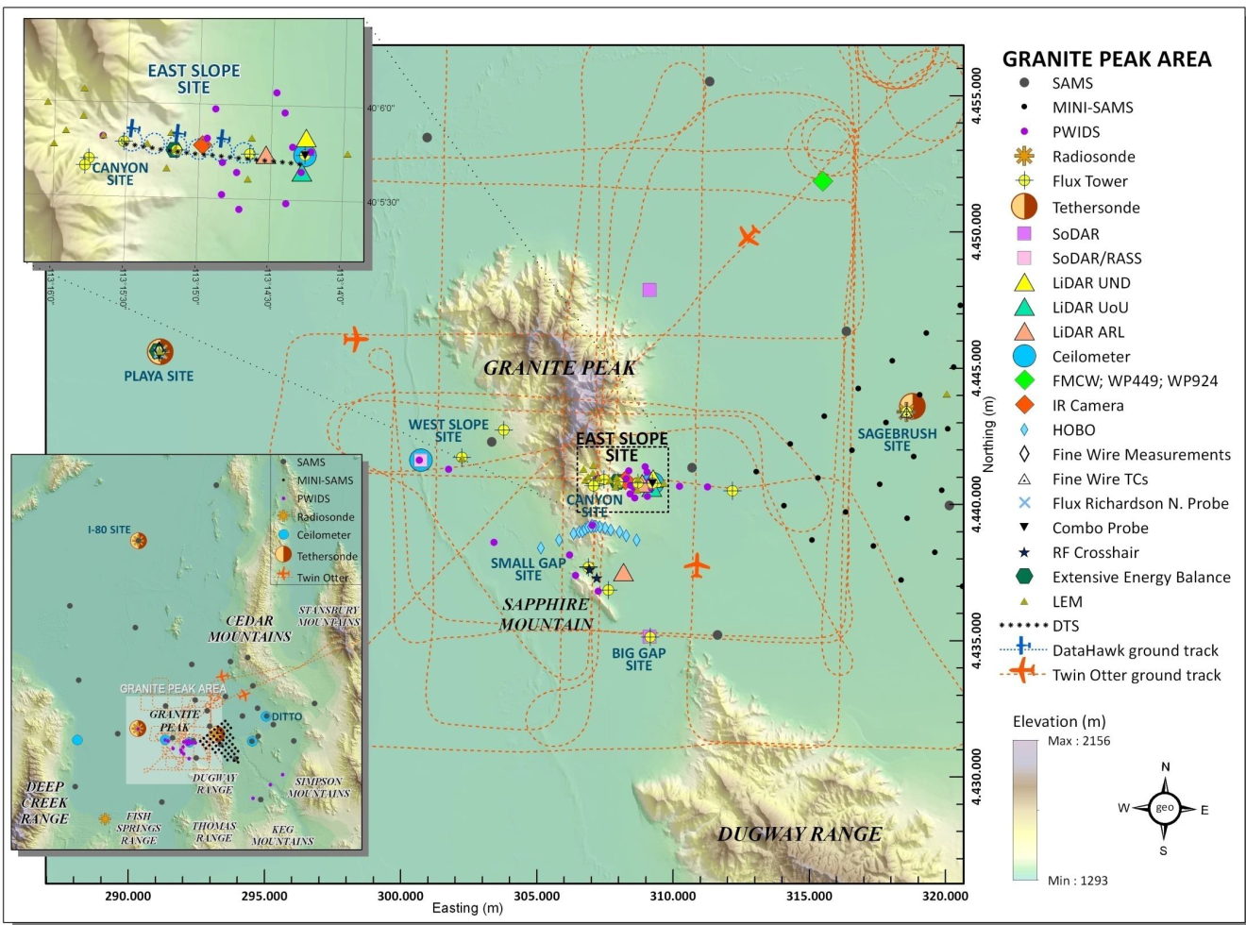
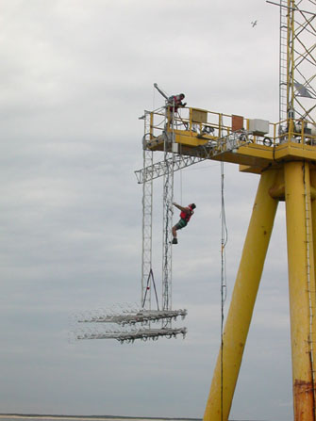
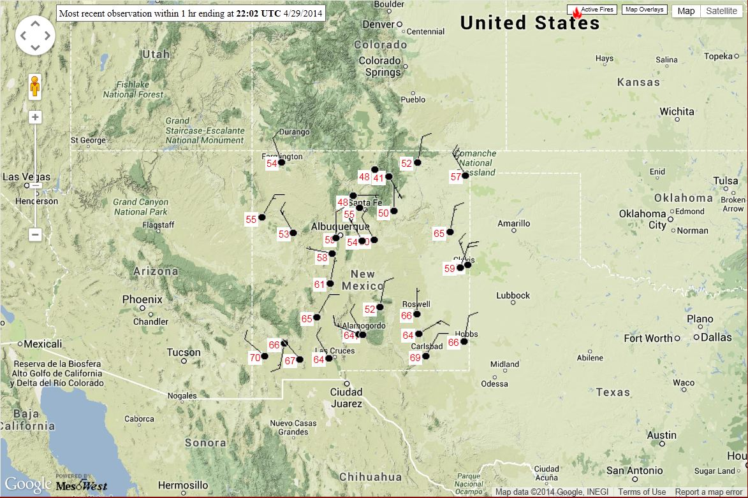
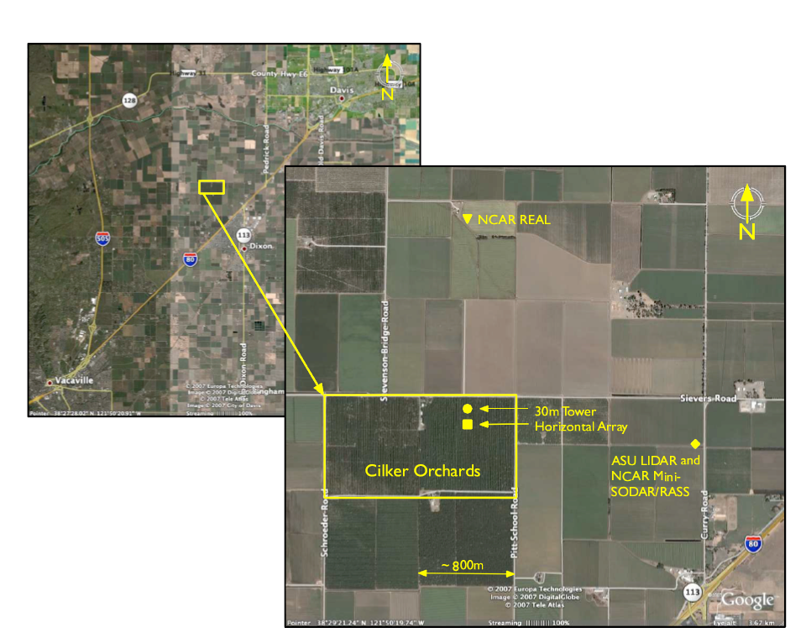
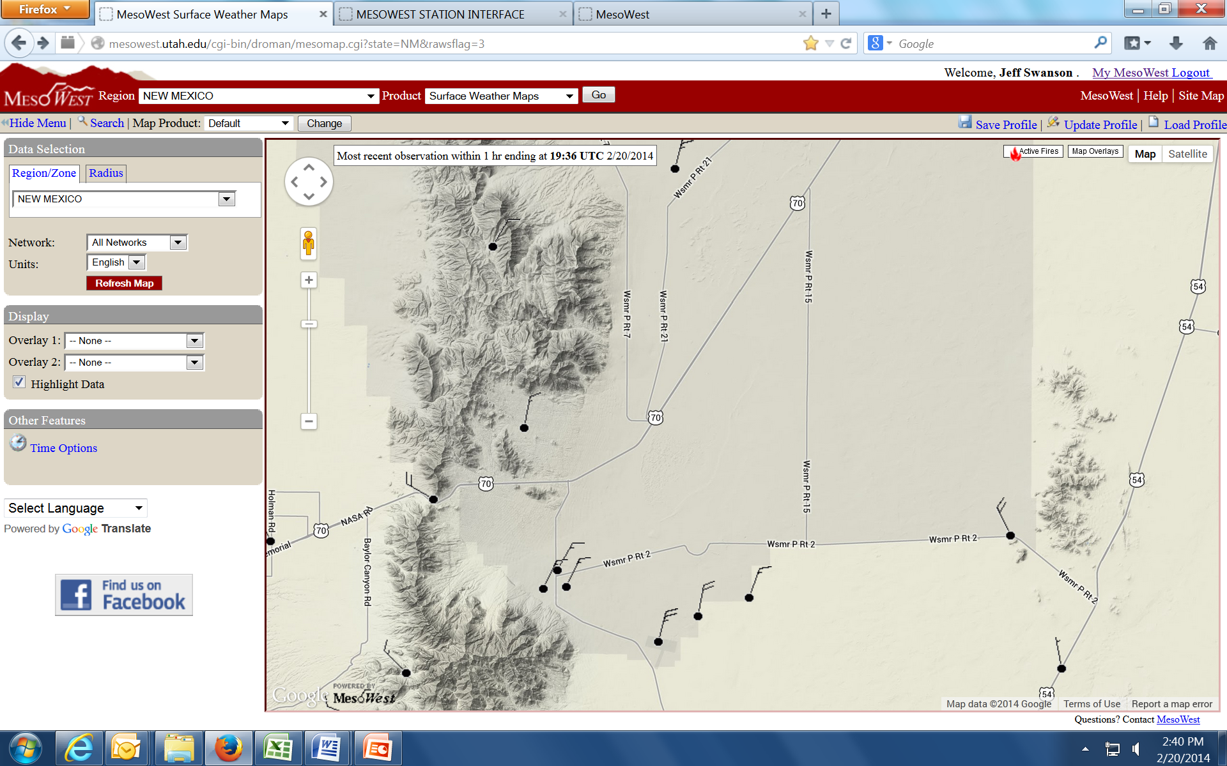
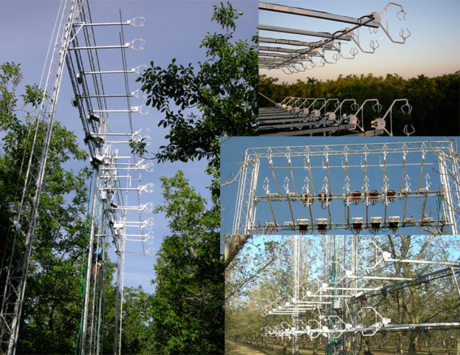
Related Work:
Meso/Micro-Nets
Meso-Net national/regional coverage is extensive, but stations are far apart and on irregular grids.
Micro-Nets have limited spatial extent and 2D/3D form factor.
Oklahoma
Dugway
Proving
Ground
NCAR Field Studies
Horizontal Array Turbulence Study (HATS, 2004)
Ocean HATS (OHATS, 2004)
Canopy HATS (CHATS, 2008)
OHATS Arrays
North America
CHATS
Deployment
WSMR
New Mexico
ARL’s special niche: Meso-gamma down to microscale resolution design and flexibility to address both civilian and military applications.
CHATS Arrays

Slide 19
MSA Concept and Execution
Phase II (FY15/16): 2D 36-Tower Array (Jornada)
  Adjacent complex terrain
  Integration with JER infrastructure
Phase III (FY16): 2D 36-Tower Array (WSMR)
  Tethersonde (TLS)
  RAOB
  UAV
Phase IV (FY16/17): Portable 2D Array with Triple Lidar
  Sodar
  TLS
  UAV
Phase V (FY17+): MSA Remote Test Site Capability
  Other DoD test ranges
  Diverse climatic environments

Slide 20
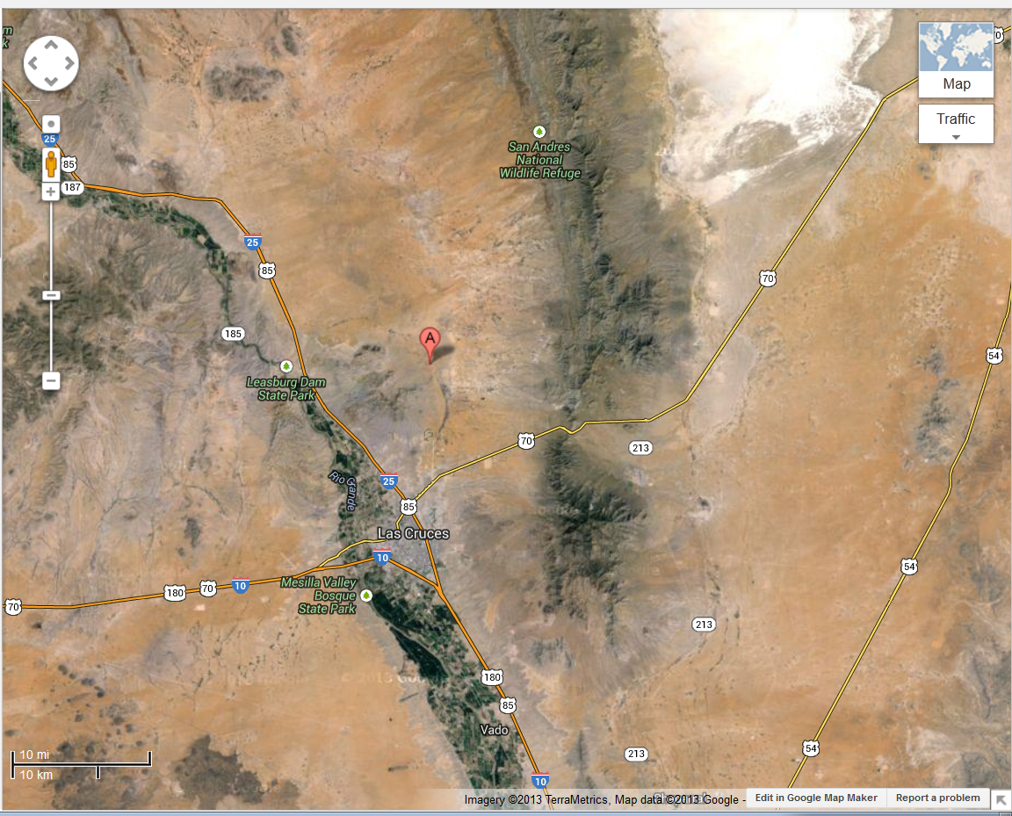
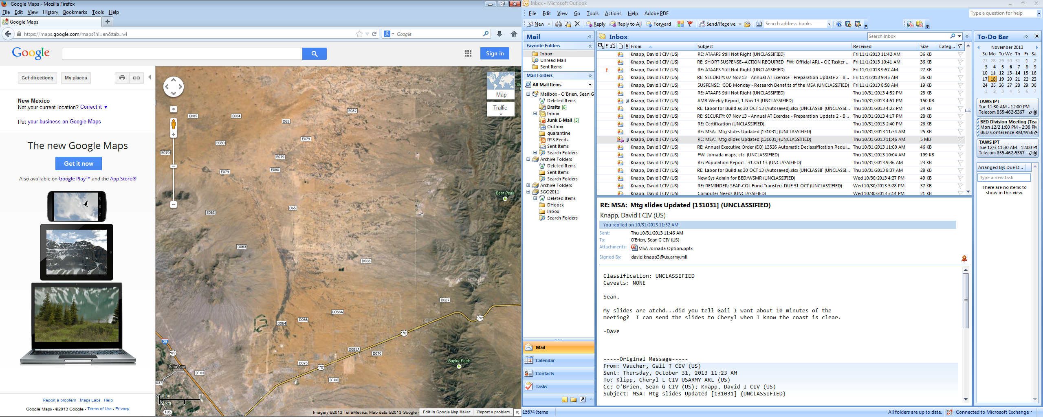
MSA Locations in WSMR Region
Phase I: WSMR (5 Towers)
Phases II: Jornada Exp Range
Phase III: WSMR
Phase IV/V: Located at either Phase II or Phase III location, depending on mission and permissions.
Phase III
Phase I
Phase II

Slide 21

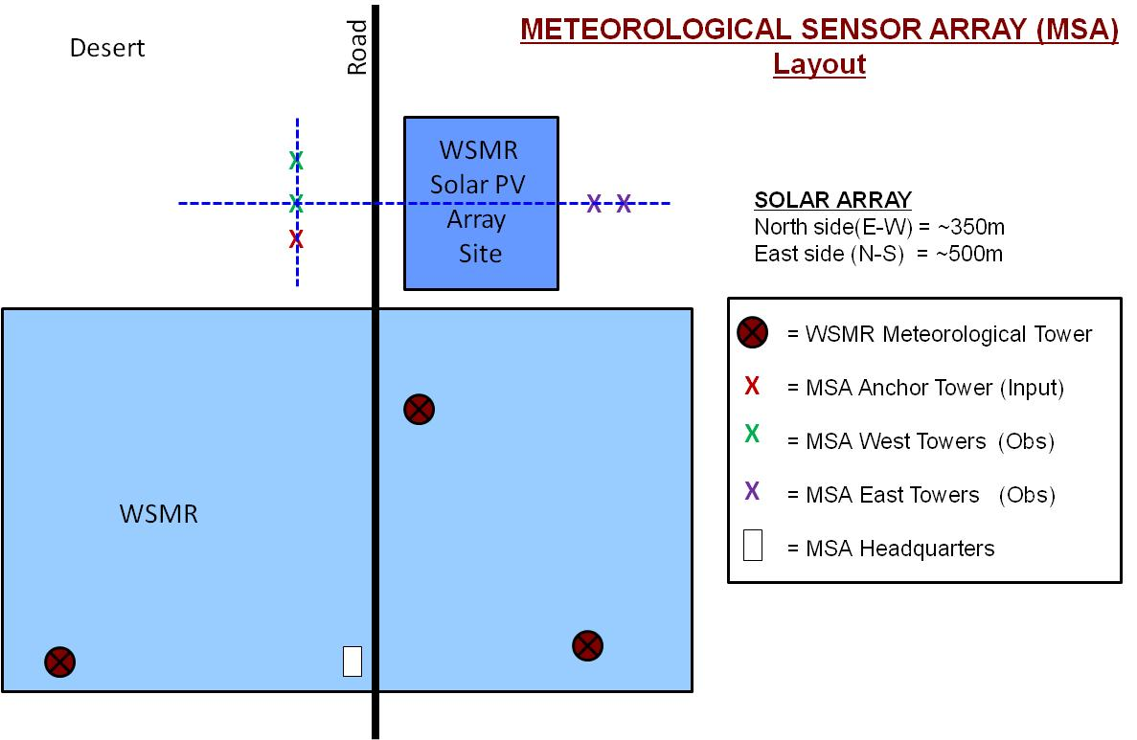
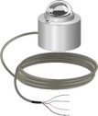
MSA Execution:
Phase I
MSA Phase I “Proof of Concept” Objectives:
Configure ARL hardware and software to acquire data in an MSA subset design.
Demonstrate viability of acquired data for validation/verification (V&V) task.
Compare measured/modeled atmospheric impacts of large solar PV array.
10 m
Data Acquisition: NM March-May Windy Season
2 m

Slide 22
MSA Locations in WSMR Region
Phase I: WSMR (5 Towers)
Phase III
Phase I

Slide 23
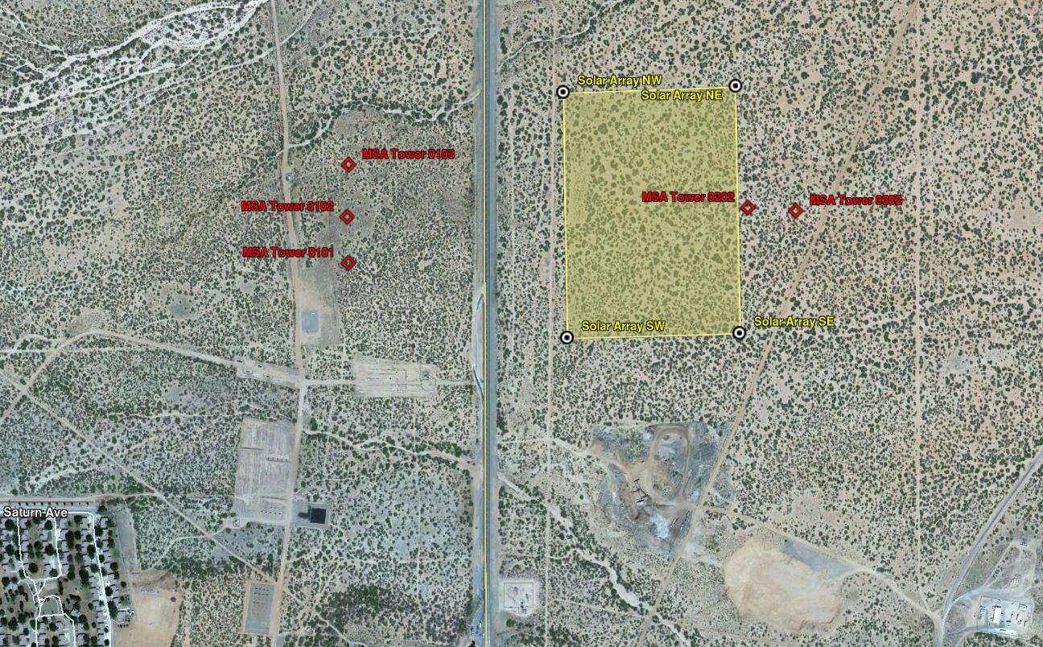
Phase I – WRE-N / Microscale Model Assessment Methods
Phase I MSA footprint
Road

Slide 24
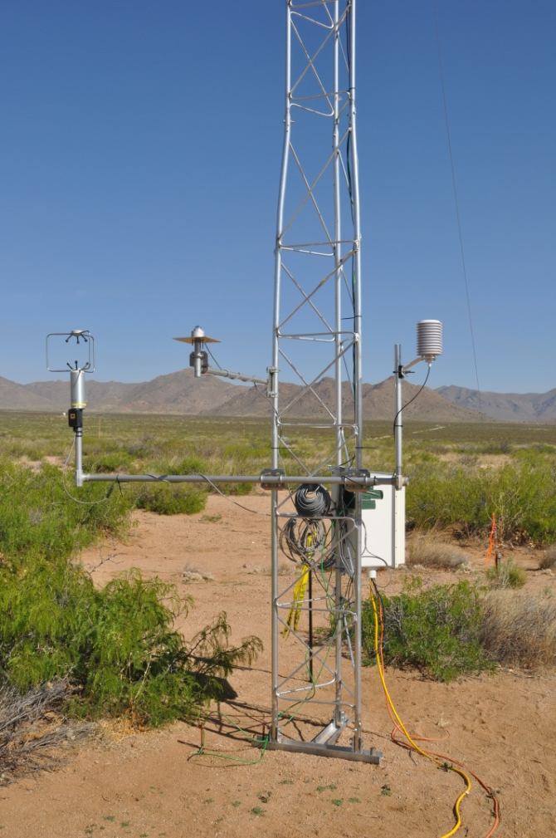

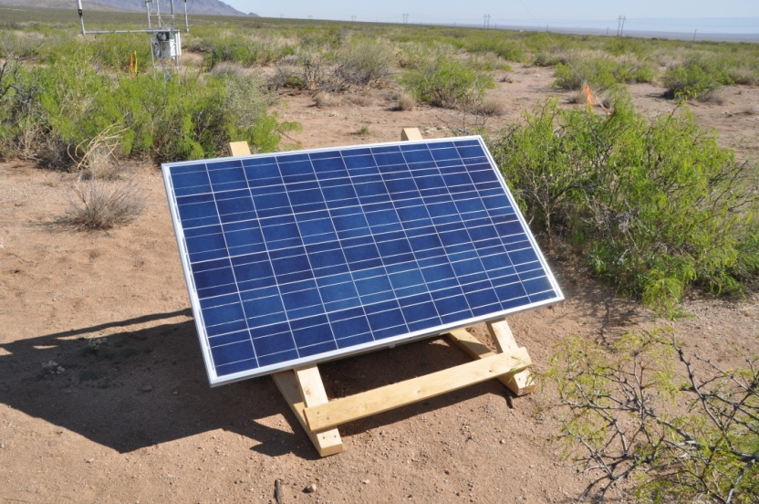
MSA Phase I Tower: Measured Parameters
METEOROLOGICAL DATA:
10m AGL:
  U-, V-, W-components
  Wind Speed/Direction
  Temperature
2m AGL:
  U-, V-, W-components
  Wind Speed/Direction
  Temperature Relative Humidity
  Dew-point Temperature
  Incoming Solar Radiation
  Pressure.

Slide 25
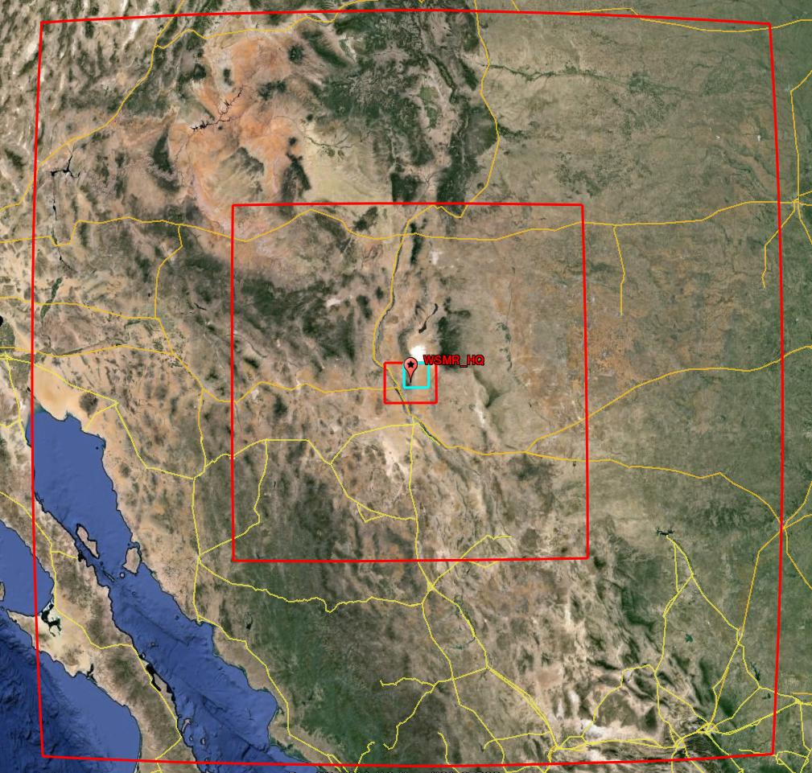
MSA
Model Assessment Domains
ARL Weather Running Estimate – Nowcast (WRE-N) Forecast Model.
Triple-nested domains:
  1566 km x 1566 km.
    9 km grid spacing
  720 km x 720 km.
    3 km grid spacing
  126 km x 126 km.
    1 km grid spacing
ARL Three-Dimensional Wind
Field (3DWF) Diagnostic Model.
50km x 50km domain.
  100 m resolution.

Slide 26
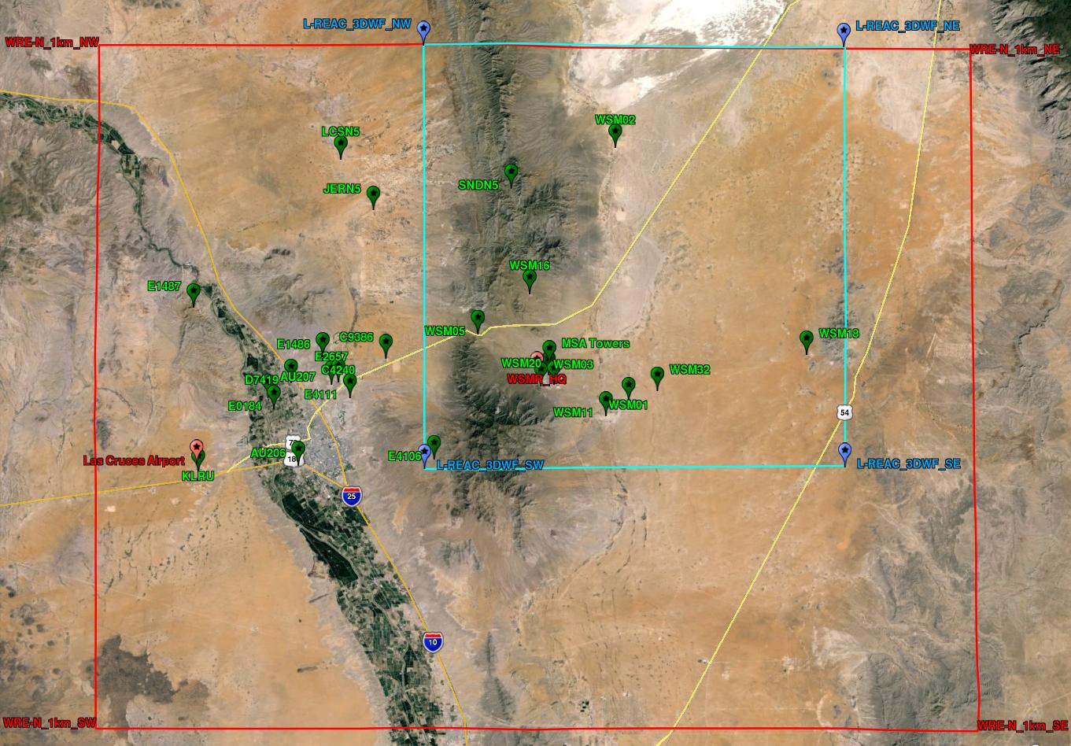
Domain
Observational Data
Phase I MSA footprint

Slide 27
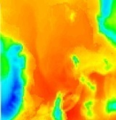
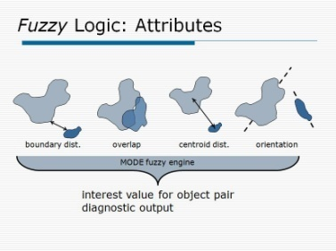

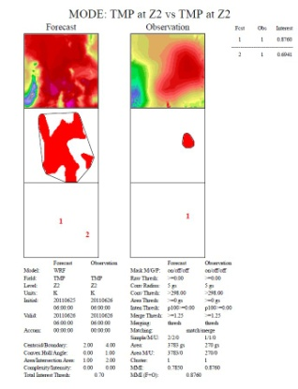
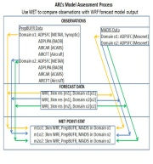
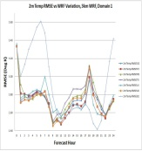
MODEL ASSESSMENT PROCESS
Challenges
  Need high resolution (1km) gridded observations.
  Show skill of high resolution modeling using traditional and non-traditional methods.
Weather Model Output
MODE Diagnostics
Weather Observations
Model Evaluation
At Observation Points
MODE Output
V&V Statistics
Improve Accuracy for:
  Wind Speed/Direction
  Wind Speed Variations
  Temperature…

Slide 28
Summary and Future Efforts
Future Efforts
MSA Products Applied to Scientific and Engineering Analysis:
  Triple lidar techniques.
  Optimum gound/air-based weather sensor placement strategies.
  ARL models: 3DWF, ABLE, WRF, WRE-N, etc
  Boundary layer turbulence models for complex terrain.
  Communities of Interest, Collaborators/Partners:
        Meso-gamma and microscale models for complex terrain
      Academic (Notre Dame, OU, NPS, AFIT), NCAR, NREL, DOE, AFWA, NOAA
      “If we build the MSA, they will come!”

Slide 29
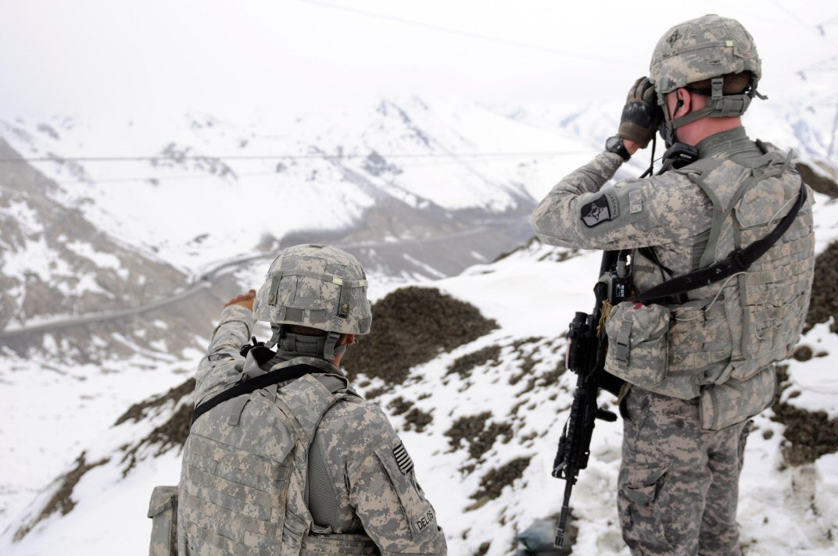
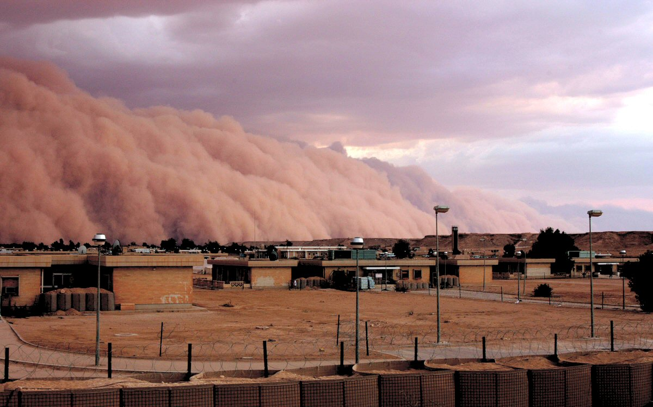
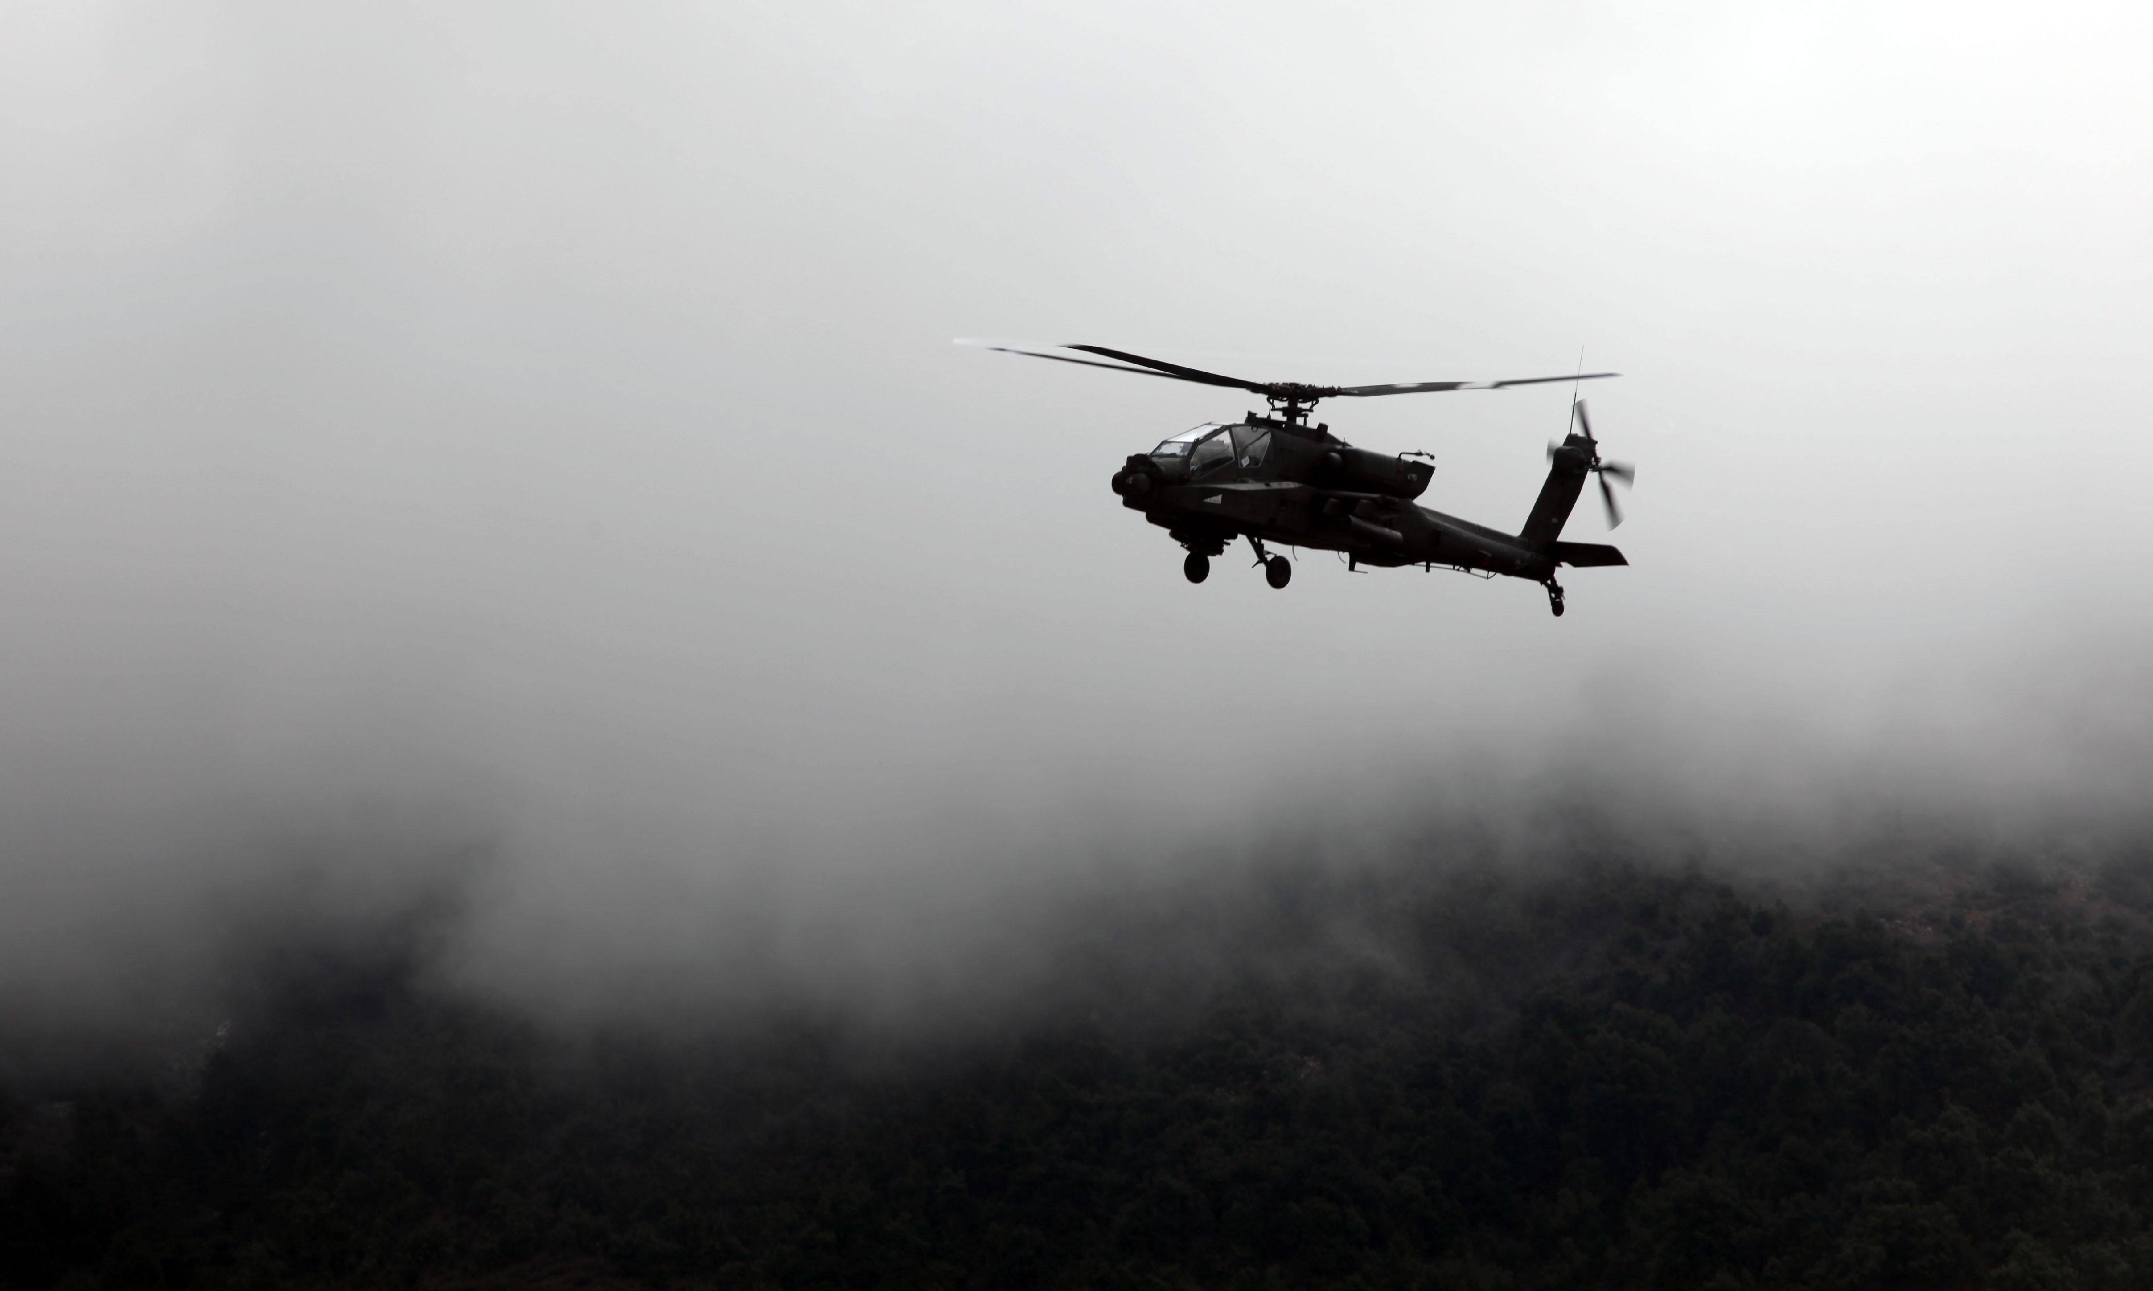
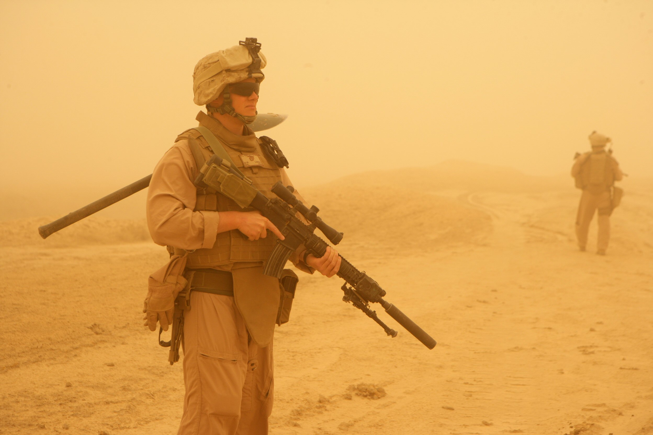
Questions?
(and shameless plug for the ARL Open Campus program)
29

