Slide 1
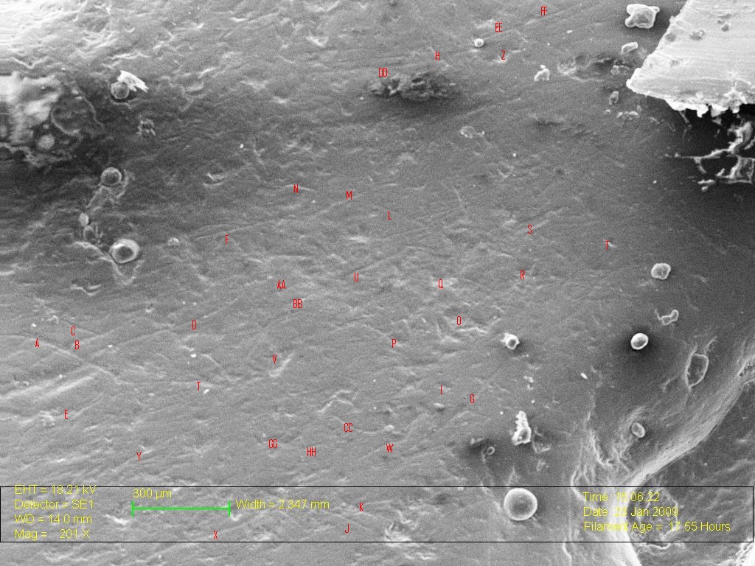
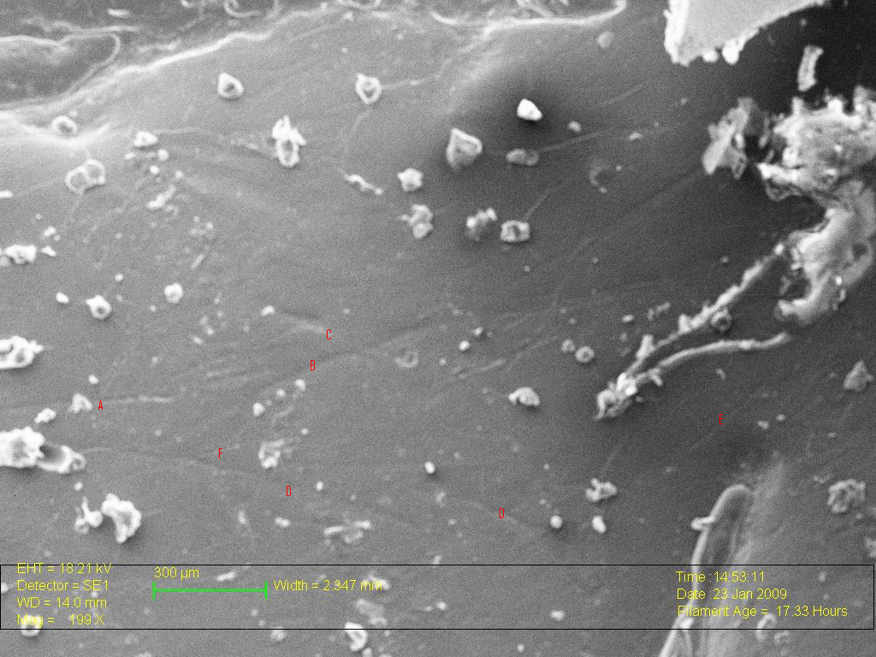
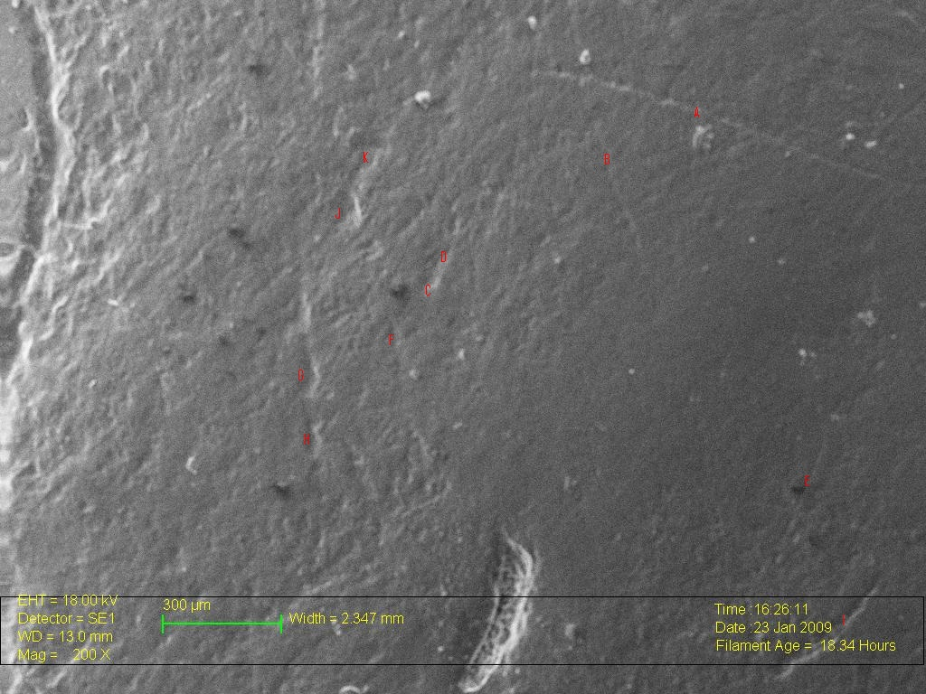
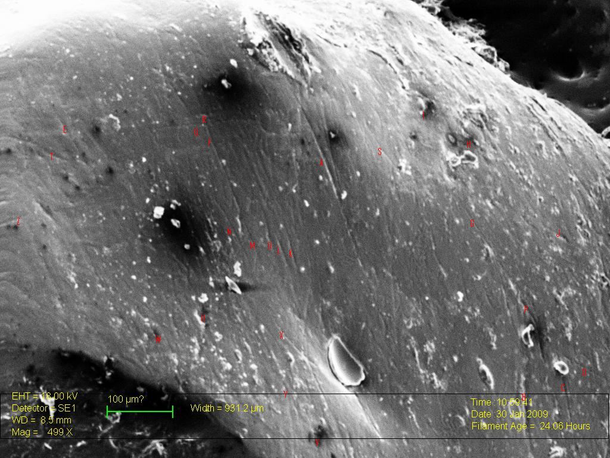
Meat, Bread, Scratches & Pits: Analysis of Dental Microwear on Byzantine Monastic Dentition From Jerusalem
Katie Keegan¹, Susan Guise Sheridan, Ph.D.¹, Jaime Ullinger, MA²
¹Dept. of Anthropology, University of Notre Dame; ²Dept. Of Anthropology, The Ohio State University
Introduction
This project addresses the dietary patterns of a monastic community from the Byzantine Monastery of St. Stephen’s in Jerusalem (AD 438-614). Intensive study of this collection has provided information for the reconstruction of occupational stress, migration patterns, and diet. This project adds to our understanding of diet by analyzing dental microwear and antemortem tooth loss, complementing prior examination of dental calculus, dental caries, and interproximal grooving.
show only the larger features on the surface of the enamel. Scratches were predominant, with few pits on each tooth. The scratches did not appear to gouge deeply into the enamel surface and there was no consistent orientation or pattern to the scratching. Two images were viewed at a higher magnification of 500X. However, the observed surfaces were still dominated by scratches that appear fairly shallow on the surface of the enamel.
Results of antemortem tooth loss (AMTL) analysis show that of the 1,247 total tooth sockets or teeth analyzed, there were 73 cases of antemortem tooth loss (5.9%). Canines showed the lowest loss rate (1.2%), followed by incisors (2.1%), premolars (4.1%), and molars (12.6%) (Table 1).
The high frequency of shallow scratches suggests the dentition used in this analysis came from people who were consuming softer foods, rather than hard, brittle food. Previous studies have shown diets dominated by hard, brittle food such as nuts and seeds are connected to a high pit frequency (e.g., Teaford and Walker, 1984; Teaford, 1988; Crompton et al., 1998; Carnieri and Mallegni, 2003). Low pit frequency can also be connected to lack of dietary grit, commonly introduced via food preparation technology, and is thought to be a contributor to increased pit size in microwear (Mahoney, 2006).
Examining possible signs of meat consumption using a qualitative study of dental microwear proves challenging. The effects of meat on enamel are primarily from adherent grit or tooth-on-tooth contact during mastication. Meat itself is too soft to indent the enamel (Puech et al., 1981; Lalueza et al., 1996; Ungar and Spencer, 1999). Therefore, it is difficult to make a connection between meat consumption and the observed microwear pattern. The best conclusion gained from the qualitative microwear study is that the prevalence of shallow scratching in the microwear pattern suggests softer food products and a lack of dietary grit in the food supply (Teaford and Walker, 1984; Teaford, 1988; Van Valkenburg et al., 1990; Strait, 1993; Crompton et al., 1998; Carnieri and Mallegni, 2003; Mahoney, 2006).
Data from dental pathology and bone chemistry have proved intriguing because results contradict historical accounts of a monastic diet with stringent prohibition of meat, except under extreme circumstances (Hirschfeld, 1992). Textual records document bread as the staple of the monastic diet, supplemented with grapes, figs, carobs, dates, and on occasion peas, lentils, and beans (Hirschfeld, 1996). Stable isotope analyses indicate the consumption of a diet consisting of C3 plants with some meat intake. Analysis of dental pathologies indicate a low prevalence of dental caries (5.0%) and extremely light distribution of dental calculus over a majority of the teeth (78.1%). These results support the bone chemistry studies, suggesting fewer fermentable carbohydrates and higher levels of protein being consumed than indicated by historical texts.
Background & Rationale
Table 1. AMTL by tooth type.
The Byzantine St. Stephen’s collection was excavated from the crypt complex on the original site of St. Stephen’s monastery. The minimum number of individuals (MNI) was obtained using the left distal femora, indicating at least 109 adults and 68 children (Sheridan, 1999). Approximately 93% of the collection is male, which is expected based on historical data that indicate a male monastic community at the site from the 5th-7th centuries.
The collection is intriguing in that the historical documents and bones tell different stories regarding diet. While texts speak of a restrictive vegetarian diet, the size and health of the bones suggest a calorie-rich diet high in protein. Studies of dental pathology as well as stable isotope and trace element analyses have indicated that the inhabitants of Byzantine St. Stephen’s were consuming considerable animal protein. Results of dental microwear analysis and antemortem tooth loss will test the hypothesis that inhabitants of Byzantine St. Stephen’s were consuming a more varied diet than the historical texts indicate.
Dental microwear is defined as microscopic pits and scratches that form on enamel as a result of mastication. These features are created as hard particles are driven into or dragged between two opposing enamel surfaces (Mahoney, 2007). Microwear patterns vary in size, frequency, orientation, and morphology. These differences have been correlated with changes in dietary hardness and abrasiveness (Teaford and Walker, 1984).
Ultimately, inferring dietary practices from dental microwear is based on analyzing the sizes and frequencies of features and then connecting these data to the general types of foods consumed. This is often challenging because pitting and scratching are not mutually exclusive. However, primate feeding studies have shown that harder objects typically show higher pit percentage while softer, tougher objects show higher striation counts (Ungar et al., 2006). Ultimately, diet can be reasonably determined by establishing the relative dominance and size of features in a particular population (Schmidt, 2001).
Antemortem tooth loss (AMTL) occurs when the tooth is shed prior to death. Causes vary, although loss usually results from severe dental attrition, or when carious lesions expose the pulp cavity allowing infection to occur (Hillson, 1996). AMTL can be indicative of a diet high in fermentable carbohydrates that results in dental caries (Featherstone, 1987).
 | C | I | P | M | Total
Antemortem Loss | 2 | 7 | 14 | 50 | 73
Viable Sockets | 168 | 332 | 327 | 347 | 1174
Total | 170 (1.2%) | 339 (2.1%) | 341 (4.1%) | 397 (12.6%) | 1247
Discussion & Conclusions
Materials & Methods
The Byzantine St. Stephen’s jaws had relatively low levels of AMTL compared to other sites from the Near East (Figure 2). AMTL was significantly different (p<0.05) from all but one published collection: the Neolithic sample form the Southern Levant which dates to 8300-5500 BC (x²=0.931, df=1, p=0.3345) (Eshed et al., 2006). These Natufians also demonstrated low levels of dental caries, a factor commonly associated with AMTL (Eshed et al., 2006).
Although Levantine monasteries during the Byzantine era typically tried to adhere to a more ascetic diet (according to historical texts), Byzantine St. Stephen’s appears to be an exception. This may be due to its urban location and/or it’s recorded affluence.
Dental microwear: Molds of 20 right mandibular second molars were made using President’s Jet regular body polyvinylsiloxane dental impression material. Replicas were created using Epofix, a high resolution epoxy resin and hardener. Resulting replicas were mounted on aluminum scanning electron microscope stubs with carbon tape and sputter coated with approximately 20 nm of gold. Twenty right mandibular second molar replicas were examined at facet 9 (on the distobuccal cusp) using a scanning electron microscope with an accelerating voltage of 20-25 keV, a working distance of 12-20 mm, and a magnification of 200X-500X.
The surfaces were oriented nearly perpendicular to the electron beam to minimize feature foreshortening. The images were digitized using Pixillion Image Converter. Images were analyzed using a semi-automated image analysis computer program (Microware version 4.02, Ungar 2002). When analyzing the dental microwear, features with a length-to-width ratio lower than 4:1 are defined as scratches, while pits are defined as dental microwear features with a length-to-width ratio higher than 4:1 (Teaford, 1988).
Antemortem Tooth Loss: AMTL was considered to have occurred when a tooth socket showed evidence of alveolar resorption (Ortner and Putschar, 1985; Frayer, 1989; Eshed et al., 2006). The data were collected from all intact maxillae and mandibles, a total of 1,247 sockets.
Figure 2. Comparison of AMTL frequencies for numerous Near Eastern sites
Supplementing the dental microwear studies with data from antemortem tooth loss studies as well as previous studies on dental calculus, dental caries, interproximal grooving, and bone chemistry supports the idea that the monks were in good health and were probably eating a diet higher in protein and lower in carbohydrates than historical texts indicate.
Results
Acknowledgements
Following SEM analysis, the sample size was reduced from 20 to seven based on quality of images (Figure 1). This pilot study focused on general microwear trends, connecting microwear patterns with results of previous dental pathology and bone chemistry studies.
The five images taken from samples under a magnification of 200X-300X
We would like to thank the NSF-REU program (SES 0649088), the University of Notre Dame’s Undergraduate Research Opportunities Program, and Glynn Family Honor’s Program Grant for funding this research. We would also like to thank Professors Paul Sciulli (Ohio State University), Christopher Schmidt (University of Indianapolis), Peter Ungar (University of Arkansas). Special thanks to Dennis Birdsell for his help with SEM imaging, and the University of Notre Dame Center for Environmental Sciences and Technology for providing the gold sputtering machine and SEM used for this study.
Figure 1. SEMs of pits and scratches on specimens: a) EBND 27.150, b) EBND 9.412, c) EBND 6.98, and, d) EBND 9.428.

