Slide 1
Higher-Order Network Structures
Workshop on Future Directions in Network Biology
Working Group Members:
Mehmet Koyuturk (Case)
Arjun Krishnan (Michigan State)
T. M. Murali (Virginia Tech)
Teresa Przytycka (NIH)
Predrag Radivojac (Northeastern)
Anna Ritz (Reed College)

Slide 2
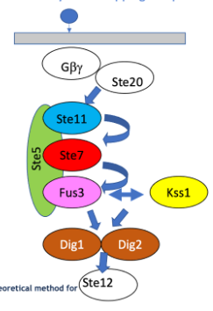
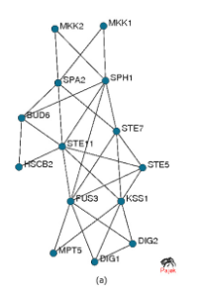
Higher-Order Network Structures: Patterns in Graphs
(& Graphlets)
Battiston et al,, Physics Reports 2020
Zotenko et al., Alg. for Mol. Biol. 2006
Choobdar et al, Nature Methods 2019

Slide 3
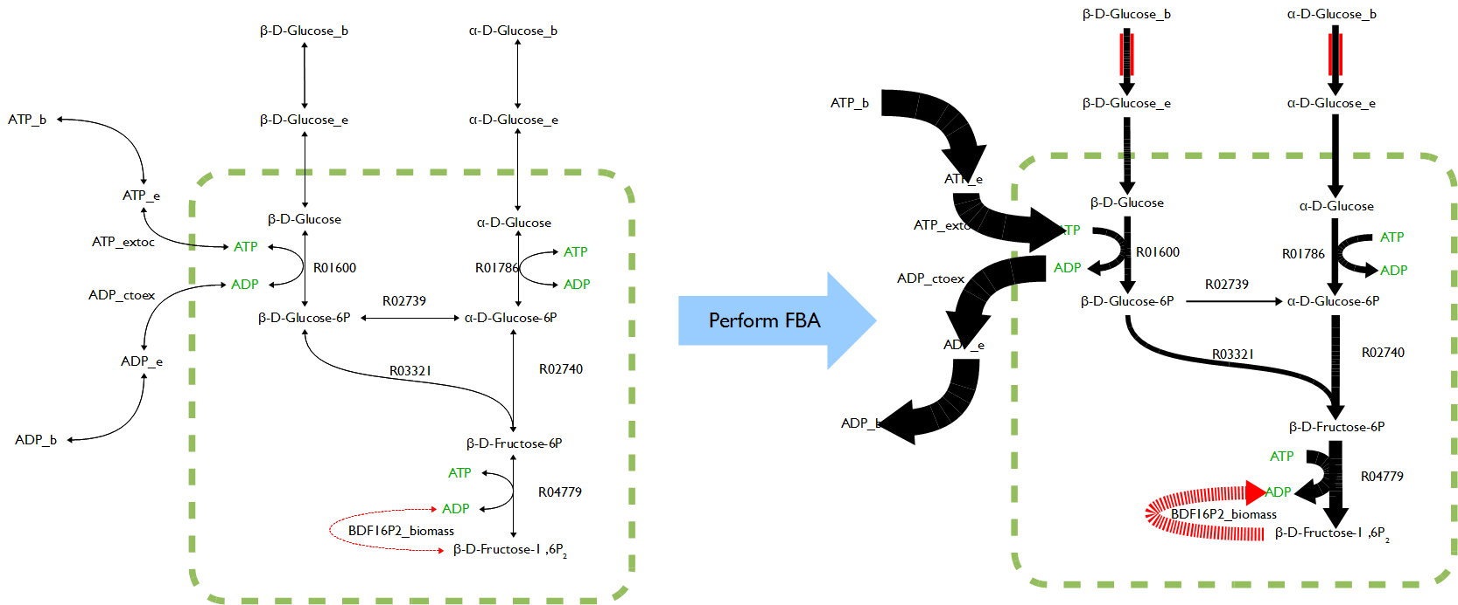
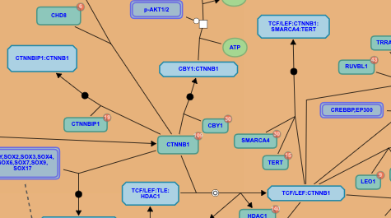
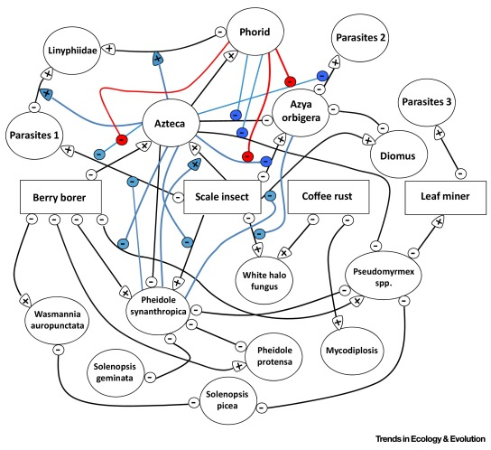
Higher-Order Network Structures: Beyond Pairwise Graphs
Metabolic Signaling (Thomas Forth, Wikipedia)
Reactome Pathway Database
Systems
Biology
Markup
Language
Coffee Agroecosystem Web
[Golubski et al., Trends Ecol. Evol 2016]

Slide 4
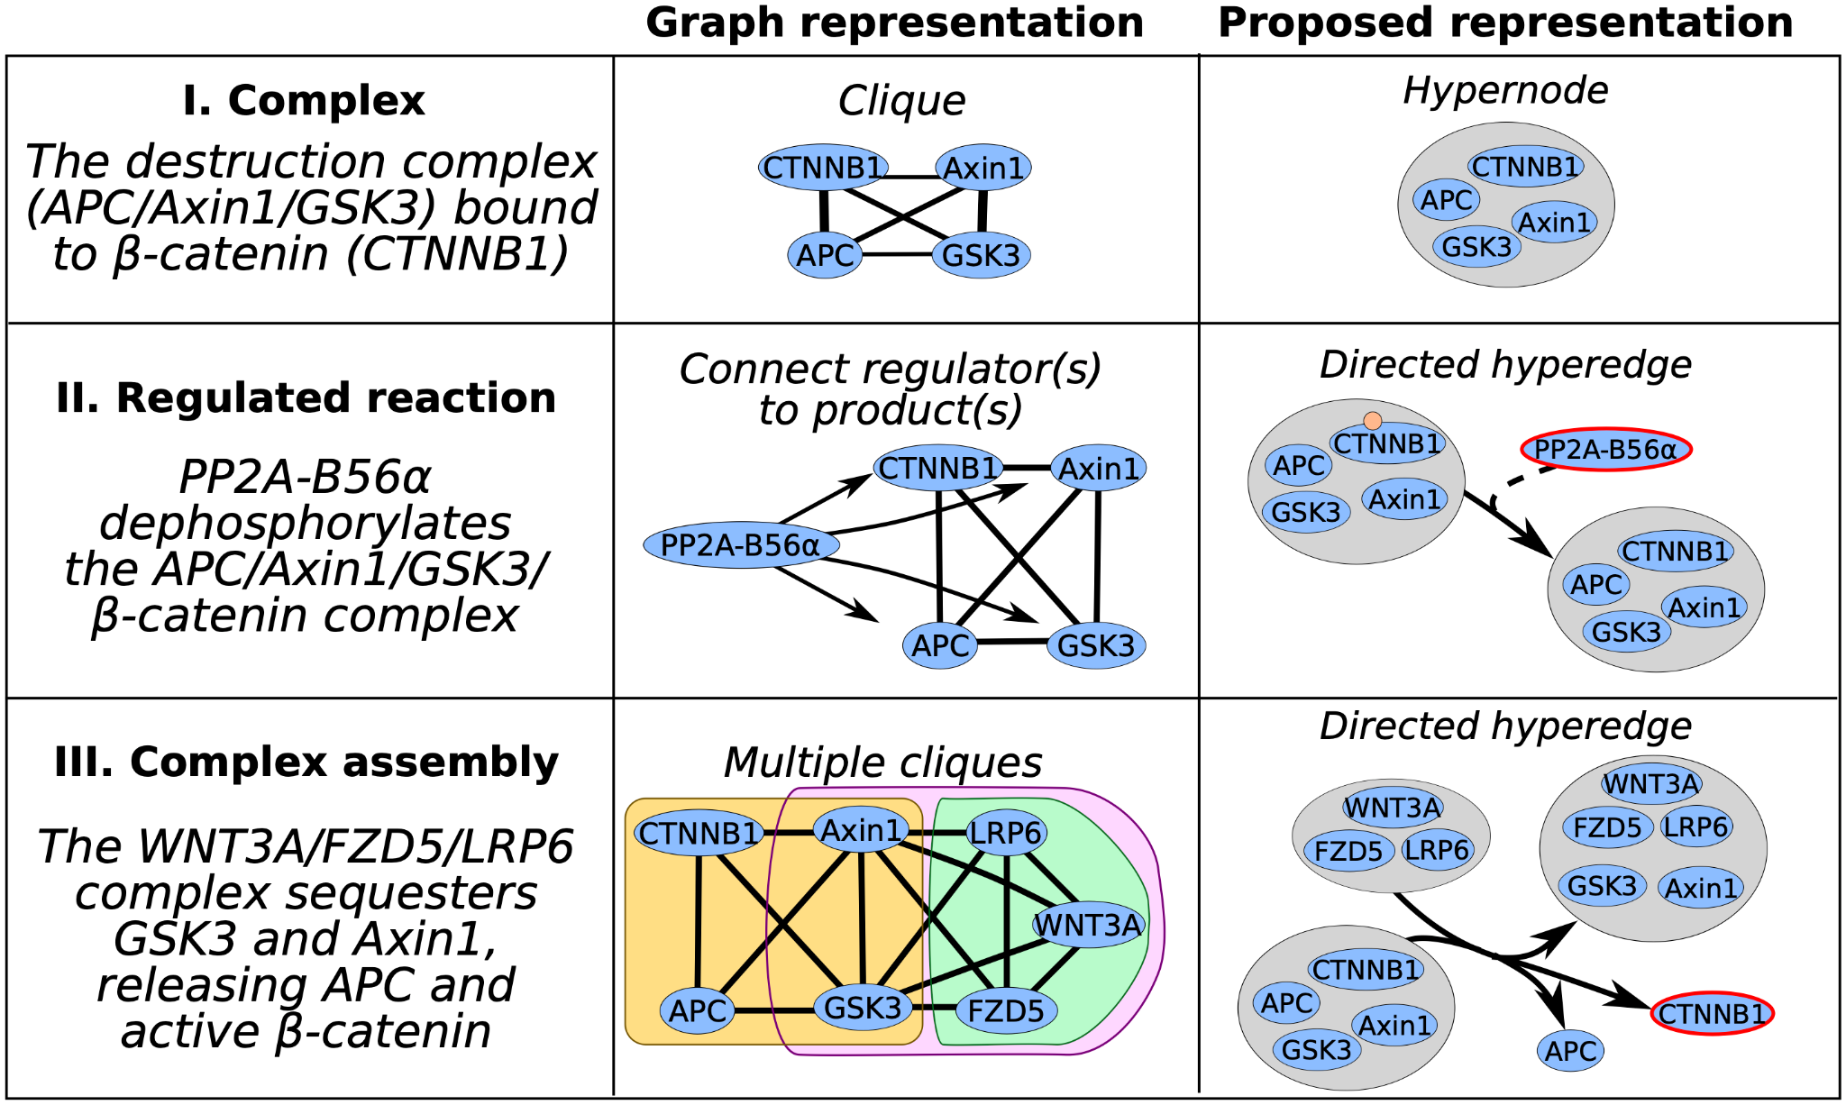
Higher-Order Network Structures: Beyond Pairwise Graphs
Ritz et al., Trends in Biotech 2015

Slide 5
Higher-Order Network Structures
→
Graphlets and the Reconstruction Conjecture
Overlapping Complexes, Classification Problems, & Hypergraphlets
Shortest Paths & Random Walks on Hypergraphs
Discussion Topics
Representation Learning
Considering Labeled Data
Establishing Baselines

Slide 6
Graphlets are small, connected, induced subgraphs of a graph
Pržulj. Bioinformatics 2007

Slide 7
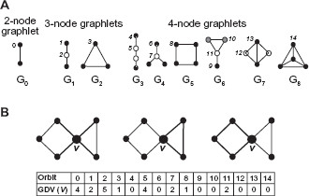
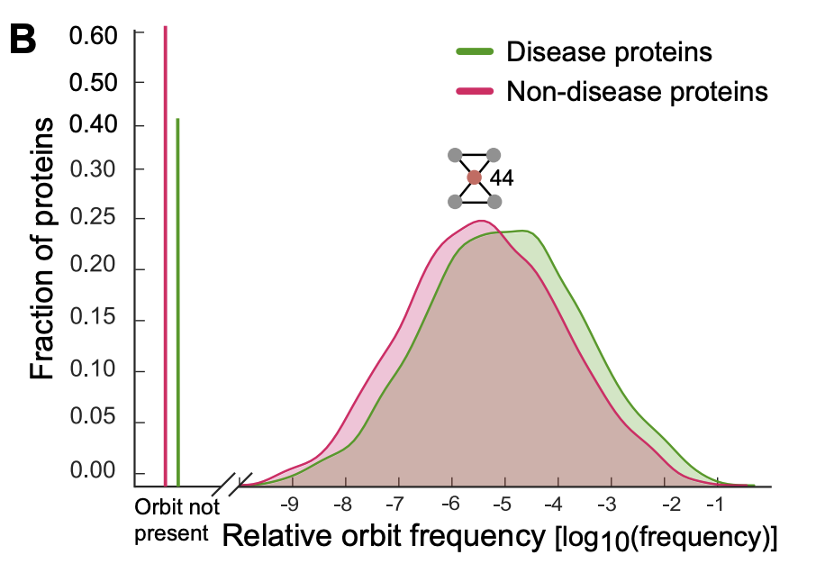
Graphlets are small, connected, induced subgraphs of a graph
Graphlet signatures for nodes
Network alignment
Identify proteins w/ similar biological processes & roles
GDV: Graphlet Degree Vector
[Milenković & Pržulj, Cancer Informatics 2008] [Milenković et al., Cancer Informatics 2010] [Agrawal, Zitnik, & Leskovec, PSB 2018]

Slide 8
Why Count Subgraphs? Reconstruction Conjecture.
Claim: All finite simple undirected graphs w/ at least 3 vertices are reconstructible
Example:
⇡
up to isomorphism
Graph G with subgraphs G₁-G₅ obtained by removing a vertex.
A deck for G, a multi-set of subgraphs.
Claim: Reconstruction holds even if only unique elements kept (set-reconstruction)
Bondy & Hemminger, J Graph Theory, 1977

Slide 9
Why Count Subgraphs? Reconstruction Conjecture.
General Claim: for any positive integer k, there exists a positive integer f(k) such that any graph on at least f(k) vertices is reconstructible from its collection of subgraphs with k vertices removed.
Additional versions of this claim exist (e.g., w/ reconstruction probability near 1).
→
“Complete” kernels (similarity measures):
can distinguish between any two graphs, these are NP-hard
as shown by Gaertner et al, COLT, 2003.
Open problem: are bipartite graphs reconstructuble? Some types are.
Bondy & Hemminger, J Graph Theory, 1977

Slide 10
Higher-Order Network Structures
→
Graphlets and the Reconstruction Conjecture
Overlapping Complexes, Classification Problems, & Hypergraphlets
Shortest Paths & Random Walks on Hypergraphs
Discussion Topics
Representation Learning
Considering Labeled Data
Establishing Baselines

Slide 11
Definitions
Undirected hypergraph
H = (V, E) where V is the set of vertices and each undirected hyperedge in E is a subset of V
Directed hypergraph
H = (V, E) where V is the set of vertices and each directed hyperedge in E is an ordered pair of subsets of V
Klamt, Haus, & Theis. PLOS Comp Biol 2009.

Slide 14
Graph Classification
https://pubchem.ncbi.nlm.nih.gov

Slide 15
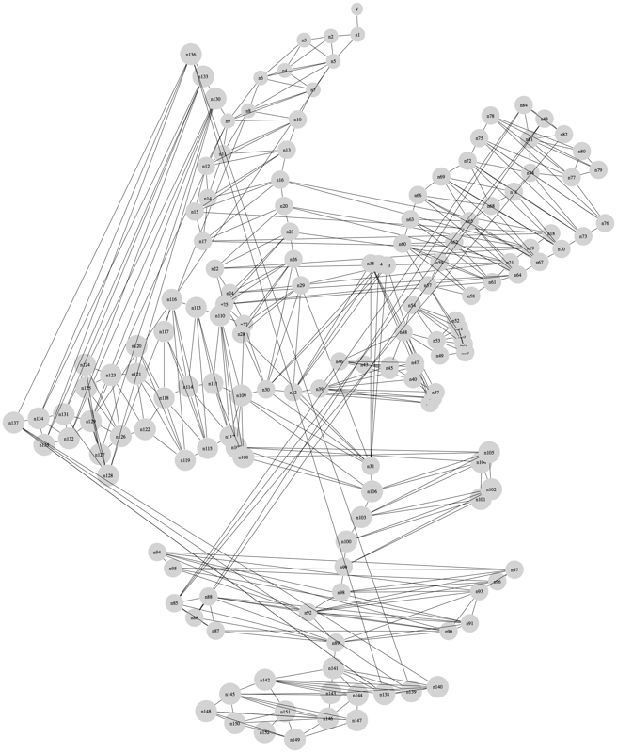
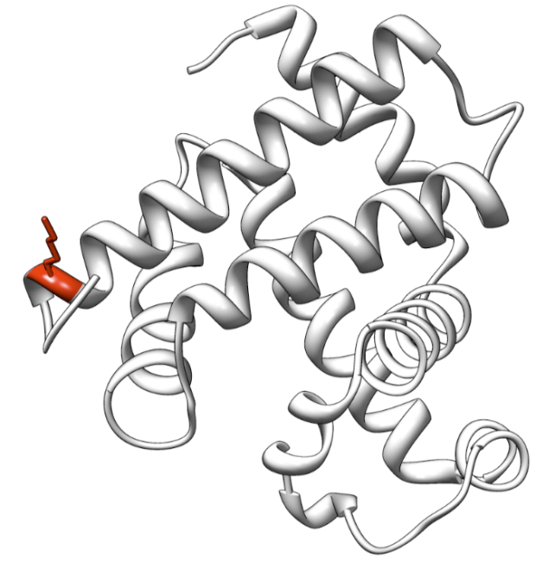
Vertex Classification

Slide 16
Hypergraphs Unify Classification Problems on Graphs
Three supervised problems: vertex or edge classification & link prediction
Dual hypergraph:
- edges become vertices
- hyperedges constructed from edges
incident to original vertices
Dual extended hypergraph:
- used in link prediction
- missing edges become new nodes
- hyperedges must be extended
Now, everything is vertex classification on hypergraphs.
Lugo-Martinez & Radivojac. arXiv 1703.04823, 2017. Lugo-Martinez et al., Bioinformatics, 2021.

Slide 17
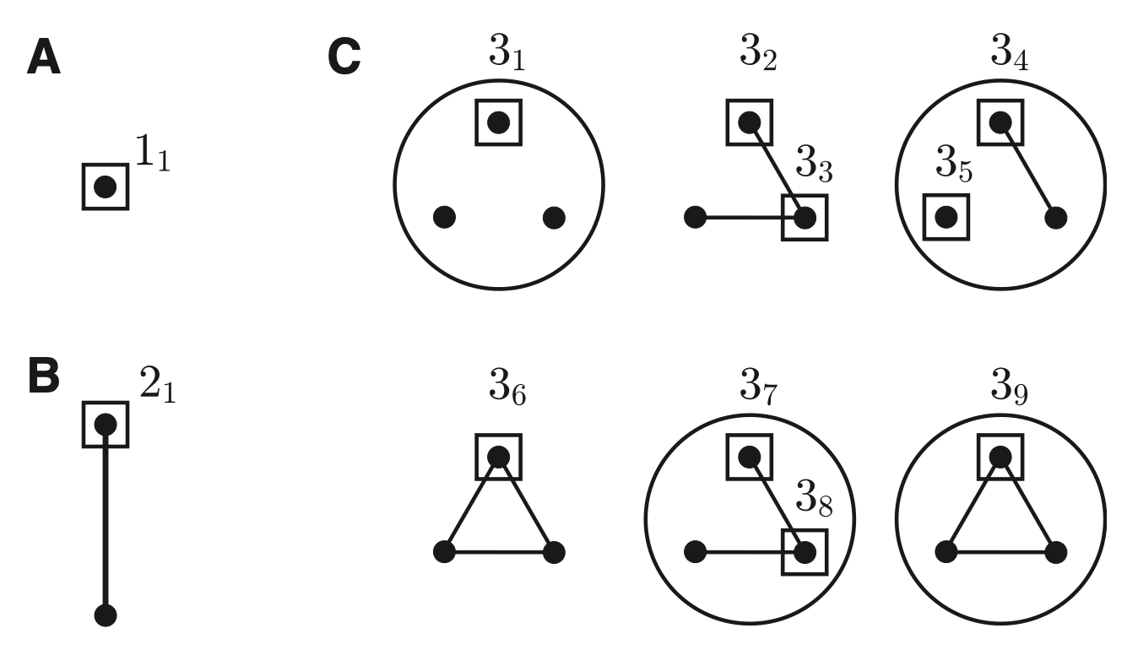
Hypergraphlet Kernels
← Hypergraphlets: small, simple, connected,
rooted hypergraphs, without self-loops.
Squares are root nodes.
Note 1: definitions vary
Note 2: hypergraphlets can be colored, but so
far colors have been discrete
Node representation:
← can also count by allowing for
mismatches (pseudocounts)
Kernel function:
Idea: cast different graph prediction problems as prediction on vertices
Lugo-Martinez & Radivojac. arXiv 1703.04823, 2017. Lugo-Martinez et al., Bioinformatics, 2021.

Slide 18
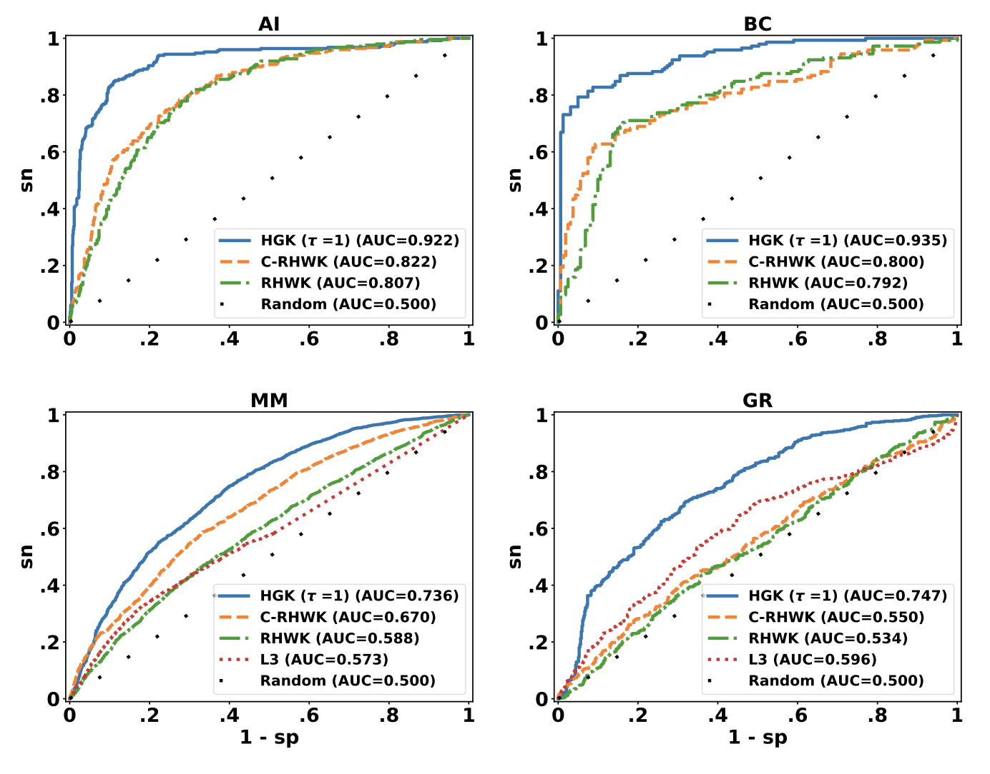
Classification Results
Results: AI = drug-target edge classification, BC = PPI hyperedge classification, MM = PPI link prediction, GR = drug-target link prediction
Lugo-Martinez et al., Bioinformatics, 2021.

Slide 19
Higher-Order Network Structures
→
Graphlets and the Reconstruction Conjecture
Overlapping Complexes, Classification Problems, & Hypergraphlets
Shortest Paths & Random Walks on Hypergraphs
Discussion Topics
Representation Learning
Considering Labeled Data
Establishing Baselines

Slide 20
Undirected and Directed Hypergraphs
Undirected Hyperedge
Ritz et al., Trends in Biotech 2015.

Slide 21
Ritz et al., Trends in Biotech 2015.

Slide 22
Wnt Pathway Reactions
Ritz et al., Trends in Biotech 2015.

Slide 23
Directed Hypergraph Connectivity
Rule: Products arise when all reactants are present. (B-connectivity)

Slide 24
Shortest Hyperpaths in Directed Hypergraphs
Rule: Products arise when all reactants are present. (B-connectivity)
A B-hyperpath from s to t is a sub-hypergraph where (a) t is B-connected to s and (b) the sub-hypergraph is minimal w.r.t. Nodes and hyperedges.
Finding the shortest B-hyperpath is NP-Hard (Ausiello et al., 1992), even when bounding the number of nodes in each hypergraph (Ritz et al., 2017).

Slide 25
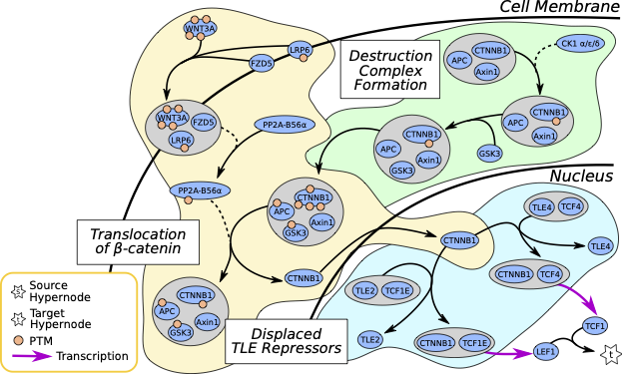
Directed Hyperpaths are More Descriptive than Paths
Ritz et al., TCBB 2017

Slide 26
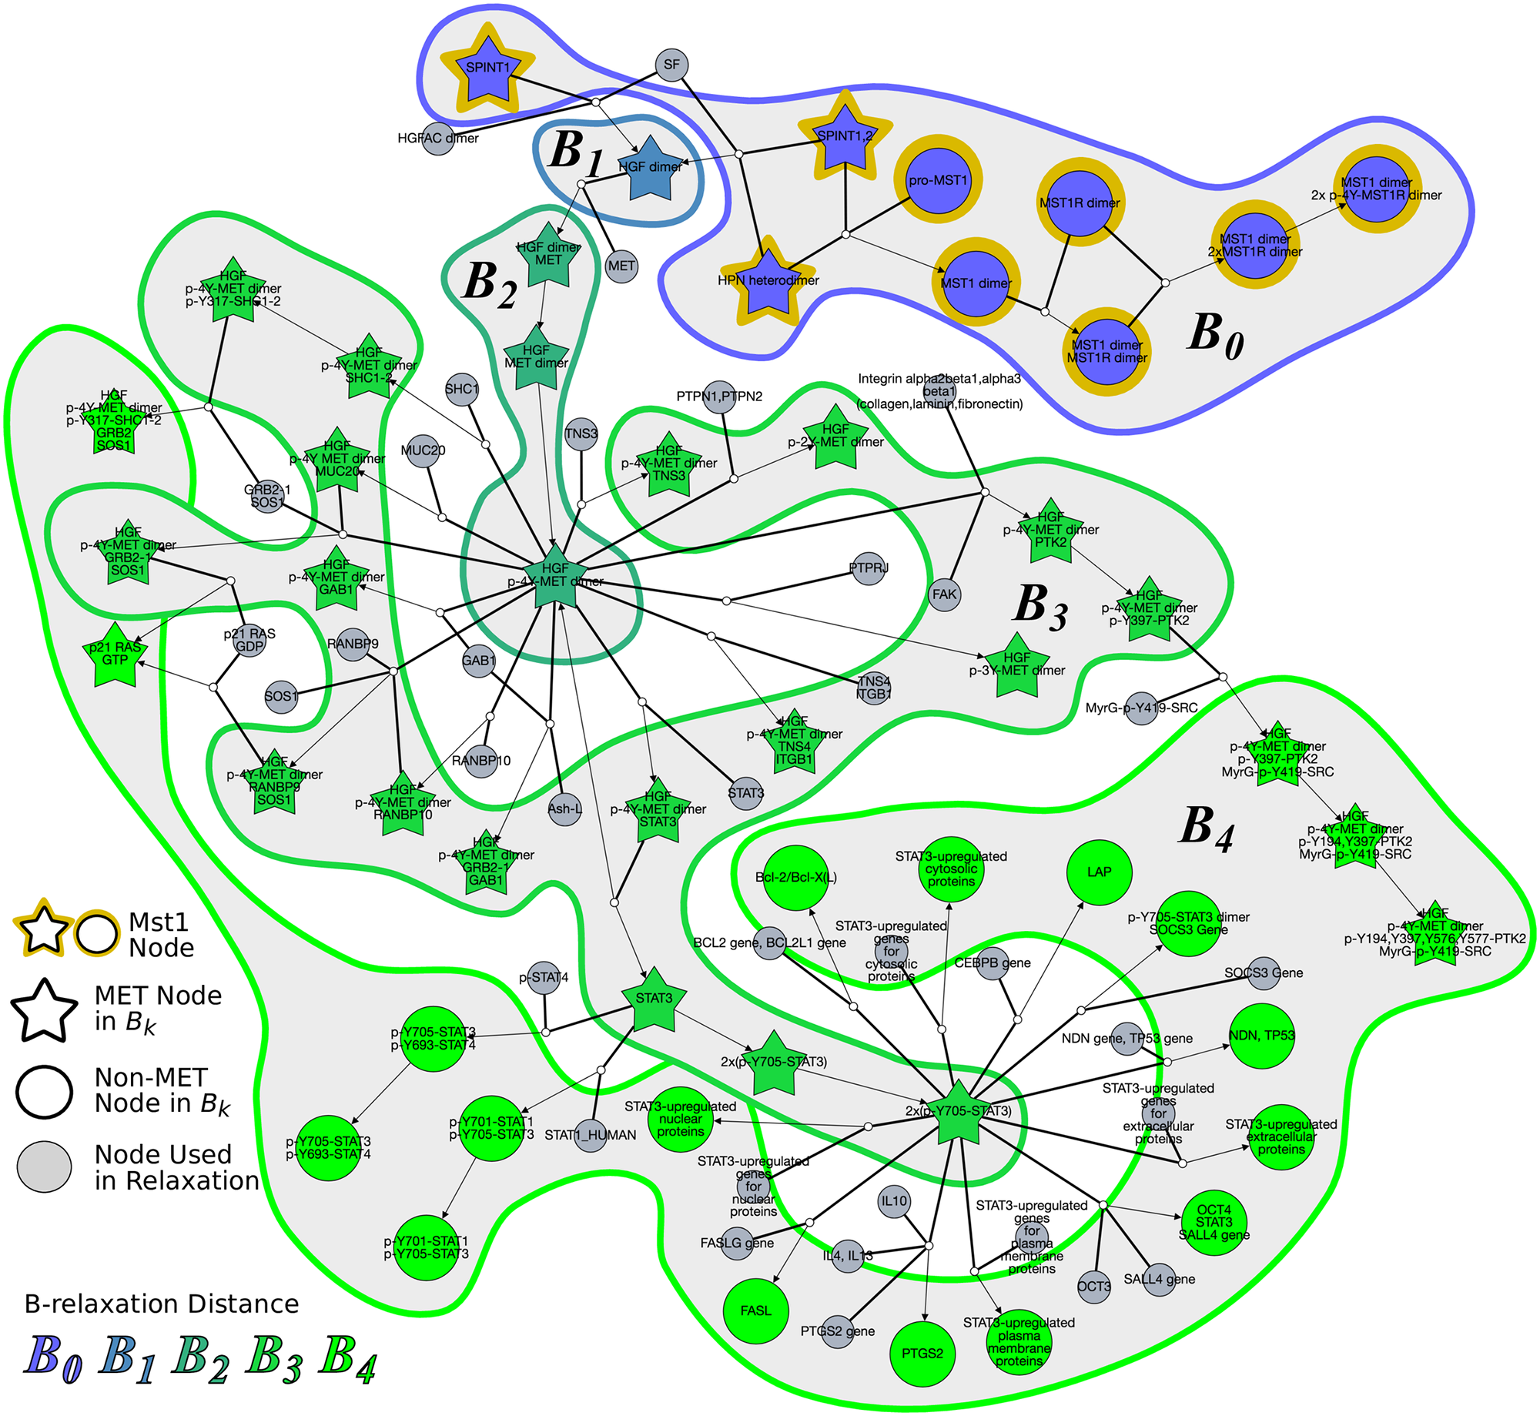
Connectivity in Practice:
Sparse and Missing Data
B-Connectivity overly strict for some pathway databases (Reactome) Relax the definition to allow one hyperedge to be traversed without all reactants BFS-like connectivity structure
Franzese et al., PLOS Comp. Biol 2019

Slide 27
Random Walks
… are behind many similarity functions on graphs.
Gartner et al., COLT, 2003.

Slide 28
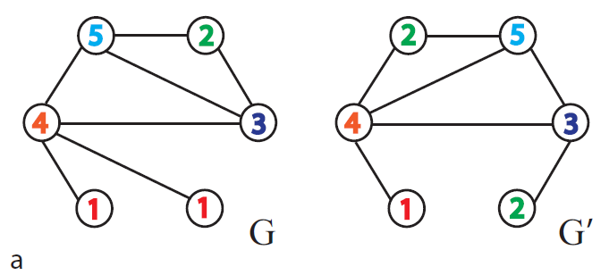
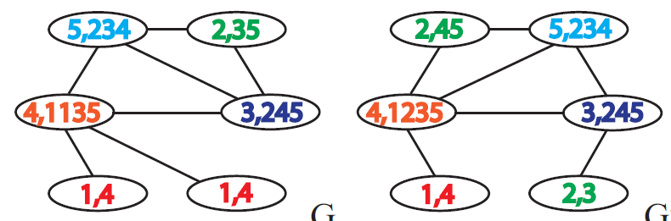
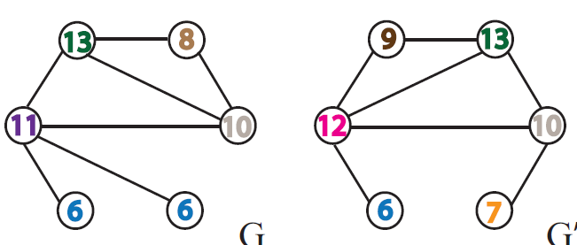
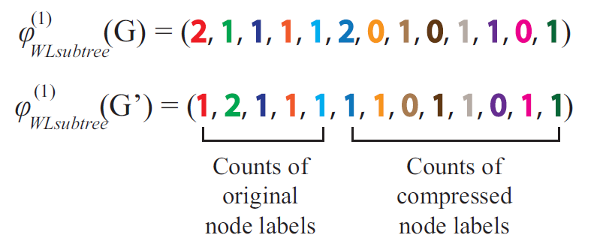
Weisfeiler-Lehman Graph Kernels
Shervashidze et al. J Mach Learn Res 2011

Slide 29
Random Walks Kernels on Ordered Hypergraphs
Example: H = (V, E)
V = {n₁, n₂, n₃, n₄, n₅}, E = {p(n₁, n₂, n₃), p(n₁, n₅, n₆), q(n₄, n₃, n₅)}
Walk: p(n₁, n₂, n₃), 1, 1, p(n₁, n₅, n₆), 2, 3, q(n₄, n₃, n₅)
Walk Type: p, 1, 1, p, 2, 3, q
Kernel: a product of counts of all walk types up to certain length
(surprising finding) a dynamic programming solution
(remember) kernel is just a similarity function w/ some constraints
Wachman & Khardon, ICML, 2007.

Slide 30
Higher-Order Network Structures
→
Graphlets and the Reconstruction Conjecture
Overlapping Complexes, Classification Problems, & Hypergraphlets
Shortest Paths & Random Walks on Hypergraphs
Discussion Topics
Representation Learning
Considering Labeled Data
Establishing Baselines

Slide 31
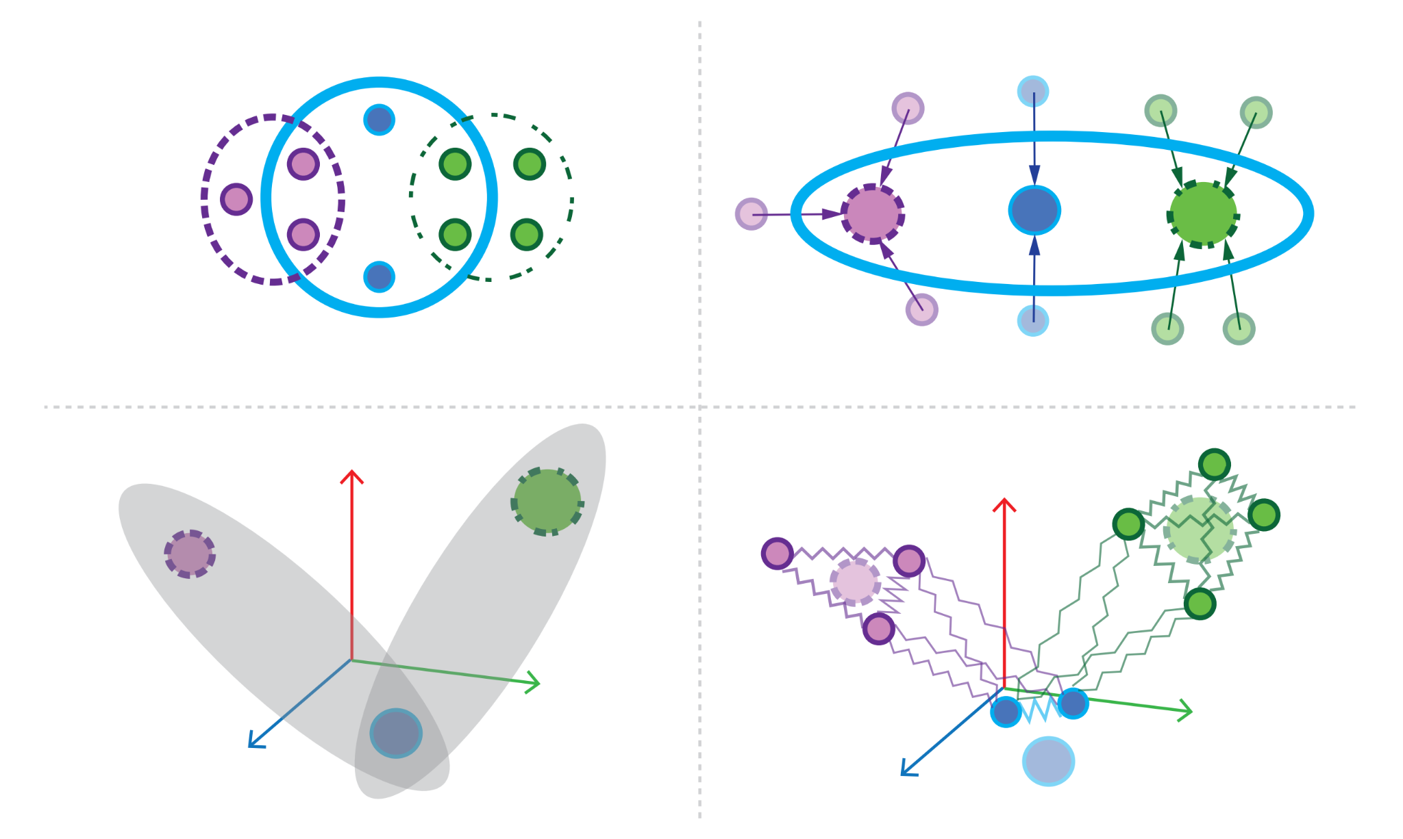
Representation Learning
DISCUSSION
Network embedding: Given a hypergraph H=(V ,E), assign a vector representation h_{u} (R^{d}; d << n) to each u∈(V ∪E). Structurally similar nodes/edges should be close in the vector space. Should exploit transitivity and any node features.
Clique (lossy) or star expansion → Standard graph embedding techniques.
Coarsening: iteratively merges nodes of the hypergraph to shrink the size of the hypergraph until it is small enough for any network embedding algorithm.
Initial embedding: generate embeddings on the coarsest hypergraph.
Refinement: the embedding vectors of the coarser hypergraph are projected onto a finer hypergraph and a refinement algorithm is used to refine these embedding vectors.
Maleki et al., arXiv, 2022.

Slide 32
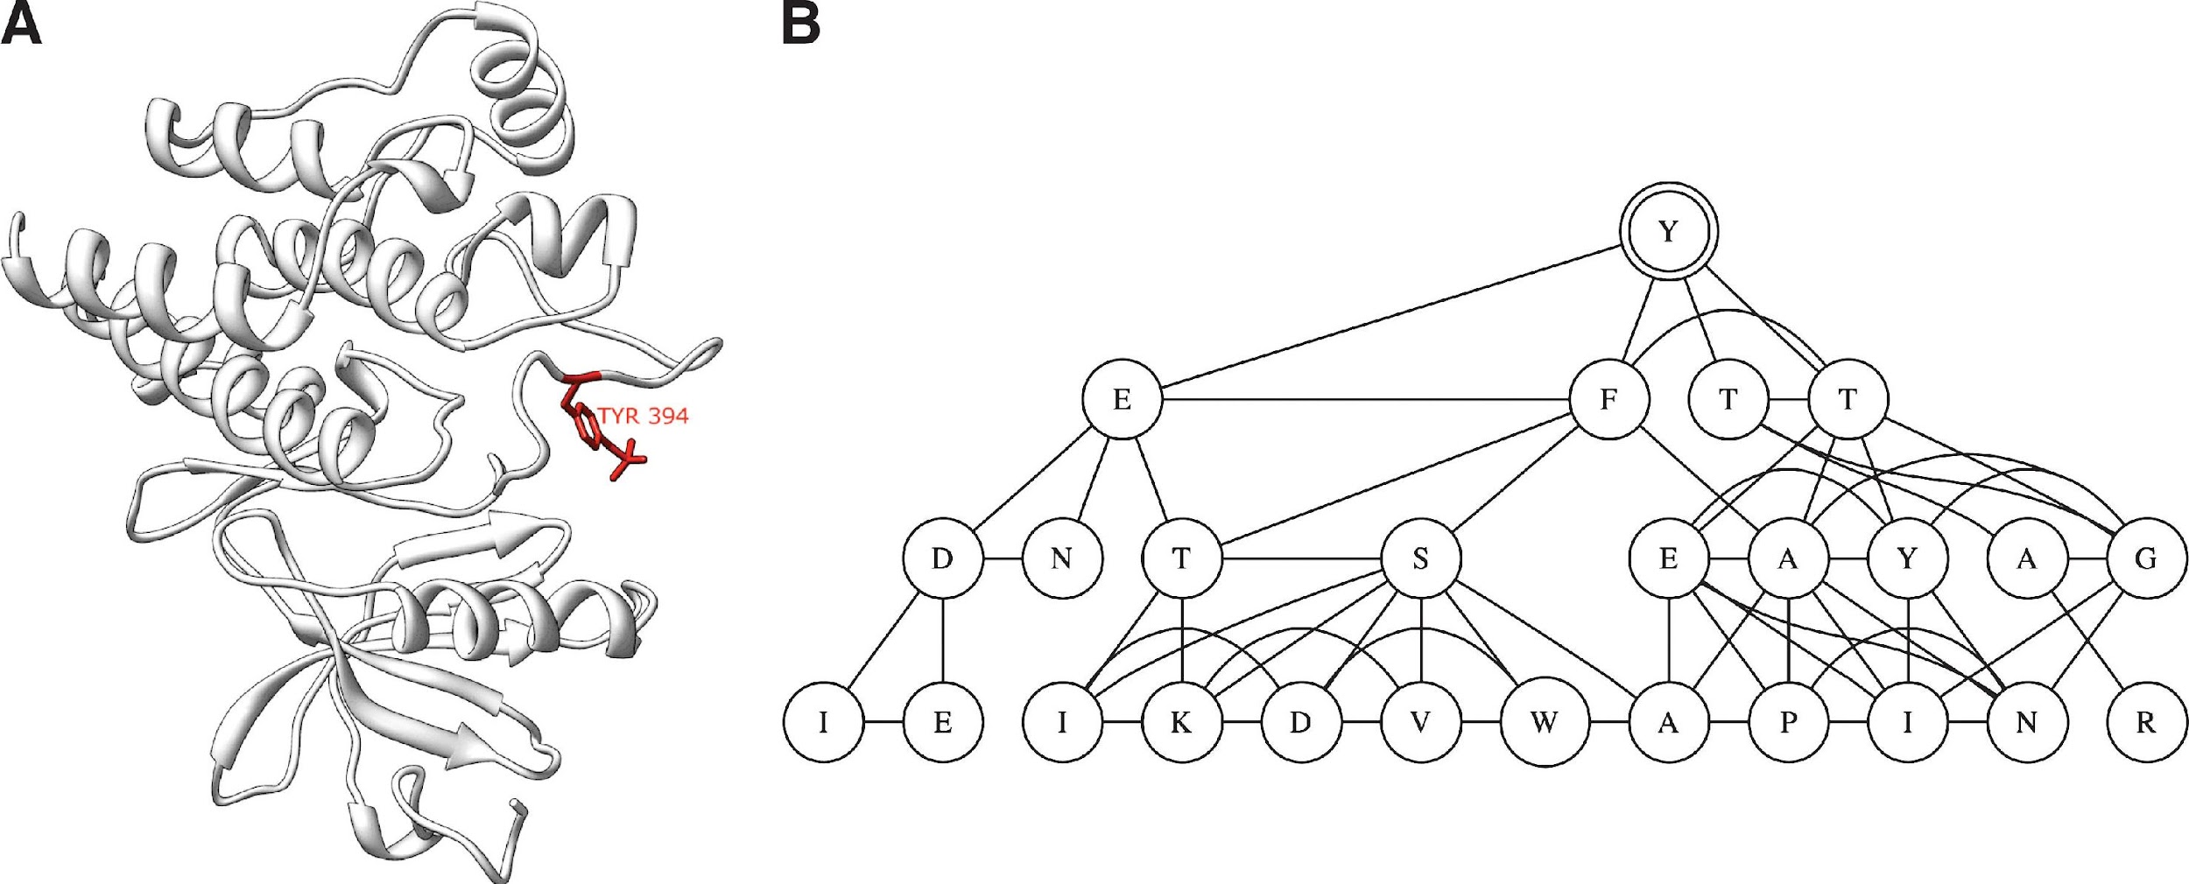
Subgraph Counting in Colored Graphs?
DISCUSSION
Depth-3 subgraph rooted at Y394 in a protein from panel A.
Node coloring: graph counting needs to get more sophisticated
Vacic et al., J Comput Biol, 2010. Lugo-Martinez, Radivojac. Network Science, 2014

Slide 33
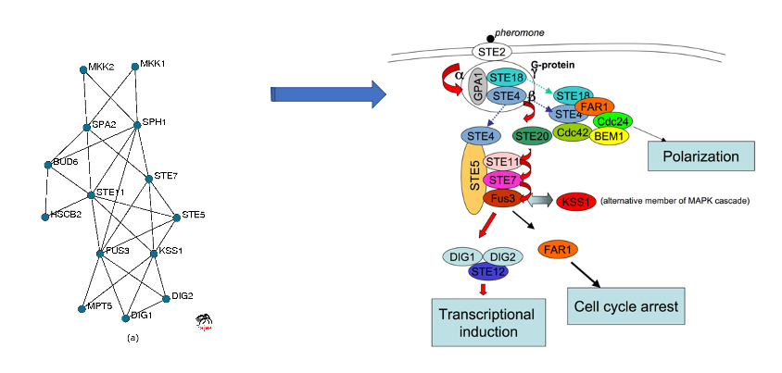
Establishing Baselines
DISCUSSION
How do we know when a higher-order representation is better than a (pairwise) graph representation?
What kind of data could help show this?
Many problems on hypergraphs are open (or known to be NP-complete)

Slide 34
End of Slide Deck

Slide 35
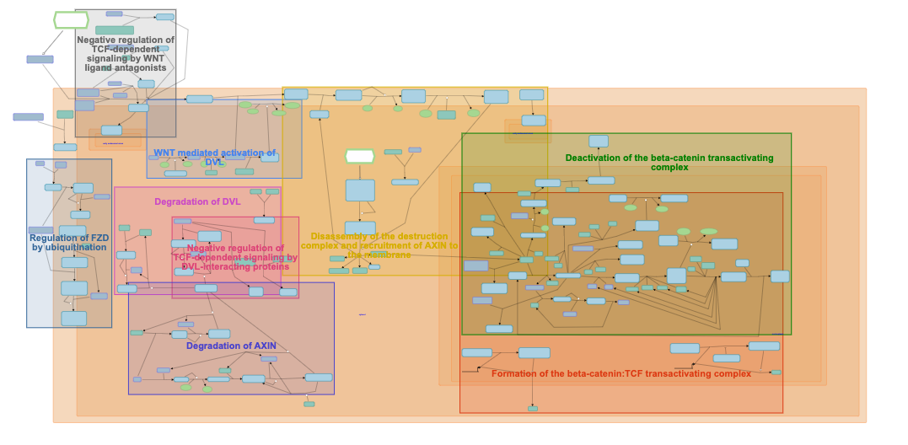
Reactome Pathway Database

Slide 36
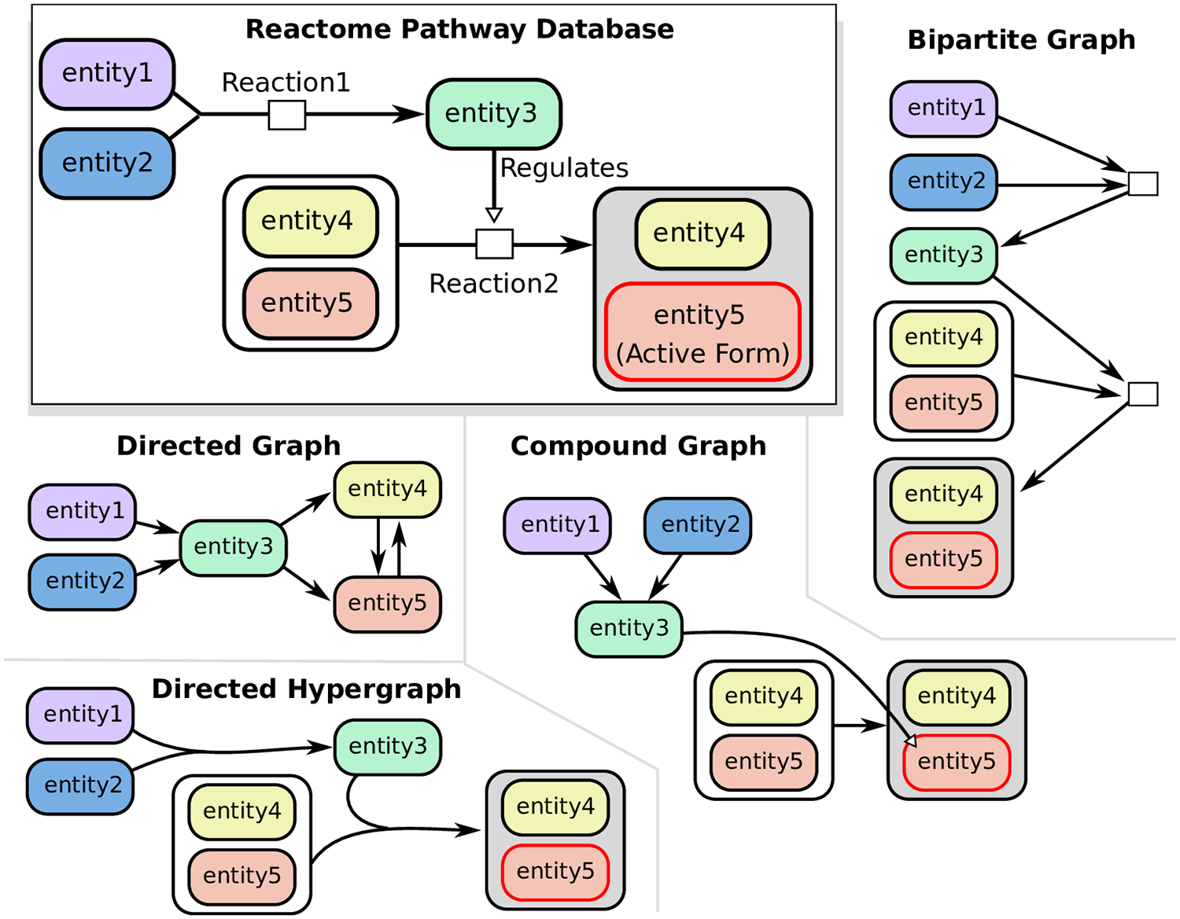
Also
Factor Graphs,
Petri Nets, Logic Nets,
etc.
[Franzese et al., PLOS Comp. Biol 2019]

Slide 37
Graphlets
Data structures for efficient counting (small k)
Extensions to different graph types
Graphlet signatures for nodes
Identify proteins w/ similar biological processes & roles
Network alignment
Graphlet distributions for networks
Identify similarities in networks from different domains
[Milenković & Pržulj, Cancer Informatics 2008] [Milenković et al., Cancer Informatics 2010] [Yaveroğlu et al., Scientific Reports 2014]

Slide 38
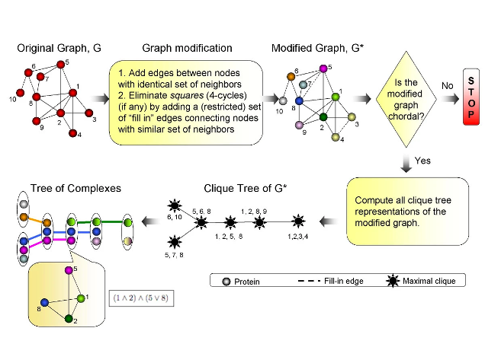
Algorithm
Zotenko et. al. 2006
Decomposition of overlapping protein complexes: A graph theoretical method for analyzing static and dynamic protein associations.

Slide 39
Subhypergraphs
Idea: cast different graph prediction problems as prediction on vertices
count subhypergraphs rooted at those vertices,
measure similarity between vertices based on counts
use for downstream analysis
Section hypergraphs: if a node is removed from the original hypergraph, all edges that contain that node are removed.
Induced hypergraphs: if a node is removed from the original hypergraph, the edges that contained that node are reduced in arity by 1. Multiplicity of some edges may increase.
Lugo-Martinez et al., Bioinformatics, 2021.

Slide 40
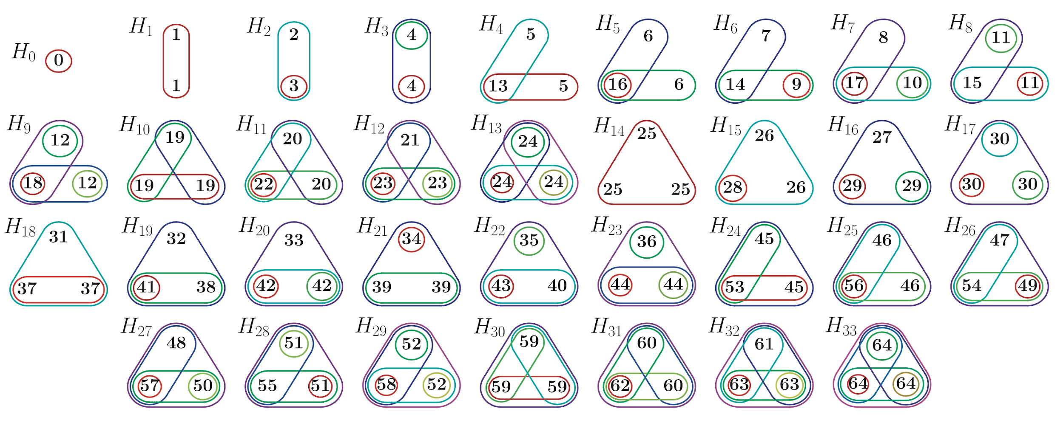
Hypergraphlets w/ self-loops but w/o roots
Gaudelet et al., Bioinformatics, 2018.

Slide 41
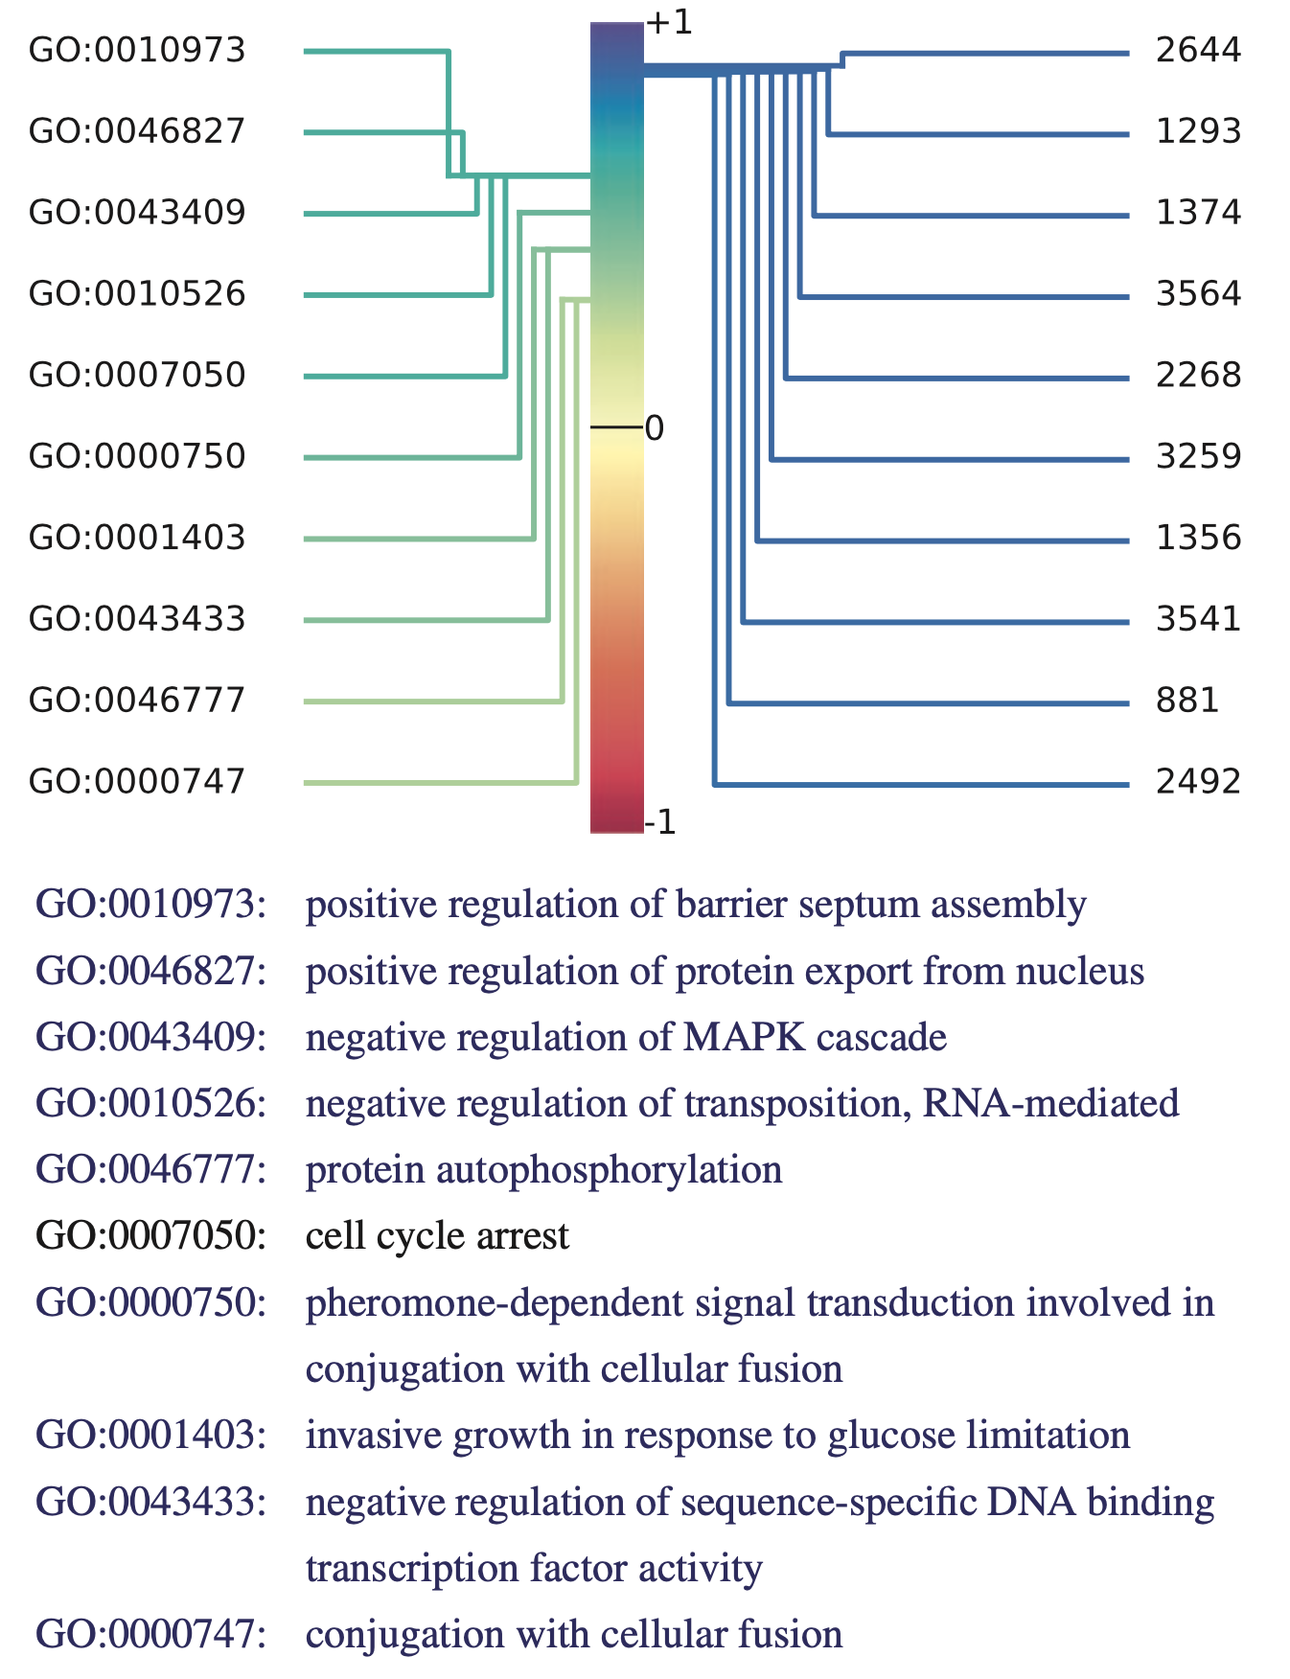
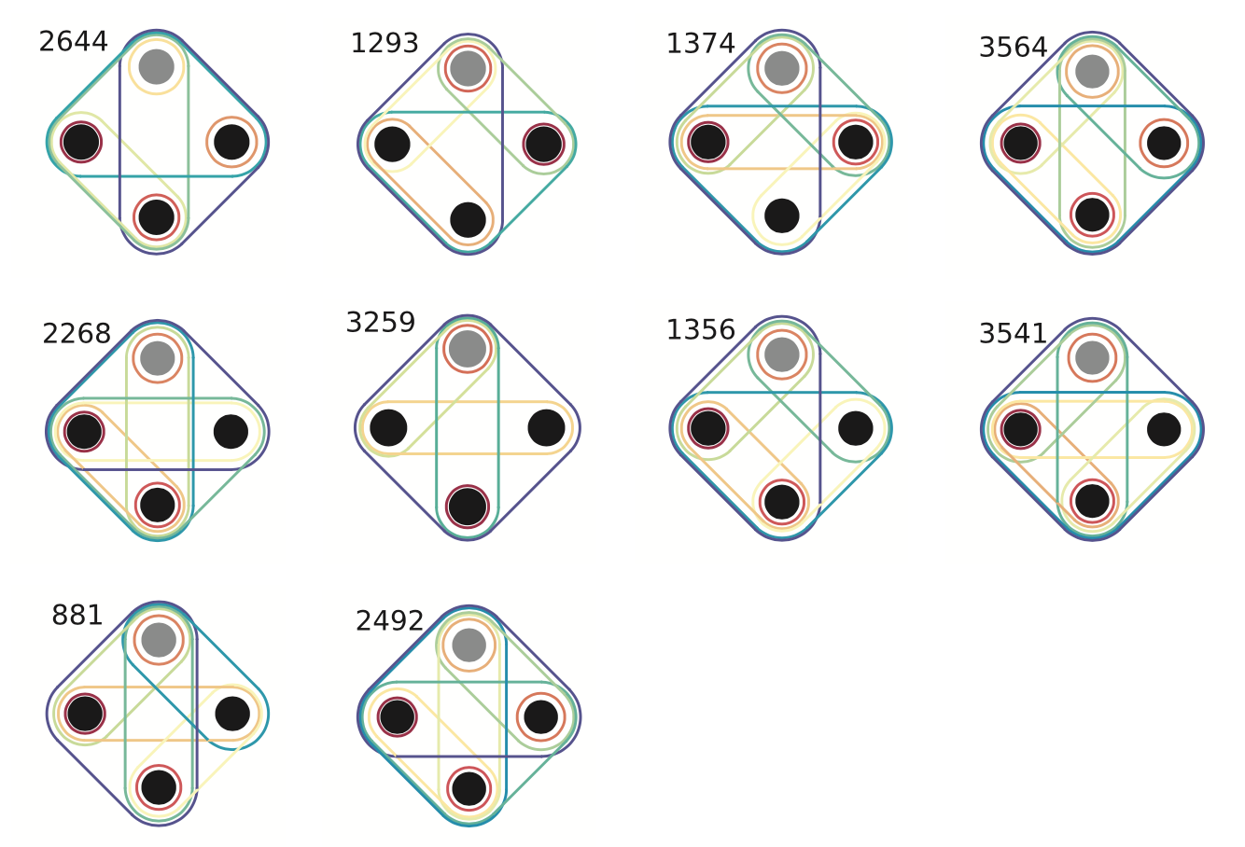
Hypergraph Enrichment
Gaudelet et al., Bioinformatics, 2018.

Slide 42
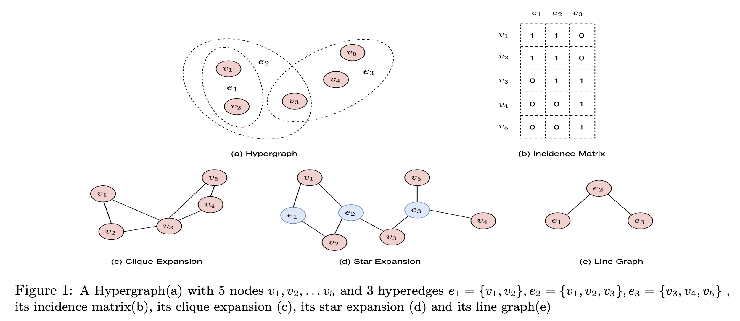
Hypergraph Approximations by Graphs
Srinivasan et al., SIAM Data Mining, 2021.

Slide 43
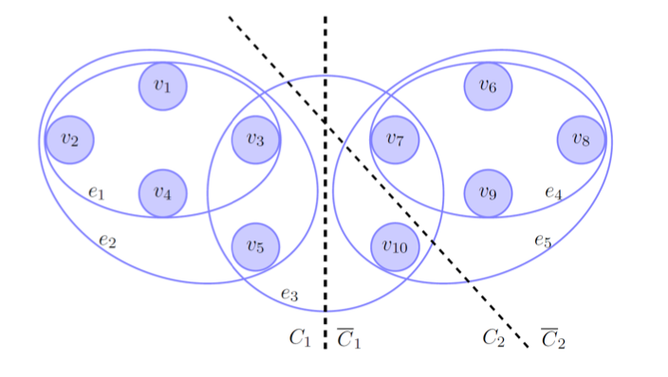
Hypergraph Approximations by Graphs
Result: a graph with the same vertex set V which for every partition of nodes (C, C’) has the same cut value as the hypergraph cut does not generally exist (Ihler et al., Information Processing Letters, 1993).
Dummy nodes with both positive and negative weights are necessary to allow for cut equivalence.
Ordered hypergraphs: even harder to use clique and star expansion.
Hein et al., NIPS, 2013.

Slide 44
Hypergraph Literature
Perspectives:
Klamt et al. Hypergraphs and Cellular Networks. PLOS Comp Biol 2009. [DOI]
Ritz et al., Signaling Hypergraphs. Trends in Biotech 2015. [DOI]
Battiston et al. Networks beyond pairwise interactions: Structure and dynamics. Physics Reports 2020. [DOI]
Shortest Paths & Connectivity:
Gallo et al., Directed hypergraphs and applications. Disc Appl Math 1993. [DOI]
Ritz et al., Pathway Analysis with Signaling Hypergraphs. TCBB 2017. [DOI]
Franzese et al., Hypergraph-based connectivity measures for signaling pathway topologies. PLOS Comp Biol 2019. [DOI]
Spencer Krieger & John Kececioglu Heuristic shortest hyperpaths in cell signaling hypergraphs, BMC-AMB 2022 (there is also ISMB preliminarily (?) accepted paper by the same authors)
Classification/Link Prediction:
Lugo-Martinez et al., Classification in biological networks with hypergraphlet kernels. Bioinformatics 2020 [DOI]
Clustering:
Chodrow et al., Generative hypergraph clustering: From blockmodels to modularity. Sci. Advances 2021. [DOI]
Representation Learning:
Zhang & Ma. MATCHA: Probing Multi-way Chromatin Interaction with Hypergraph Representation Learning. Cell Systems 2020.[DOI]

Slide 45
Hypergraph Literature (Outside Biology)
Link prediction
Benson et al., Simplical closure and higher-order link prediction, PNAS, 2018.
Walks/Proximity
Aksoy et al., Hypernetwork science via high-order hypergraph walks, EPJ Data Science, 2020.
Chitra & Raphael. Random Walks on Hypergraphs with Edge-Dependent Vertex Weights. ICML 2019. [DOI]
Embedding
Yang et al., Revisiting User Mobility and Social Relationships in LBSNs: A Hypergraph Embedding Approach, WWW, 2019.
Sun et al., Heterogeneous Hypergraph Embedding for Graph Classification, WSDM, 2021.

