Slide 1
Inference and Comparison of Biological Networks
Lenore Cowen, Ben Raphael, Mona Singh, Xinan Holly Yang, Mehmet Koyuturk, Kimberly Glass
June 13, 2022

Slide 2
Four Main Subtopics
Inference of networks
Link predictions and their applications
Condition-specific subnetwork inference
Differential network analysis

Slide 3
Subtopic 1:
Inference of networks
Kimberly Glass

Slide 4
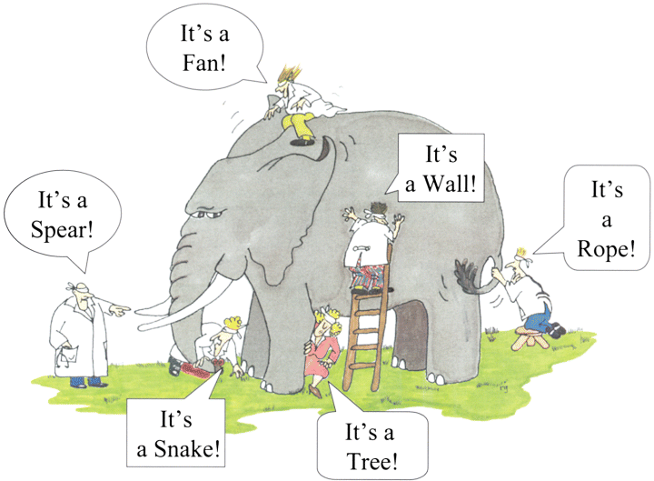
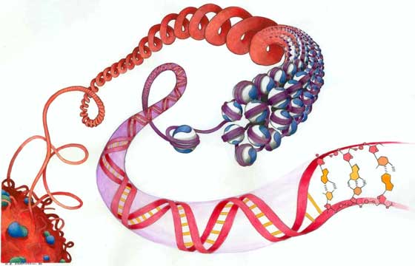
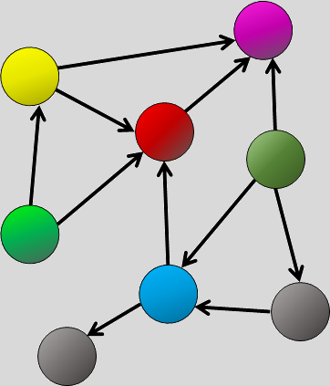
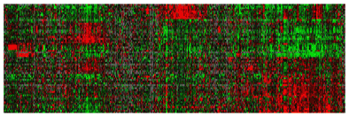
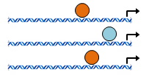
Inferring networks from (omics) data
It’s protein
interactions
Biological Network
(omics) Data
It’s genetic
variants
It’s gene
expression
It’s TF
regulation
It’s CG
methylation
It’s chromatin
structure
Network Inference
http://expertcytometry.com/the-story-of-the-blind-men-and-the-elephant-or-why-its-better-to-see-your-cells/

Slide 5
Building and Interpreting Biological Networks
Biological networks often aren’t known a priori but are created using genomic data.
How a network is inferred (“reconstructed”) often depends both on what data is available AND what we want the edges in the network to represent (biological question).
  Influences the choice of method for inferring a network.
The meaning of the edges in a reconstructed network depend on the method used to generate those edges.
  Influences how to interpret the network.
Types of Biological Relationships
regulates
regulatory interactions
(protein-DNA)
gene A
gene B
binds
functional complex
B is a substrate of A
(protein-protein)
gene A
gene B
reaction
product
is a
substrate for
gene A
gene B
metabolic pathways

Slide 6
Interpreting the “edges” in Biological Networks
Co-expression Networks
A
B
A
B
A
B
Relational Networks
Correlation Network
Regulatory Network
Generally Undirected (non-causal relationships)
Nodes all of same “type”
Generally no “signs” on edges
Example: Protein A is a dimerization partner with protein B.
Data:
Yeast-two-hybrid
Synthetic-lethality
Undirected (non-causal relationships)
Nodes all of same “type”
Edges can have “signs”
Example: When the expression of Gene A changes, so does the expression for Gene B.
Data:
high-throughput/microarrays
(expression, methylation, metabolomic etc)
Directed Network (causal relationships)
Can have “types” of nodes
Edges can have “signs”
Example: TF A regulates
Gene B.
Data:
ChIP-chip/seq,
TF-motif scan

Slide 7
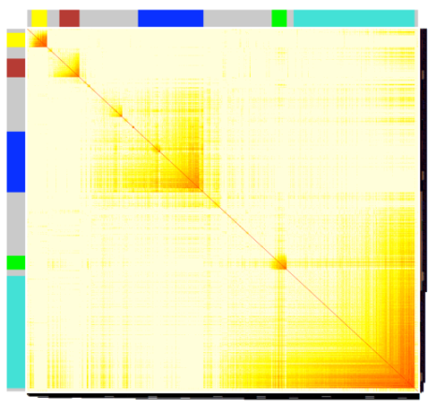
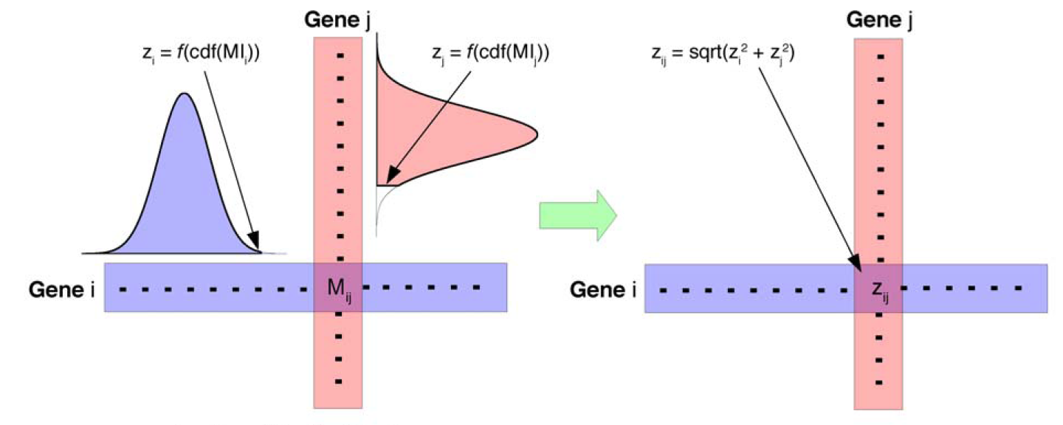
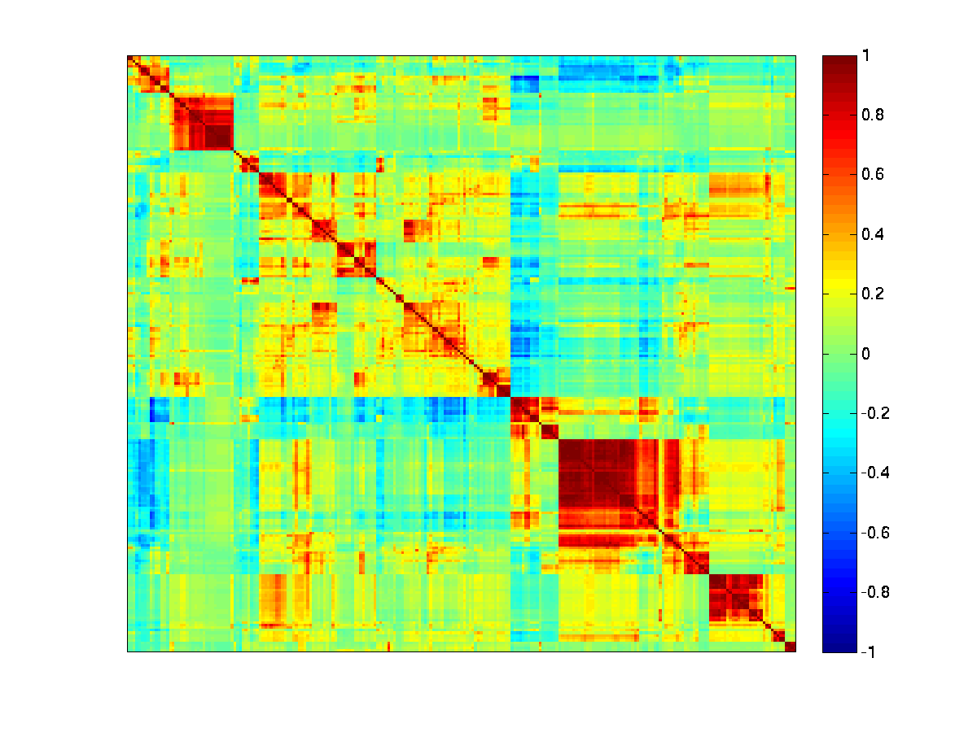
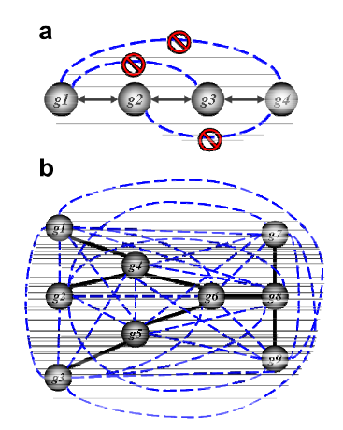
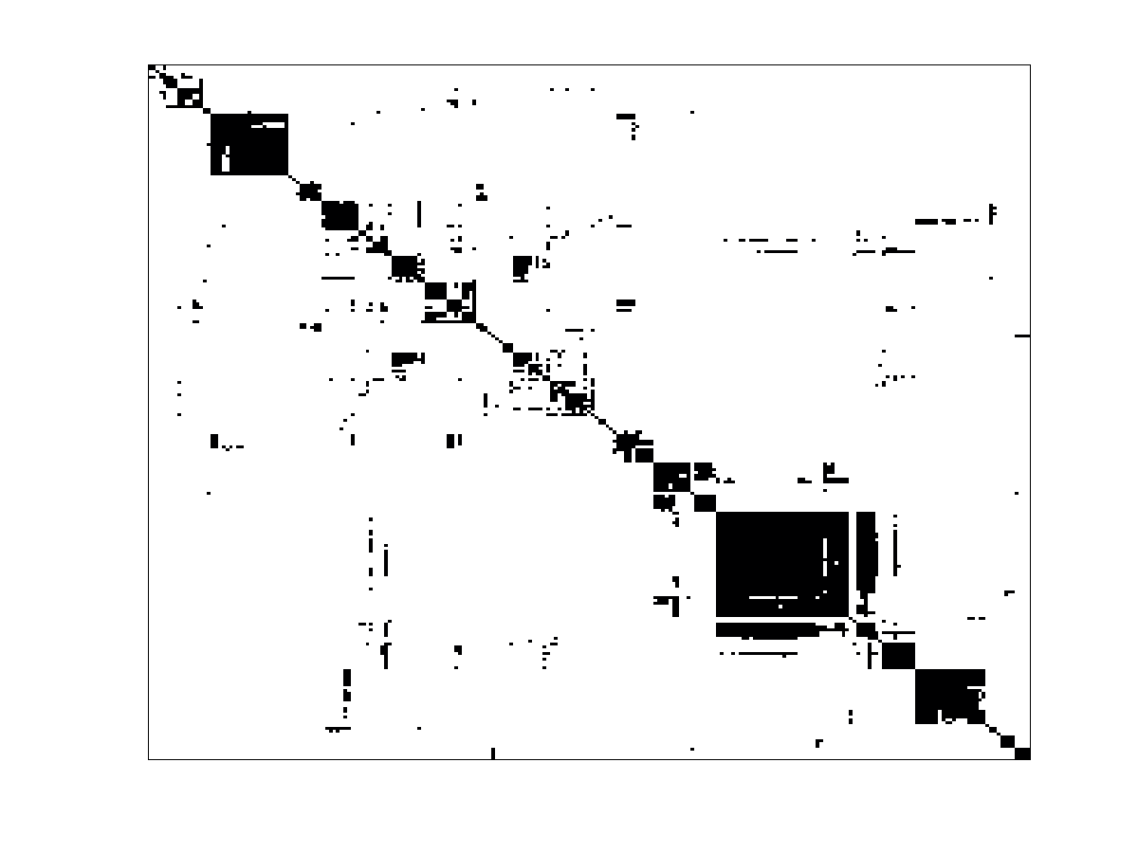
CLR
(Context Likelihood of Relatedness)
Coexpression Network Inference
WGCNA
(Weighted Gene Co-expression Network Analysis)
Many Approaches
genes
Key Idea: Scale co-expression for biological topology.
Key Idea: Normalize each gene pair against a background.
conditions
(1) Use expression data to calculate a “similarity matrix”
five gene “modules”
detected: yellow, red,
blue, green, cyan.
genes
(r²)^{power}
genes
Zhang, Horvath. Stat Appl Genet Mol Biol. 2005
Faith, Gardner et al. PLoS Biol. 2007
(2) Threshold to define an adjacency matrix
genes
ARACNe
(Algorithm for the Reconstruction of Accurate Cellular Networks)
genes
Key Idea: Remove indirect relationships.
Margolin, Califano et al. BMC Bioinformatics. 2005

Slide 8
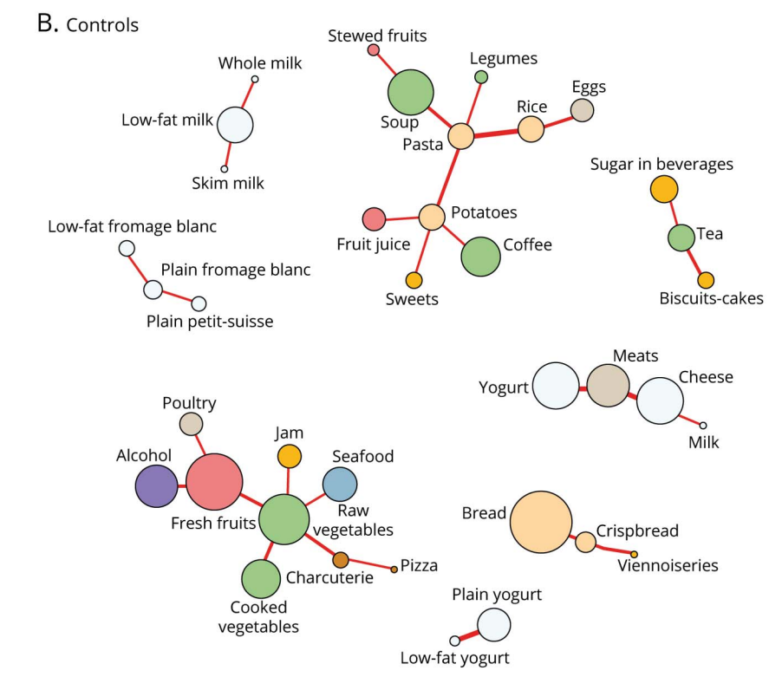
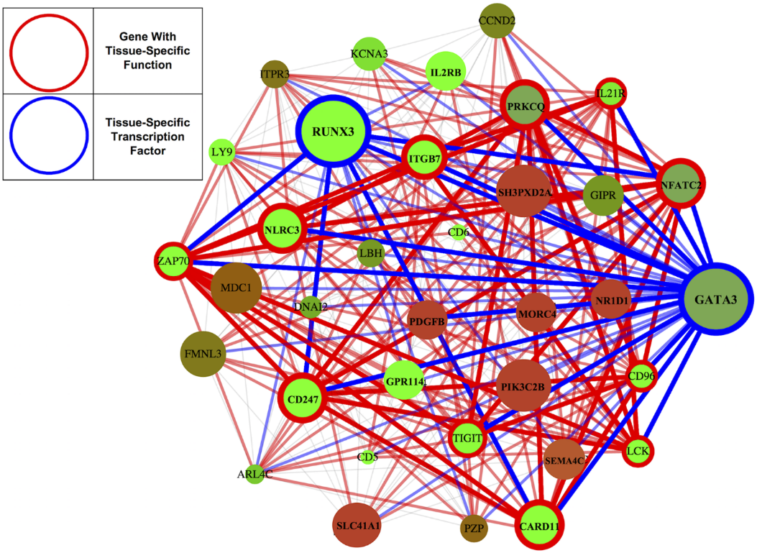
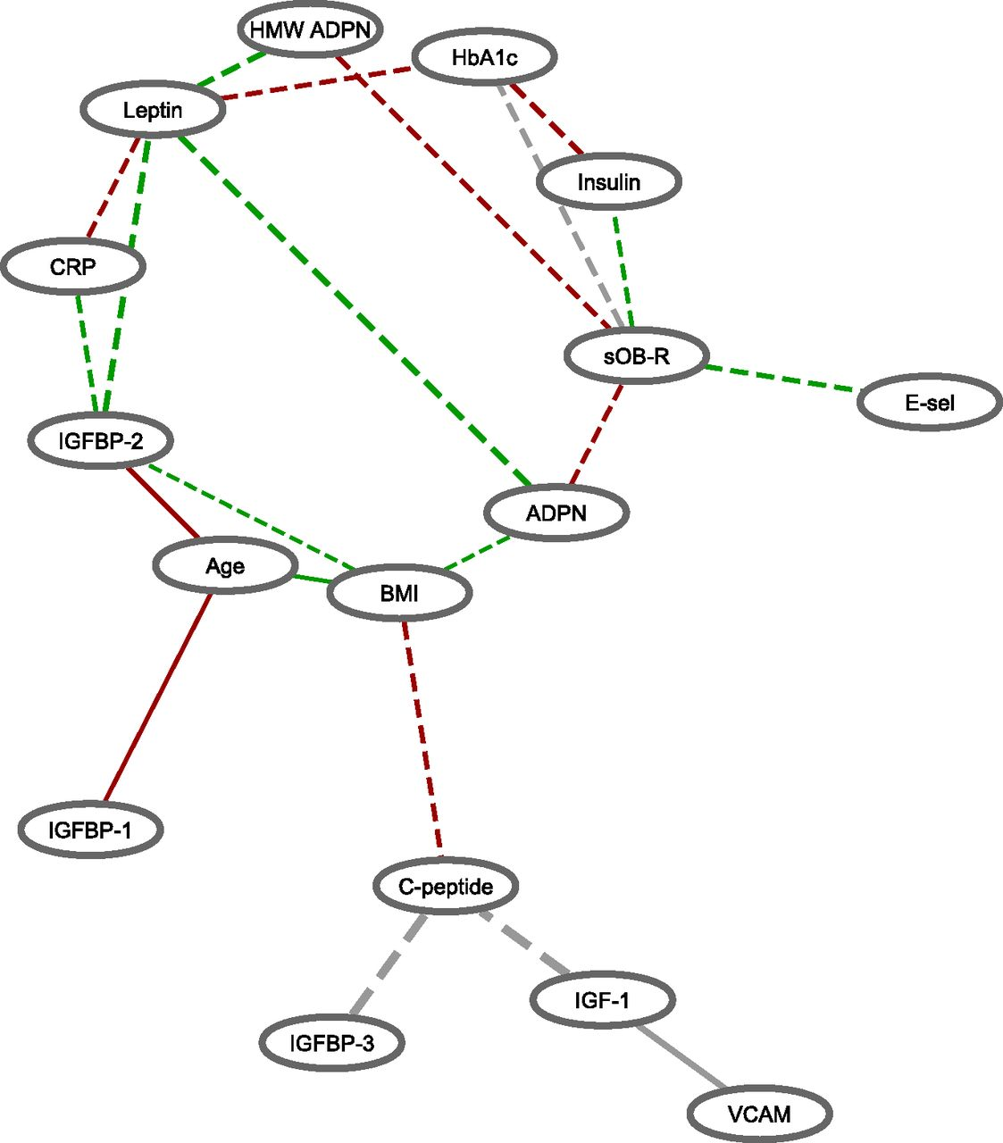
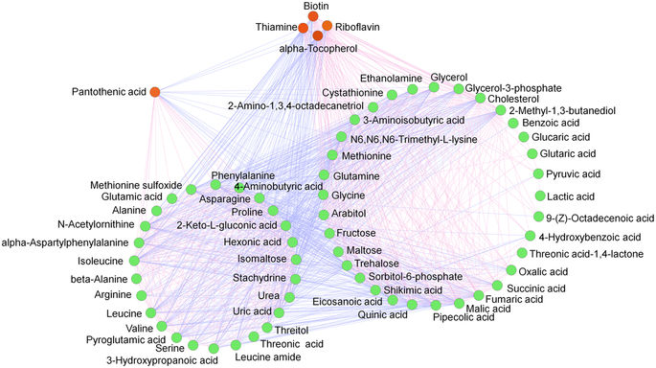
Correlation Networks are Widely used in Biology
Nodes are foods
Nodes are genes
Pierson et. al. PLoS Computational Biology. 2015
Samieri et. al. Neurology 2020
Nodes are metabolites
Nodes are biomarkers
Dong et. al. Scientific Reports. 2017.
Huang et. al. Diabetes. 2019.

Slide 9
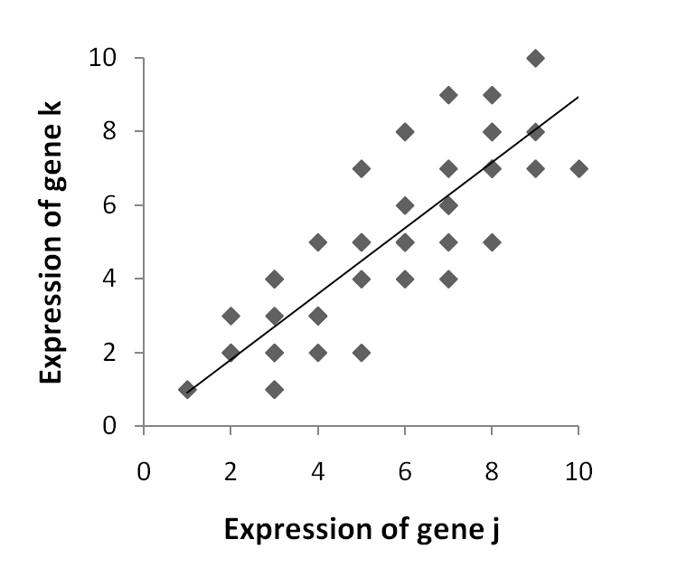
Correlation is not Causation
Co-expression occurs when:
(1) One gene regulates another.
(2) Two genes are targeted by the same regulator.
Both are represented the same way in a co-expression network.
Expression of gene B
Expression of gene A
A
Co-expression Network
A
B
A
_{TF}
OR
A
B
B
B
TF expressed
A
B
Sometime later…..
genes are expressed

Slide 10
Interpreting the “edges” in Biological Networks
A
B
A
B
A
B
Relational Networks
Correlation Network
Regulatory Network
Generally Undirected (non-causal relationships)
Nodes all of same "type"
Generally no "signs" on edges
Example: Protein A is a dimerization partner with protein B.
Data:
Yeast-two-hybrid
Synthetic-lethality
Undirected (non-causal relationships)
Nodes all of same "type"
Edges can have "signs"
Example: When the expression of Gene A changes, so does the expression for Gene B.
Data:
high-throughput/microarrays
(expression, methylation, etc)
Directed Network (causal relationships)
Can have "types" of nodes
Edges can have "signs"
Example: TF A regulates
Gene B.
Data:
ChIP-chip/seq,
TF-motif scan

Slide 11
Gene Regulation is Complex
protein expression
in vivo TFBS
miRNA expression
protein-protein interactions
potential miRNA BS
genetic variants
mRNA expression
potential TFBS
3D chromatin structure
TSS
CpG methylation
DNA sequence
chromatin state

Slide 12
Gene Regulation is Complex
protein expression
in vivo TFBS
miRNA expression
protein-protein interactions
potential miRNA BS
genetic variants
mRNA expression
potential TFBS
Target Gene
(may also be a TF)
3D chromatin structure
TSS
CpG methylation
Transcription
Factors (TFs)
DNA sequence
chromatin state

Slide 13
Gene Regulatory Networks
TF-Gene Regulatory Network
Two main ways to produce this type of network:
G₁
TF₁
Experimentally | Computationally
Technique: ChIP-seq | Technique: DNA sequence scan for TF binding sites (“motifs”)
Limitations: very expensive, limited number of antibodies | Limitations: only know recognitions sequences for ~50% of TFs, prone to false positives, not context-specific
Strength: High quality, context-specific | Strengths: cheap
A Combination
Technique: combine computational predictions with other omics data
Limitations: difficult to do, requires understanding regulatory mechanism and the caveats of each omics data type being used
Strengths: gives fairly cheap context-specific predictions
G₂
G₃
TF₂
G₄
G₅
TF₃
G₆

Slide 14
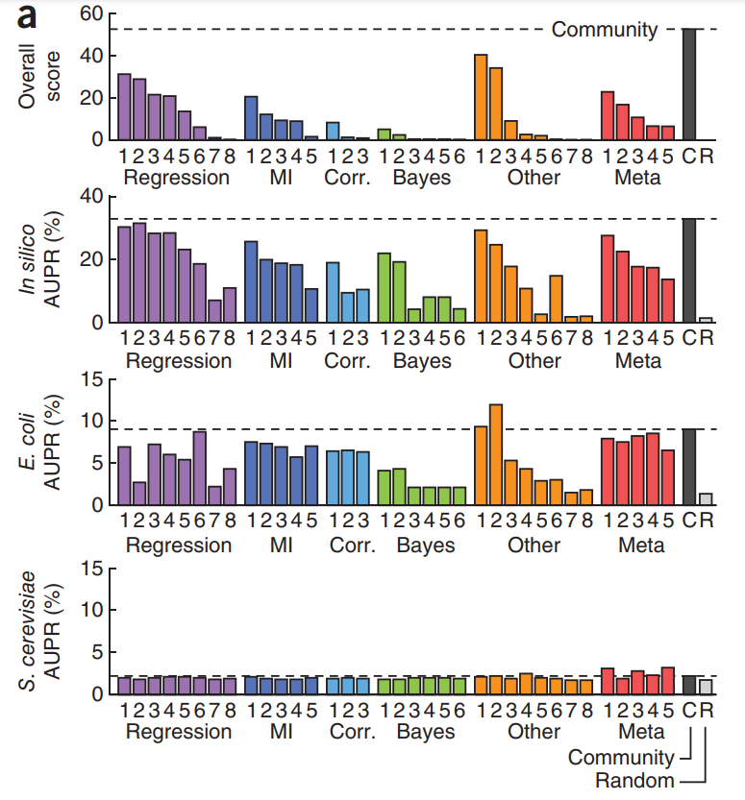
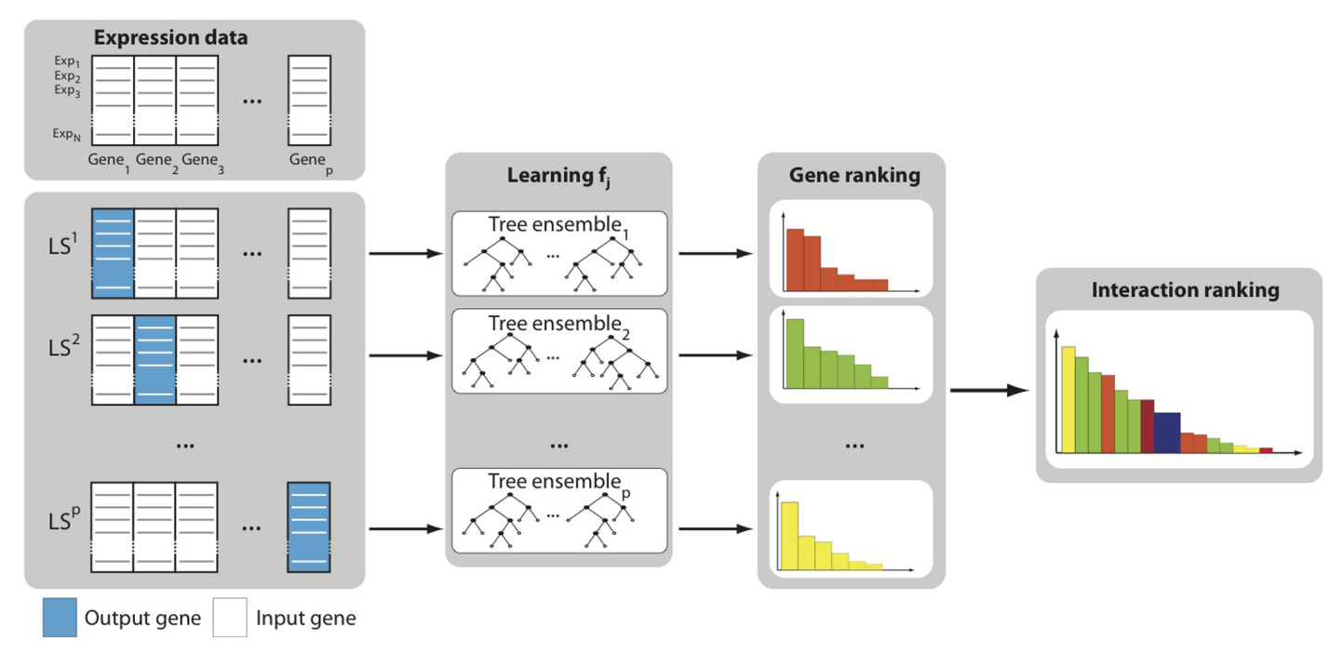
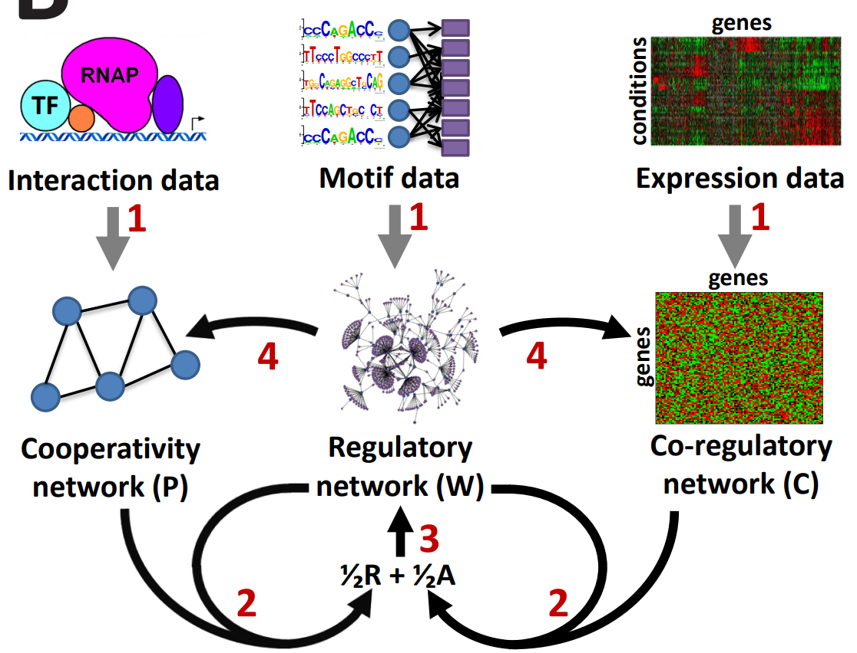
Methods Using Gene Expression Data
There are lots of methods to infer gene regulatory networks using expression data
Most perform poorly in higher order organisms
A handful of approaches
Inferelator
→ uses linear regression, L1 shrinkage and LASSO
Bonneau et. al. Genome Biology. 2006.
GENIE3
→ uses tree-based ensemble methods
PANDA
→ integrates multiple networks using message-passing
Huynh-Thu et. al. PLoS One. 2010.
Glass et. al. PLoS One. 2013.
Marbach et. al. Nature Methods. 2012.

Slide 15
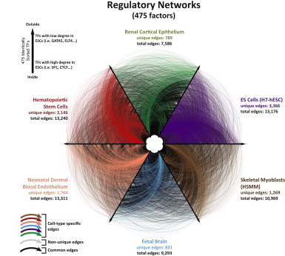
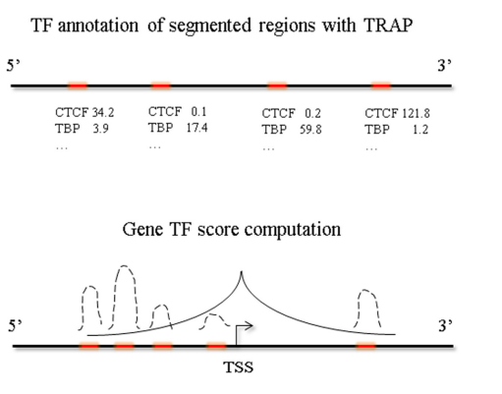
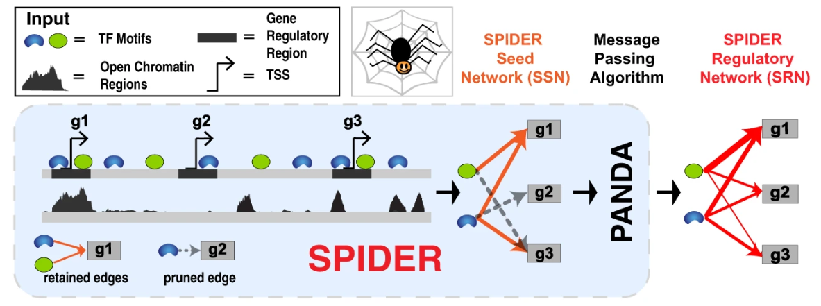
Methods Using Epigenetic Data
TEPIC
Most Approaches
Key Idea: Combine TF binding affinities with annotation data.
Interactions with Epigenetic Evidence
All potential interactions
Epigenetic data
Neph et. al. Cell. 2012.
Schmidt et. al. Nucleic Acids Research. 2017.
Motif found in gene’s promoter and located in region of open chromatin
SPIDER
Motif found within gene’s promoter
Key Idea: Identified consistent structures in pruned network using message-passing.
TF motif
TF1 → Gene1
Gene2
Gene4
Gene1
Gene3
Open Chromatin
Sonawane et. al. NPJ Systems Biology. 2021.

Slide 16
Summary / Discussion Points
Coexpression/Correlation networks are “easy” to use and are widely applied in biology. However, they have multiple limitations, including difficulty translating the edges to biological mechanism.
Gene regulatory networks are difficult to infer. Despite many methods, accuracy remains low and it is challenging to effectively integrate multiple types of omics data into the models.

Slide 17
Subtopic 2:
Link Predictions and their applications
Mona Singh; Lenore Cowen

Slide 18
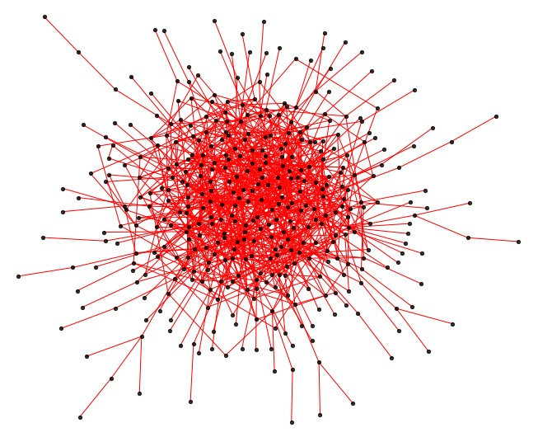
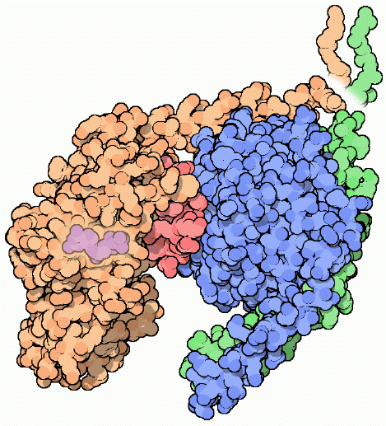
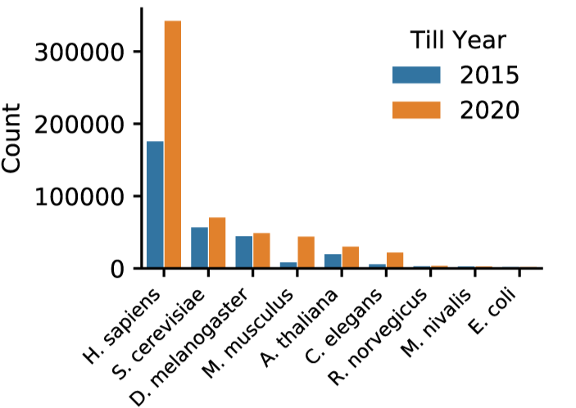
Physical Protein-Protein Interaction Networks
S
GDP
Ga
Gb
Gg
Source: Biogrid
Notes:
Looking at one popular source of this network data, Biogrid, we see that we have the most data known for humans, but we also have data in some well-studied model organisms, yeast, fly, and mouse.

Slide 19
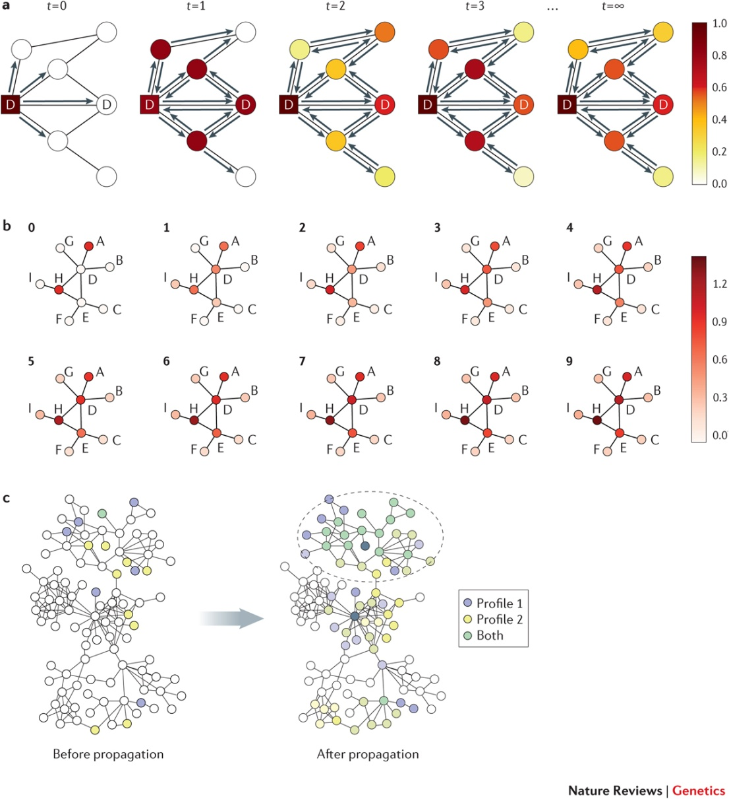
Global methods predict links based on Overall Topological Interconnection Structure
Popular methods
    Common Neighbors, etc.
    L3 Measure (Kovacs et al)
    Network Propagation Scores
    Diffusion Methods
    Embedding Methods (Nelson et al)
    GLIDE (Devkota et al)
Kovács, István A., et al. "Network-based prediction of protein interactions." Nature communications 10.1 (2019): 1-8.
Nelson, Walter, et al. "To embed or not: network embedding as a paradigm in computational biology." Frontiers in genetics 10 (2019): 381.
Devkota, Kapil et al. “GLIDER: Function Prediction from GLIDE-based Neighborhoods.” Bioinformatics (2022).
Cowen, Lenore, et al. "Network propagation: a universal amplifier of genetic associations." Nature Reviews Genetics 18.9 (2017): 551-562.

Slide 20
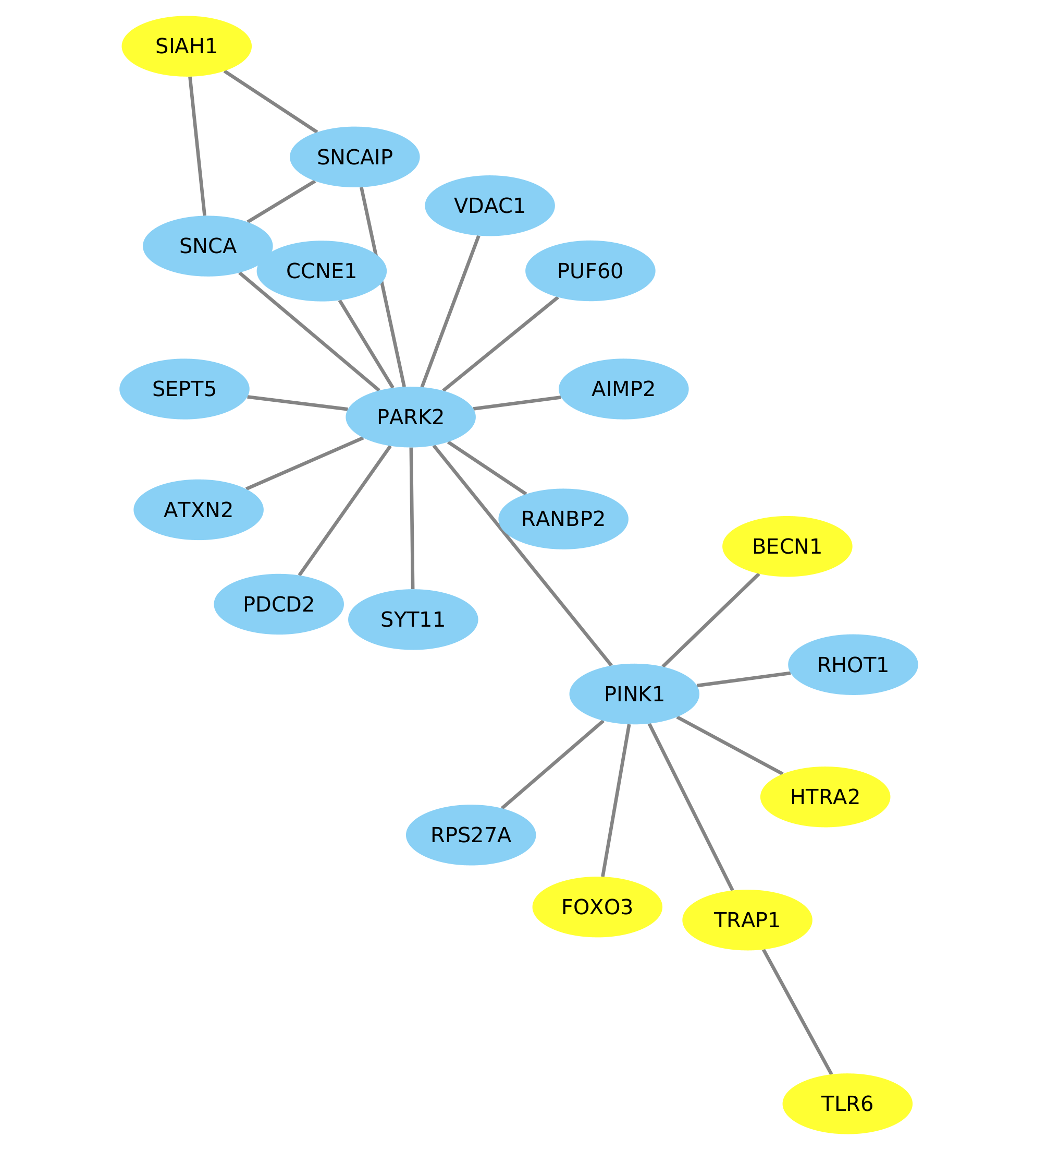
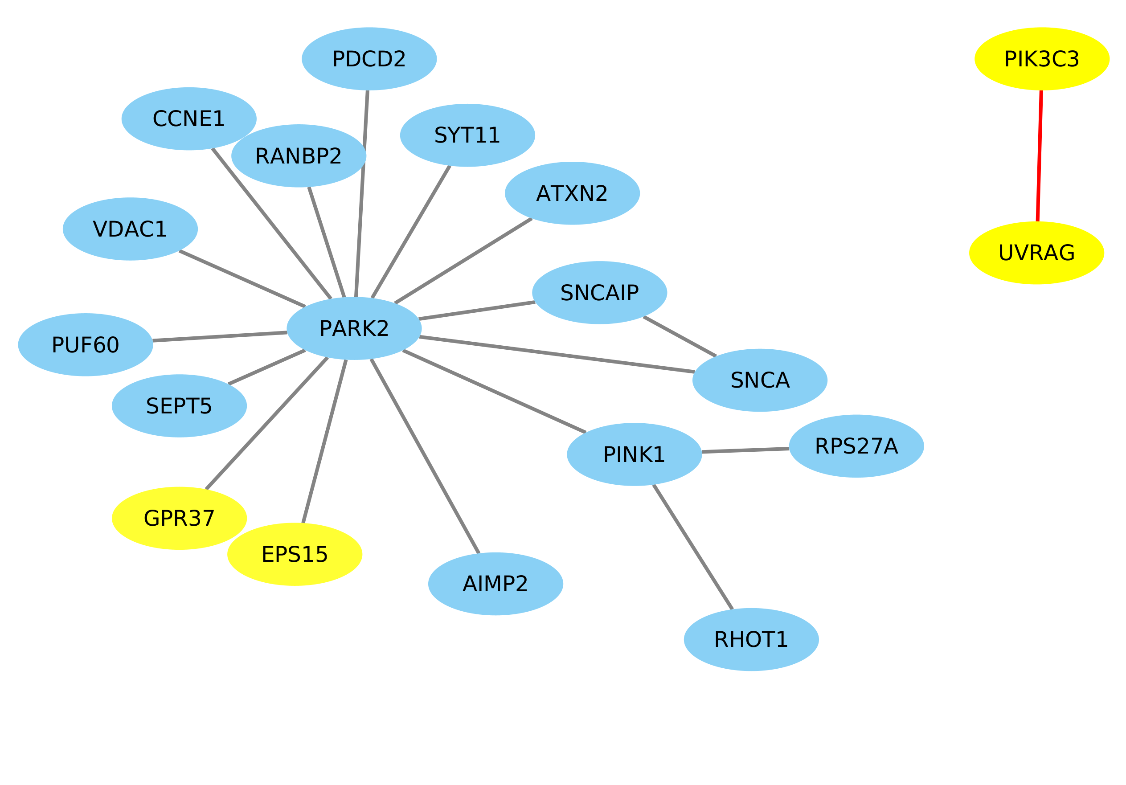
Global Methods Predict Links from Overall Topological Interconnection Structure
Common Neighbors
L3
Physical protein interaction links may have specific patterns of interconnection--

Slide 21
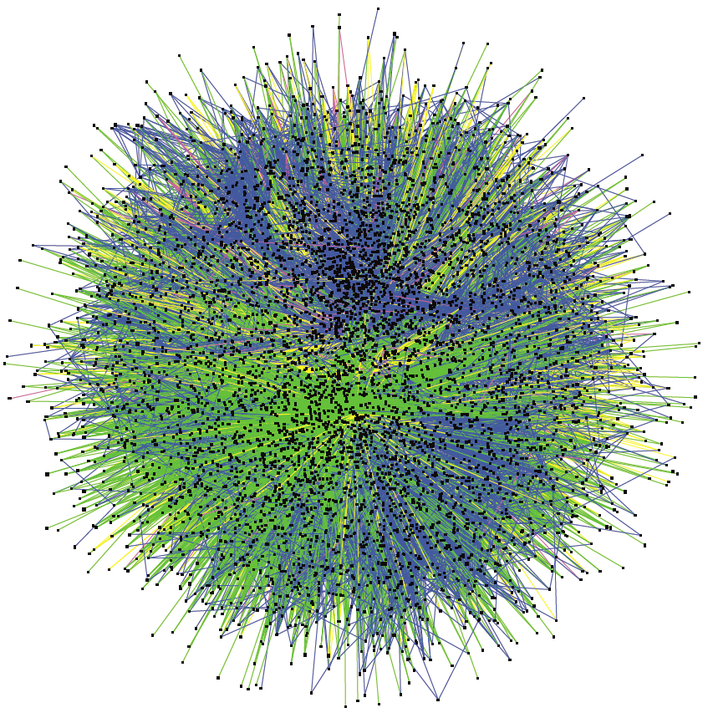

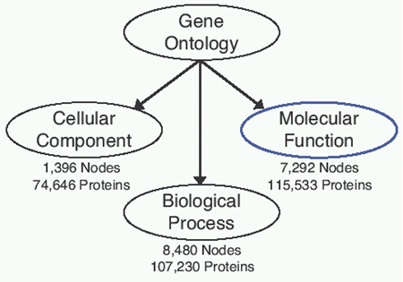
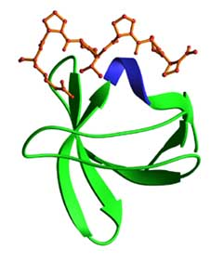
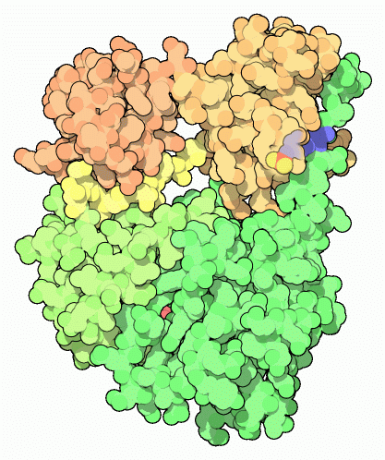




Link prediction & protein features
Topology reflects:
Essentiality
Modularity/Function
Dynamics
Disease Genes
5,003 proteins
3,726 proteins
4,337 proteins
Structural domains
(supfam.org)
Jong et al. (2001)
Song & Singh (2013)
Zotenko et al. (2008)
Nabieva et al (2005)
Song & Singh (2009)
Han et al., (2004)
Pritykin & Singh (2017)
Goh et al. (2007)
Ghersi & Singh (2013)
.
.
.
SH3
MSNGHRCKS…
Functional Motifs
Notes:
All this work, with the exception of the network alignmetns, which considered sequences, treats protein interaction networks as abstract mathematical objects, and the proteins just as graph vertices. However, proteins, of course, are real entities with various properties. From a computational perspective, these properties can be described and systematized in numerous ways. For example, one can talk about structural domains that a protein has, such as SH3 domain, or its sequence motifs, some of which also correspond to domains, or its biological function, as described, for example, by the Gene Ontology or MIPS functional catalogue
So another way to show the interaction network is like this <click>, if one colors the node by the GO biological process
(Src Tyrosine Kinase)

Slide 22
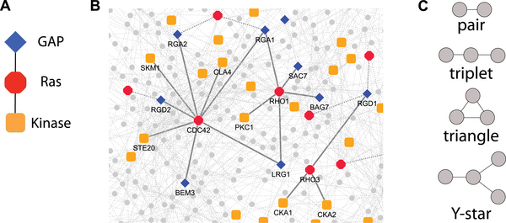
Network schemas: enriched topology & annotations patterns
Banks, Nabieva, Chazelle, Singh (2008) PLOS Computational Biology
Banks, Nabieva, Peterson & Singh (2008) Genome Biology

Slide 23
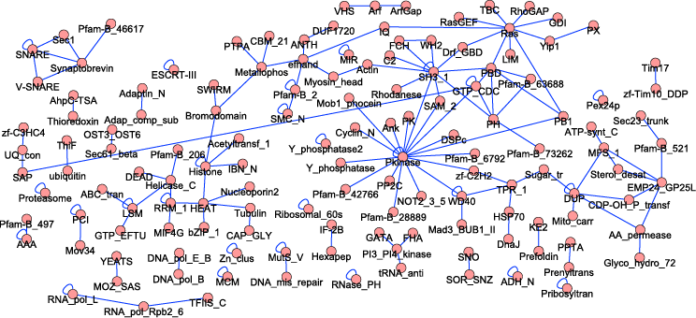
Pairwise schemas enriched in physical PPI networks
Higher-order schemas
Topology | Recurrent schemas | Emergent schemas
 | 419 | 151
 | 842 | 55
 | 31 | 26
 | 999 | 32
Signaling
Link prediction should use topology AND annotations
Distinction: PPI vs functional
Transport
Yeast PPI network
Pfam motifs
Banks, Nabieva, Chazelle, and Singh, PLOS Comp Bio (2008)
Notes:
Here are the pairs.
You can see there are a lot of pairs of all kinds of processes.
Let me highlight those involved in ubiquitination. They’re in two – remember this.
Some domains are involved in a lot of pairs such as Ras, kinaase, and also the SH3 domain

Slide 24
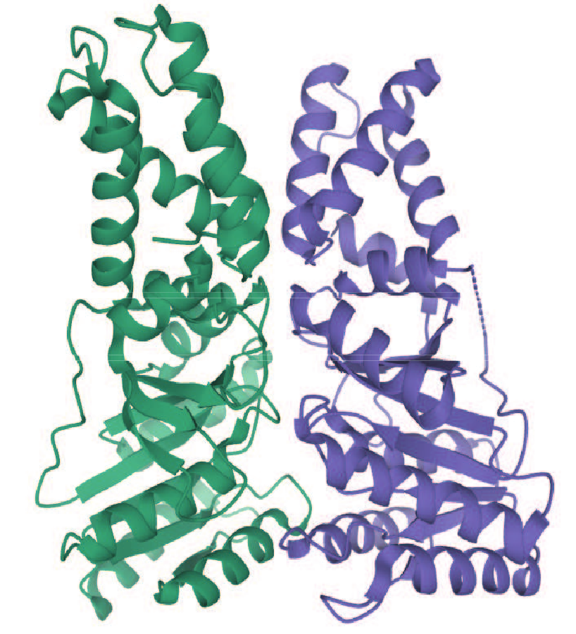
Predicting links from sequence
(and/or other features de novo)
A Language Model can be used to represent the sequences
Predicted Interaction [0,1]
D-SCRIPT
NN

Slide 25
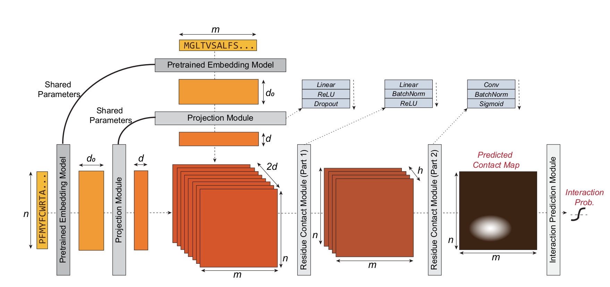
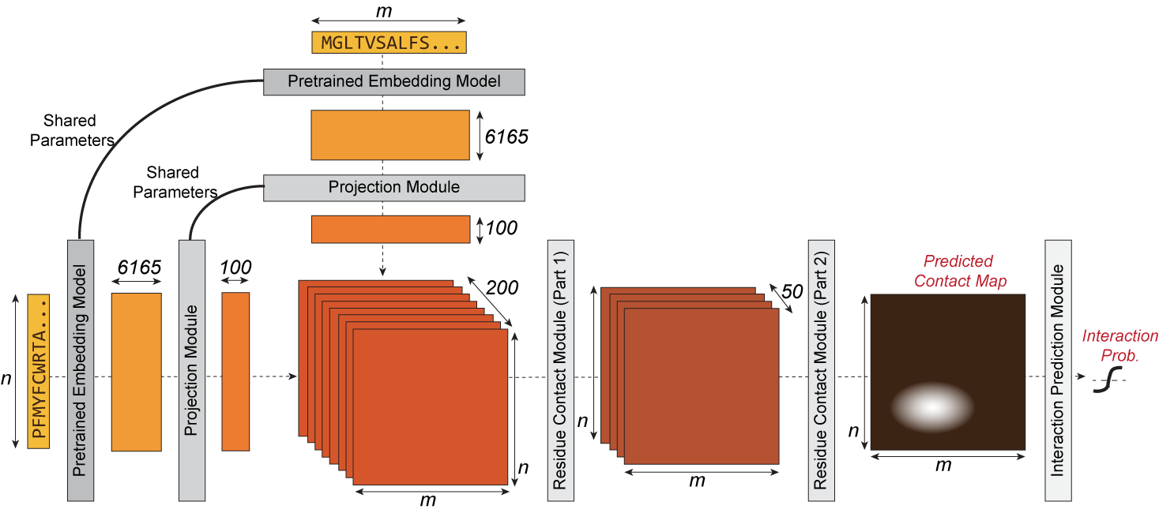
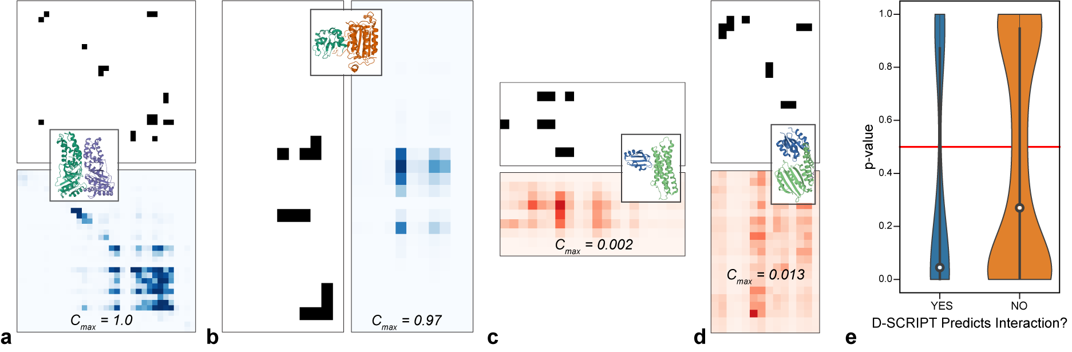
D-Script Can Predict PPIs Across Species:
Intermediate Contact Map Level Produces Interpretability
Sledzieski S, Singh R, Cowen L and Berger B. 2021.
D-SCRIPT translates genome to phenome with sequence-based, structure-aware, genome-scale predictions of protein-protein interactions.
Cell Systems 12(10): 969-982.

Slide 26
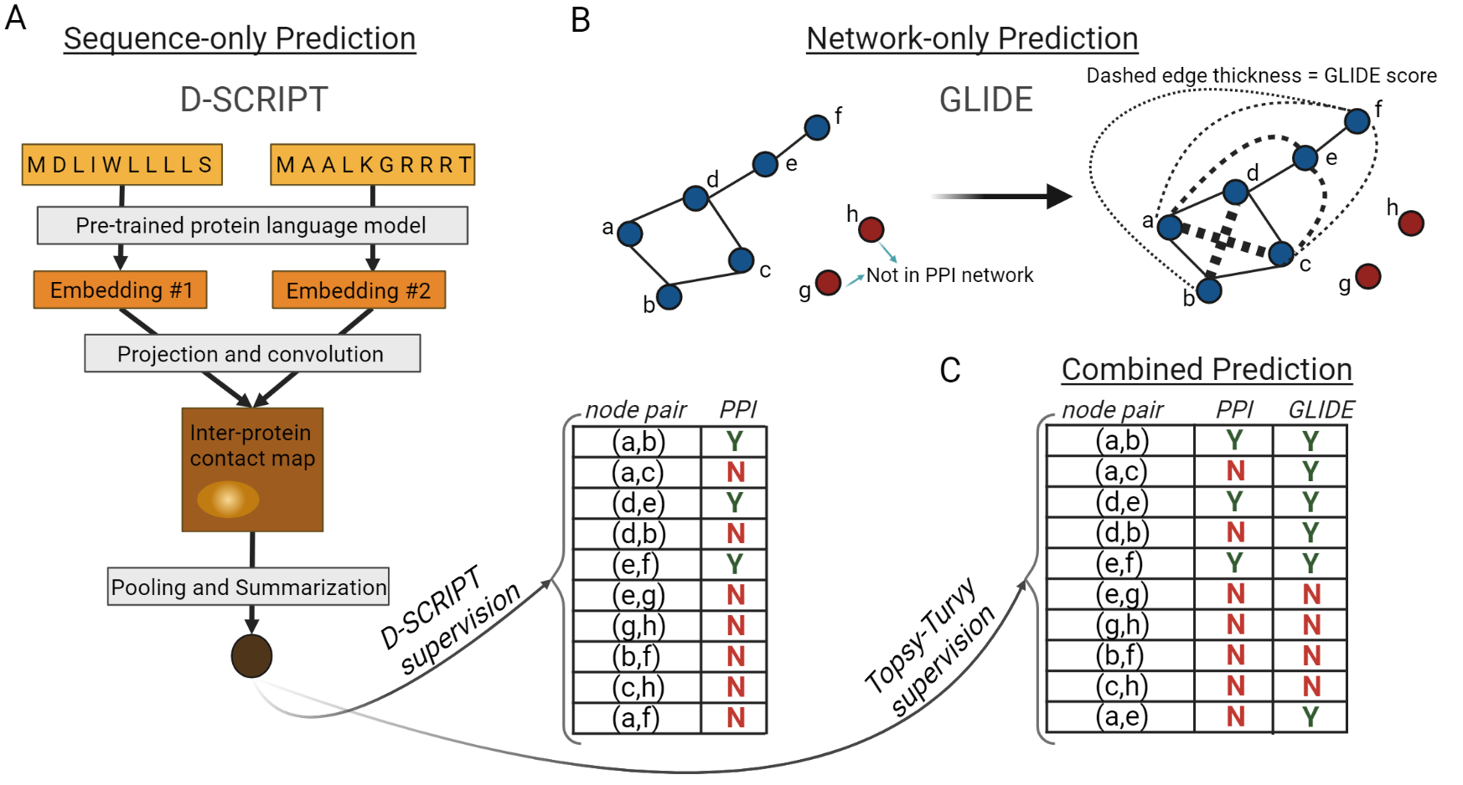
Topsy-Turvy: Supervising Bottom-up PPI Prediction with the Network
Singh R, Devkota K, Sledzieski S, Berger B and Cowen L. 2022.
Topsy-Turvy: Integrating a Global View Into Sequence-Based PPI Prediction

Slide 27
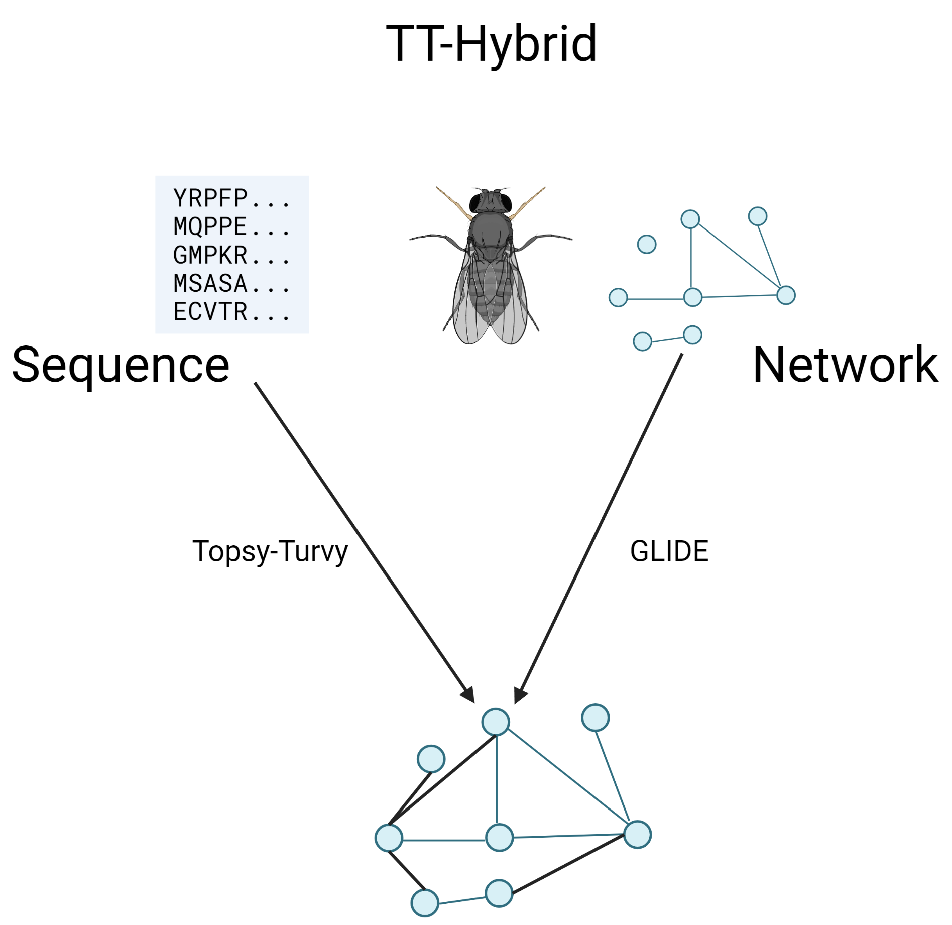
How best to combine both approaches?
This is an important open problem:
- Our TT-Hybrid method attempts this
Need to be careful about ascertainment bias when evaluating results: (i.e. existing training data overestimates network-based edges and under-estimates sequence-based edges).
Created with BioRender
Singh R, Devkota K, Sledzieski S, Berger B and Cowen L. 2022.
Topsy-Turvy: Integrating a Global View Into Sequence-Based PPI Prediction

Slide 28
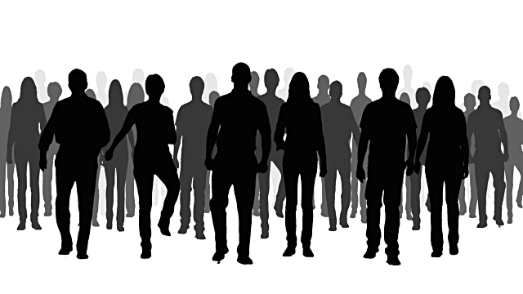






Variation in the Human Population
...ATTCGTCATGCGTGACGAGATCGAGCTAGCGCGAAATCGAGGAGGCGATC...
...ATTCGTCGTGCGTGAGCAGATCGAGCTAGCGCGATATCGAGGAGTCGATC...
...ATTCGTCGTGCGTGACGAGATCGAGCTAGCGCGATATCGAGGAGTCGATC...
...ATTCGTCGTGCGTGACGAGATCGAGCTAGCGCGCAATCGAGGAGGCGATC...
...TTTCGTCGTGCGTGACGAGATCGAGCTAGCGCGATATCGGAGAGGCGGTC...
...TTTCGTCTCCCGTGTCCAGATAAAGCTAGCGCGTTATCGGAGAGGAGATC...
disease
Understanding affects of variation/mutations on network
Notes:
Of course when we talk about understanding how humans work, we can’t forget that there is a vast diversity across individuals.
<click> This is reflected in human genomes, which vary across individuals, and we’d like to understand how the variation we see in DNA is reflected in diverse phenotypes,
<click> and especially in disease phenotypes.
<click> Again a key idea underlying our work is that it’s important to think about genomic variation not in terms of just strings of DNA but in the context of networks

Slide 29
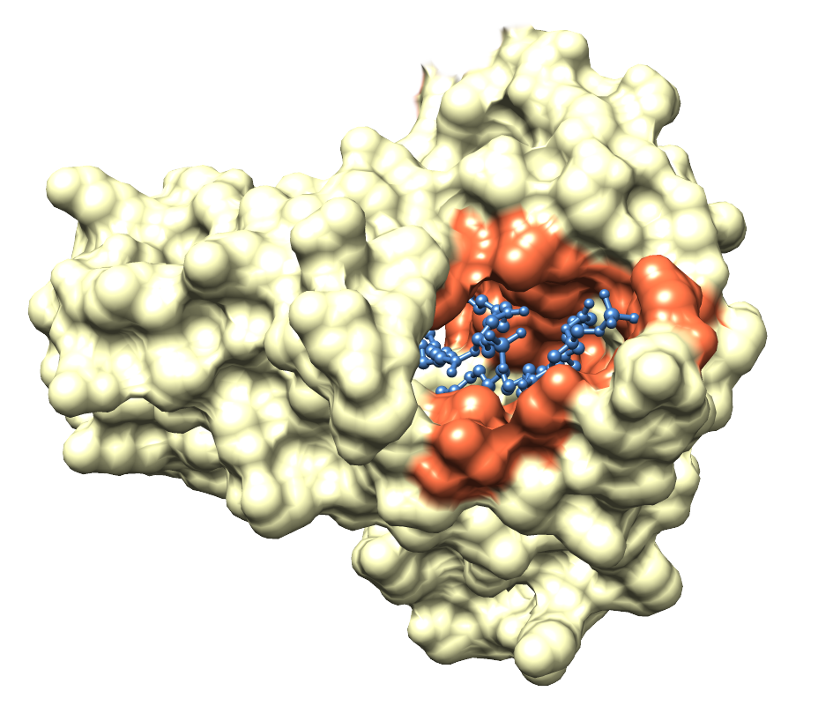
Mutations Can Alter Networks
Certain positions mutations important for
interactions/networks
RALNKMFCELAKTQI…
No effect
p1
p5
p3
p6
p8
p2
p4
Kobren and Singh (2019)
Kobren, Chazelle & Singh (2020)
p7
Predict personalized networks
1. Predict de novo interactions
2. Predict impact of variation on
existing networks
GACACTAATGCAGG… Regulatory regions
Nodes = cellular molecules
(e.g., proteins)
Edges = interactions
(e.g., physical, regulatory)
Notes:
So one key idea underlying the work I will talk about today is that mutations can alter interactions and networks. Let's say we have a network, where nodes are biological molecules and edges indicate relationships (for example physical interactions or regulatory interactions Variations or mutations within a genome can have different effects on these networks
<click> Suppose we are considering what is happening with this one protein
<click> And we have this mutation <click> which can cause a gain of an interaction
<click> Another mutation <click> can cause a loss of an interaction
<click> Other mutations <click> may have basically no effect
<click> Or mutations <click> may kill the whole protein
<click> and all of its interactions
<click> These mutations can also affect noncoding regions
<click> and a mutation <click> may cause a loss or gain of a regulatory interaction
So certain mutations and even locations are important for networks
<click> And many of these alterations in networks are reflected in interaction interfaces. So here we have a protein interacting w/ a small molecule, and the region of interaction is in red. Mutations within that red region are more likely to affect the interaction with the small mol.

Slide 30
Predicting Impact of Mutations on Interactions: Learning Interfaces From Protein-DNA Interactions
Structural
Interface:
Mapping from
PWM to DNA
positions in
model
Contact map C
Learn energy terms by simultaneously
learning structural interfaces
Wetzel, Zhang and Singh, RECOMB (2022)

Slide 31
Subtopic 3:
Condition-specific network inference
Ben Raphael
Princeton University

Slide 32
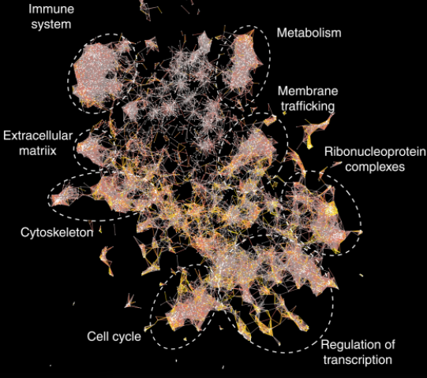
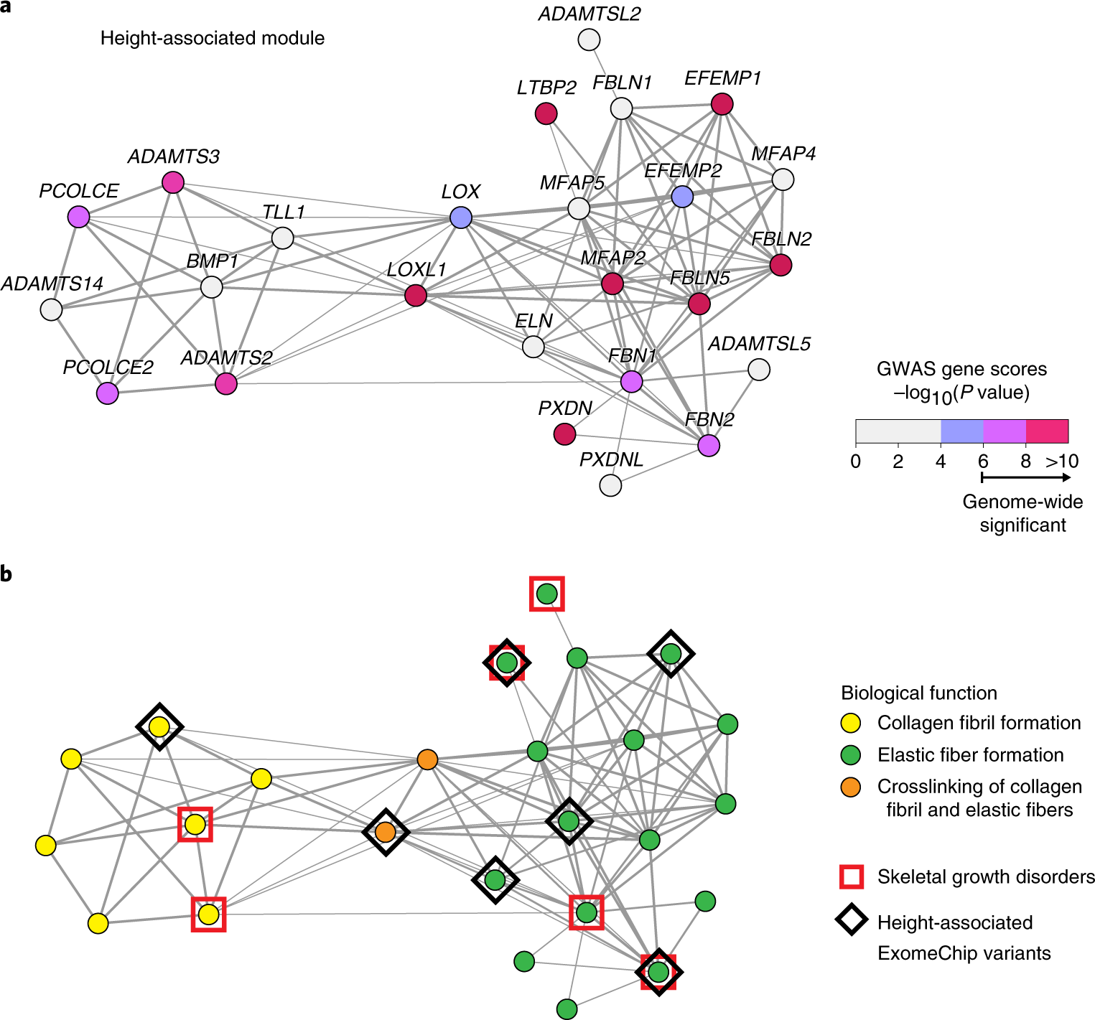
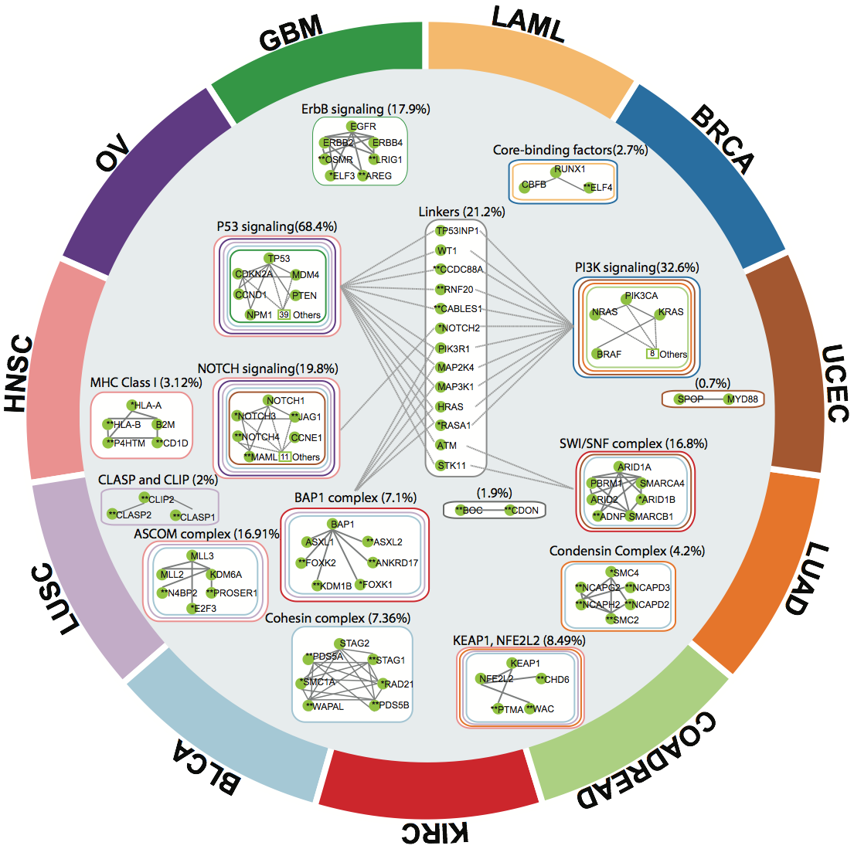
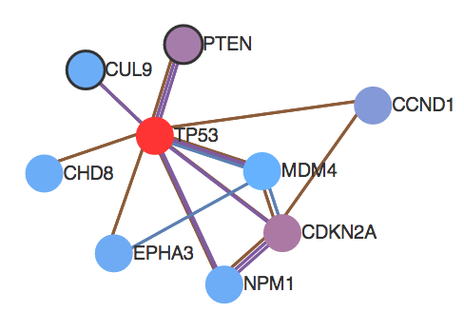
Biological Interaction Networks as Prior Knowledge
Function Prediction
Genome-wide association studies (GWAS)
Many applications:
Differential gene expression
Somatic mutations in cancer
Protein function prediction
…
Height
[Choobdar, Ahsen, Crawford et al. Nature Methods 2019]
Somatic mutations in cancer
P53 signaling
Proteins with similar functions are connected in an interaction network
+ > 30 other genes
[Leiserson, Vandin et al, Nature Genetics 2015]
Notes:
Biological functions are driven by interactions between proteins. Thus a standard approach for analyzing biological data is to use a biological interaction network as prior information.
This is a graph whose vertices are genes or proteins, and whose edges correspond to interactions b/w the genes/proteins

Slide 33
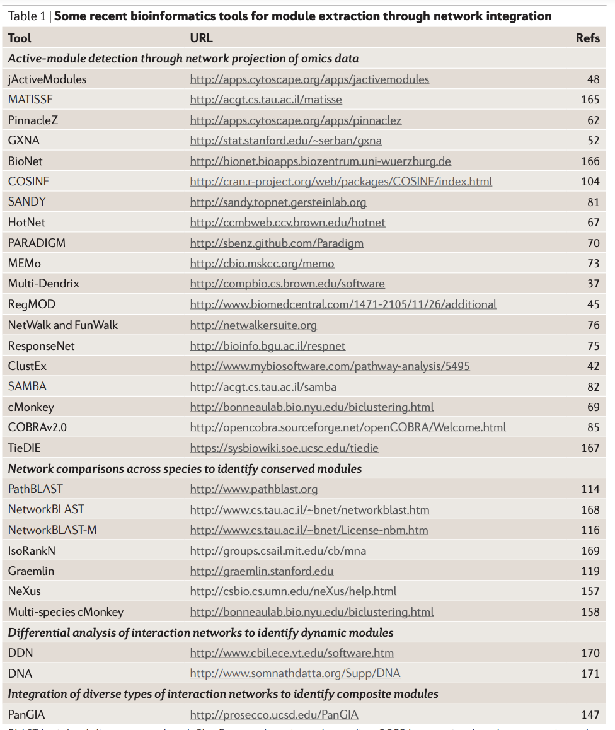
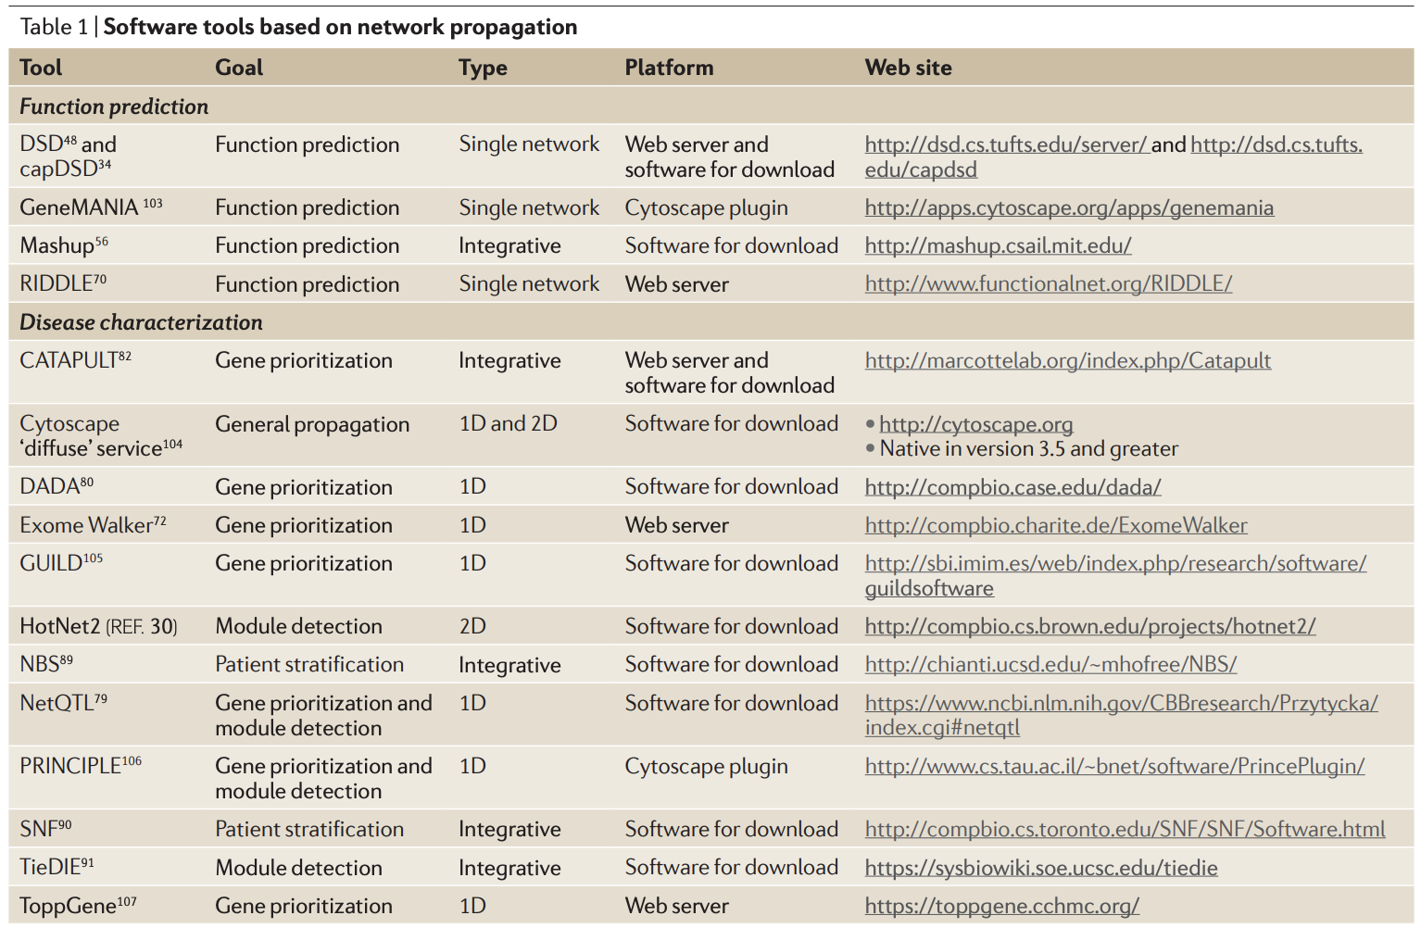
Many biological network algorithms developed in past 20 years
Mitra et al, Nature Reviews Genetics (2013)
Cowen et al, Nature Reviews Genetics (2017)
Notes:
Over the past 20 years, many algorithms have been developed that use biological interaction networks.

Slide 34
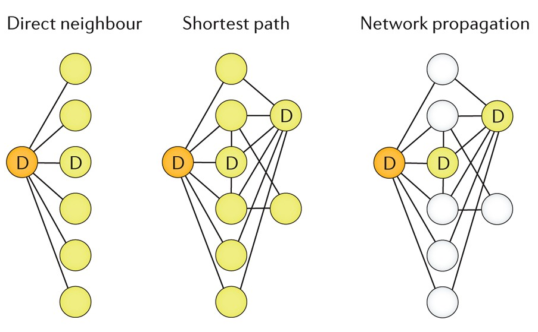
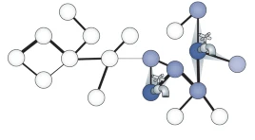
Two major approaches
Network Ranking
Ranked list of nodes
Known
Algorithm
Unknown
Network similarity measure
Altered Subnetworks
High-scoring subnetworks
High
Cowen et al, Nature Reviews Genetics (2017)
Network flow
Low
Berger et al, Nature Reviews Genetics (2013)

Slide 35
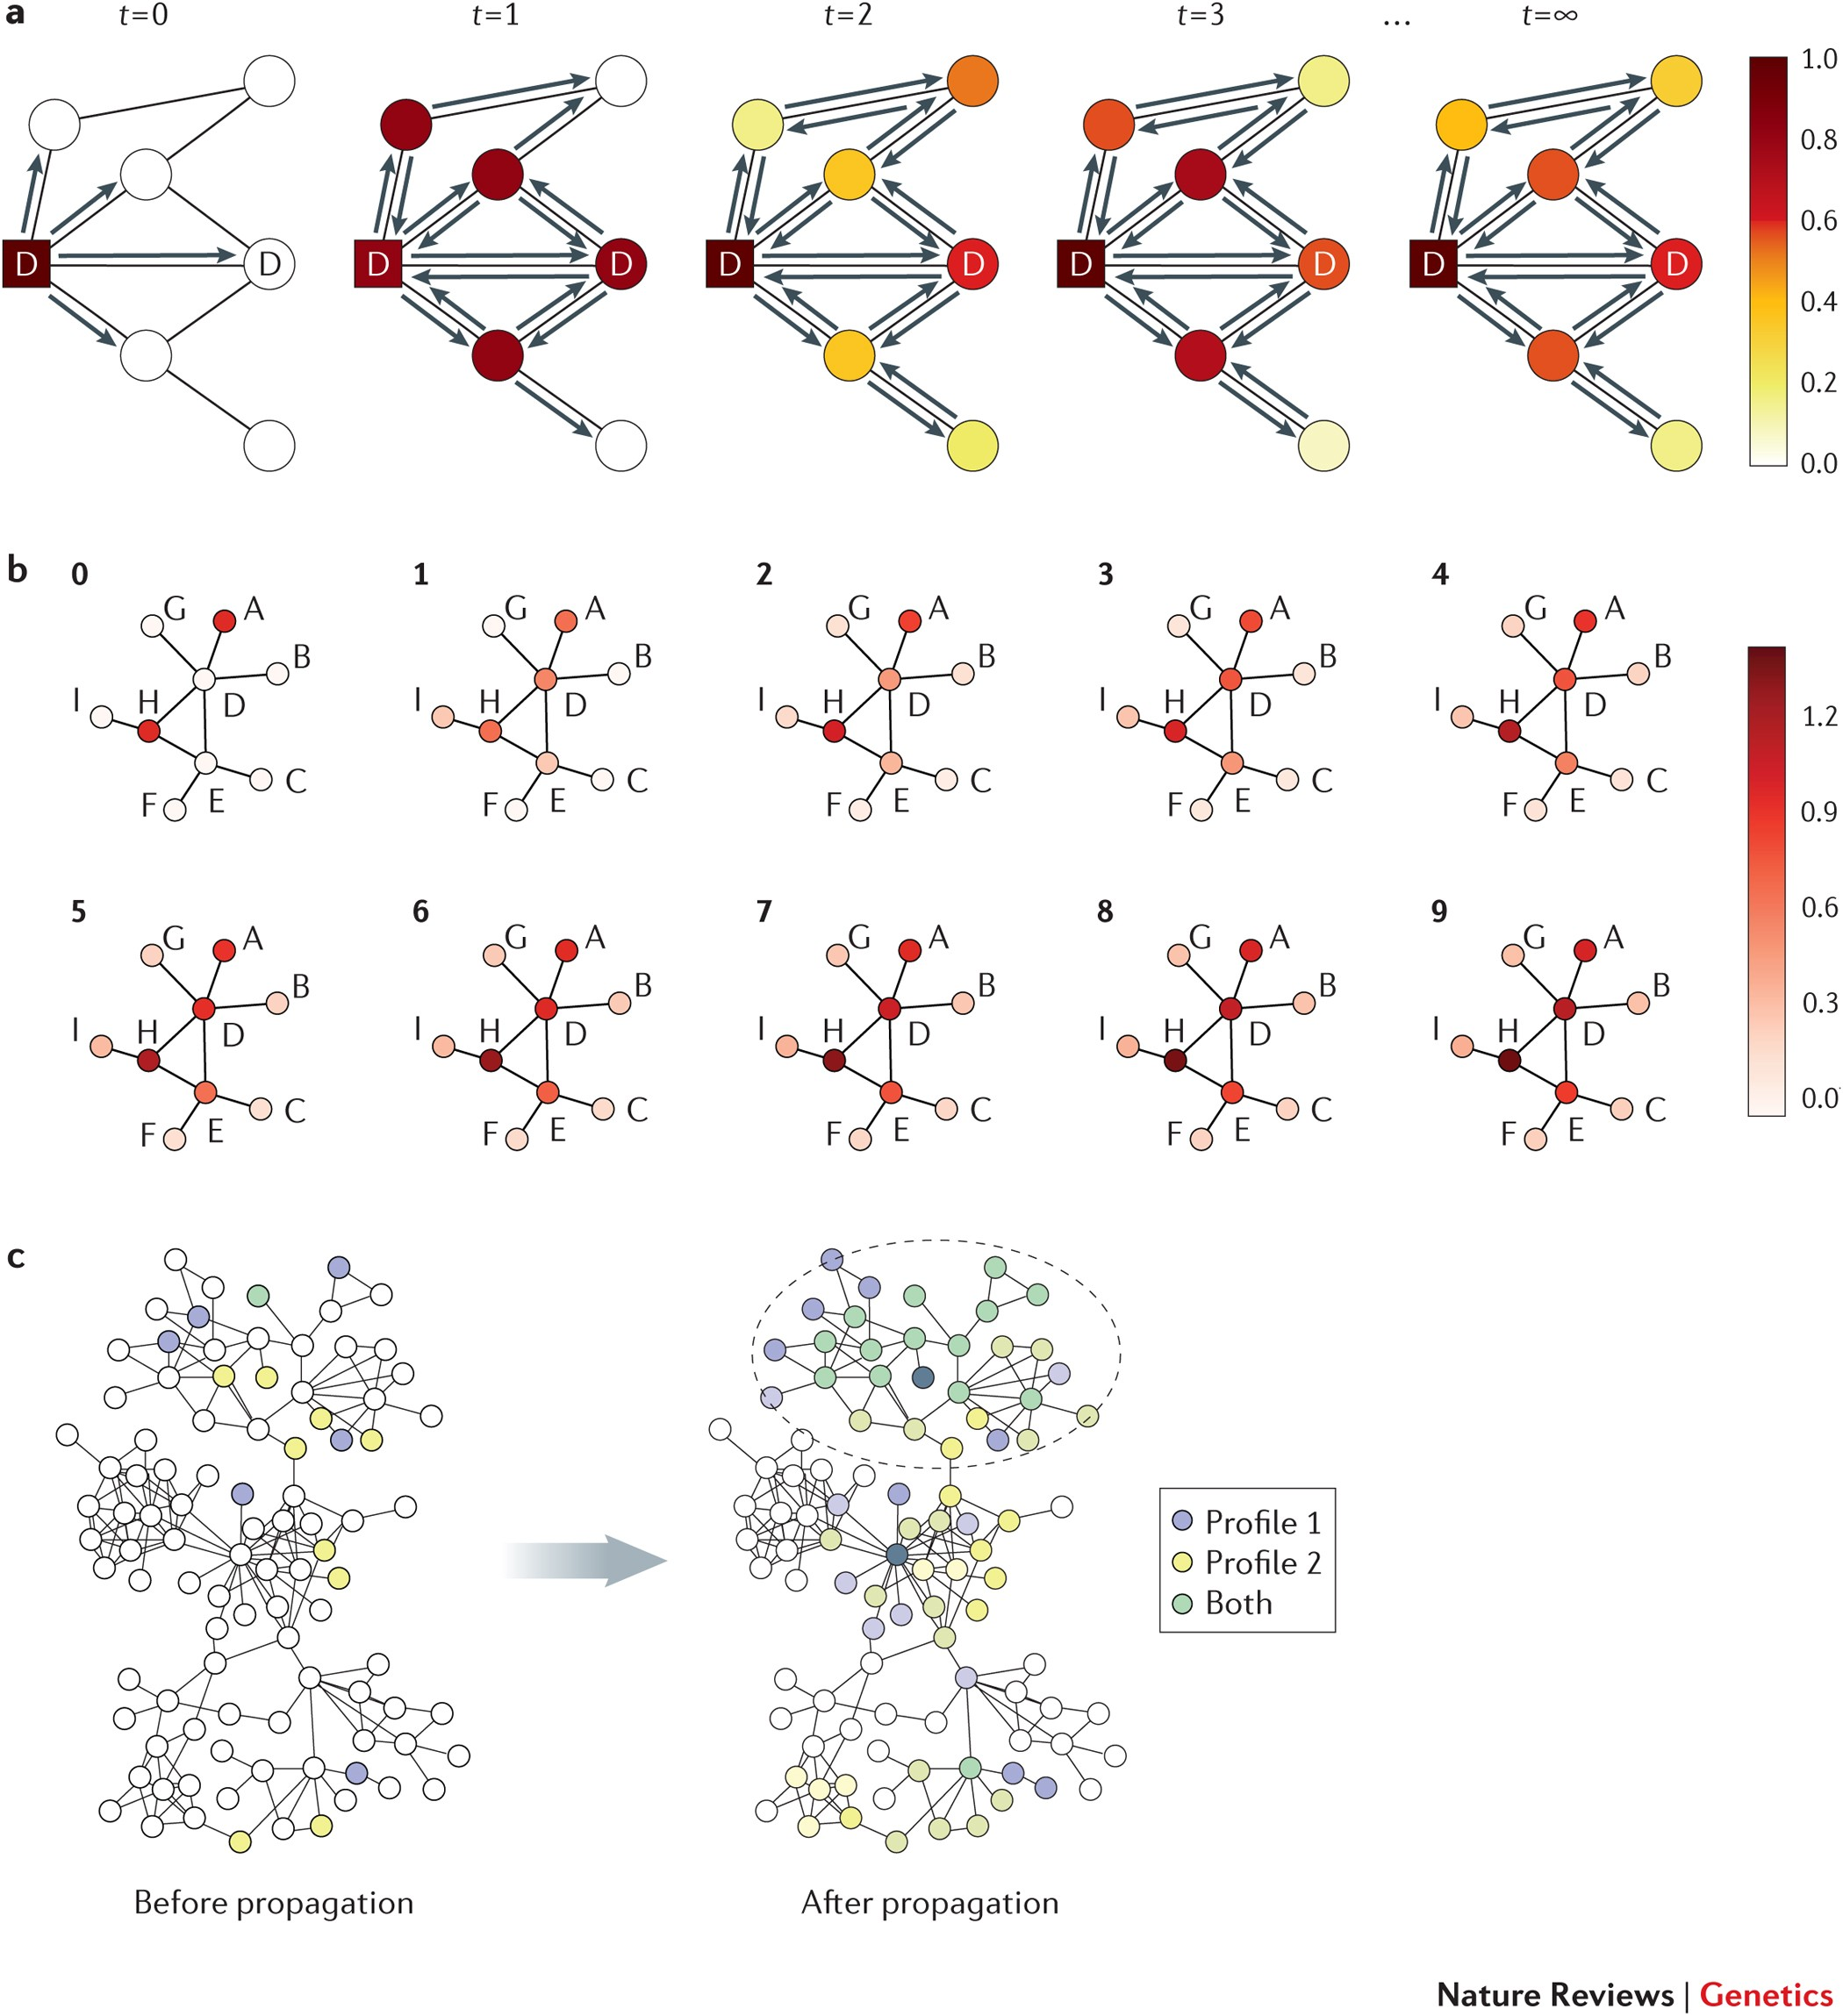


Network propagation models global network structure
Cowen et al. (Nature Reviews Genetics 2017)
Network propagation = Matrix-vector multiplication
Random walk similarity matrix
Vertex scores
Cowen et al. (Nature Reviews Genetics 2017)
Notes:
By using random walks, netprop uses global structure of network
Netprop is also computationally efficient as it only requires matrix-vector multiplication, where the matrix is a similarity matrix induced by the random walk. Different methodswill use different similarity matrices, corresponding to different types of random walks.

Slide 36


Combining Prior & New Information
New
Information
Prior Knowledge
Use Q to set transition probabilities
Perform guided random walks with restarts
Propagate prior information
Hristov, Chazelle, Singh (2020)
Notes:
Before I go into the specifics of the method, let me first illustrate the idea. We have a biological network (click ->>) and prior knowledge that these two genes are related to the disease of interest. We would like to propagate this knowledge
So that nodes that are close to the known disease-relevant nodes have a higher prior of being related to the diseases

Slide 37




Network propagation yields vertex scores (ranking)…
High
Network propagation
Low
Subnetwork identification requires additional heuristics
???
PRINCE
“We aim at inferring densely connected protein complexes that contain high scoring proteins … we start with the top 100 [propagated] scoring proteins as seeds … To each seed we iteratively add a neighboring protein with the highest score … A refinement phase takes place where proteins are removed from a putative complex to ensure that … its member proteins are densely interacting.”
HotNet2
Notes:
Although these methods have been successful empirically, these algorithms rely on ad hoc heuristics and thus do not have rigorous statistical guarantees, unlike the first class of methods.
For example, PRINCE uses this heuristic iterative approach to find connected and edge dense subnetworks with large propagated scores
Because of these various heuristics, these algorithms lack rigorous statistical guarantees, which makes it hard to understand specific biases of these methods.

Slide 38

Generative model: Altered Subnetwork Distribution
High
G=(V, E) is interaction network
is subnetwork family (set of subsets of V)
is the altered subnetwork
Vertex scores are distributed as
Low
= altered distribution (unknown)
= background distribution (typically known)
Example of distributions: z-scores
[Reyna et al. RECOMB 2020, J. Comp.Biol. 2021]

Slide 39


Generative model: Altered Subnetwork Distribution
G=(V, E) is interaction network
is subnetwork family (set of subsets of V)
is the altered subnetwork
Vertex scores are distributed as
= altered distribution (unknown)
= background distribution (typically known)
Example of distributions: z-scores
Examples of subnetwork families:
Connected family
= connected subgraphs S $⊆$ V
Edge-dense family
= subgraphs with density(S) > p
Cut family
= subgraphs with cut(S) < ρ

Slide 40
Generative model: Altered Subnetwork Distribution
G=(V, E) is interaction network
is subnetwork family (set of subsets of V)
is the altered subnetwork
Vertex scores are distributed as
High
Low
= altered distribution (unknown)
= background distribution (typically known)
Altered Subnetwork Problem (ASP): Given graph G, subnetwork family and vertex scores , find altered subnetwork A.
[Reyna et al. RECOMB 2020, J. Comp.Biol. 2021]
ASP = estimating parameters of distribution

Slide 41
Easy to solve ASP without network
Hard to solve ASP
Small distance between , distributions
Large distance between , distributions
Altered Subnetwork Distribution
Subnetwork family
Altered subnetwork problem: Given X_{v} and find A
Altered subnetwork
Vertex scores

Slide 42
is large
Hard to solve ASP
Hard to solve ASP
Easy to solve ASP without network
Small distance between , distributions
Large distance between , distributions
Easy to solve ASP without vertex scores
Altered Subnetwork Distribution
Subnetwork family
Altered subnetwork problem: Given X_{v} and find A
Altered subnetwork
Vertex scores
is small

Slide 43
is large
Hard to solve ASP
“Sweet spot” - both network (subnetwork family) and vertex scores are necessary
Hard to solve ASP
Easy to solve ASP without network
Small distance between , distributions
Large distance between , distributions
Easy to solve ASP without vertex scores
Important to compare against naïve baselines that use
“scores only”
“network only”
is small

Slide 44
Summary/Discussion Points
1. Many studies do not compare vs. scores-only and network-only baselines
Identification of disease genes using network and GWAS p-values [Carlin et al. iScience 2019] Reanalysis of data [Chitra et al. RECOMB 2022]
(N) Network alone is sufficient to identify reference genes
(S) Scores alone are sufficient to identify reference genes
(B) Both network and scores help identify reference genes

Slide 45
Summary/Discussion Points
2. Many subnetwork algorithms do not have rigorous statistical guarantees
  jActiveModules [Ideker et al. 2002] finds max scoring connected subnetworks, but often yields large subnetworks
  jActiveModules score (maximum likelihood estimator) is biased! [Reyna et al. 2020, 2021. Chitra et al. ICML 2021]
High
Low
Altered subnetwork
Maximum Likelihood Estimator (MLE)

Slide 46
Summary/Discussion Points
3. Choice of subnetwork family (connected subnetworks, dense subnetworks, propagation subnetworks, etc.) largely based on empirical performance
Diffusion / propagation
Connected subnetworks
Edge-dense subnetworks
Min-cut

Slide 47
Subtopic 4:
Differential Network Analysis
Holly Yang; Kimberly Glass

Slide 48






Why compare biological networks?
Susan
Jane
Susan:
Healthy
Network
Jane:
Healthy
Network
Susan:
Responsive
to treatment
Jane:
Non-responsive
to treatment
Differences in the networks can lead to differences in response

Slide 49




Differential Network Analysis
Differences in Edges
Differences in Targeting
Can be more than pairwise
Weighill et. al. Frontiers in Genetics. 2021.
Glass et. al. BMC Bioinformatics. 2015.
Sonawane et. al. Cell Reports. 2021.

Slide 50












Networks for Individual Samples
Gene Expression Data
Network Inference
(data integration)
Genes
Multiple Samples
One Network
networks corresponding to each of the input samples
Represents information from all the input samples
?????
Samples often represent a diverse set of conditions or people

Slide 51


Estimating Sample-Specific Networks
SSN
Sample-Specific Pearson Correlation Network
LIONESS
Linear Interpolation to Obtain Network Estimates for Single Samples
Liu et. al. Nucleic Acids Research. 2016.
Kuijjer et. al. iScience. 2019.
Basic Idea: Infer a network with and without a sample and use the difference to estimate the sample-specific network.

Slide 52

Example: Sexual Dimorphism in GTEx
For 8716 samples we have:
(1) gene expression profile
(2) gene regulatory network
We compare males/female:
(1) gene expression levels
(2) network edge-weights
Lopes-Ramos et. al. “Sex Differences in Gene Expression and Regulatory Networks across 29 Human Tissues” Cell Reports. 2020.
Notes:
Add Chen reference

Slide 53







Example: Sexual Dimorphism in GTEx
Females
Males
Quantify Differential Expression Using Linear Model:
$$Y \sim β0+β1Batch+β2Race+β3Age+β4BMI+β5Sex+ε$$
⇨ Results in a single value for each gene.
Genes
Females
Males
Quantify Differential Targeting Using Linear Model:
$$Y \sim β0+β1Batch+β2Race+β3Age+β4BMI+β5Sex+ε$$
⇨ Results in a single value for each edge (TF→gene).
Edges
We compare males/female:
(1) gene expression levels
(2) network edge-weights
Lopes-Ramos et. al. “Sex Differences in Gene Expression and Regulatory Networks across 29 Human Tissues” Cell Reports. 2020.

Slide 54

Biological networks are dynamic
GRN
-- De Smet & Marchal (2010)
-- Waddington (1957)
-- De Przytycka and Kim (2010)

Slide 55
Biological transition states and subtypes
-- Teschendorff & Feinberg, Nat Rev Genet (2021)

Slide 56
Network algorithms to study transition states
Entropy and energy-based approaches
  Stochastic differentiation equations, QuanTC
  Unsupervised learning cell plasticity (MuTrans)
Tipping-point theory-based approach
  Co-expression (DNB)
  Co-expression & GRN (BioTIP)
-- Zhou, Nat Comm (2021)
-- Yang, NAR (2022)
Notes:
QuanTC: https://github.com/yutongo/QuanTC
MuTrans: https://github.com/cliffzhou92/MuTrans-release
BioTIP: https://github.com/xyang2uchicago/BioTIP

Slide 57
Strength/limit of current systems dynamic methods
-- Brackston, PLoS CompBio, (2018)
often
Entropy-based Y Y
Tipping-point-based Y N
-- Yang, NAR (2022)

Slide 58
Future direction to understand GRN dynamics
Challenging
  Changes in different spatial and temporal frames
  Involves feedbacks
  Includes transition states accounting for abrupt bifurcations
  Responds to genetic and environment factors
Direction
  Inferring a causal network
  Converging stable-state-based models into systems dynamic approaches
    self-stabilizing algorithms to find spanning tree (root TF and target genes)
    Querying (Packet routing)
    ???

