Slide 1
ML on networks (graphs)
Serdar Bozdag
Arjun Krishnan
Yang Shen
Byung-Jun Yoon
Haiyuan Yu
| Univ. North Texas
| MSU/CU
| TAMU
| TAMU
| Cornell

Slide 2
Overview
Introduction (AK)
Network embedding
Unsupervised / self-supervised pre-training (YS)
Condition-specific node/subgraph embeddings (AK)
Multiplex heterogeneous networks (SB, BJY)
Graph-based transfer learning (AK, BJY)
Spatial / geometric networks (HY, YS)
Other emerging problems
Open discussion

Slide 3
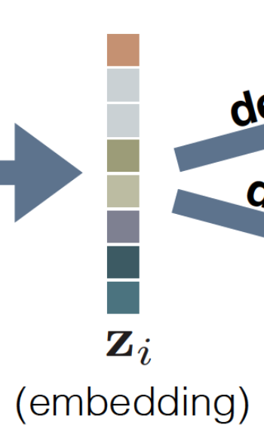
Intro to network embedding
Node classification
Subgraph or whole graph classification
Community detection
Link prediction
Graph alignment
Node neighborhood (or) label
Encoder
Decoder
Hamilton et al., (2018) IEEE CSTCDE

Slide 4
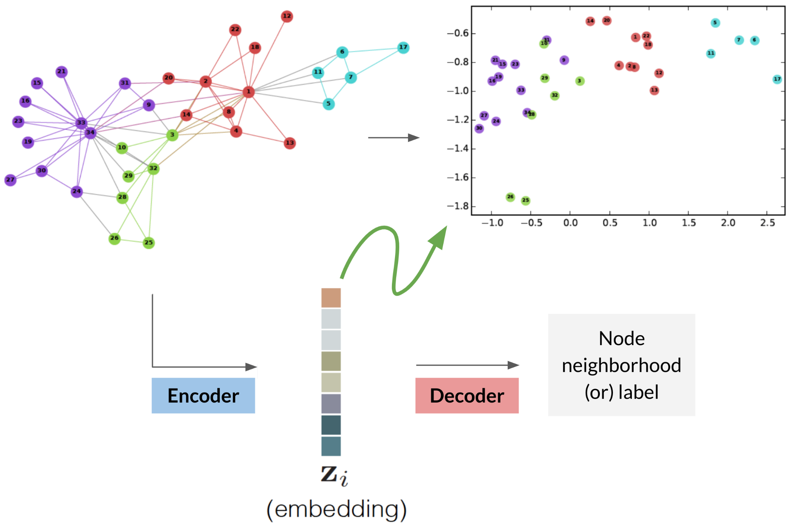
Intro to network embedding
Hamilton et al., (2018) IEEE CSTCDE

Slide 5
Intro to network embedding
Problems
No parameters shared between nodes in the encoder
Encoder does not leverage node attributes
Inherently transductive.
Solutions
Incorporate graph structure into the encoder
Leverage node attributes
Generate embeddings for nodes not seen during training

Slide 6
Intro to graph neural networks (GNNs)
Deep Convolutional Neural Network (CNN) for images Learn small and localized filters to scan through an image and generate representations in the next layer of the neural network.
Graphs are similar to images Pixels (nodes) on a mesh grid (edges/topology). But, no natural ordering of the neighboring nodes and num. of neighbors of each node invariably isn’t the same.
Bruna 2013, Defferrard 2016, Kipf/Welling 2016:
A spatial interpretation of aggregating representations of neighboring nodes followed by a transformation
Gilmer 2017:
Message passing neural network
Veličković 2018:
Graph attention

Slide 7
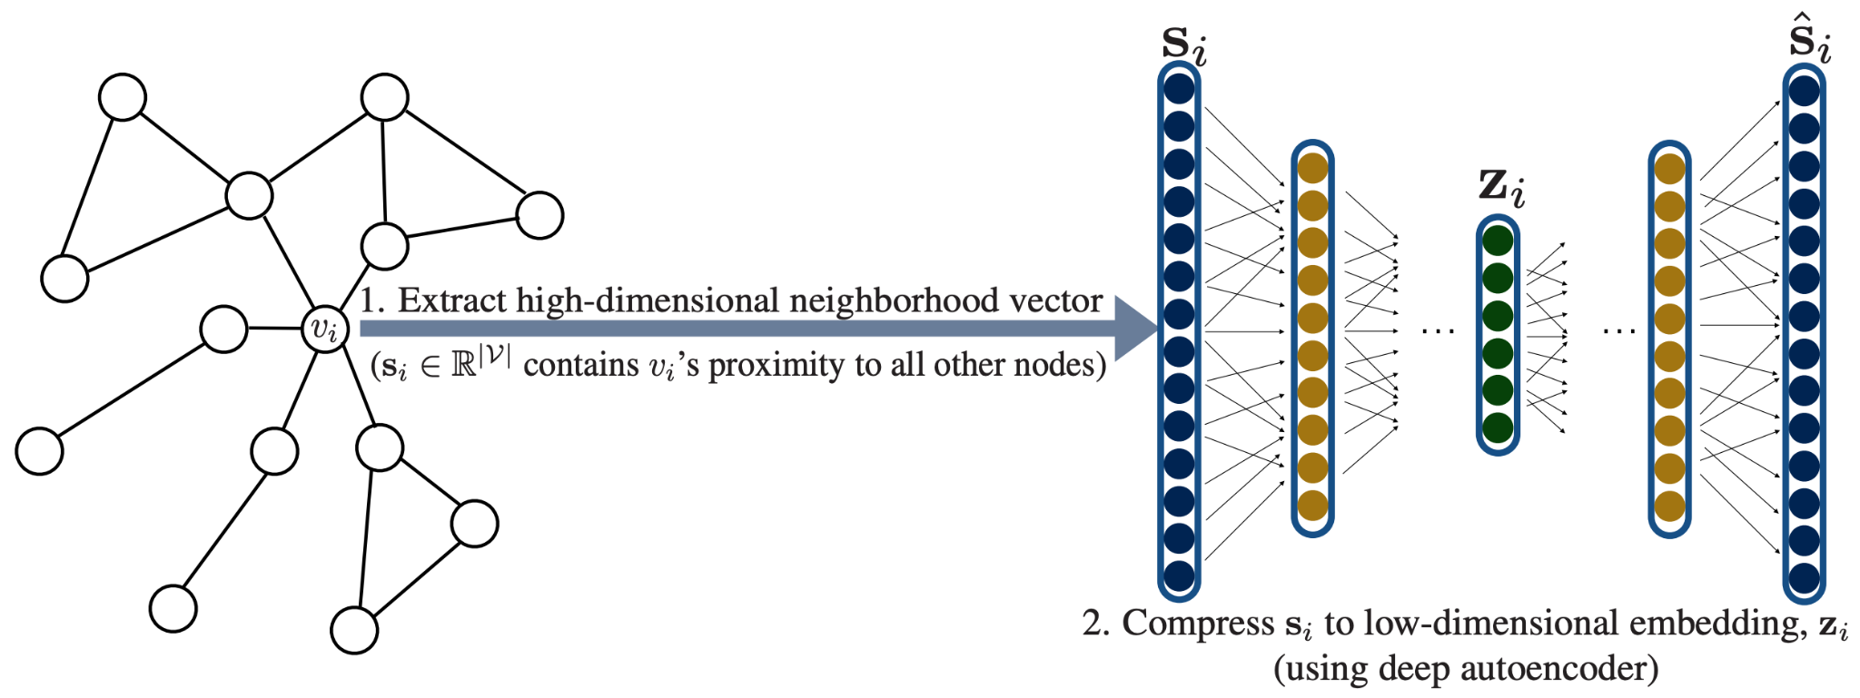
Intro to GNNs
Hamilton et al., (2018) IEEE CSTCDE

Slide 8
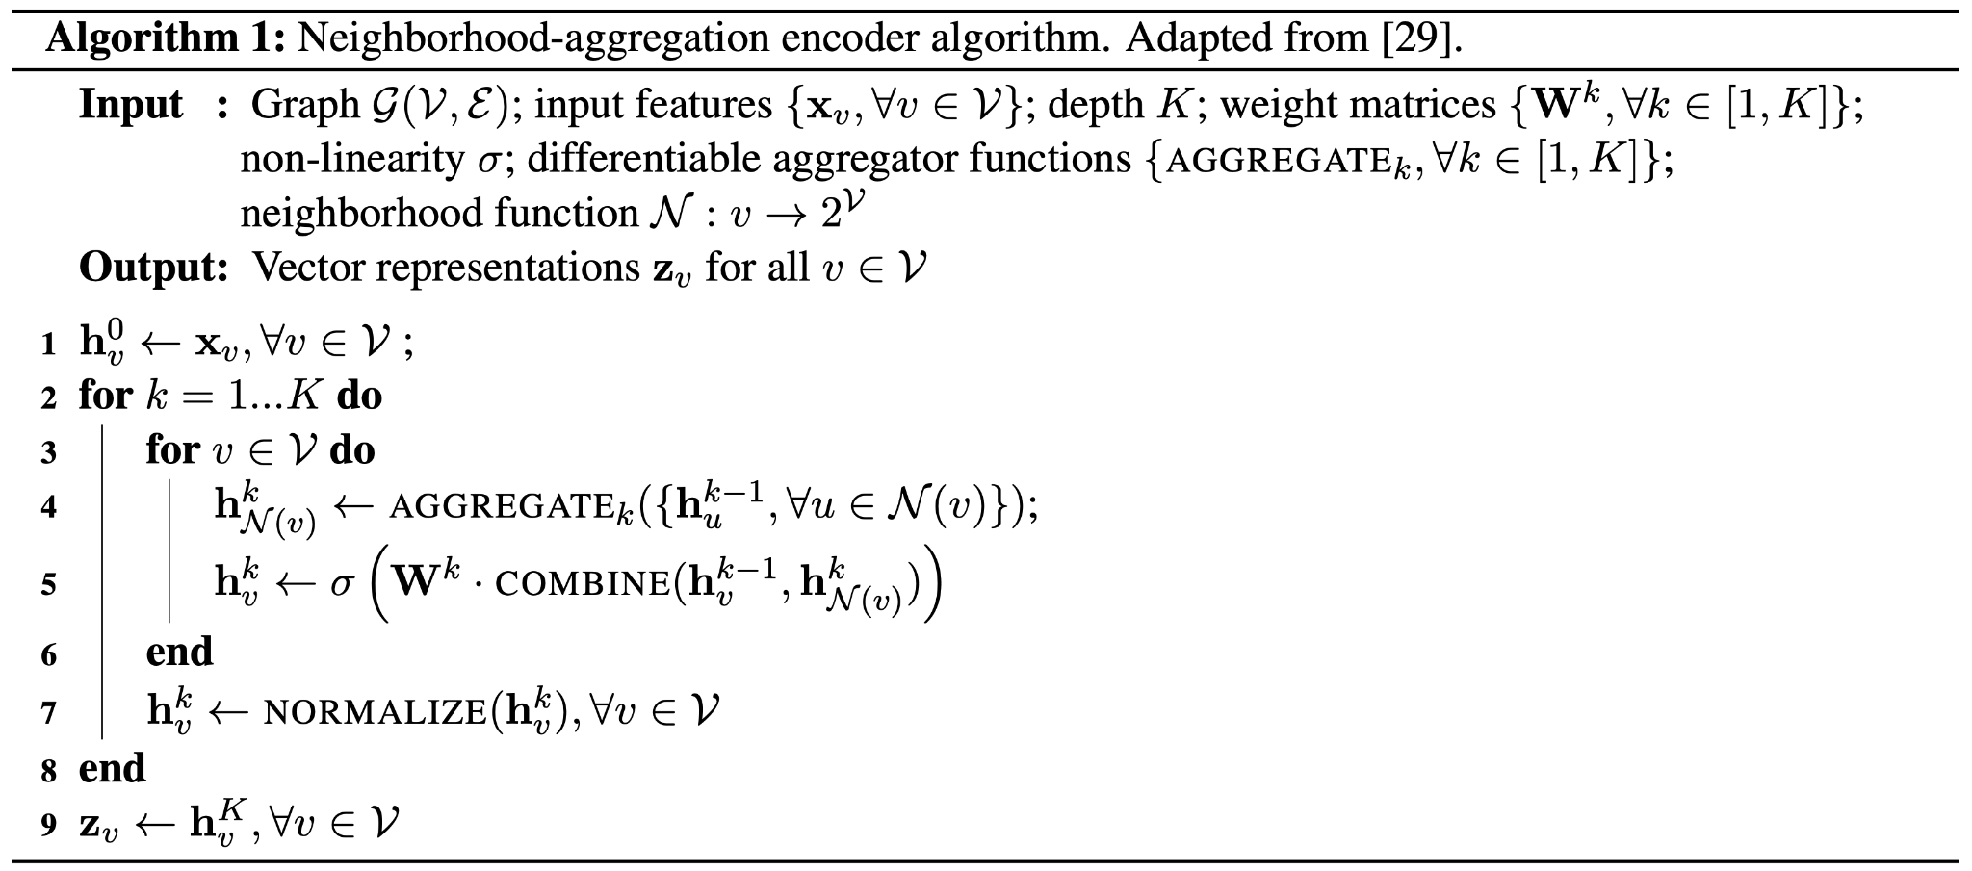
Intro to GNNs
Aggregator functions + weights are shared across all nodes
Aggregate embeddings of neighbors
This is combined with node embedding from prev. iteration
Hamilton et al., (2018) IEEE CSTCDE

Slide 9
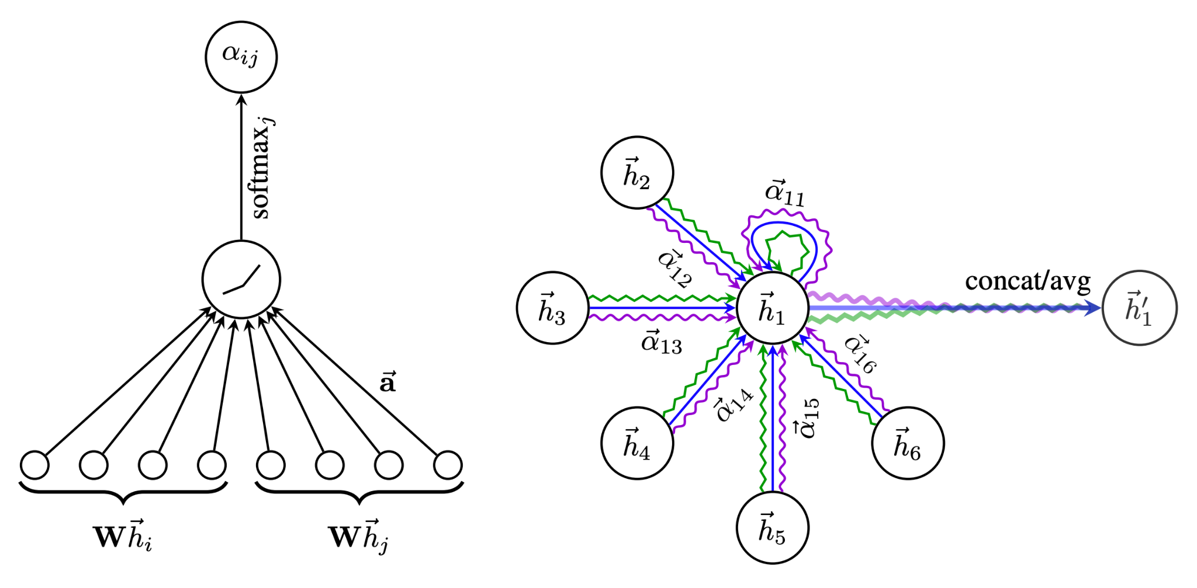
Intro to GNNs
Simplest formulation of GNN Each neighbor contributes equally to update the representation of the central node (isotropic aggregation).
Graph attention networks (GAT) Improved learning capacity by an attention mechanism that assigns different importance to each neighbor's contribution (anisotropic aggregation).
Veličković et al., (2018) ICLR

Slide 10
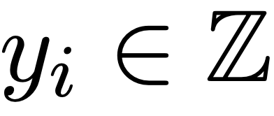
Intro to GNNs
Incorporating task supervision
Hamilton et al., (2018) IEEE CSTCDE

Slide 11
Overview
Introduction (AK)
Network embedding
Unsupervised / self-supervised pre-training (YS)
Condition-specific node/subgraph embeddings (AK)
Multiplex heterogeneous networks (SB, BJY)
Graph-based transfer learning (AK, BJY)
Spatial / geometric networks (HY, YS)
Other emerging problems
Open discussion

Slide 12
Supervised graph embedding: Bottlenecks
So far, beyond matrix factorization and random walks,
supervised learning using GNNs for graph embedding. However …
Required labels are often expensive and limited
Labelling needs experiments, computation, labor, domain knowledge …
Examples: Properties of small-molecule drug candidates (assays, QM), annotation of everyday images, diagnosis from medical images

Slide 13
Supervised graph embedding: Bottlenecks
So far, beyond matrix factorization (DeepWalk, node2vec, metapath2vec), supervised learning using GNNs for graph embedding. However …
Required labels are often expensive and limited
Labelling needs experiments, computation, labor, domain knowledge …
Examples: Properties of small-molecule drug candidates (assays, QM), annotation of everyday images, diagnosis from medical images
Learned embedding could suffer from
Poor generalizability (Does the embedding learn something general to be useful? Need for understanding and transferring the learned embedding!)
Weak robustness (Is the embedding insensitive to data uncertainty, which is common in biomed? ) especially when the labeled datasets for training GNNs are small.

Slide 14
Supervised graph embedding: Bottlenecks
So far, beyond matrix factorization (DeepWalk, node2vec, metapath2vec), supervised learning using GNNs for graph embedding. However …
Required labels are often expensive and limited
Labelling needs experiments, computation, labor, domain knowledge …
Examples: Properties of small-molecule drug candidates (assays, QM), annotation of everyday images, diagnosis from medical images
Learned embedding could suffer from
Poor generalizability (Does the embedding learn something general to be useful? Need for understanding and transferring the learned embedding!)
Weak robustness (Is the embedding insensitive to data uncertainty, which is common in biomed? ) especially when the labeled datasets for training GNNs are small.

Slide 15
Unsupervised and self-supervised graph embedding
Neither uses labels that are often expensive and rare
Both exploit unlabeled data (inputs) that are abundant
Then what is self-supervised learning?
A branch of unsupervised learning where “the machine predicts any part of its input from observed part” (Yann LeCun)
Use pretext tasks to pretrain encoder
Pre-trained encoder can be transferred to downstream tasks
L. Jing and Y. Tian, "Self-Supervised Visual Feature Learning With Deep Neural Networks: A Survey," in
IEEE Transactions on Pattern Analysis and Machine Intelligence, 2021, doi: 10.1109/TPAMI.2020.2992393.

Slide 16
Self-supervised pretext tasks: Predictive and contrastive
Predictive/
Reconstructive
Contrastive
X. Liu et al., "Self-supervised Learning: Generative or Contrastive,"
in IEEE Transactions on Knowledge and Data Engineering, doi: 10.1109/TKDE.2021.3090866.

Slide 17
Predictive self-supervised graph embedding
Y. Xie, Z. Xu, J. Zhang, Z. Wang and S. Ji, "Self-Supervised Learning of Graph Neural Networks: A Unified
Review," in IEEE Transactions on Pattern Analysis and Machine Intelligence, doi: 10.1109/TPAMI.2022.3170559.

Slide 18
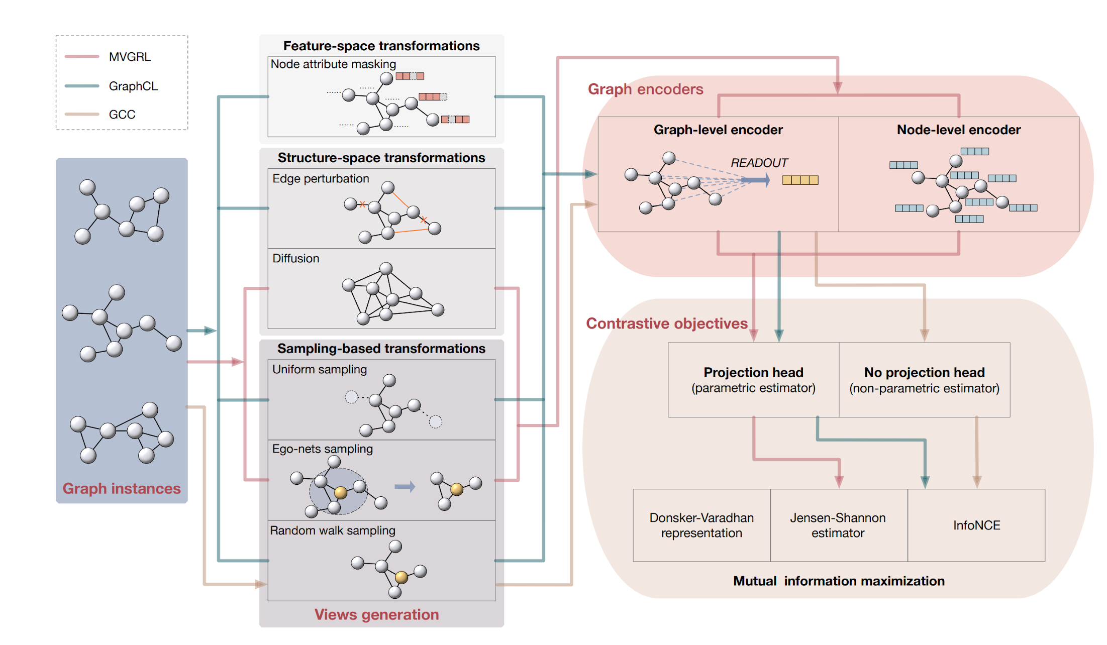
Contrastive self-supervised graph embedding
Y. Xie, Z. Xu, J. Zhang, Z. Wang and S. Ji, "Self-Supervised Learning of Graph Neural Networks: A Unified
Review," in IEEE Transactions on Pattern Analysis and Machine Intelligence, doi: 10.1109/TPAMI.2022.3170559.

Slide 19
Challenges to self-supervised graph embedding
Self-supervised learning for graphs is a non-trivial extension from earlier success for images and texts!
Unlike images (2D grids), graphs are non-Euclidean
Graphs are often abstraction of data of diverse nature
Open challenges to design pretext tasks
“No universal theoretical framework” for predictive methods
“No optimal graph view w.r.t. downstream tasks” for contrastive methods
“Needs better incorporation of domain knowledge”
…
Explainability
More complex graphs
…

Slide 20
Overview
Introduction (AK)
Network embedding
Unsupervised / self-supervised pre-training (YS)
Condition-specific node/subgraph embeddings (AK)
Multiplex heterogeneous networks (SB, BJY)
Graph-based transfer learning (AK, BJY)
Spatial / geometric networks (HY, YS)
Other emerging problems
Open discussion

Slide 21
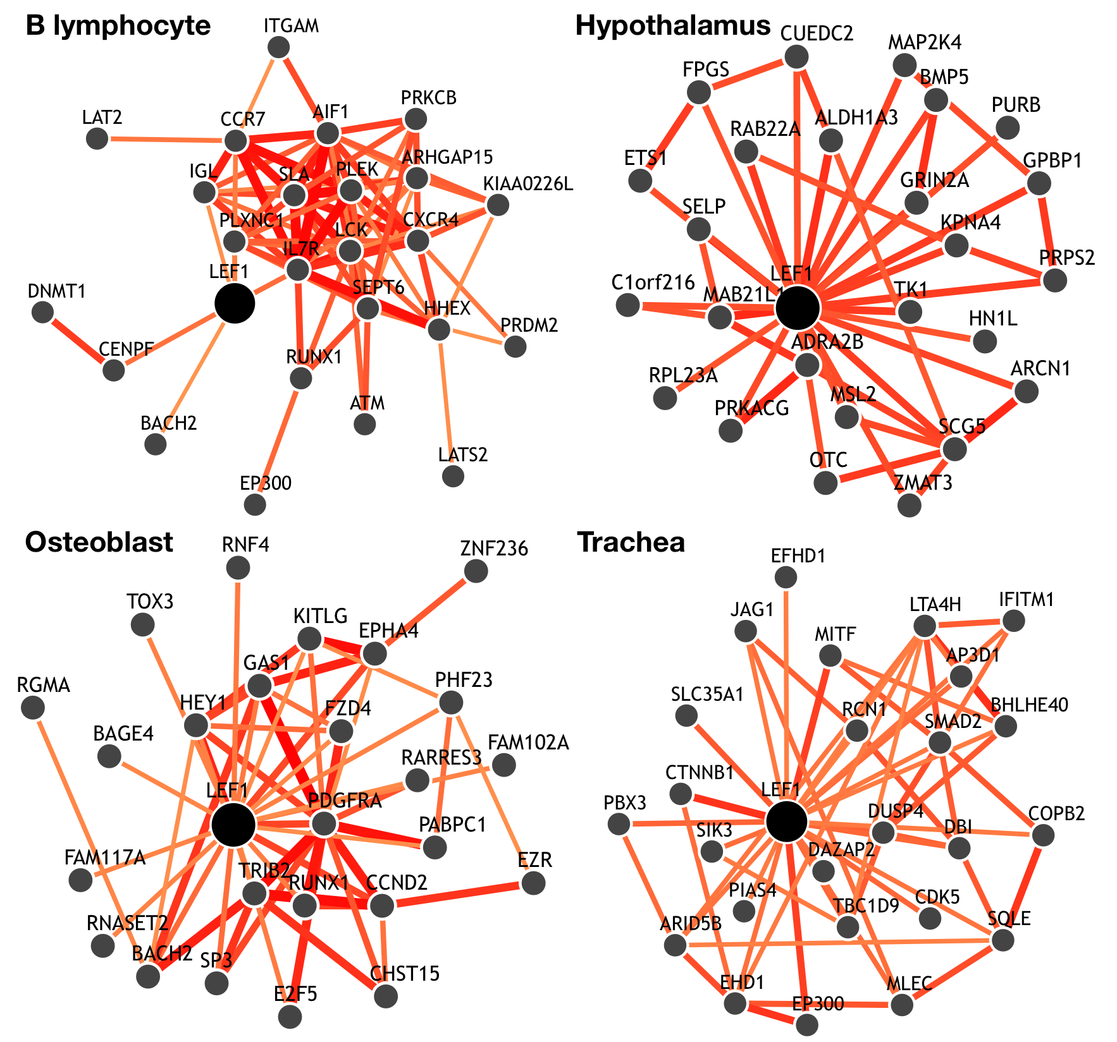
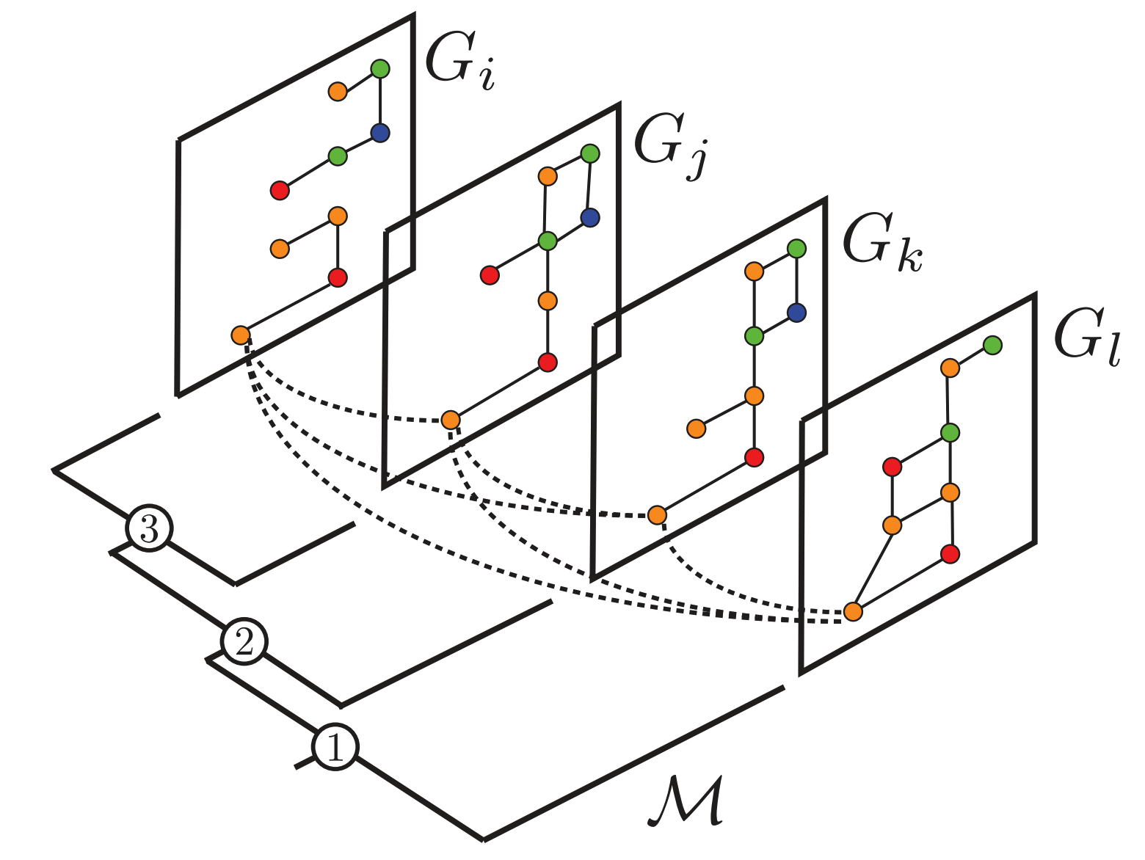
Condition-specific network embeddings
Building one network per condition and then embedding them.
Greene, Krishnan, Wong, et al., (2016) Nat. Genet.; Zitnik et al., (2017) Bioinfo.

Slide 22
Condition-specific network embeddings
Using condition/context information as node features and performing node embedding.
Zitnik et al., (2017) Bioinfo.; Li et al., (2021) arXiv

Slide 23
Overview
Introduction (AK)
Network embedding
Unsupervised / self-supervised pre-training (YS)
Condition-specific node/subgraph embeddings (AK)
Multiplex heterogeneous networks (SB, BJY)
Graph-based transfer learning (AK, BJY)
Spatial / geometric networks (HY, YS)
Other emerging problems
Open discussion

Slide 24
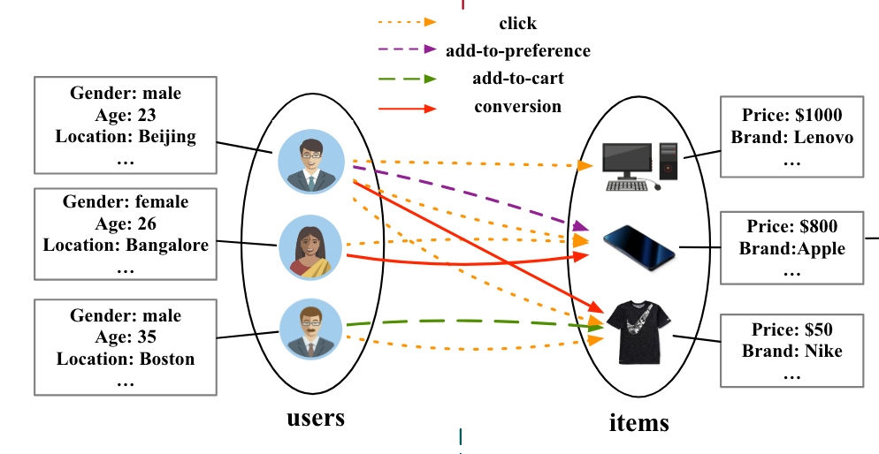
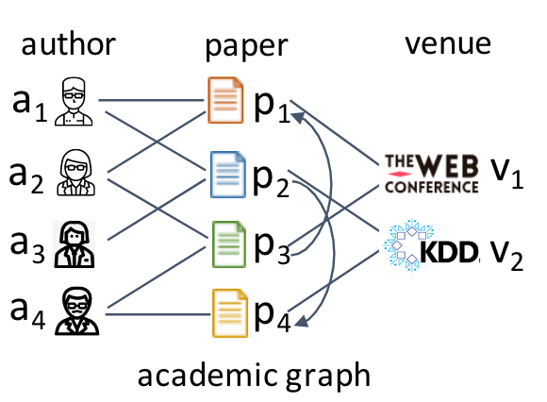
Multiplex heterogeneous networks
Graphs where number of node types and edge types > 2
Also known as
Multi-view networks
Heterogeneous information networks (HIN)
Lee, Bohyun, et al. 2020
Cen, Yukuo, et al. 2019.
Zhang, Chuxu, et al. 2019.

Slide 25
ML applications using multiplex heterogeneous network embeddings
Node classification
Drug repurposing
Drug side effect prediction
Gene prioritization
…
Link prediction
Drug target prediction
Recommendation system
Fraud detection
…

Slide 26
Multiplex heterogeneous network embedding approaches
Shallow embedding methods
Based on random walk with restart on multiplex networks or meta-paths
Utilizes a form of skip-gram algorithm (self-supervised)
Cannot utilize node attributes
No parameter sharing
Deep learning-based methods
Can utilize node attributes
Defines a node-type or edge-type specific neighborhood (some use meta-paths)
Transductive or inductive
Some utilize attention mechanism (intra- and inter-layer attention)
Some self-supervised methods exist

Slide 27
Multiplex heterogeneous network embedding approaches
Shallow embedding methods
Based on random walk with restart on multiplex networks or meta-paths
Utilizes a form of skip-gram algorithm (self-supervised)
Cannot utilize node attributes
No parameter sharing
Deep learning-based methods
Can utilize node attributes
Defines a node-type or edge-type specific neighborhood (some use meta-paths)
Transductive or inductive
Some utilize attention mechanism (intra- and inter-layer attention)
Some self-supervised methods exist

Slide 28
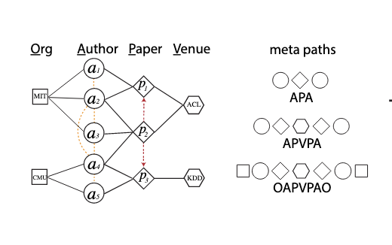
Shallow learning methods: Defining the paths
Meta-paths
Random walk w/ restart on multiplex heterogeneous networks
Dong, Yuxiao, Nitesh V. Chawla, and Ananthram Swami. 2017.
Pio-Lopez, Léo, et al. 2021
Metapath2Vec
NECo
MultiVERSE
Dursun, Cagatay, et al. 2020.
Notes:
Metapath2vec
It is a shallow learning method.
Can work on nodes with multiple type of nodes and links (GATNE paper says it cannot work on multiple type of edges)
A heterogenous neighborhood of a node is computing by employing a meta-path-based random walk
They conduct skip-gram algorithm as in node2vec on these paths to learn node embeddings

Slide 29
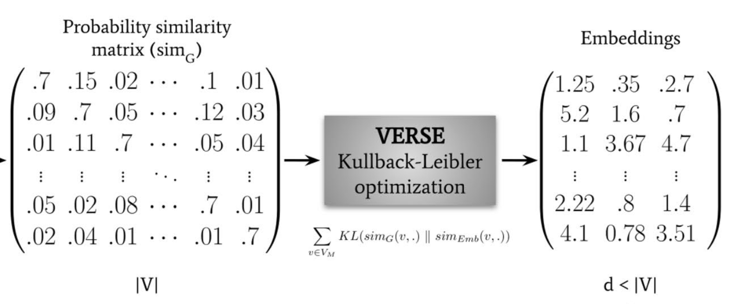
Shallow learning methods: Learning the embeddings
Skip gram
(Node2Vec, DeepWalk, etc.)
Heterogeneous Skip gram
(Metapath2Vec)
KL Diverge based optimization
(MultiVERSE)

Slide 30
Limitations
Cannot not utilize the node attributes
Definition of meta-paths require some semantic understanding of the graph
The number of nodes or edge types could be limited.
Most methods do not utilize edge weights
Inherently transductive
Crucial hyperparameters that are hard to tune (e.g., intra-, inter-layer jump probability, restart probability)

Slide 31
Multiplex heterogeneous network embedding approaches
Shallow embedding methods
Based on random walk with restart on multiplex networks or meta-paths
Utilizes a form of skip-gram algorithm (self-supervised)
Cannot utilize node attributes
No parameter sharing
Deep learning-based methods
Can utilize node attributes
Defines a node-type or edge-type specific neighborhood (some use meta-paths)
Transductive or inductive
Some utilize attention mechanism (intra- and inter-layer attention)
Some self-supervised methods exist

Slide 32
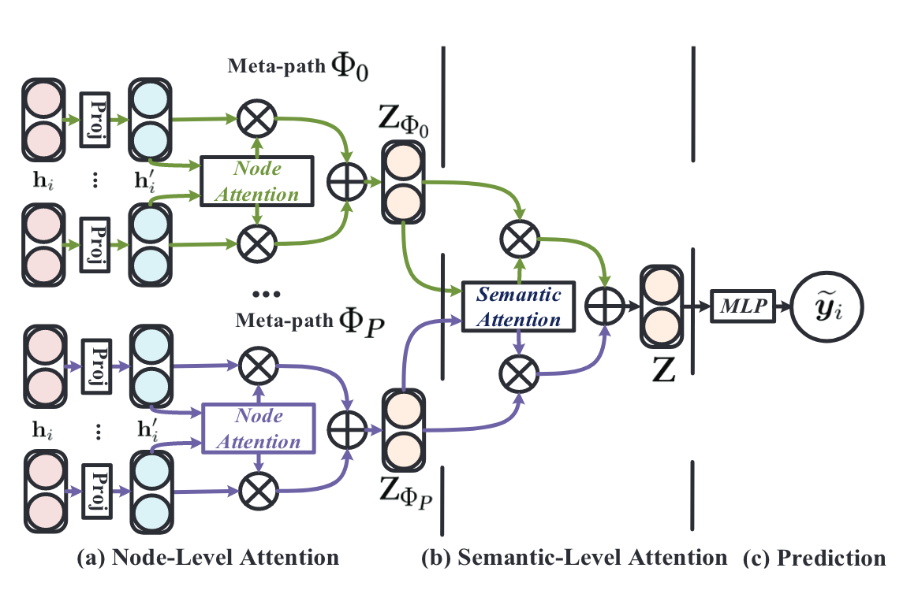
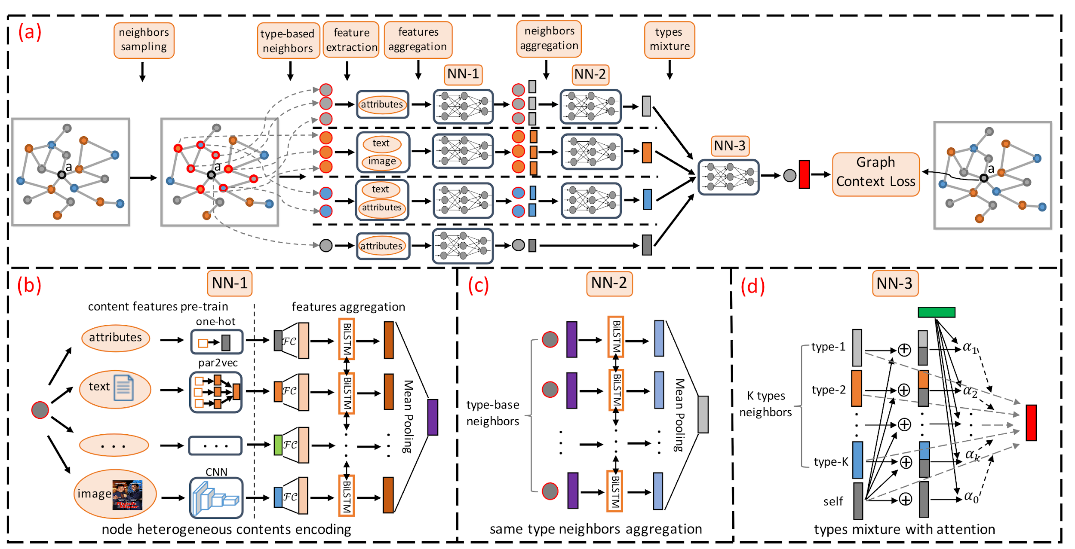
Deep learning-based methods (1/2)
HetGNN
Zhang, Chuxu, et al. 2019.
HAN
Wang, Xiao, et al. 2019.
Unsupervised
Combines different types of attributes, neighbors and node types
Semi-supervised
Utilizes attention mechanism between nodes and meta-paths

Slide 33
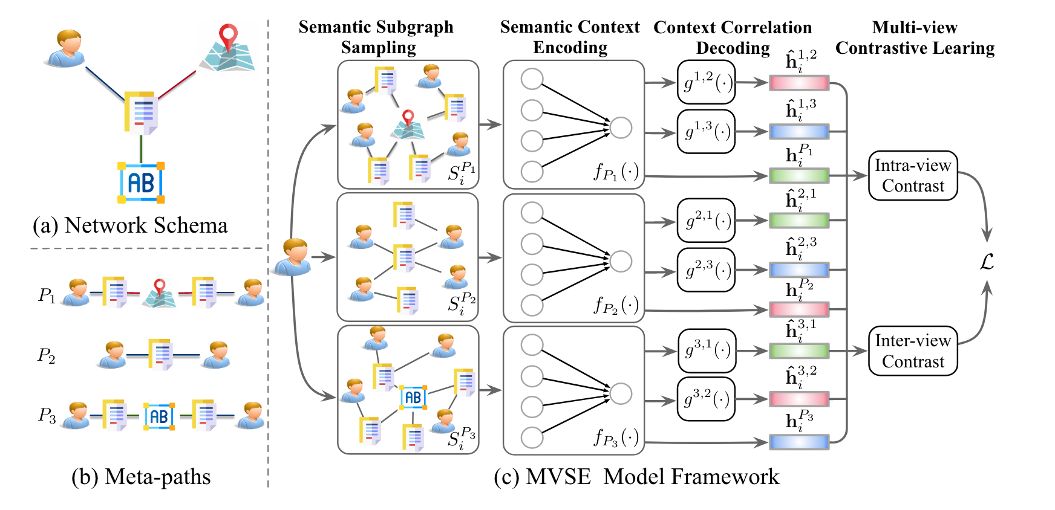
Deep learning-based methods (2/2)
GATNE
Cen, Yukuo, et al. 2019
MVSE
Zhao, Jianan, et al. 2021.
Transductive and inductive
Utilizes self-attention
Inductive method can utilize node attributes
Main application: link prediction
Self-supervised method
Utilizes meta-paths
Intra- and inter-semantic contrastive learning
Notes:
GATNE
Build a base embedding and edge embedding
In transductive model, each node has a base embedding that is shared with edge types and an edge embedding.
An aggregated function is utilized to get edge embeddings from neighbors for each edge type.
Utilizing self attention mechanisms, edge embeddings across all types are added together, which is combined with base embedding.
In their inductive version, the goal is to learn a transformation function for each node type, which gets the node attributes and generates a base embedding.
A similar transformation function is learned for edge embeddings for each edge type and node type. In other words, the base embedding function is node type specific and edge embedding function is node type and edge type specific.
MVSE
intra-view constrative learning. - Preservation of Semantic Contexts:
On each view, InfoNCE loss is performed to preserve the intra-semantic information.
inter-view constrative learning (Preservation of Semantic Correlations):
Inter-semantic information is considered by decoding to other semantic spaces to capture the correlation between semantics

Slide 34
Challenges and future directions
Choosing the right meta-paths is crucial. How to know which paths are relevant?
More focus on meta-graphs and network motifs might be needed
Methods for Dynamic multiplex heterogeneous network embedding
More theoretical study of deep learning based methods
Learning fair/unbiased and explainable embeddings

Slide 35
Papers: Embedding multiplex heterogeneous networks
Wang X, Bo D, Shi C, Fan S, Ye Y, Yu PS. A Survey on Heterogeneous Graph Embedding: Methods, Techniques, Applications and Sources. IEEE Transactions on Big Data. 2022;1–1.
Pio-Lopez L, Valdeolivas A, Tichit L, Remy É, Baudot A. MultiVERSE: a multiplex and multiplex-heterogeneous network embedding approach. Sci Rep. Nature Publishing Group; 2021 Apr 22;11(1):8794.
Xie Y, Zhang Y, Gong M, Tang Z, Han C. MGAT: Multi-view Graph Attention Networks. Neural Networks. 2020 Dec 1;132:180–189.
Lee B, Zhang S, Poleksic A, Xie L. Heterogeneous Multi-Layered Network Model for Omics Data Integration and Analysis. Frontiers in Genetics [Internet]. 2020;10. Available from: https://www.frontiersin.org/article/10.3389/fgene.2019.01381
Dursun C, Smith JR, Hayman GT, Kwitek AE, Bozdag S. NECo: A node embedding algorithm for multiplex heterogeneous networks. 2020 IEEE International Conference on Bioinformatics and Biomedicine (BIBM). 2020. p. 146–149.
Zhang C, Song D, Huang C, Swami A, Chawla NV. Heterogeneous Graph Neural Network. Proceedings of the 25th ACM SIGKDD International Conference on Knowledge Discovery & Data Mining [Internet]. New York, NY, USA: Association for Computing Machinery; 2019. p. 793–803. Available from: https://doi.org/10.1145/3292500.3330961
Wang X, Ji H, Shi C, Wang B, Ye Y, Cui P, Yu PS. Heterogeneous Graph Attention Network. The World Wide Web Conference [Internet]. New York, NY, USA: Association for Computing Machinery; 2019. p. 2022–2032. Available from: https://doi.org/10.1145/3308558.3313562
Cen Y, Zou X, Zhang J, Yang H, Zhou J, Tang J. Representation Learning for Attributed Multiplex Heterogeneous Network. Proceedings of the 25th ACM SIGKDD International Conference on Knowledge Discovery & Data Mining [Internet]. 2019. p. 1358–1368. Available from: http://arxiv.org/abs/1905.01669
Dong Y, Chawla NV, Swami A. Metapath2Vec: Scalable Representation Learning for Heterogeneous Networks. Proceedings of the 23rd ACM SIGKDD International Conference on Knowledge Discovery and Data Mining [Internet]. New York, NY, USA: ACM; 2017. p. 135–144. Available from: http://doi.acm.org/10.1145/3097983.3098036
Zhao, Jianan, et al. "Multi-view Self-supervised Heterogeneous Graph Embedding." Joint European Conference on Machine Learning and Knowledge Discovery in Databases. Springer, Cham, 2021.

Slide 36
Overview
Introduction (AK)
Network embedding
Unsupervised / self-supervised pre-training (YS)
Condition-specific node/subgraph embeddings (AK)
Multiplex heterogeneous networks (SB, BJY)
Graph-based transfer learning (AK, BJY)
Spatial / geometric networks (HY, YS)
Other emerging problems
Open discussion

Slide 37
Transfer learning
Transfer learning (TL) aims to take advantage of the learning outcomes for a specific tasks in one system (domain) for effective learning of another related task in a relevant system (domain)
TL enables transfer of data/knowledge generated in one system to another, hence useful in studying biological systems, especially when data are scarce
Domain adaptation (DA) typically assumes domains have the same feature space with different distributions, while TL is more general and not necessarily assume identical feature space

Slide 38
Transfer learning
For example, when studying biological systems, transfer learning techniques may be used to address the following questions:
How can biomarkers discovered in one system applied to another?
How does gene regulations/pathways in one system apply to another system?
How does a predictive model developed for one type of complex disease (e.g., cancer) apply to another type?

Slide 39
Graph-based transfer learning
Li et al., (2021) arXiv

Slide 40
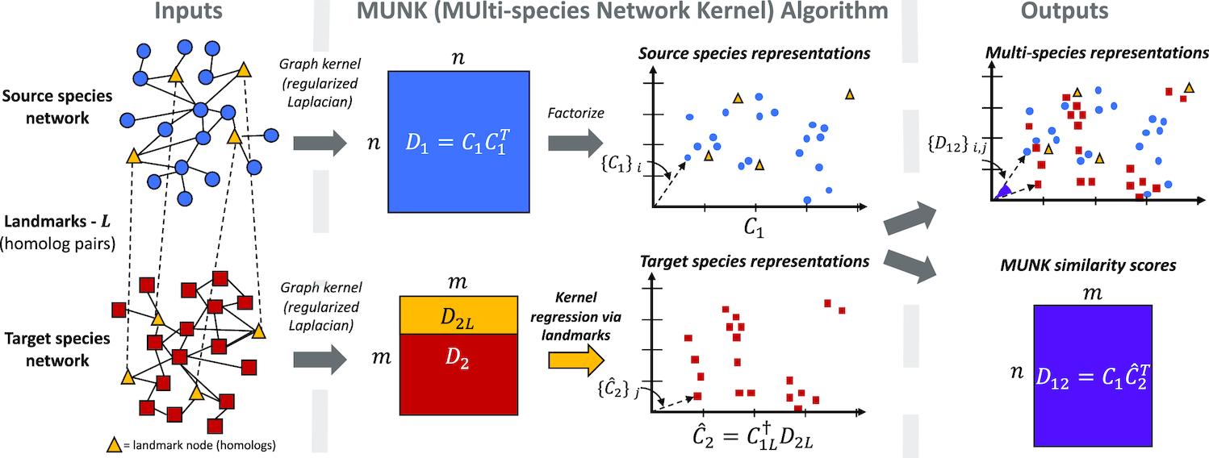
Graph-based transfer learning
Embed then align
Fan et al., (2019) Nuc. Acids. Res.

Slide 41
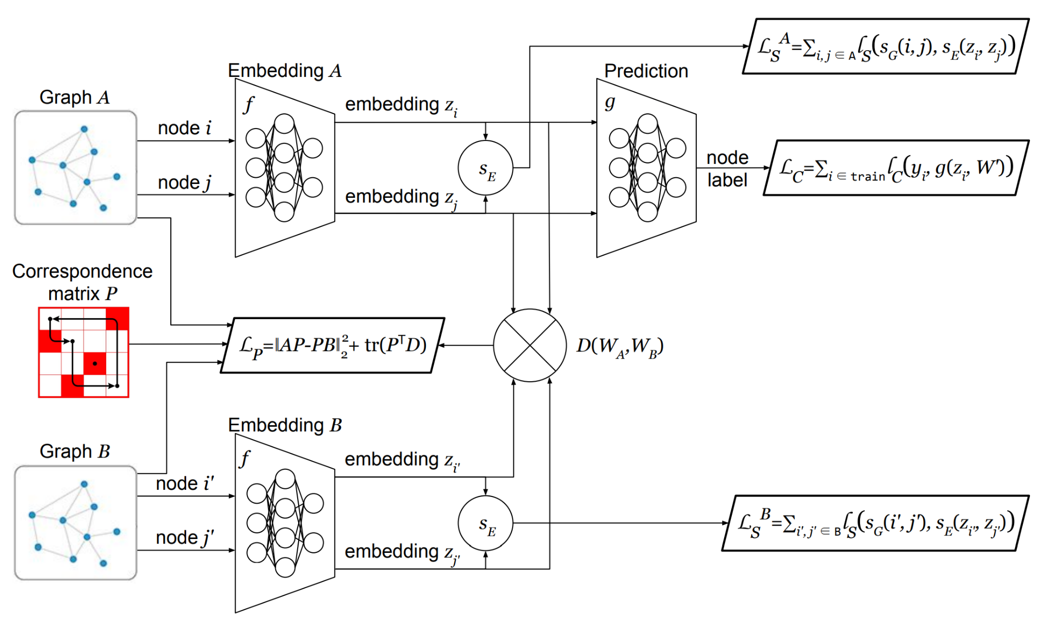
Graph-based transfer learning
Embed jointly while maintaining reasonable alignment
Gritsenko et al., (2021) IEEE ICDM

Slide 42
Overview
Introduction (AK)
Network embedding
Unsupervised / self-supervised pre-training (YS)
Condition-specific node/subgraph embeddings (AK)
Multiplex heterogeneous networks (SB, BJY)
Graph-based transfer learning (AK, BJY)
Spatial / geometric networks (HY, YS)
Other emerging problems
Open discussion

Slide 43
Spatial/3D graphs: Motivation
Spatial information is critical to predicting the label
Example: Stereoisomers
Poorly soluble in water
Water soluble
Anti-cancer drug
No important medical use

Slide 44
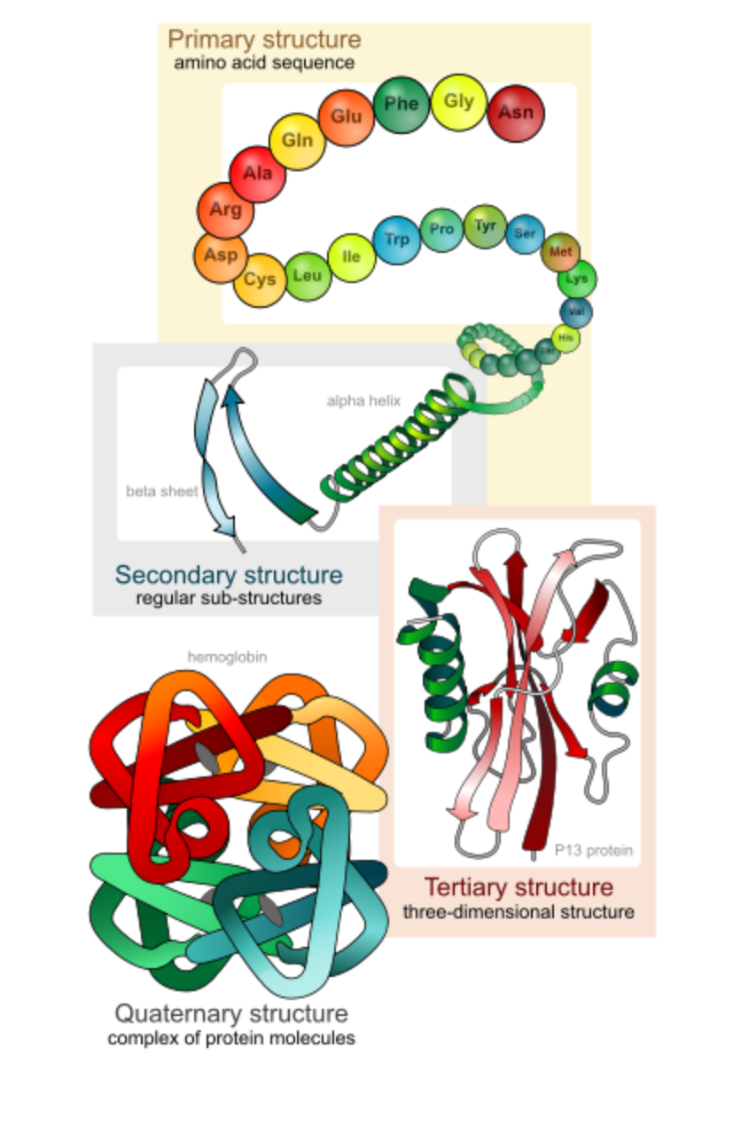
Spatial/3D graphs: Motivation
Spatial information is (part of) the label to predict
For instance, 3D shapes/surfaces that are important for protein function
AlphaFold
(2020)
AlphaFold2
(2021)
2D graphs
(Distograms)
3D graphs
Example: Protein Structure
Example: The highlighted pocket is the active site of the enzyme

Slide 45
Euclidean CNNs vs. Geometric CNNs
2D kernel
3D kernel
Euclidean (extrinsic) convolution
Take data in its Euclidean representation
NOT invariant to deformations
Geometric (intrinsic) convolution
Filter applied on the surface itself
Invariant to deformations
Bronstein, Michael M., et al. "Geometric deep learning: Grids, groups, graphs, geodesics, and gauges." arXiv preprint arXiv:2104.13478 (2021).

Slide 46
Spatial/3D graphs: Current methods
Represent/
Parametrize
Graph Input
GNN Model
Output
Input-invariant
Internal/
Relative/
Local Coord.
Conventional
GNNs
Model-invariant/
equivariant
External/
Absolute/
Global Coord.
(Cartesian) or mixture
SE(3) or E(3)
Equivariant
GNNs

Slide 47
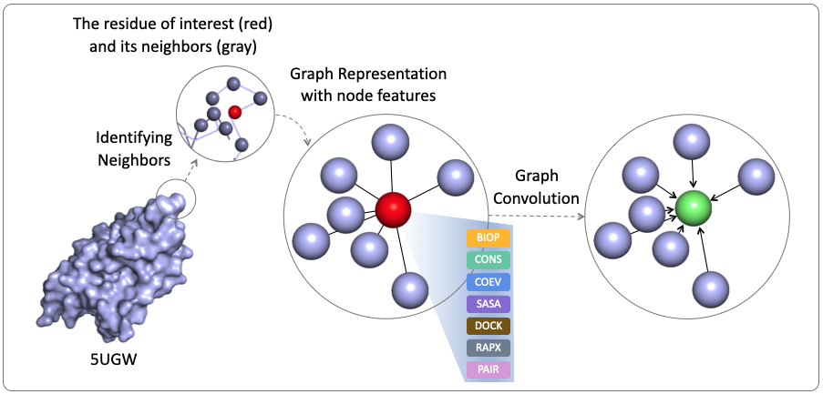
Spatial graphs: Input-invariant methods overview

Slide 48
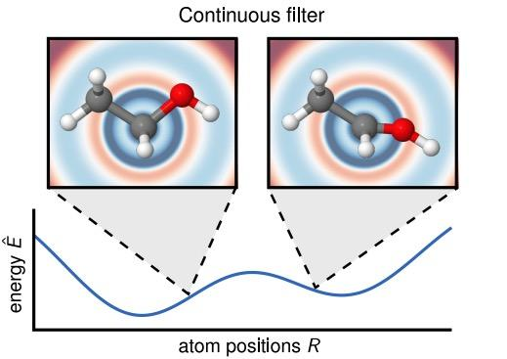
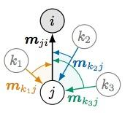
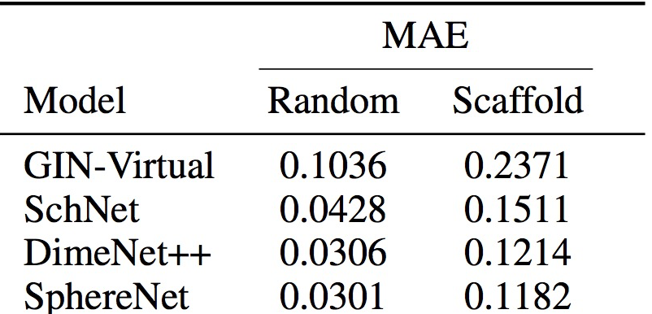
Spatial graphs: Input-invariant methods & challenges
SchNet: distance
DimeNet: +angle
SphereNet: +dihedral
…
Credit: Dr. Yi Liu &
Dr. Shuiwang Ji
Representation completeness
Representation “effectiveness”
Message passing efficiency and accuracy
Best 2D GNN
3D GNNs
K Schütt et al. “Schnet: A continuousfilter convolutional neural network for modeling quantum interactions.“ NIPS 2017.
J Klicpera. “Directional message passing for molecular graphs." ICLR, 2020. Also GemNet, OrbNet …
Y Liu*, L Wang*, M Liu, X Zhang, B Oztekin, and S Ji, “Spherical Message Passing for 3D Molecular Graphs”, ICLR 2022.

Slide 49
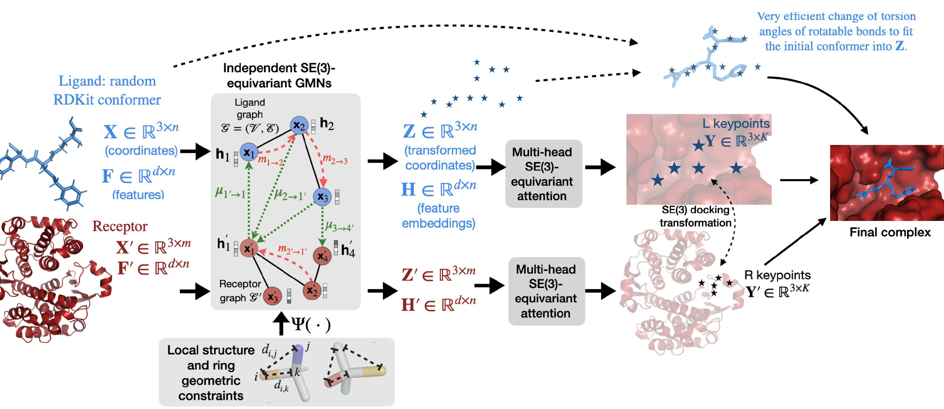
Spatial graphs: Model-equivariant methods & challenges
Tensor Field Networks (Thomas et al., 2018)
SE(3) Transformers (Fuchs et al., 2020)
PaiNN (Schutt et al., 2021)
E(n)-Equivariant GNN (Satorras et al., 2021)
H Stark, O-E Ganea, L Pattanaik, R Barzilay, and TS Jaakkola,
“EquiBind: Geometric Deep Learning for Drug Binding Structure Prediction”, ICLR MLDD 2022..
NequIP (Batzner et al., 2021)
…
Many Ways to Equivariance?
Balancing the Needs: Equivariance vs. Expressiveness
Computational Efficiency (messages and message passing …) ...

Slide 50
Overview
Introduction (AK)
Network embedding
Unsupervised / self-supervised pre-training (YS)
Condition-specific node/subgraph embeddings (AK)
Multiplex heterogeneous networks (SB, BJY)
Graph-based transfer learning (AK, BJY)
Spatial / geometric networks (HY, YS)
Other emerging problems
Open discussion

Slide 51
Other emerging problems
Explainability, interpretability (YS, AK)
…
Uncertainty quantification (BJY)
…
Meta-learning (MZ)
…

Slide 52
Other topics: Explainable graph learning
In the context of specific domains …
How to define explainability?
How to assess explainability?
How to achieve explainability?
Intrinsic / transparent?
Post-hoc (&model-agnostic) / opaque?
Any unique challenge in graph explainable learning?
Non-Euclidean structured /irregular data, which affects the pattern of explanations (no longer important pixels in images)

Slide 53
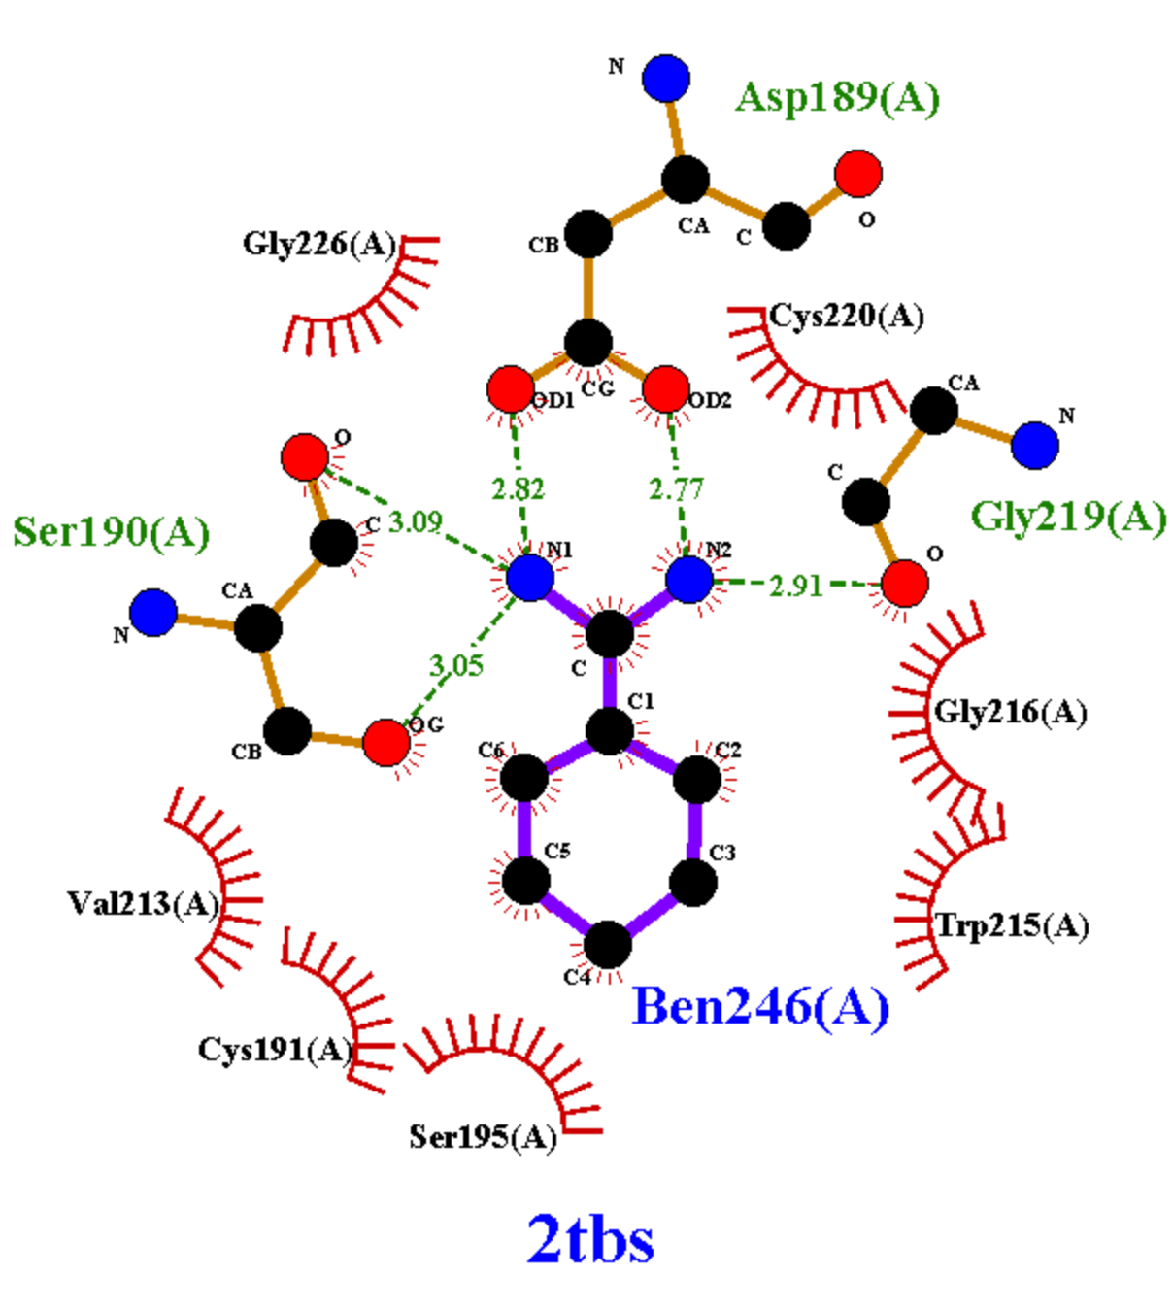
Attentions as explanations: Protein-drug affinity prediction
Credit: Dr. Jiangning Song
How to define model interpretability?
Need to conform to scientific knowledge, human understanding, and drug-discovery needs
Ability to explain predicted affinities through intermolecular atomic contacts (Intrinsic)
Ground truth exists!
How to assess model interpretability?
Accuracy of contact prediction underlying affinity prediction. => Attention alone is inadequate!
How to enhance model interpretability?

Slide 54
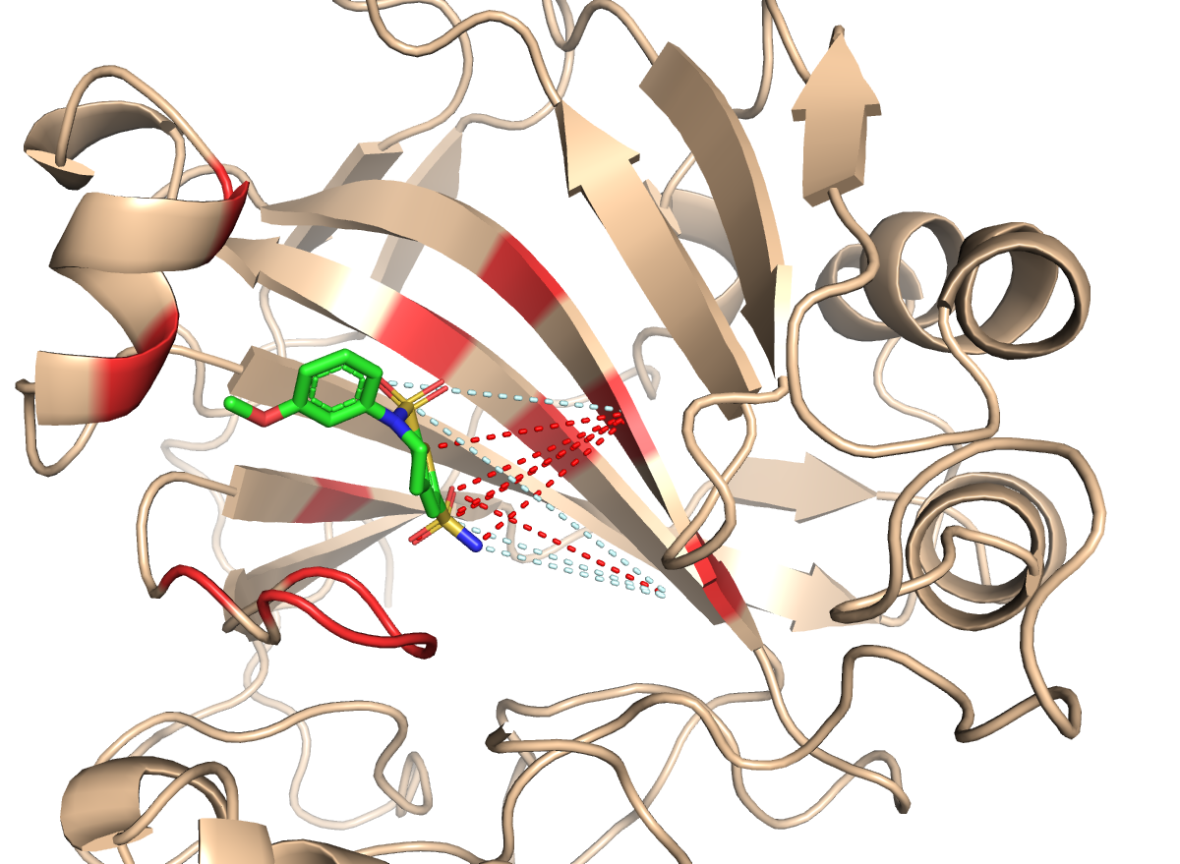
How to enhance model interpretability
Supervise attentions
Teach models with examples where to pay attention
Regularize attentions
Teach models with knowledge where to pay attention
Intrinsically explainable NN architecture
Physics-motivated interatomic “relations”
Increasingly focusing attentions
Seq-predict. surface, putative binding k-mers/residues/pairs
Human carbonic anhydrase II
(no homologs in training set)
AL1
----- Incorrect top-10 pred. contacts
----- Correct top-10 pred. contacts
M. Karimi, D. Wu, Z. Wang, and Y. Shen, "Explainable Deep Relational Networks for Predicting Compound–Protein Affinities and Contacts”, in J. Chem. Inf. Model. 2021, 61, 1, 46–66

Slide 55
Other emerging problems
Explainability, interpretability (YS, AK)
…
Uncertainty quantification (BJY)
…
Meta-learning (MZ)
…

Slide 56
Uncertainty Quantification (UQ) in biological networks
Consider the problem of inferring a biological network (e.g., gene regulatory network)
Due to the complexity of the network and the scarcity of data/knowledge, we end up with an uncertainty class of networks consistent with data/knowledge

Slide 57
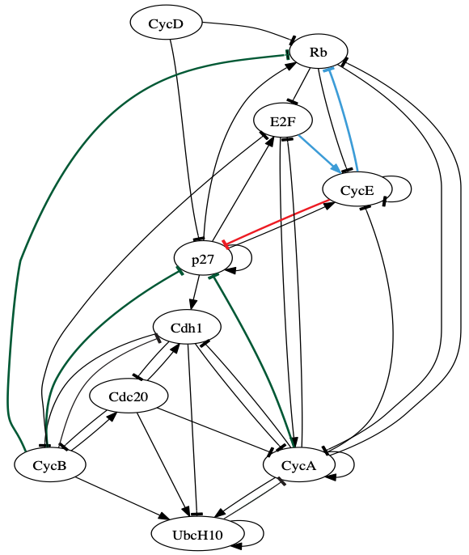
UQ | Examples / Applications
Robust network intervention under uncertainty

Slide 58
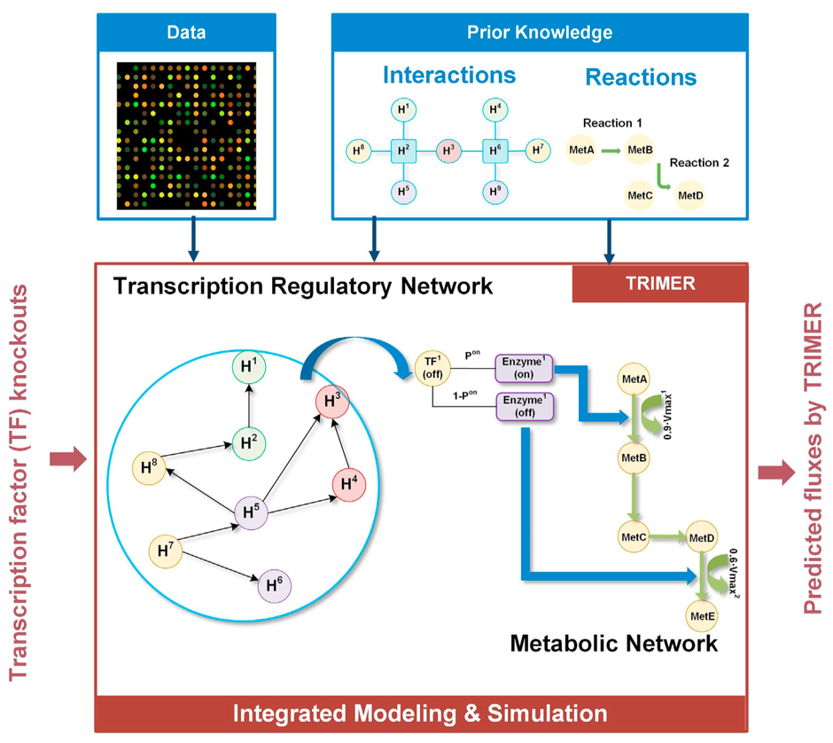
UQ | Examples / Applications
Integrative modeling of transcription & metabolic regulation

Slide 59
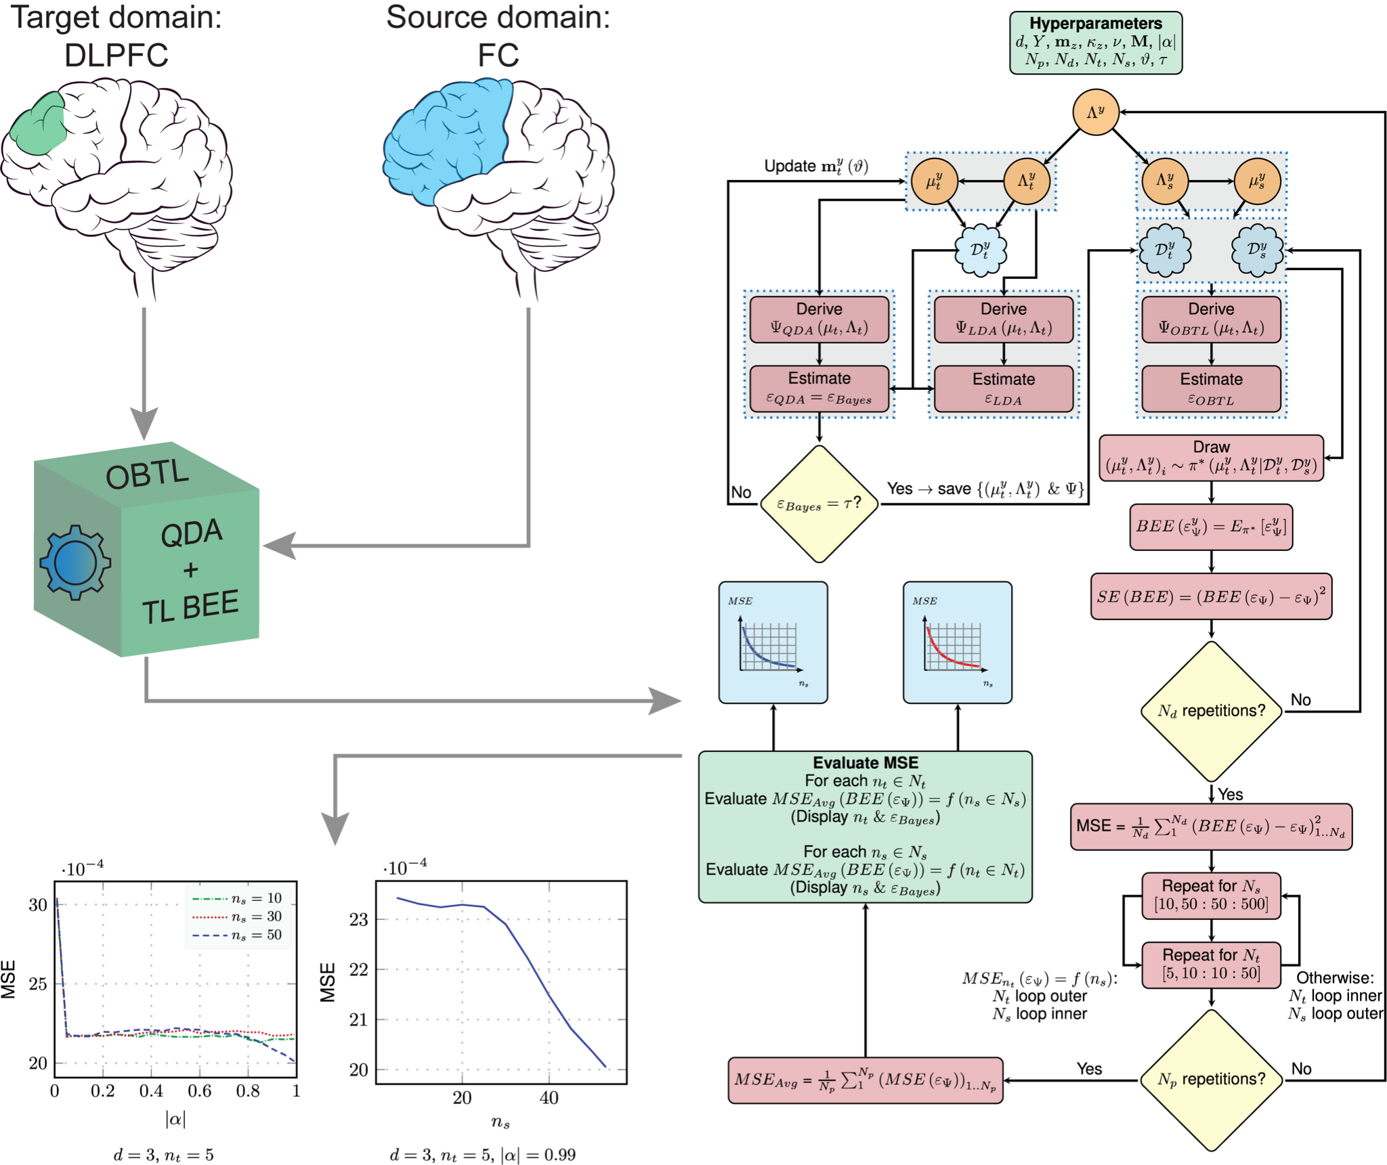
UQ | Examples / Applications
Optimal Bayesian transfer learning for biomarker discovery & error estimation

Slide 60
UQ | Challenges and needs arising from uncertainty
How do we quantify uncertainty? → Focus on the “objective” (e.g., predictive task) and assess how the uncertainty hinders attaining the objective
How do we optimally reduce uncertainty? → Active learning, optimal experimental design (OED)
How can we incorporate prior (network) knowledge? (esp., to enhance the performance of data-driven ML models) → Bayesian methods (use prior constructed from scientific/expert knowledge) → Transfer learning & domain adaptation

