Slide 1
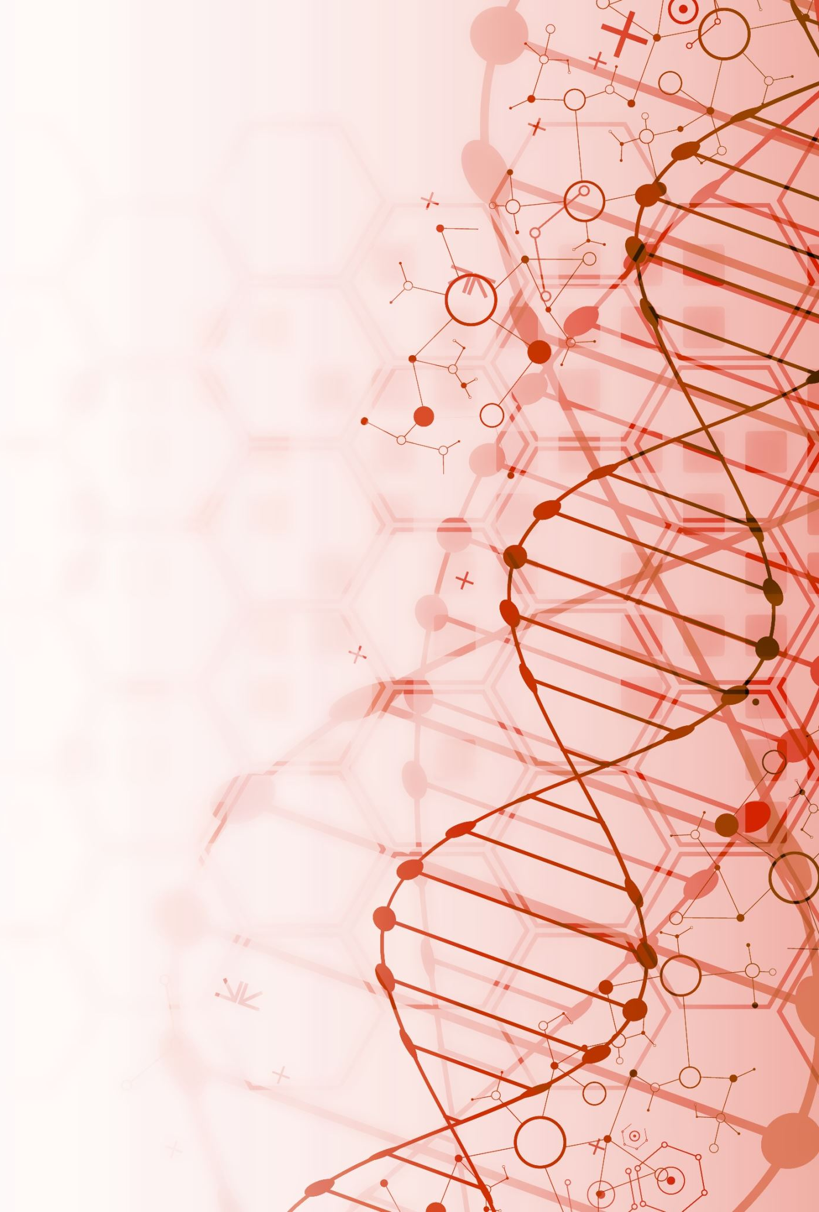
Network-based personalized medicine in and outside of clinic
BY
DANNY CHEN
DEISY GYSI
HENG HUANG
TERESA PRZYTYCKA
DONNA SLONIM

Slide 2
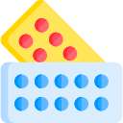
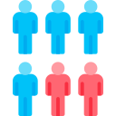

Definition of medicine over time
1700
Scientific method applied to medicine
1996
Heterogeneity in patients
2015
Precision Medicine Initiative
1990
Evidence-Based Medicine
2004
Individualized Medicine
Kosorok and Laber, 2019, Ann Rev. Stat. Appl, 6:263-286.

Slide 3
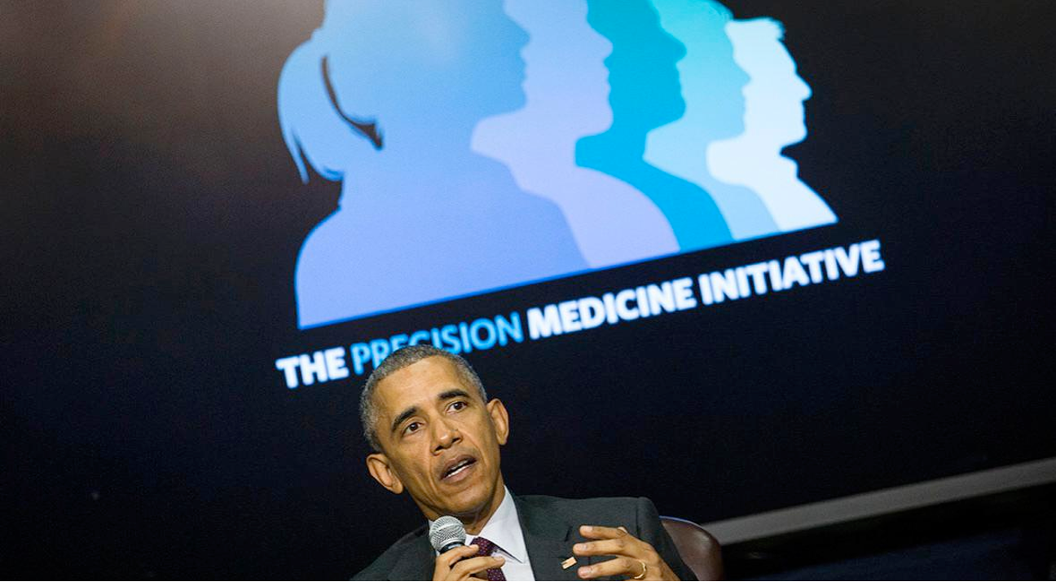
What do we mean by “precision medicine?”
Notes:
https://www.nejm.org/doi/full/10.1056/NEJMp1500523

Slide 4

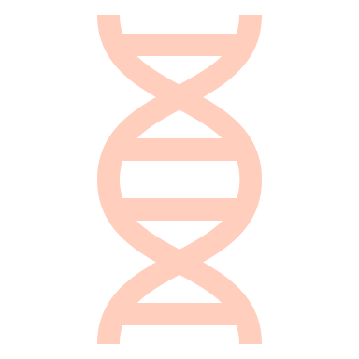
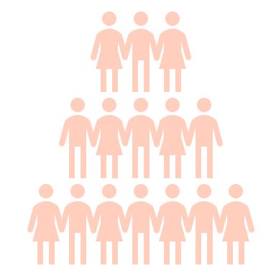
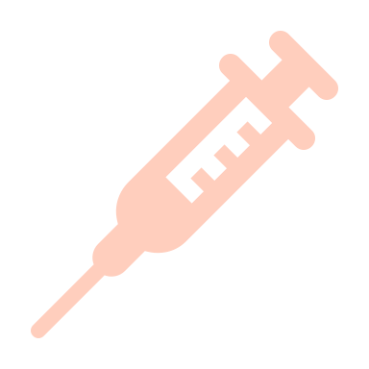




Goals of Precision Medicine
Drug Discovery
Biomarker Identification
Study Design
Causal Treatments
Assessment of disease risk
Prevention
Diagnostics
Effective treatments

Slide 5
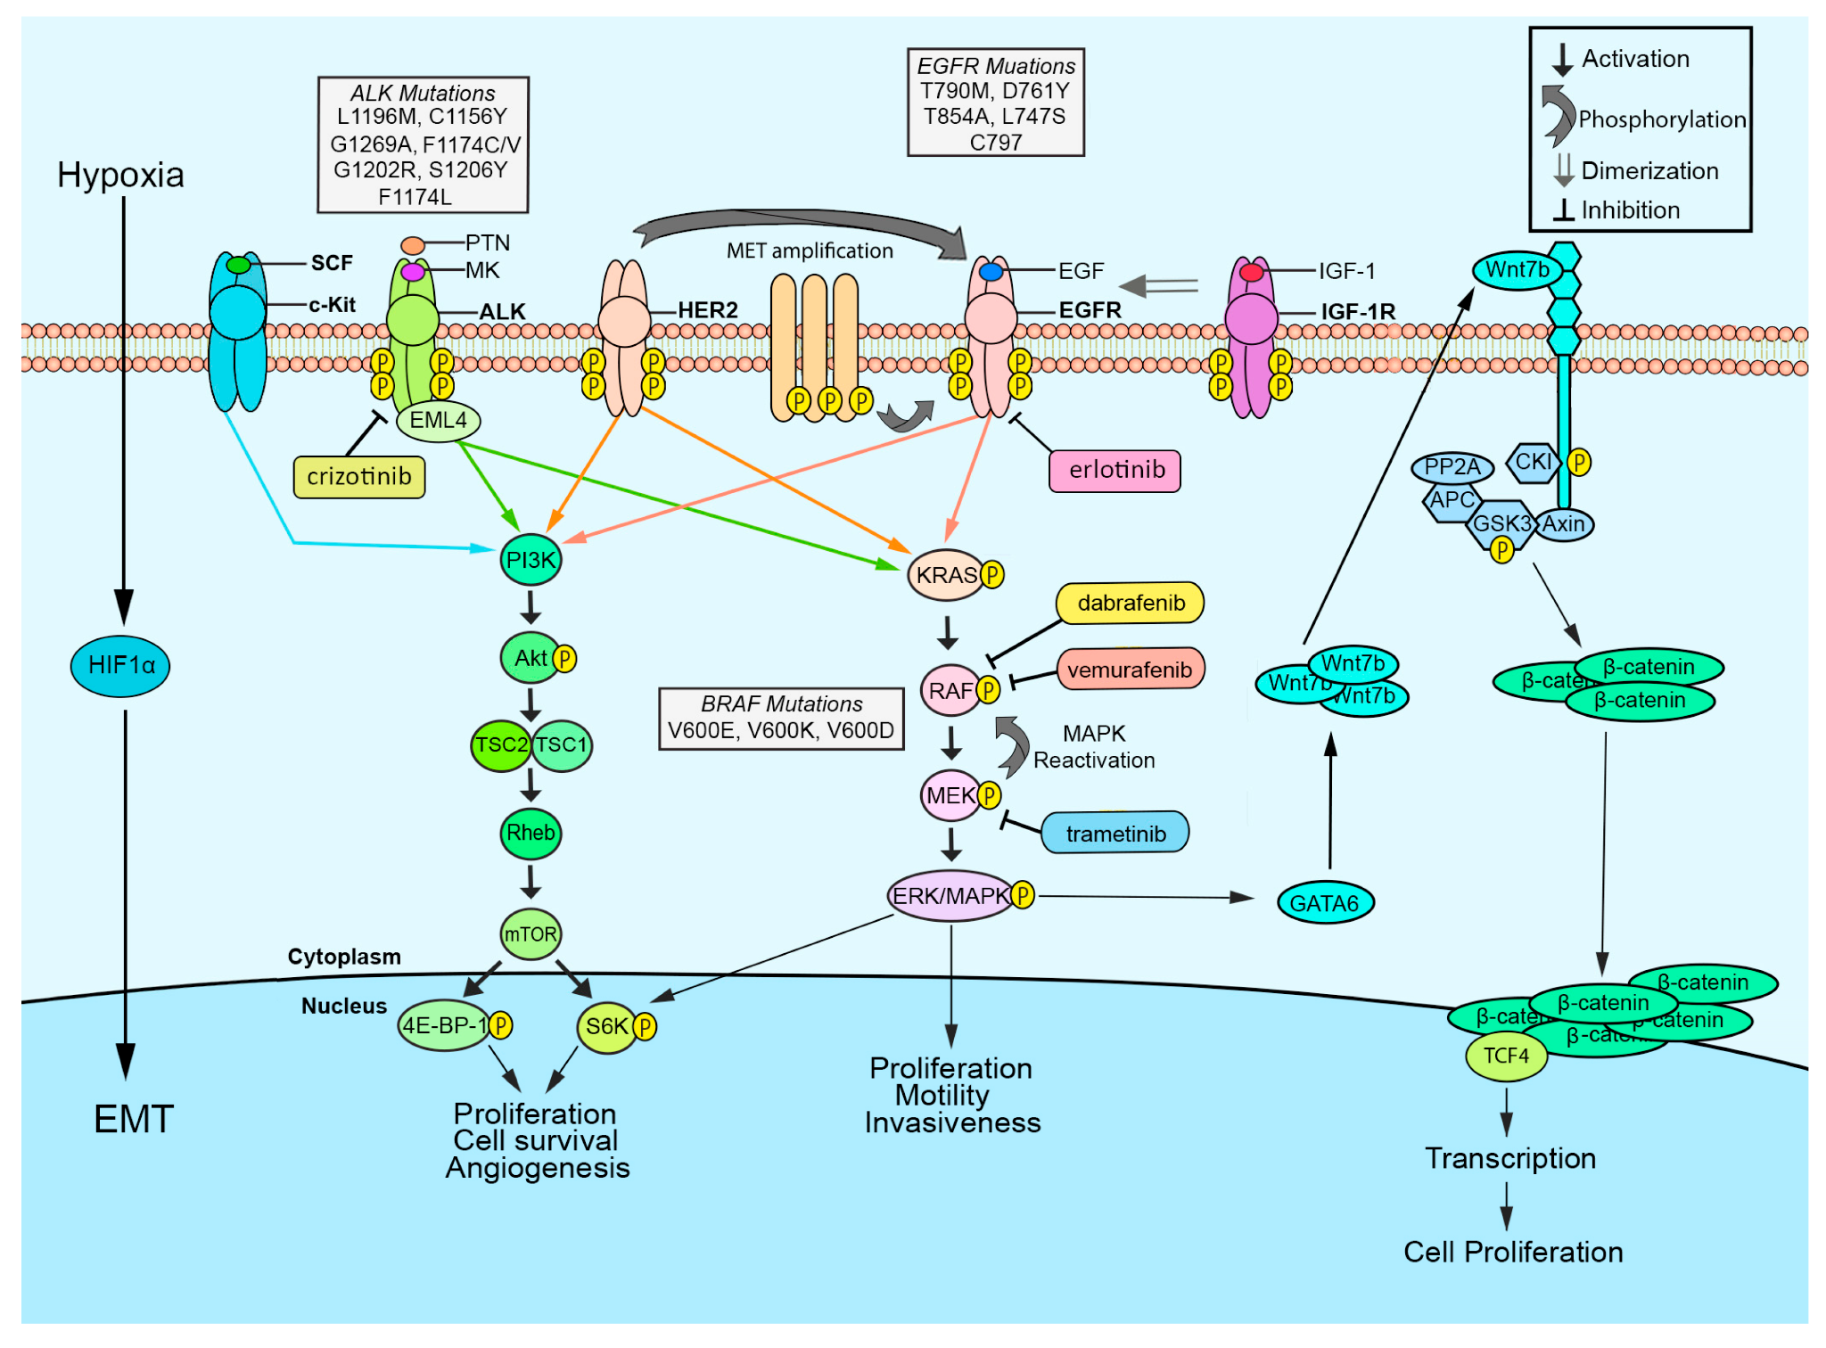
Finding disease subtypes
Non-Small Cell Lung Cancer
  Overexpressed genes targeted by specific therapies.
  Subdividing patients into groups can improve survival and quality of life.
Schrank, et al. Cancers 2018, 10(7).

Slide 6

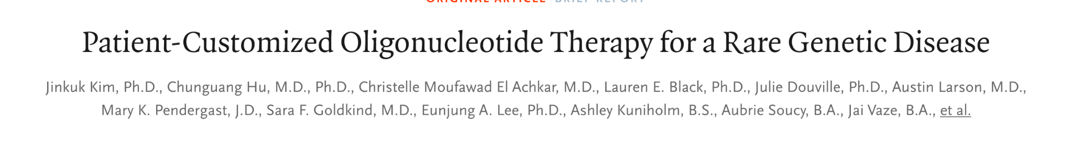
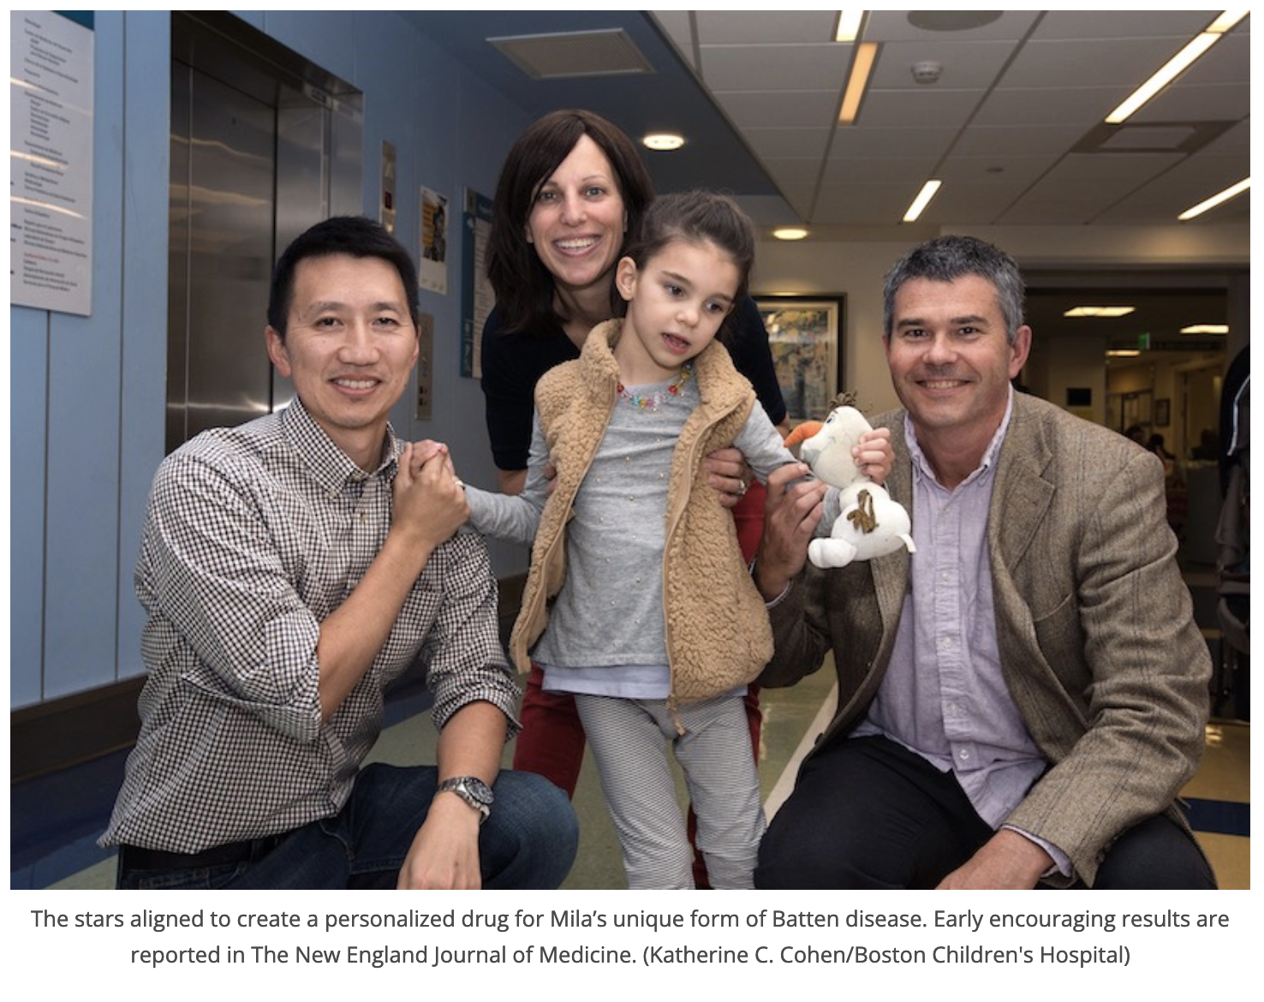
N-of-1 Clinical Trials
Mila had a rare form of Batten’s disease, a fatal disorder of the nervous system.
Sequencing identified an insertion in a key gene.
Dr. Timothy Yu at Boston Children’s developed an antisense oligo therapeutic and arranged for an N-of-1 clinical trial.
Notes:
Also mention Matt M.

Slide 7

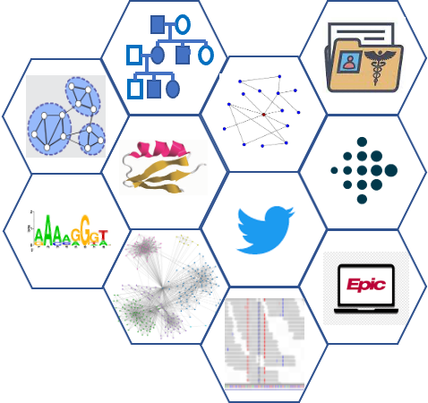
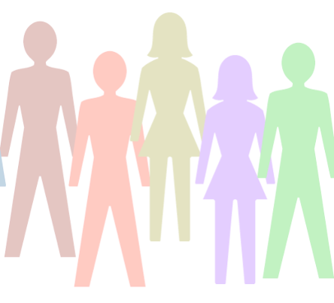

The “Holy Grail” of precision medicine
Map individual patients to treatment plans
E.g. Determine which antidepressant will work best for a given person.
Applies widely, not just to some with one particular mutation.

Slide 8
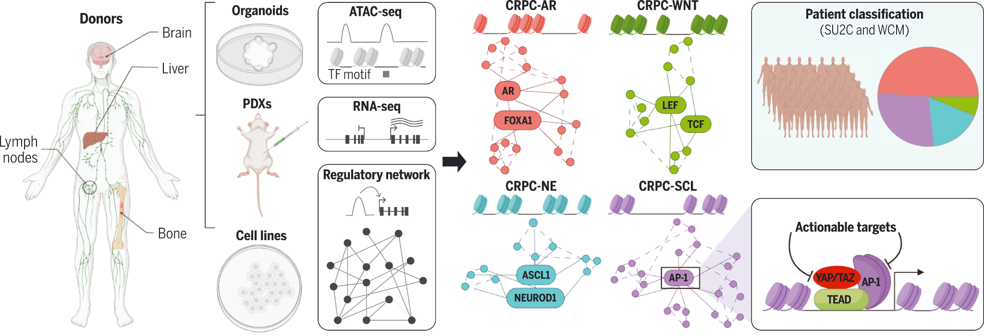
How does network science fit in?
Chromatin structure governs prostate cancer subclasses
Built regulatory networks; identified key TFs
YAP / TAZ inhibitors available for AP-1 focused subclass
Tang, et al. Science, 376:6596, May, 2022

Slide 9
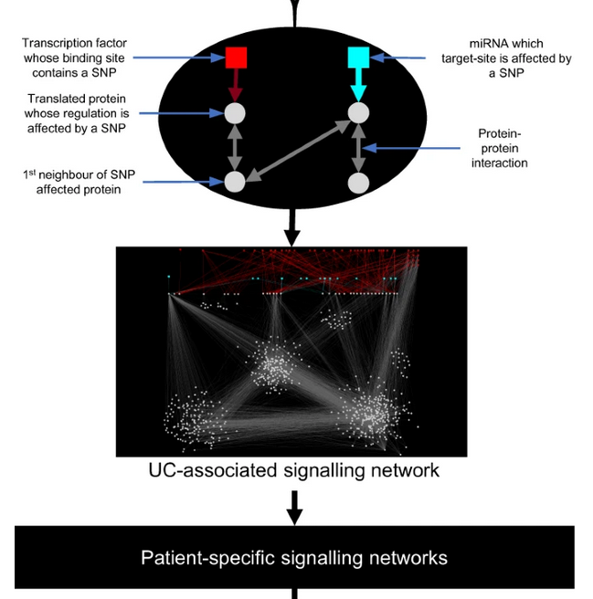
How does network science fit in?
Ulcerative colitis example:
Most disease-associated SNPs are non-coding.
Stratifies patients by clustering patient SNPs in networks and investigating interacting / regulating proteins as possible targets.
Validated clusters in a separate cohort.
… could be truly patient specific, but the focus is still primarily on finding common subclusters.
Brooks-Warburton, et al., Nat. Comm. 13:2299 (2022).

Slide 10
Outline
Multi-scale
Noise
Applications
Challenges

Slide 11
Multi-scale data integration

Slide 12
Overview
Significance:
Different biological and biomedical data provide specific views for the problem with corresponding mechanisms
These multi-scale heterogeneous data often complement to each other
Challenges:
How can we integrate heterogeneous data with considering their interrelations?
How can we integrate different formats of data, such as vectors, pathways, networks?
Although the multimodal data are often available during model training, we may only have single modal data in prediction. Can we use multimodal data to enhance the model which will conduct prediction with single modal data?

Slide 13
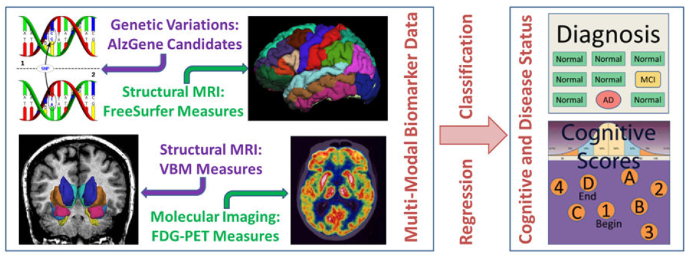
Multimodal Heterogeneous Data Integration
Global feature importance: some types of features are important than the other types
Local feature importance: one type is not important, but individual features from this modality could be important

Slide 14
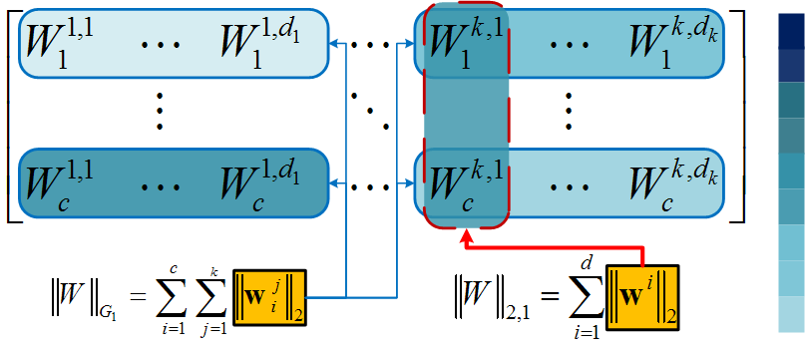
Data Integration via Structured Sparsity-Inducing Norms
MRI
SNP
AD
…
MCI
Learning proper weight for each modality
Learning proper weight for each individual feature

Slide 15
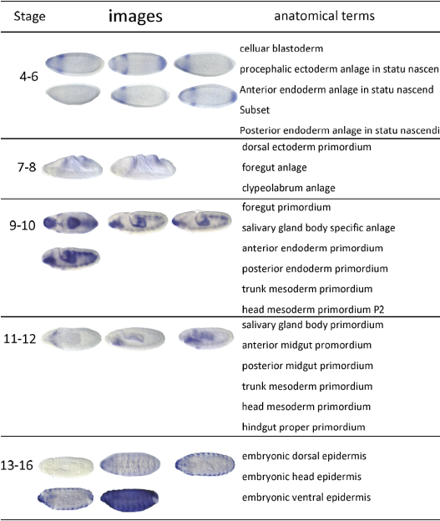
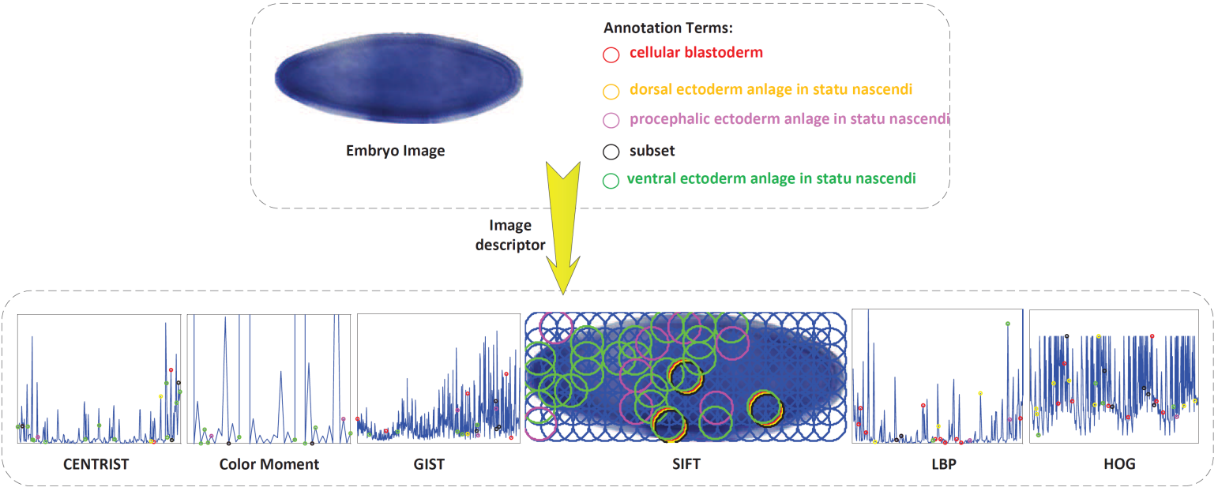
Drosophila Gene Expression Image Analysis
The in situ hybridization (ISH) visualizes gene expression patterns to help understand the mechanisms of gene regulation

Slide 16
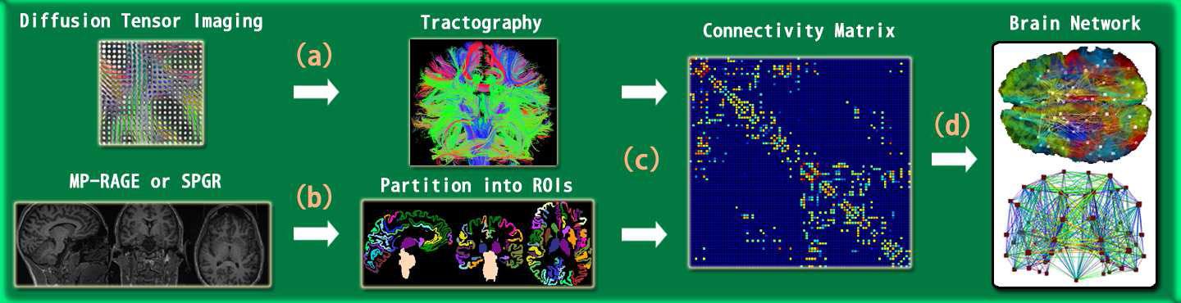
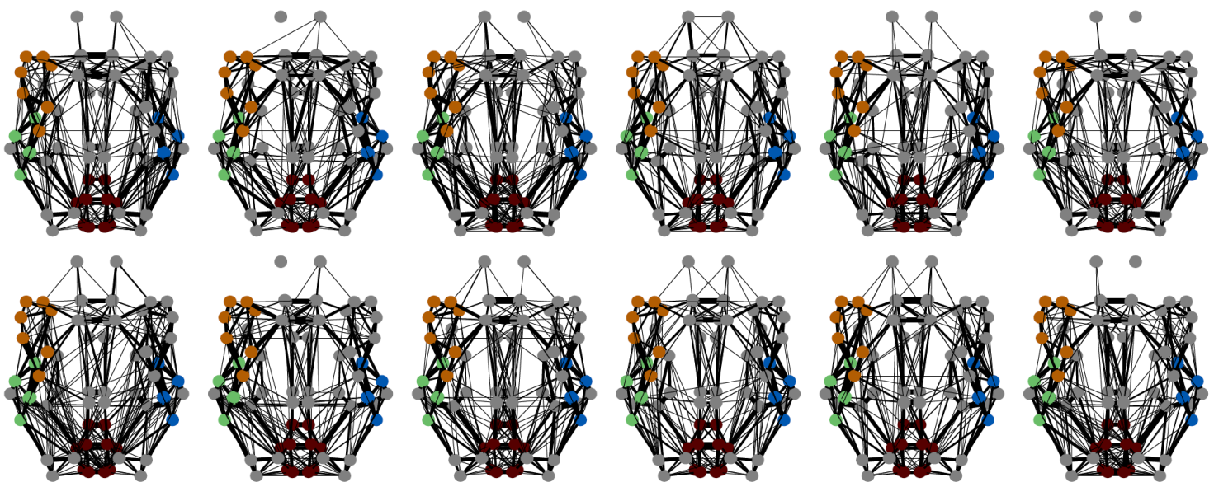
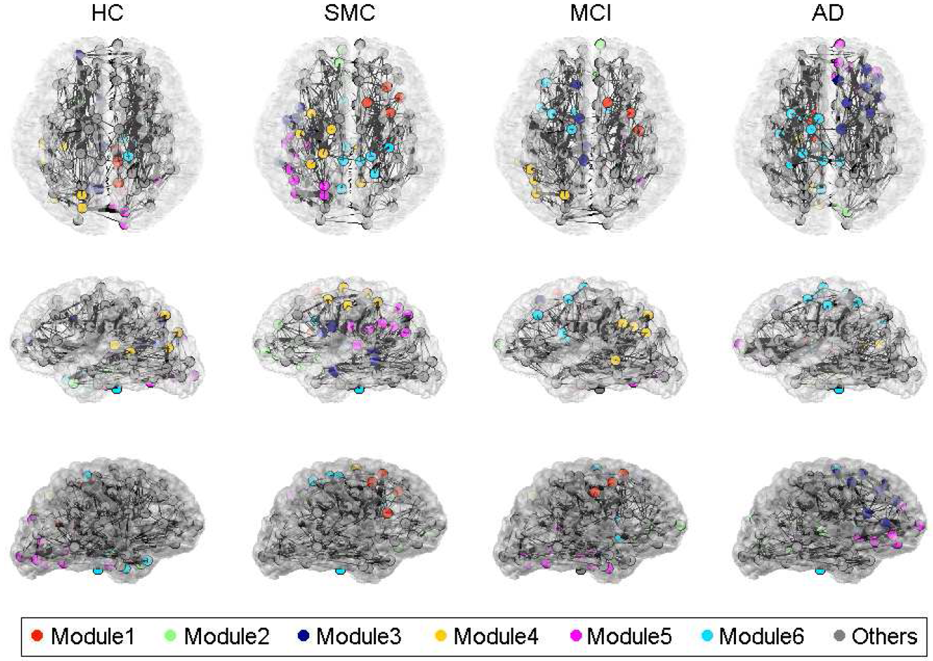
Multimodal Network Integration for Classification
For example, integrating heterogeneous brain networks to predict conditions

Slide 17
Integrating Heterogeneous Brain Networks
Many mental disorders are degenerative, and clinical measures can better capture the progress
Multi-view brain networks can provide complementary viewpoint
We learn the representations for multi-view brain networks, then make predictions, e.g. predicting the medical scores using the data from the Parkinsons Progression Markers Initiative
An adaptive pooling scheme in graph convolutional network is proposed

Slide 18
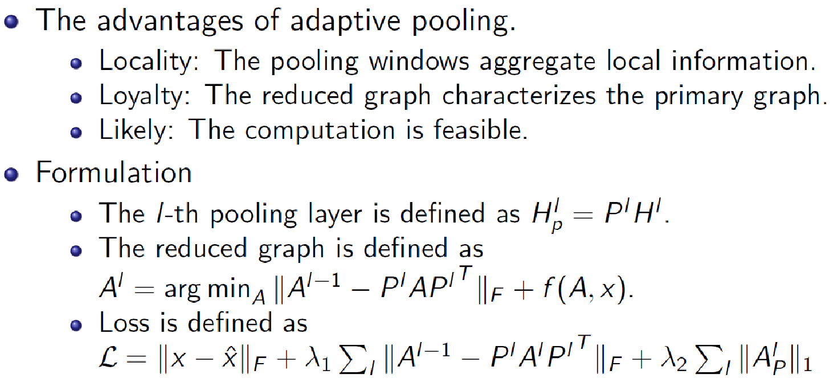
Methodology: Formulation

Slide 19
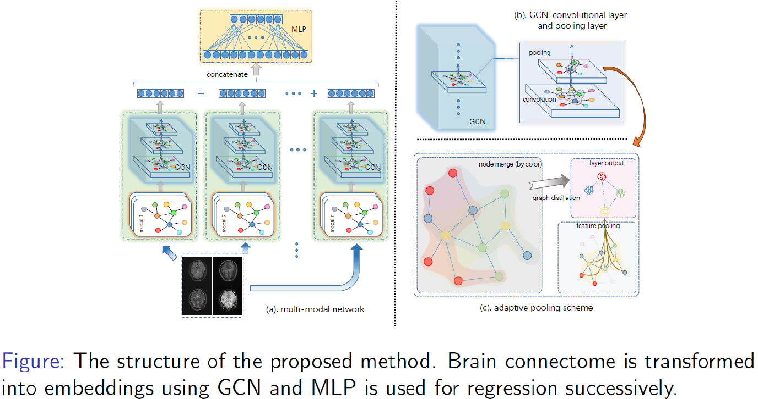
Methodology: Architecture

Slide 20
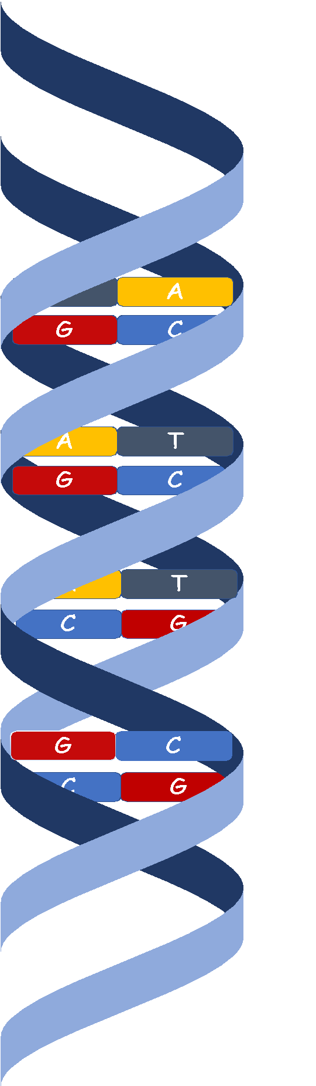
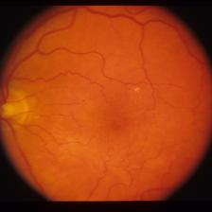
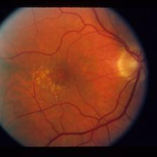
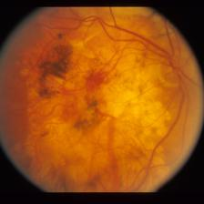
Multimodal Genotype and Phenotype Mutual Learning
Age-related Macular Degeneration (AMD)
  A leading cause of blindness among elder adults in developed countries.
  Estimates that its prevalence will increase to 288 M people worldwide in 2040.
  Symptoms: presence of drusen and/or leaky blood vessels on Macula.
  Challenge: the genetic data are available in model training, but not in many clinics during prediction
Early
Intermediate
Advanced

Slide 21
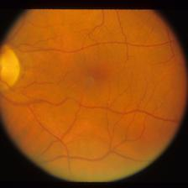
Method
How to effectively use the auxiliary modality (Genome sequence) in the training dataset if the final model is single-modal?
Main idea: Train the single modal model (S-model) mutually with a pretrained multimodal one (M-model).
M-model
y
S-model

Slide 22
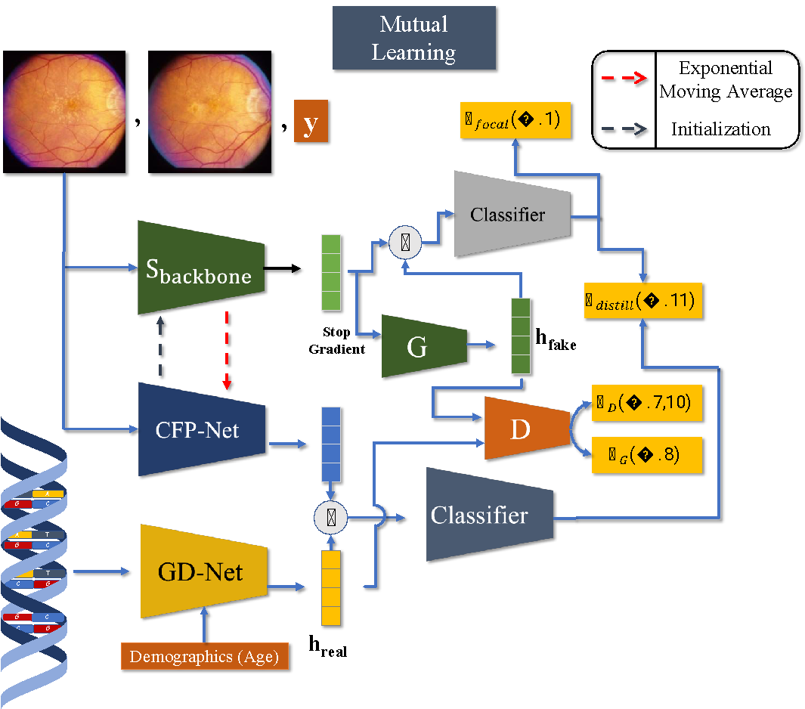
Method
Schematic of our mutual learning model

Slide 23
Noise in Personalized Medicine

Slide 24
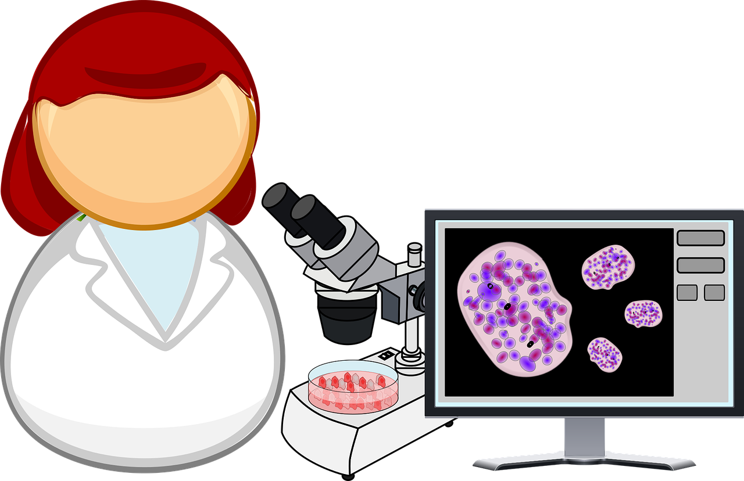

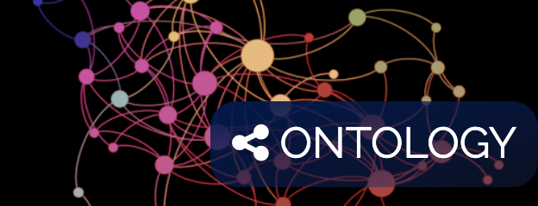
Biomedical image analysis and deep learning
Image data
Algorithms
  CNNs
  GNNs
  …
Diagnoses
  Cancer
  Scoliosis
  Diabetes
Knowledge
  Protein-protein interactions
  High risk factors
  Drug discoveries
https://pixabay.com/vectors/analysis-biology-cell-cell-culture-2025834/
https://phdcomics.com
http://geneontology.org/
Notes:
1.5min/1.5
The biomedical algorithms aim to convert the data to diagnoses and knowledge.
Image data (e.g., ) graph data (e.g., ) and text data (e.g., ) .
The task are various. We can roughly categorize them into Diagnoses and Knowledge acquiring.
analysis from different granu: Cancer: Image/G/Topo
It is inspiring to study how to combine
Our goal is to extract valuable information from data with algorithms.
First let's look at the data, there's multiple modalities and sources of data. The image data graph data and the text data.
The valuable information can roughly categorized into: for diagnosis and acquiring knowledge. The diagnoses include cancer diagnosis scoliosis diagnosis diabetes diagnosis. Acquiring knowledge include studying protein interactions, finding out high risk factors, these learned knowledge may be helpful for drug discoveries.
In research we often find that, to extract valuable information, often need to analysis from different granuity. Take cancer diagnosis as an example. The pathology images are the golden standard. We can study the nuclei metosis (cell division) with CNN, study the cell microenvironment with GNN and glands morphology with topo. data analysis tools.
It is inspiring to study how to combine the three levels (image, graph and topo.) to comprehensively stud the properties of biomedical data.

Slide 25
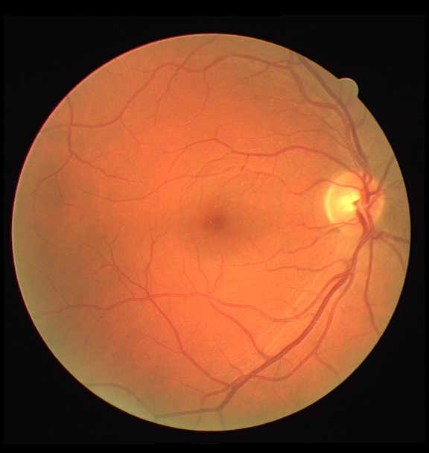
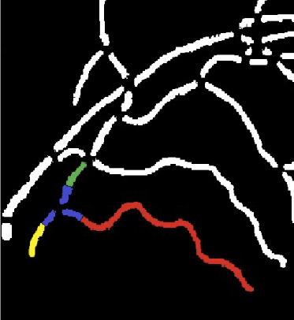
Biomedical images and biological networks
Biomedical images have been extensively used in biomedical research and clinical practice
  Disease diagnosis, treatment planning, monitoring, and evaluation, drug design, cancer studies, …
2D, 3D, 4D images, possibly very large sizes
Images can come from different sources
  Biomedical experiments (e.g., different subjects, organs/tissues, diseases, imaging modalities)
  Clinic (e.g., in-patient, out-patient)
  Outside the clinic (e.g., cell phones, Internet, sensors, hand-held devices, edge computing)
Network models can be used to represent structures of different levels in biomedical images
A fundus image
Retinal vessels
Notes:
1.5min/1.5
The biomedical algorithms aim to convert the data to diagnoses and knowledge.
Image data (e.g., ) graph data (e.g., ) and text data (e.g., ) .
The task are various. We can roughly categorize them into Diagnoses and Knowledge acquiring.
analysis from different granu: Cancer: Image/G/Topo
It is inspiring to study how to combine
Our goal is to extract valuable information from data with algorithms.
First let's look at the data, there's multiple modalities and sources of data. The image data graph data and the text data.
The valuable information can roughly categorized into: for diagnosis and acquiring knowledge. The diagnoses include cancer diagnosis scoliosis diagnosis diabetes diagnosis. Acquiring knowledge include studying protein interactions, finding out high risk factors, these learned knowledge may be helpful for drug discoveries.
In research we often find that, to extract valuable information, often need to analysis from different granuity. Take cancer diagnosis as an example. The pathology images are the golden standard. We can study the nuclei metosis (cell division) with CNN, study the cell microenvironment with GNN and glands morphology with topo. data analysis tools.
It is inspiring to study how to combine the three levels (image, graph and topo.) to comprehensively stud the properties of biomedical data.

Slide 26
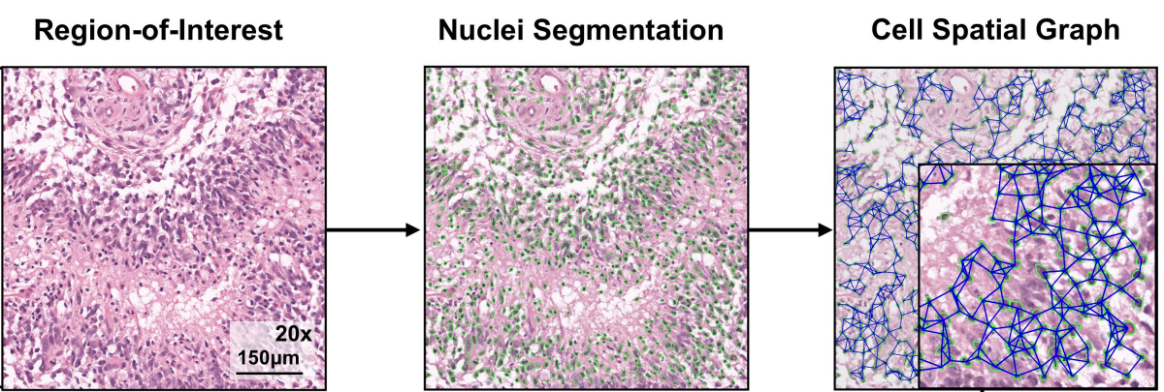
Images: Low level, fine granularity
Images: In pixel space
  Classification
    Directly to results: Diagnoses/cancer screening
    Hard to explain the results
  Segmentation and detection
    Map image pixels to instance labels
    Indirectly: Acquiring knowledge/assisting doctors making diagnoses
    More reliable/interpretable to doctors
Tools: CNNs, Transformers (extract visual/appearance features)
Drawbacks
  Fixed field of view: trade-off between the field size and the patch resolution
  May disregard meaningful instances
  May disregard structural compositions of tissues
Chen, Richard J., et al.IEEE Transactions on Medical Imaging (2020).
Notes:
2min/4
Three major tasks are:
can make high accurate predictions.

Slide 27

Graphs: Middle level, medium granularity
Graphs: Instances + pairwise relations
E.g., cell graph (cells + neighbor links)
Gene ontology (protein concepts + dependency relations)
Tools: GNNs (extract relations, more explainable results)
Drawbacks
Only pairwise relations
Local visual features
Chen, Richard J., et al. IEEE Transactions on Medical Imaging (2020).
Notes:
1min/5
cell graphs, the nodes are the cells and the edges are the neighboring relations. In gene ontology graphs, the nodes are protein attributes and the edges are the depency relation between them.

Slide 28
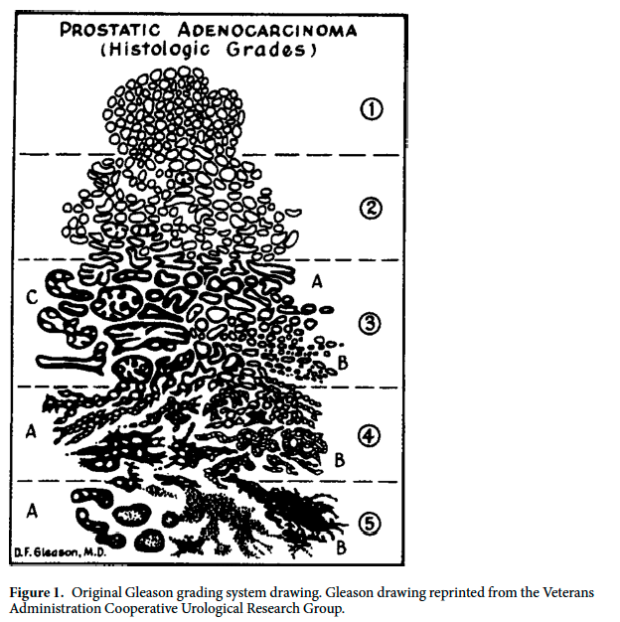
Topology: High level, coarse granularity
Evenly distributed with regular shapes
Capable to capture
  Instance distributions
  Computational geometric information
  E.g., clustering patterns, shape priors, graph topology
More Aggressive
Tool: Persistent homology
  Track evolving topological structures across multiple scales (e.g., cells to gland to distribution)
Randomly distributed with irregular shapes
Drawbacks
  Disregard too much details
  Lack representation ability for local features
Lawson, Peter, et al.Scientific Reports 9.1 (2019): 1-15.
Notes:
1min/6

Slide 29
An overview
Images
Graphs
Topology
 | Images (fine) | Graphs (medium) | Topology (coarse)
Approaches | CNNs Transformers | GNNs | Persistent homology
Advantages | Extracting visual features | Extracting relations and structural info. | Global distribution patterns
Disadvantages | Instance information Structural information | Visual features Global graph topology | Lack of representation ability for local features
Images + Graphs | Image classification
Graphs + Topology | Knowledge graph embedding
Images + Topology | Image segmentation with priors
Combining 3 levels | New approaches
Notes:
2min/8
Fine to coarse

Slide 30
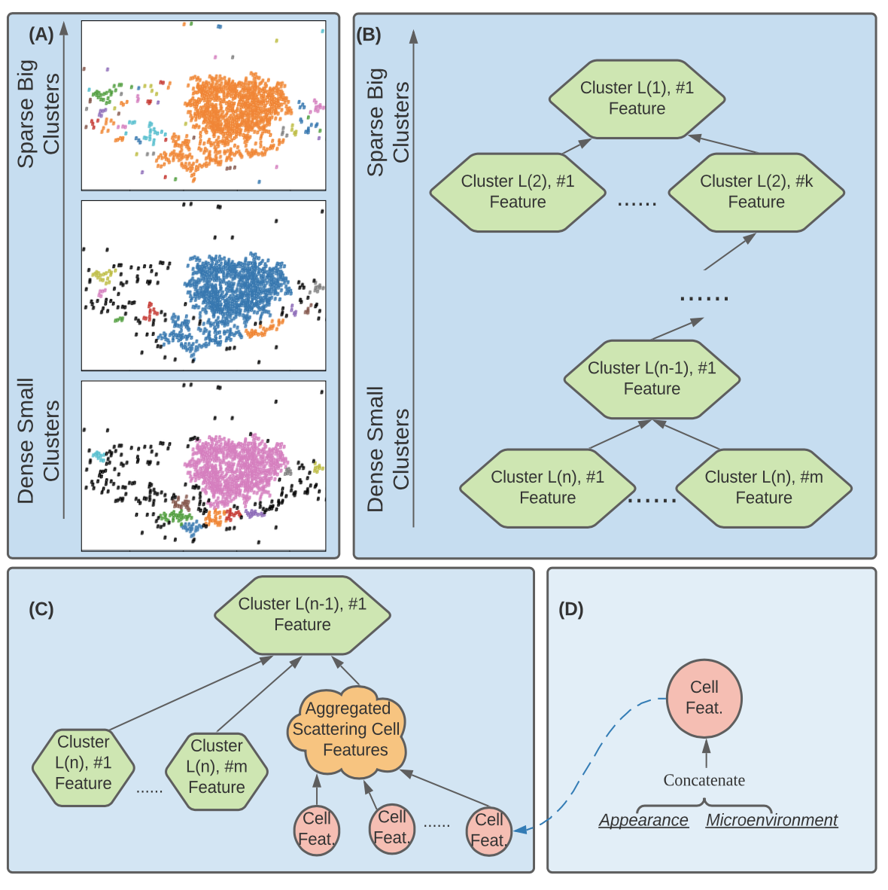
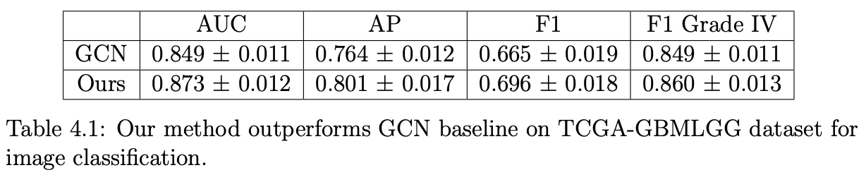
A unified hierarchical model: An example
Combine three levels of cell information
  Cell appearance features: CNN
  Cell microenvironment/clusters: GNN
  Topology: Filtration tree (FT)
    Describe cell gathering patterns
    Guide aggregation of cell information
Filtration tree
  (A): DBSCAN with three density values
  Nodes: Cluster features
  Edges: Dense small clusters merge into sparse big ones
  Use GNN aggregation modules 🡪 one global feature vector
Notes:
2min/43
Applications on H & E/ Immunofluorescence images
same patho. three density values.
points are cell coordinates. Cells in the cluster color
Bottom to top the clustering density decrease.
Small clusters merge into big ones.
2 The info. aggreate from dense to sparse. Eventually, all
FT. cell cluster feature.
Edges: lowlevel dense merge big sparfe ones.
(A): The three subfigures illustrate the cell clustering pattern in the same pathology image with three clustering density parameters. Points represent cell coordinates. Cells in the same cluster are plotted with the same color (black color represents scattering cells). From bottom to top, the density parameter of DBSCAN decreases, making (a1) dense small clusters merge into sparse big ones and (a2) new clusters emerge from scattering cells as the cluster density parameter decrease. (B) Filtration tree. Each node is a cell cluster feature. Edges represent small clusters gathering and form bigger ones. (i.e., (a1)). (C) The cluster feature is aggregated from lower-level dense clusters and scattering cells (i.e., (a2)). (D) Cell features are concatenations of encoded appearance and microenvironment.

Slide 31
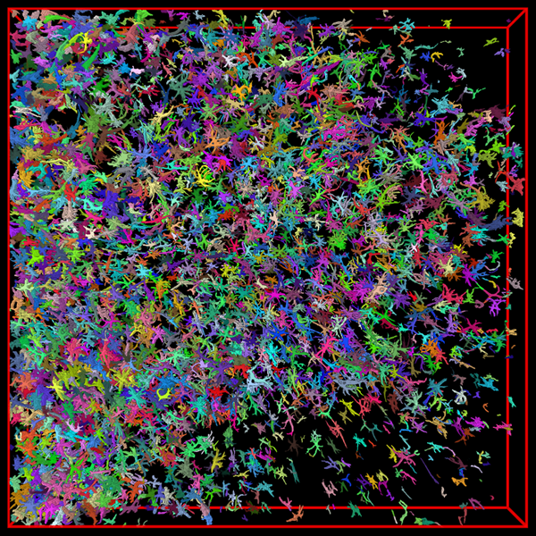
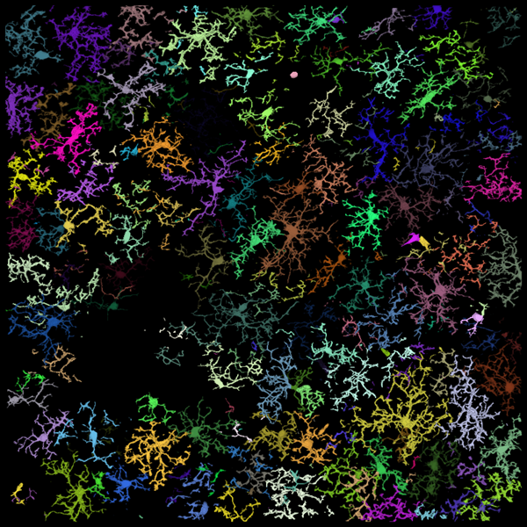
A critical challenge: Labeling biomedical images
Labeled biomedical image data (ground truth) are crucial
  Biomedical research, clinical practice, biomedical databases
  Training machine learning (deep learning) models
But, many difficulties!
  expensive
  arduous
  tedious
  insufficient
  incomplete
  inaccurate
  inconsistent
  non-standard
  non-transferable
  low dimension
Astrocytes in the brain
Glial cells in the brain

Slide 32
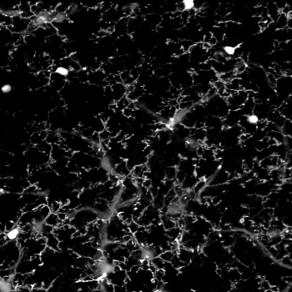
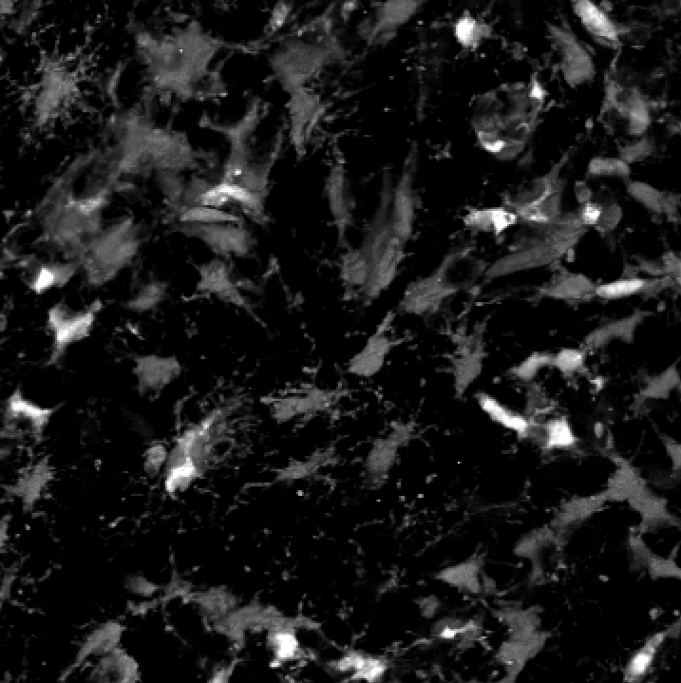
Annotation effort for biomedical images can be exceedingly high!
It is very difficult to label sufficient biomedical image data, especially 3D/4D images, for DL model training
  Only biomedical experts can annotate well
  Biomedical images often contain many object instances (e.g., millions cells)
  The need for re-annotations, due to (frequent) changes in biomedical experiments and studies (e.g., new subjects, species, diseases, ages, drugs, equipment, …) and/or in different imaging settings
Glial cells have very different appearances around tumors
Re-annotation is needed for deep learning model training
Normal glial cells
Glial cells around a tumor

Slide 33
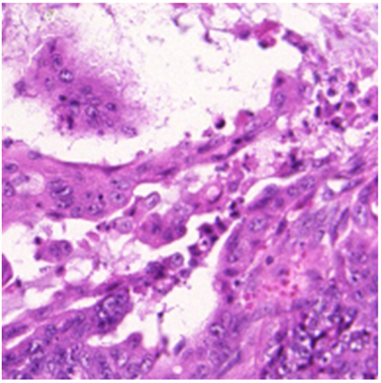
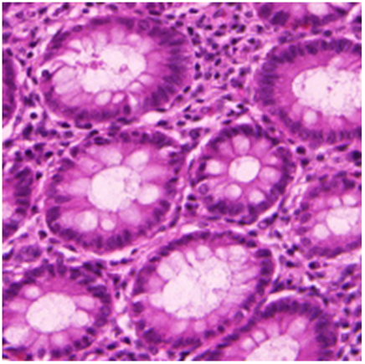
Exploiting deep learning for image annotation
Based on algorithms and DL techniques, develop new automatic/semi-automatic methods for biomedical image annotation, to reduce effort and burden of experts
  Selective labeling
  Sparse labeling
  Sketchy labeling
  Automatic labeling
  Error-tolerant labeling
  Transferable labeling
  Preliminary labeling
  High dimensional labeling
Difficult
Representative
Images from MICCAI 2015 Gland Segmentation Challenge

Slide 34
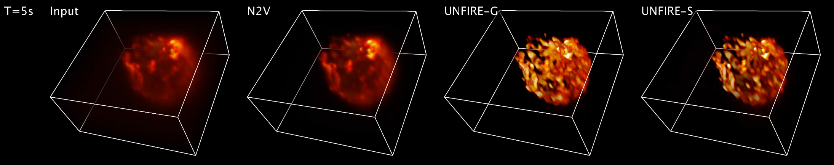
Noise and blurriness in biomedical images
Image quality can be affected by multiple factors (e.g., objective lens, energy dose, exposure time, point spread function, subject characteristics, etc.), causing noise and blurriness, and consequently inaccurate or even impossible analyses
Removing noise and blurriness in biomedical images is a critical problem

Slide 35
Applications

Slide 36
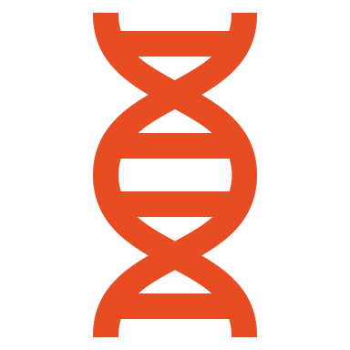
Disease Module Detection
  Complex diseases are underlined by dysregulated gene modules, rather than dysregulation of individual genes
  Identification of these modules helps in understanding the disease
  Heterogeneity of disease related modules guides disease classification
  Help assigning individual patients to disease subtypes and treatment regime

Slide 37
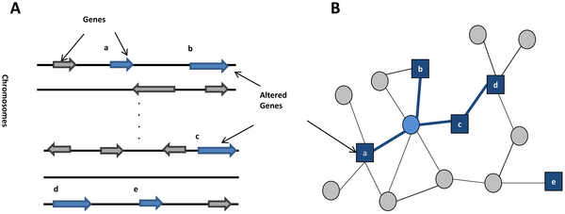
Types of disease associated gene modules
1. Modules enriched with genetic alterations (germline mutations or somatic mutations in cancer
Known disease associated mutated genes
Predicted disease associated mutated gene
Cho DY et al (2012) PLOS Computational Biology 8(12): e1002820

Slide 38
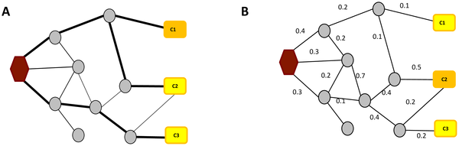
Types of disease associated gene modules
2. Information propagation modules/pathways – using networks to explain eQTLs
Shortest path based:
Carter GW, Prinz S, Neou C, Shelby JP, Marzolf B, et al. (2007) Prediction of phenotype and gene expression for combinations of mutations. Mol Syst Biol 3: 96.
Network Flow based
Kim YA, Wuchty S, Przytycka TM (2011) Identifying causal genes and dysregulated pathways in complex diseases. PLoS Comput Biol
Cho DY et al (2012) PLOS Computational Biology 8(12): e1002820

Slide 39
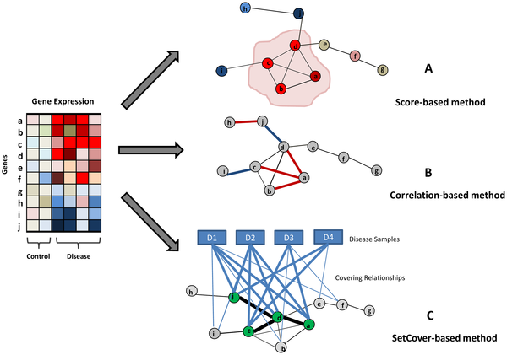
Types of disease associated gene modules
3. Differential gene expression modules
Scoring based methods
Examples: Chuang HY, Lee E, Liu YT, Lee D, Ideker T (2007) Network-based classification of breast cancer metastasis. Mol Syst Biol 3: 140
Define activity score and search for most discriminative modules
Correlation based methods:
Examples: Muller et al. (2008) Jointly Active Connected Subnetworks,
Connected set cover based methods
Examples: Ulitsky et al (2010). DEGAS) searches for a smallest set of genes forming a connected subnetwork, application to Parkinson’s disease
Kim et. al. – modules dysregulated in cancer

Slide 40
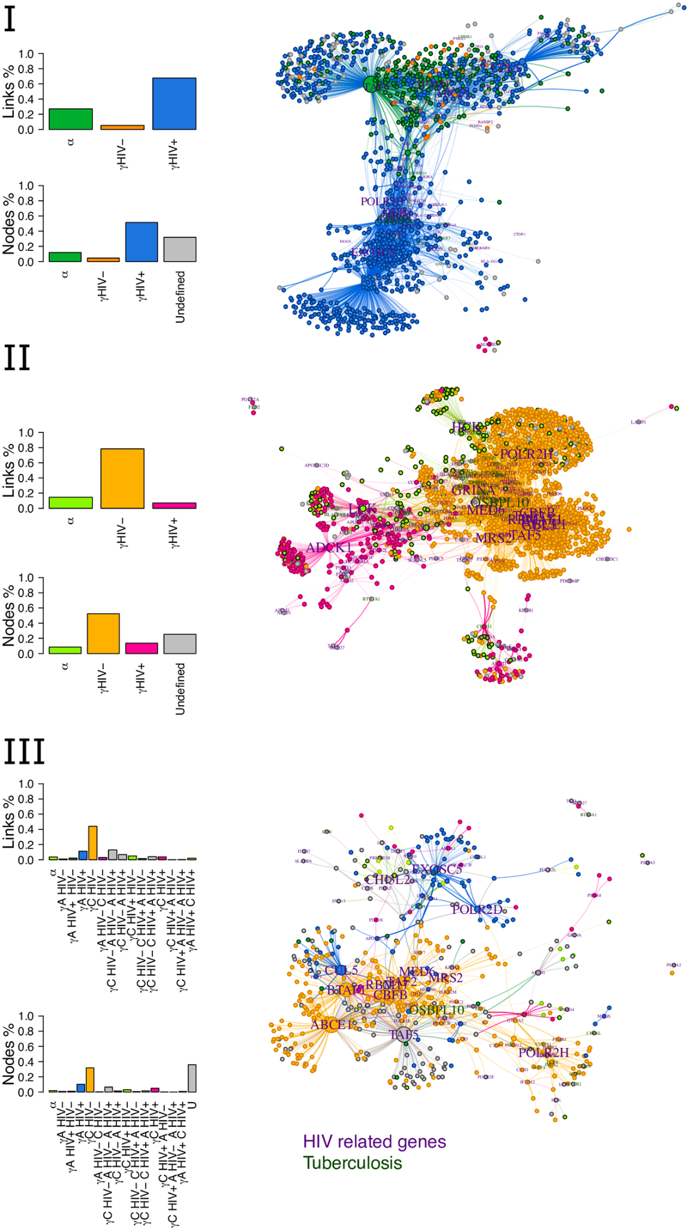
Types of disease associated gene modules
3. Differential co-expression modules
Genes are differentially co-expressed in different groups of patients.
Define signature genes for each group
Gysi, D. M., et al (2020). PLoS ONE, 15(10 October), e0240523

Slide 41
Drug response associated modules
  Understandings drug action in the context of interaction network
  Prediction of drug response
  Prediction of drug interactions

Slide 42
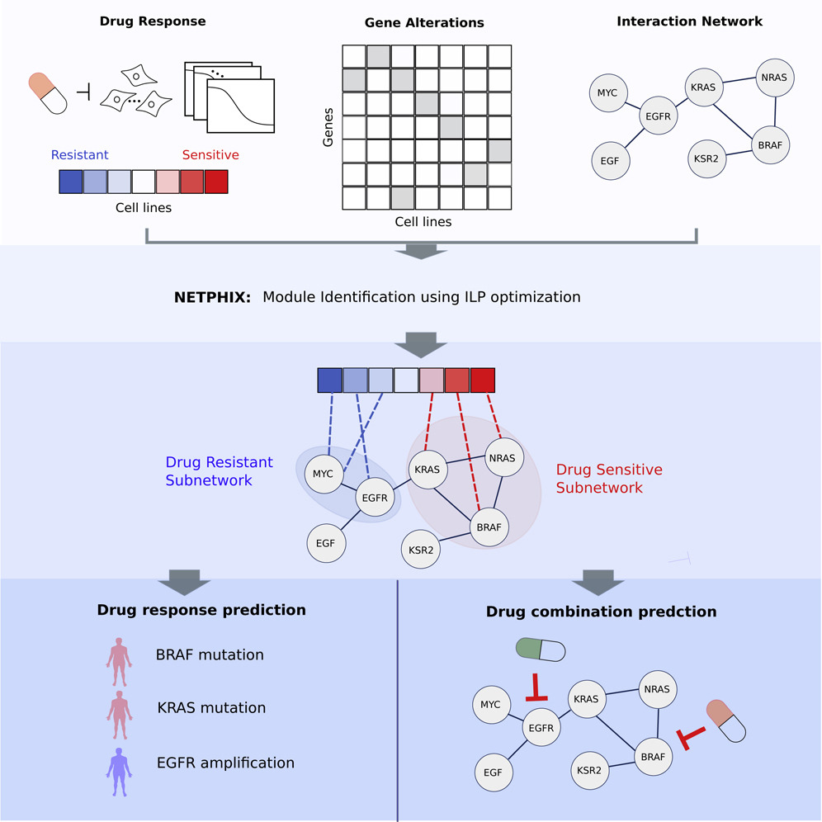
Drug response associated modules

Slide 43

Host-pathogen interaction networks modules
Key for understanding infections microbial diseases and developing antimicrobial drugs
Importance of tissue specificity!
Proteins targeted by SARS-CoV-2 form a large connected component
Gysi, DM et. al PNAS 2021

Slide 44

Patient Similarity network
Motivation:
Disease subtyping
Understanding features driving disease similarity

Slide 45

Patient Similarity network
Using patient similarity network and hierarchical topic model for disease subtyping and defining features driving the subtyping
Notes:
Figure 1. Inference of the probabilistic model of disease subtypes. ( A ) The input to the inference algorithm is the patient phenotype similarity network and a set of genomic factors (mutations, CNVs, etc.) ( B ) Each disease subtype ( K = 4) is modeled by a distribution of the factors (shown as boxes). Each patient has some probability of belonging to each subtype thus genetic factors of each patient are mixtures of genetic characteristic of each subtype. ( C ) The links between patients are modeled as binary variables where a probability of a link is defined by the similarity of the probabilistic subtype assignment. ( D ) Final model where patients are colored based on the most likely subtype assignment and uncolored nodes represent defining genomic factors.
Unless provided in the caption above, the following copyright applies to the content of this slide: Published by Oxford University Press 2013. This work is written by US Government employees and is in the public domain in the US.Published by Oxford University Press 2013. This work is written by US Government employees and is in the public domain in the US.

Slide 46

Patient similarity network using similarity network fusion
Wang et. al Nature Methods 2014

Slide 47
Disease Comorbidity
Diseases similar to one another are located in similar neighbourhoods in the PPI, this can help us understand:
Disease Progression
Disease Comorbidity
Treatment sharing / drug repurposing

Slide 48

Menche et al, Science. 2015.

Slide 49

Comorbidity
Network overlap of diseases is an indicative of comorbidity
Disease similarity can indicate disease progression
Diseases with network overlap can share similar drugs/treatments
Gulbahce, PLoS Comput Biol. 2012.
Menche, Science. 2015.
Notes:
The disease relevance of the human proteins targeted by the virus predict the symptoms/signs and diseases caused by a pathogen [REF]
Predict potential comorbidity patterns by identifying diseases whose molecular mechanisms overlap with cellular processes targeted by SARS-CoV2.

Slide 50
Drug Repurposing
Utilize existing drugs to treat other diseases
Sildenafil was first approved to treat coronary artery disease (CAD), hypertension and angina pectoris.
Side effects in CT Phase I

Slide 51


Methods
Network Based Proximity
Network Based Diffusion
AI-Based
Zitnik, Bioinformatics. 2018
Zitnik, Info. Fision. 2019
Gysi, DM et. al PNAS 2021
Guney, Nature Comm. 2016

Slide 52
Further Challenges

Slide 53


Challenges: Evaluation w/ network models
Cross-validation / recapitulating known data
Does it make sense to use only part of a network or the data?
Does any gold standard exist?
Can we simulate usefully?
Guo, et al. Brief Bioinform. 2022 Jan; 23(1): bbab437.
Notes:
Challenges
Privacy, Multidata on the same patient, trade of privacy and utility;
Evaluation of network methods - what does this mean, how can we do it?
How to define if this is the “correct” or the best medicine/ drug; often don’t know causality
DKS

Slide 54



Challenges: Evaluation of precision medicine outcomes
Biological validation -
Can we determine causality?
Can we afford to test it systematically?
To what degree is it feasible? Bias? Anecdotal?
Validating algorithms, or representations? Interpretability?
Guo, et al. Brief Bioinform. 2022 Jan; 23(1): bbab437.
Notes:
Challenges
Privacy, Multidata on the same patient, trade of privacy and utility;
Evaluation of network methods - what does this mean, how can we do it?
How to define if this is the “correct” or the best medicine/ drug; often don’t know causality
DKS

Slide 55

Challenges: Privacy
To what degree can we both share / make use of, and prevent abuse of, network data mined or gathered in pursuit of precision medicine?
Cryptographic methods to improve security typically limit unforeseen utility

Slide 56

Challenges: Consent / control of data
Do most data producers or patients understand what is done with their data?
What could be done? How does this affect our ability to gain consent?
How do we give individuals control of their data? Computational solutions?
Notes:
Only do video if there is time - but it’s funny and relevant. Discuss how many people using this *outside-clinic* data realize that this is going on. Given that, how do we design solutions that are both ethical and beneficial to patients?

Slide 57

Challenges: Technology and Methodology
Single Cell Technologies: How to integrate this data into a network
How to make it accessible
Temporal-Spatial dependency
Dynamics in immunology

