Slide 1
Exploring Structure and Content on the Web Extraction and Integration of the Semi-Structured Web
Tim Weninger
Department of Computer Science
University of Illinois Urbana-Champaign
weninge1@illinois.edu

Slide 2
Rules of this tutorial
Ask questions
Ask lots of questions
If something is not clear, ask a question

Slide 3
The Web
Social Networks
Early Messenger Networks
Social Media
Gaming Networks
Professional Networks
Hyperlink Networks
Blog Networks
Wiki-networks
Web-at-large
Internal links
External links
Notes:
This is what we’re talking about today!

Slide 4
The Web is a Hyperlink Network

Slide 5
Ranking on the Web
Query: $X$

Slide 6
Clustering on the Web
Sim($X, Y)$

Slide 7
This Tutorial is about the structure and content of the Web
Name
Phone
Office
Age
Gender
Email
Author
Dateline
Topic
Persons
Location

Slide 8
Imagine what we could do…
Search
Show structured information in response to query
Automatically rank and cluster entities
Reasoning on the Web
Who are the people at some company?
What are the courses in some college department?
Analysis
Expand the known information of an entity
What is a professor’s phone number, email, courses taught, research, etc?

Slide 9
Outline
Preliminaries
Information Extraction
Break (30 min)
Information Integration
Web Information Networks

Slide 10
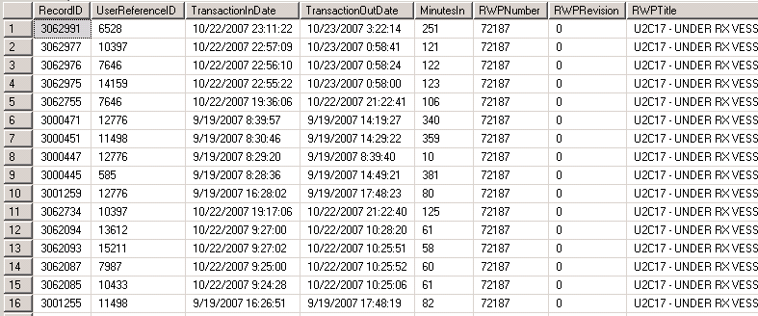
Databases and Schemas
Databases usually have a well defined schema

Slide 11
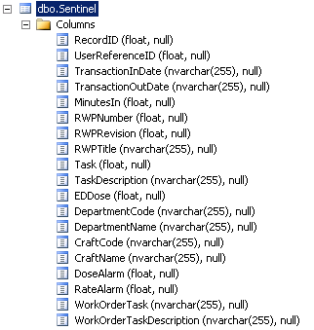
Databases and Schemas
Databases usually have a well defined schema

Slide 12
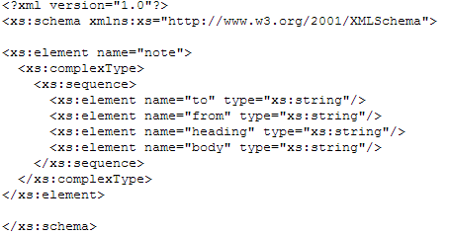
XML – a data description language
XML Schema

Slide 13
XML – a data description language
XML Instance

Slide 14
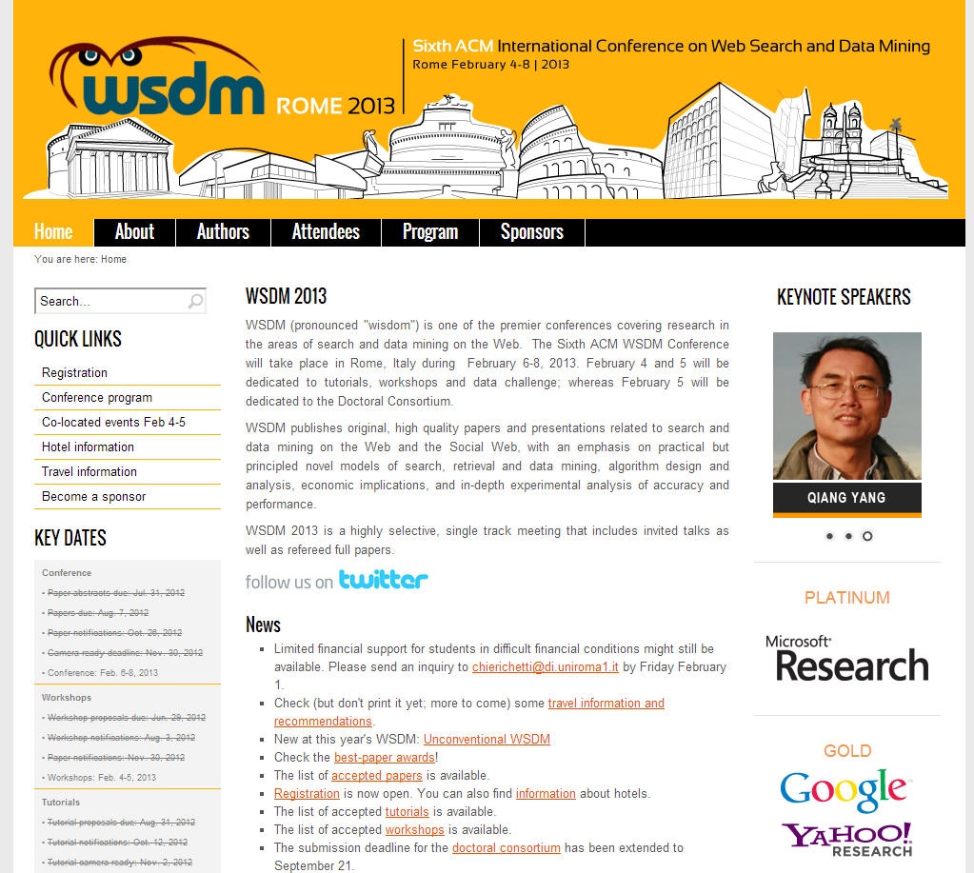
HTML and Semi-Structured data

Slide 15
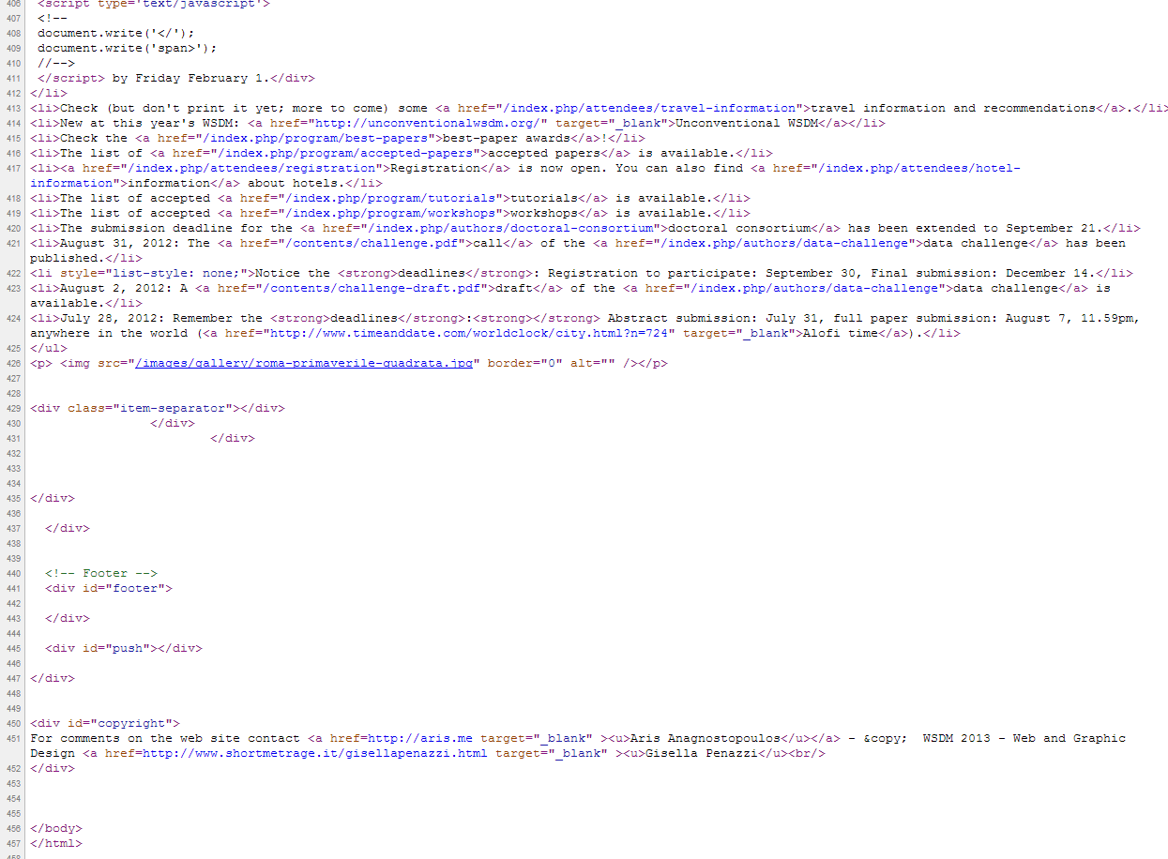
HTML and Semi-Structured data
What’s the schema?

Slide 16
HTML and Semi-Structured data
HTML has no schema!
HTML is a markup language
A description for a browser to render
HTML describes how the data should be displayed
HTML was never meant to describe the data.

Slide 17
HTML and Semi-Structured data
HTML was never meant to describe the data.
But there is so much data on the Web
…we have to try

Slide 18
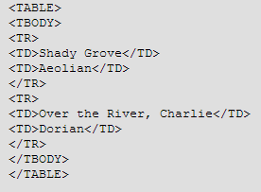
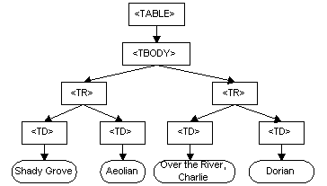
Document Object Model
HTML -> DOM
DOM is a tree model of the HT markup language

Slide 19
What the DOM is not
From the W3C:
The Document Object Model does not define what information in a document is relevant or how information in a document is structured. For XML, this is specified by the W3C XML Information Set [Infoset]. The DOM is simply an API to this information set.

Slide 20
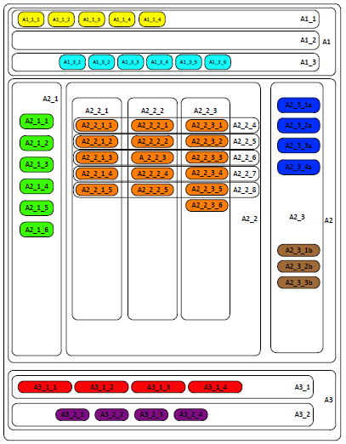
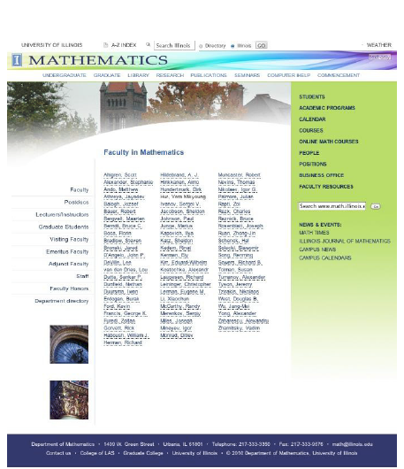
Web page rendering
HTML -> DOM -> WebPage
Web page rendering according to Web standards
Uses the Boxes Model

Slide 21
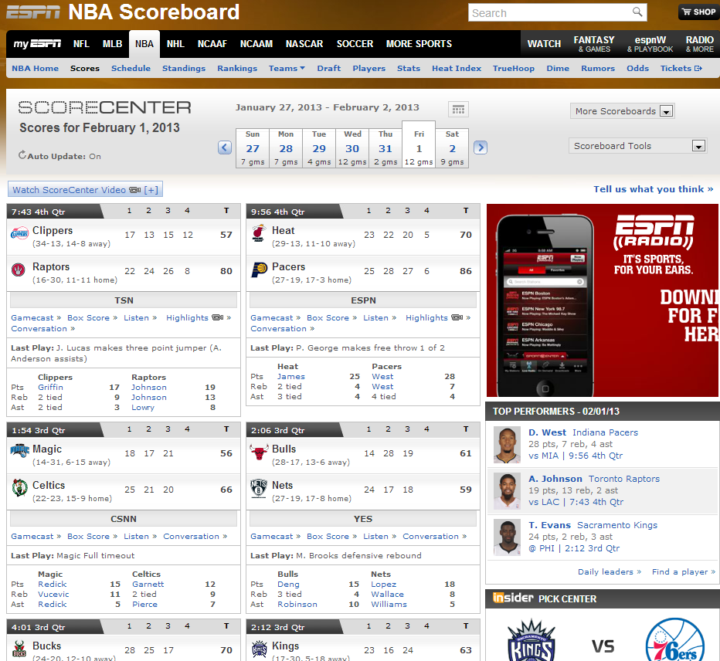
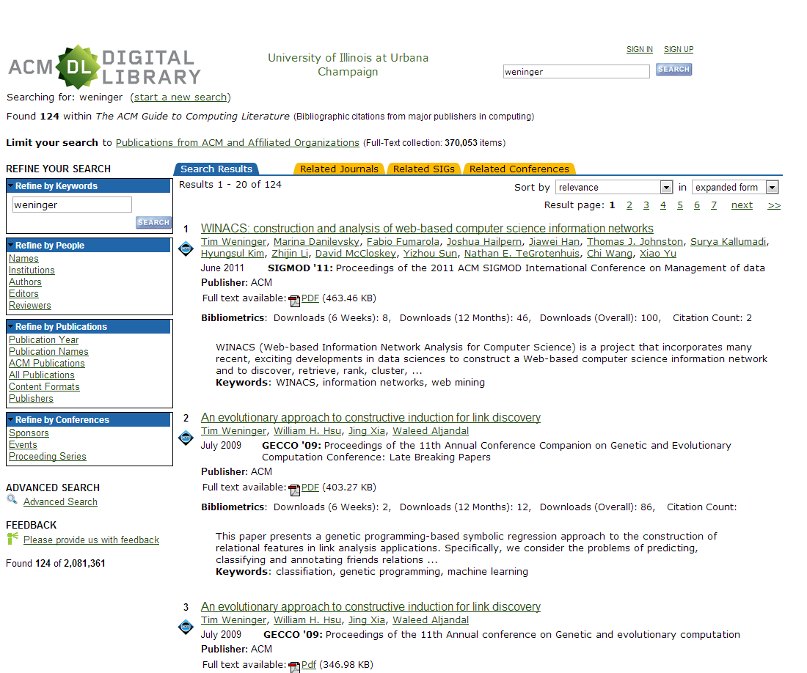
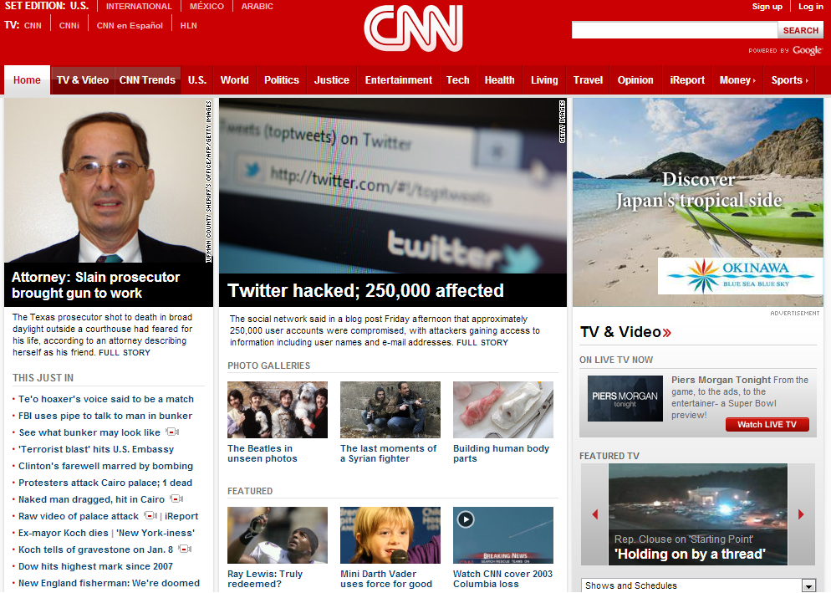
Web databases
LOTS of pages on the Web are database interfaces

Slide 22
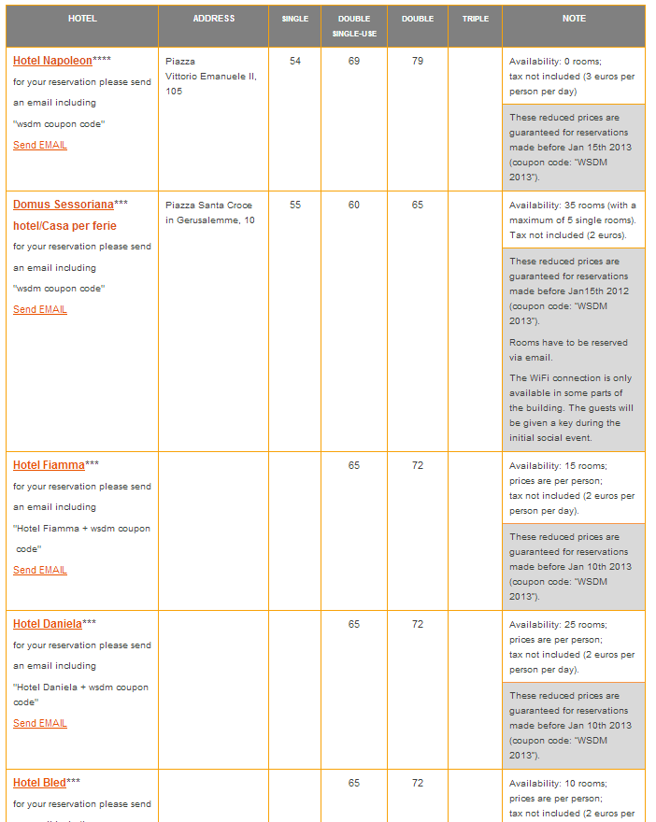
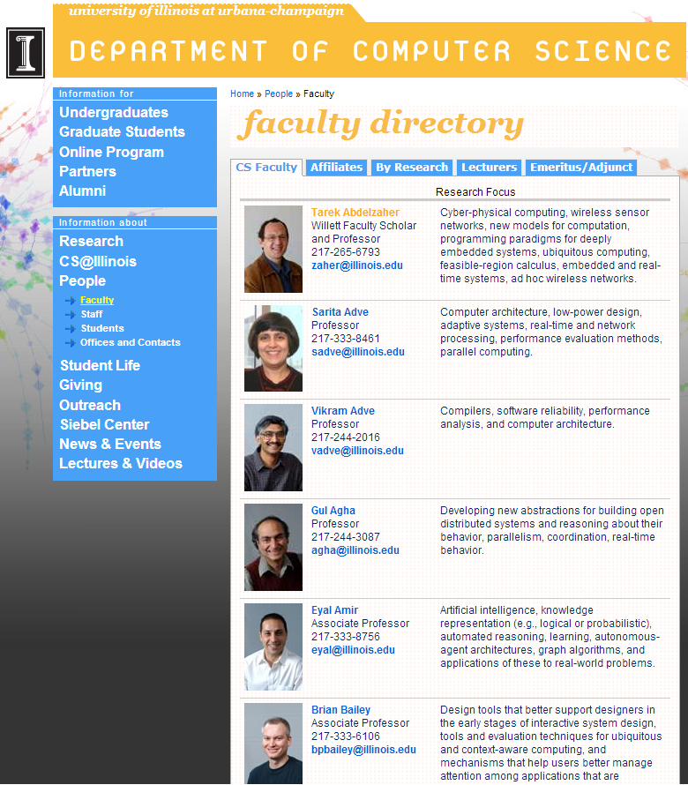
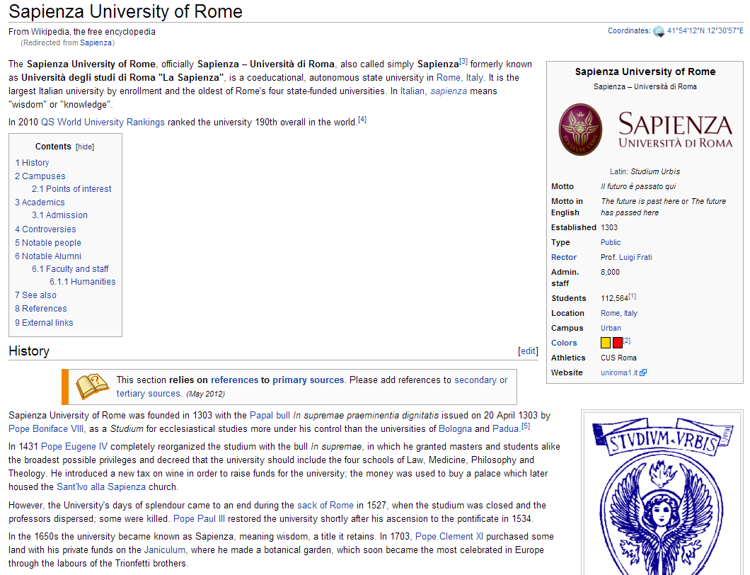
Web databases
Some pages are not database interfaces
….but they could be

Slide 23
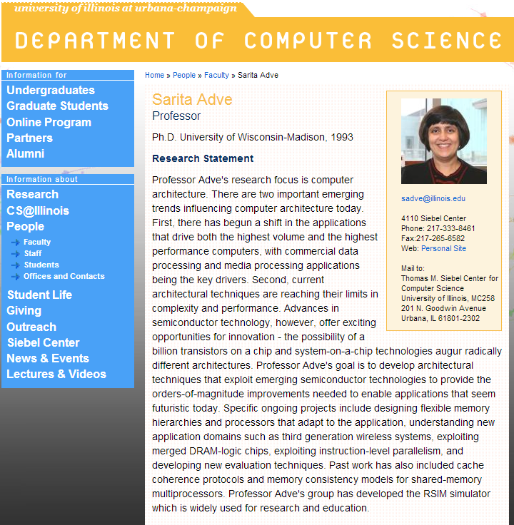
Relational Databases on the Web
WebPages can have relational data

Slide 24
Data can be hidden in text too!

Slide 25
HTML and Semi-Structured data
Our goal is to extract information from the Web
…and make sense out of it!

Slide 26
Outline
Preliminaries
Information Extraction from text
Break (30 min)
Information Extraction from tables and lists
Web Information Networks

Slide 27
Content Extraction

Slide 28
Web Content Extraction
Extract only the content of a page
Taken from The Hutchinson News on 8/14/2008

Slide 29
Web Content Extraction
Two Approaches
Heuristic Approaches
Work one “document-at-a-time”
Template Detection Approaches
Require multiple documents that contain the same template
Benefits of content extraction
Reduce the noise in the document
Reduce document size
Better indexing, search processing
Easier to fit on small screens

Slide 30
Wrapper Generation
Documents on the Web are made from templates
Popularity of Content Management Systems
Database queries are used to “fill out” HTML content
Template are the framework of the Web page(s)
The structure of is very similar (near identical) among template Web pages.
Cluster similarly structured documents
Generate Wrappers
Extract Information

Slide 31
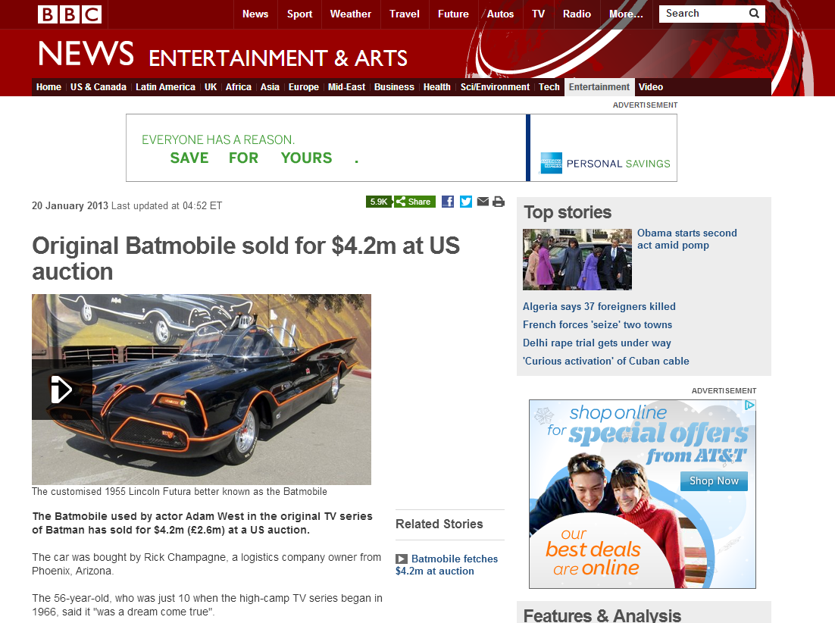
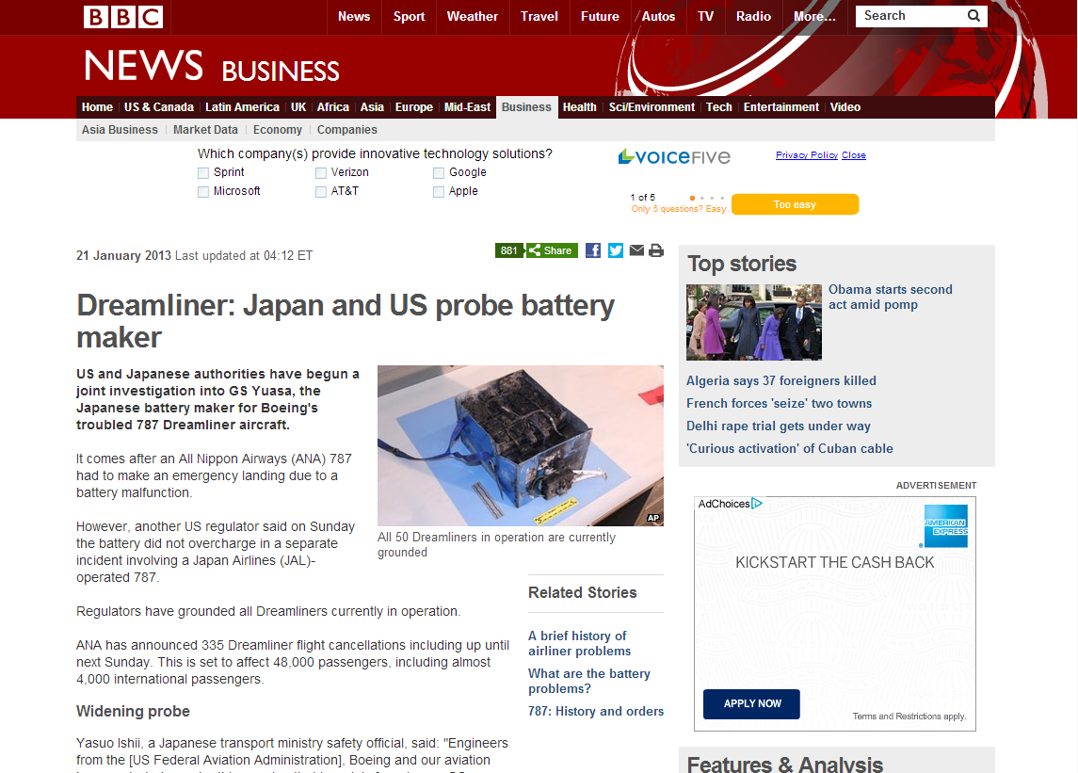
Wrapper Generation
Documents on the Web are made from templates
Database query “fills in” the content
Separate AJAX/HTTP calls “fill in” content

Slide 32
Locating Web page templates
First Bar-Yossef and Rajagopalan ‘02 proposed a template recognition algorithm using DOM tree segmentation
Template detection via data mining and its applications
Lin and Ho ‘02 developed InfoDiscoverer which uses the heuristic that template generated contents appear more frequently.
Discovering informative content blocks from web documents
Debnath et al. ‘05 develop ContentExtractor but also include features like image or script elements.
Automatic extraction of informative blocks from webpages

Slide 33
Locating Web page templates
Yi, Liu and Li ‘03 use the Site Style Tree(SST) approach finds that identically formatted DOM sub-trees denote the template
Eliminating noisy information in web pages for data mining
Crecensi et al. ’01 develop Roadrunner which uses the Align, collapse under mismatch and extract (ACME) approach to generate wrappers.
Towards Automatic Data Extraction from Large Web Sites.
Buttler ‘04 proposes the path shingling approach which makes use of the shingling technique.
A short survey of document structure similarity algorithms

Slide 34
Wrapper Generation
Generate extraction rules
//div[@class ="content"]/table[1]/tr/td[2]/text()
A home away from school
Day care has after-school duties as some clients start academic year
By Kristen Roderick – The Hutchinson News – kroderick@hutchnews.edu
The doors at Hadley Day Care opened Wednesday afternoon, and children scurried in with tales of…

Slide 35
Wrapper Generation
Advantages
Easy to implement and learn
Can have perfect precision and recall
Disadvantages
Web sites change their templates often
Any small change breaks the wrapper
Need several examples to learn the wrapper
Called “domain-centric” approaches

Slide 36
Single Document Content Extraction
Look at a single document at a time
Use heuristics and data mining principles to find main content.
No template detection
No extraction rule learning
Called “Web-centric” approaches

Slide 37
Early Content Extraction Approaches
Body Text Extraction (BTE)
Interprets HTML document as word and tag tokens
Identifies a single, continuous region which contains most words while excluding most tags.
Document Slope Curves (DSC)
Extension of BTE that looks at several document regions.
Link Quota Filters (LQF)
Remove DOM elements which consist mainly of text occurring in hyperlink anchors.

Slide 38
Tag Ratios Content Extraction
Two algorithms
Same time, same conference
Same concept
Gottron, et al. ‘07 Content Code Blurring
Weninger, et al. ‘07 Content Extraction via Tag Ratios
Notes:
Earlier approaches looked for clues by looking at different types of html tags Modern web pages use CSS

Slide 39
Text to Tag Ratio
Text: 21 - Tags: 8 -> TTR: 2.63
Text: 22 - Tags: 8 -> TTR: 2.75
Text: 298 - Tags: 6 -> TTR: 49.67
Text: 0 - Tags: 0 -> TTR: 0
Text: 0 - Tags: 1 -> TTR: 0
http://www2010.org/www/2010/04/program-guide/
Notes:
Text To Tag Ratio

Slide 40
Text to Tag Ratio Histogram
Notes:
Each line in a file gets a TTR score

Slide 41
Histogram Clustering in 2-Dimensions
Looks for jumps in the moving average of TTR
Notes:
Look for jumps in the TTR histogram

Slide 42
Histogram Clustering in 2-Dimensions
Absolute value gives insight

Slide 43
Histogram Clustering in 2-Dimensions
Make a scatterplot
Notes:
Plot the two histrograms (1) TTR (2) differential Histogram

Slide 44
Modified k-Means
Notes:
Make k=3, k(0) = (0,0)

Slide 45
Single Document Content Extraction
Advantages
Only need a single document at a time
Unsupervised
No training required
Disadvantages
Precision and Recall varies
On the (1) algorithm, (2) parameters, (3) Web page

Slide 46
Rule Extraction

Slide 47
Textual Extraction
Web text holds good information, but full NLP understanding is difficult
Two flavors of text extraction
Domain-at-a-time
Web-at-large (domain-agnostic)
Very different techniques required for each
Notes:
47

Slide 48
Domain at a time
Documents on the Web are made from templates
A single domain has similar language

Slide 49
Domain at a time text extraction
If we know the schema/domain, we know the rules
BBC Business – “owned by”, “sales of”, “CEO of”, etc.

Slide 50
Known Domains: Rule Learning
User provides initial data
Algorithm searches for terms, then induces rules.
Microsoft | Redmond
IBM | Armonk
Intel | Santa Clara
“Servers at Microsoft’s headquarters in Redmond…”
“The Armonk-based IBM has introduced…”
“Intel, Santa Clara, cut prices of its Pentium…”
[ORGANIZATION]’s headquarters in [LOCATION]
[LOCATION]-based [ORGANIZATION]
[ORGANIZATION], [LOCATION]
Notes:
50
Past approaches do not work on Web
Hand-written extraction rules / data -- User effort cannot scale to sheer # of domains; training data often tailored to one text genre
Advance specification of interesting relations -- Target relations not known ahead of time
Full linguistic parse of text -- Such parsers are computationally expensive

Slide 51
Known Domains: Rule Learning
User provides initial data
Algorithm searches for terms, then induces rules.
Extraction rules are intricate and break easily
Different extraction rules per domain
Can’t scale
Have to parse all of the text
Computationally very expensive
Microsoft | Redmond
IBM | Armonk
Intel | Santa Clara
Notes:
51
Past approaches do not work on Web
Hand-written extraction rules / data -- User effort cannot scale to sheer # of domains; training data often tailored to one text genre
Advance specification of interesting relations -- Target relations not known ahead of time
Full linguistic parse of text -- Such parsers are computationally expensive

Slide 52
Domain independent – Source dependent
Don’t analyze raw text - use dataset-specific extraction techniques
Yet another great ontology (YAGO)
Finds TYPE relationship in Wikipedia
Looks at Wikipedia category pages
Categories can be different
Conceptual (naturalized citizens of the US)
Relational (1879 births)
Thematic (Physics)
Administrative (unsourced articles)
Only Conceptual ones indicate TYPE
YAGO parses category names, tests if head of the name is plural; if so, it’s Conceptual

Slide 53
Domain independent – Source dependent
YAGO/YAGO2
Looks at the Wikipedia structures to learn rules

Slide 54
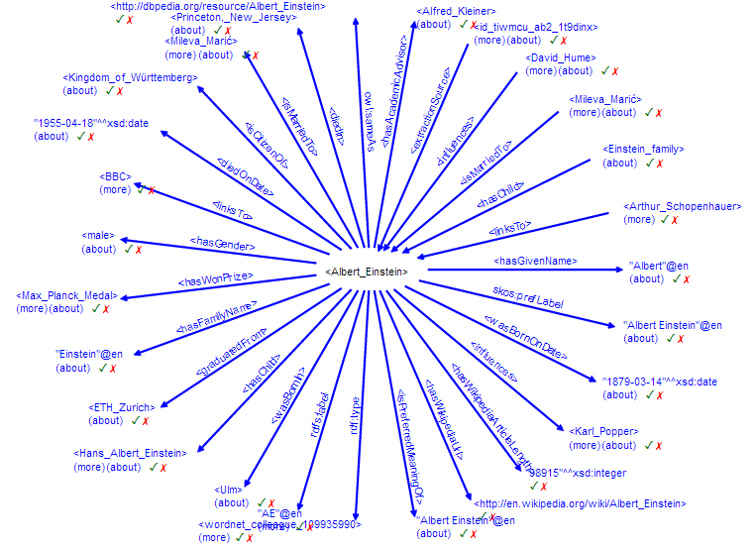
Domain independent – Source dependent
YAGO/YAGO2

Slide 55
YAGO
Techniques are not general at all
Limited to 14-100 hand-picked relations
Manually generate the relationships we want to look for
Great performance
Able to extract 40 Million facts in YAGO
80 million facts in YAGO2

Slide 56
Web-At-Large Text Extraction
“Open Information Extraction”
Discovers rules/predicates on the fly
Does not require domain semantics or much human input.
Run on the whole Web
Textrunner Banko et al. ‘07

Slide 57
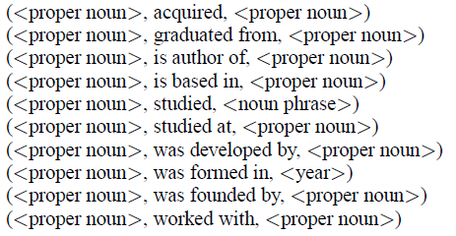
Open Information Extraction - Textrunner
Self-Supervised Classifier
Train extraction-classifier using data & features generated by (expensive) linguistic parser
Dependency Parser -

Slide 58
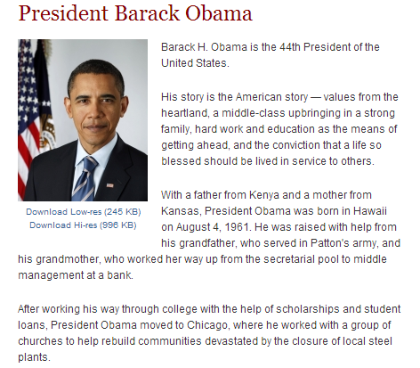
Open Information Extraction - Textrunner

Slide 59
Open Information Extraction - Textrunner
Result Assessment
Tuple-extraction frequency counts
Use heuristics
not a too-long parse dependency between the two NPs
neither NP is simply a pronoun
path between NPs does not pass a sentence-like boundary
etc.
Use Naïve Bayes Classifier to find good extractions
Features:
part-of-speech tags
Number of tokens in a relation
whether an NP is a proper noun

Slide 60
Open Information Extraction - Textrunner
Compared to Domain-dependent extraction
Better coverage
It’s not restricted on the types of relations
It’s not restricted on the domain
Lower precision
Increase in recall results in lower precision
More noise introduced from the Web-at-large

Slide 61
Outline
Preliminaries
Information Extraction from text
Break (30 min)
Information Extraction from tables and lists
Web Information Networks

Slide 62
Outline
Preliminaries
Information Extraction from text
Break (30 min)
Information Extraction from tables and lists
Web Information Networks

Slide 63
Record Extraction

Slide 64
Record Extraction
Find structured data in semi-structured HTML
Find database tables (rows & columns) in a Web page
Data Record Extraction
List Extraction
WebTable Integration

Slide 65
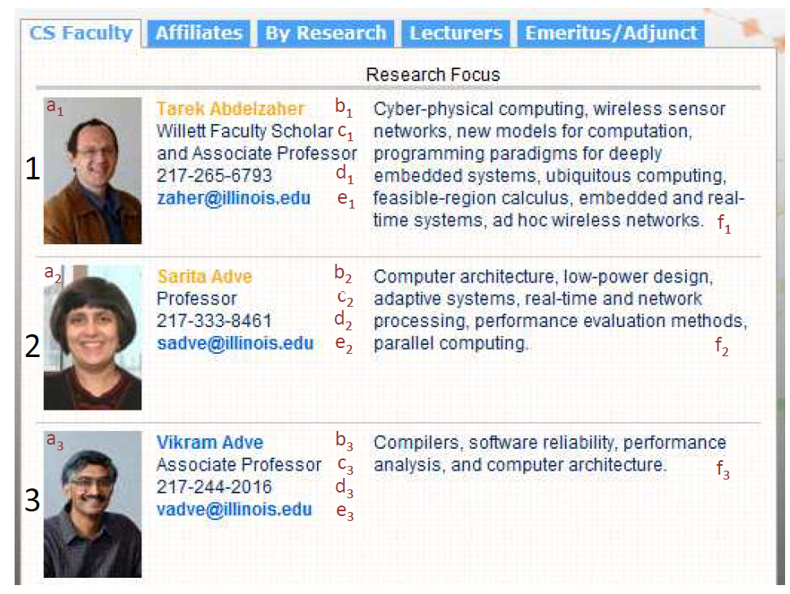
Example of Data Records

Slide 66
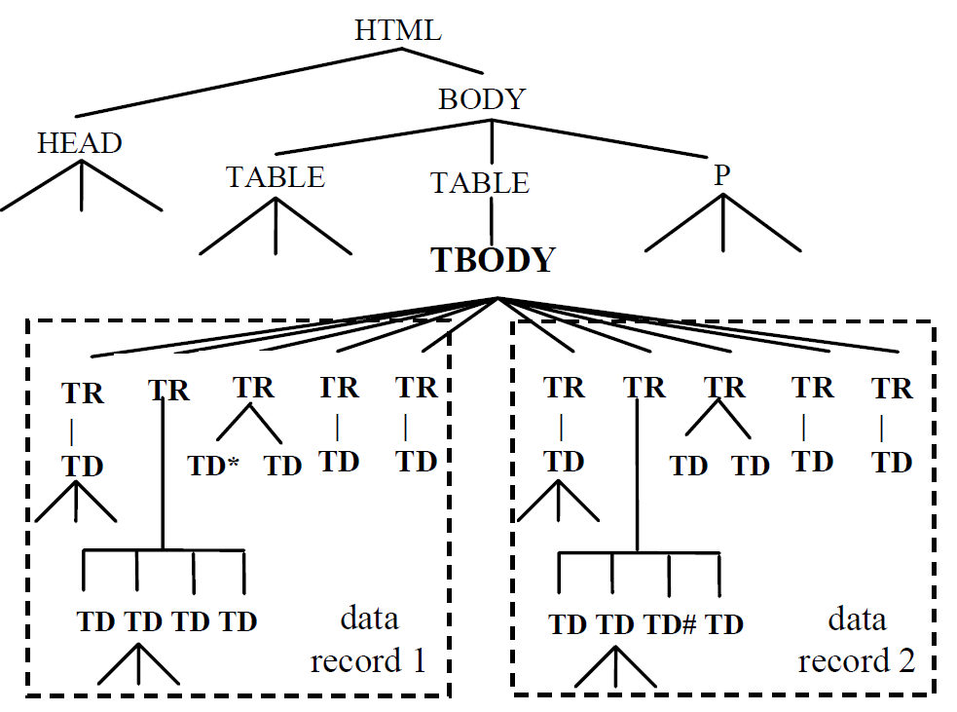
Data Record Extraction
Mining Data Records from the Web (MDR), Liu et al ’03
Generate Tag Tree

Slide 67
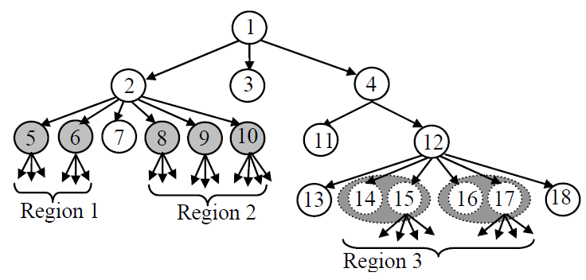
MDR
Find Generalized Nodes
Generalized nodes have subtrees of the same size, depth, are adjacent, and have a certain string similarity

Slide 68
MDR
Match identical data records

Slide 69
DEPTA
Zhai, Liu ‘05 DEPTA
Structured Data Extraction from the Web based on Partial Tree Alignment
Match similar data records

Slide 70
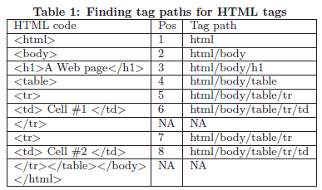
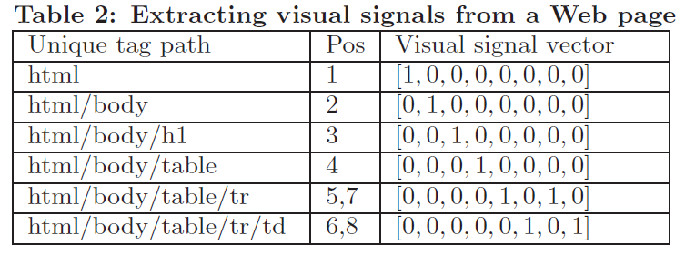
Record Extraction using Tag Path Clustering
Inverted Index

Slide 71
Record Extraction using Tag Path Clustering
Derive similarities from the visual signal vectors
Distance between centers of gravity
Interleaving measure
Similarity measure

Slide 72
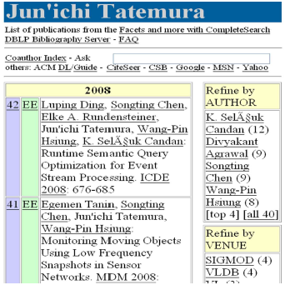
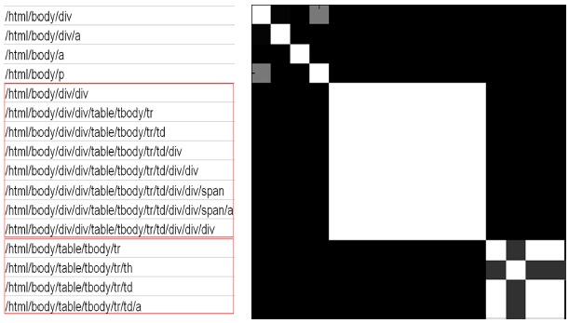
Record Extraction using Tag Path Clustering
Similarity Matrix of tag paths

Slide 73
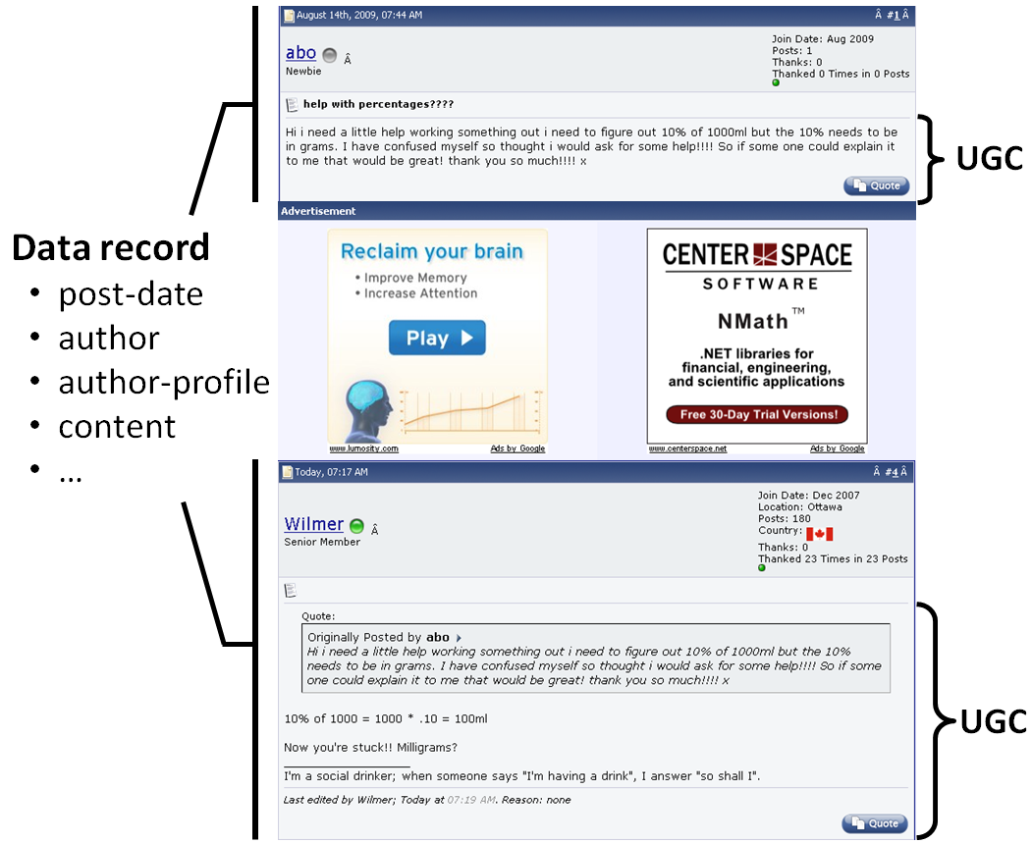
MiBAT – Extraction of Records containing UGC
Song et al. ‘10 – Extracts data records containing user generated content (UGC)

Slide 74
MiBAT
Finding Anchor Trees
Nodes within the record that match across all subtrees
Use those anchors to tie the data records together
Those anchor trees need to be predefined
Are a date, time, or some common structured text that a Regular Expression can find.

Slide 75
DOM Record Extraction
Advantages
Unsupervised
Only needs one page at a time
Tag-agnostic
Doesn’t matter what the type of the HTML tag is
Disadvantages
Precision and Recall varies
Depends on the Web page and assumptions of the algorithm
HTML is not a schema
Misses AJAX, Javascript, other HTTP calls
What is the purpose of HTML?

Slide 76
Visual Based Record Extraction
Assumptions:
HTML describes the structure of a document
Repeating Patterns = Records
HTML is a markup language
We need to render the Web page

Slide 77
Visual Web Page Rendering
Notes:
A Web page is full of boxes, boxes within boxes

Slide 78
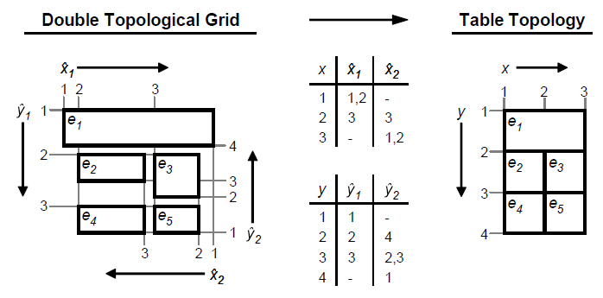
VENTex – Visual Record Extraction
Gatterbauer et al. ‘07 Visual Record Extraction VENTex
Towards Domain-Independent Information Extraction from Web Tables

Slide 79
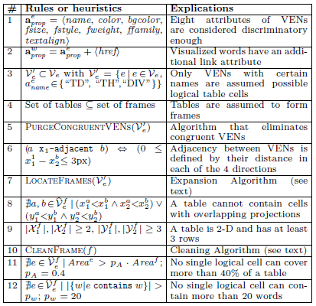
Visual Record Extraction
VENTex relies on lots of heuristics
Does not consider underlying DOM

Slide 80
Hybrid List Extraction
Fumarola et al. ‘12 Hybrid List Extraction HyLiEn
Property 1:
If box a is contained in box b, then b is an ancestor of a in the rendered box tree.
Property 2:
If a and b are not related under property 1, then they do not overlap visually on the page.
Notes:
Boxes can be rendered to a tree

Slide 81
Candidate Generation based on Visual Features
A list candidate $l=\{l1,l2,…,l_{n}\}$on a rendered Web page consists of a set of vertically and/or horizontally aligned boxes.
Two lists $l$ and $l’$ are related $(l∼l’)$ if they have an element in common.
A set of lists $S$ is a tiled structure if for every list $l∈S$ there exists at least one other list $l’∈S$ such that $l∼l’$ and $l≠l’$. Lists in a tiled structure are called tiled lists.
Notes:
We can generate lists by aligning boxes

Slide 82
Output: Web page annotated
Vertical List
Tiled List
Horizontal List
Notes:
There are different types of alignments
Vertical, horizontal, tiled
Above is output of our algorithm… colors denote lists

Slide 83
HyLiEn
Notes:
Sometimes lists have attributes
3 records with 6 attributes each

Slide 84
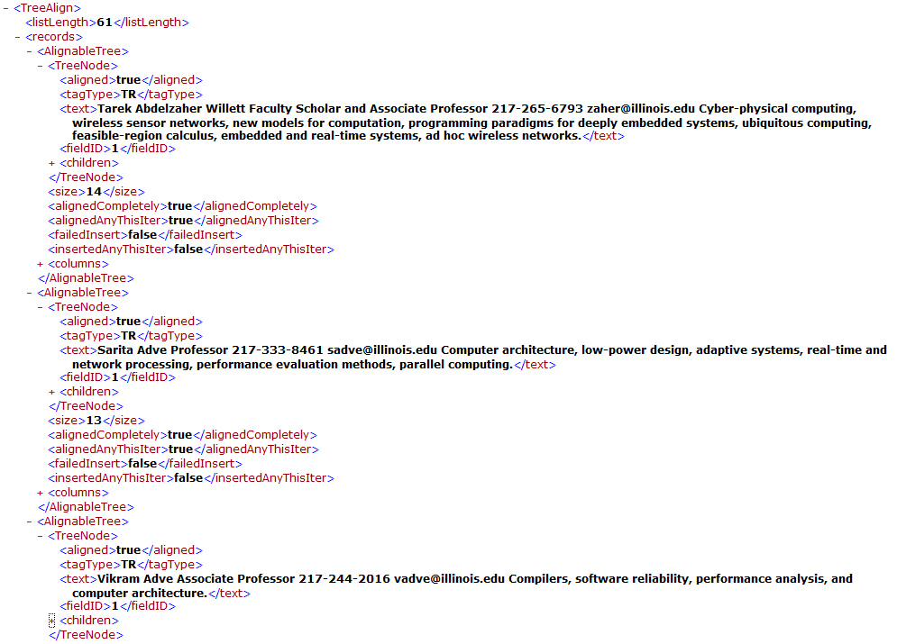
HyLiEn
RESTful service: http://dmserv1.cs.illinois.edu/listextractorservice.listextractorsvc.svc/extract/xml/?url= http://cs.illinois.edu/people/faculty
61 Faculty
Tarek A.
Sarita A.
Vikram A.
…and 58 more…
Notes:
We have a REST service that generates json extraction of lists on a web page

Slide 85
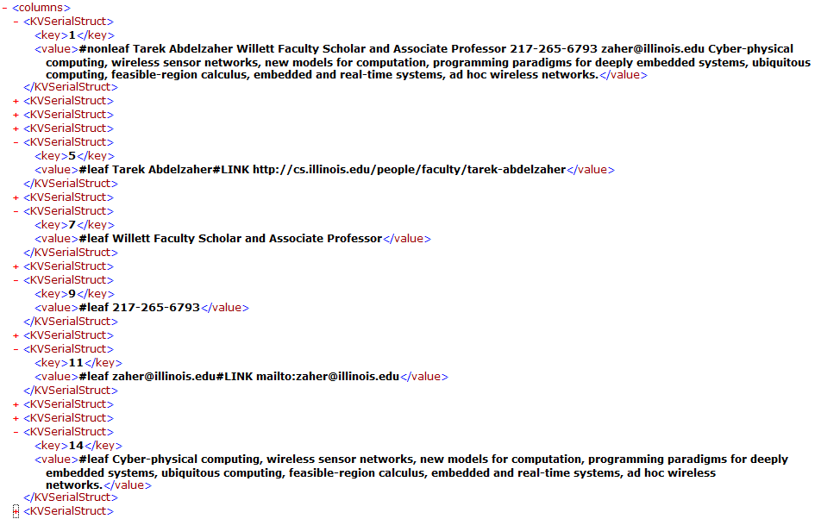
Lets take a look at a single record
Tarek A.
Name & Link
Title
Phone
Email
Research
Notes:
Ids for each attribute

Slide 86
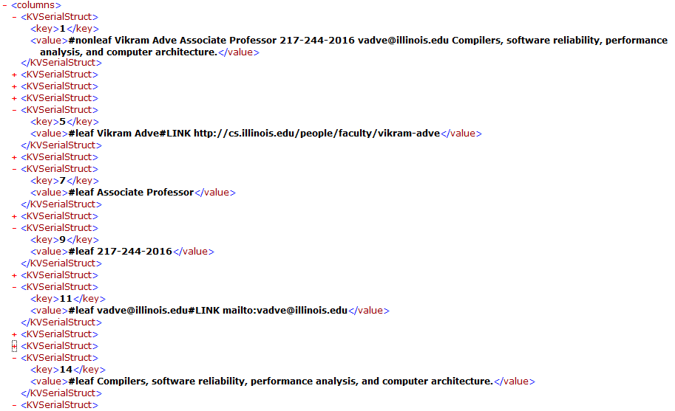
Lets take a look at a ANOTHER record
Vikram A.
Name & Link
Title
Phone
Email
Research
Notes:
These ids are aligned across records

Slide 87
Visual Record Extraction
Advantages
More accurate than DOM-methods
Unsupervised
Only needs one page at a time
Tag-agnostic
Doesn’t matter what the type of the HTML tag is
Disadvantages
Precision and Recall varies
Depends on the Web page and assumptions of the algorithm
Precision not as good as tag-gnostic methods
Recall not as good as wrappers
Notes:
We’ve got to render the web page to do it right
Independent, tag agnostic
We get a database table from web page lists/tables/records

Slide 88
Integrating Web data

Slide 89
WebTables
Cafarella et al. ‘08 – The Relational Web WebTables
Exploring the Relational Web
In corpus of 14B raw tables, they estimate 154M are “good” relations
Single-table databases; Schema = attr labels + types
Largest corpus of databases & schemas available
The WebTables system:
Recovers good relations from crawl and enables search
Builds novel apps on the recovered data

Slide 90
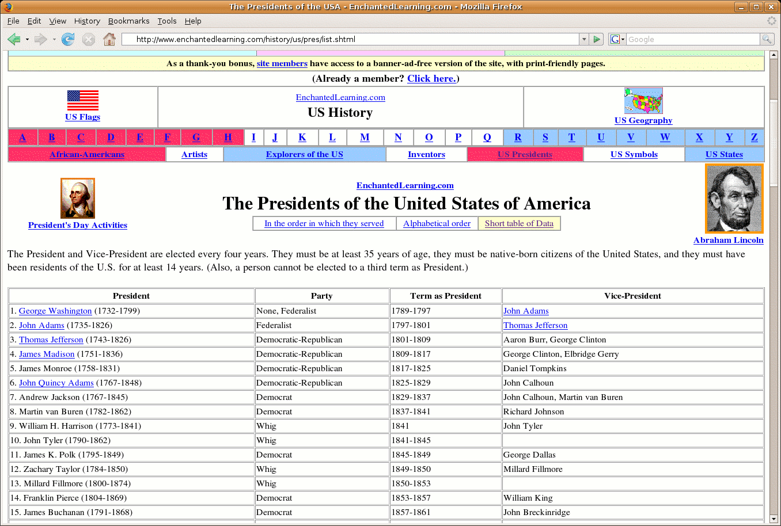
WebTables
Bad table
Good table
Slide courtesy Cafarella & Halevy
Notes:
This unstructured page clearly contains a database. Tuple-oriented, typed columns that represent attributes, and column labels
It also contains tables that are not databases at all.

Slide 91
Some Challenges
Data is semi-structured:
No schema
Columns do not have uniform type
Quality varies a lot
Finding real tables is hard, as is extraction
Data is about everything.
You can’t build a schema over everything

Slide 92
Vertical Tables
Slide courtesy Cafarella & Halevy

Slide 93
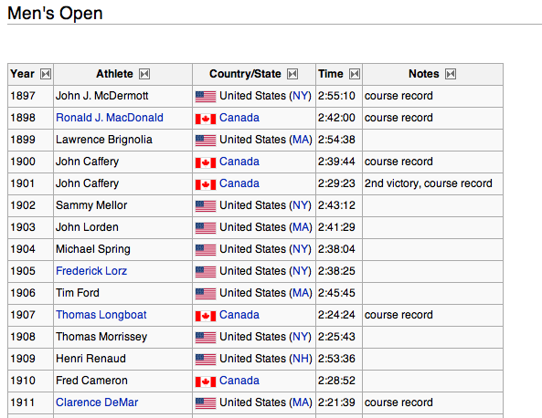
Winners of the Boston Marathon
…but that information is nowhere in the table
Slide adapted from Cafarella & Halevy

Slide 94
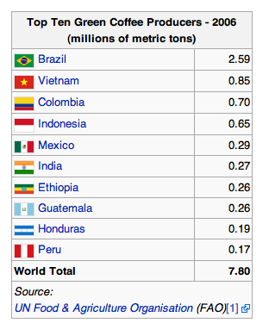
Much better, but schema extraction is needed
Slide courtesy Cafarella & Halevy

Slide 95
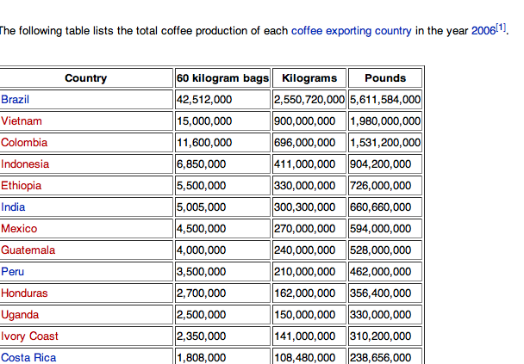
Schema Ok, but context is subtle (year = 2006)
Slide courtesy Cafarella & Halevy

Slide 96
Population Table #2
Slide courtesy Cafarella & Halevy

Slide 97
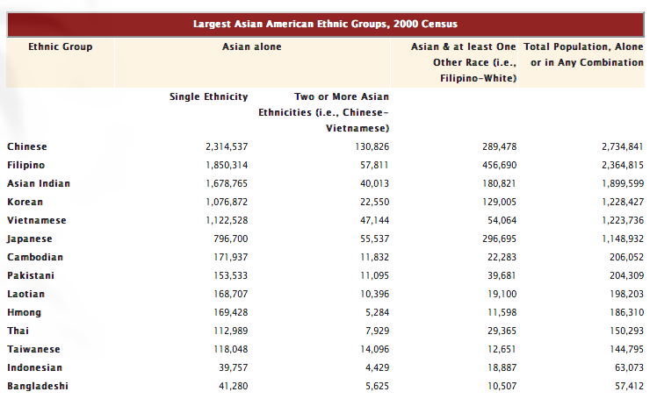
Asian Population Table
Slide courtesy Cafarella & Halevy

Slide 98
WebTables: Exploring the Relational Web
In corpus of 14B raw tables, Cafarella et al estimate 154M are “good” relations
Single-table databases; Schema = attr labels + types
Largest database ever!
The Webtables system:
Recovers good relations from crawl and enables search
Builds novel apps on the recovered data
Notes:
How many databases can we find?
A few things to note: single-tables only, we have a particular notion of “schema”, and it’s HUGE!
This talk is about “WebTables” system

Slide 99
WebTables
Inverted Index
Raw HTML Tables
Recovered Relations
Relation Search
Job-title, company, date | 104
Make, model, year | 916
Rbi, ab, h, r, bb, avg, slg | 12
Dob, player, height, weight | 4
… | …
2.6M distinct schemas
5.4M attributes
Attribute Correlation Statistics Db
Slide courtesy Cafarella & Halevy

Slide 100
Synonym Discovery
Use schema statistics to automatically compute attribute synonyms
More complete than thesaurus
Given input “context” attribute set C:
A = all attrs that appear with C
P = all (a,b) where a∈A, b∈A, a≠b
rm all (a,b) from P where p(a,b)>0
For each remaining pair (a,b) compute:
Slide courtesy Cafarella & Halevy
Notes:
Intuition is: If two attributes are synonymous, then we have a few observations:
Attrs should not appear together in the same schema (ie, p(a, b) == 0)
If p(a, b) == 0 when p(a)p(b) is large, then syn() score should be higher
synonymous attrs a b should often appear in the same contexts. I.e., p(z | a, C) ~= p(z | b, C)
If a, b always “replace” each other, then the denominator will be close to zero.
If they rarely “replace” each other (appearing with quite different contexts), then the denominator will be large.

Slide 101
Synonym Discovery Examples
name | e-mail|email, phone|telephone, e-mail_address|email_address, date|last_modified
instructor | course-title|title, day|days, course|course-#, course-name|course-title
elected | candidate|name, presiding-officer|speaker
ab | k|so, h|hits, avg|ba, name|player
sqft | bath|baths, list|list-price, bed|beds, price|rent
Slide courtesy Cafarella & Halevy

Slide 102
More Work on WebTables
Annotate the data in WebTables with ontology information extracted earlier
Relation label
Writes(Book,Person) bornAt(Person,Place)
leader(Person,Country)
Entity
Type hierarchy
Title
Author
Person
Type label
Uncle Petros and the Goldback conjecture
A Doxiadis
Book
Physicist
Uncle Albert and the Quantum Quest
Russell Stannard
B94
B95
B41
Entities
P22
Entity label
The Time and Space of Uncle Albert
Lemmas
Albert Einstein
Relativity: The Special and the General Theory
A Einstein
Uncle Albert and the Quantum Quest
Relativity: The Special…
Catalog

Slide 103
Further Challenges
Noisy data
A. Einstien vs Albert Einstein vs Einstien
Ambiguity of entity names
“Michael Jordan” is both a computer scientist and an athlete
Missing type links in Ontology
Universities in Rome -> Universities in Italy

Slide 104
Outline
Preliminaries
Information Extraction
Break (30 min)
Information Integration
Web Information Networks

Slide 105
Hyperlink Networks as Homogeneous Info. Networks

Slide 106
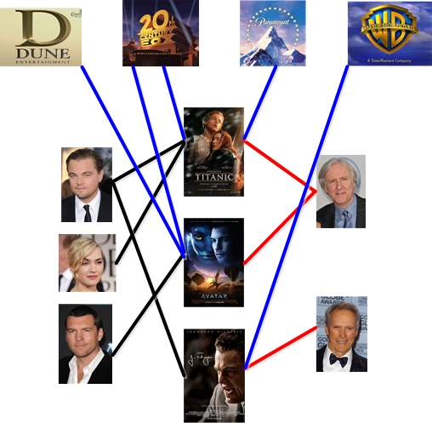
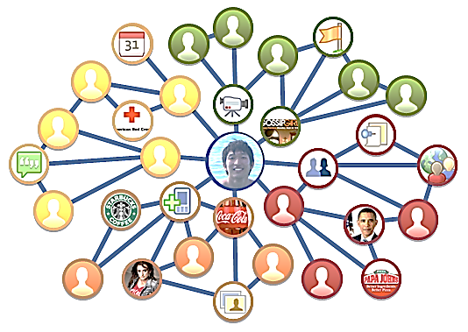
Homogeneous Networks lack class
Heterogeneous networks have type information
Movie
Studio
Actor
Director
Movie
The IMDB Movie Network
The Facebook Network

Slide 107
Hyperlink Networks as Heterogeneous Info. Networks

Slide 108
Hyperlink Networks as Heterogeneous Info. Networks
Name
Phone
Office
Age
Gender
Email
Author
Dateline
Topic
Persons
Location

Slide 109
Homogeneous -> Heterogeneous Information Networks
Task – Heterogenize the Web
Classification Task with many nuances
What are the classes?
Class granularity?
How do we predict the types computationally?
?

Slide 110
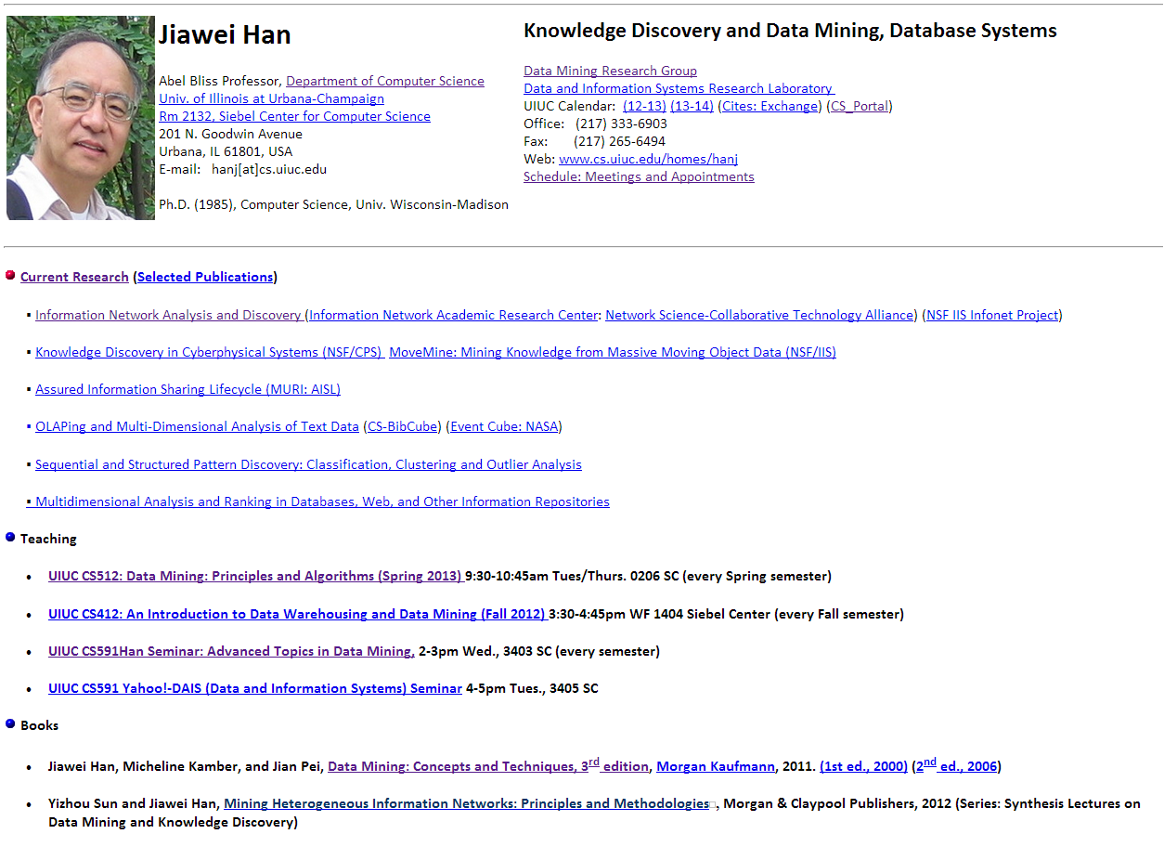
Heterogenization
What is this thing?
Animal, Person, Professor, Full Professor, Man,
Data Miner, Male-Full Professor-Data Miner?

Slide 111
Heterogenization
Animal, Person, Professor, Full Professor, Man,
Data Miner, Male-Full Professor-Data Miner?
This is the goal!
The answer is important
We use these results to do other things
HINT - The network tells us

Slide 112
Hierarchical Web Information Networks

Slide 113
Web Hierarchies
The Web pages’ location within the Web indicates:
Its class
Its relative class
Web Hierarchy
The Web has a hidden Hierarchy
Note: hidden $≠$ latent

Slide 114
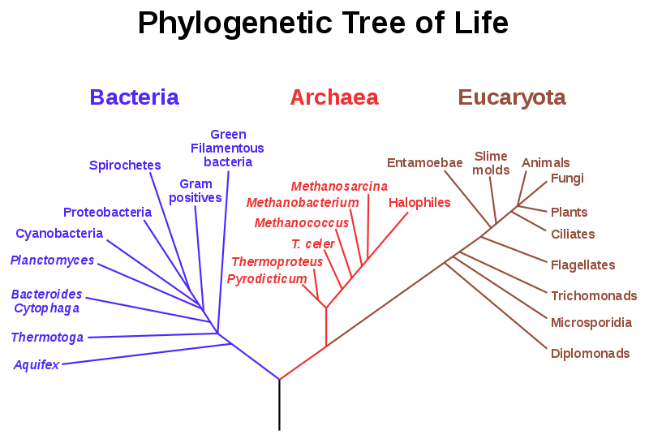
Some Methods create/learn Taxonomies
Hierarchical LDA (hLDA) Blei et al. ’03,10
TopicBlock Ho et al. ‘12
Pachinko Allocation Model (hPAM) Mimno et al. ’07

Slide 115
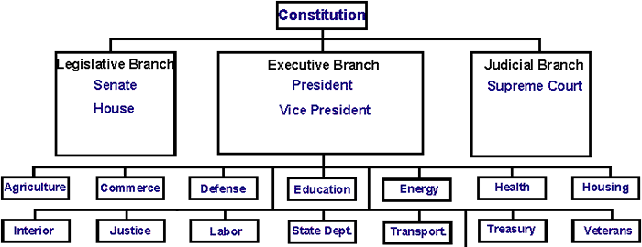
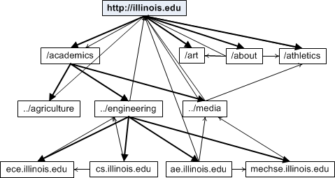
We are interested in Hierarchies
Hierarchical Document Topic Model (HDTM) Weninger et al ‘12

Slide 116
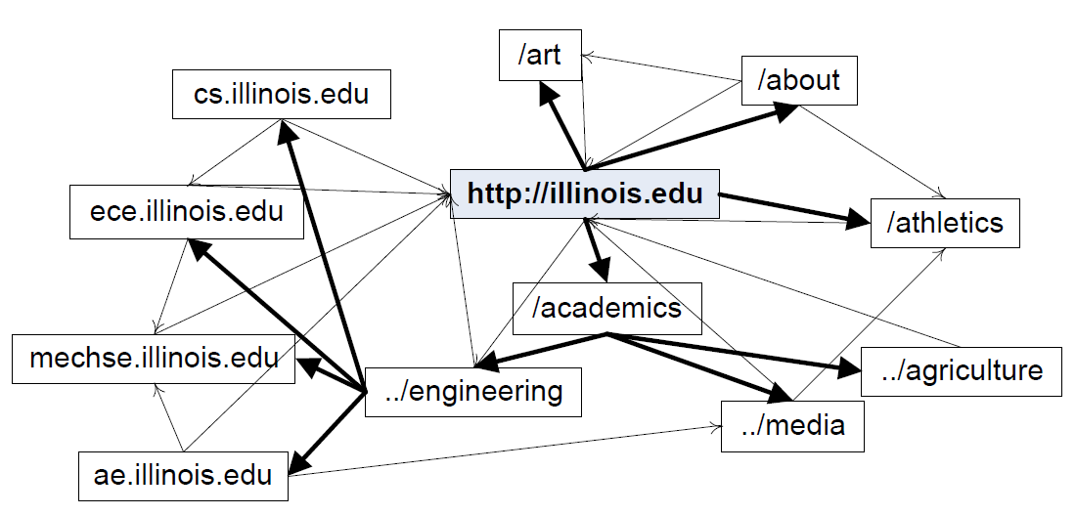
Example
Colleges
Engineering Departments
Departments

Slide 117
What does this tell us?
Given a rooted graph we find a hierarchy
Random Walk with Restart generates parenthood probabilities
This gives us one possible hierarchy. There are many.
New Challenge - Can’t label
$$X$$
$$Y<:X$$
$$Z<:Y$$
$$W<:Z$$

Slide 118
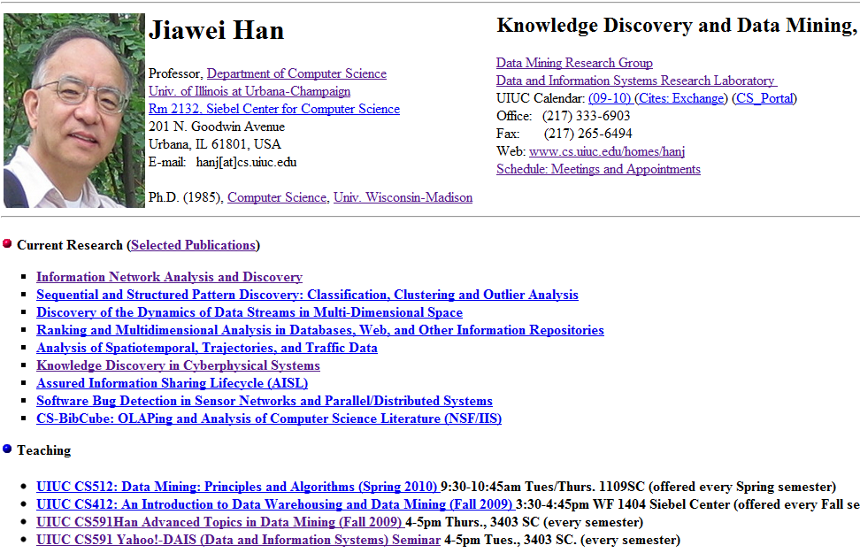
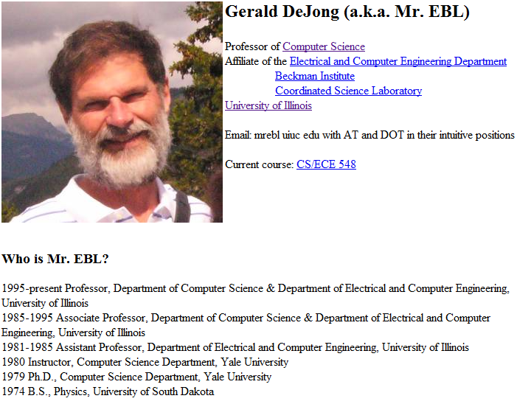
Set of similarly typed pages
What can we say about these pages?
Class Label/Type?
Name?
Notes:
Can we find entities of the same type?

Slide 119
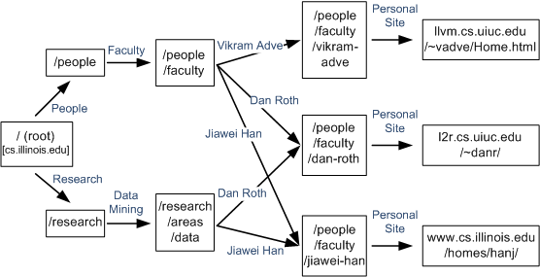
Exploring Link Paths Weninger, et al. 12
Let’s explore link-paths in a hierarchy
Hierarchy #1
People
Faculty
Jiawei Han
Personal Site
Hierarchy #2
Research
Data Mining
Jiawei Han
Personal Site

Slide 120
Exploring Link Paths
What do these pages have in common?
Hierarchy #1
People
Faculty
Hierarchy #2
Research
Data Mining
Name
Phone
Office
Age
Gender
Email
Next Step

Slide 121
Remember Relational WebTables
Notes:
Sometimes lists have attributes
3 records with 6 attributes each

Slide 122
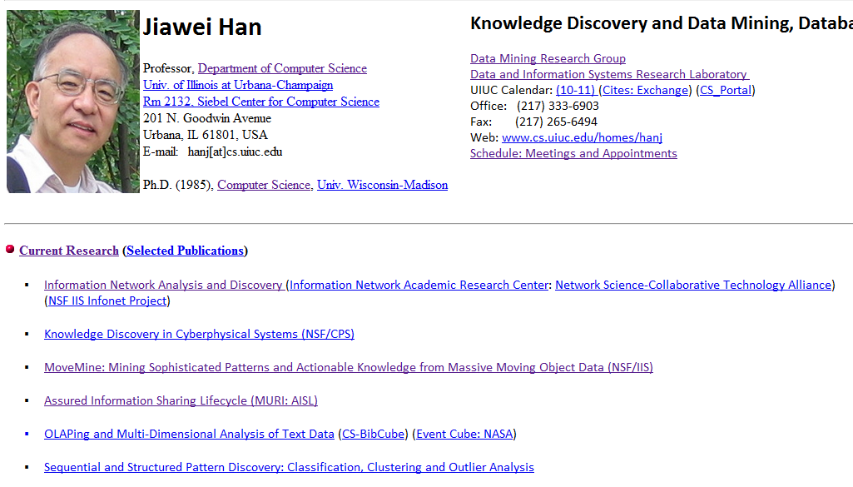
Attribute Propagation
Propagate information through the link paths
Name
Phone
Office
Fax
Research
Email

Slide 123
Aside - Links Paths are also good for Known Item Search
Anchor texts look like queries.
Often resemble database records too
Lets match Web pages to improve Web search
Hierarchy #1
People
Faculty
Jiawei Han
Personal Site
Hierarchy #2
Research
Data Mining
Jiawei Han
Personal Site
#1
Notes:
We can use link paths for record linkage.
We can match the anchor text with a tolerance \lambda
When lambda = 0 it is very strict… much match names exactly… lambda = 1 then it picks the closest record.

Slide 124
New types of search - Web Meta-Paths Sun et al. ‘12 Best Paper
Objects are connected together via different types of relationships!
Results from University of Illinois Network collected from the Web
“Han-DAIS-Zhai”
“Han-DAIS-Chang”
“S.Adve-UPCRC-V.Adve”
“CS412-Han-DAIS-Zhai-CS410”
“CS412- Han-DAIS-Chang-CS512”
“CS433-S.Adve-UPCRC-V.Adve-CS426”
Prof-Group-Prof
Course-Prof-Group-Prof-Course

Slide 125
Thank you

