Slide 1
Streaming Topic Modeling
Justin Garrard

Slide 2
MOtivation
Can ”infinite compute” capacity turn batch jobs into a streaming application?
Wouldn’t it be cool to be able to model what people are talking about online in near real-time?

Slide 3
Light topic modeling
Doc 1
Vector 1
Doc 2
Vector 2
LDA Model - 2 topics
Dictionary
Doc 3
Vector 3
.
.
.
.
.
.
Doc n-1
Vector n-1
Doc n
Vector n

Slide 4
Light topic modeling
Doc 1
Vector 1
Doc 2
Vector 2
LDA Model - 2 topics
Dictionary
Doc 3
Vector 3
.
.
.
.
.
.
Classification
Doc n-1
Vector n-1
Doc n
Vector n
New Doc

Slide 5
DISTRIBUTED WORKFLOW

Slide 6

Start
LDA Model - 4 topics
Shared
Dictionary
Doc
Vectors
LDA Model - 4 topics
Shared
Dictionary
$$∗{10}^{x}$$
Vector
Classification

Slide 7
Start
LDA Model - 4 topics
Shared
Dictionary
Doc
Vectors
LDA Model - 4 topics
Shared
Dictionary
$$∗{10}^{x}$$
Vector
Classification

Slide 8
For science
Is bigger better?
  Does training the model on more data per classification make the prediction:
    More accurate?
    More Granular? (i.e. could ‘politics’ be broken down to model individual issues)
How many tweets make this worthwhile?
  What volume of new documents to classify is required to notice a speedup over running classification on a local machine?

Slide 9
From https://www.sportsmemorabilia.com/

Slide 10
Getting Punched in the Face by AWS

Slide 11
Getting Punched in the Face by AWS
Lambdas cannot access the public internet without an AWS Virtual Private Cloud configuration

Slide 12
Getting Punched in the Face by AWS
Lambdas cannot access the public internet without an AWS Virtual Private Cloud configuration
  I am stuck running reddit requests from my main program, then using lambdas for preprocessing
  Currently pulling back and ‘cleaning’ ~130000 words in 15 seconds for one “topic”

Slide 13
Getting Punched in the Face by AWS
Lambdas cannot access the public internet without an AWS Virtual Private Cloud configuration
  I am stuck running reddit requests from my main program, then using lambdas for preprocessing
  Currently pulling back and ‘cleaning’ ~130000 words in 15 seconds for one “topic”
  My local ec2 bricked at preprocessing 2M words, so I could only model less than 20 topics
    Even fewer if I decided to pull back more words per Reddit page in the interest of granularity/accuracy

Slide 14
Getting Punched in the Face by AWS
Your Lambdas have dependencies? I hope you don’t have a lot of dependencies!

Slide 15
Getting Punched in the Face by AWS
Your Lambdas have dependencies? I hope you don’t have a lot of dependencies!
The Gensim library I need for my models is 253 MB!
  Manually curate which files in the Gensim libraries are vital and shave the rest
  Then include saved Dictionary and LDA Model and ship the whole thing to S3
.zip Upload Method | Maximum Size
Uploading .zip online | 50 MB
Upload via S3 | 250 MB

Slide 16
Conclusions
Without the VPC my prospects for speeding up the data retrieval aren’t promising
  “Is bigger better” is currently on ice until scraping way bigger becomes feasible
The Lambda Topic Prediction has just come become deployable
  There are Gensim path dependencies hidden somewhere in the libraries
The only feasible test left is to measure where the streaming benefit of “infinite compute” kicks in.

Slide 17
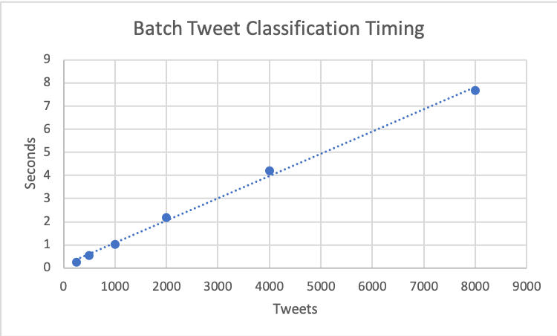
Conclusions

Slide 18
Conclusions

Slide 19
Conclusions-Lessons Learned
85% Package Management, 13% Lambda Limitations, 2% Application
Python3 does not ship native to AWS ec2
  Need to access ec2’s extended package options and manage python3 out of virtualenv
Develop a local understanding of python binaries to troubleshoot in the Lambda serverless void

