Slide 1
Morava E-theory of the Goodwillie tower
Mark Behrens* (MIT) and
Charles Rezk (UIUC)

Slide 3
Goodwillie tower of Id

Slide 4
Goodwillie tower of Id

Slide 5
Goodwillie tower of Id

Slide 6
Goodwillie tower of Id

Slide 7
Bousfield-Kuhn functor

Slide 8
Bousfield-Kuhn functor

Slide 9
Bousfield-Kuhn functor

Slide 10
$v_{n}$-periodic Goodwillie tower

Slide 11
$v_{n}$-periodic Goodwillie tower

Slide 12
$v_{n}$-periodic Goodwillie tower

Slide 13
$v_{n}$-periodic Goodwillie tower

Slide 14
$v_{n}$-periodic Goodwillie tower

Slide 15
$v_{n}$-periodic Goodwillie tower

Slide 16
$v_{n}$-periodic Goodwillie tower

Slide 17
$v_{n}$-periodic Goodwillie tower

Slide 18
Morava E-theory Dyer-Lashof Algebra

Slide 19
Morava E-theory Dyer-Lashof Algebra

Slide 20
Morava E-theory Dyer-Lashof Algebra

Slide 21
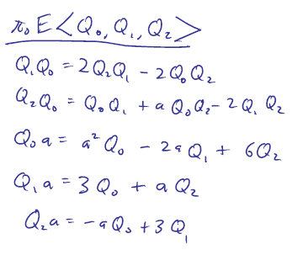
Morava E-theory Dyer-Lashof Algebra

Slide 22
Morava E-theory Dyer-Lashof Algebra

Slide 23
Morava E-theory Dyer-Lashof Algebra

Slide 24
Morava E-theory Dyer-Lashof Algebra

Slide 25
Morava E-theory Dyer-Lashof Algebra

Slide 26
Morava E-theory Dyer-Lashof Algebra

Slide 27
Morava E-theory of the layers

Slide 28
Morava E-theory of the tower

Slide 29
Proof of the “Pre-thm” – TAQ

Slide 30
Proof of the “Pre-thm” – TAQ

Slide 31
Proof of the “Pre-thm” – TAQ

Slide 32
Proof of the “Pre-thm” – TAQ

Slide 33
Proof of the “Pre-thm” – TAQ

Slide 34
Proof of the “Pre-thm” – TAQ

Slide 35
Proof of the “Pre-thm” – TAQ

Slide 36
Modular Isogeny Complex

Slide 37
Modular Isogeny Complex

Slide 38
Modular Isogeny Complex

Slide 39
Modular Isogeny Complex

Slide 40
Modular Isogeny Complex

Slide 41
Modular Isogeny Complex

Slide 42
Modular Isogeny Complex

