Slide 1
Exotic spheres and topological modular forms
Mark Behrens (MIT)
(joint with Mike Hill, Mike Hopkins, and Mark Mahowald)

Slide 2
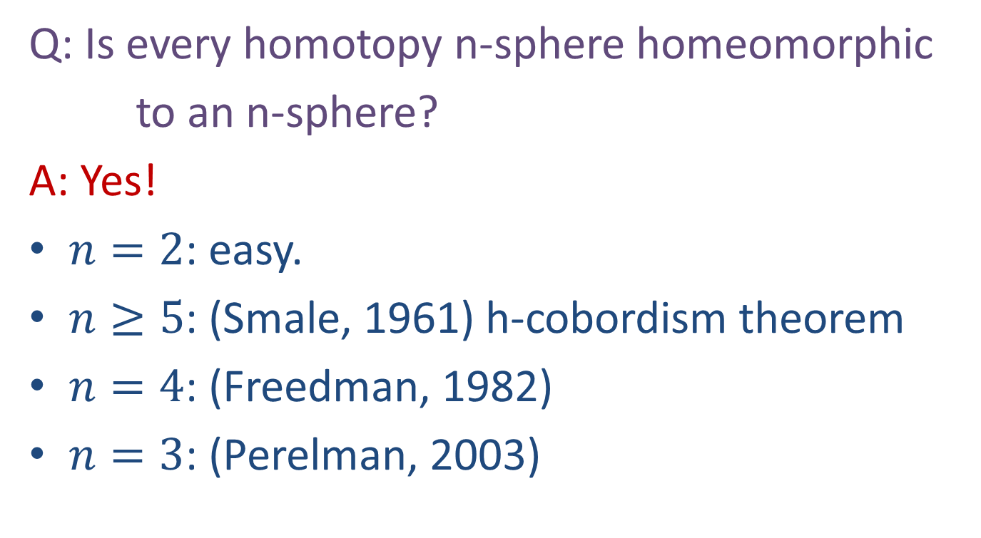
Poincaré Conjecture
Q: Is every homotopy n-sphere homeomorphic
to an n-sphere?
A: Yes!
$n=2$: easy.
$n≥5$: (Smale, 1961) h-cobordism theorem
$n=4$: (Freedman, 1982)
$n=3$: (Perelman, 2003)

Slide 3
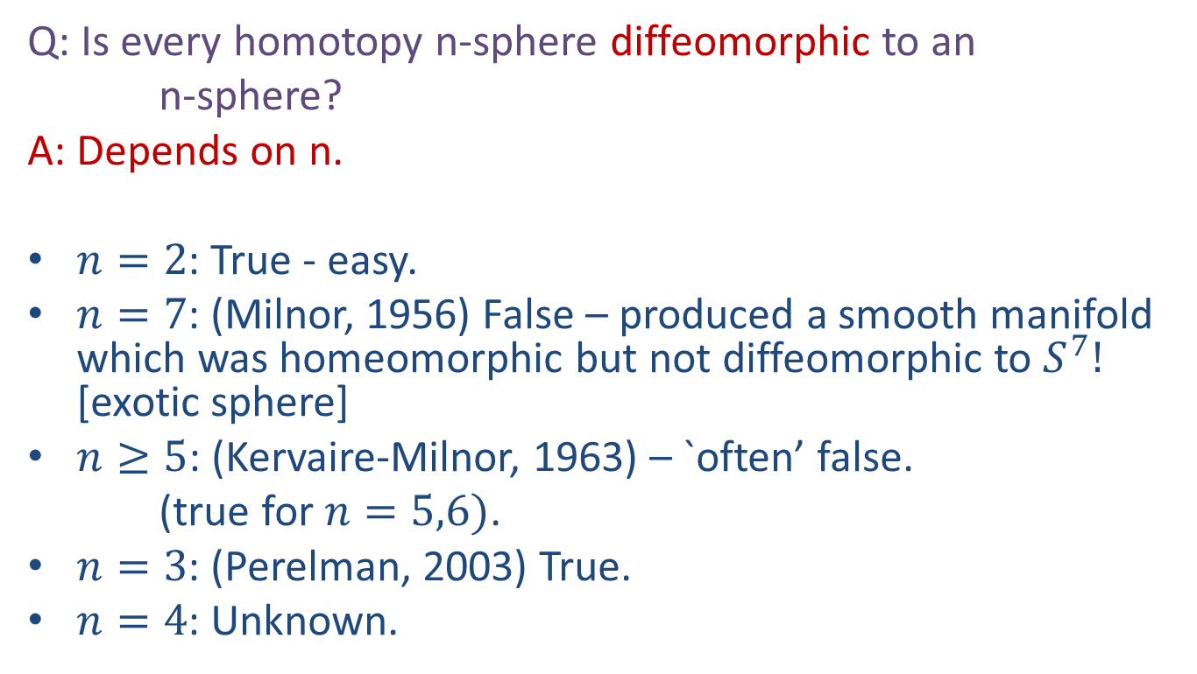
Smooth Poincaré Conjecture
Q: Is every homotopy n-sphere diffeomorphic to an
n-sphere?
A: Depends on n.
$n=2$: True - easy.
$n=7$: (Milnor, 1956) False – produced a smooth manifold which was homeomorphic but not diffeomorphic to $S^{7}!$ [exotic sphere]
$n≥5$: (Kervaire-Milnor, 1963) – `often’ false.
(true for $n=5,6)$.
$n=3$: (Perelman, 2003) True.
$n=4$: Unknown.

Slide 4
Smooth Poincaré Conjecture
Q: Is every homotopy n-sphere diffeomorphic to an
n-sphere?
A: Depends on n.
$n=2$: True - easy.
$n=7$: (Milnor, 1956) False – produced a smooth manifold which was homeomorphic but not diffeomorphic to $S^{7}!$ [exotic sphere]
$n≥5$: (Kervaire-Milnor, 1963) – `often’ false.
(true for $n=5,6)$.
$n=3$: (Perelman, 2003) True.
$n=4$: Unknown.

Slide 5
Main Question
For which n do there exist exotic n-spheres?

Slide 6
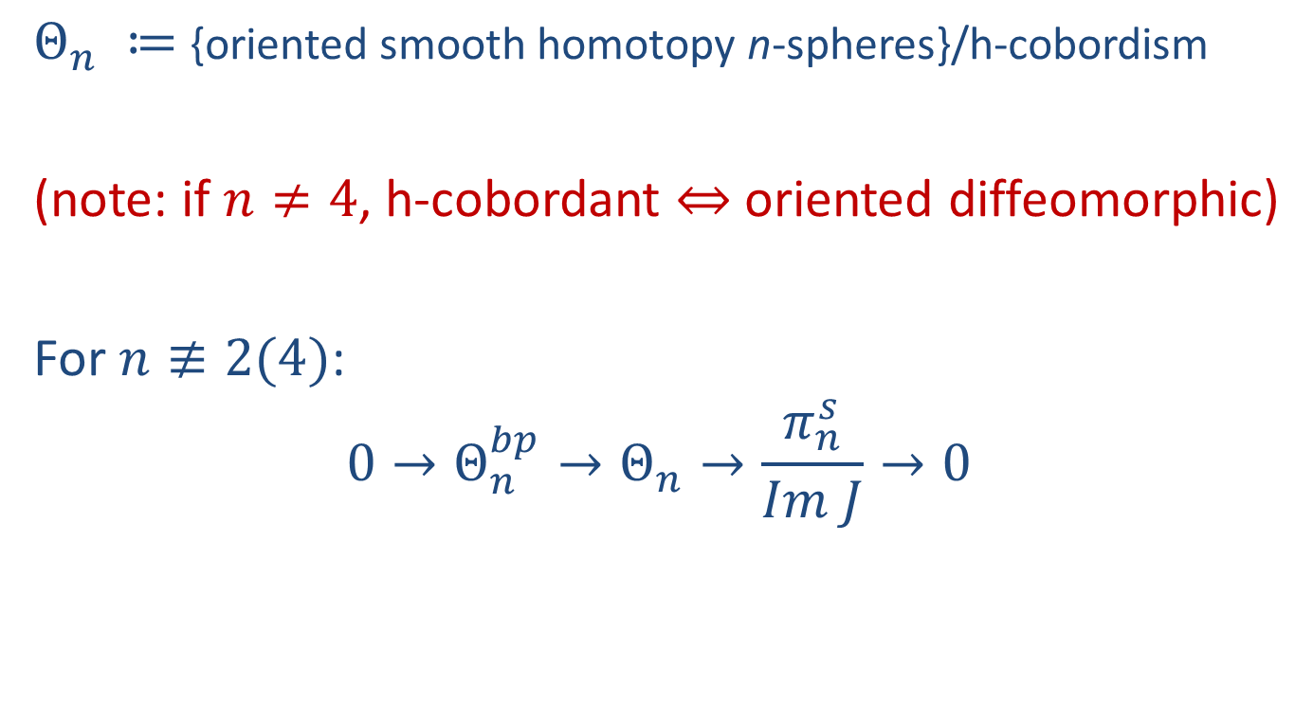
Kervaire-Milnor
$Θ_{n} ≔${oriented smooth homotopy n-spheres}/h-cobordism
(note: if $n≠4$, h-cobordant $⇔$oriented diffeomorphic)
For $n≢2(4)$:
$$0→Θ_{n}^{bp}→Θ_{n}→\frac{π_{n}^{s}}{Im J}→0$$

Slide 7

Kervaire-Milnor
$Θ_{n} ≔${oriented smooth homotopy n-spheres}/h-cobordism
For $n≢2(4)$:
$$0→Θ_{n}^{bp}→Θ_{n}→\frac{π_{n}^{s}}{Im J}→0$$

Slide 8
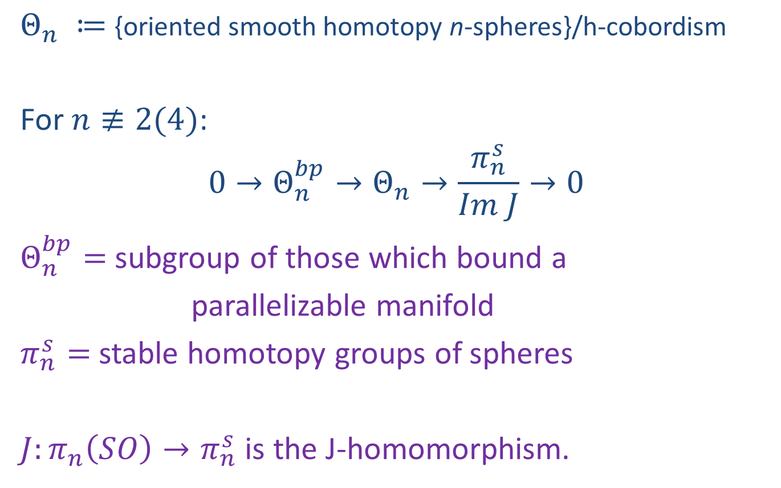
Kervaire-Milnor
$Θ_{n} ≔${oriented smooth homotopy n-spheres}/h-cobordism
For $n≢2(4)$:
$$0→Θ_{n}^{bp}→Θ_{n}→\frac{π_{n}^{s}}{Im J}→0$$
$Θ_{n}^{bp}=$ subgroup of those which bound a
parallelizable manifold
$π_{n}^{s}=$ stable homotopy groups of spheres
$J:π_{n}\left(SO\right)→π_{n}^{s}$ is the J-homomorphism.

Slide 9
Kervaire-Milnor
$Θ_{n} ≔${oriented smooth homotopy n-spheres}/h-cobordism
For $n≢2(4)$:
$$0→Θ_{n}^{bp}→Θ_{n}→\frac{π_{n}^{s}}{Im J}→0$$
$Θ_{n}^{bp}=$ subgroup of those which bound a
parallelizable manifold
$π_{n}^{s}=$ stable homotopy groups of spheres
$J:π_{n}\left(SO\right)→π_{n}^{s}$ is the J-homomorphism.

Slide 10
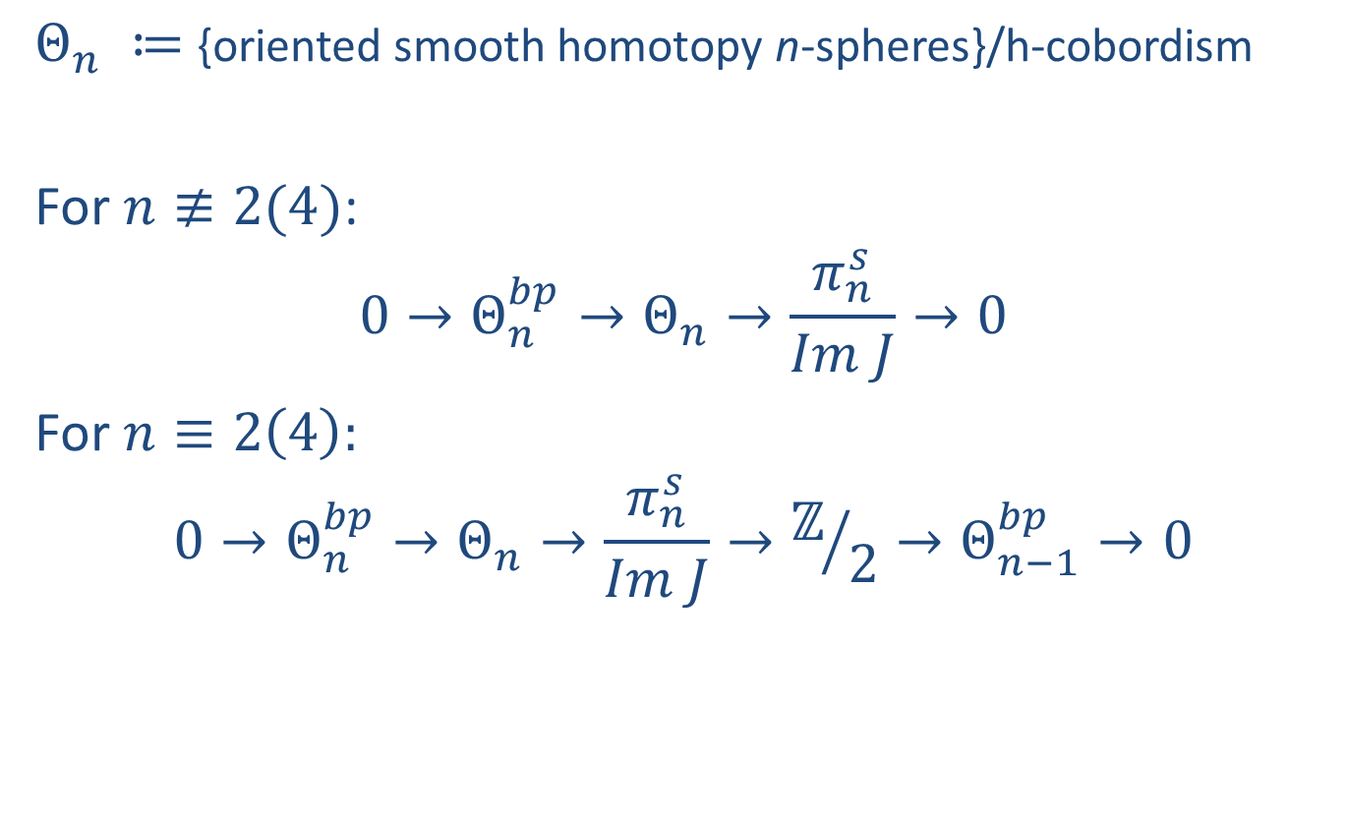
Kervaire-Milnor
$Θ_{n} ≔${oriented smooth homotopy n-spheres}/h-cobordism
For $n≢2(4)$:
$$0→Θ_{n}^{bp}→Θ_{n}→\frac{π_{n}^{s}}{Im J}→0$$
For $n≡2\left(4\right):$
$$0→Θ_{n}^{bp}→Θ_{n}→\frac{π_{n}^{s}}{Im J}→ℤ/2→Θ_{n−1}^{bp}→0$$

Slide 11

$$Θ_{n}^{bp}$$
Trivial for n even
Cyclic for n odd

Slide 12
$$Θ_{n}^{bp}$$
Trivial for n even
Cyclic for n odd
  Generated by boundary of an explicit parallelizable manifold given by plumbing construction

Slide 13
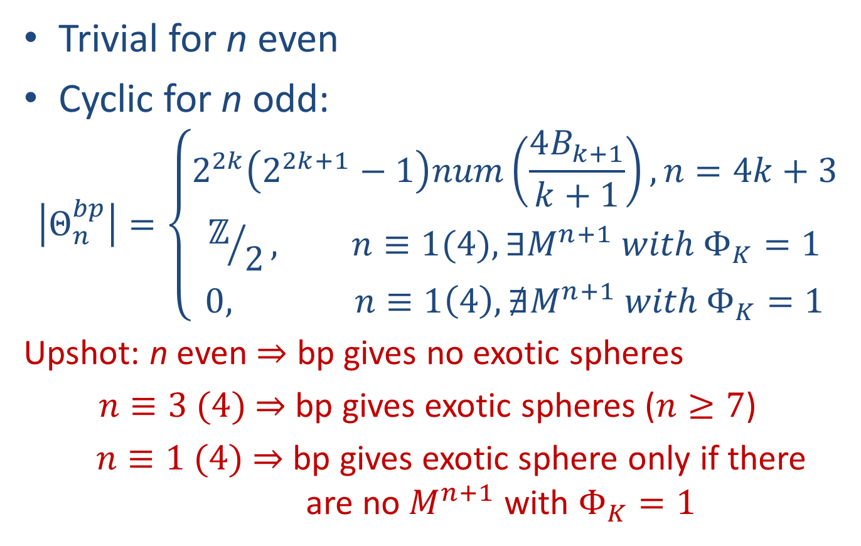
$$Θ_{n}^{bp}$$
Trivial for n even
Cyclic for n odd:
$$\left|Θ_{n}^{bp}\right|=\left\{\begin{matrix}2^{2k}\left(2^{2k+1}−1\right)num\left(\frac{4B_{k+1}}{k+1}\right), n=4k+3 \\ ℤ/2, n≡1(4), ∃M^{n+1} with Φ_{K}=1 \\ 0, n≡1\left(4\right), ∄M^{n+1} with Φ_{K}=1\end{matrix}\right.$$
Upshot: n even $⇒$ bp gives no exotic spheres
$n≡3 (4)$ $⇒$ bp gives exotic spheres ($n≥7$)
$n≡1 (4)$ $⇒$ bp gives exotic sphere only if there are no $M^{n+1}$ with $Φ_{K}=1$

Slide 14
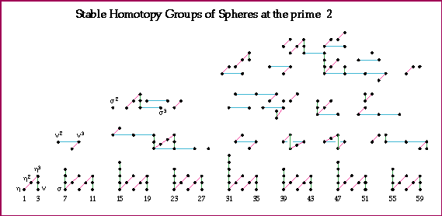
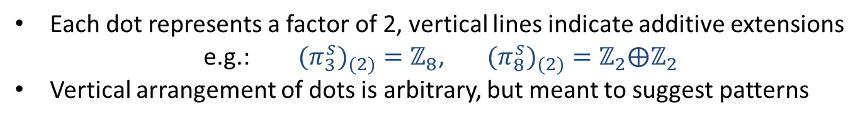
Computation: Mahowald-Tangora-Kochman
Picture: A. Hatcher
Each dot represents a factor of 2, vertical lines indicate additive extensions
e.g.: ${{(π}_{3}^{s})}_{(2)}=ℤ_{8}$, ${{(π}_{8}^{s})}_{(2)}=ℤ_{2}⨁ℤ_{2}$
Vertical arrangement of dots is arbitrary, but meant to suggest patterns

Slide 15
Each dot represents a factor of 2, vertical lines indicate additive extensions
e.g.: ${{(π}_{3}^{s})}_{(2)}=ℤ_{8}$, ${{(π}_{8}^{s})}_{(2)}=ℤ_{2}⨁ℤ_{2}$
Vertical arrangement of dots is arbitrary, but meant to suggest patterns

Slide 16
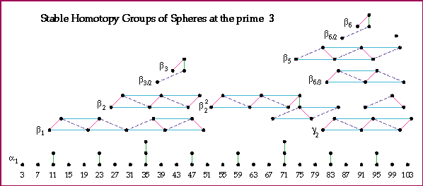
Computation: Nakamura -Tangora
Picture: A. Hatcher

Slide 17
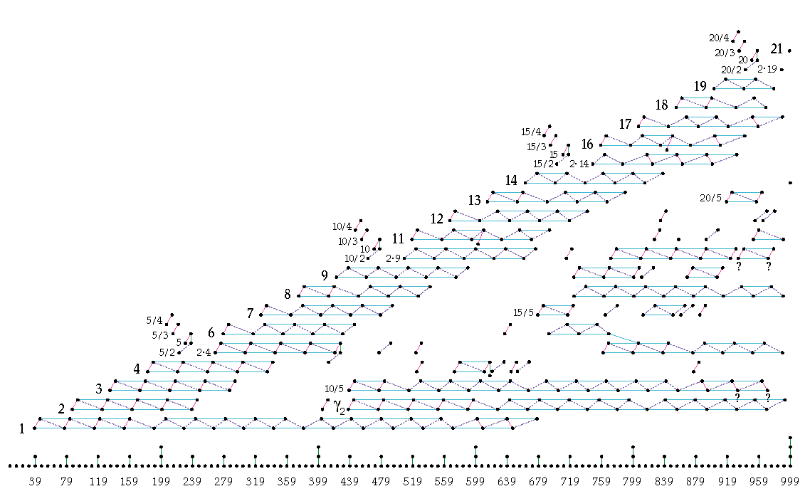
(π_{n}^{s})₍₅₎
Computation: D. Ravenel
Picture: A. Hatcher
n

Slide 18
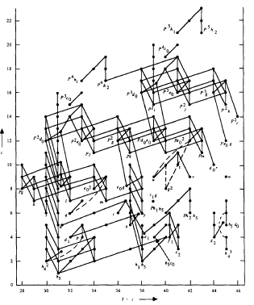
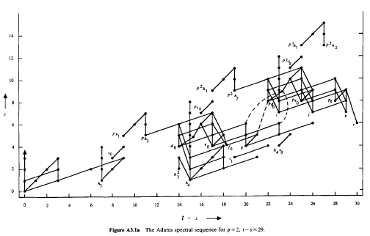

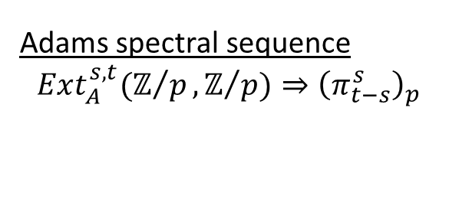
Adams spectral sequence
$$Ext_{A}^{s,t}(ℤ/p,ℤ/{p)⇒{\left(π_{t−s}^{s}\right)}_{p}}$$
$$π_{t−s}^{s}$$

Slide 19
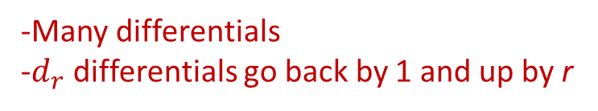
Adams spectral sequence
$$Ext_{A}^{s,t}(ℤ/p,ℤ/{p)⇒{\left(π_{t−s}^{s}\right)}_{p}}$$
$$π_{t−s}^{s}$$
-Many differentials
-$d_{r}$ differentials go back by 1 and up by r

Slide 20
Adams spectral sequence
$$Ext_{A}^{s,t}(ℤ/p,ℤ/{p)⇒{\left(π_{t−s}^{s}\right)}_{p}}$$
$$π_{t−s}^{s}$$

Slide 21
Adams spectral sequence
$$Ext_{A}^{s,t}(ℤ/p,ℤ/{p)⇒{\left(π_{t−s}^{s}\right)}_{p}}$$
$$π_{t−s}^{s}$$

Slide 22

Kervaire Invariant
$$Φ_{K}:π_{n}^{s}→ℤ/2$$
Browder:
$${(Φ}_{K}≠0)⇒\left(n=2^{k}−2\right)$$

Slide 23

Kervaire Invariant
$$Φ_{K}:π_{n}^{s}→ℤ/2$$
Browder:
$${(Φ}_{K}\left(x\right)≠0)⇔\left({x detected by h_{j}^{2}}_{ }in ASS\right)$$

Slide 24
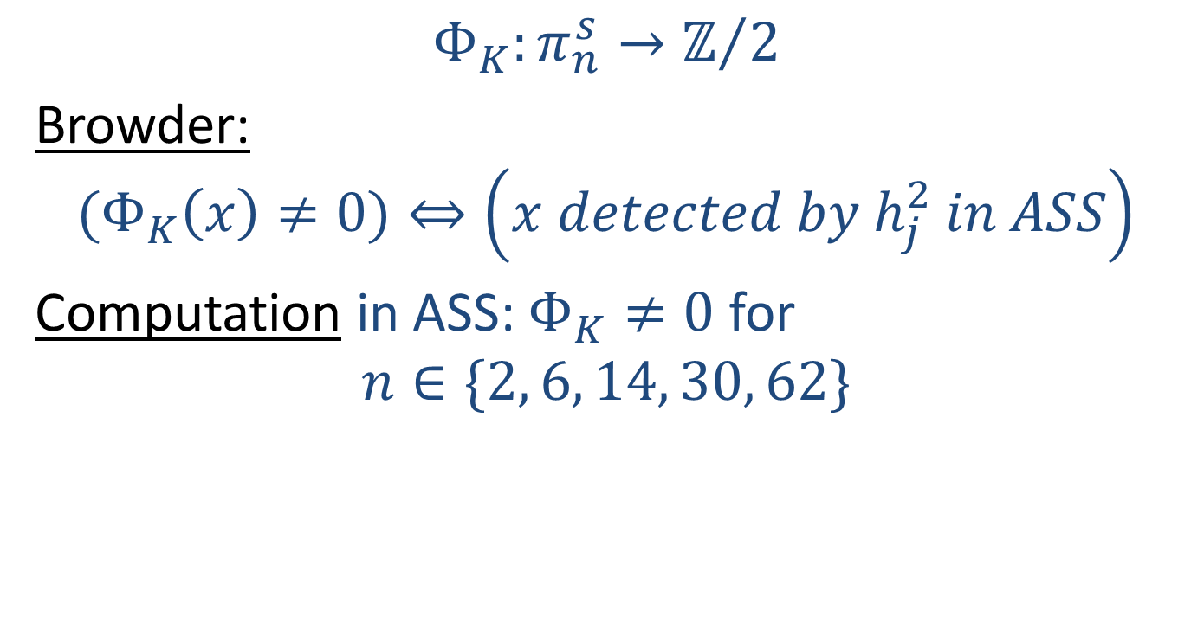
Kervaire Invariant
$$Φ_{K}:π_{n}^{s}→ℤ/2$$
Browder:
$${(Φ}_{K}\left(x\right)≠0)⇔\left({x detected by h_{j}^{2}}_{ }in ASS\right)$$
Computation in ASS: $Φ_{K}≠0$ for
$$n∈\{2, 6, 14, 30, 62\}$$

Slide 25
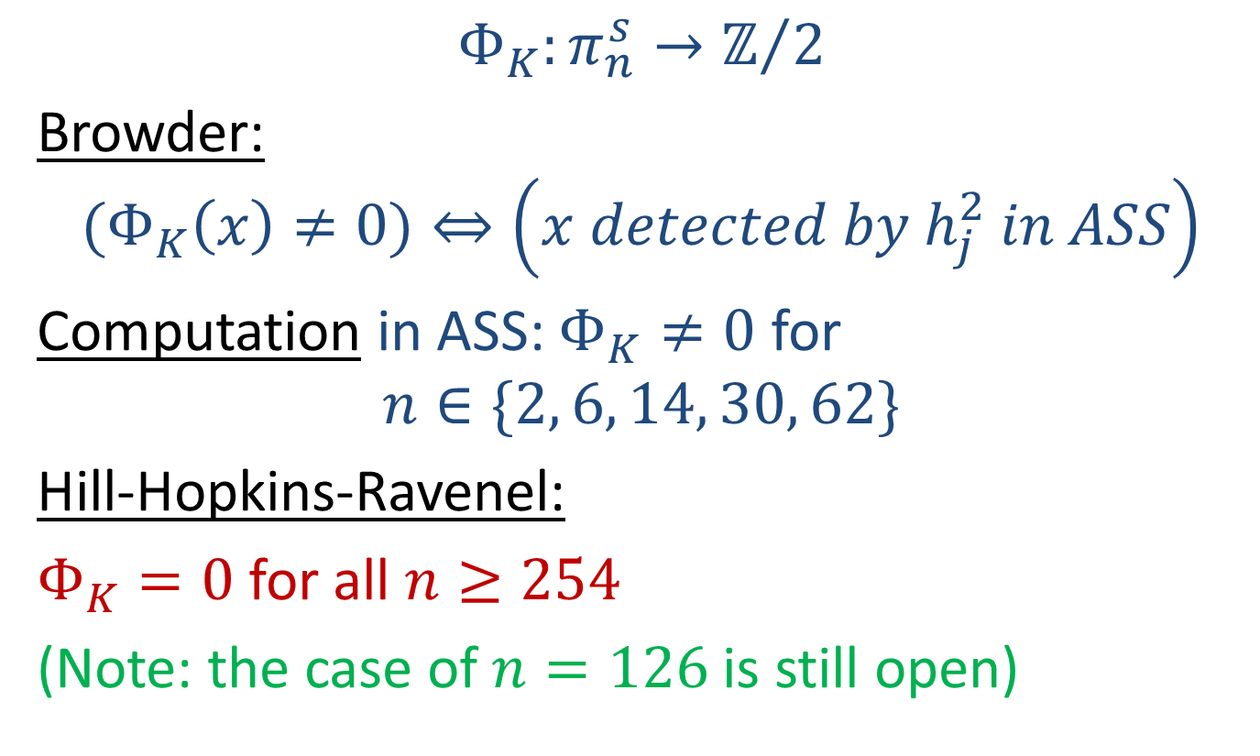
Kervaire Invariant
$$Φ_{K}:π_{n}^{s}→ℤ/2$$
Browder:
$${(Φ}_{K}\left(x\right)≠0)⇔\left({x detected by h_{j}^{2}}_{ }in ASS\right)$$
Computation in ASS: $Φ_{K}≠0$ for
$$n∈\{2, 6, 14, 30, 62\}$$
Hill-Hopkins-Ravenel:
$Φ_{K}=0$ for all $n≥254$
(Note: the case of $n=126$ is still open)

Slide 26
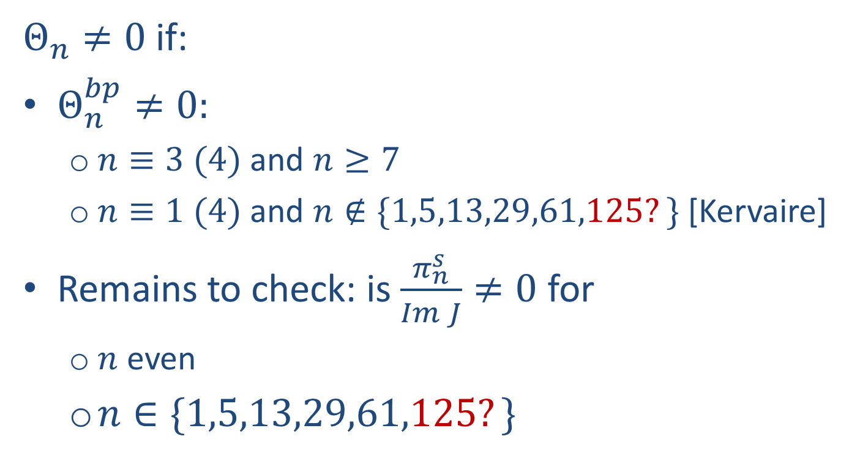
Summary: Exotic spheres
$Θ_{n}≠0$ if:
$Θ_{n}^{bp}≠0:$
  $n≡3 (4)$ and $n≥7$
  $n≡1 (4)$ and $n∉\{1,5,13,29,61,125?\}$ [Kervaire]
Remains to check: is $\frac{π_{n}^{s}}{Im J}≠0$ for
  $n$ even
  $n∈\{1,5,13,29,61,125?\}$

Slide 28
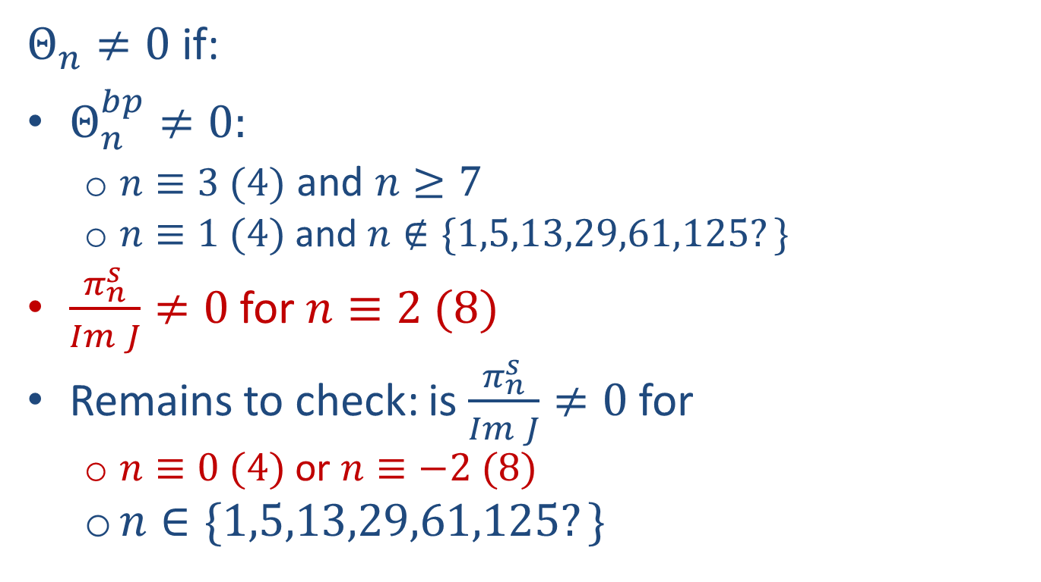
Summary: Exotic spheres
$Θ_{n}≠0$ if:
$Θ_{n}^{bp}≠0:$
  $n≡3 (4)$ and $n≥7$
  $n≡1 (4)$ and $n∉\{1,5,13,29,61,125?\}$
$\frac{π_{n}^{s}}{Im J}≠0$ for $n≡2 (8)$
Remains to check: is $\frac{π_{n}^{s}}{Im J}≠0$ for
  $n≡0 (4)$ or $n≡−2 (8)$
  $n∈\{1,5,13,29,61,125?\}$

Slide 29

Low dimensional computations
Limitation: only know ${\left(π_{n}^{s}\right)}_{2}$ for $n≤63$
${\left(\frac{π_{n}^{s}}{Im J}\right)}_{p}=0$ in this range for $p≥7.$

Slide 30
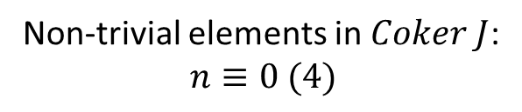
Low dimensional computations
Non-trivial elements in $Coker J$:
$$n≡0 (4)$$

Slide 31
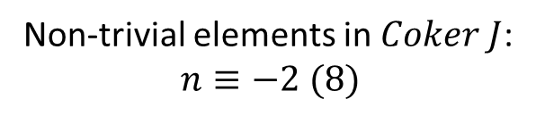
Low dimensional computations
Non-trivial elements in $Coker J$:
$$n≡−2 (8)$$

Slide 32
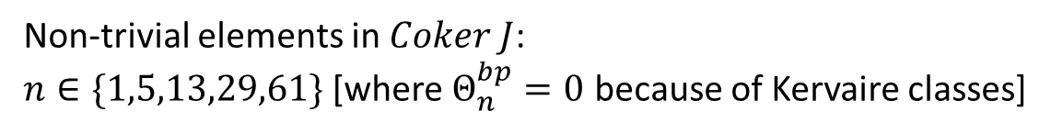
Low dimensional computations
Non-trivial elements in $Coker J$:
$n∈\{1,5,13,29,61\}$ [where $Θ_{n}^{bp}=0$ because of Kervaire classes]

Slide 33

Low dimensional computations
Conclusion
For $n≤63$, the only $n$ for which $Θ_{n}=0$ are:
$$1,2,3,4,5,6,12,61$$

Slide 34

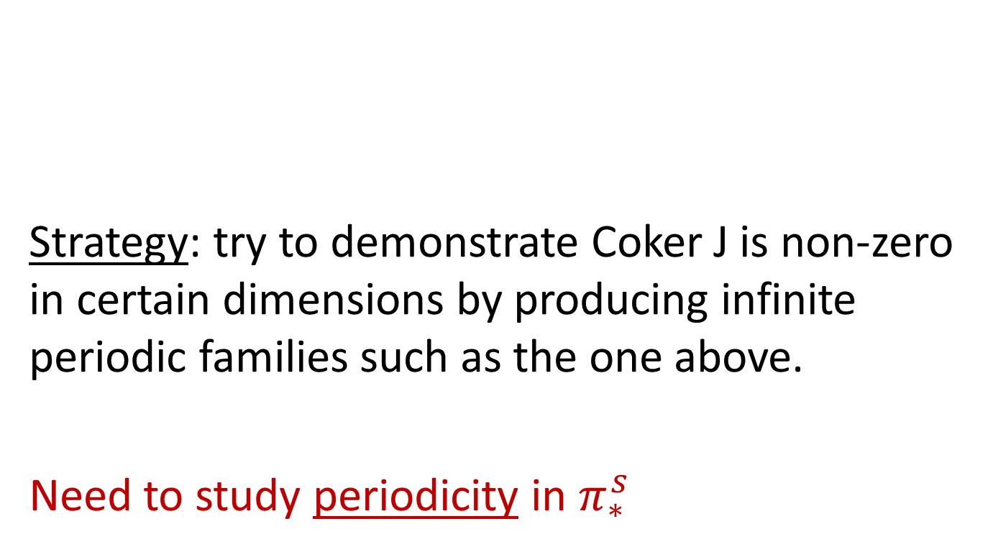
Beyond low dimensions…
Strategy: try to demonstrate Coker J is non-zero in certain dimensions by producing infinite periodic families such as the one above.
Need to study periodicity in $π_{∗}^{s}$

Slide 35
v₁ - periodic layer
(π_{n}^{s})₍₅₎
period = 2(p-1) = 8

Slide 36
v₂ - periodic layer
(π_{n}^{s})₍₅₎
period = 2(p² - 1) = 48

Slide 37
v₃ - periodic layer
period = 2(p³ - 1) = 248

Slide 38
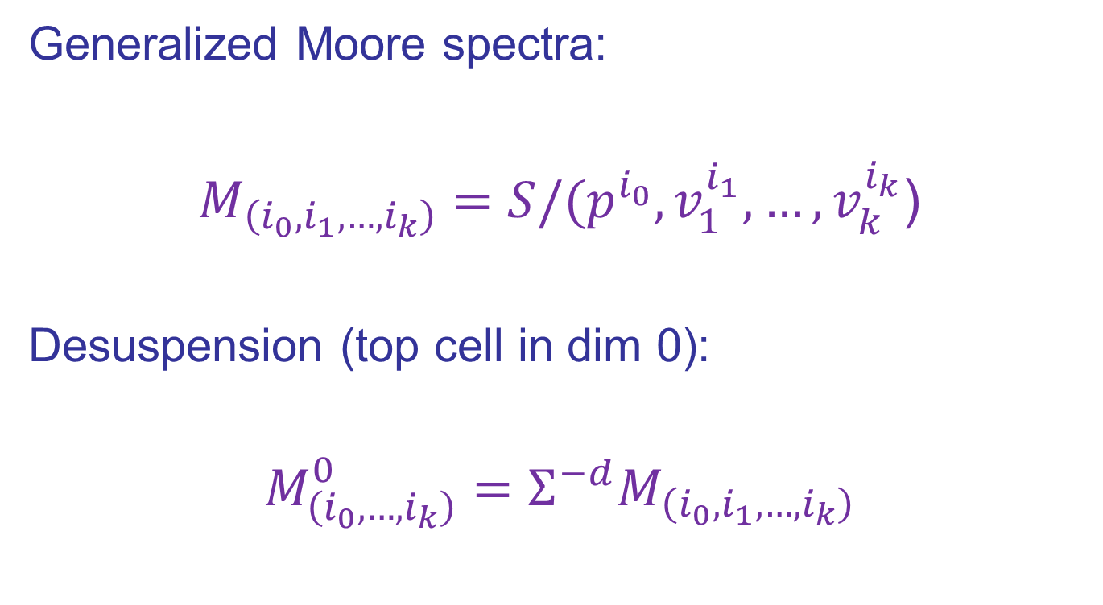

$v_{n}$-periodic families
Generalized Moore spectra:
$M_{\left(i_{0},i_{1},…,i_{k}\right)}=S/(p^{i_{0}},v_{1}^{i_{1}},…,v_{k}^{i_{k}}$)
Desuspension (top cell in dim 0):
$$M_{\left(i_{0}, …,i_{k}\right)}^{0}=Σ^{−d}M_{\left(i_{0},i_{1},…,i_{k}\right)}$$

Slide 39

$v_{n}$-periodic families
$x∈π_{t}(S)$, $(p^{i_{0}}, …,v_{n−1}^{i_{n−1}}$)-torsion
$⇕$
$π_{t}M_{\left(i_{0}, …, i_{n−1}\right)}^{0}→π_{t}S$

Slide 40

$v_{n}$-periodic families
$x∈π_{t}(S)$, $(p^{i_{0}}, …,v_{n−1}^{i_{n−1}}$)-torsion
$⇕$
$π_{t}M_{\left(i_{0}, …, i_{n−1}\right)}^{0}→π_{t}S$
Find a $v_{n}$-self map
$$Σ^{d}M_{\left(i_{0}, …, i_{n−1}\right)}^{0}→M_{\left(i_{0}, …, i_{n−1}\right)}^{0}$$

Slide 41
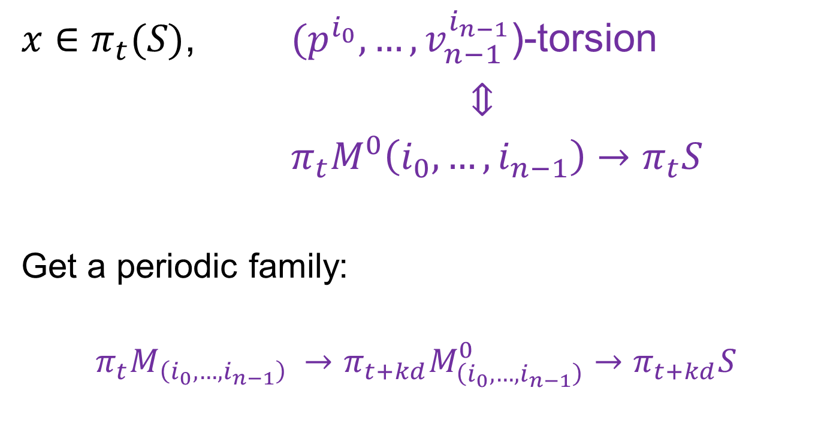
$v_{n}$-periodic families
$x∈π_{t}(S)$, $(p^{i_{0}}, …,v_{n−1}^{i_{n−1}}$)-torsion
$⇕$
$π_{t}M^{0}\left(i_{0}, …, i_{n−1}\right)→π_{t}S$
Get a periodic family:
$$π_{t}{M_{\left(i_{0}, …, i_{n−1}\right)}}_{ }→π_{t+kd}M_{\left(i_{0}, …, i_{n−1}\right)}^{0}→π_{t+kd}S$$

Slide 42
v₂ - periodic layer
= β−family
(π_{n}^{s})₍₅₎

Slide 43
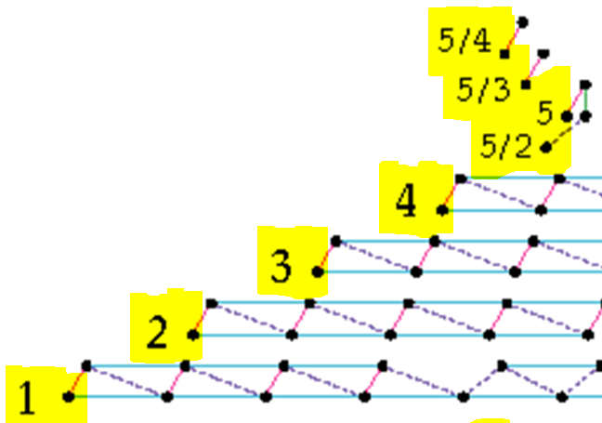
Greek Letter Names (Miller-Ravenel-Wilson)

Slide 44

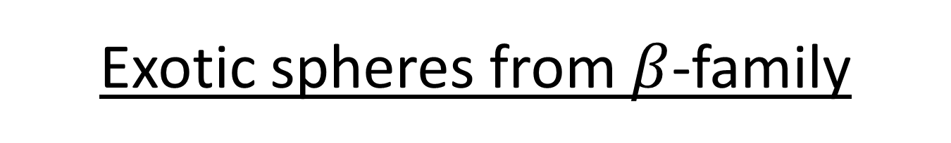
Exotic spheres from $β$-family
$β_{k}$ exists for $p≥5$ and $k≥1$ [Smith-Toda]
  $Θ_{n}≠0$ for $n≡−2\left(p−1\right)−2 mod 2(p^{2}−1)$

Slide 46
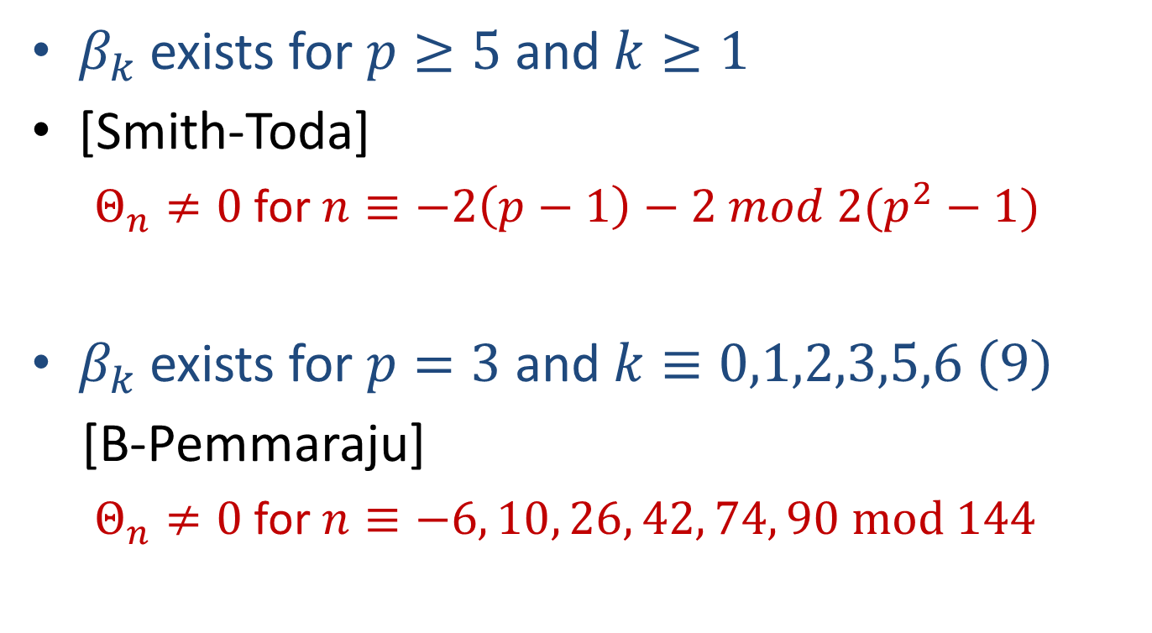
Exotic spheres from $β$-family
$β_{k}$ exists for $p≥5$ and $k≥1$
[Smith-Toda]
  $Θ_{n}≠0$ for $n≡−2\left(p−1\right)−2 mod 2(p^{2}−1)$
$β_{k}$ exists for $p=3$ and $k≡0,1,2,3,5,6 \left(9\right)$
[B-Pemmaraju]
  $Θ_{n}≠0$ for $n≡−6, 10, 26, 42, 74, 90 mod 144$

Slide 47
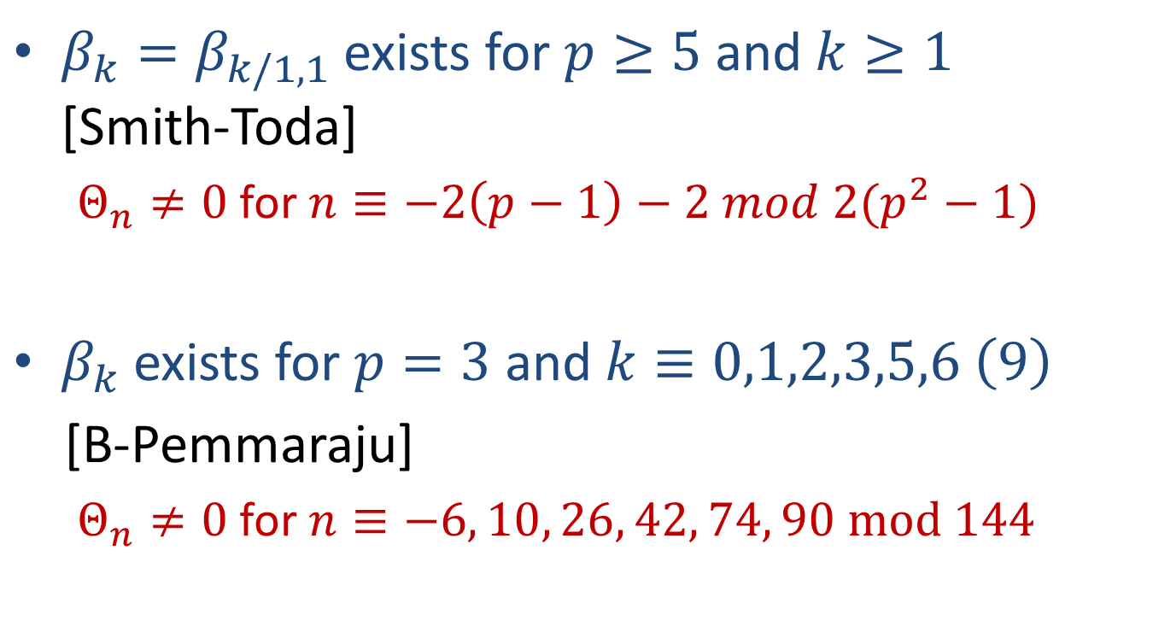
Exotic spheres from $β$-family
$β_{k}=β_{k/1,1}$ exists for $p≥5$ and $k≥1$ [Smith-Toda]
  $Θ_{n}≠0$ for $n≡−2\left(p−1\right)−2 mod 2(p^{2}−1)$
$β_{k}$ exists for $p=3$ and $k≡0,1,2,3,5,6 \left(9\right)$
[B-Pemmaraju]
  $Θ_{n}≠0$ for $n≡−6, 10, 26, 42, 74, 90 mod 144$

Slide 49
KO Hurewicz homomorphism

Slide 50
Hurewicz image of TMF (p = 3)

Slide 52
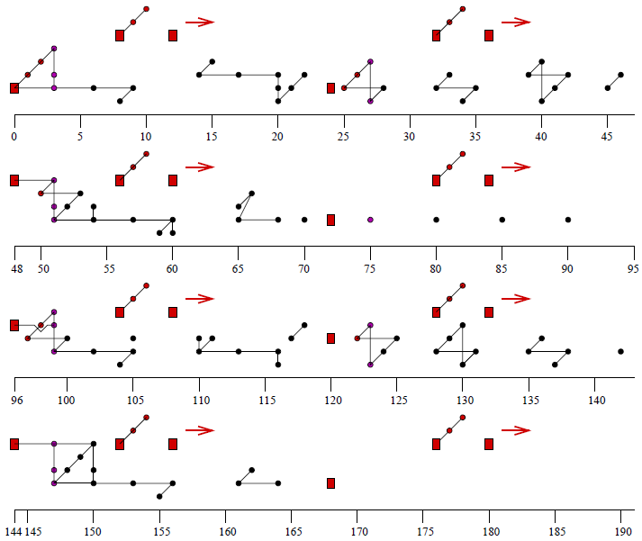

Slide 53
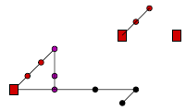

Slide 57


Hurewicz image of TMF (p = 2)

Slide 60
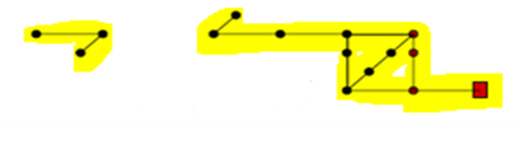

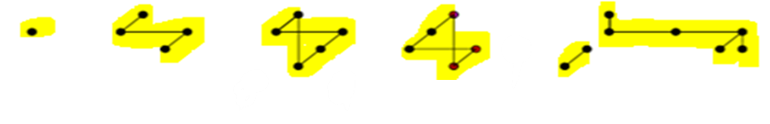

Slide 61



Slide 63
Plan to determine Hurewicz Image of tmf

Slide 64
Plan to determine Hurewicz Image of tmf

Slide 65
Plan to determine Hurewicz Image of tmf

Slide 66
Plan to determine Hurewicz Image of tmf

Slide 67
Plan to determine Hurewicz Image of tmf

Slide 68
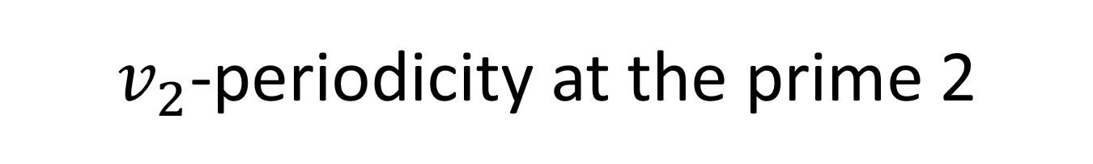
$v_{2}$-periodicity at the prime 2

Slide 69
$v_{2}$-periodicity at the prime 2

Slide 70
$v_{2}$-periodicity at the prime 2

Slide 71
$v_{2}$-periodicity at the prime 2

Slide 72

$v_{2}^{32}$ on $M_{1,4}^{0}$

Slide 73
$v_{2}^{32}$ on $M_{1,4}^{0}$

Slide 74
$v_{2}^{32}$ on $M_{1,4}^{0}$

Slide 75
$v_{2}^{32}$ on $M_{1,4}^{0}$

Slide 76

$v_{2}^{32}$ on $M_{1,4}^{0}$

Slide 77
$v_{2}^{32}$ on $M_{1,4}^{0}$

Slide 78
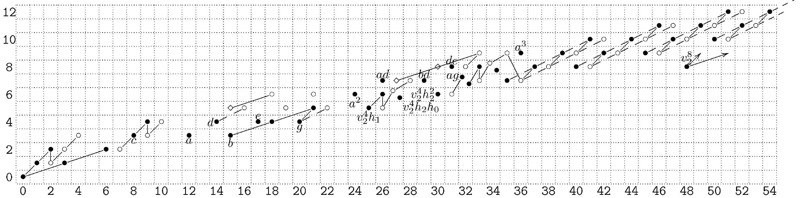
v₂⁸
ZOOM in on this area…

Slide 79
v₂⁸

Slide 80
v₂⁸

Slide 81
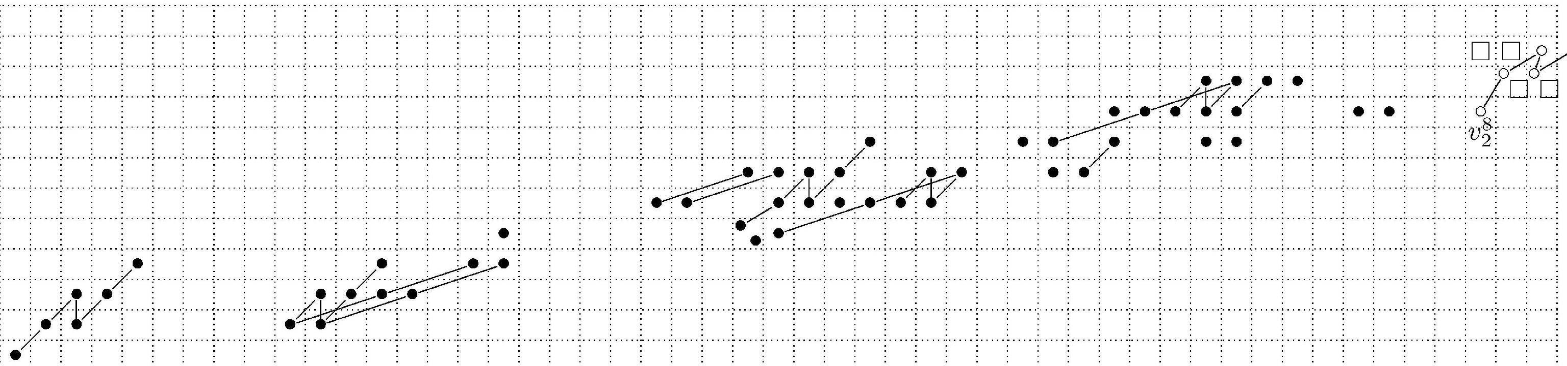

Slide 83
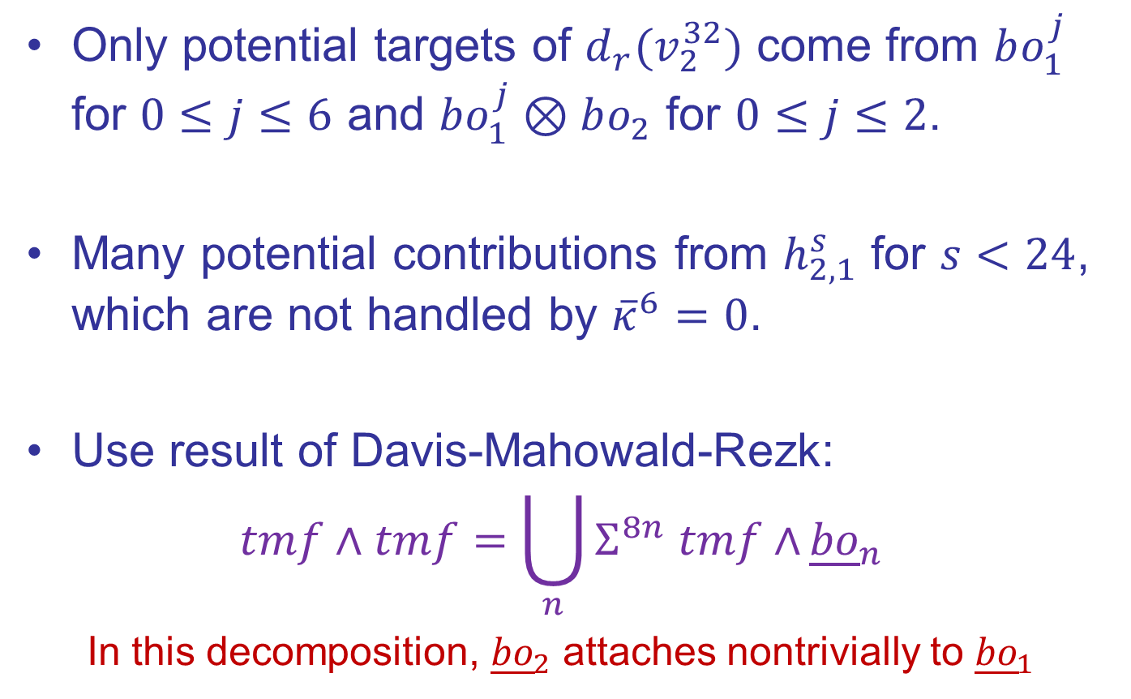

Modifications for the case of $M_{3,8}^{0}$
Only potential targets of $d_{r}(v_{2}^{32})$ come from $bo_{1}^{j}$ for $0≤j≤6$ and $bo_{1}^{j}⊗bo_{2}$ for $0≤j≤2$.
Many potential contributions from $h_{2,1}^{s}$ for $s<24$, which are not handled by ${\overline{κ}}^{6}=0$.
Use result of Davis-Mahowald-Rezk:
$$tmf∧tmf=\bigcup_{n}{Σ^{8n} tmf∧}{\underline{bo}}_{n}$$
In this decomposition, ${\underline{bo}}_{2}$ attaches nontrivially to ${\underline{bo}}_{1}$

Slide 84
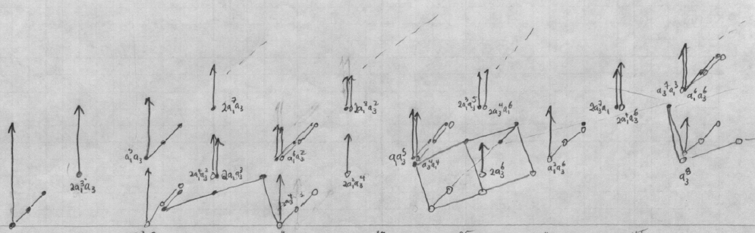

Slide 85
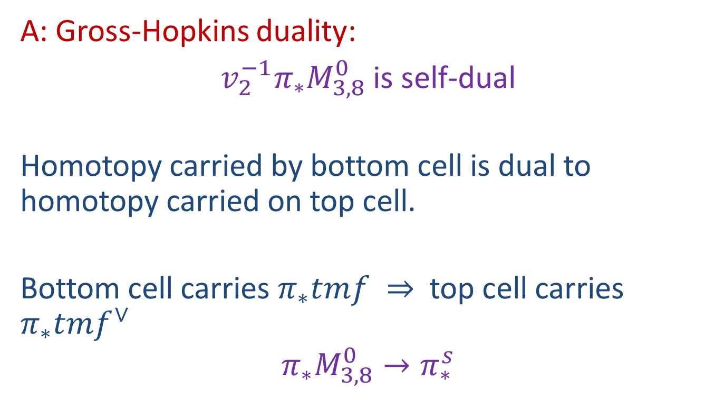
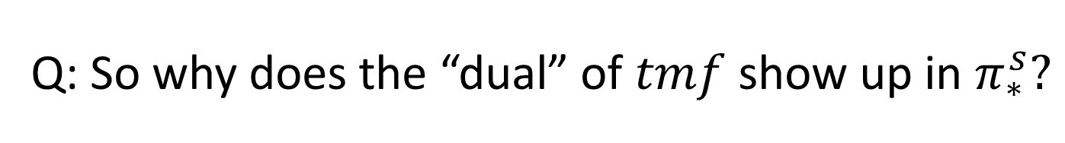
Q: So why does the “dual” of $tmf$ show up in $π_{∗}^{s}?$
A: Gross-Hopkins duality:
${v_{2}^{−1}π}_{∗}M_{3,8}^{0}$ is self-dual
Homotopy carried by bottom cell is dual to homotopy carried on top cell.
Bottom cell carries $π_{∗}tmf ⇒$ top cell carries $π_{∗}tmf^{∨}$
$$π_{∗}M_{3,8}^{0}→π_{∗}^{s}$$

